Slide 1
A stock assessment for eastern Bering Sea snow crab
Cody Szuwalski

Slide 2
GMACS BYCATCH OFL & PROJ UNCERTAINTY
Hopefully ready to transition (pending CPT and SSC approval)
Good fits
Difficulties in comparison
Reference points working

Slide 3
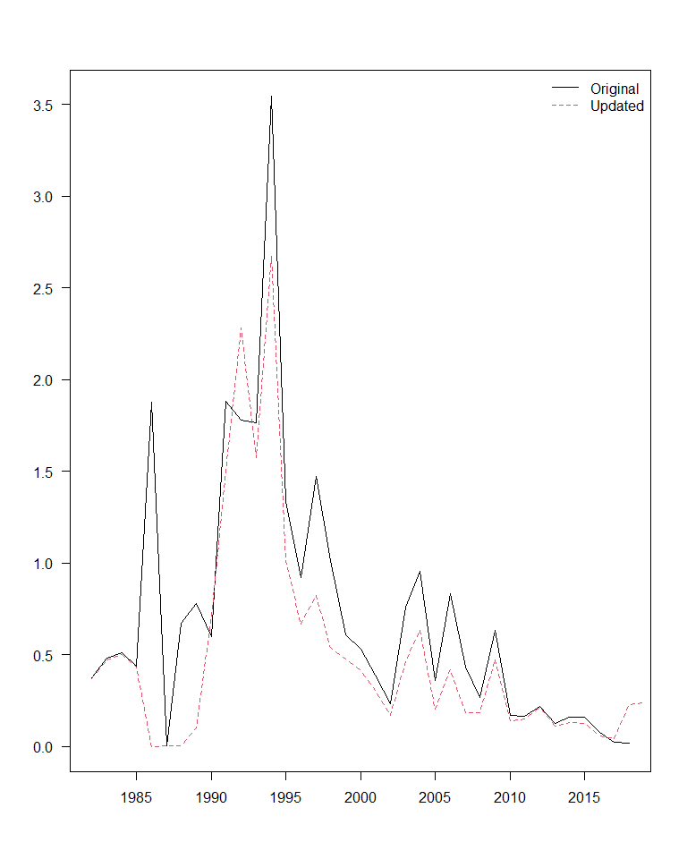
GMACS BYCATCH OFL & PROJ UNCERTAINTY
Change in bycatch data downloaded from AKFIN
Revision of method for creating .DAT files (no more one year at a time)
Will not talk further about this; all 2020 models (20.1, 20.2, 20.3) use the updated bycatch data
Deep dive on data next year

Slide 4
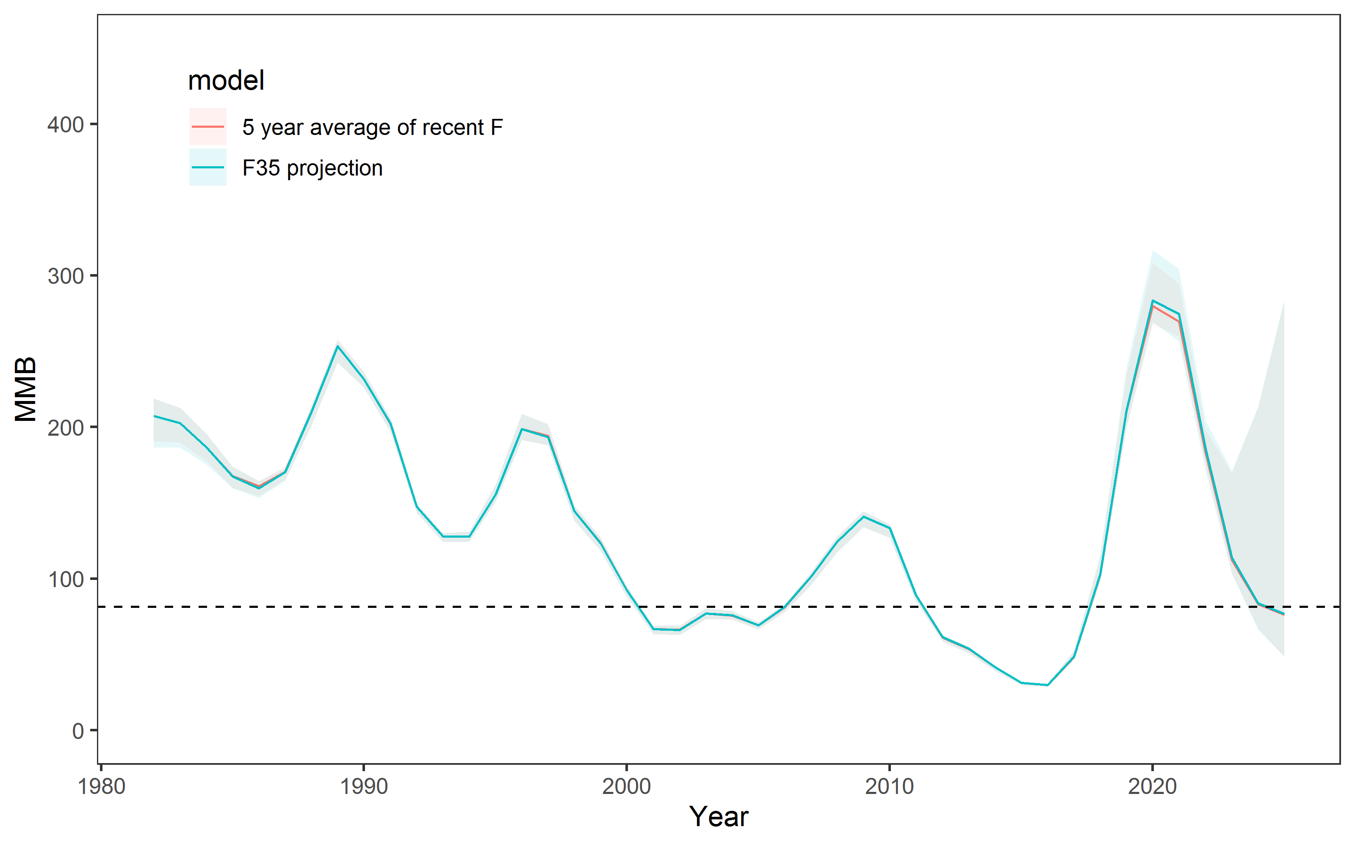
GMACS BYCATCH OFL & PROJ UNCERTAINTY
2020 OFL from author preferred model is >3x 2019
Reaching the peak in MMB driven by the large recruitment in 2015

Slide 5
GMACS BYCATCH OFL & PROJ UNCERTAINTY
Discrepancy between 2018 and 2019 survey data
Missed survey:
  Imputed survey
  Retrospective analyses including and excluding terminal year of survey data
Change in size of estimated recruitment from 2019 to 2020

Slide 6
What model do we choose? (I hope easy)
What do we do with that model? (Perhaps less easy)

Slide 7
2020 model scenarios
19.1: Status quo fit to 2018/2019 data with updated bycatch
20.1: 19.1 fit to 2019/2020 data
20.2: GMACS fit to the same data as 20.1
20.3: 20.2 + increased weight on 2010 BSFRF data to ‘force’ catchability

Slide 8
Model overview
July 1
Survey
Logistic selectivity in 2 ‘eras’
Linked to BSFRF data
Size composition and biomass index
7.5/12 M
Directed fishery
Non-directed fishery
Mating
4.5/12 M
Molting
Growth
Recruitment

Slide 9
Model overview
Survey
Mature males, immature for both sexes, mature females
Estimated with a prior
7.5/12 M
Directed fishery
Non-directed fishery
Mating
4.5/12 M
Molting
Growth
Recruitment

Slide 10
Model overview
Survey
7.5/12 M
Directed fishery
Logistic selectivity
Retention selectivity
Discard mortality equal to 30%
Fit to:
Retained length comps
Total length comps
Retained biomass
Male and female discard biomass
Non-directed fishery
Mating
4.5/12 M
Molting
Growth
Recruitment

Slide 11
Model overview
Survey
7.5/12 M
Directed fishery
Non-directed fishery
Logistic selectivity
Discard mortality equal to 80%
Mating
4.5/12 M
Molting
Growth
Recruitment

Slide 12
Model overview
Survey
7.5/12 M
Directed fishery
Non-directed fishery
Mating
Freely estimated maturity curves
February 15
4.5/12 M
Molting
Growth
Recruitment

Slide 13
Model overview
Survey
7.5/12 M
Directed fishery
Non-directed fishery
Mating
4.5/12 M
Molting
All immature crab assumed to molt
Terminal molt to maturity
Growth
Recruitment

Slide 14
Model overview
Survey
7.5/12 M
Directed fishery
Non-directed fishery
Mating
4.5/12 M
Molting
Growth
Linear growth in GMACS; kinked growth curve for females in SQ
Recruitment

Slide 15
Key changes in model structure in GMACS
Fishing mortality
  Definitions of ‘total mortality’ and how female mortality is treated are different between models
Growth
  Both sexes linear in GMACS
  Male linear, female kinked in SQ
BSFRF availability
  All year/sex combinations of BSFRF data have a freely estimated availability curve in GMACS (not so in status quo model)
Recruitment
  GMACS estimates a yearly recruitment and a parameter that divides that recruitment between sexes
  SQ estimates separate recruitment deviations for both sexes with smoothing penalties on devs

Slide 16
Model | MMB | B35 | F35 | FOFL | OFL
19.1 | 109.56 | 123.71 | 1.80 | 1.80 | 54.05
20.1 | 144.29 | 120.51 | 1.60 | 1.60 | 95.40
20.2 | 207.19 | 113.66 | 1.65 | 1.65 | 184.91
20.3 | 517.13 | 183.95 | 2.61 | 2.61 | 448.38

Slide 17
Difficulties in model comparison
GMACS and status quo likelihoods are not comparable
How to compare models?
  Visual fits
  Mean relative absolute error (survey and catch)
    Mean(abs(obs-pred)/obs)
  Mean absolute error (size comps)
    Mean(abs(obs-pred))

Slide 18
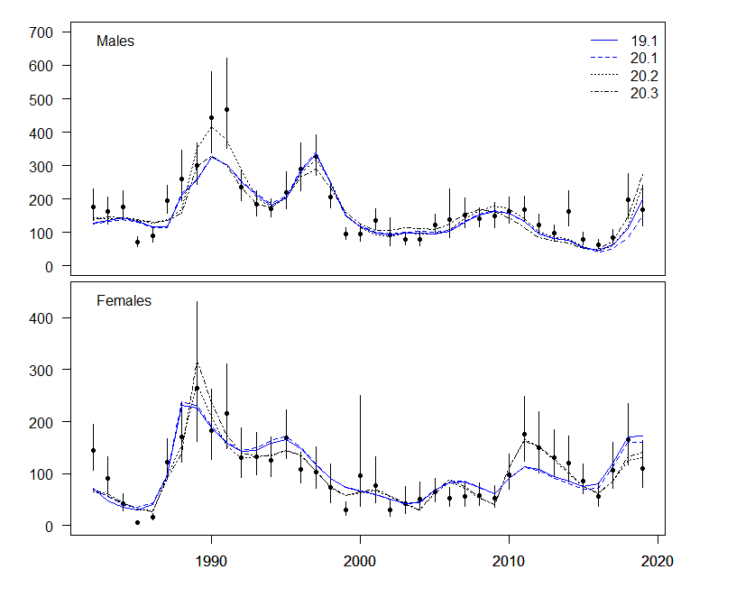
Fits to data
Data source | 20.1 | 20.2 | 20.3
Survey biomass |  | X
Growth
Catch
Retained size comp
Total size comp
Bycatch size comp
BSFRF size comp
Survey size comp (imm M)
Survey size comp (imm F)
Survey size comp (mat M)
Survey size comp (mat F)

Slide 19
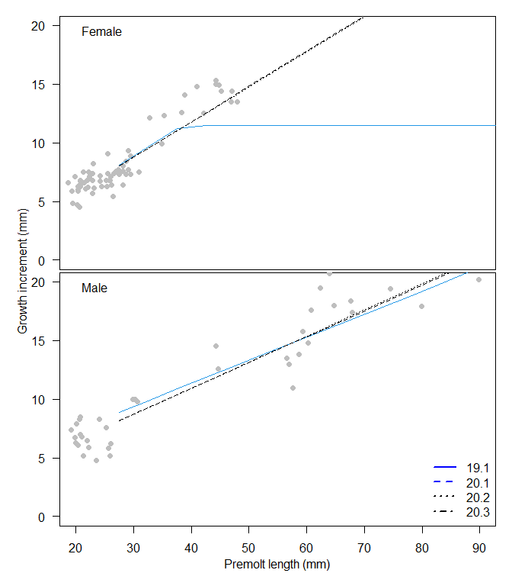
Fits to data
Data source | 20.1 | 20.2 | 20.3
Survey biomass |  | X
Growth |  | X | X
Catch
Retained size comp
Total size comp
Bycatch size comp
BSFRF size comp
Survey size comp (imm M)
Survey size comp (imm F)
Survey size comp (mat M)
Survey size comp (mat F)

Slide 20
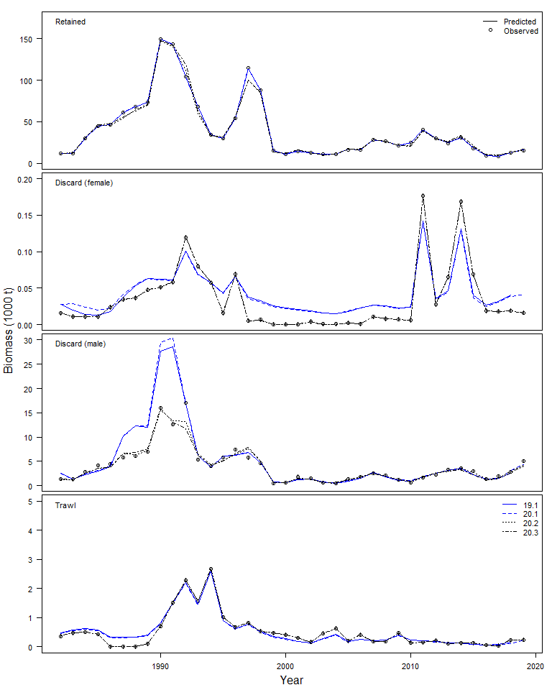
Fits to data
Data source | 20.1 | 20.2 | 20.3
Survey biomass |  | X
Growth |  | X | X
Catch |  | X | X
Retained size comp
Total size comp
Bycatch size comp
BSFRF size comp
Survey size comp (imm M)
Survey size comp (imm F)
Survey size comp (mat M)
Survey size comp (mat F)

Slide 21
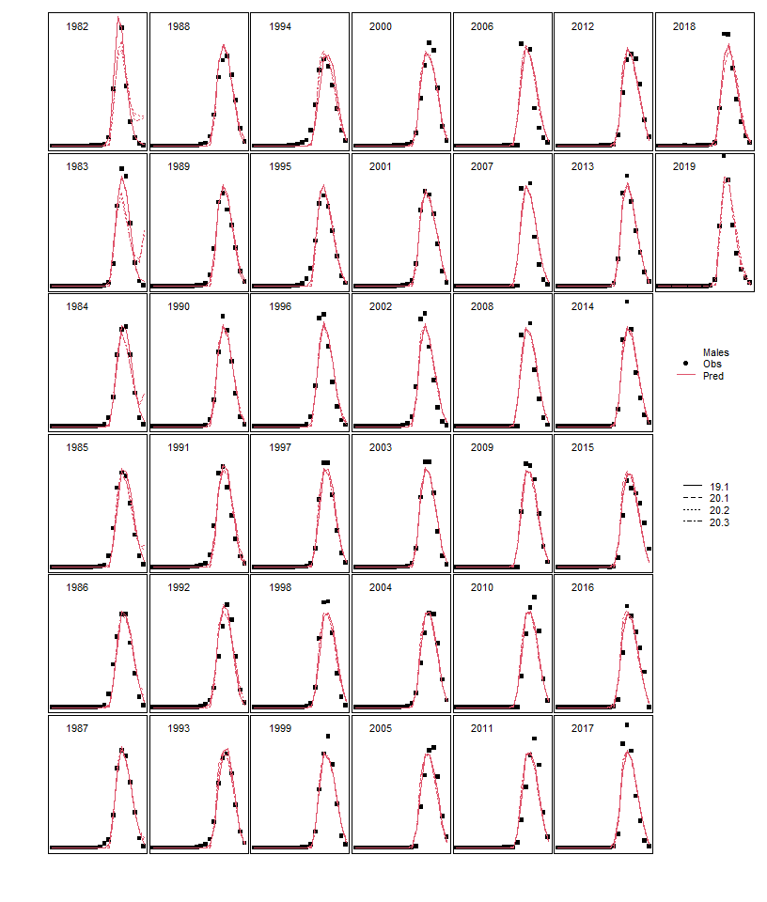
Fits to data
Data source | 20.1 | 20.2 | 20.3
Survey biomass |  | X
Growth |  | X | X
Catch |  | X | X
Retained size comp | X
Total size comp
Bycatch size comp
BSFRF size comp
Survey size comp (imm M)
Survey size comp (imm F)
Survey size comp (mat M)
Survey size comp (mat F)

Slide 22
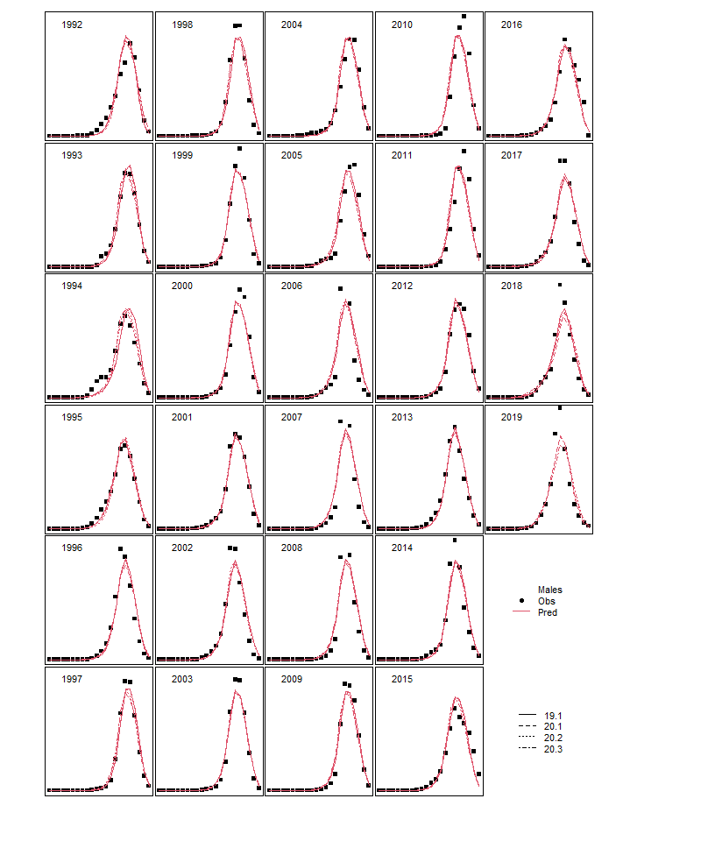
Fits to data
Data source | 20.1 | 20.2 | 20.3
Survey biomass |  | X
Growth |  | X | X
Catch |  | X | X
Retained size comp | X
Total size comp | ~ | ~ | ~
Bycatch size comp
BSFRF size comp
Survey size comp (imm M)
Survey size comp (imm F)
Survey size comp (mat M)
Survey size comp (mat F)

Slide 23
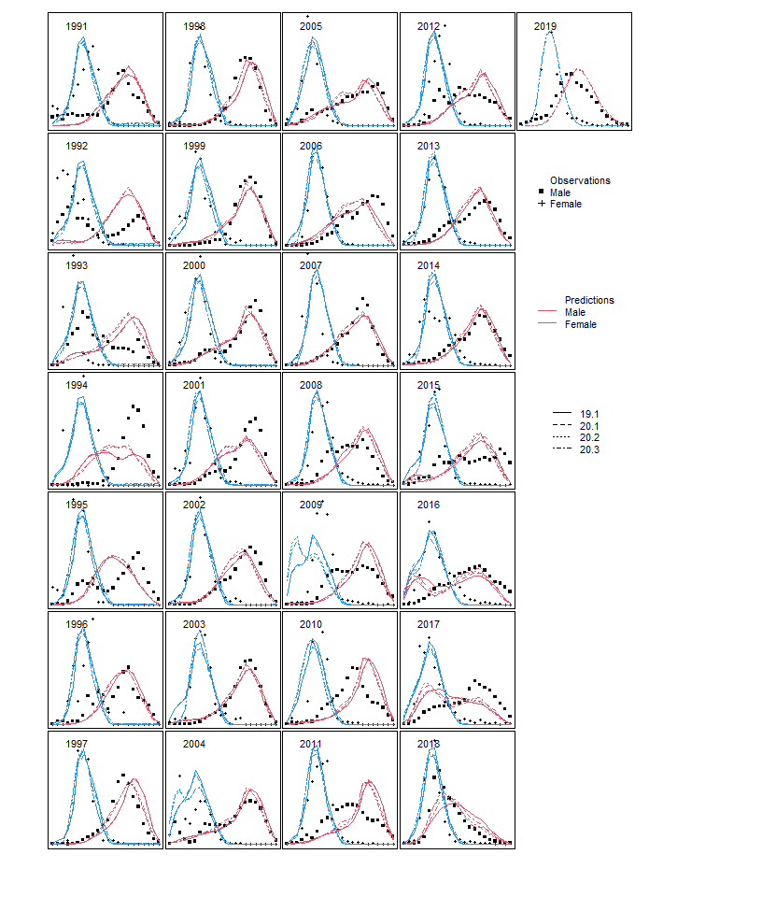
Fits to data
Data source | 20.1 | 20.2 | 20.3
Survey biomass |  | X
Growth |  | X | X
Catch |  | X | X
Retained size comp | X
Total size comp | ~ | ~ | ~
Bycatch size comp | ~ | ~ | ~
BSFRF size comp
Survey size comp (imm M)
Survey size comp (imm F)
Survey size comp (mat M)
Survey size comp (mat F)

Slide 24
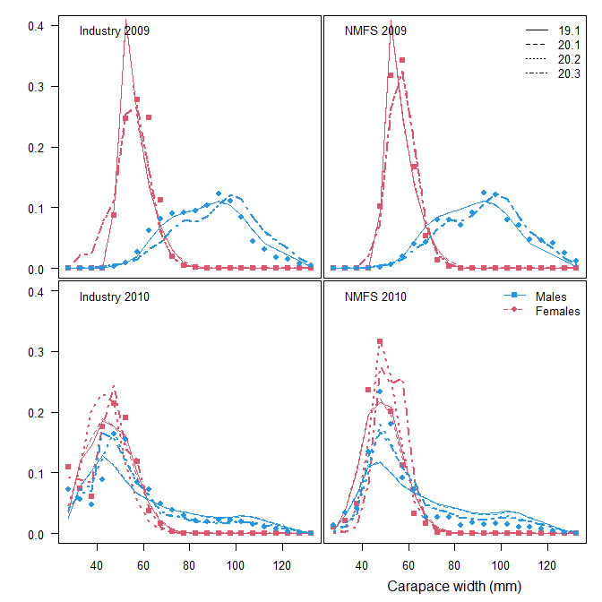
Fits to data
Data source | 20.1 | 20.2 | 20.3
Survey biomass |  | X
Growth |  | X | X
Catch |  | X | X
Retained size comp | X
Total size comp | ~ | ~ | ~
Bycatch size comp | ~ | ~ | ~
BSFRF size comp |  | X | X
Survey size comp (imm M)
Survey size comp (imm F)
Survey size comp (mat M)
Survey size comp (mat F)

Slide 25
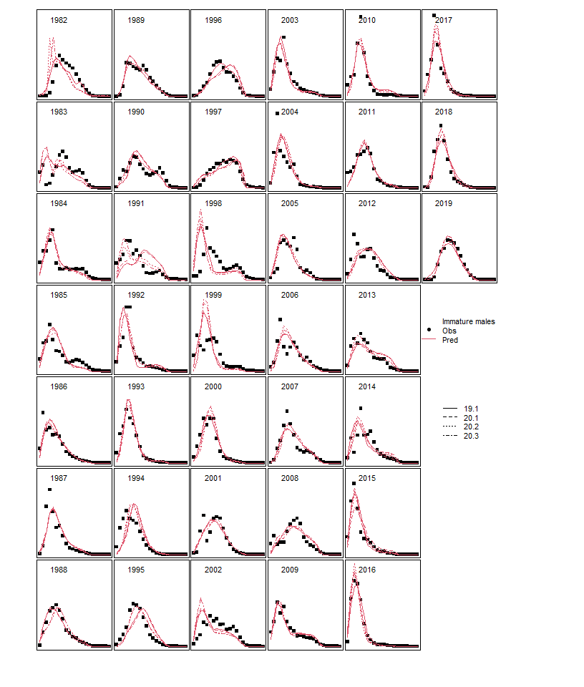
Fits to data
Data source | 20.1 | 20.2 | 20.3
Survey biomass |  | X
Growth |  | X | X
Catch |  | X | X
Retained size comp | X
Total size comp | ~ | ~ | ~
Bycatch size comp | ~ | ~ | ~
BSFRF size comp |  | X | X
Survey size comp (imm M) | ~ | ~ | ~
Survey size comp (imm F)
Survey size comp (mat M)
Survey size comp (mat F)

Slide 26
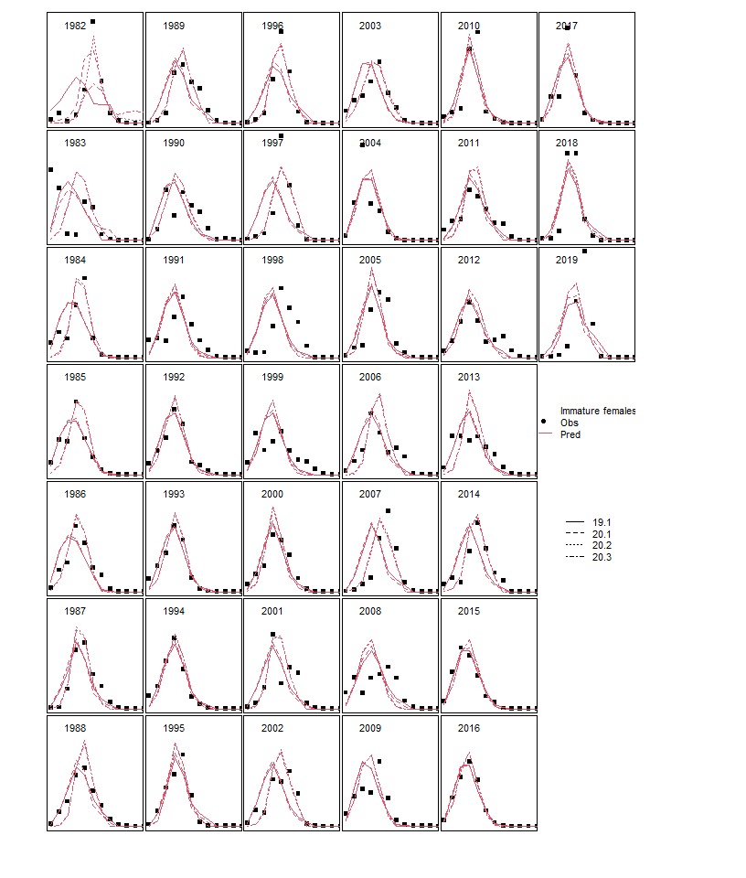
Fits to data
Data source | 20.1 | 20.2 | 20.3
Survey biomass |  | X
Growth |  | X | X
Catch |  | X | X
Retained size comp | X
Total size comp | ~ | ~ | ~
Bycatch size comp | ~ | ~ | ~
BSFRF size comp |  | X | X
Survey size comp (imm M) | ~ | ~ | ~
Survey size comp (imm F) |  | X | X
Survey size comp (mat M)
Survey size comp (mat F)

Slide 27
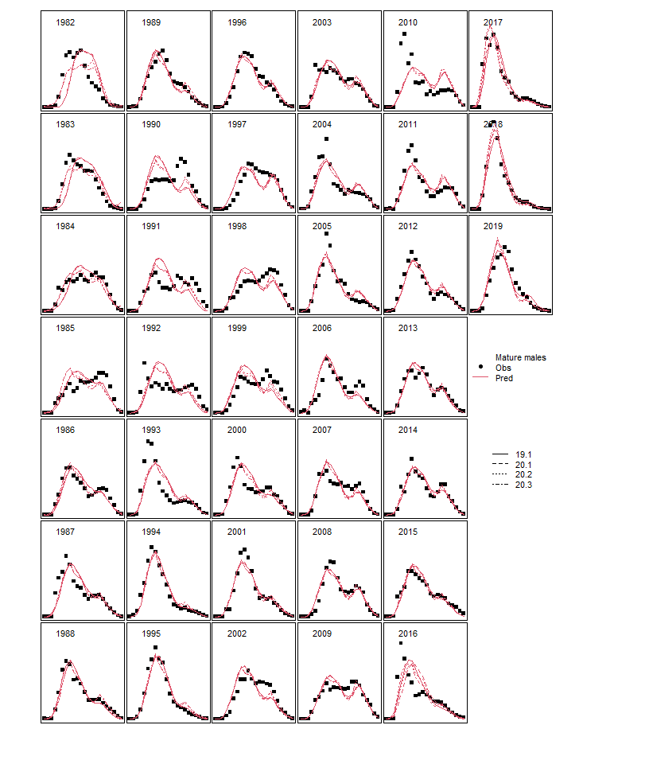
Fits to data
Data source | 20.1 | 20.2 | 20.3
Survey biomass |  | X
Growth |  | X | X
Catch |  | X | X
Retained size comp | X
Total size comp | ~ | ~ | ~
Bycatch size comp | ~ | ~ | ~
BSFRF size comp |  | X | X
Survey size comp (imm M) | ~ | ~ | ~
Survey size comp (imm F) |  | X | X
Survey size comp (mat M) | ~ | ~ | ~
Survey size comp (mat F)

Slide 28
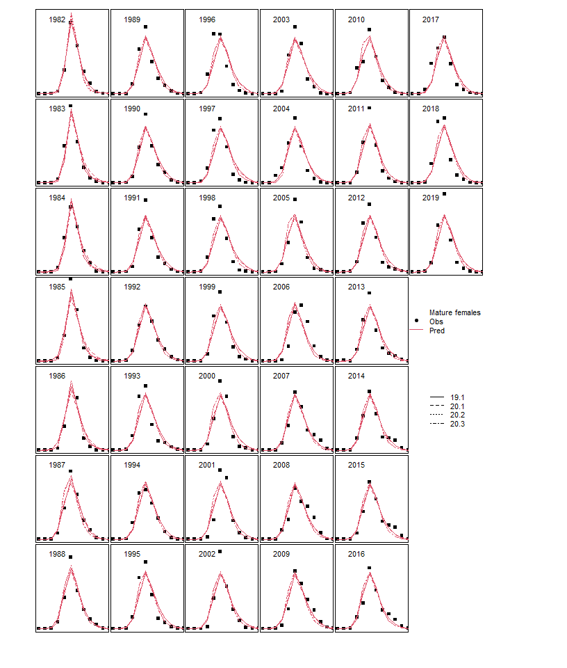
Fits to data
Data source | 20.1 | 20.2 | 20.3
Survey biomass |  | X
Growth |  | X | X
Catch |  | X | X
Retained size comp | X
Total size comp | ~ | ~ | ~
Bycatch size comp | ~ | ~ | ~
BSFRF size comp |  | X | X
Survey size comp (imm M) | ~ | ~ | ~
Survey size comp (imm F) |  | X | X
Survey size comp (mat M) | ~ | ~ | ~
Survey size comp (mat F) | ~ | ~ | ~

Slide 29
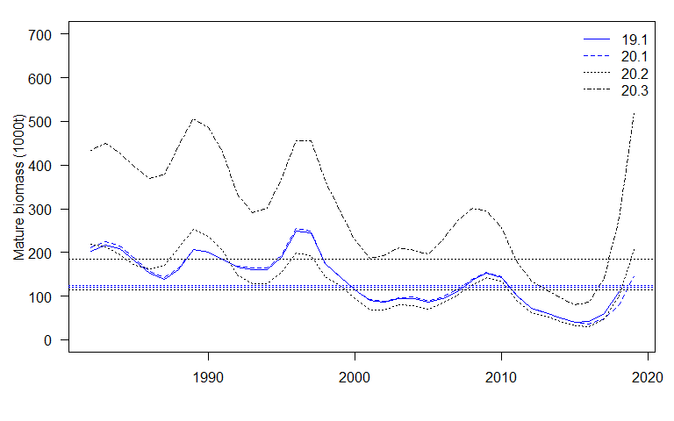
Estimated population processes
Population process | 20.1 | 20.2 | 20.3
Mature male biomass | X | X
Survey selectivity
Probability of maturing
Fishing mortality
Recruitment
Natural mortality
Status

Slide 30
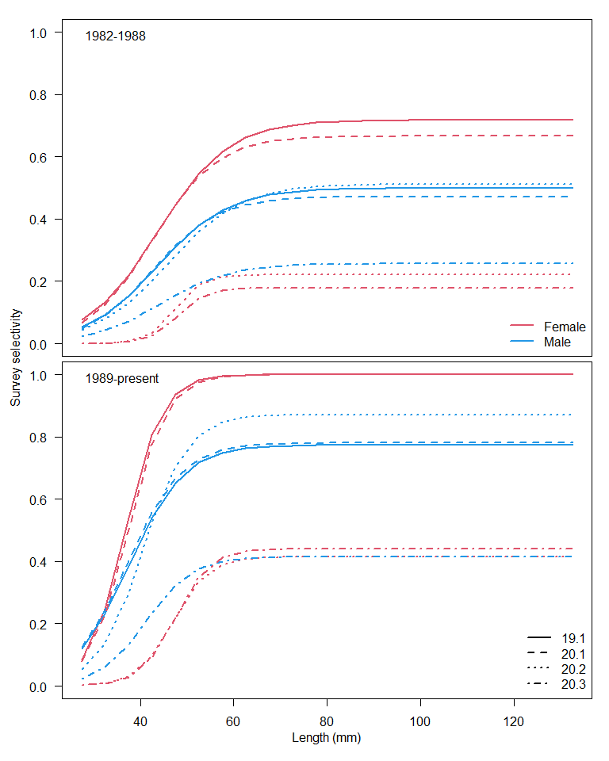
Estimated population processes
Population process | 20.1 | 20.2 | 20.3
Mature male biomass | X | X
Survey selectivity | ~ | ~ | ~
Probability of maturing
Fishing mortality
Recruitment
Natural mortality
Status
Female q for 20.2 is the implied q from the BSFRF data, without the extra weight of 20.3
Consider difference in functional form for survey selectivity

Slide 31
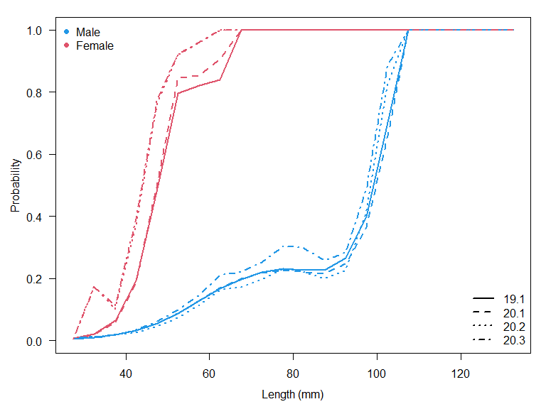
Estimated population processes
Population process | 20.1 | 20.2 | 20.3
Mature male biomass | X | X
Survey selectivity | ~ | ~ | ~
Probability of maturing | ~ | ~
Fishing mortality
Recruitment
Natural mortality
Status

Slide 32
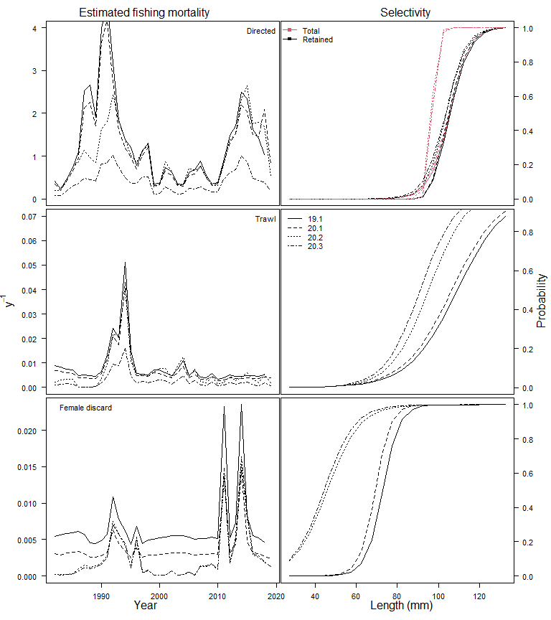
Estimated population processes
Population process | 20.1 | 20.2 | 20.3
Mature male biomass | X | X
Survey selectivity | ~ | ~ | ~
Probability of maturing | ~ | ~
Fishing mortality |  | X | X
Recruitment
Natural mortality
Status

Slide 33
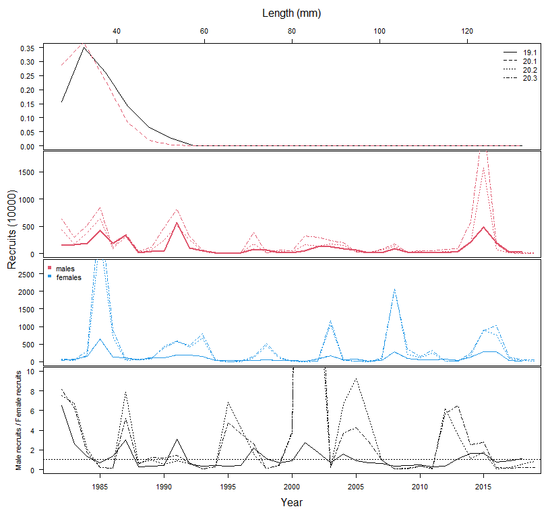
Estimated population processes
Population process | 20.1 | 20.2 | 20.3
Mature male biomass | X | X
Survey selectivity | ~ | ~ | ~
Probability of maturing | ~ | ~
Fishing mortality |  | X | X
Recruitment | ~ | ~ | ~
Natural mortality
Status
Survey q influences the scales
Smoothness penalties on status quo devs

Slide 34
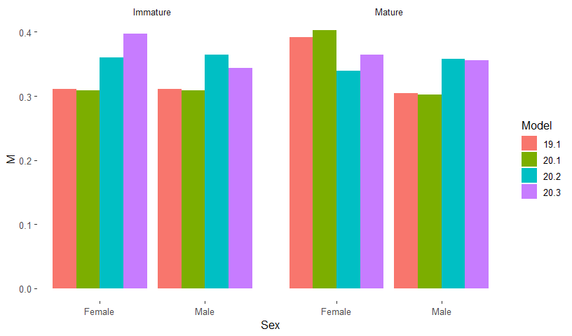
Estimated population processes
Population process | 20.1 | 20.2 | 20.3
Mature male biomass | X | X
Survey selectivity | ~ | ~ | ~
Probability of maturing | ~ | ~
Fishing mortality |  | X | X
Recruitment | ~ | ~ | ~
Natural mortality |  | X
Status

Slide 35
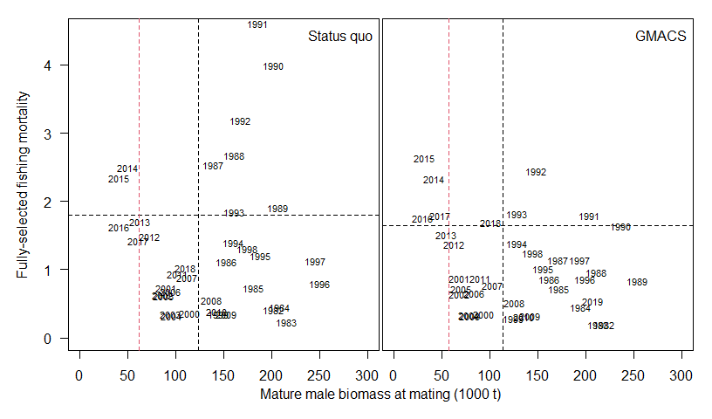
Estimated population processes
Population process | 20.1 | 20.2 | 20.3
Mature male biomass | X | X
Survey selectivity | ~ | ~ | ~
Probability of maturing | ~ | ~
Fishing mortality |  | X | X
Recruitment | ~ | ~ | ~
Natural mortality |  | X
Status | ~ | ~ | ~

Slide 36
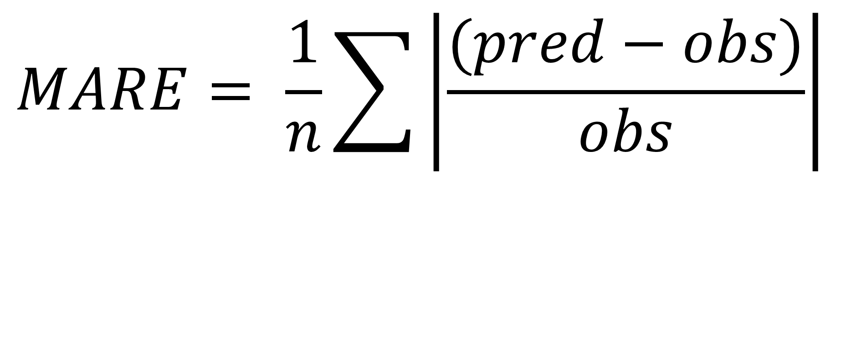
$$MARE= \frac{1}{n}\sum{\left|\frac{(pred−obs)}{obs}\right|}$$
LOWER IS BETTER PREDICTION
*this is not ideal because it does not consider the uncertainty in the point estimates

Slide 37
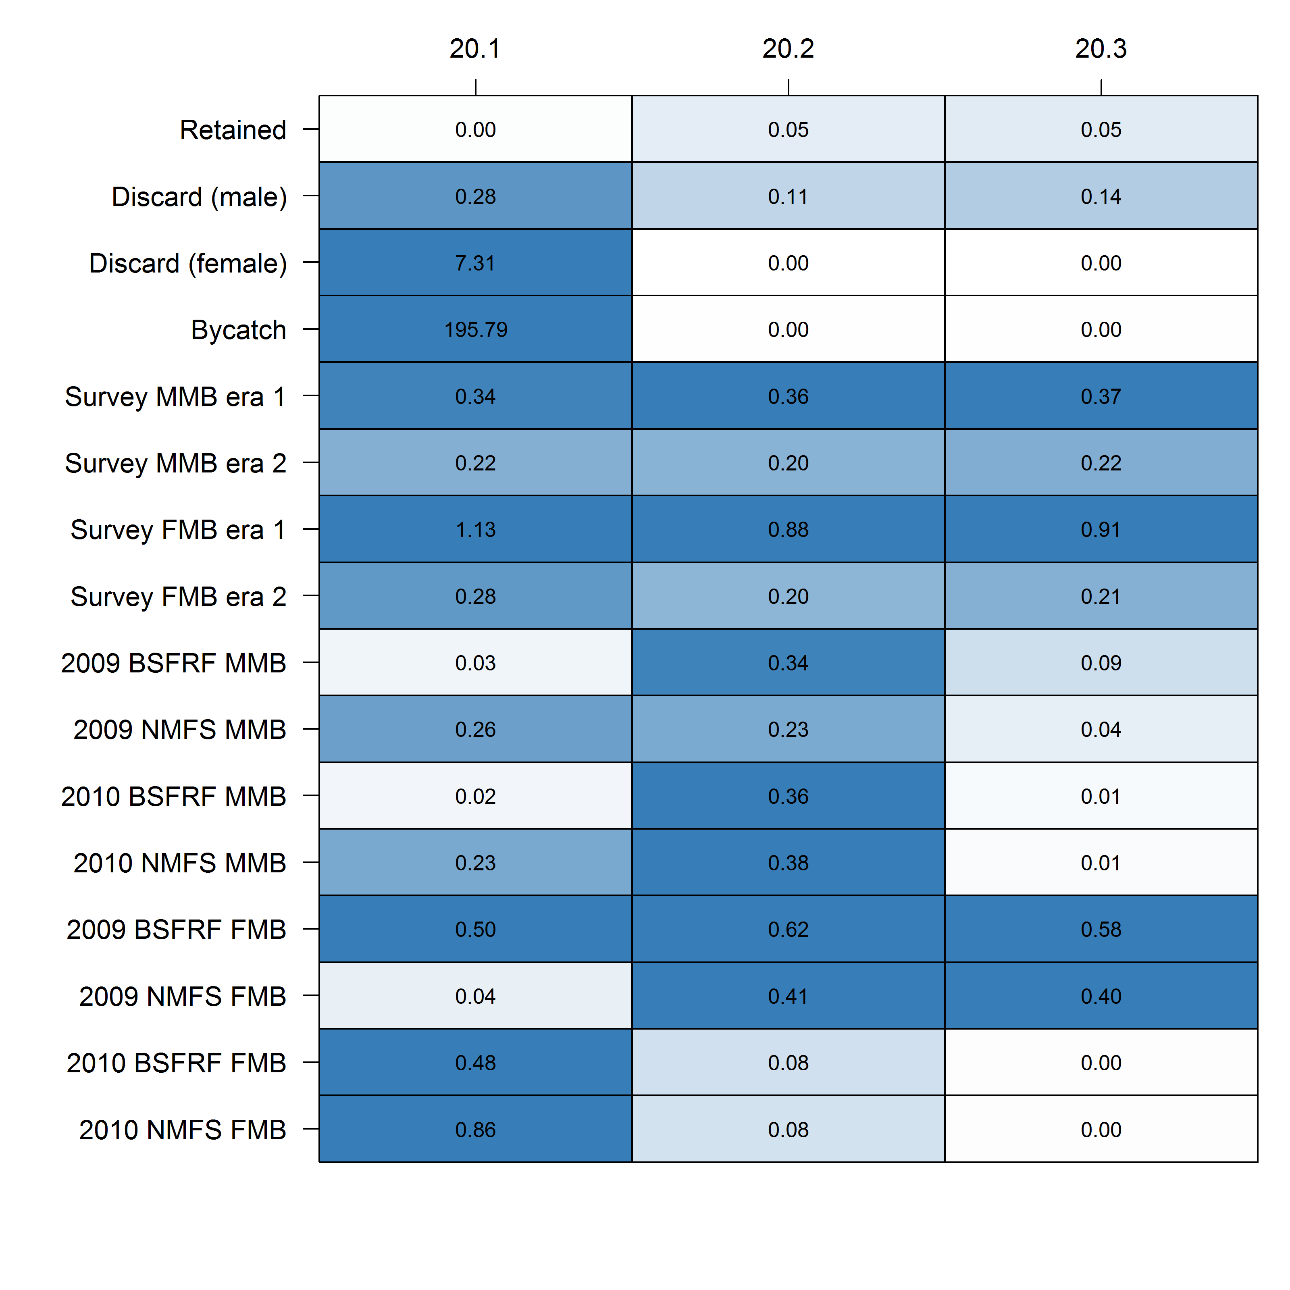
Data source | 20.1 | 20.2 | 20.3
Survey biomass |  | X
Growth |  | X | X
Catch |  | X | X
Retained size comp | X
Total size comp | ~ | ~ | ~
Bycatch size comp | ~ | ~ | ~
BSFRF size comp |  | X | X
Survey size comp (imm M) | ~ | ~ | ~
Survey size comp (imm F) |  | X | X
Survey size comp (mat M) | ~ | ~ | ~
Survey size comp (mat F) | ~ | ~ | ~

Slide 39

$$MAE= \frac{1}{n}\sum{\left|(pred−obs)\right|}$$
LOWER IS BETTER PREDICTION

Slide 40
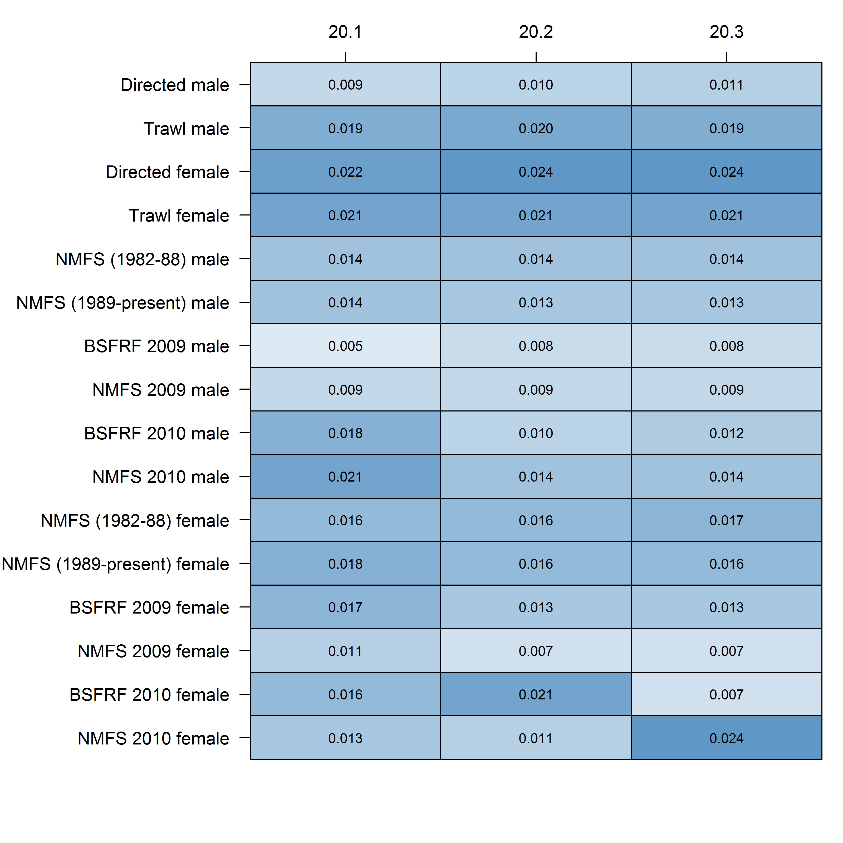
Data source | 20.1 | 20.2 | 20.3
Survey biomass |  | X
Growth |  | X | X
Catch |  | X | X
Retained size comp | X
Total size comp | ~ | ~ | ~
Bycatch size comp | ~ | ~ | ~
BSFRF size comp |  | X | X
Survey size comp (imm M) | ~ | ~ | ~
Survey size comp (imm F) |  | X | X
Survey size comp (mat M) | ~ | ~ | ~
Survey size comp (mat F) | ~ | ~ | ~

Slide 41
Rationale for author’s preference for GMACS
Data source | 20.1 | 20.2 | 20.3
Survey biomass |  | X
Growth |  | X | X
Catch |  | X | X
Retained size comp | X
Total size comp | ~ | ~ | ~
Bycatch size comp | ~ | ~ | ~
BSFRF size comp |  | X | X
Survey size comp (imm M) | ~ | ~ | ~
Survey size comp (imm F) |  | X | X
Survey size comp (mat M) | ~ | ~ | ~
Survey size comp (mat F) | ~ | ~ | ~
Model structure
  Fishing mortality
  Linear growth
  Natural mortality
  BSFRF availability
Survey biomass
Fits to the data

Slide 42
Uncertainty in the OFL
Mismatch between 2018 and 2019 survey
Missed survey
Retrospective patterns
Increase in estimated recruitment in GMACS from 2019 to 2020

Slide 45
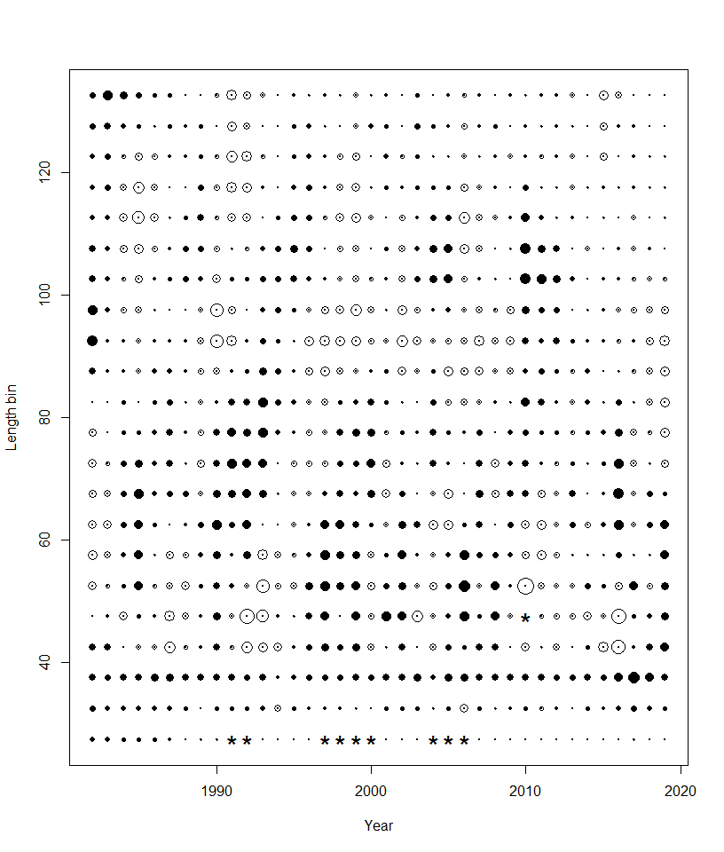
Immature males
Mature males

Slide 46
Uncertainty due to a missed survey
Many stocks on a biennial cycle
Snow crab is ‘special’—positive retrospective patterns
Two analyses:
  Retrospective analysis + include/exclude last year of survey data
  Imputed survey:
    run the model with a value for 2020 index (but no size data) with a very high CV
    Calculate the 25th and 75th quantiles for the residuals of fits to the survey MMB and FMB
    Impute a value for the survey based on the quantiles (2 runs)

Slide 47
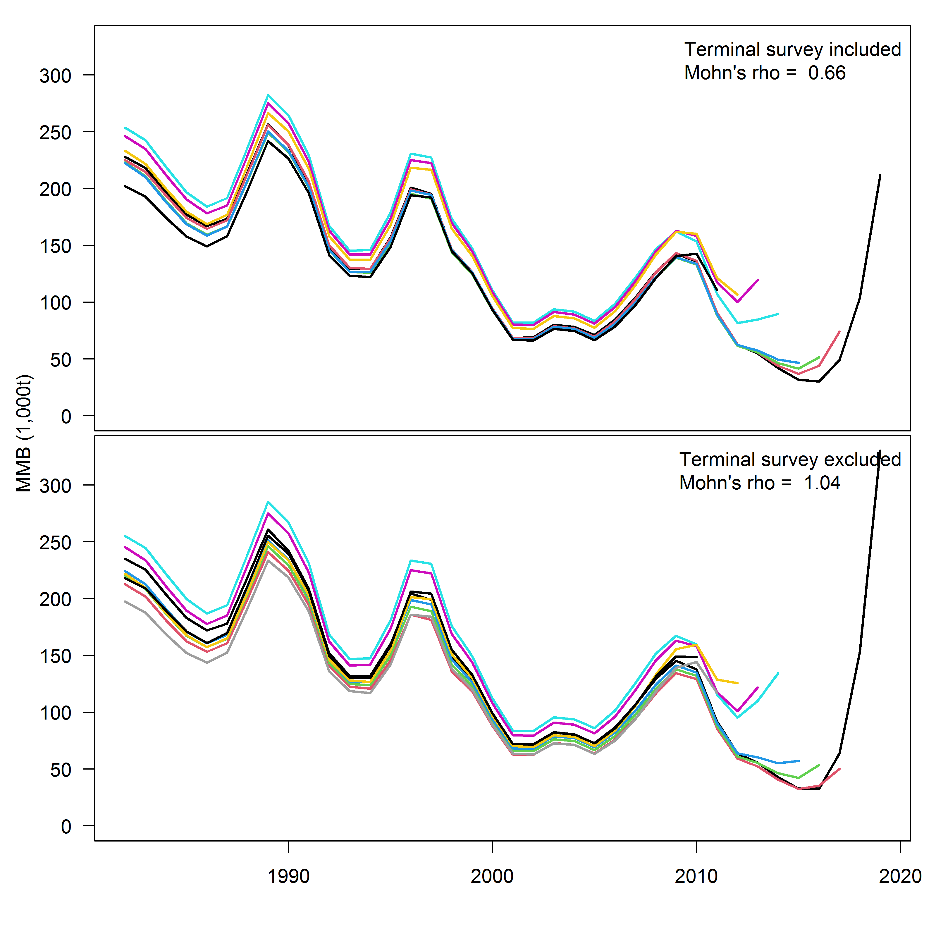

Slide 49
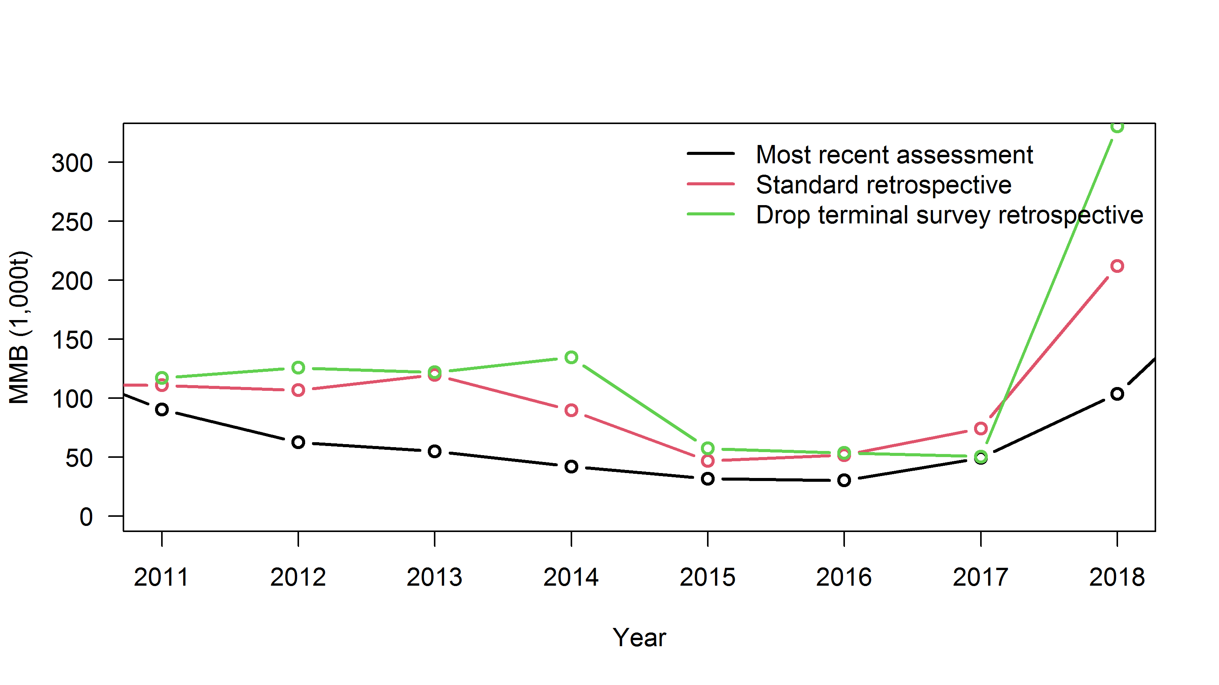

Slide 50
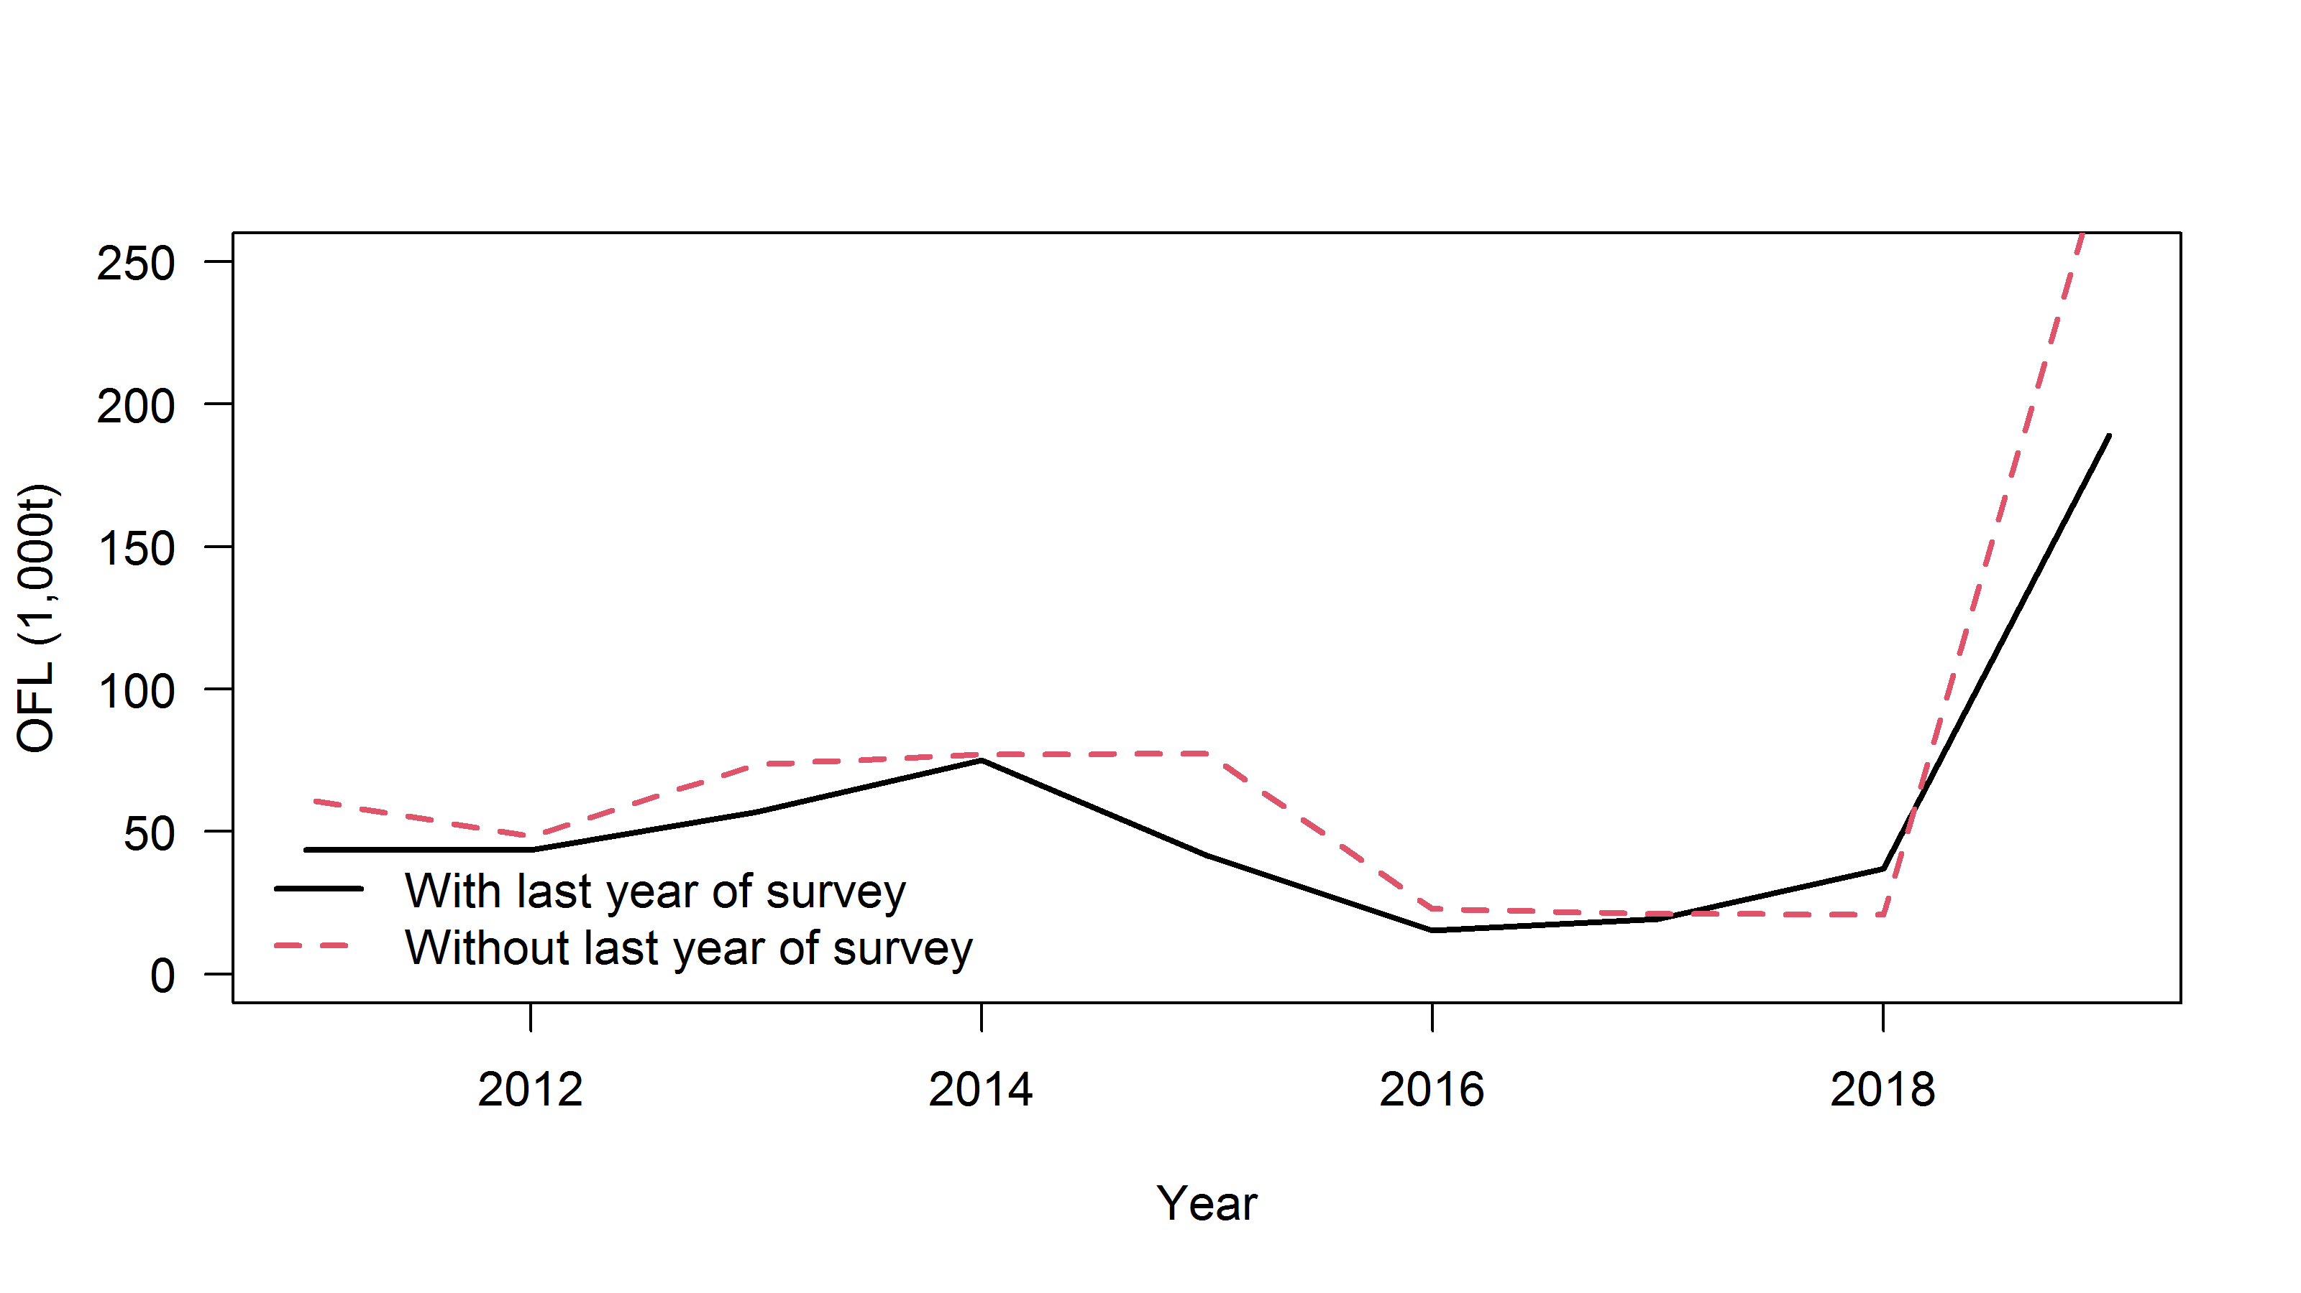

Slide 51
Imputed survey

Slide 55
Estimated recruitment

Slide 56
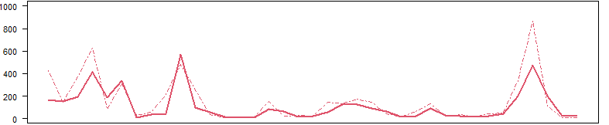
2019 data: GMACS (dotted lines) vs. Status quo (solid line)
2020 data: GMACS (dotted lines) vs. Status quo (solid line)
Why would 2015 recruitment be so much higher for GMACS than for SQ with 2019 data?
Why would the GMACS recruitment increase so much from 2019 to 2020?
Why didn’t SQ increase with the new data?

Slide 57
Sequential addition of catch data
GMACS trawl
GMACS discard female
GMACS ret + total
GMACS, add retained catch
GMACS, no new catch data

Slide 59
Why would 2015 recruitment be so much higher for GMACS than for SQ with 2019 data?
  GMACS has no constraining smoothing parameter for recruitment
  GMACS immature natural mortality is much higher than SQ
Why would the GMACS recruitment increase so much from 2019 to 2020?
  The ratio between discarded catch and retained catch is a big signal.
Why wouldn’t the SQ recruitment estimates increase in 2020 too?
  2020 SQ does not get the trend in the last two years of survey MMB

Slide 61
What model do we choose?
I prefer GMACS.

Slide 62
Model | MMB | B35 | F35 | FOFL | OFL
19.1 | 109.56 | 123.71 | 1.80 | 1.80 | 54.05
20.1 | 144.29 | 120.51 | 1.60 | 1.60 | 95.40
20.2 | 207.19 | 113.66 | 1.65 | 1.65 | 184.91
20.3 | 517.13 | 183.95 | 2.61 | 2.61 | 448.38

Slide 63
What do we do with that model?
Potential for an additional buffer based on:
1. discrepancies in 2018 & 2019 survey
2. changes in estimated recruitment
3. worsening of retrospective patterns with no survey

