Slide 1
Accounting for Uncertainty in Crab Stock Assessments from Loss of 2020 Survey
September 2020

Slide 2
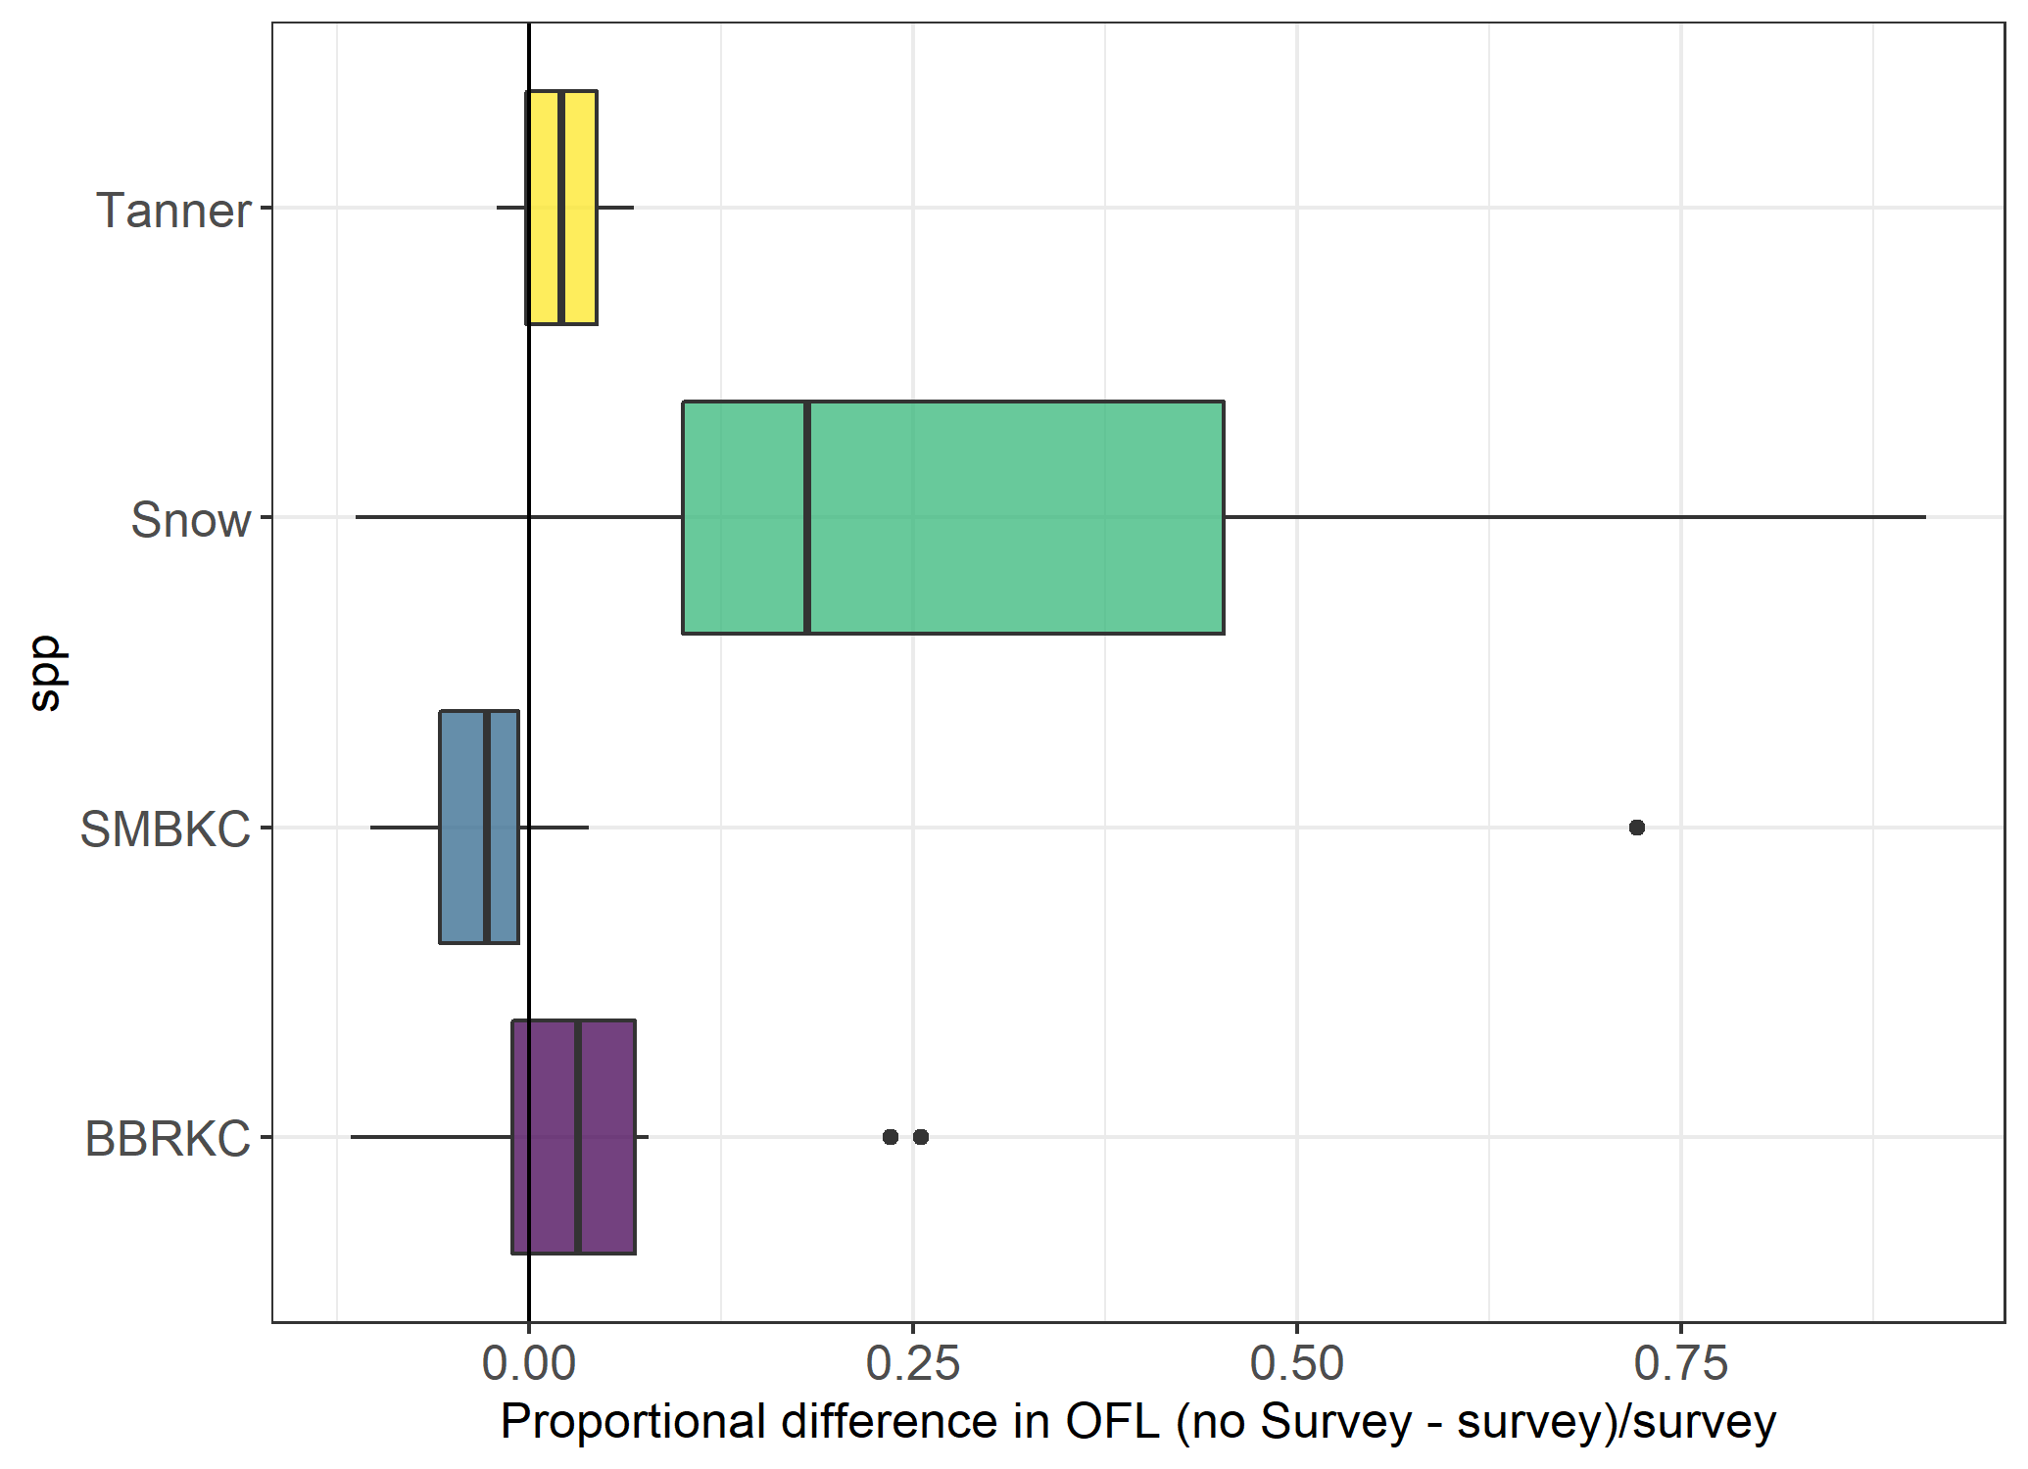
Approach 1: retrospective with and without terminal year of survey data effect on OFL

Slide 3
Approach 3 – Summarizing sensitivity of the OFL estimate to potential high and low 2020 survey data point
OFL_high – OFL_low / OFL_base
BBRKC 10.6%
Snow 26.5%
Tanner 4.4%
SMBKC 13.6%

Slide 4
Stock | 2020 proposed ABC buffer | Rational | Trajectory | Uncertainty analysis results | Proposed additional 2020 buffer
BBRKC | 20% | Overpredicting recent survey (18,19) Cold pool distribution shifts Align with other stocks Long-term declining trend | Down | Minimal | 0 – 5% ??
Snow | 25% | Model structure uncertainties (high predicted recruitment in 2015) Retrospective patterns Uncertainty around M Discrepancy between 2018 and 2019 survey data | Up | Strong positive retrospective bias, without survey overestimating OFL | 25%
SMBKC | 25% | Overfished Poor model fit to survey data Data poor stock Unfavorable environment | Flat | Minimal - Recent years underestimate OFL without survey | none
Tanner | 20% | Parameters hitting bounds Poor convergence | Flat?/Down | Minimal | none

