Slide 1
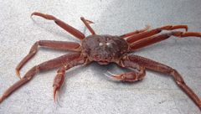
2020 Tanner Crab Stock Assessment
William Stockhausen
AFSC/NMFS/NOAA
Sept 16, 2020

Slide 2
2019/20 Summary
Fisheries
  Directed fisheries closed
  TAC: 0 t. Retained catch: 0 t
  Total catch mortality: 540 t
  Overfishing did not occur (2019/20 OFL = 28,860 t)
  Stock not overfished
Surveys
  No 2020 NMFS EBS shelf bottom trawl survey
  2019 NMFS EBS shelf survey results
    mature male biomass: 20,100 t (-50%)
    mature female biomass: 4,800 t ( -2%)

Slide 3
CPT and SSC Comments

Slide 4
Outline
SSC & CPT Comments
Recent Fishery and Survey Trends
Model Description
Model Scenarios
Model Evaluation
Missing Survey Uncertainty
Status Determination & OFL Calculation
Final Remarks

Slide 5
SSC Comment: The SSC reminds all stock assessment authors to implement the guidelines for model numbering for consistency and easier version tracking over time and emphasizes how important this is for SSC review.
Response (9/20): The SSC numbering convention is followed in this chapter.
CPT Comment: Should no survey occur, the CPT recommends that stock assessment authors roll over last year’s accepted model, incorporating updated fishery data when possible, and projecting OFL/ABCs based on our understanding of stock trends from surveys to 2019.
Response (9/20): The 2020 NMFS EBS Shelf bottom trawl survey was indeed cancelled. Model runs were conducted with last year’s accepted model, updated with fishery data for 2019/20 (Scenario 19.03(2020)). Additional runs were made that included simulated 2020 survey data which bracketed the survey biomass for 2020 predicted by 19.03(2020) by 25% of expected variation.

Slide 6
SSC Comment: the SSC encouraged authors to work together to create a standard approach for creating priors on selectivity and catchability from these (BSFRF/NMFS side-by-side trawl) data for use in the respective assessments. A hierarchical comparison of all species pooled, separated species, and separated sexes may be helpful for understanding where statistically supported differences exist. Where sample sizes are modest (e.g., snow crab), bootstrapping, or a sample size-weighted estimate rather than a raw average may be useful for aggregating across years.
Response (updated 9/20): An option to use such priors has been added to the Tanner crab assessment model code, but it has not yet been utilized. Results from a preliminary attempt to develop priors on sex/size-specific catchability (q x selectivity) and availability were presented for Tanner crab in the May 2020 CPT Report. Further work estimating catchability outside the assessment model using catch ratio analysis of the BSFRF/NMFS side-by-side trawl data using GAMMs is underway but incomplete (see Appendix 4 for an interim report). A model scenario (20.10) using the “best” estimates (from a limited, preliminary set of candidate models) of sex-specific catchability from this analysis is presented in this chapter, however, the estimated catchability curves are used as “known” in the assessment model.
SSC Comment: The SSC requested that, for the next assessment, models be reparametrized, simplified, or have parameter bounds adjusted such that no parameters remain at the bounds after estimation.
Response (9/20): Model scenario 20.10 considered here reduced the number of parameters at bounds from 12 to 5 but was unsatisfactory for other reasons. It appears that reparameterizing selectivity functions from using logistic functions to using half-normal functions may eliminate several such parameters. A simplified male-only model including only the directed and snow crab fisheries as source of fishing mortality is being investigated, as well as whether bycatch in the BBRKC fishery is small enough to be dropped post-2004 (at least for females). As such, a number of avenues are being explored but work continues on this topic.

Slide 7
SSC Comment: Provide additional information on data weighting. Specifically, identify standardized residuals appreciably greater than would be expected by chance (e.g., values of four and larger), report mean input and harmonic mean effective sample sizes by source for evaluation of model fit, and consider basing input sample sizes on the number of trips/hauls sampled rather than the number of individual crab measured.
Response (9/20): Information is not currently provided to base input sample sizes on the number of trips/hauls sampled for fishery-related size compositions, and the sample sizes in the survey are limited to 200 in order to avoid numerical issues (the number of hauls would typically be 375 in any survey year post-1987, and would never be as low as 200 in any case). Geometric mean, not harmonic mean, effective sample sizes based on the McAllister-Ianelli method are provided for all size composition data. Large standardized residuals are not specifically flagged as part of the assessment model output. This capability will be added in the future.

Slide 8
SSC Comment: The SSC reiterated its previous recommendation on analysis of the BSFRF data. The SSC encouraged authors to work together to create a standard approach for creating priors on selectivity and catchability from these data for use in the respective assessments. A hierarchical comparison of all species pooled, separated species, and separated sexes may be helpful for understanding where statistically supported differences exist. Where sample sizes are modest (e.g., snow crab), bootstrapping, or a sample size-weighted estimate rather than a raw average may be useful for aggregating across years.
Response: This needs to be highlighted as a request to the CPT to add this topic as an agenda item to its January 2021 meeting, if possible. It seems like the best avenue forward at the moment is for individual authors to continue to develop the best analysis for their own stock. These can be compared in January and perhaps the best of these can be used as the basis for an hierarchical model, as the SSC recommends. Off hand, it seems likely that the differing morphological characteristics of Chionoecetes and Paralithodes crab, as well as the different environmental conditions they experience across the EBS shelf, will affect catchability differently and produce statistically-supported differences among the stocks.
CPT Comment: Therefore, the CPT recommends that model 20.07 be identified as a preliminary base model for September. The CPT discussed a refinement to model 20.07 (here denoted model 20.07b), in which the empirical availability curves are input as data vectors with specified uncertainty, rather than assumed known. If Model 20.07b turns out to be straightforward to implement, as we expect, then Model 20.07b could be regarded as the preliminary base model rather than Model 20.07.
Response: Given the current model code, Model 20.07b would be possible to implement, once the empirical curves and associated uncertainty were developed. Empirical curves (smooth functions of size) were developed by fitting the ratio of observed survey abundance in the side-by-side study area to that from the entire survey area on an annual basis for 2013-2017 using the same size bins as in the assessment model (Appendix 3). However, it is unclear what the appropriate measure of uncertainty should be. Estimates of uncertainty from fitting the empirical curves seem to be too small, while ones developed previously from bootstrapping (May 2020 CPT Tanner Crab Report) seem to be too large. With more pressing issues (characterizing the uncertainty associated with the missing 2020 NMFS EBS shelf bottom trawl survey), it was not possible to further resolve this one. The author looks forward to recommendations to move forward.

Slide 9
CPT Comment: Consider ways to remove any additional complexity in the Tanner crab assessment that does not add to our understanding of stock dynamics.
Response (9/20): A male-only model including only the directed and snow crab fisheries is in development as a simplified baseline for adding further complexity (e.g., bycatch in the groundfish and BBRKC fisheries). A model that starts in 1982, after the survey gear change, is under consideration for development. Its implementation would require new code to parameterize the initial size compositions; this approach would be substantially different from the way the model is initialized at present.
CPT Comment: Evaluate potential conflicts between data sets in the assessment using likelihood profiles and other approaches.
Response (9/20): This is a good suggestion, but ADMB’s likelihood profiling does not appear to be adequate to address this request because it does not report individual components to the likelihood. Thus, some specialized software needs to be developed in order to proceed.
CPT Comment: Further work is needed to incorporate empirical estimates of catchability in the assessment. Quantifying uncertainty in catchability is critical. Uncertainty estimates should consider year-to-year variation catchability either as a random effect or as a level of a hierarchical model.
Response: Survey catchability for the NMFS EBS shelf bottom trawl survey was estimated outside the assessment model using BSFRF-NMFS side-by-side (paired tows) data in a catch-comparison analysis (Appendix 4). The catchability curves were estimated using GAMs with haul as a random effect. The analysis of models with year as a random effect, as well as the addition of potential environmental covariates, is pending. The curves were used in Scenario 20.10 as “known” values without any uncertainty. The author welcomes more-specific recommendations on how best to quantify the uncertainty, as well as how to include it in the assessment model.

Slide 10
SSC comment: Provide a retrospective analysis for future assessments.
Response (9/20): Retrospective analyses are now provided.
SSC comment: Add the 2018 BSFRF/NMFS side-by-side data for all future analyses of that time-series.
Response (9/20): BSFRF has not provided this data, although it has been promised.
The CPT suggested exploring the relationship between natural mortality, growth, and overestimates of large crab. For example, estimate growth outside the model to attempt to address the overestimates of large crab.
Response (9/20): Model scenarios have been run where growth is estimated outside the model. This does not seem to solve this issue. Software to perform a likelihood profile on male growth parameters is under development and the results of the profile will hopefully shed some light on this issue.
The CPT suggested exploring maturity states for growth increment data and make recommendations for directions for growth model development.
Response (9/20): Except for 2019 data, there seems to be little information on whether or not a molt was considered terminal.

Slide 11
Recent Fishery and Survey Trends

Slide 12
Aspects of State Management
Source: Ben Daly (ADFG)

Slide 13
Retained catch biomass

Slide 14
Retained catch size compositions

Slide 15
Total catch in all fisheries

Slide 16
Total catch size comps: Crab Fisheries
Males
Females

Slide 17
Total catch size comps: Groundfish Fisheries

Slide 18
Recent NMFS EBS Shelf Survey Trends
4,900 t ( -2%)
No 2020 survey
4,800 t ( -2%)
8,540 t (+16%)
20,100 t (-50%)

Slide 19
Legal male survey trends

Slide 20
Trends in Survey Abundance

Slide 21
Trends in Survey Abundance

Slide 22
Model Description

Slide 23
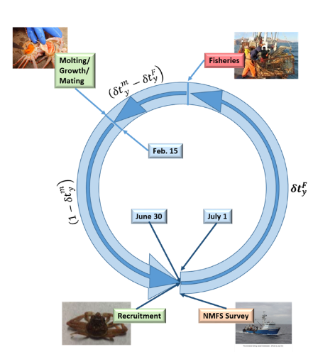
Tier 3 stage/size-based population dynamics model
  model year runs July 1 to June 30
  sex, shell condition, maturity state, carapace width
  sex/stage-based natural mortality (2 time stanzas)
  trawl survey occurs July 1
  fisheries occur Feb. 15
    directed fishery (retained and bycatch)
    bycatch in snow crab fishery
    bycatch in BBRKC fishery
    bycatch in groundfish fisheries
  sex-specific growth & maturity (after fisheries)
    pre-molt/post-molt size transition matrix
    size-specific probability of terminal molt to maturity
  spawning stock (MMB) assessed at mating, before growth
Notes:
updated 2018

Slide 24
Base model: population processes

Slide 25
Base model: fishery characteristics

Slide 26
Base model: fishery characteristics

Slide 27
Base model: NMFS survey characteristics

Slide 28
Base model: likelihood components

Slide 29
Base model: Data

Slide 30
Model Scenarios

Slide 31
Model Scenarios
Assessment
Other model explorations
3 scenarios evaluated for 2020 assessment
19.03(2020): updated 2019 assessment model
  Bycatch data added for 2019/20
New models use BSFRF-NMFS SBS data
  20.07:
    availability curves for SBS data determined outside model
    fits BSFRF SBS data
  20.10:
    NMFS survey catchability determined outside model
    fits to NMFS data only
Reduced complexity scenarios
  male only
  directed fishery (TCF) only
  TCF + snow crab fishery only
Alternative parameterizations
  lognormal fits to fishery catch data
  half-normal selectivity functions
  fixed M
Goal: eliminate parameters at bounds
  some success, not complete

Slide 32
Model scenarios

Slide 33
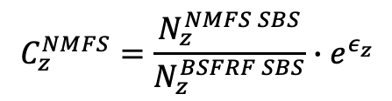


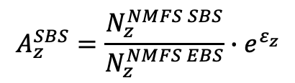


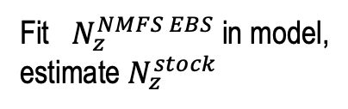


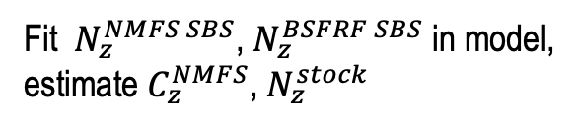


Using Side-By-Side Studies’ Data
$$N_{z}^{survey}=A_{z}^{survey}∙C_{z}^{survey}∙N_{z}^{stock}$$
Options
$$N_{z}^{NMFS EBS}= 1 ∙ { C}_{z}^{NMFS} ∙N_{z}^{EBS}$$
Fit
Estimate outside model
Estimate $C_{z}^{NMFS}$ outside model
$N_{z}^{NMFS EBS}$, $N_{z}^{NMFS SBS}$, $N_{z}^{BSFRF SBS}$
$$N_{z}^{BSFRF SBS}=A_{z}^{SBS}∙ 1 ∙N_{z}^{EBS}$$
in model, estimate
$A_{z}^{SBS}$, $C_{z}^{NMFS}$, $N_{z}^{stock}$
$$N_{z}^{NMFS SBS}=A_{z}^{SBS} ∙C_{z}^{NMFS} ∙N_{z}^{EBS}$$
$$A_{z}^{SBS}$$
$$A_{z}^{SBS}=\frac{N_{z}^{NMFS SBS}}{N_{z}^{NMFS EBS}}∙e^{ε_{z}}$$
Fit $N_{z}^{NMFS SBS}$, $N_{z}^{BSFRF SBS}$ in model,
estimate $C_{z}^{NMFS}$, $N_{z}^{stock}$
$$C_{z}^{NMFS}=\frac{N_{z}^{NMFS SBS}}{N_{z}^{BSFRF SBS}}∙e^{ε_{z}}$$
Fit $N_{z}^{NMFS EBS}$ in model,
estimate $N_{z}^{stock}$

Slide 34

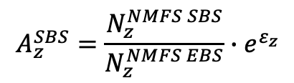
Empirical Availability: Females
$$A_{z}^{SBS}=\frac{N_{z}^{NMFS SBS}}{N_{z}^{NMFS EBS}}∙e^{ε_{z}}$$
Found best fitting cubic spline GAM by year to
$$ln\left(A_{z}^{SBS}\right)\sim N(cs\left(z\right),σ_{z}^{2})$$
using gcv to determine optimal dof’s

Slide 35
Empirical Availability: Males
$$A_{z}^{SBS}=\frac{N_{z}^{NMFS SBS}}{N_{z}^{NMFS EBS}}∙e^{ε_{z}}$$
Found best fitting cubic spline GAM by year to
$$ln\left(A_{z}^{SBS}\right)\sim N(cs\left(z\right),σ_{z}^{2})$$
using gcv to determine optimal dof’s

Slide 36
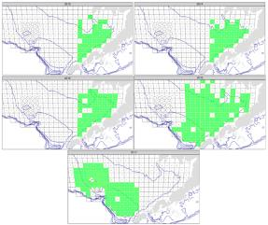
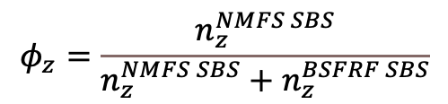
Empirical Catchability
On a per-haul basis
$$φ_{z}=\frac{n_{z}^{NMFS SBS}}{n_{z}^{NMFS SBS}+n_{z}^{BSFRF SBS}}$$
s(z) is a smooth function of size
eventually, include covariates (depth, sediment type)

Slide 37
Empirical Catchability
females
males
2016
2017

Slide 38
Model Results

Slide 39
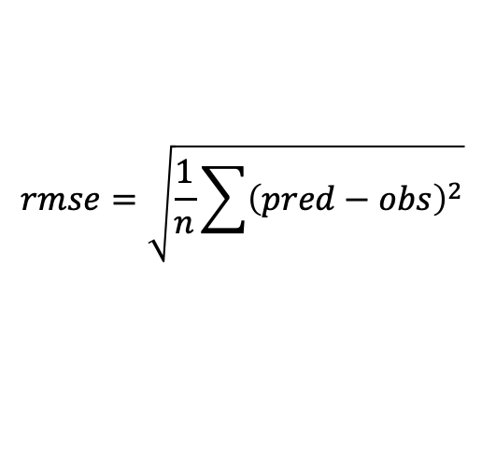
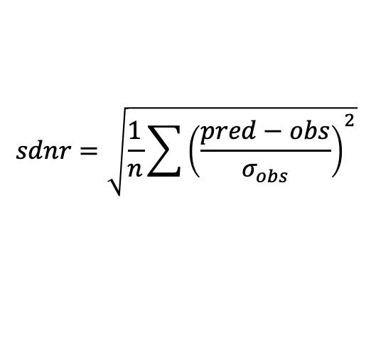
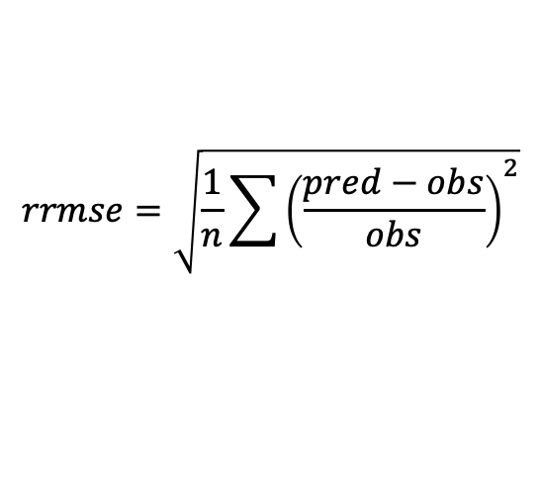
Model Comparisons
$$sdnr=\sqrt{\frac{1}{n}\sum{{\left(\frac{pred−obs}{σ_{obs}}\right)}^{2}}}$$
standard deviation of normalized residuals
$$rmse=\sqrt{\frac{1}{n}\sum{{\left(pred−obs\right)}^{2}}}$$
root mean square error
$$rrmse=\sqrt{\frac{1}{n}\sum{{\left(\frac{pred−obs}{obs}\right)}^{2}}}$$
root relative mean square error
smaller is better!

Slide 40
Model Evaluation: Fits to NMFS Survey Biomass

Slide 41
Model Evaluation: Fits to NMFS Survey Biomass

Slide 42
Model Evaluation: Fits to NMFS Survey Biomass

Slide 43
Model Evaluation: Fits to NMFS Survey Size Comps

Slide 44
Model Evaluation: Fits to NMFS Survey Size Comps
males

Slide 45
Model Evaluation: Fits to NMFS Survey Size Comps
males

Slide 46
Model Evaluation: Fits to NMFS Survey Size Comps
immature females

Slide 47
Model Evaluation: Fits to NMFS Survey Size Comps
immature females

Slide 48
Model Evaluation: Fits to BSFRF SBS Survey Biomass

Slide 49
Model Evaluation: Fits to BSFRF SBS Survey Biomass

Slide 50
Model Evaluation: Fits to BSFRF SBS Survey Biomass

Slide 51
Model Evaluation: Fits to BSFRF SBS Survey Size Comps

Slide 52
Model Evaluation: Fits to BSFRF SBS Survey Size Comps
males
immature females
mature females

Slide 53
Model Evaluation: Fits to Retained Catch Biomass

Slide 54
Model Evaluation: Fits to Retained Catch Size Comps

Slide 55
Model Evaluation: Fits to TCF Total Catch Biomass

Slide 56
Model Evaluation: Fits to TCF Total Catch Biomass

Slide 57
Model Evaluation: Fits to TCF Male Total Catch Size Comps

Slide 58
Model Evaluation: Fits to TCF Female Total Catch Size Comps

Slide 59
Model Evaluation: Fits to SCF Total Catch Biomass

Slide 60
Model Evaluation: Fits to SCF Total Catch Biomass

Slide 61
Model Evaluation: Fits to SCF Male Total Catch Size Comps

Slide 62
Model Evaluation: Fits to SCF Female Total Catch Size Comps

Slide 63
Model Evaluation: Fits to GF Total Catch Biomass

Slide 64
Model Evaluation: Fits to GF Male Total Catch Size Comps

Slide 65
Model Evaluation: Fits to GF Male Total Catch Size Comps

Slide 66
Model Evaluation: Fits to GF Female Total Catch Size Comps

Slide 67
Model Evaluation: Fits to GF Female Total Catch Size Comps

Slide 68
Model Evaluation: Fits to RKF Total Catch Biomass

Slide 69
Model Evaluation: Fits to RKF Total Catch Biomass

Slide 70
Model Evaluation: Fits to RKF Male Total Catch Size Comps

Slide 71
Model Evaluation: Fits to RKF Female Total Catch Size Comps

Slide 72
Model Evaluation: Fits to Growth Data

Slide 73
Model Evaluation: Fits to Maturity Ogives

Slide 74
Model Evaluation: Fits to Maturity Ogives

Slide 75
Model Evaluation: Non-Selectivity Parameter Estimates

Slide 76
Model Evaluation: Selectivity Parameter Estimates

Slide 77
Model Evaluation: More Selectivity Parameter Estimates

Slide 78
Model Evaluation: Likelihood Components

Slide 79
Model Evaluation: Likelihood Components

Slide 80
Model Evaluation:

Slide 81
Model Evaluation:

Slide 82
Model Evaluation:

Slide 83
Model Evaluation:

Slide 84
Model Evaluation: NMFS Survey Catchability

Slide 85
Model Evaluation: Estimated Natural Mortality

Slide 86
Model Evaluation: Estimated Pr(molt-to-matuity)

Slide 87
Model Evaluation: Trends in Recruitment and Mature Biomass

Slide 88
Model Evaluation: Trends in Recruitment and Mature Biomass

Slide 89
Model Evaluation:

Slide 90
Retrospective analysis
19.03(2020)
20.07
Mohn’s rho: 0.986
Mohn’s rho: 0.737
Mohn’s rho: -0.0471
Mohn’s rho: 0.0187

Slide 91
MCMC Considerations: 19.03(2020)

Slide 92
MCMC Considerations: 20.07

Slide 93
MCMC Results: 19.03(2020)

Slide 94
MCMC Results: 20.07

Slide 95
Model Evaluation: Author’s Preferred Scenario
Author’s preferred scenario: 20.07
Pro’s:
  Includes BSFRF SBS data to set scale
  Fits to data similar to base model
  Slightly better retrospective patterns
  MCMC results better (but still inadequate mixing)
  Fewer problematic parameter estimates
Con’s:
  Doesn’t fit most datasets quite as well as base model (not surprising given extra fits to BSFRF data)

Slide 96
Missing Survey Uncertainty

Slide 97
Missing Survey Uncertainty: 19.03 Retrospective Analysis
With Terminal Year Survey
Without Terminal Year Survey

Slide 98
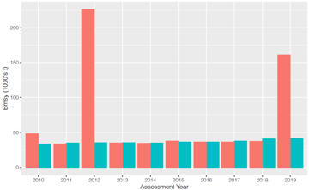
Missing Survey Uncertainty: Retrospective Without Terminal Year Survey
Recruitment averaging: 1982 - terminal year

Slide 99
Missing Survey Uncertainty: Retrospective Without Terminal Year Survey
Recruitment averaging: 1982 – (terminal year-1)

Slide 100
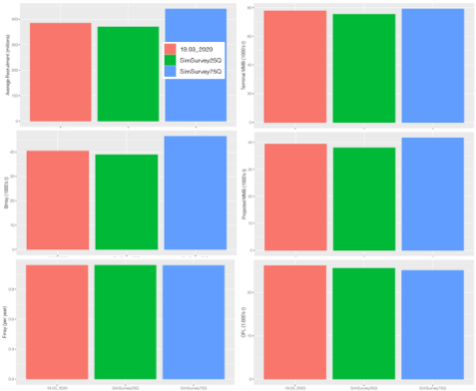
Characterizing missing survey uncertainty: simulated 2020 survey
Avg Rec
Term MMB
B_{MSY}
Proj MMB
F_{MSY}
OFL

Slide 101
Characterizing Missing Survey Uncertainty
Retrospective
Analysis
Must use 1982-(term year-1) averaging period
Effect on MLE estimates is small
Effect on MCMC appears to be large
No need to adjust 20% ABC buffer
Simulated Surveys

Slide 102
Status Determination and OFL Calculation

Slide 103
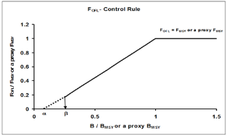
OFL/ABC MCMC Calculations
project stock forward using control rule
determine F_{OFL}
determine OFL
use MCMC to obtain distributions
OFL = median of OFL pdf
p-star ABC = 49th percentile OFL pdf
buffer ABC = 80% OFL

Slide 104
Options
Author preferred scenario: 20.07
Period for average recruitment: 1982-2019
20.07: MCMC
units: 1000’s t
20.07: MLE
19.03(2020): MLE

Slide 105
Final Remarks

Slide 106
State Management: New Harvest Control Rule
Based on
  BSFRF, ADFG, UW, AFSC cooperative research
  Madi Shipley MS Thesis (successfully defended 9/11/20!!)
  Daly et al., 2020
2018 HCR
2020 HCR

Slide 107
Future work (1)
Improve MCMC performance
  identify source(s) of poor performance
  revise to use NUTS
Finish SBS catch comparison analysis
  integrate 2018 SBS data
  develop estimated catchability curves
    no need to fit BSFRF data in model
  develop priors for catchability curves
    need to fit BSFRF data in model
    need availability curves
Examine fishery/survey size data for consistency
  some very large females in fishery bycatch
  add max size bin for females(?)
  drop size composition data with very small sample sizes
  split aggregated directed fishery into district components
  split aggregated groundfish bycatch into gear-specific components

Slide 108
Future work (2)
improve model stability/estimability
  continue effort to eliminate parameters at bounds or with huge CIs
  reparameterize logistic selectivity functions as half-normal functions
continue investigation into using lognormal fits to fishery catch biomass data
drop 1975-1981 survey data?
  different gear
  inconsistent areas covered
transition to Gmacs

Slide 109
Research needs
Size-weight relationships for fisheries
  are they the same as for survey?
  do survey weights need to be revisited?
More terminal molt growth data
Identify environmental drivers for
  recruitment
  redistribution

Slide 110
Extras

Slide 111
Model Evaluation: Diagnostics with Survey Data Not Fit

Slide 112
Model Evaluation: Diagnostics with Survey Data Not Fit

Slide 113
Model Evaluation: Diagnostics with Survey Data Not Fit

