Slide 1
Evaluating the impact of a lack of recent survey data in Alaska Fisheries Science Center groundfish and crab stock assessment models
Meaghan D. Bryan, Martin Dorn, William T. Stockhausen, Steven J. Barbeaux, Jim Ianelli, Sandra Lowe, Carey McGilliard, Cole Monnahan, Paul Spencer, Ingrid Spies, Cody Szuwalski, Grant G. Thompson
Alaska Fisheries Science Center
Resource Ecology and Fisheries Management Division
Status of Stocks and Multispecies Assessments

Slide 2
Objectives
Evaluate and get a better understanding of the expected uncertainty with the loss of the most recent survey data for a number of groundfish and crab species
Identify species that would be more sensitive to the loss of data
Notes:
Main goal of this analysis was to help our understanding of expected uncertainty with the loss of the most recent survey data and identify the species that would be more sensitive to the loss of data.

Slide 3
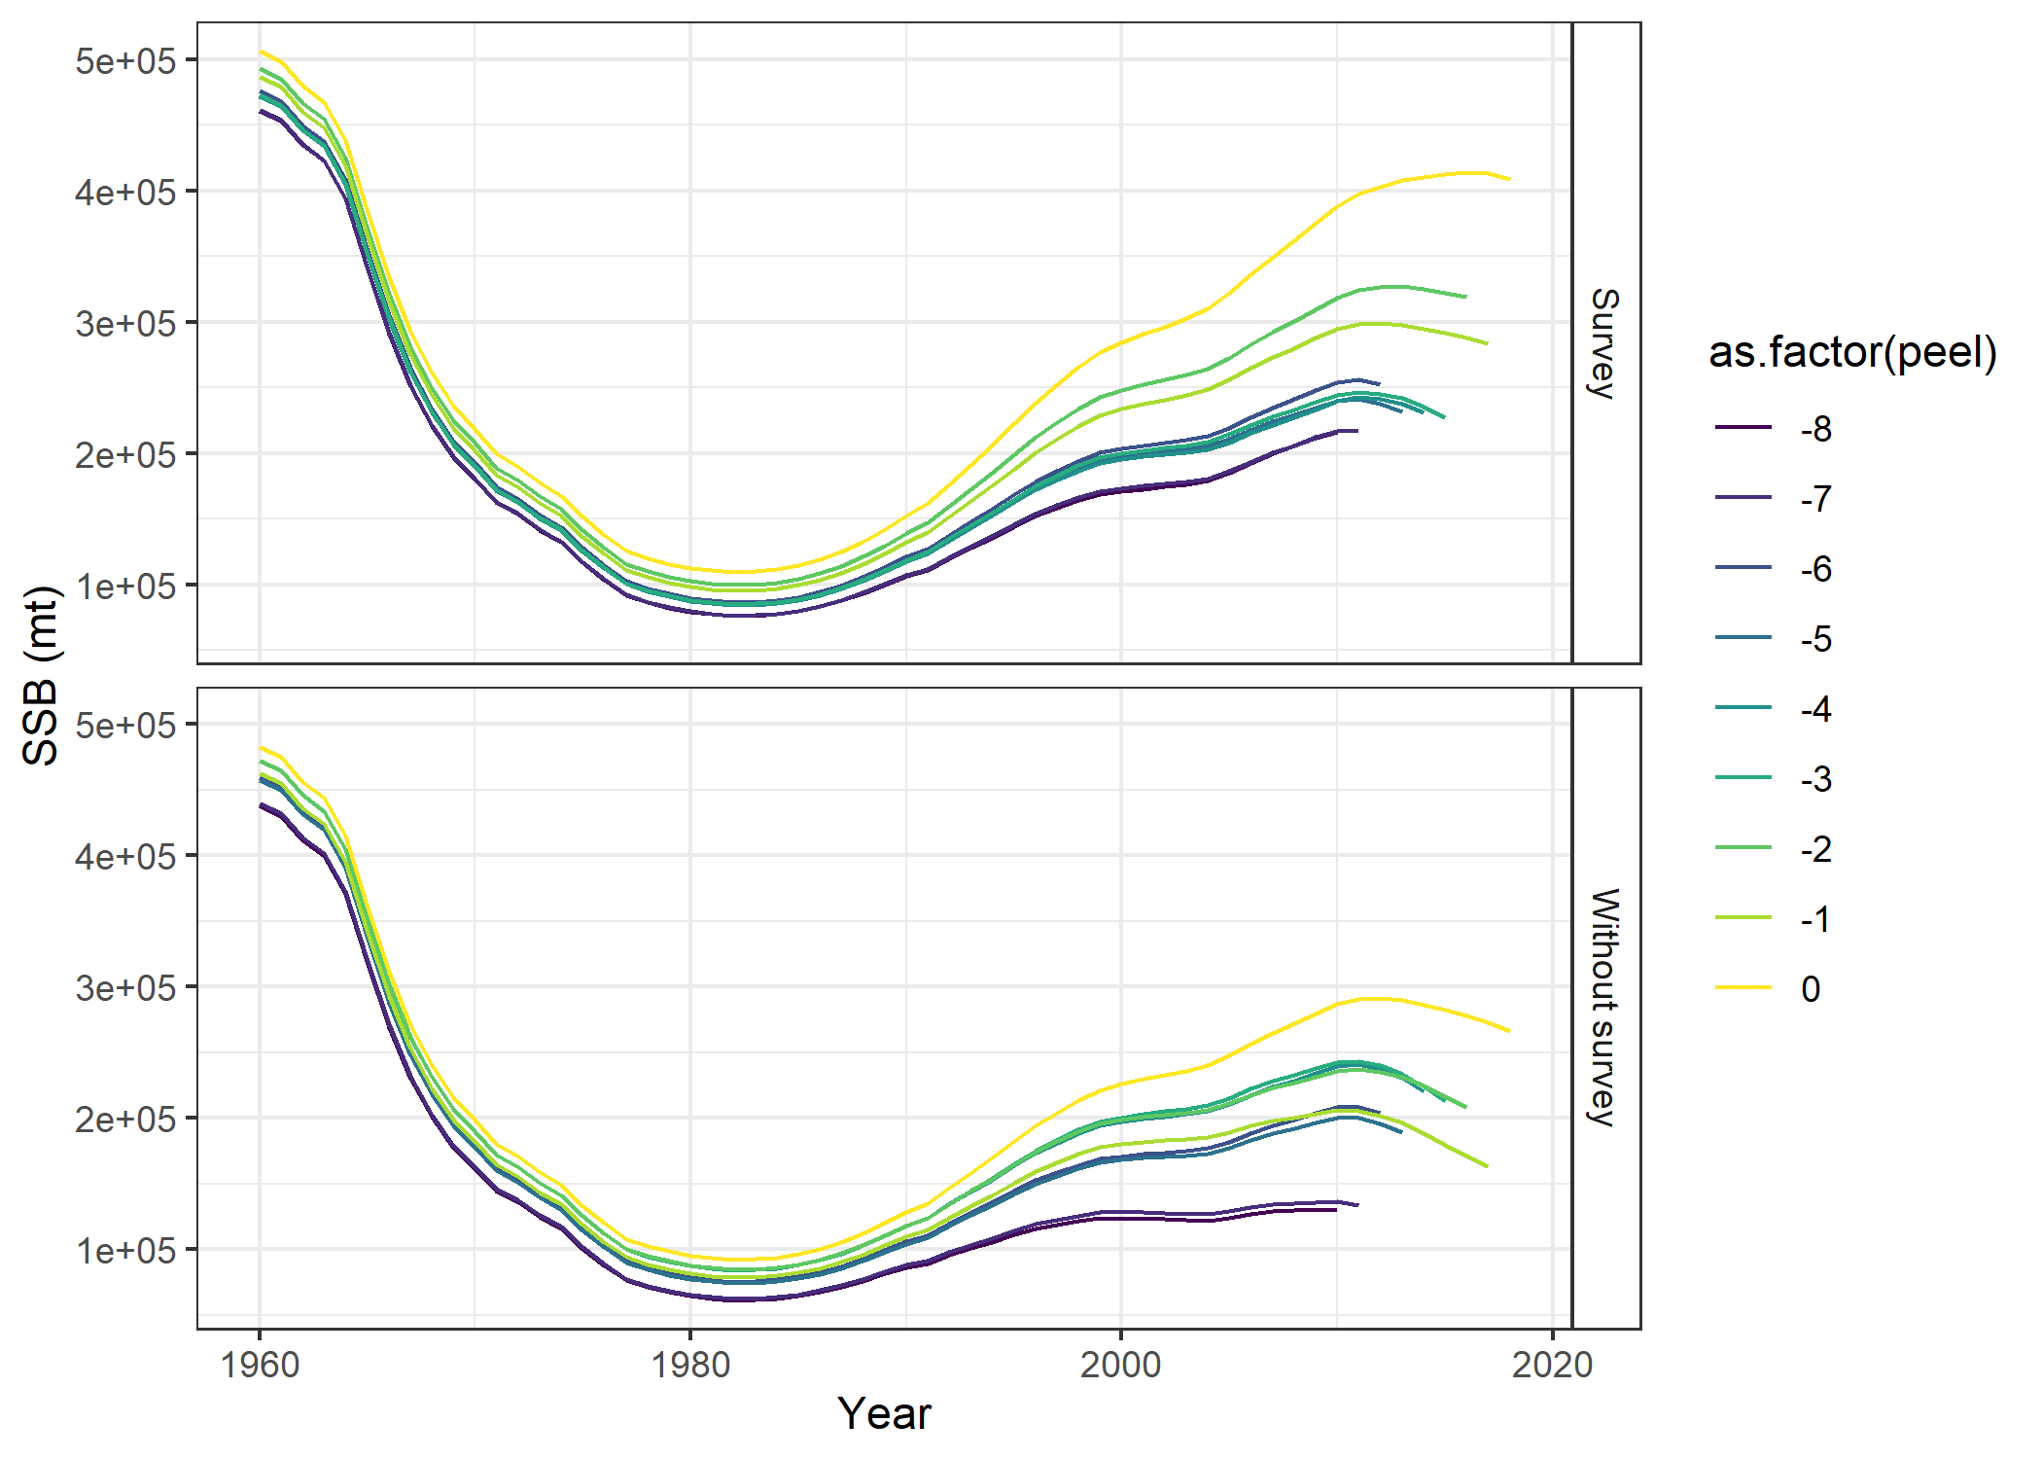
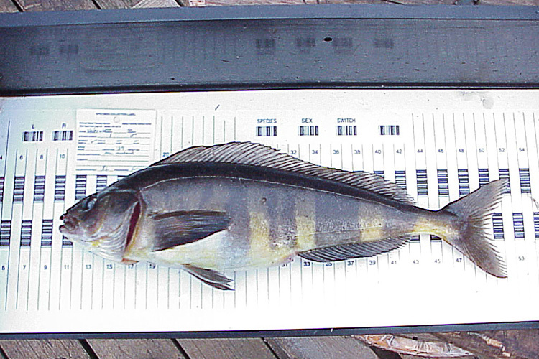
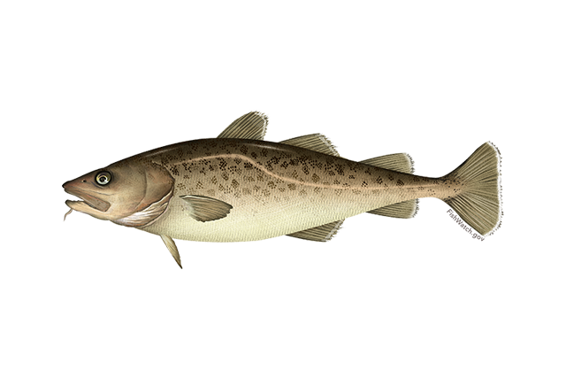
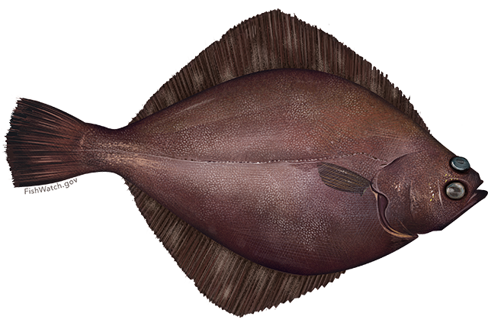
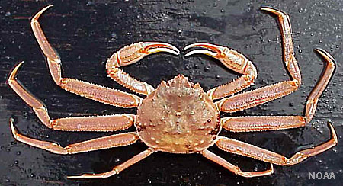
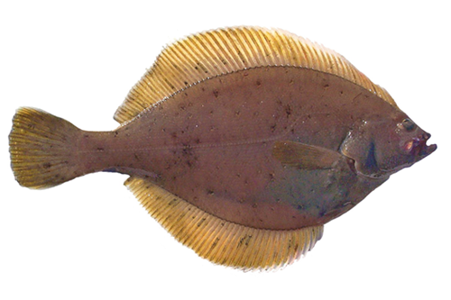
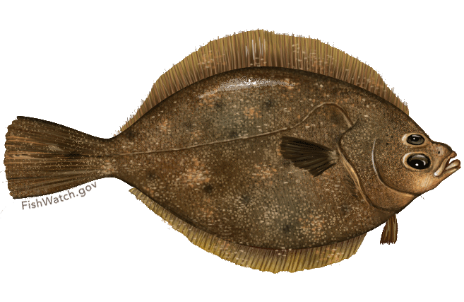
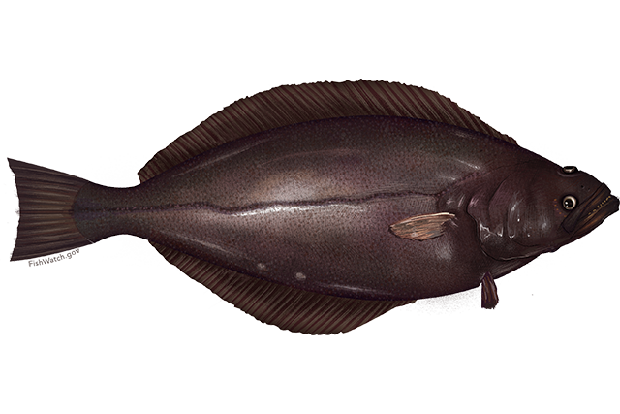
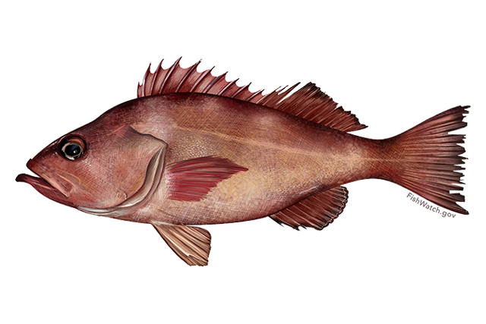
Analysis
Standard retrospective
  Measures consistency of model when new data are available
Retrospective missing most recent survey data
  Survey data were down-weighted
    CV of survey biomass increased
    Input sample size of composition data lowered
  Biennial surveys – most recent survey removed even it was the year before the terminal year
Notes:
There were two components to this analysis.
The 1st was to do a standard retrospective analysis where we run the assessment model while sequentially removing the most recent year of data. This is usually done to measure the consistency of the assessment model when new data become available on an annual basis and provides a base of comparison.
The 2nd was to essentially the same thing, but the survey data were down-weighted in the terminal year of each peel so that they would not contribute to the likelihood. This way we have a paired comparison with the standard retrospective.
We did the analysis for a subset of tier-1 and tier-3 groundfish and crab species that we assess and we mainly focused on species reliant on the EBS shelf bottom trawl survey or the AI bottom trawl survey since they were cancelled this year. The one exception was GOA Pacific cod.
The POP and Atka mackerel assessments include the AI trawl survey and EBS P. cod and the flatfish assessments use the EBS shelf bottom trawl survey.
We used the last accepted full assessment to use for the analysis, so some of the full assessments run through 2019 and others through 2018.

Slide 4

Statistics
Model estimated CV
Mohn’s rho (ρ) – average relative bias
  $ρ=\left(\overline{\frac{X_{Y−p}−X_{Y−p,full}}{X_{Y−p,full}}}\right)$, where
    X – quantity of interest, Y - terminal year, p – peel, full – model with full time series
Ralston sigma (Ralston et al. 2011 )
  $σ_{Ralston}=\sqrt{\frac{1}{\sum_{p=1}^{P}{p−1}}\sum_{y}{{\left(ln\left[X_{Y−p,i}\right]−ln\left[X_{Y−p, ref }\right]\right)}^{2}}}$, where
    ref - last assessment model
Additional variance
  $σ^{2}= \frac{\sum_{y=0}^{Y}{{\left(\frac{X_{no survey,y}−X_{y}}{X_{y}}\right)}^{2}}}{Y−1}$, where Y is the total number of retrospective peels
Notes:
Several measures of uncertainty were calculated and to help our understanding of the impact of missing the most recent survey:
Model estimate CV - measures the estimated precision of the assessment model
Mohn’s rho, which is the typical statistic we calculate to summarize the direction and degree of bias in the the retrospective pattern. This is a measure of the average relative bias between the retrospective peels and the model run with the full time series of data. This was calculated separately for the standard retro and the retro with the most recent survey data removed.
Sigma - This statistic was used by Ralston et al (2011) to measure the uncertainty in terminal year biomass among a suite of assessment models that differed in model structure. It is similar to a mean square error statistic and assumes the last assessment model is the best representation of the truth. This was also calculated separately for the standard retro and the retro with the most recent survey data removed.
Sigma^2 measures uncertainty between the standard retrospective and the retrospective with missing survey data. Itrepresents additional uncertainty from dropping a survey and assuming the standard retrospective represents the true dynamics.

Slide 5
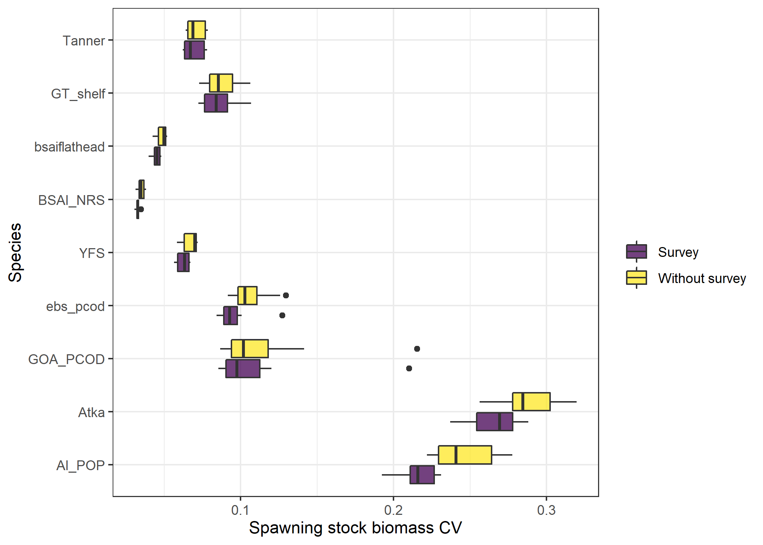
Model estimated uncertainty
Tanner crab
Greenland turbot
Flathead sole
Annual
Northern rock sole
Yellowfin sole
EBS Pacific cod
GOA Pacific cod
Atka mackerel
Biennial
POP
Notes:
This plot shows the distributions of the CV of the terminal estimates of SSB and represents the model estimated precision in SSB.
The purple boxes represent the results from the standard retrospective with the survey data and the yellow represent the results from the retrospectives where the most recent survey data are removed from the assessments.
Did not have CVs for snow crab.
Biggest differences in CV are seen for POP and Atka mackerel. Both rely on the biennial Aleutian Islands bottom trawl survey. When the most recent survey data were removed, creating a bigger gap between the information provided by the survey data and the terminal estimate leading to greater uncertainty. GOA P.cod relies on a few other surveys, which may help to explain the lack of difference in CVs.
The CVs were generally similar for the stocks with annual surveys. Some difference in CV for EBS Pcod and BSAI NRS.
For the sake of time,
I have streamlined the remaining results that I am going to present. am going to focus on uncertainty in SSB and handful of species

Slide 6
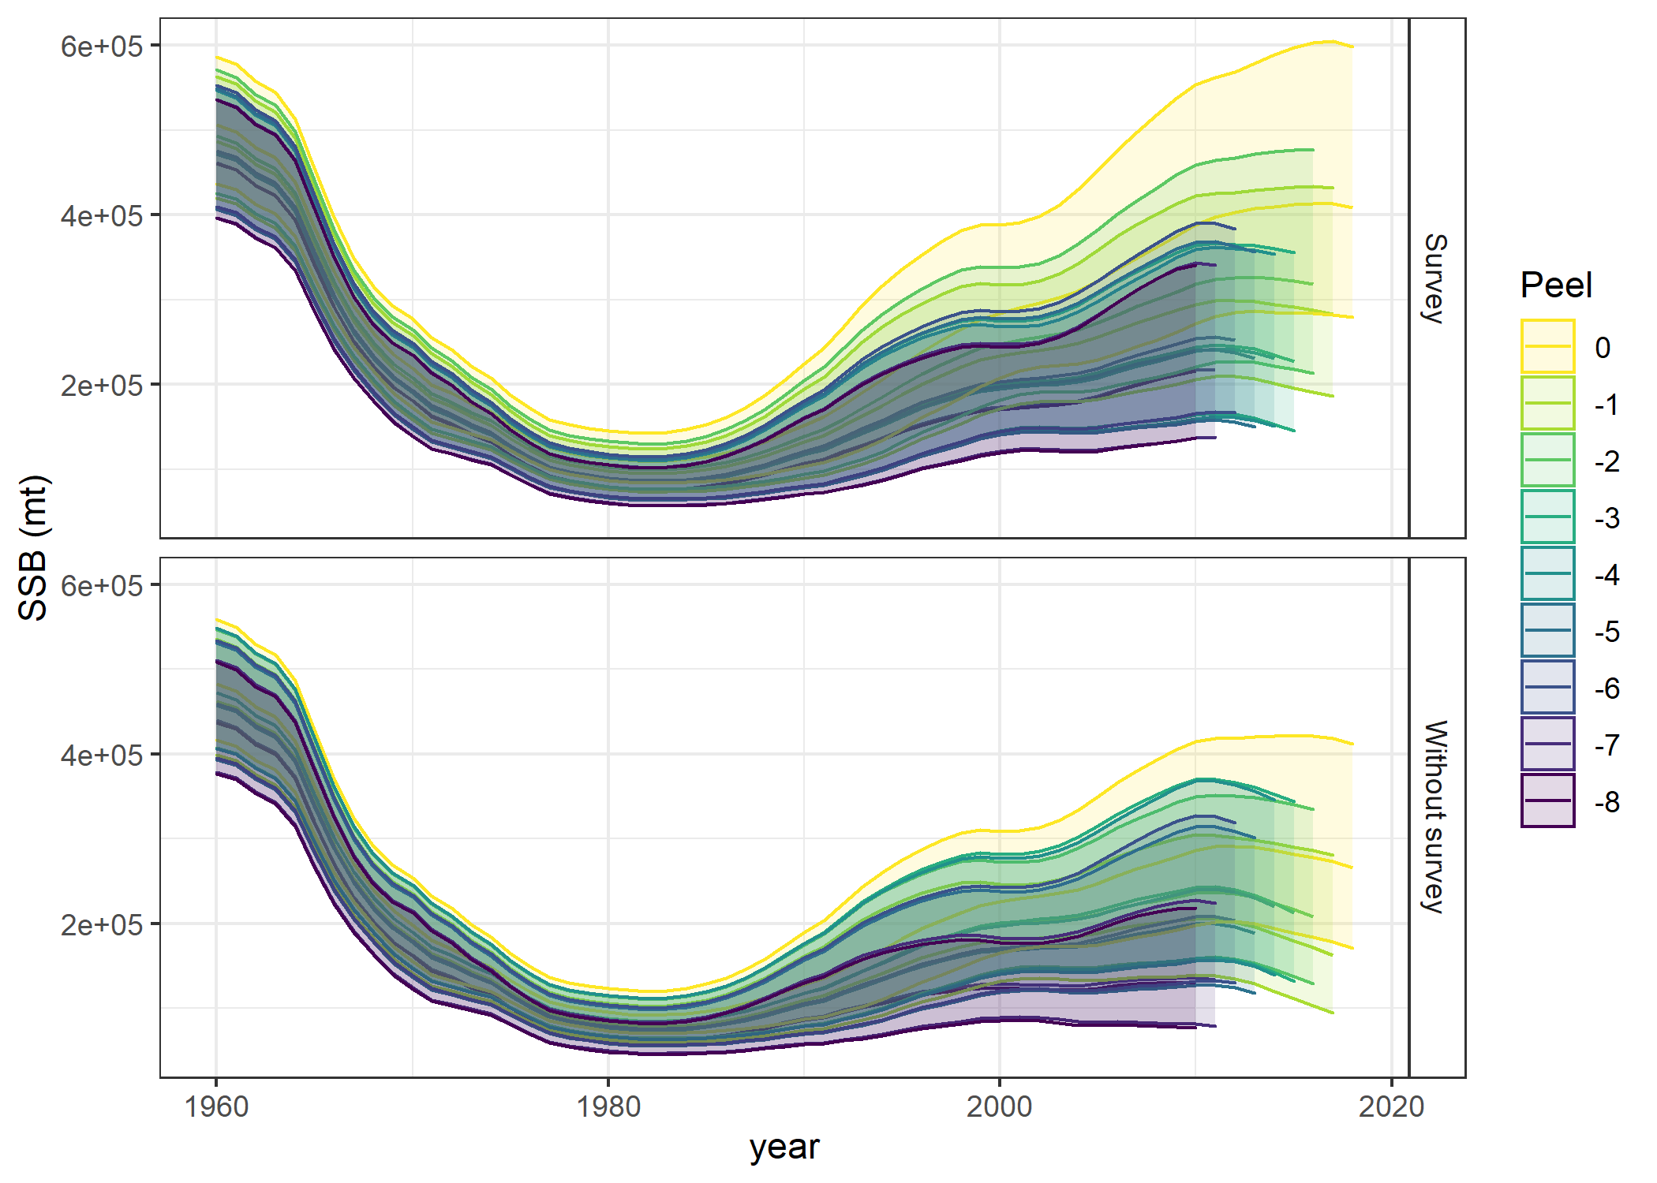
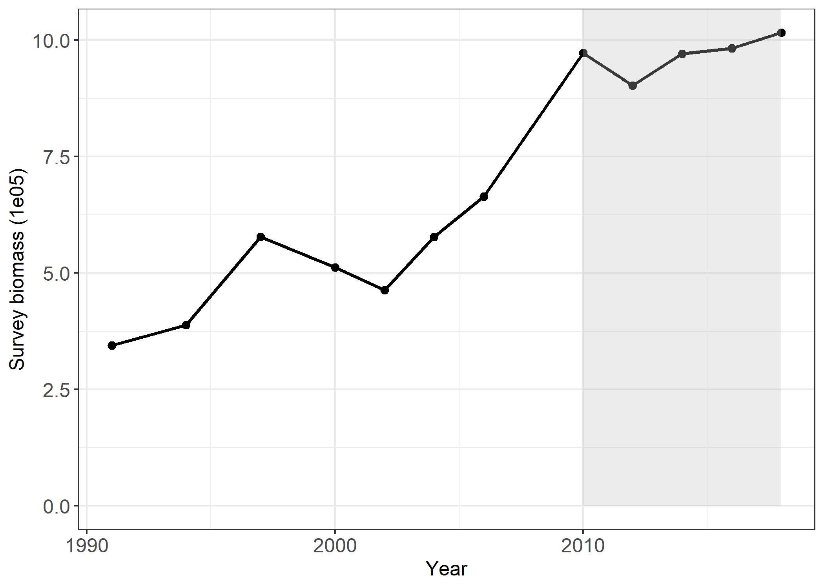
BSAI Pacific ocean perch
 | Mohn’s rho (ρ)
Species | Survey | No survey
BSAI POP | -0.391 | -0.551
Notes:
Both retrospectives exhibit a consistently negative retrospective bias, so that ssb is underestimated with respect to the full model. The retrospective covers a period of time that is fairly flat compared to the considerable growth between 2002 and 2010.
Catchability is assumed to be constant over time for the AI survey and evaluations of the composition data indicate that q has changed over time. Exploratory runs have shown that allowing catchability to vary over time reduces the retrospective pattern.

Slide 7
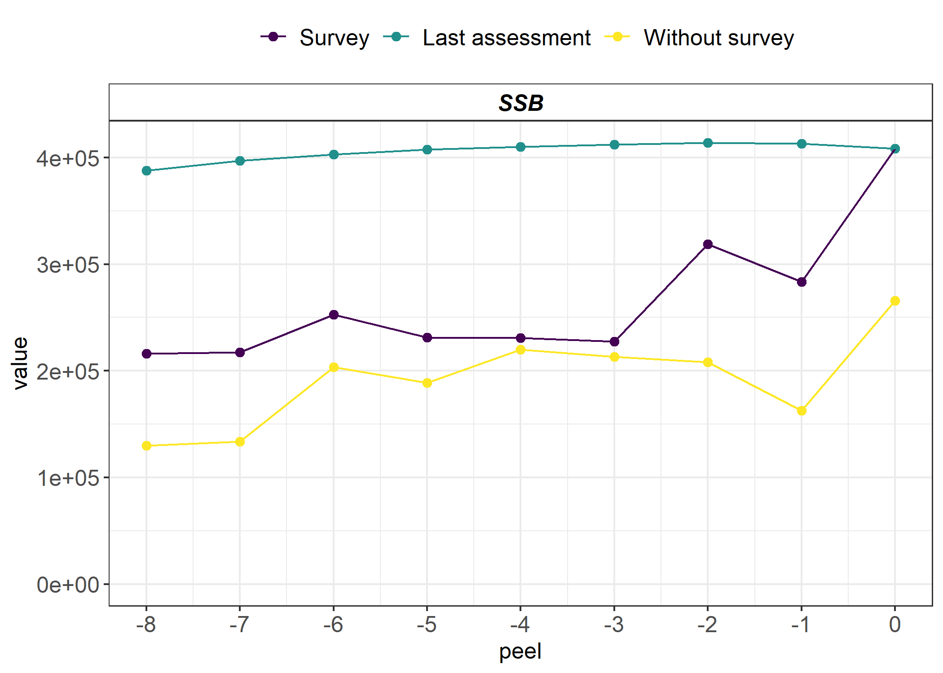
BSAI Pacific ocean perch
 | Mohn’s rho (ρ) |  | Ralston |  | Additional
Species | Survey | No survey | σ Survey | σ No survey | σ²
BSAI POP | -0.391 | -0.551 | 0.487 | 0.789 | 0.101
Notes:
The plot on the right shows the terminal year estimates for the standard retrospective (purple lined labelled survey) and the retro missing the most recent survey data (yellow points and line) and the ssb estimates in those years from the last accepted assessment model (teal line).
The stars are the years when the survey was conducted.
There is a fair amount of uncertainty between the last assessment model, which expects ssb to be relatively stable over this time period, and the standard retro and the uncertainty becomes larger when the recent survey data are not available. The uncertainty is largely driven by the retrospective pattern but the additional variance terms, which compares the purple and yellow points indicate there may be some other source of uncertainty.
Without survey – perhaps it is underestimating a maturing cohort.

Slide 8
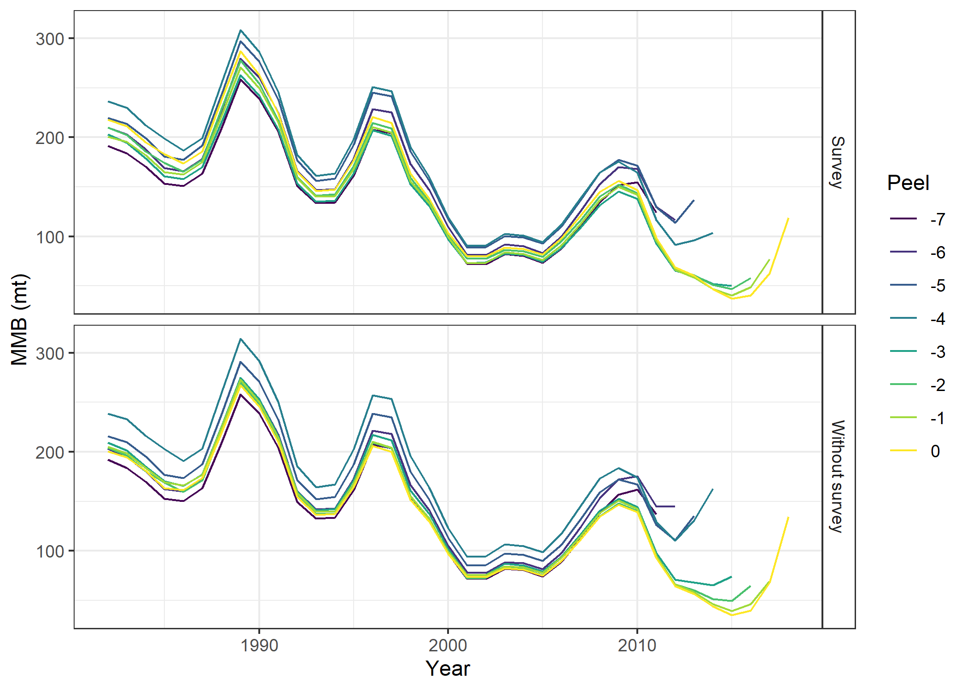
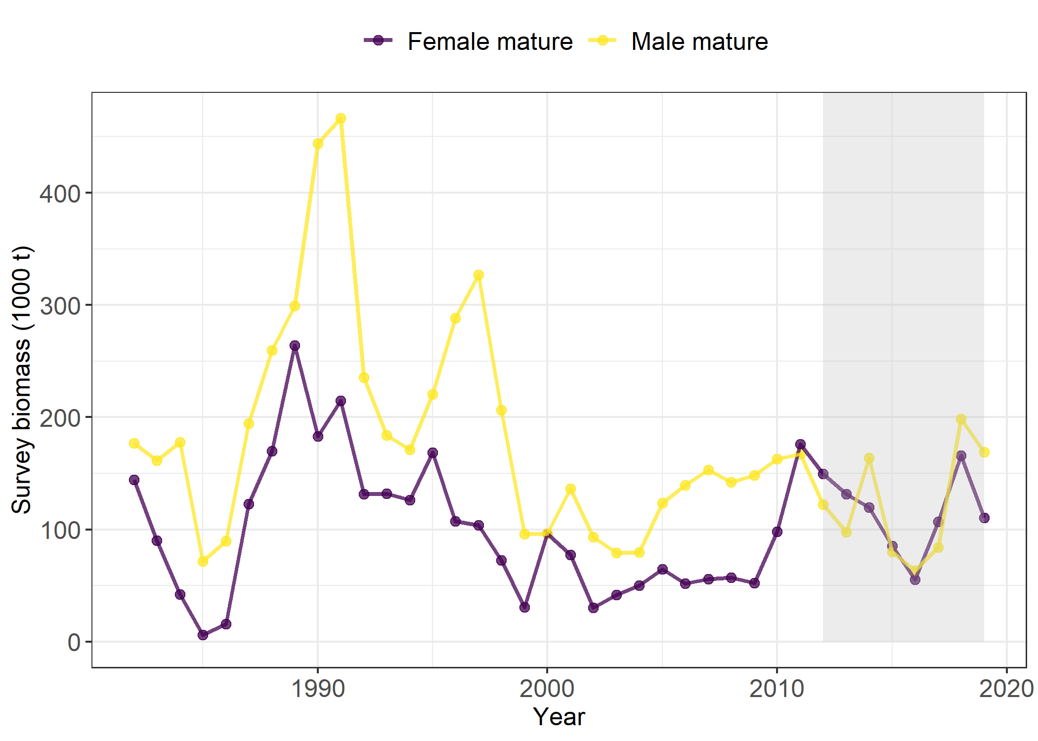
EBS snow crab
 | Mohn’s rho (ρ)
Species | Survey | No survey
EBS Snow crab | 0.635 | 0.985
Notes:
EBS snow crab also had a consistent retrospective bias. Both retrospectives exhibit a consistently positive retrospective bias, so that mature male biomass is overestimated with respect to the full model. Similar to the POP assessment catchability is assumed to be constant and there is some evidence in the composition data that catchability is time varying. Also, the 2014 observation of mature male biomass is large relative to surrounding observations an the there is no indication of an large incoming recruitment event in the composition data. So this too adds to the positive retrospective pattern.

Slide 9
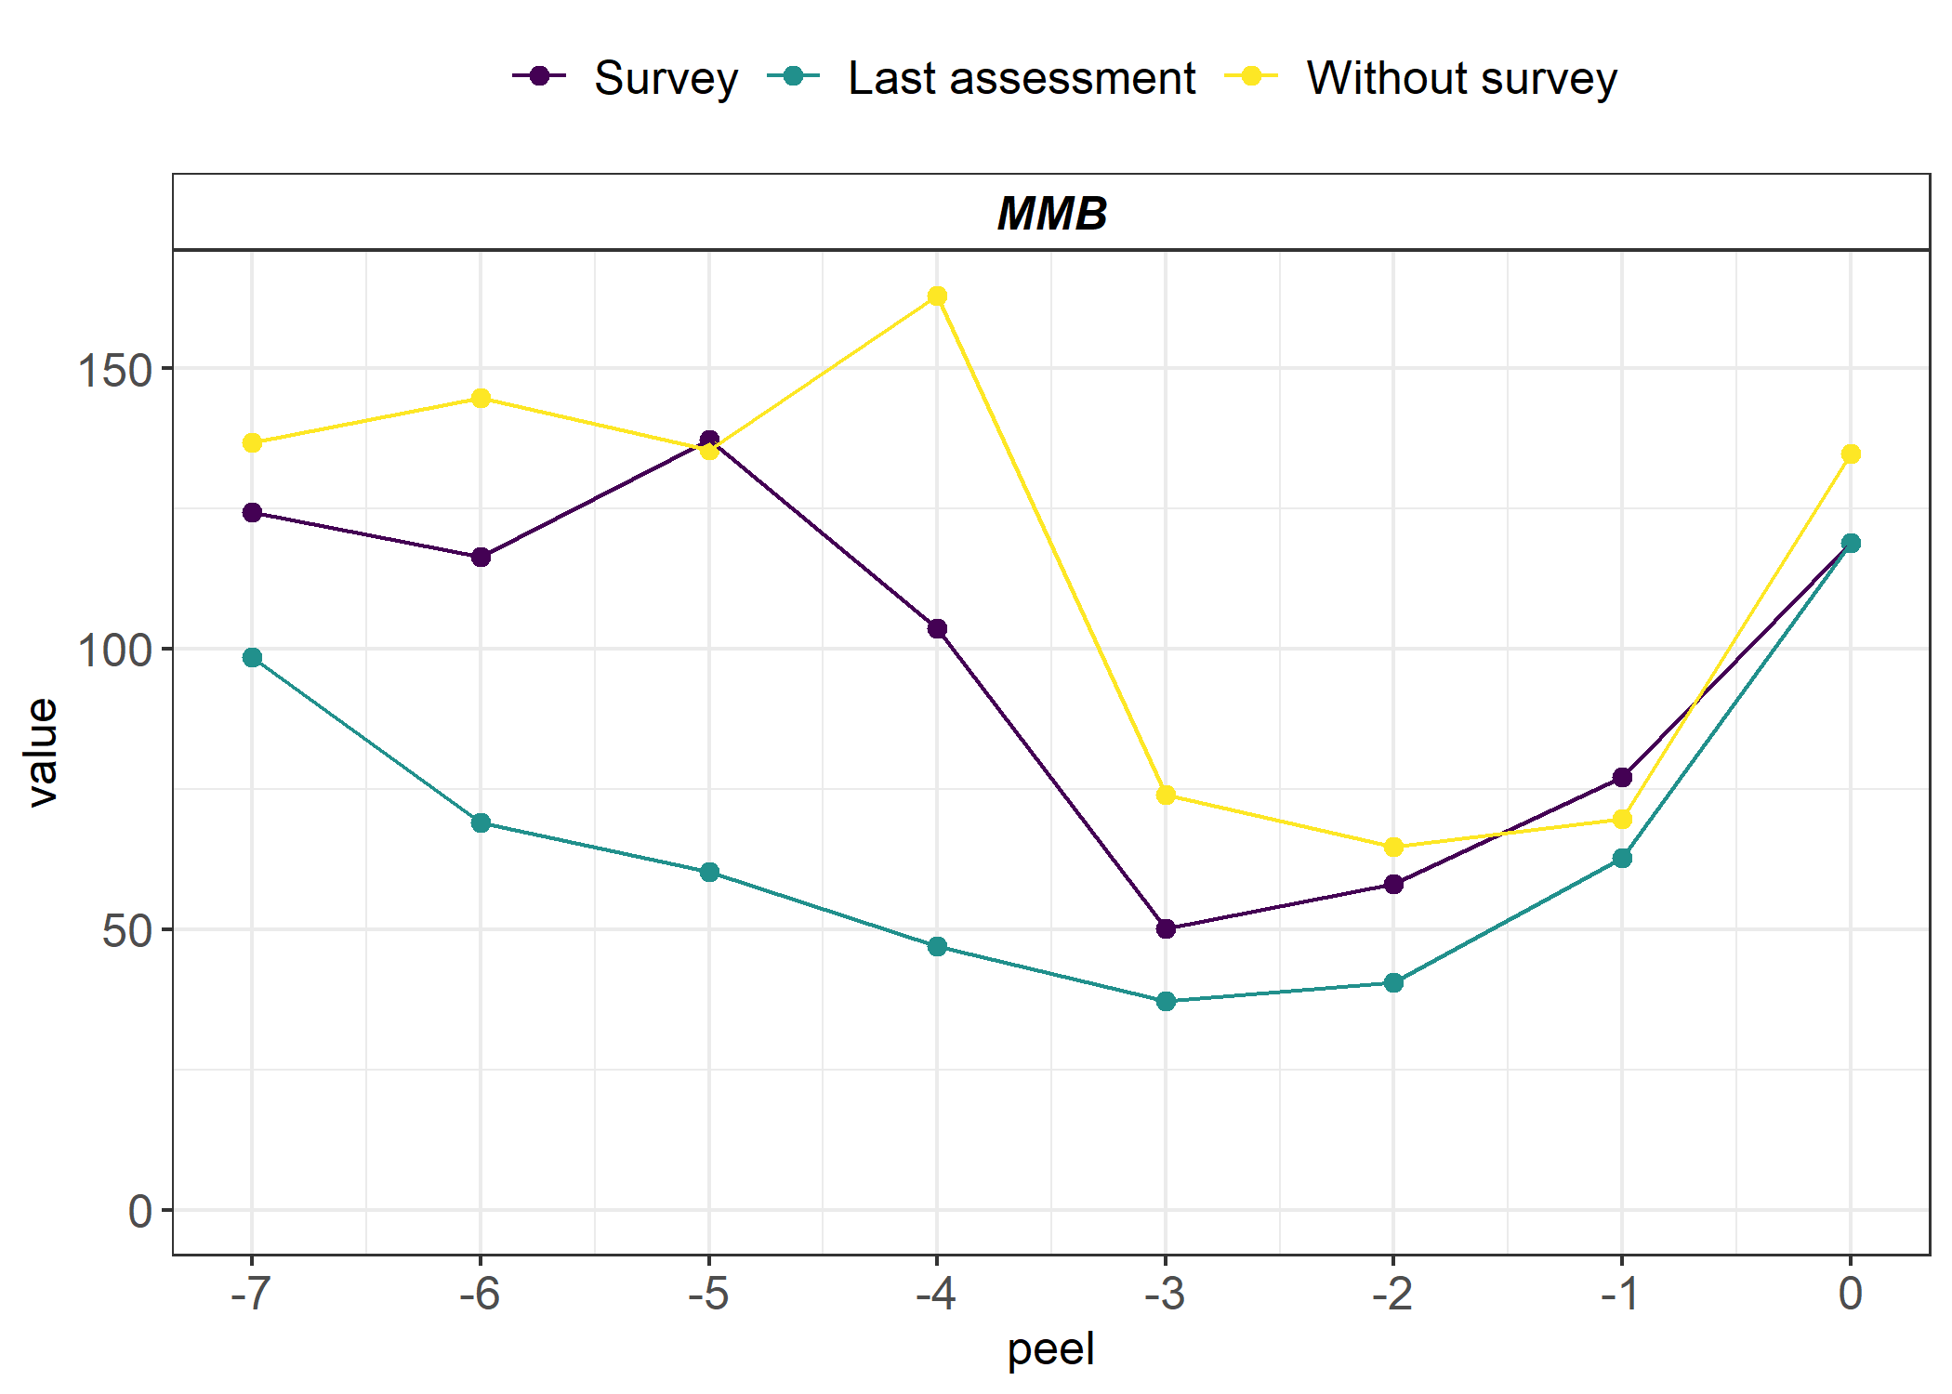
EBS snow crab
 | Mohn’s rho (ρ) |  | Ralston |  | Additional
Species | Survey | No survey | σ Survey | σ No survey | σ²
EBS Snow crab | 0.635 | 0.985 | 0.459 | 0.629 | 0.094
Notes:
When you compare the terminal estimates of MMB from the retrospective analyses to the MMB estimates from the last assessment in those same years you see the uncertainty is largely attributable to the retrospective pattern, which worsens when the most recent survey data are not available. The uncertainty is largely driven by the retrospective pattern but the additional variance terms, which compares the purple and yellow points indicate there may be some other source of uncertainty.

Slide 10
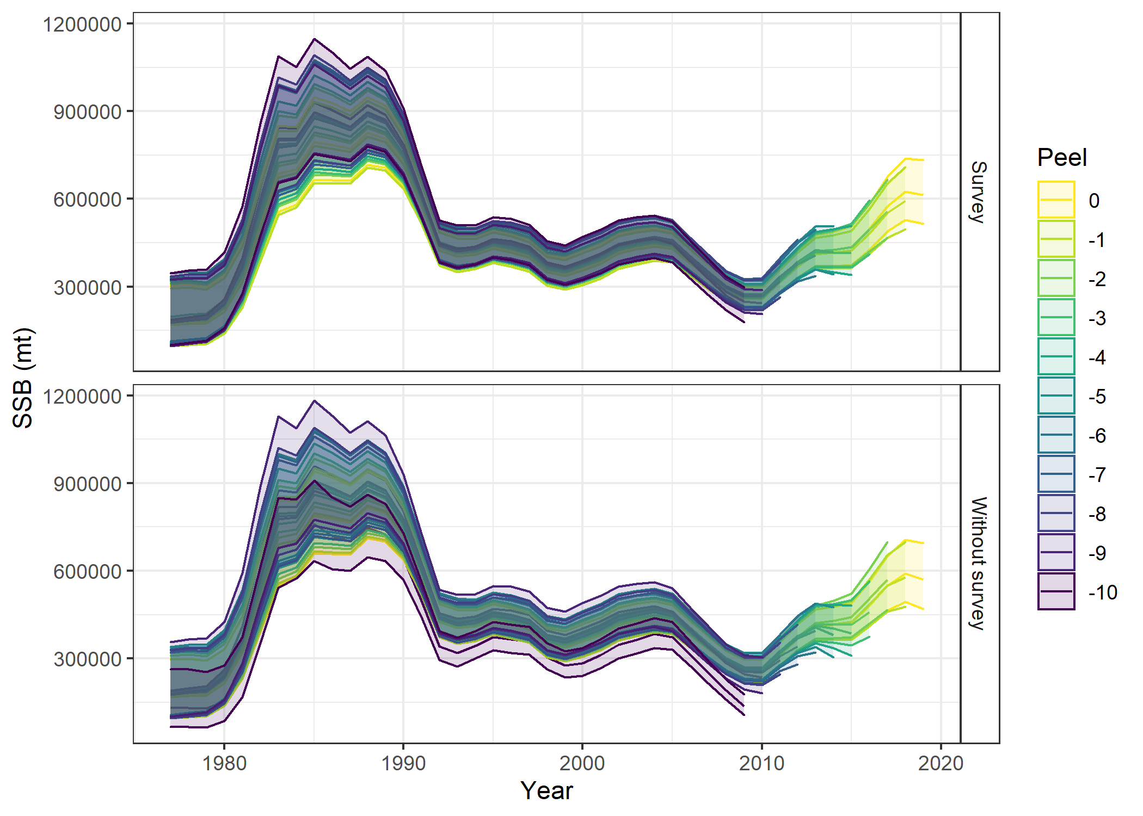
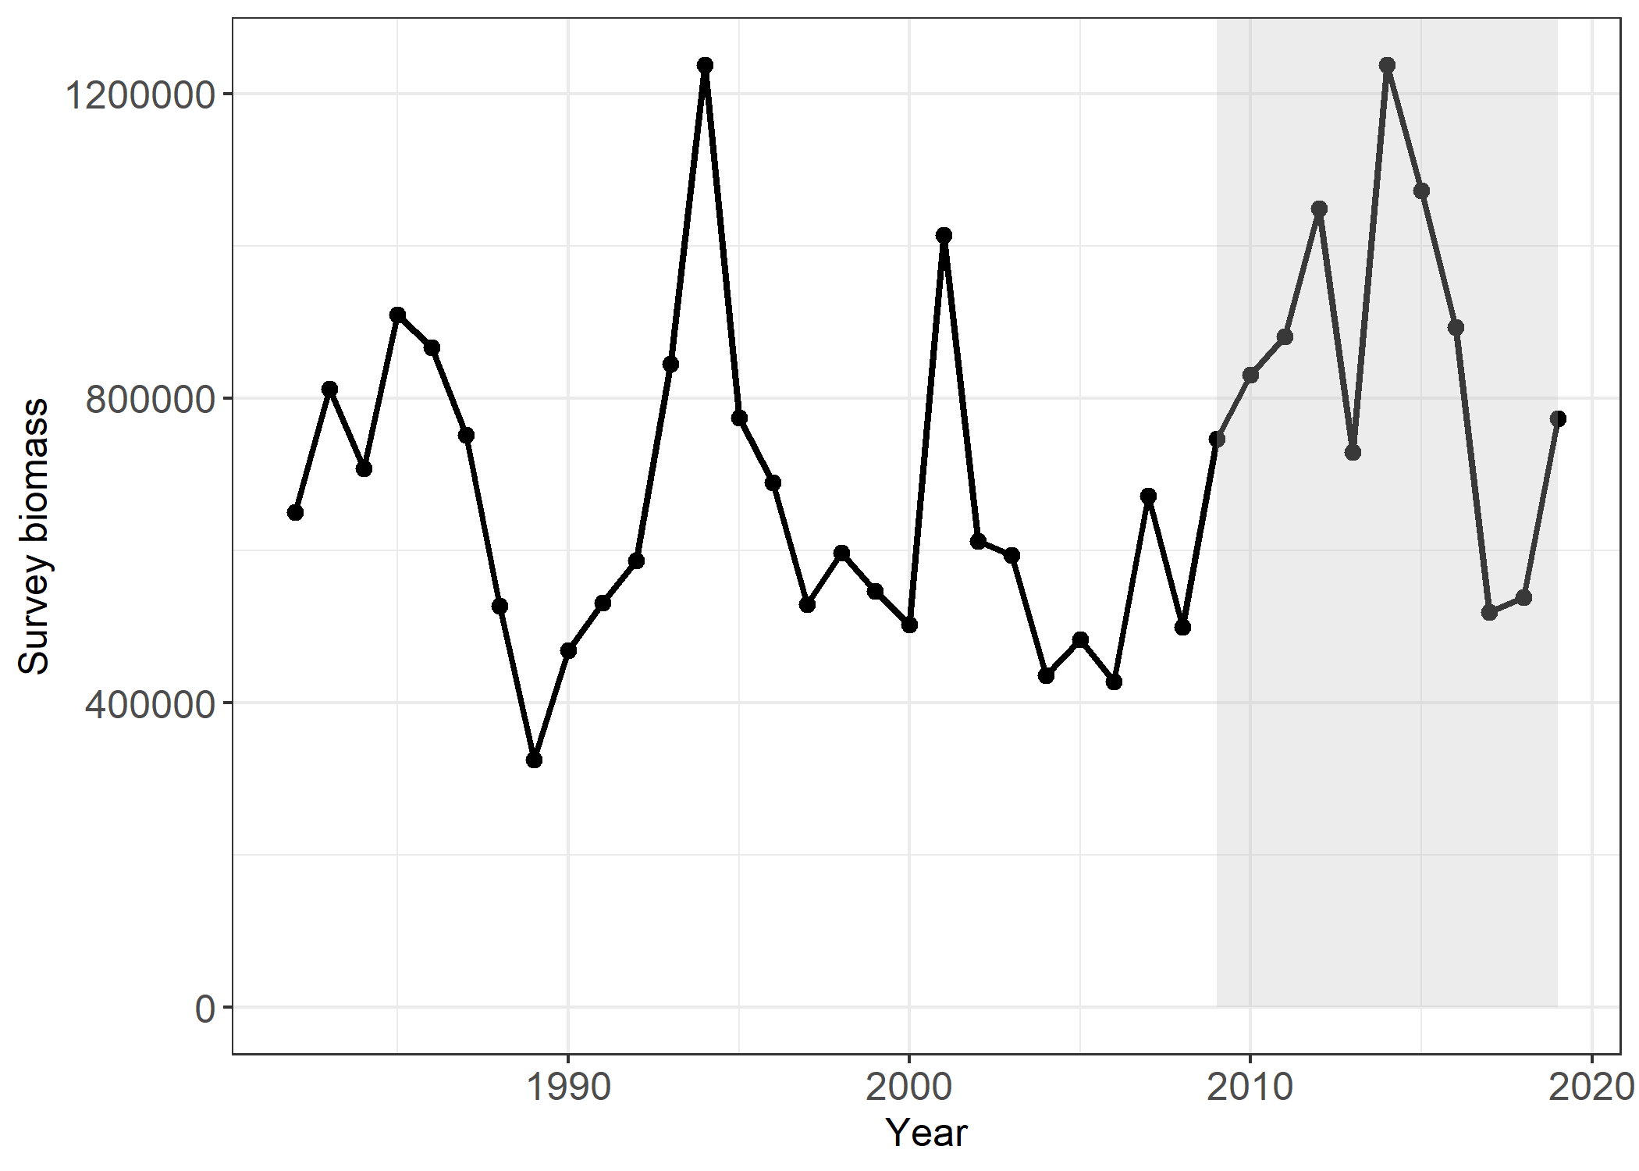
EBS Pacific cod
 | Mohn’s rho (ρ)
Species | Survey | No survey
EBS Pacific cod | -0.037 | -0.121
Notes:
The EBS Pacific cod assessment has almost no retrospective pattern.

Slide 11
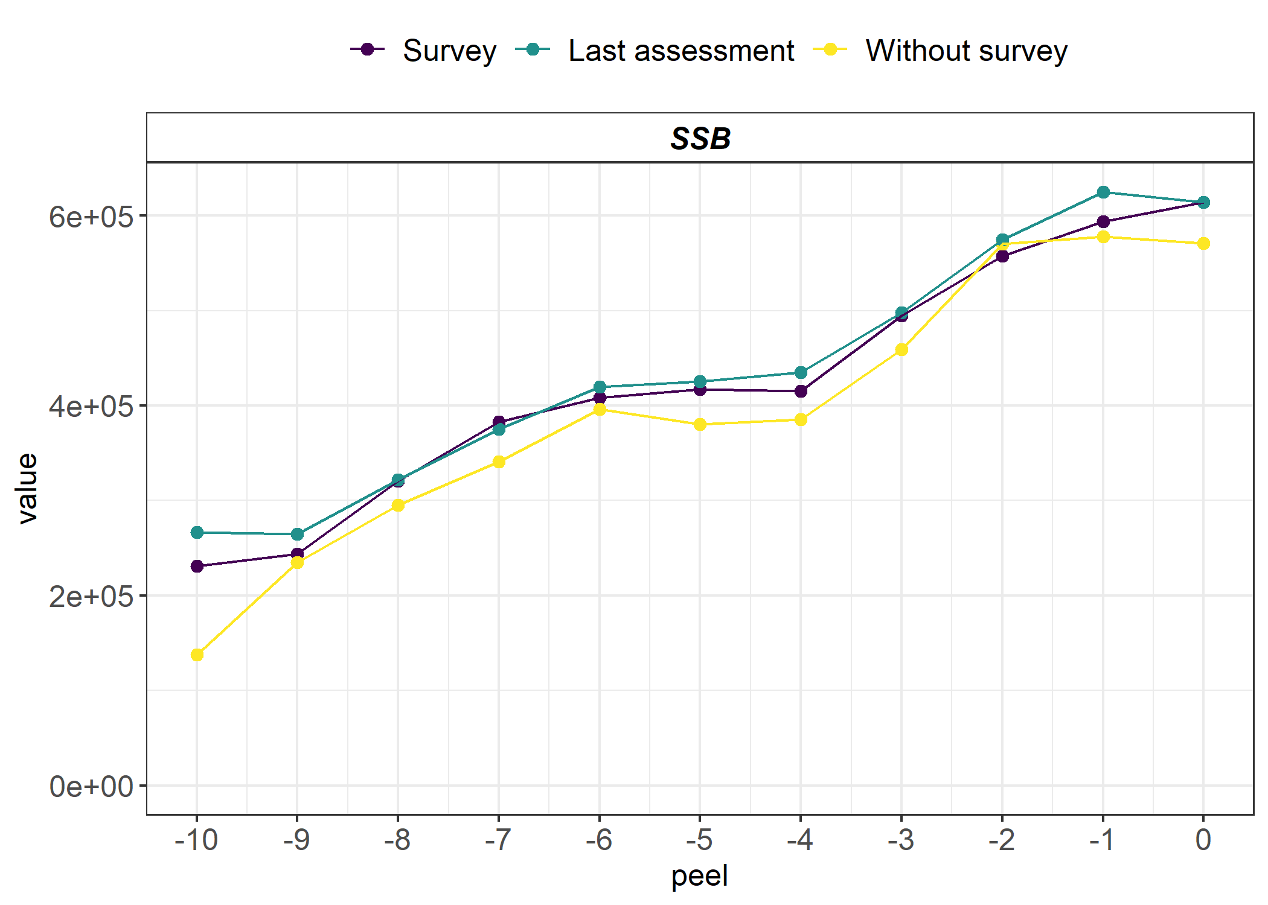
EBS Pacific cod
 | Mohn’s rho (ρ) |  | Ralston |  | Additional
Species | Survey | No survey | σ Survey | σ No survey | σ²
EBS Pacific cod | -0.037 | -0.121 | 0.062 | 0.238 | 0.021
Notes:
There was a considerable increase in uncertainty when the most recent survey data were removed from the assessment model. Given the lack of a retrospective bias and the similarity between the standard retro and the last assessment this indicates some other source of variability.

Slide 12
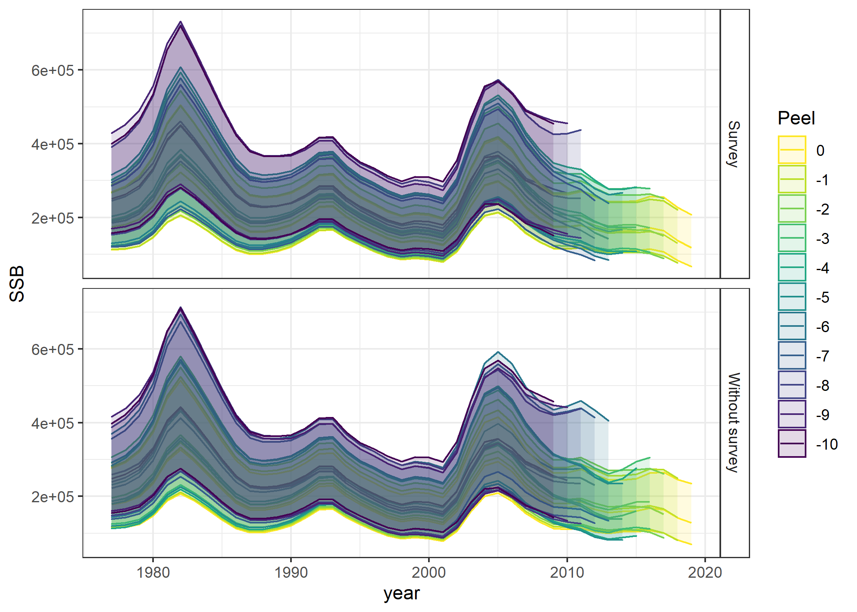
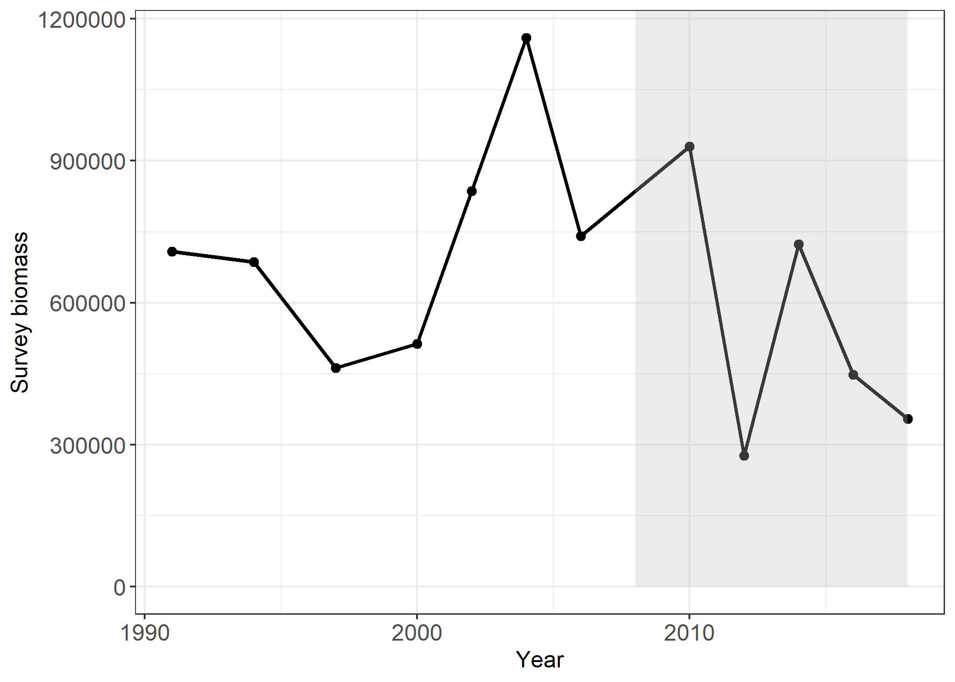
BSAI Atka mackerel
 | Mohn’s rho (ρ)
Species | Survey | No survey
BSAI Atka mackerel | 0.114 | 0.188

Slide 13
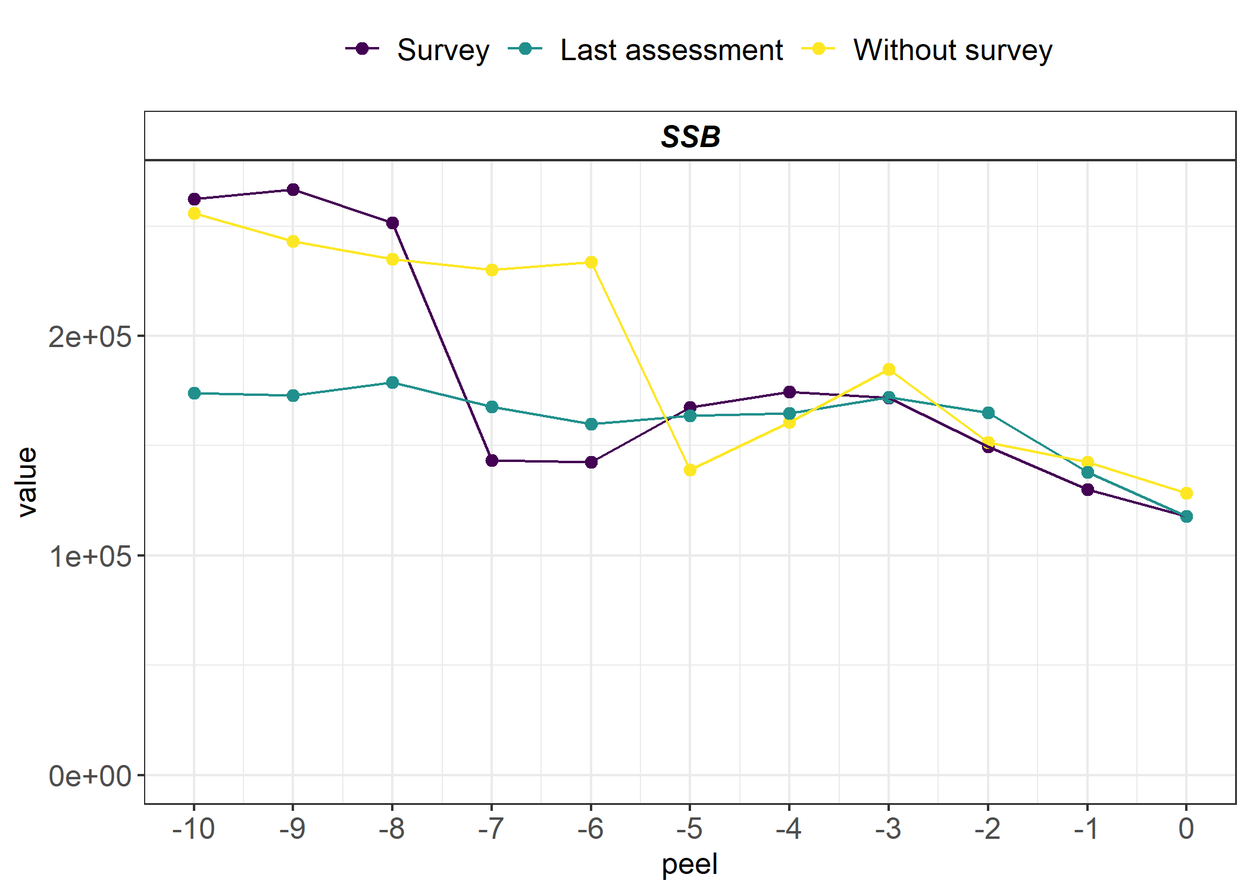
BSAI Atka mackerel
 | Mohn’s rho (ρ) |  | Ralston |  | Additional
Species | Survey | No survey | σ Survey | σ No survey | σ²
BSAI Atka mackerel | 0.114 | 0.188 | 0.242 | 0.264 | 0.085

Slide 14
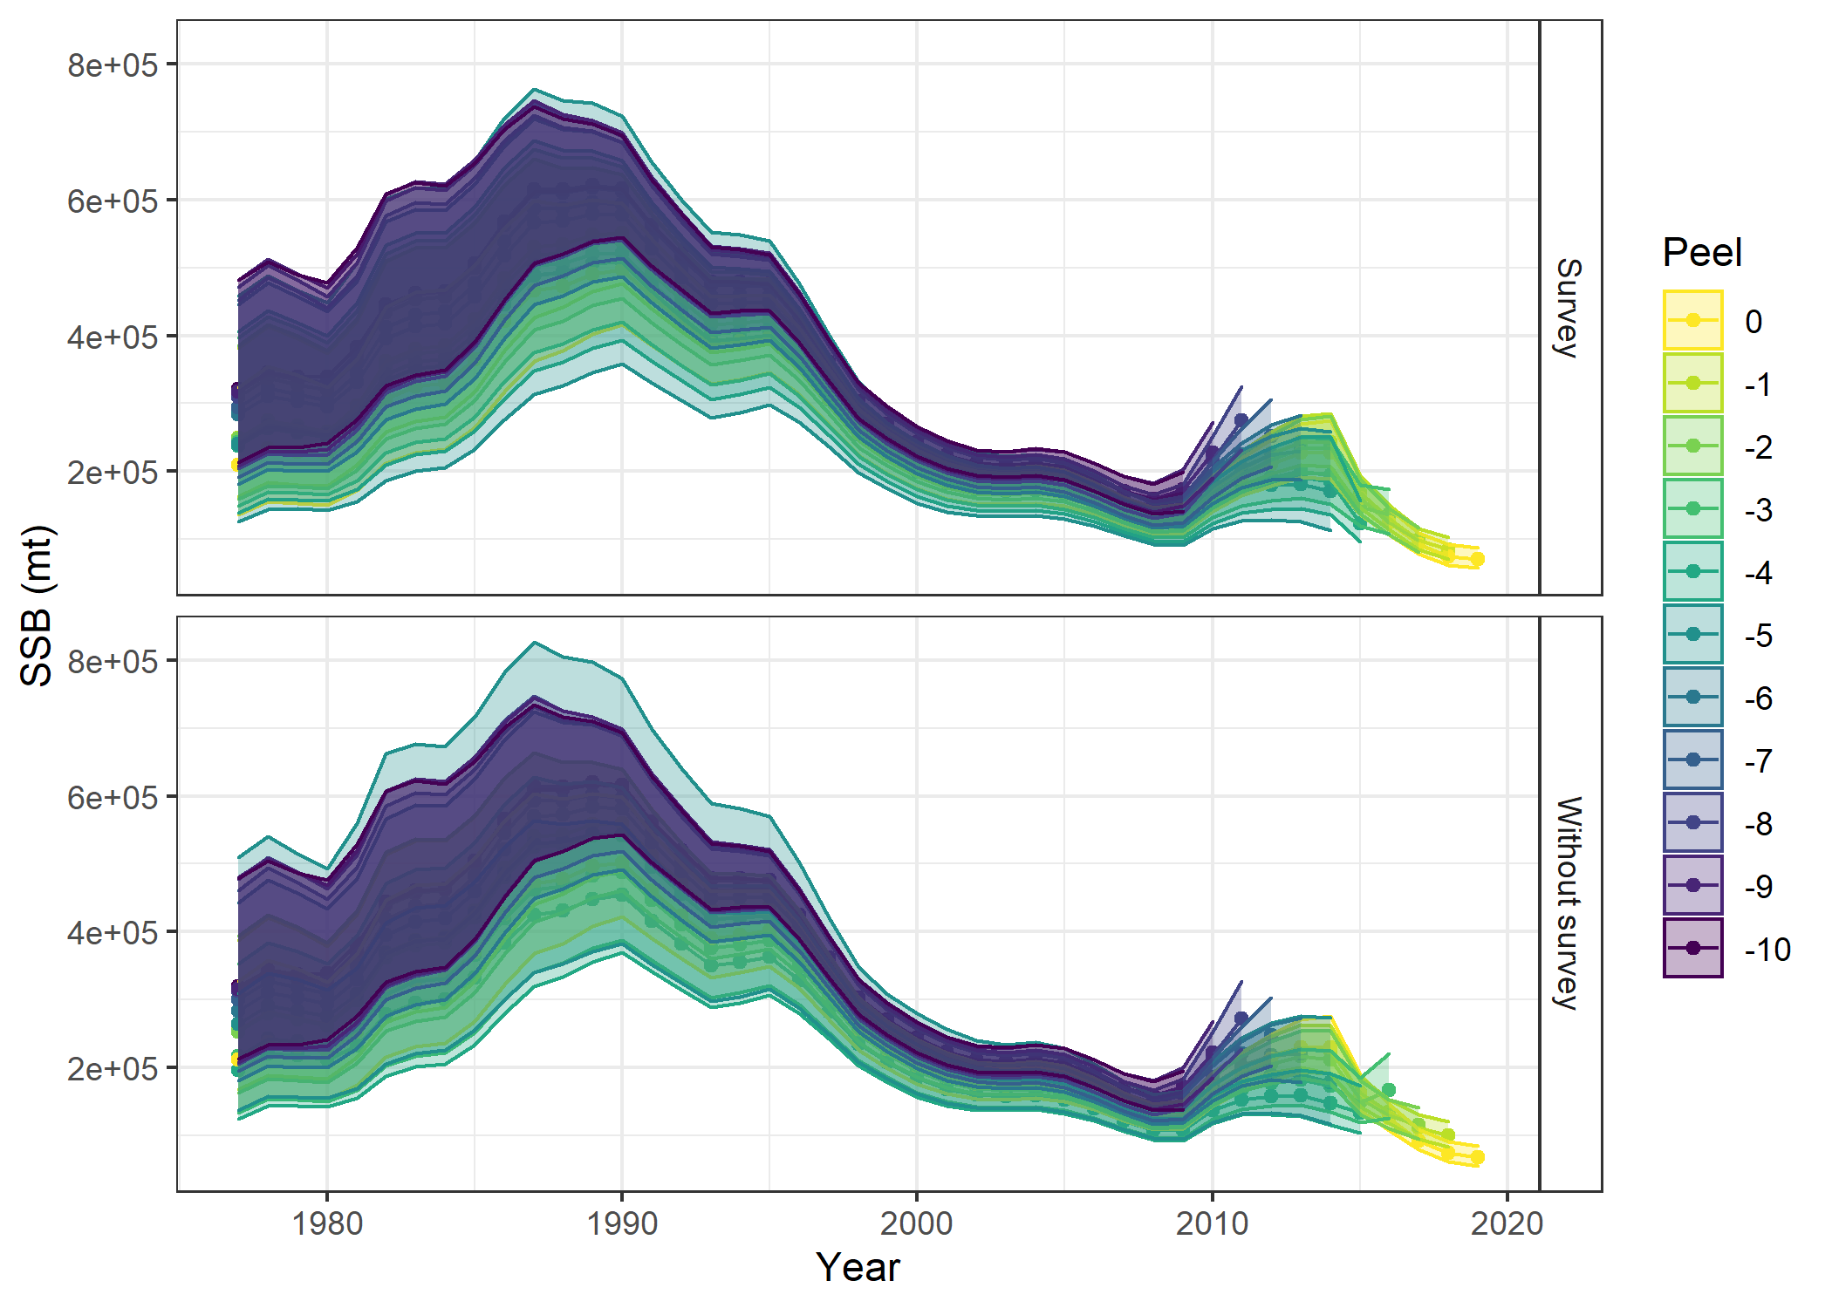
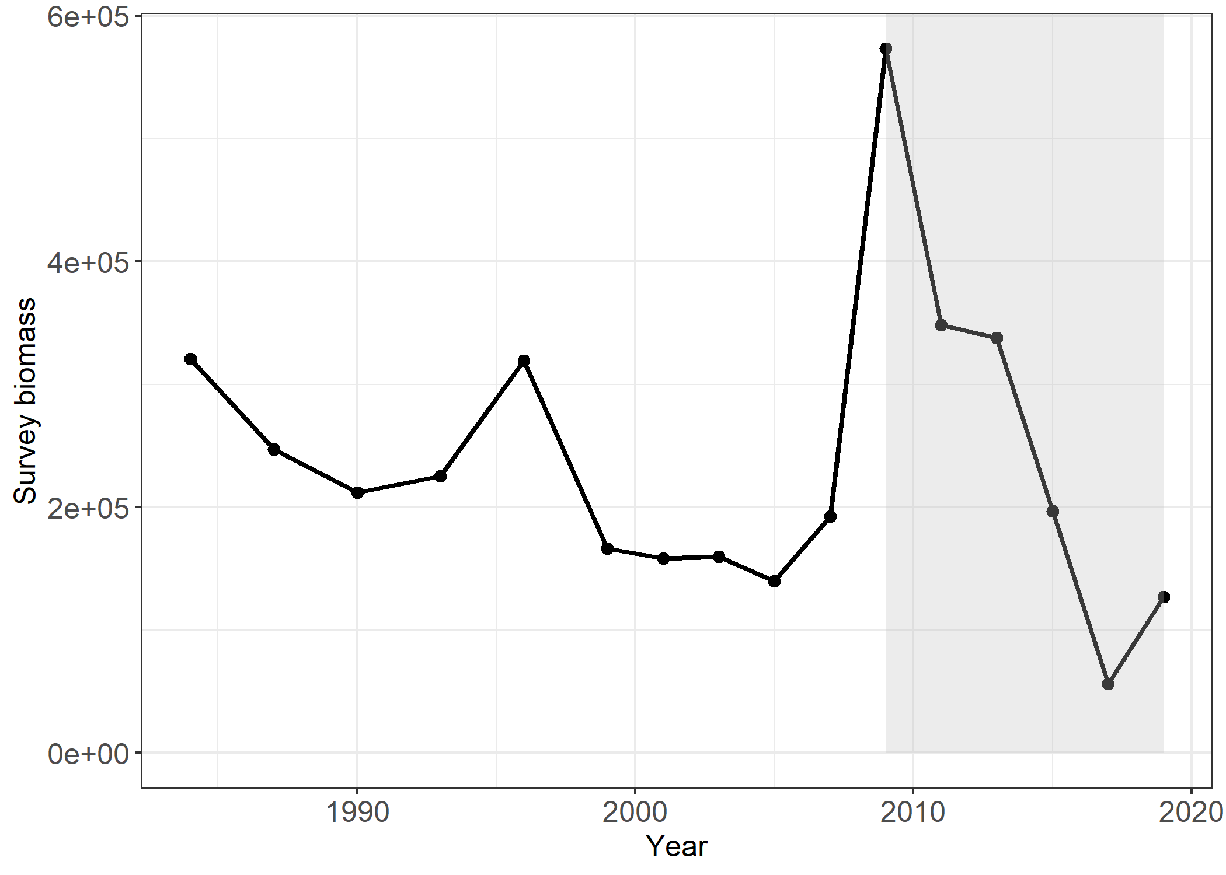
GOA Pacific cod
 | Mohn’s rho (ρ)
Species | Survey | No survey
GOA Pacific cod | 0.118 | 0.178

Slide 15
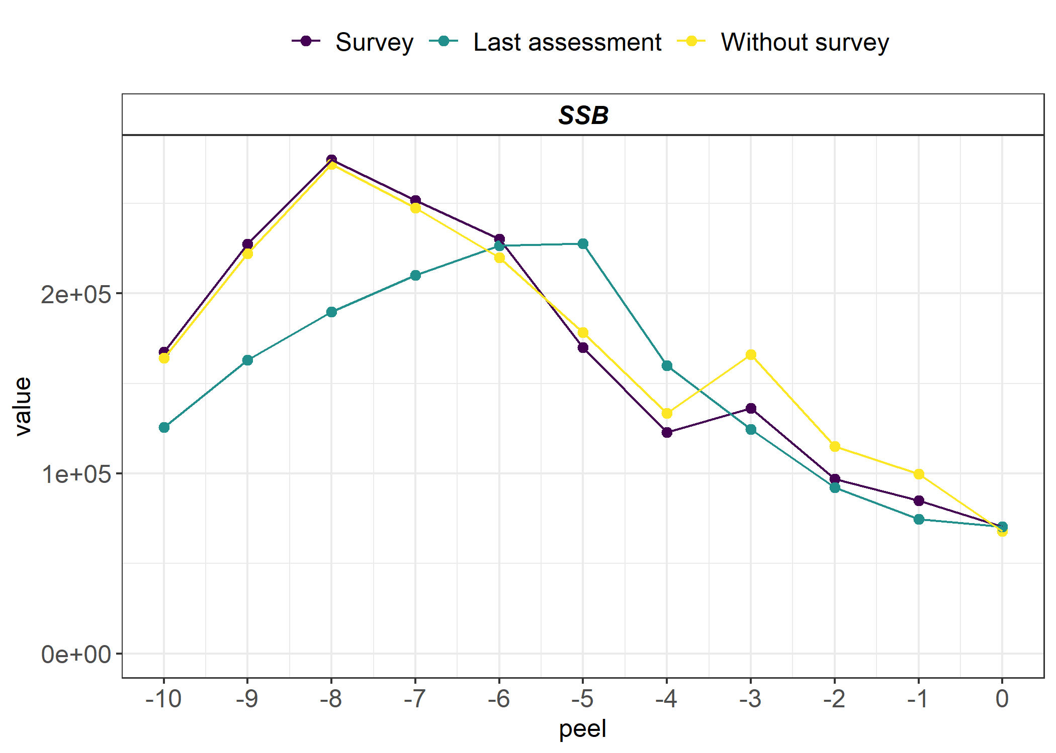
GOA Pacific cod
 | Mohn’s rho (ρ) |  | Ralston |  | Additional
Species | Survey | No survey | σ Survey | σ No survey | σ²
GOA Pacific cod | 0.118 | 0.178 | 0.246 | 0.265 | 0.013

Slide 16
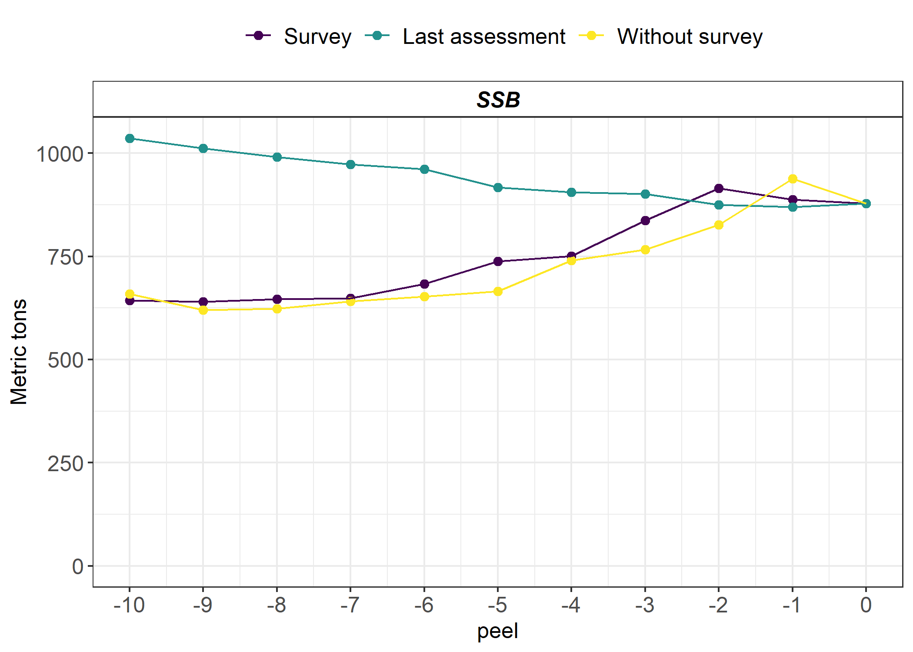
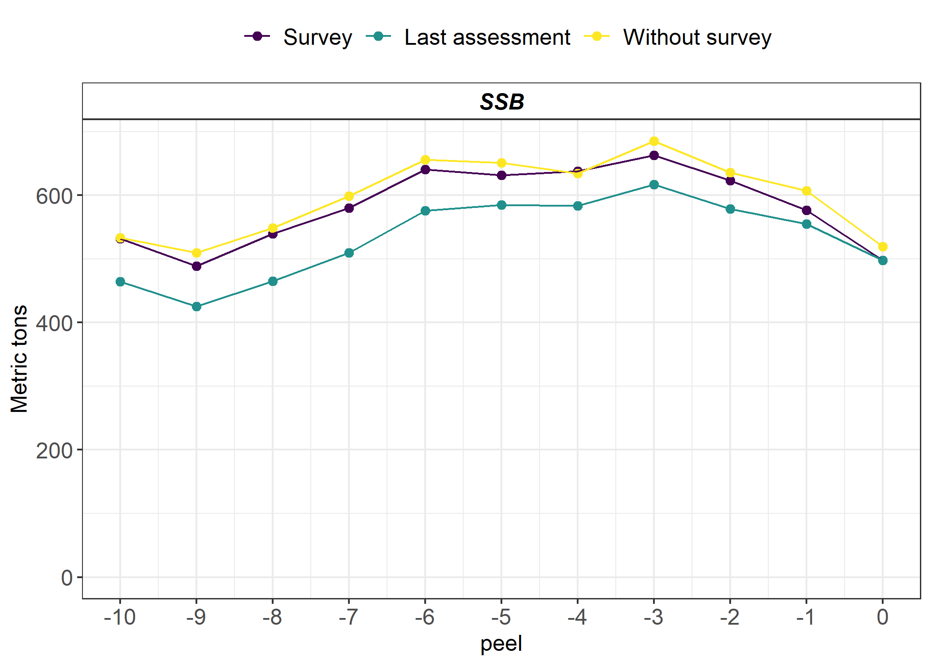
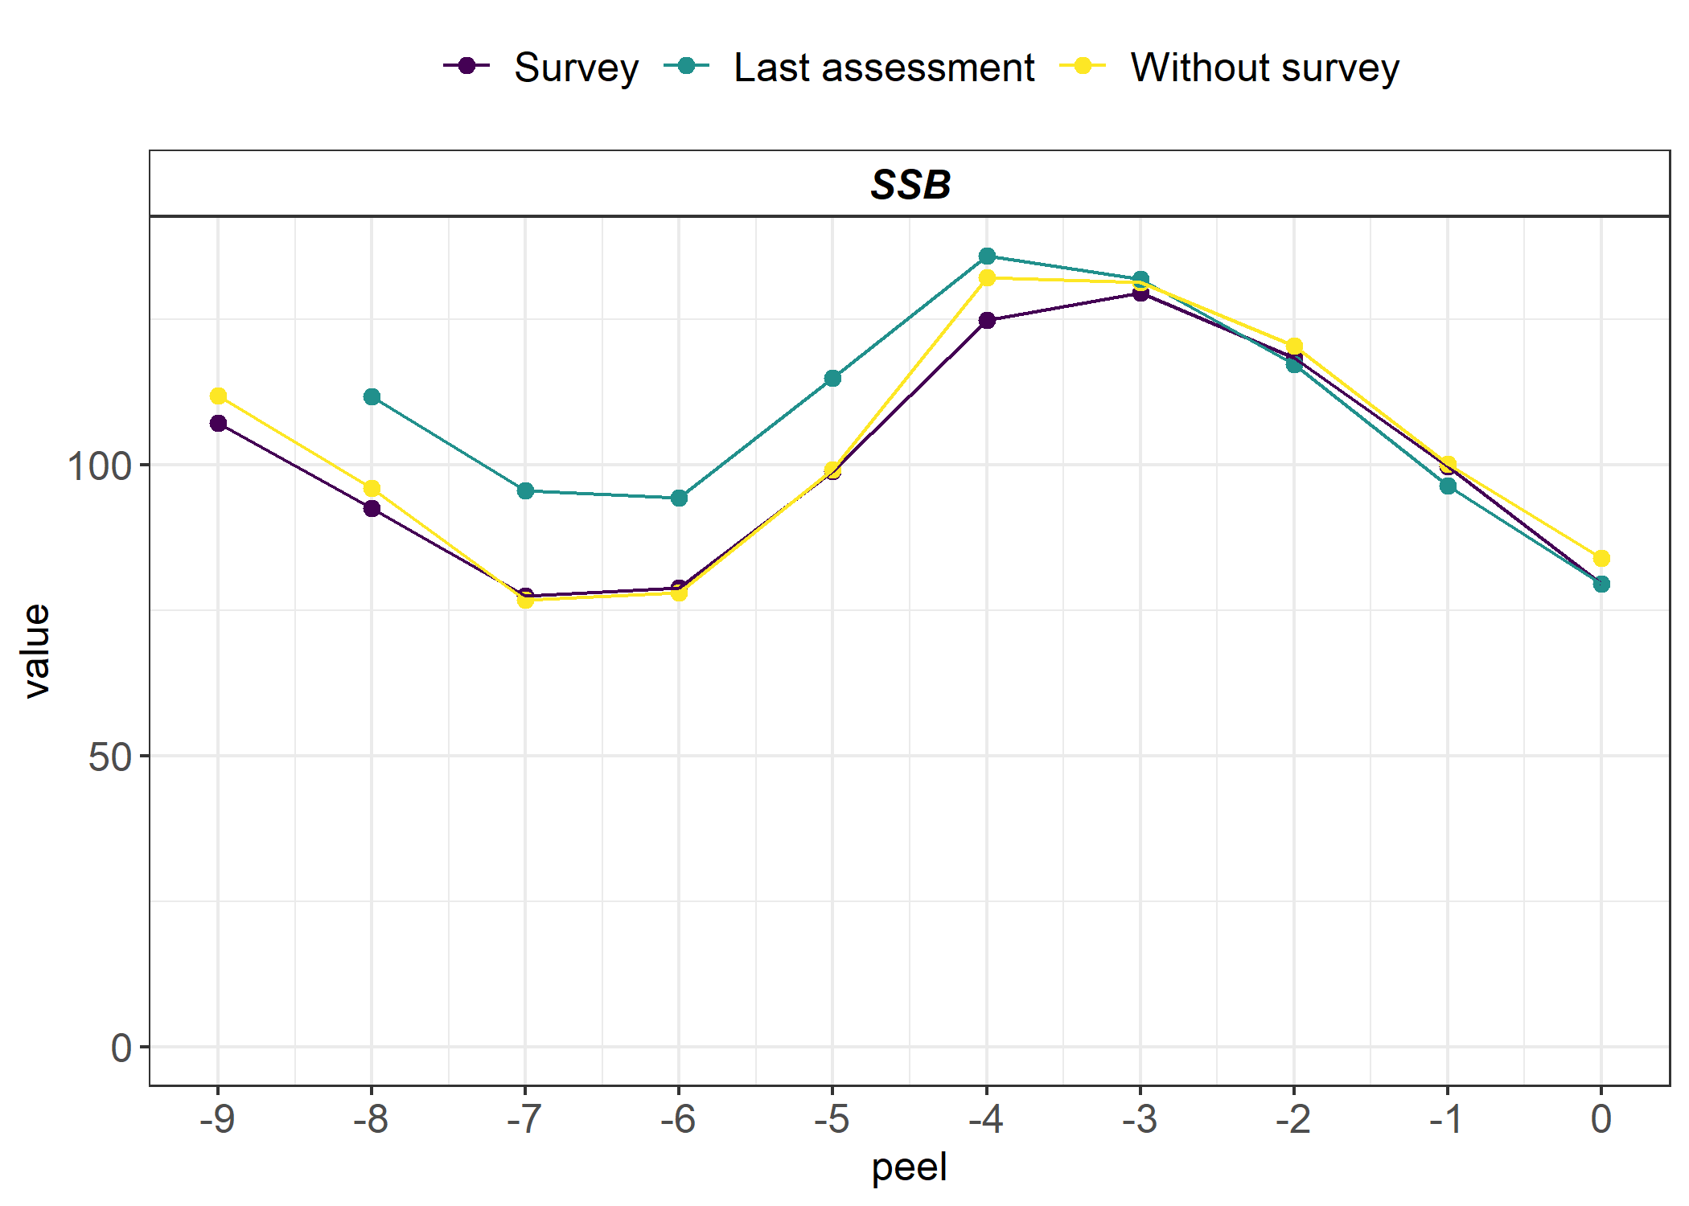
 | Mohn rho (ρ) |  | Ralston |  | Additional
Species | Survey | No survey | σ Survey | σ No survey | σ²
BSAI yellowfin sole | -0.209 | -0.237 | 0.332 | 0.359 | 0.003
BSAI northern rock sole | 0.107 | 0.134 | 0.113 | 0.137 | 0.001
BSAI flathead sole | -0.046 | -0.045 | 0.069 | 0.055 | 0.001
BSAI Greenland turbot | 0.098 | 0.110 | 0.107 | 0.112 | 0.002
EBS Tanner crab | -0.098 | -0.082 | 0.139 | 0.129 | 0.001
Yellowfin sole
Northern rock sole
Tanner crab
Notes:
The remaining species showed varying degrees of retrospective patterns. When comparing the results from the two retrospective analyses to the last assessment, you can clearly see the effect of the retrospective pattern is driving the uncertainty more so than the loss of survey data since the purple and yellow lines are quite similar to each other.

Slide 17
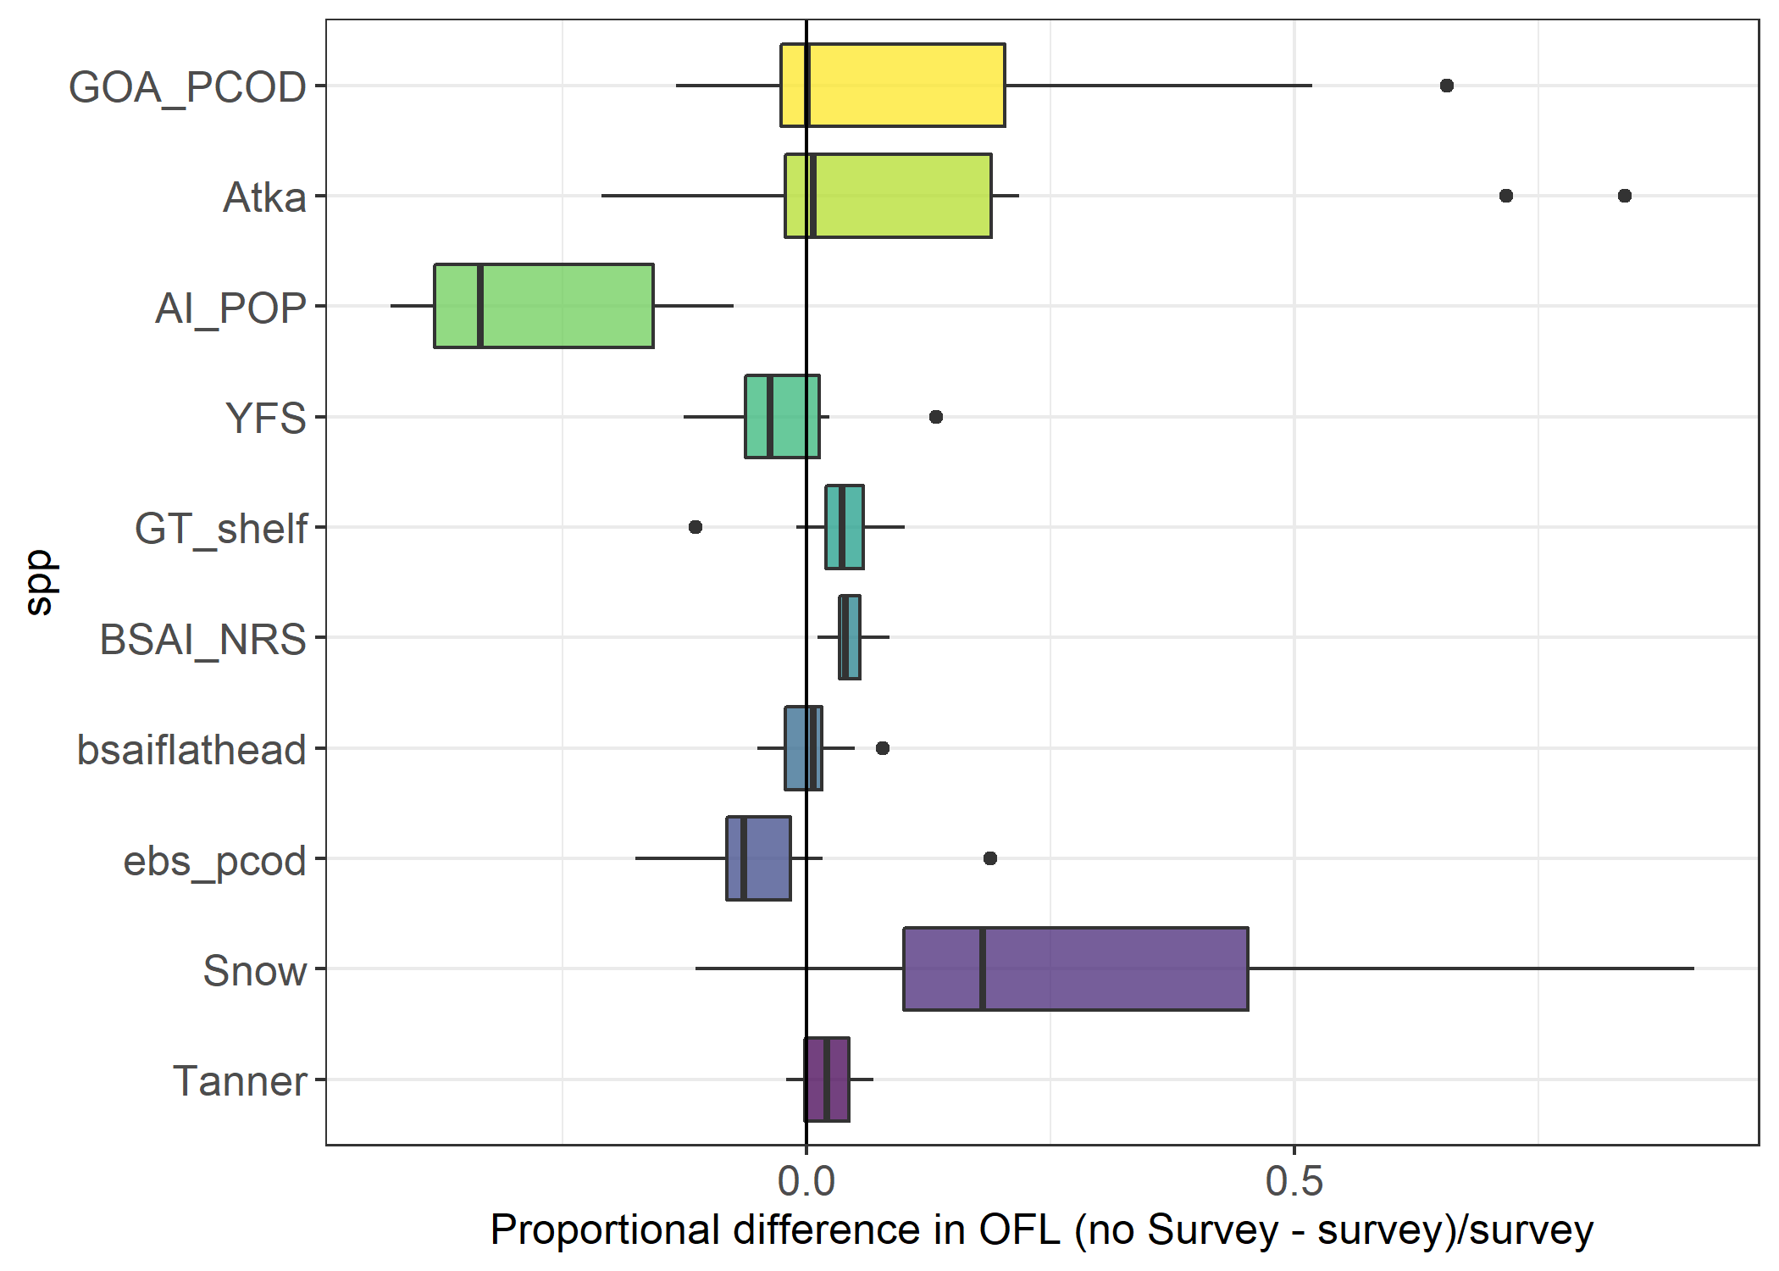
Overfishing limits
GOA Pacific cod
Atka mackerel
Biennial
POP
Yellowfin sole
Greenland turbot
Northern rock sole
Annual, groundfish
Flathead sole
EBS Pacific cod
Snow crab
Annual, crab
Tanner crab
Notes:
From a management advice perspective, we looked at the proportional difference in OFL. Positive value here indicates the OFL is larger when the most recent survey data are missing from the assessment and a negative value indicates the OFL is smaller when the most recent survey data are missing.

Slide 18
Conclusions
Analysis provides us with a range of expected uncertainty for age structured assessment models
Assessments with consistent retrospective bias exhibited greatest uncertainty
Survey frequency may be a contributing factor
Notes:
This analysis gives us some indication of the range of expected uncertainty and it also indicates that the magnitude of uncertainty is species specific, dependent on assessment model specification and historical retrospective patterns, and to some degree survey frequency.
AK ecosys is experiencing incredible shifts in dynamics and without frequent surveys this shifts could be missed leading to greater uncertainty. One way to test this is through simulation experiments

Slide 19
Acknowledgments
Survey value work group
  RACE, REFM, FMA, ABL, HEPR
Anne Hollowed
Dana Hanselman
Chris Lunsford
Pete Hulson

Slide 20
Questions?

Slide 21
Extra

Slide 22
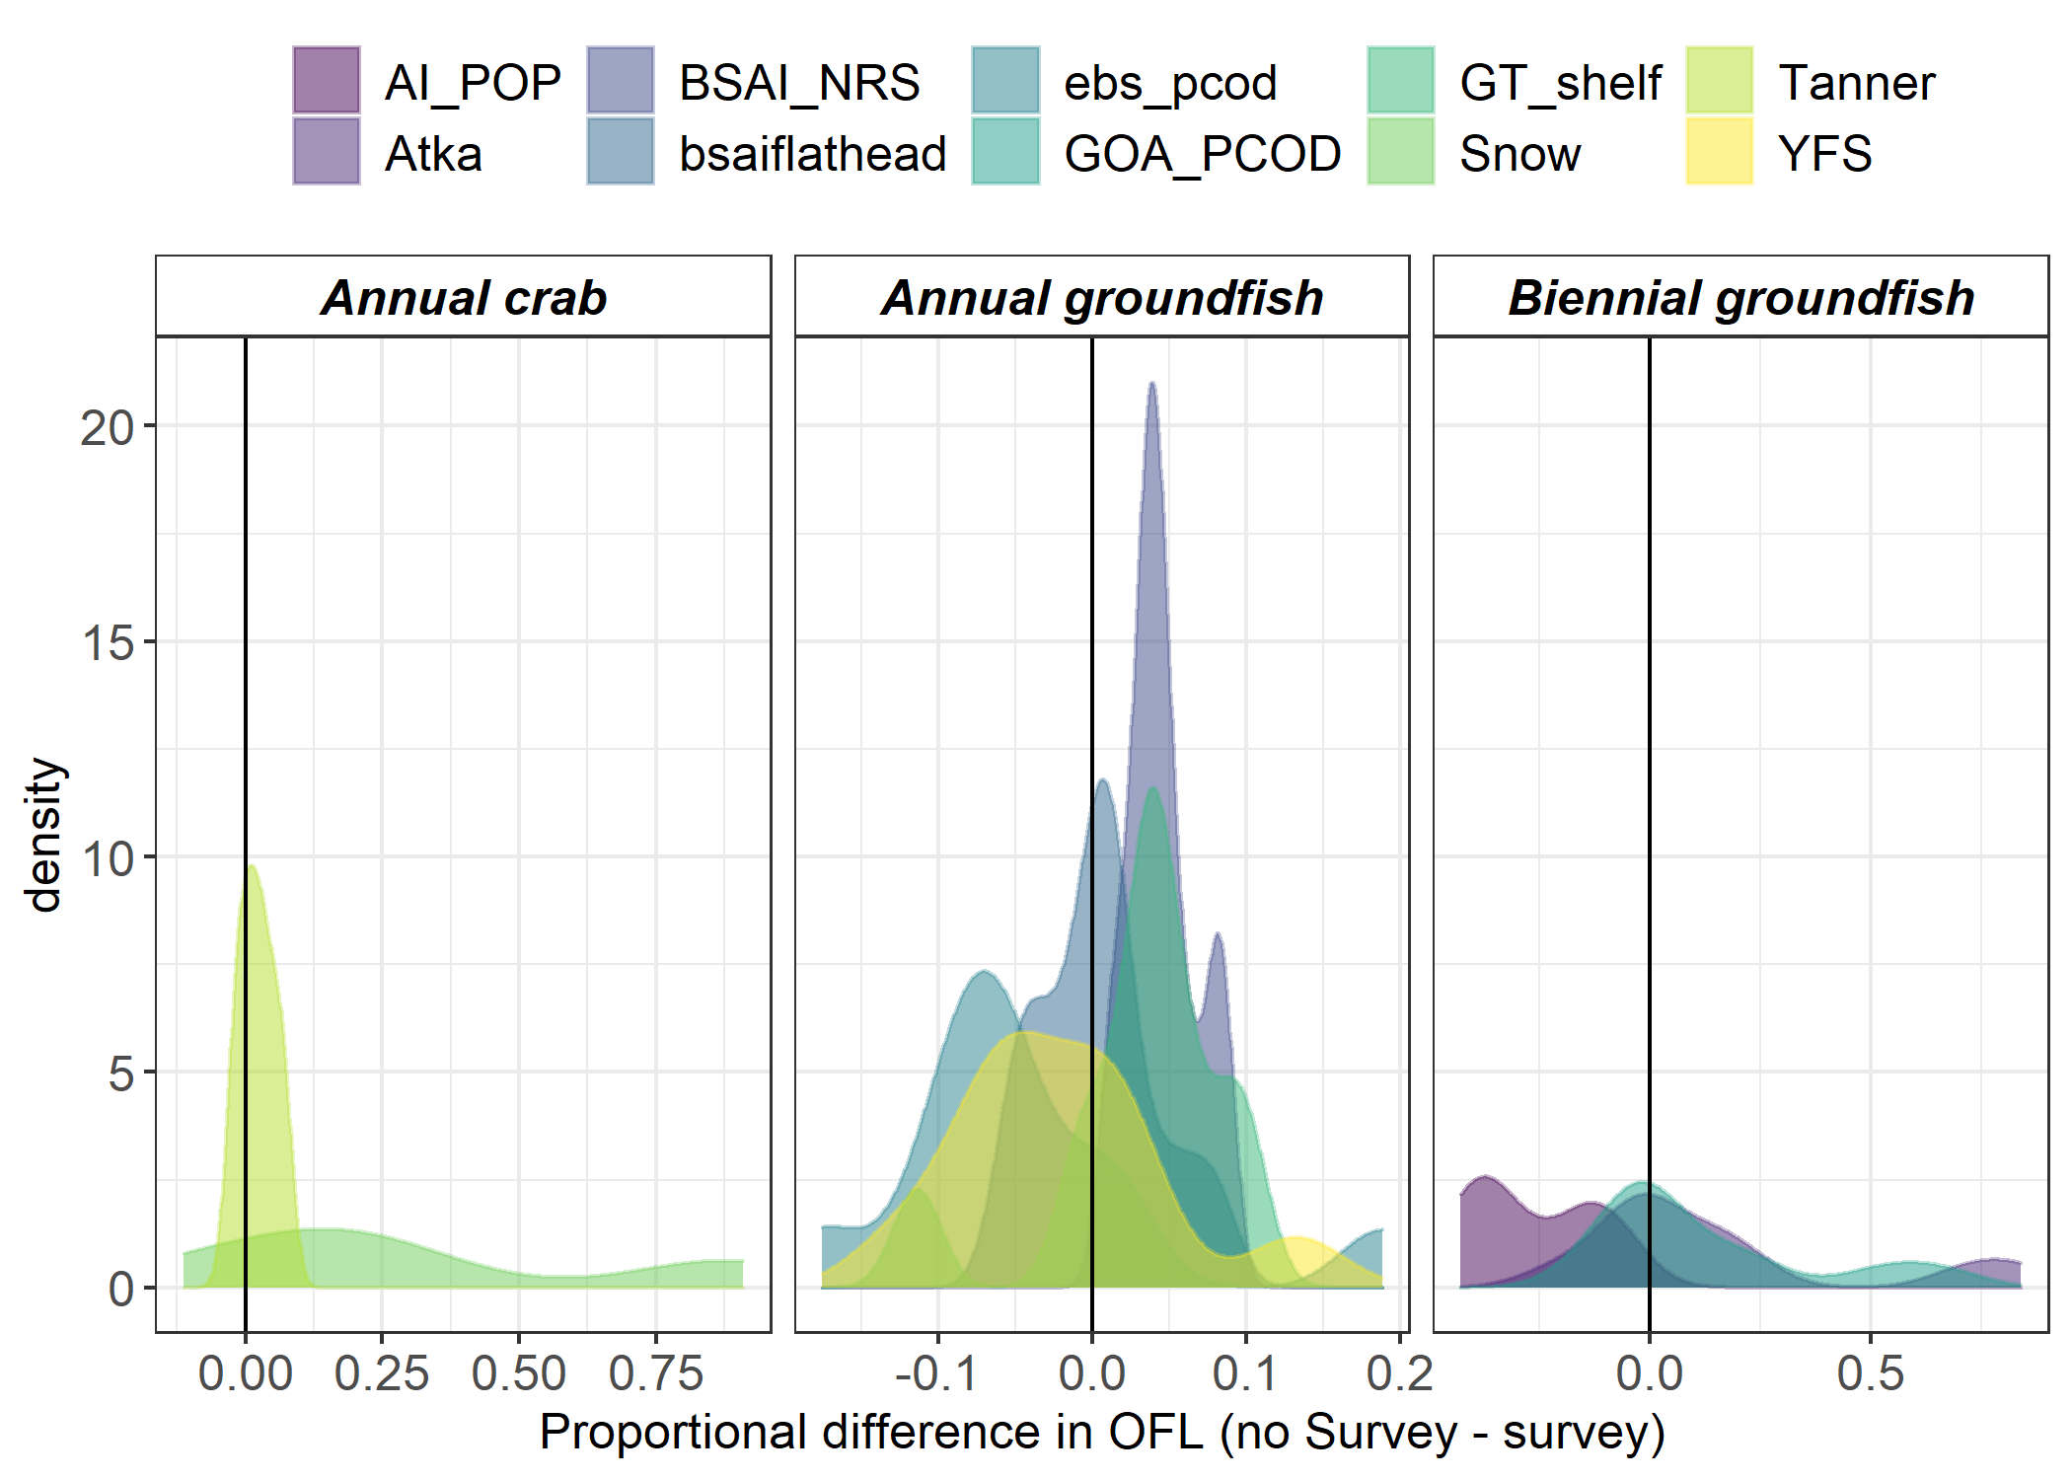
Overfishing limits
Notes:
From a management advice perspective, we looked at the proportional difference in OFL. Positive value here indicates the OFL is larger when the most recent survey data are missing from the assessment and a negative value indicates the OFL is smaller when the most recent survey data are missing.

Slide 23
Comparison of spawning biomass coefficients of variation in “on” and “off” survey years
Grant G. Thompson

Slide 24
Methods
Focused on stocks using the GOA and AI bottom trawl surveys
  SSB and standard error estimates from a total of 29 stocks were submitted by stock assessment authors
Average coefficient of variation computed separately for “on” and “off” years
Ratio of CV in “on-year plus one” to CV in the preceding “on” year

Slide 25
Results
Pooled CV was 8% higher on average in “off” years for Tier 1 – 3 stocks
For the 3 cases in which the time series terminated in an “off” year, the pooled CV was 35% higher on average than it was for those same 3 stocks overall.
For the 3 cases in which the time series terminated in an “off” year, the pooled CV was 35% higher on average than it was for those same 3 stocks overall
Pooled CV of 56% higher on average when comparing “off” years to “on” years for the 9 Tier 5 stocks showed an average increase in

Slide 26
Results
The 13 stocks/complexes managed under Tiers 1-3 showed an average increase of only about 1% between “on+1” and “on” years for the time series overall.
For the 3 cases in which the time series terminated in an “off” year, the CV ratio was about 7% higher on average than it was for those same 3 stocks overall.
The 9 stocks managed under Tier 5 showed an average increase of about 42% between “on+1” and “on” years for the time series overall.
For the 1 case in which the time series terminated in an “off” year, the CV ratio was 146% higher than it was for that same stock overall.

