Slide 1

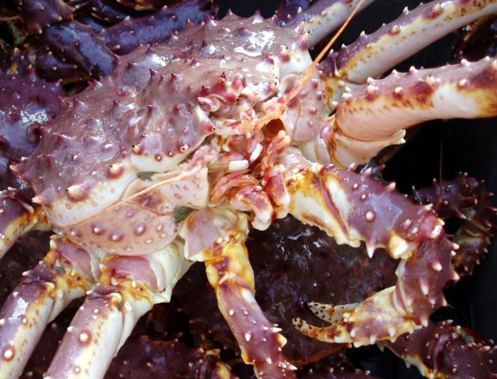
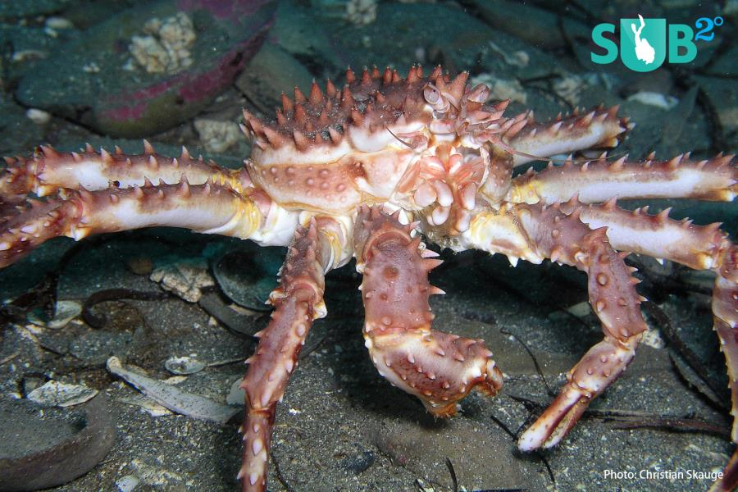
VAST 2020 Bristol Red King Crab results and diagnostics
Jonathan Richar
Jon.richar@noaa.gov
Notes:
Well, good afternoon everyone, and welcome to my (hopefully) brief overview of the VAST model and its diagnosticsfor BBRKC,

Slide 2

VAST
Applies delta-generalized linear mixed models within a spatio-temporal context
Incorporates predictors for probability of encounter, and catch-rate given encounter
  Both allow for spatial and spatio-temporal variation
Delta-model for observations*
$$\operatorname{Pr}\left(B=b\right)=\left\{\begin{matrix}1−p(s,t) & if B=0 \\ p(s,t) ×g(B;r(s,t)) & if B>0\end{matrix}\right.$$
  Where
  1. $p(s,t)$ is the probability of encountering the species
  2. $r(s,t)$ is the expected biomass when the species is encountered
    $g(B;r(s,t))$ is the distribution for positive catches
    *Thorson and Cunningham 2018
Notes:
Because Jim isn’t here today, I’ll start with a very brief, high earth orbit level overview of VAST…..VAST uses a delta model structure to break observations into 0s and positive catch and models these observation groups separately to reduce variance

Slide 3

Linear predictor for encounter probability*
$$\operatorname{logit}\left[\left.p\left(s_{i}, t_{i}\right)\right]\right.=β_{p}\left(t_{i}\right)+L_{pω}ω_{p}\left(s_{i} \right)+L_{pε}ε_{p}\left(s_{i},t_{i}\right)$$
Where
  $β_{p}\left(t_{i}\right)$ is an intercept
  $ω_{p}\left(s_{i}\right)$ is spatial variation, $Var_{s∈\{D\}}\left(ω_{p}\right)=1$
  $ε_{p}\left(s_{i}, t_{i}\right)$ is spatio-temporal variation, $Var_{s∈\{D\}|t}\left(ε_{p}\right)=1$
Linear predictor for catch-rate given encounter*
$$\log\left[\left.r\left(s_{i}, t_{i}\right)\right]\right.=β_{p}\left(t_{i}\right)+L_{rω}ω_{p}\left(s_{i} \right)+L_{rε}ε_{r}\left(s_{i},t_{i}\right)$$
Where
  $β_{r}\left(t_{i}\right)$ is an intercept
  $ω_{r}\left(s_{i}\right)$ is spatial variation, $Var_{s∈\{D\}}\left(ω_{r}\right)=1$
  $ε_{r}\left(s_{i}, t_{i}\right)$ is spatio-temporal variation, $Var_{s∈\{D\}|t}\left(ε_{r}\right)=1$
      * Thorson and Cunningham 2018
Notes:
Linear predictors are then used to model encounter and catch rate given encounter…as previously noted these include terms for spatial and spatio-temporal variation

Slide 4

  Density is then calculated as a function of encounter and catch rates*
$$\hat{d}\left(s, t\right)=\hat{p}\left(s, t\right)×\hat{r}\left(s, t\right)$$
  Density estimates calculated at knots based on adjacent station sample values
    Knots control resolution
    VAST places knots automatically, such that average distance from observatrions is minimized
    Estimates extrapolated to surface using SPDE mesh/grid approximation within an extrapolation region
      Predefined extrapolation regions included with VAST package
      User may also define their own extrapolation region and import it.
      Custom extrapolation areas may be defined on the fly based on user provided sampling grid.
                *Thorson and Cunningham 2018

Slide 5
Data and settings
Estimated Bristol Bay red king crab total GE65, as well as male GE65 and female GE65.
Data: abundance/biomass at station data produced as an intermediate step in creation of design based estimates.
VAST settings
  RACE-standard model used with limited modification to make converge
  No covariates (depth, NBT, etc.)
  Delta-gamma observation model
  Knot method = grid
  #Knots: 500
  Fine scale = T
  Bias correction = T (employs an epsilon bias-correction estimator)
  Custom extrapolation regions based on SAP strata used for design based estimates
    6.25 km2 (2.5 km x 2.5 km) grid squares
Notes:
Alright, enough of that

Slide 6
Parameter settings
Total Abundance
Total Biomass
$FieldConfig
 | Component_1 | Component_2
Omega | IID | IID
Epsilon | IID | 0
Beta | IID | IID
$FieldConfig
 | Component_1 | Component_2
Omega | IID | IID
Epsilon | IID | IID
Beta | IID | IID
$RhoConfig (years as fixed effects)
Beta1 Beta2 Epsilon 1 Epsilon2
0 0 0 0
Notes:
Models were run with Spatial and spatio-temporal components enabled, except for Epsilon_2 in the total abundance model, which was disabled to make the model converge.
As per RACE standards models were run with years as fixed effects, a

Slide 7
Model diagnostics presented
Comparisons of design-based and VAST estimates
Catch rate Pearson residuals
  Spatially extrapolated residuals for catch rate model component
  Scale and regional trends
Encounter rate Pearson residuals
  Spatially extrapolated residuals for encounter rate model component
  Again, scale and regional trends
Modeled encounter probability vs. actual
  1:1?
  Does prediction interval encompass observations, esp. at extremes?
Positive catch rate Q-Q plots
  Signs of skew/ distribution inadequacies?
Parameter estimates, gradients and standard errors
  Gradients small (<1e-6)? Parameter standard errors reasonable?
Notes:
For model diagnostics, I will be presenting…

Slide 8
BBRKC – Total GE65

Slide 9
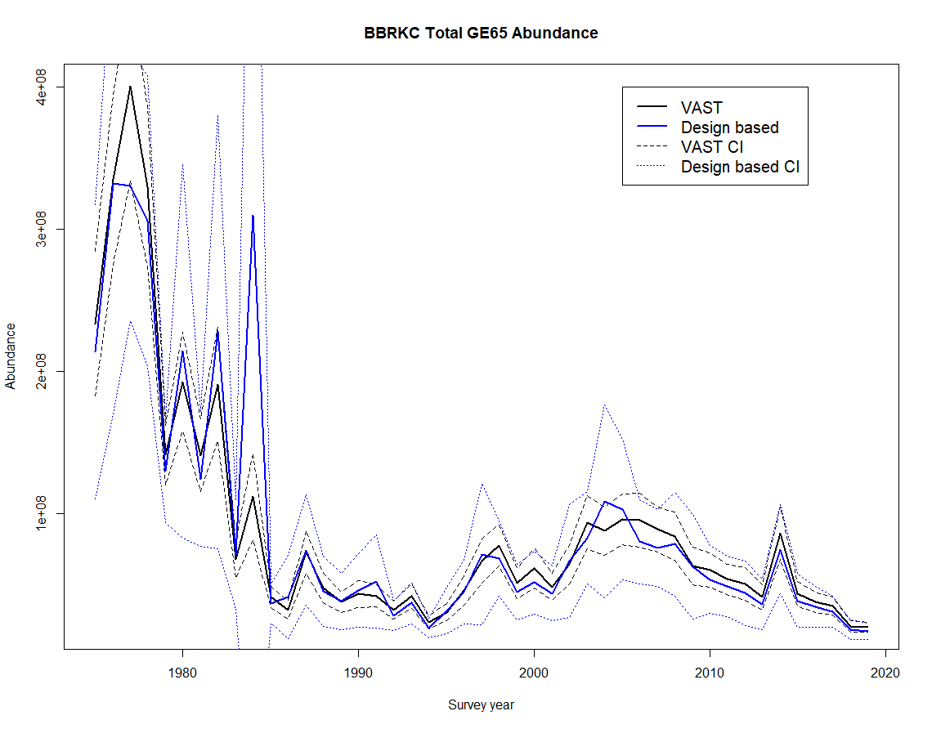
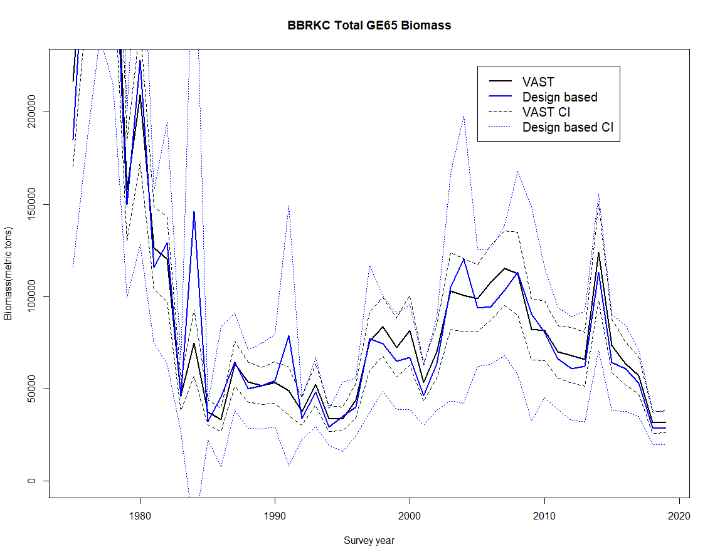
Estimates
Abundance
Biomass
Notes:
Design based and VAST derived trends track each other fairly well, although there are discrepancies in estimates—in some years design based are (much larger), and in many years, VAST estimates are slightly larger. VAST Cis are however always notably smaller relative to the design based equivalent.

Slide 10
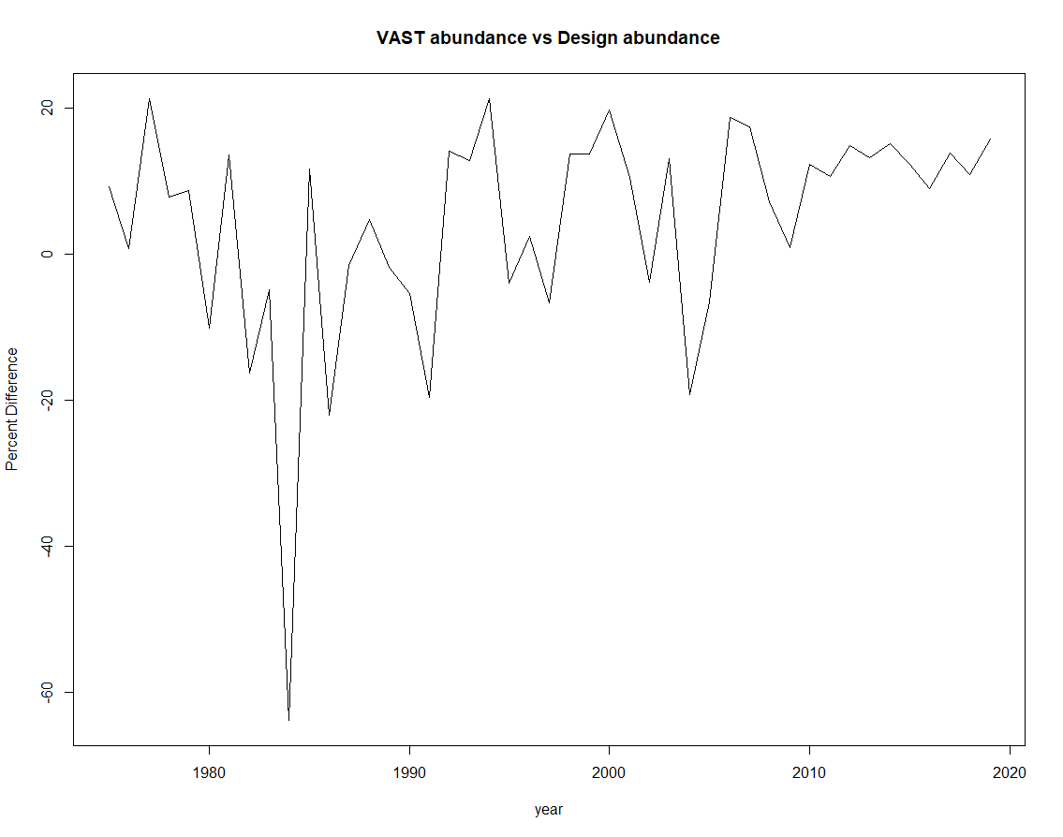
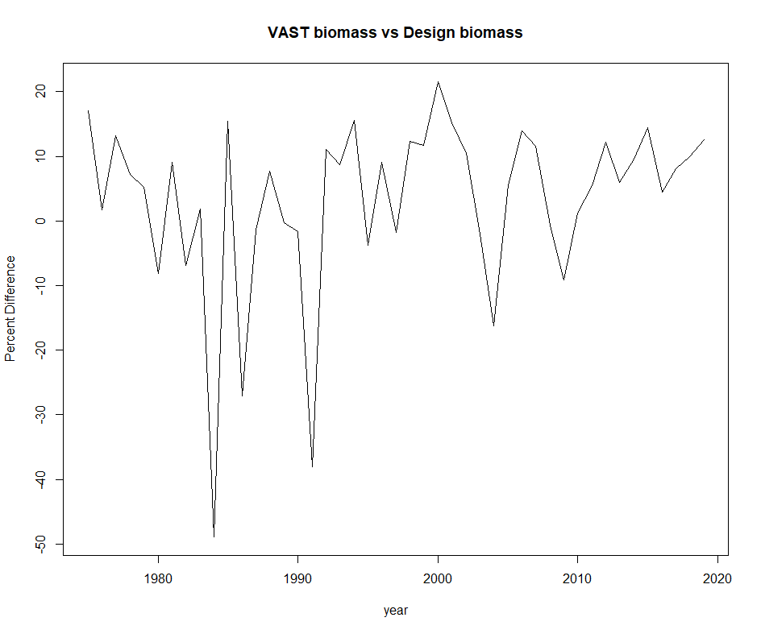
Abundance
Biomass
Mean = +3.18%
Mean = +4.15%
Notes:
Looking at the percent difference between design based and VAST derived estimates

Slide 11
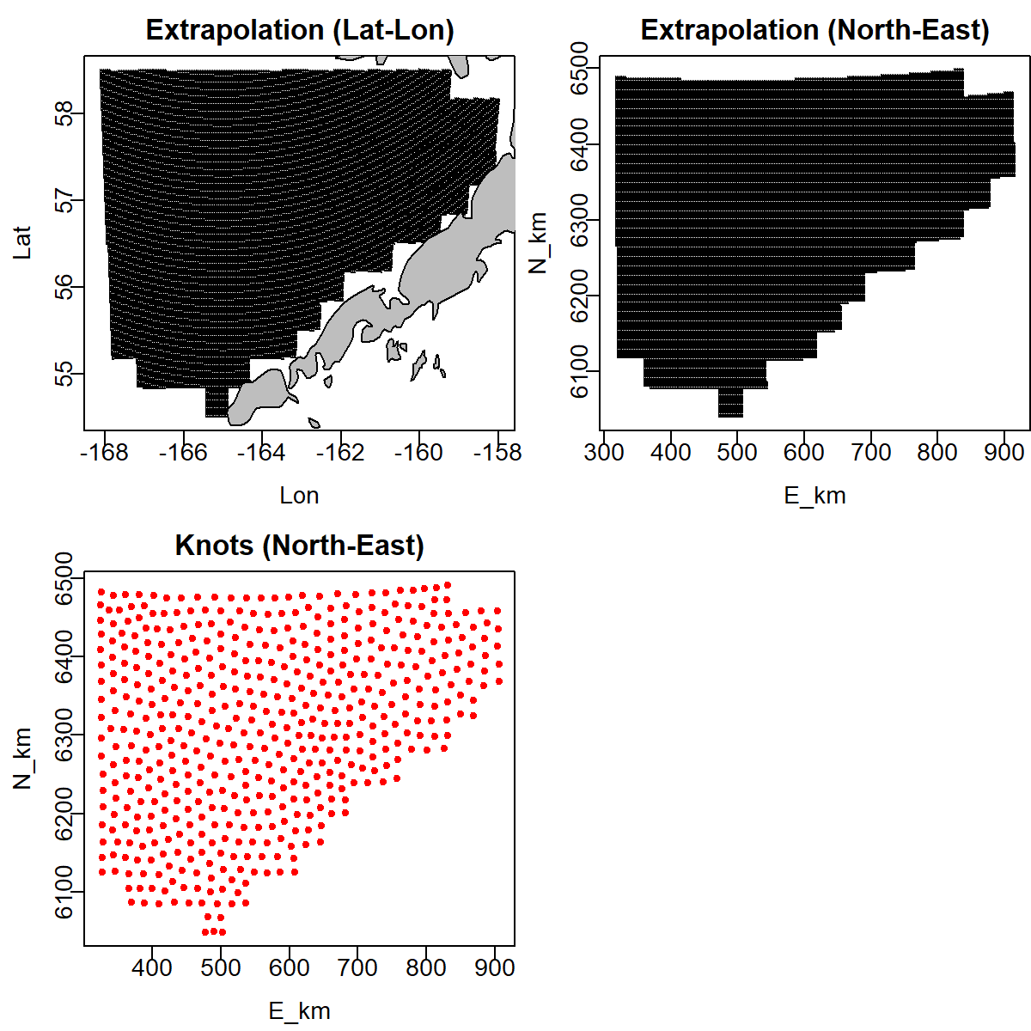
Despite using SAP Bristol Bay strata to define VAST strata, slight discrepancy in area:
  VAST Bristol Bay area = 188781.2 km2
  Design based = 187053.04
VAST extrapolation region is 0.92% larger
Notes:
…This likely accounts for some of the mean increase in the VAST estimates relative to the design based.

Slide 12
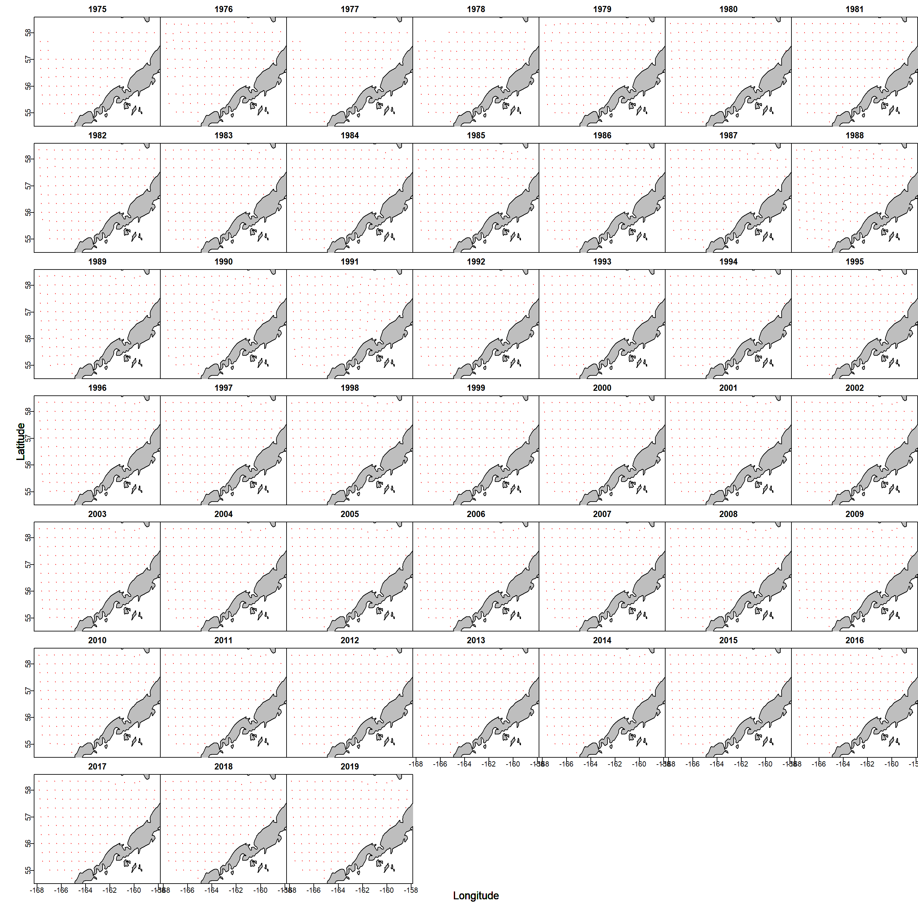
Notes:
Looking at data extent…this matched the extrapolation area well, though with some discrepancies in the mid 70s

Slide 13
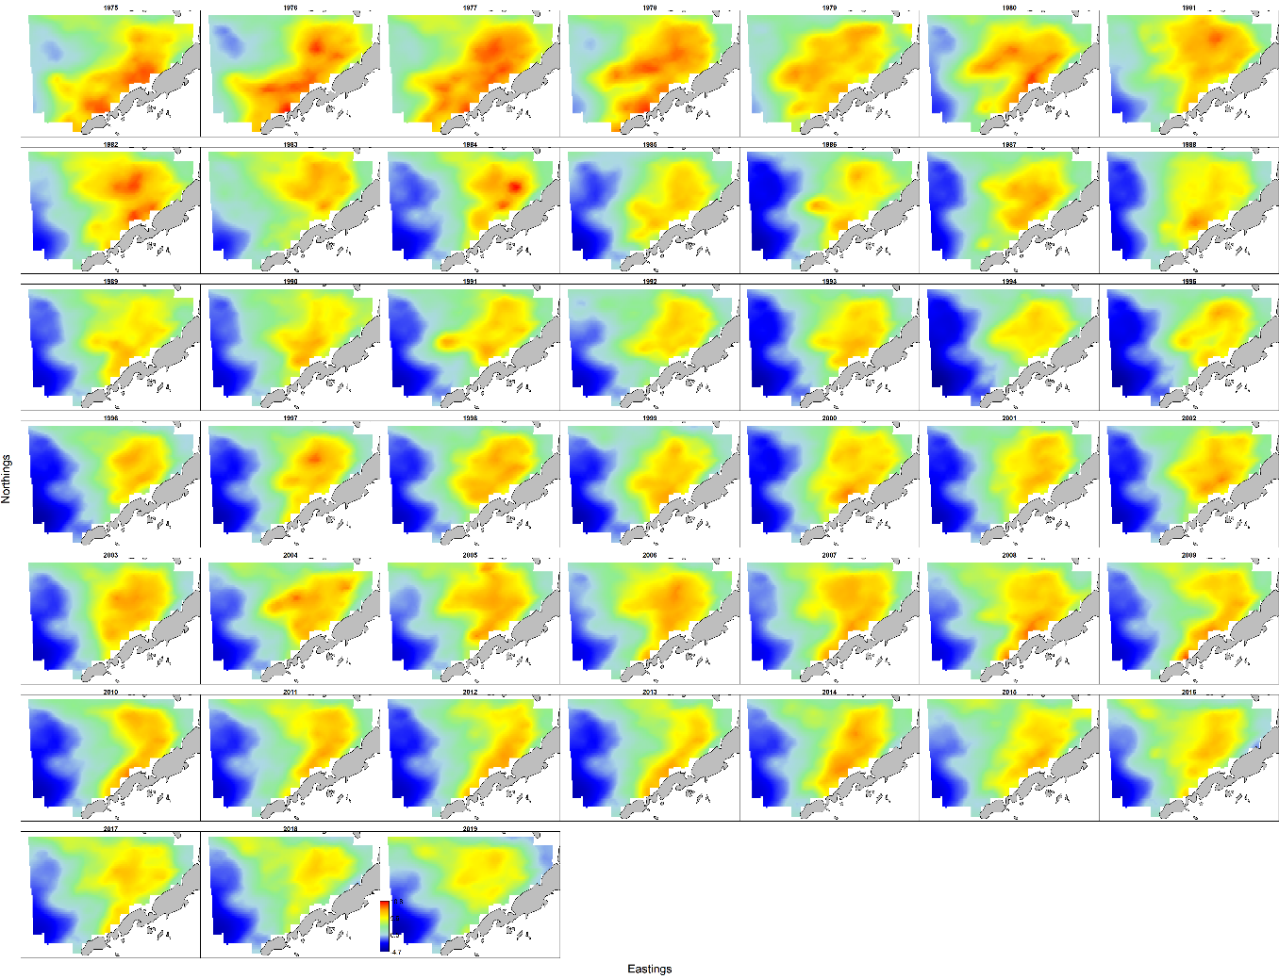
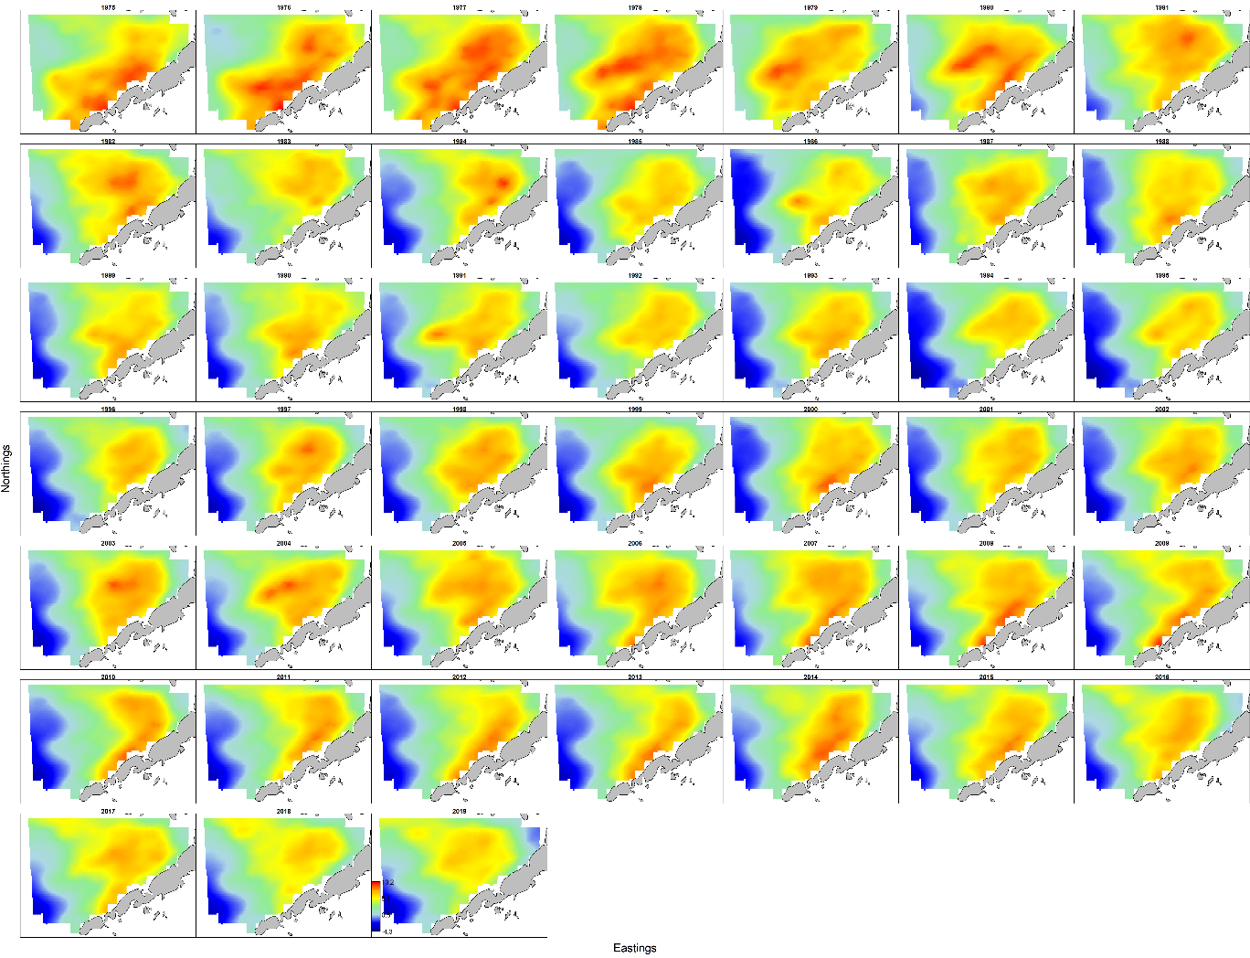
Density
Abundance
Biomass
Notes:
Density maps generated by VAST are consistent with survey data, and with each other

Slide 14
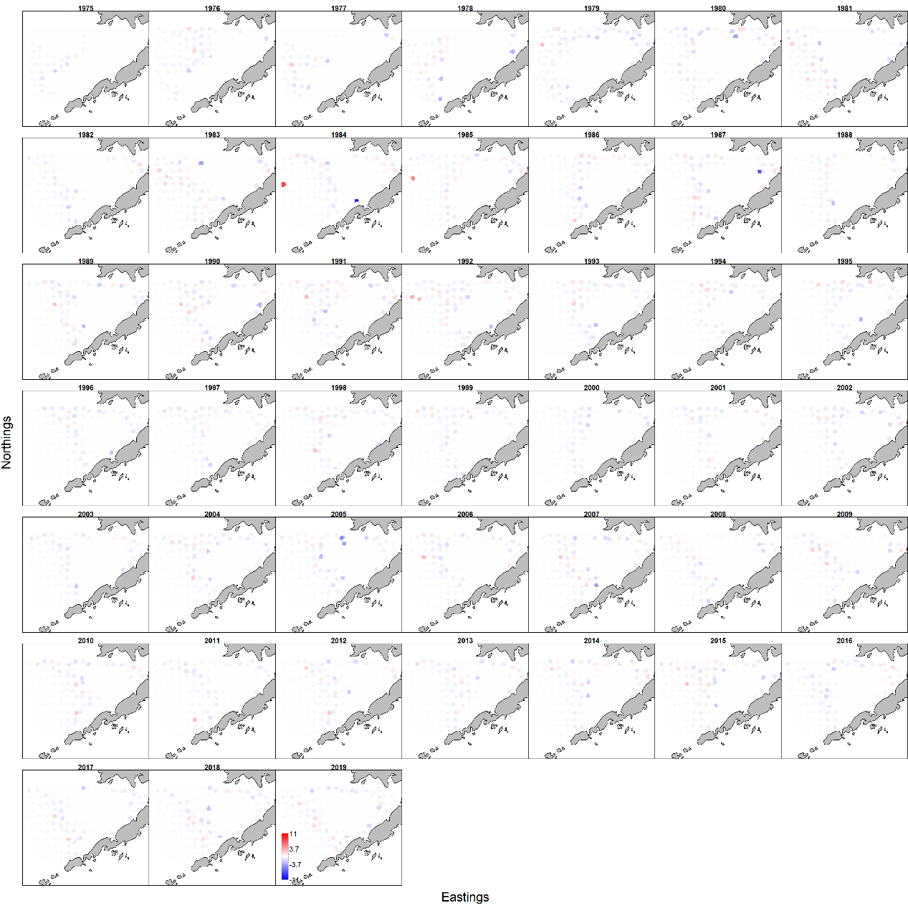
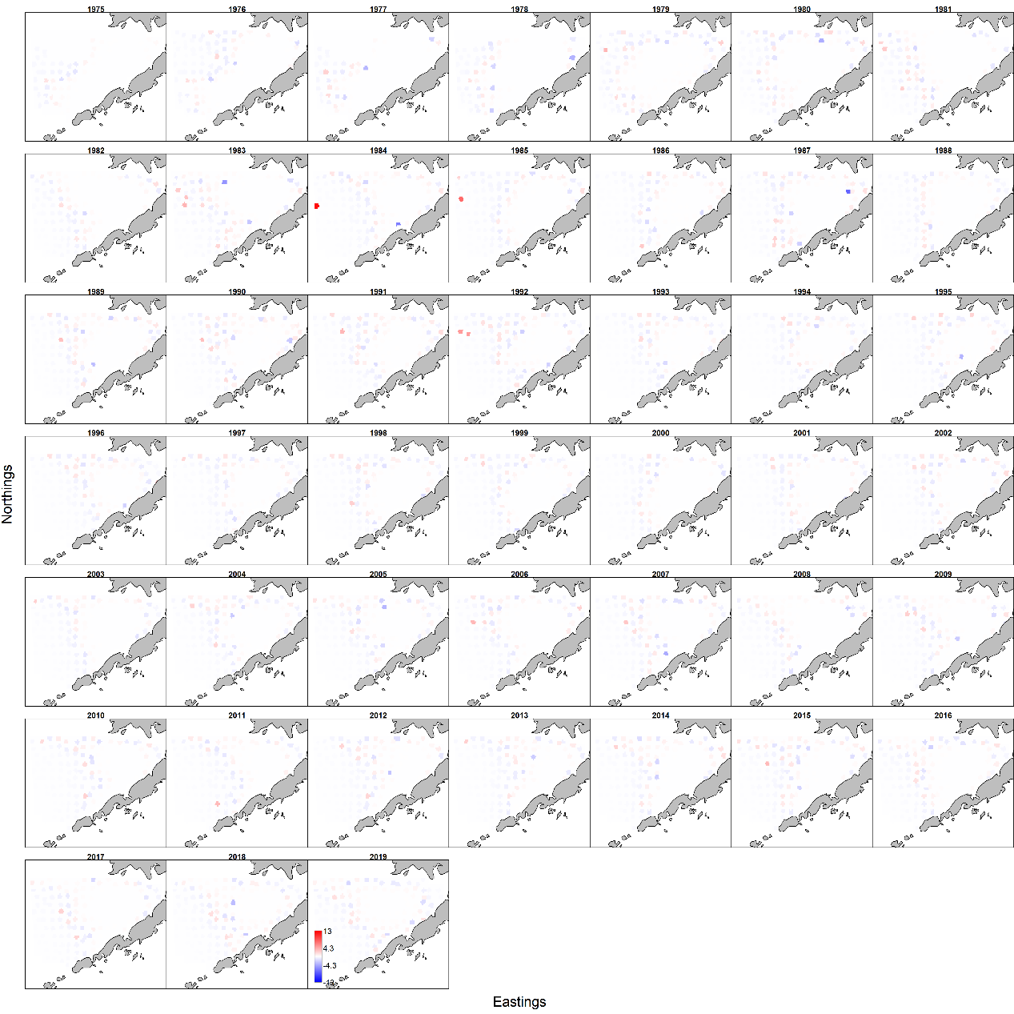
Encounter Pearson residuals
Abundance
Biomass
Notes:
Now looking at the Pearson residuals…again the things to look for here are the magnitude of the residuals and the presence of any spatial trends.
For the encounter component residuals there is evidence of a spatial trend pertaining to the zero/low catch stations in both the abundance and biomass models, although residuals have a fairly limited magnitude. We will be coming back to this.

Slide 15
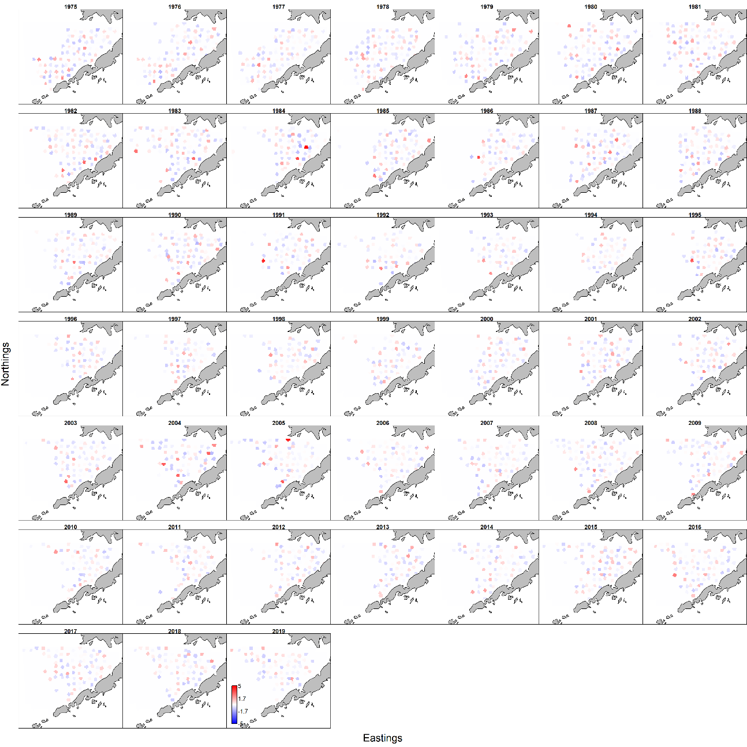
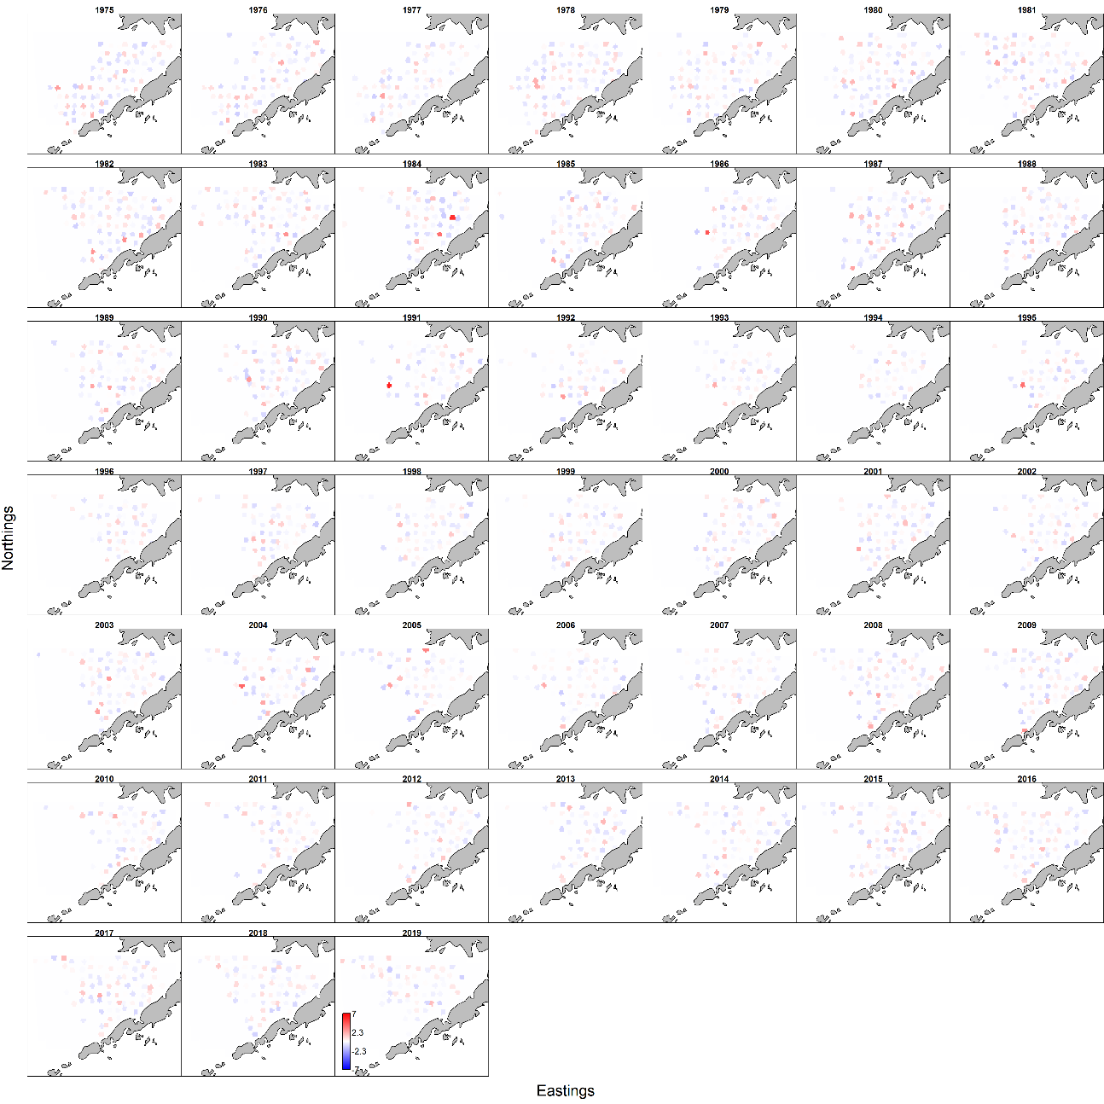
Catch rate Pearson residuals
Abundance
Biomass
Notes:
Catch rate models performed better, with residuals not suggesting strong evidence for a spatial trend, although if you squint and look at them upside down….
Residuals generally have a limited magnitude, although there are a few large ones, typically “at” high catch stations

Slide 16
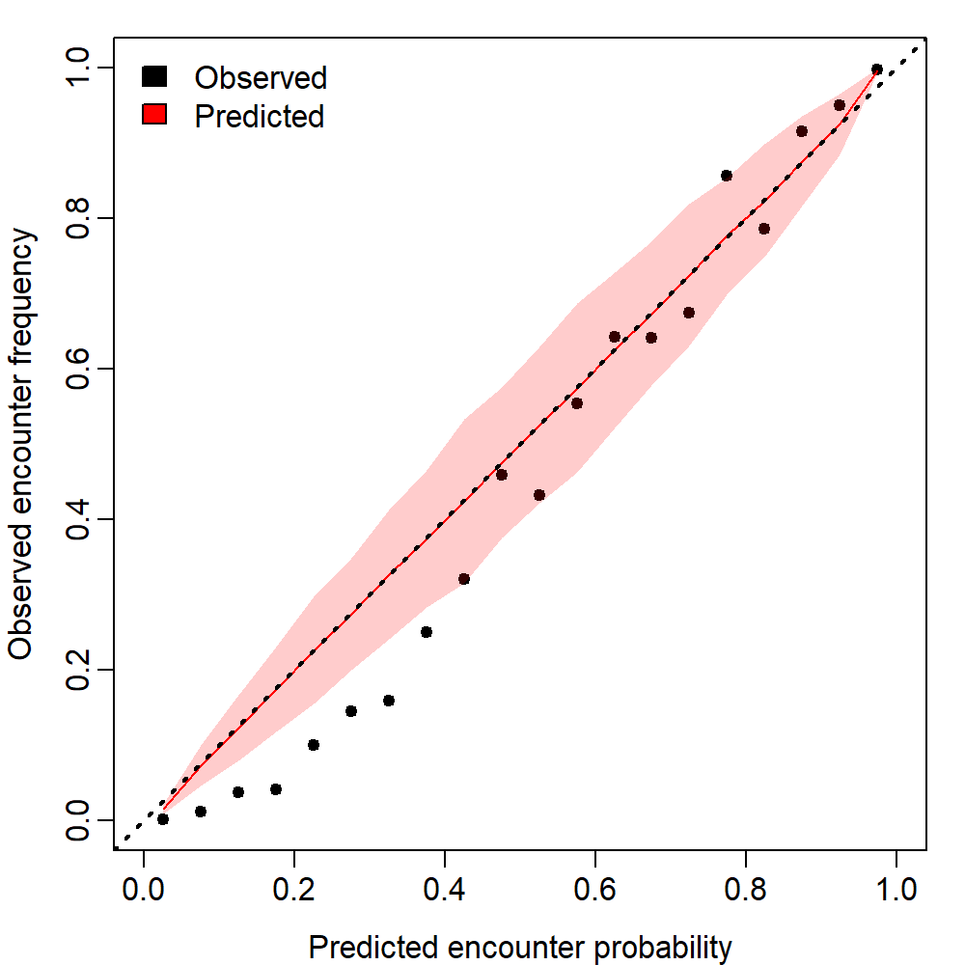

Modeled encounter probability vs. actual
Abundance
Biomass
Notes:
As suggested by the encounter pearson residual plots, the encounter model components had some difficulty with low probability stations, and observed frequencies fall well outside the prediction intervals on the low end

Slide 17
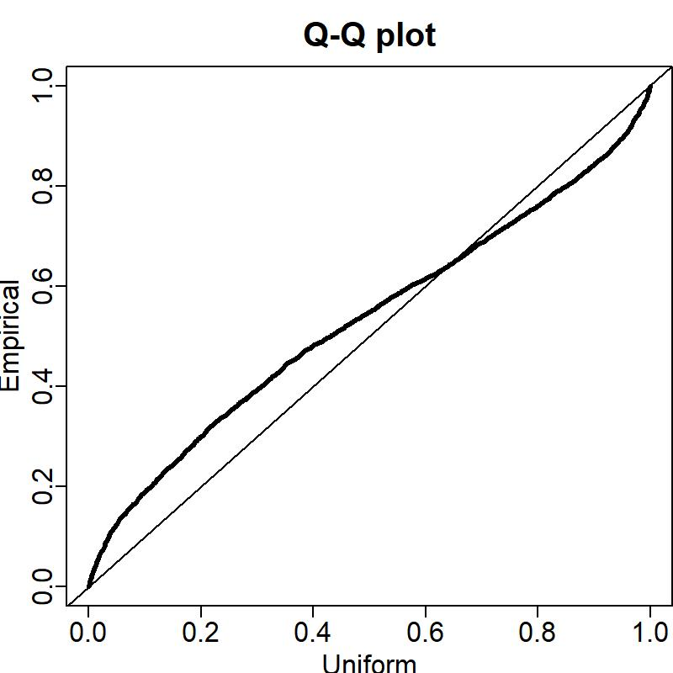

Positive catch rate Q-Q plots
Abundance
Biomass
Notes:
The catch rate Q-Q plots are thin tailed suggesting paucity of data at distribution extremes

Slide 18
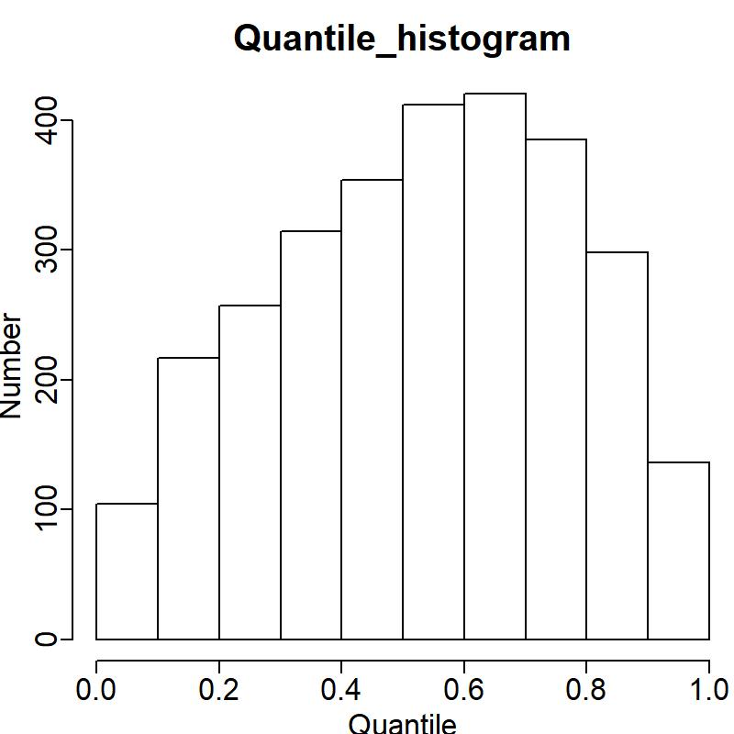
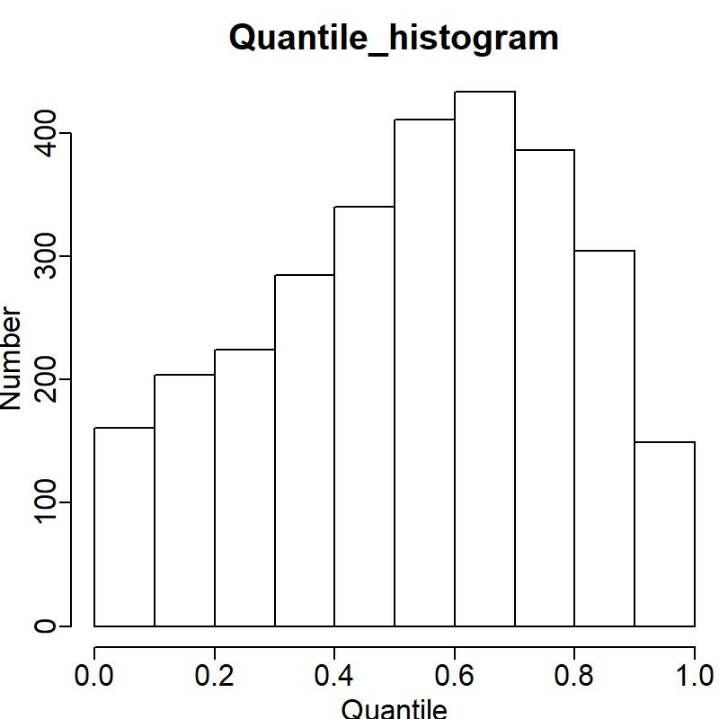
Positive catch rate quantile Histograms
Abundance
Biomass
Notes:
Moving on to the catch rate quantile histograms these reinforce that the tails of the distribution are underpopulated and…thin tailed…these should be essentially flat (i.e. a uniform distribution)

Slide 19
Model parameters- Abundance

Slide 20
Abundance-parameter diagnostics

Slide 21
Abundance – Parameter SD report

Slide 22
Model parameters - Biomass

Slide 23
Biomass parameter diagnostics

Slide 24
Biomass - Parameter SD report

Slide 25

Diagnostics summary
All models converged with decent fits
However……
  Some model difficulty with high/low encounter probabilities
  Positive catch rate Q-Q plots “thin tailed”—extremes somewhat underpopulated relative to distribution assumptions, particularly on low ends
    Some skew
Extrapolation region discrepancy
  Design based grid area issue?
  Issue with VAST grid?
Overall: Diagnostics are not perfect, but data are on the whole useable

Slide 26
Other data
Male and female GE65 biomass models also run, but not included
Results similar to those presented here
  For females also had to disable Epsilon2
  Not for males
  Would be happy to discuss with brave souls who would like to hear more

Slide 27
Male and Female GE65 biomass model parameters
Female
Male

Slide 28
Citations
Thorson, J and Cunningham C. Spatio-temporal index standardization: Overview and basics. January 2018. NOAA AFSC Seattle WA. Model workshop powerpoint.

Slide 29

I’m sorry Dave, I can’t answer that
jon.richar@noaa.gov
Notes:
And now we find out who in the room is familiar with the works of Arthur C. Clarke and Stanley Kubrick….Also, questions?

