Slide 1
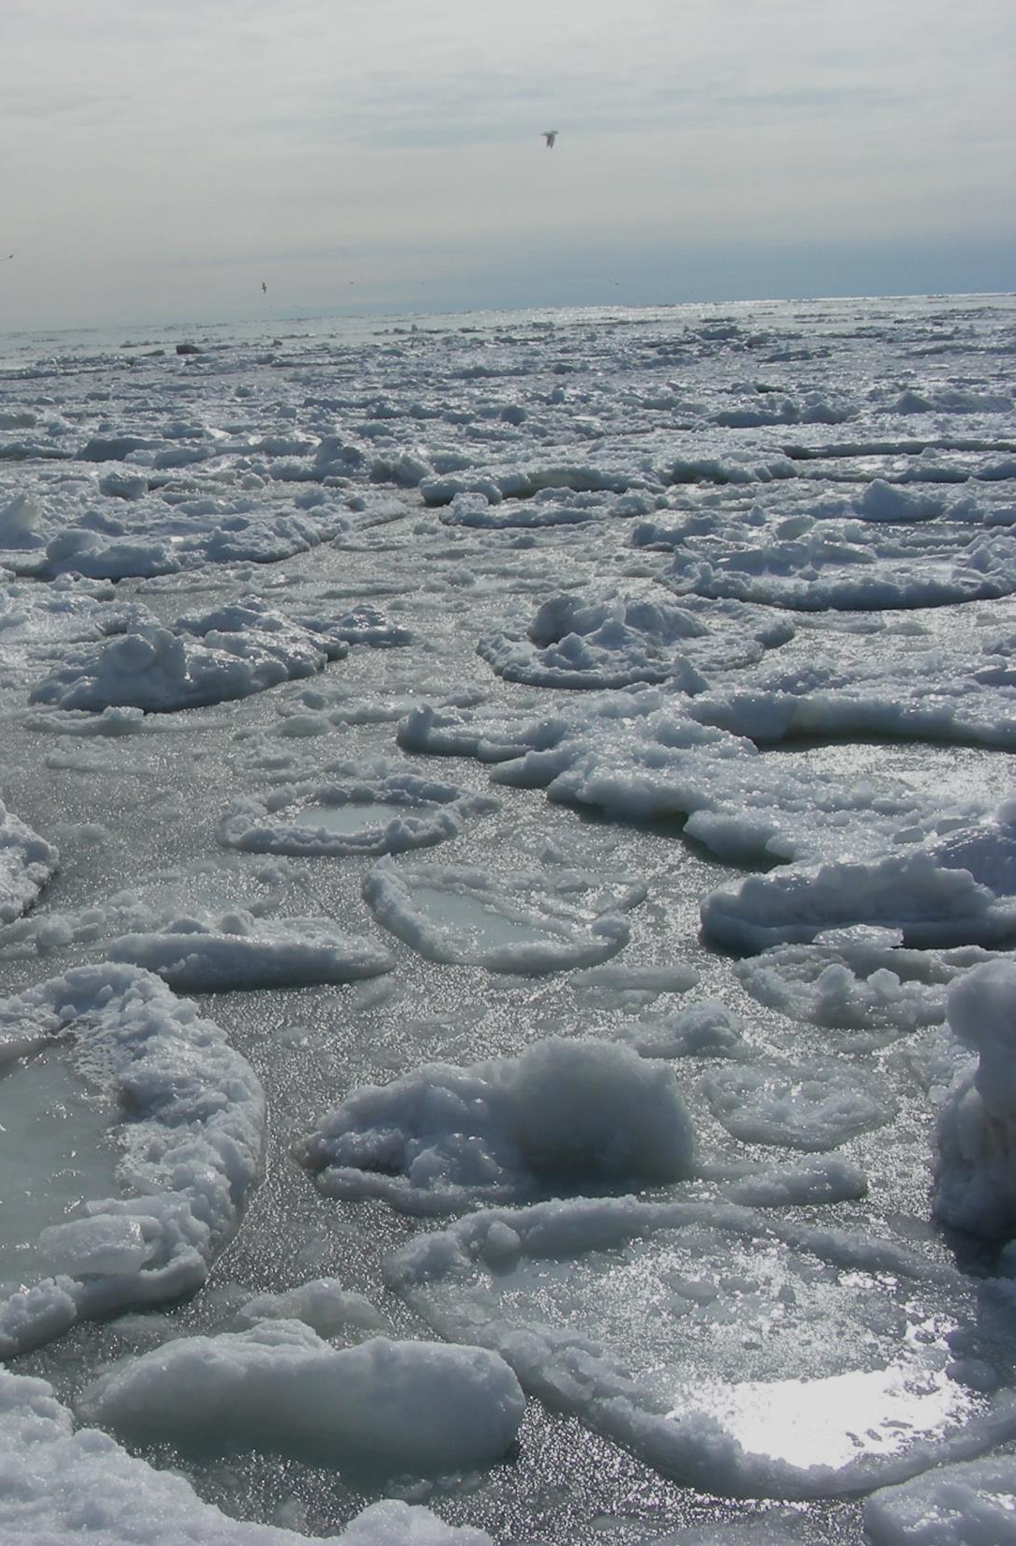

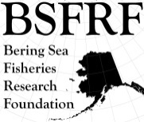


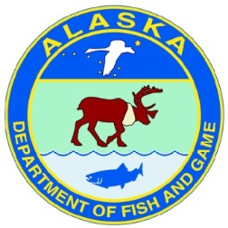
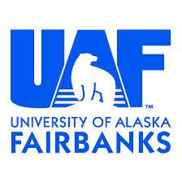



BSFRF Research Update
Scott Goodman – CPT, September 2021
Post-Doc
Research/Support
Develop New
Co-op Partners
Pre-recruit
Surveys
Ocean Acifification
Research
Life History
Research
Trawl Selectivity
Research
Stock Assessment
Support
BSFRF Survey Data
Standardize - Share
Movement Research
Tagging & Monitoring
Crab Aging
Research
Growth Project
Sampling OPI/BRD
Snow Crab Cooperative
Workshop (JAN – OCT)
Discard - Handling
Mortality
Natural
Mortality
2021 Contingency Planning
Bycatch Research
BREP Projects
Harvesters - Processors
Cooperative Research Partners

Slide 2
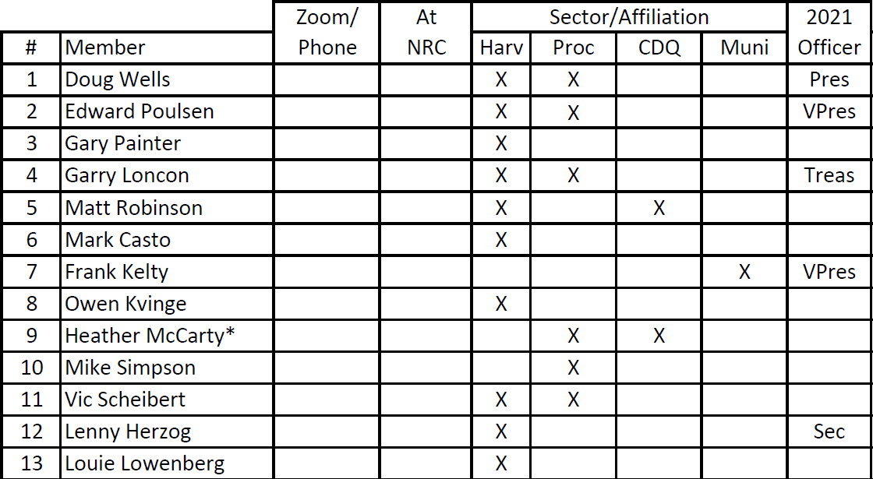
Current Board of Directors
Current Science Advisors
Gary Stauffer (NOAA retired)
Gordon Kruse (UAF retired)
Madison Heller-Shipley (NRC, UW)
Scott Goodman (BSFRF, NRC)

Slide 3
Current research updates
Priority on data compiling and sharing – getting BSFRF database accessible
Crab and Climate Mini-Symposium (virtual meeting May 26)
Direct support of the NMFS survey science parties – legs 2 and 3, complete
Next steps on Snow Crab Workshop – coming up soon
October cooperative charter focused on BBRKC tagging – satellite tags
BREP bycatch research is continuing in Kodiak and in the field
Further research on crab bycatch – collaborating with other sectors
Consideration for growth sampling updates – snow crab/Tanner crab
Collaborating on research/survey with supporting groups (skipper surveys, gear instrumentation, others)
Continuing work on MSE and MSE-lite options (Heller-Shipley)
Exploring options to engage with NPRB (MOA, project ideas)
Looking to ‘think out of the box’ on research ideas that may help soon given current outlook for shelf stocks
Seeking opportunities/sources for funding BSFRF and related projects as status impacts stakeholder supported foundation

Slide 4

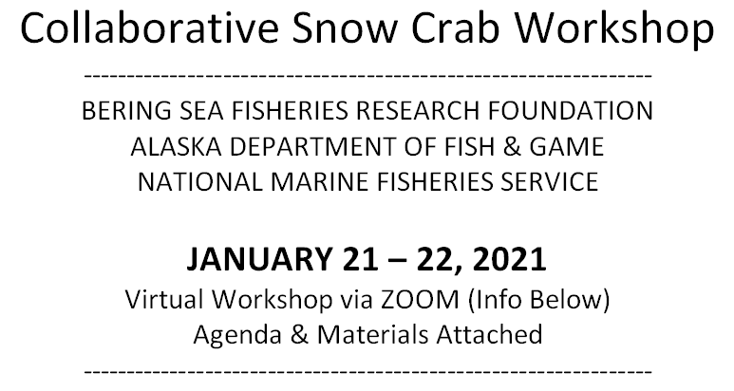

Welcome – Workshop will start soon…

Slide 5
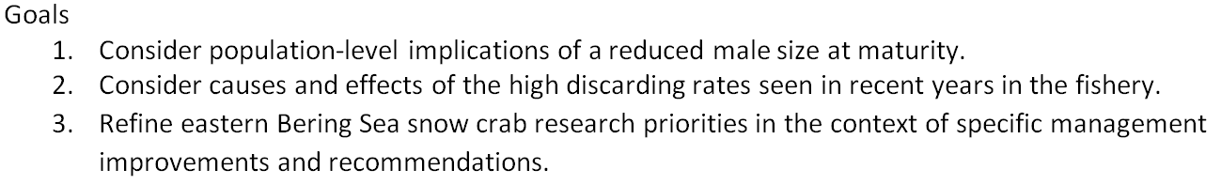
What we are trying to accomplish
Research
Management
Biology
Workshop #1
January
Workshop #2
tbd OCTOBER
Economic Implications
-- not part of workshop --
Reconsidering the focus of workshop 2

Slide 6
What’s next? Steering Committee Planning
Final workshop #1 materials including recommendations available soon, this will be intended to provide guidance on activity to prep for next steps
Steering Committee met last week and will meet on June 24-25
Current fishery information and upcoming survey data are key, some fishery data available soon, and survey data available late AUG-SEP
OCTOBER 2021 tentative plans for Workshop 2:
  Allows for stakeholder availability (crabbers are getting ready)
  NMFS survey is complete and crab researchers are more available
  CPT cycle and Council activity will be done or underway
  TAC setting may be complete
  Stay Tuned for More Info Soon !
  Please direct questions to Scott Goodman [sgoodman@nrccorp.com], Madison Heller-Shipley [mshipley@nrccorp.com]

Slide 7
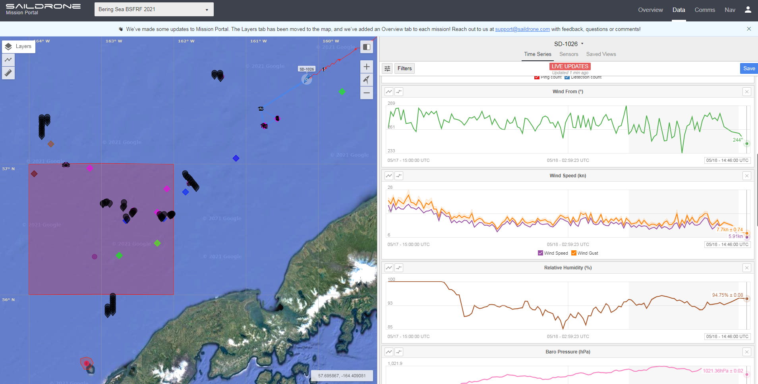
Current research updates
Movement/Tagging update – switching tag tech

Slide 8
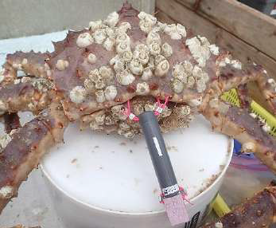
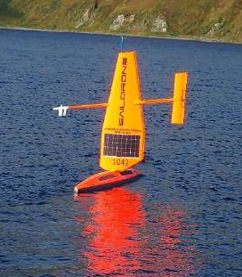
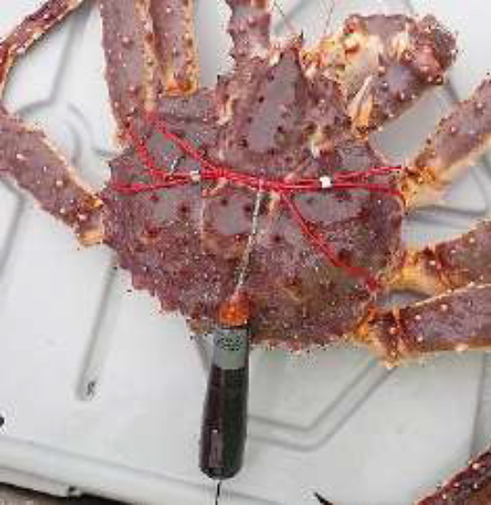
Current research updates
Movement/Tagging update – switching tag tech
Acoustic Tag
2019
2020
Saildrone
2019
2021
Satellite Tag
2020
2021
2022

Slide 9
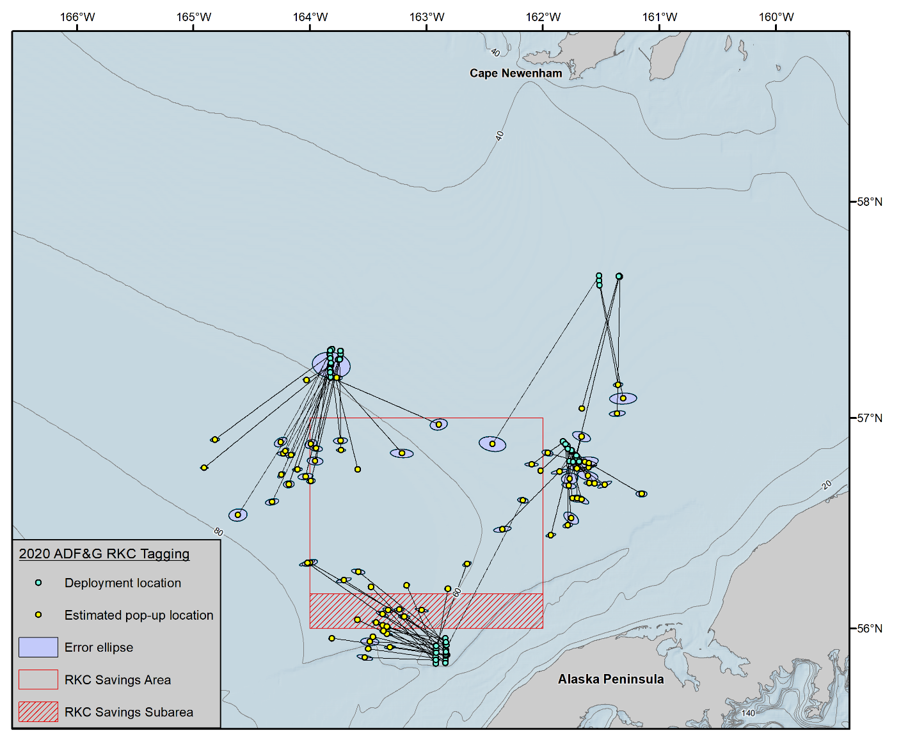
Current research updates
Movement/Tagging update – switching tag tech
Satellite Tag
2020
2021
2022
Figure 2: Movement vectors for legal male Bristol Bay red king crab between July and October, 2020. All crab were tagged with pop-up satellite tags (Wildlife Computers, MrPAT and MiniPAT), with crab end location likely occurring within the error ellipse.

Slide 10
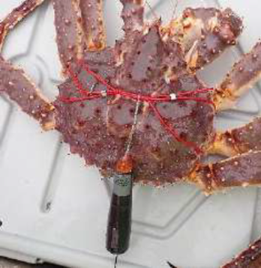
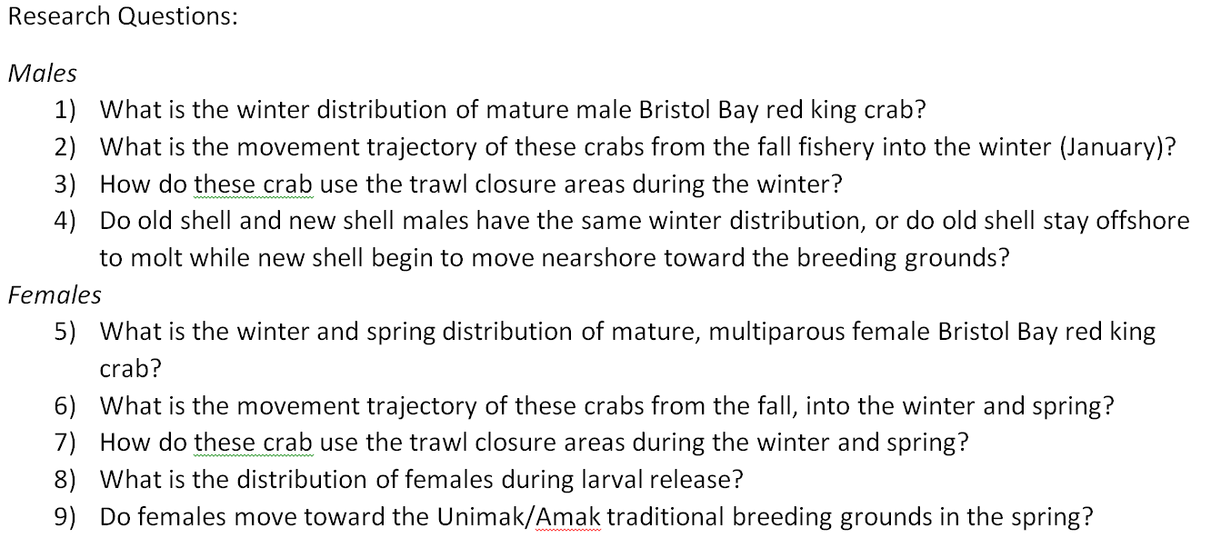
Current research updates
Movement/Tagging update – switching tag tech

Slide 11
Current research updates
Movement/Tagging update – switching tag tech
Large Research Project Focus:
ADFG $ 191 k
NOAA $ 164 k + Charter/Sampling
BSFRF $ 234 k
Total $ 590 k

Slide 12
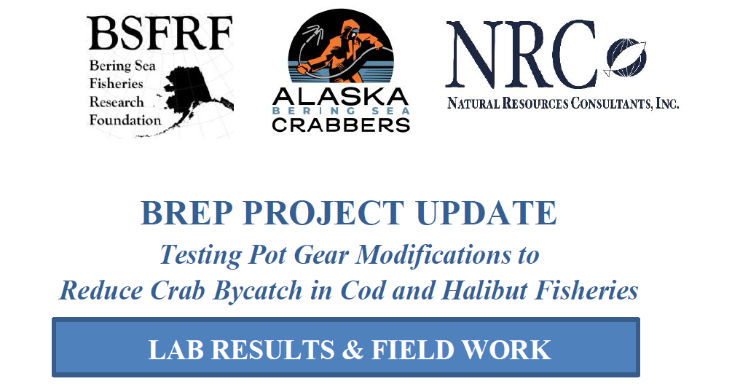
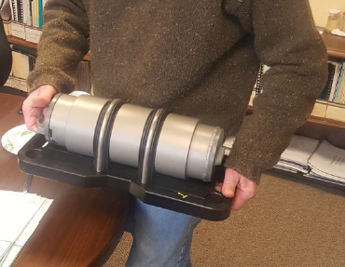
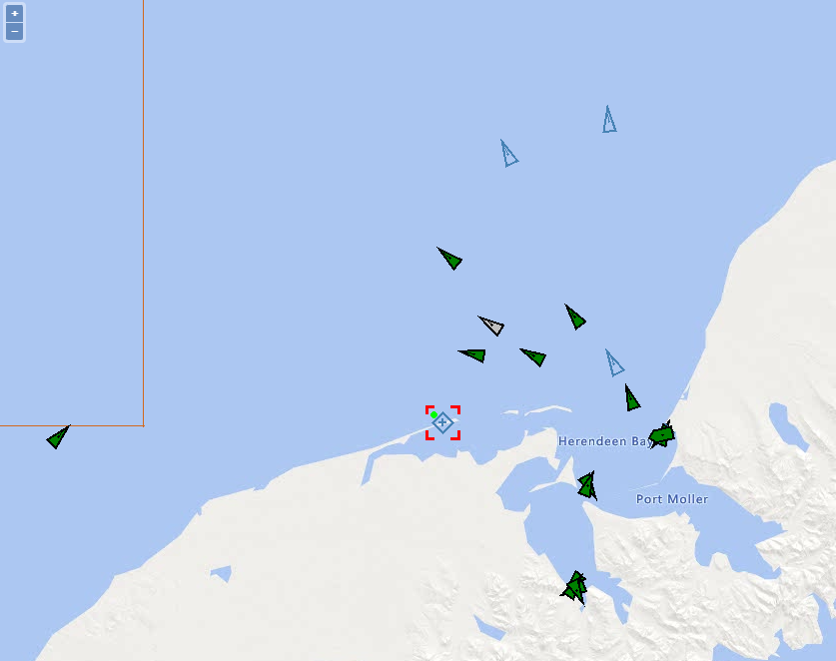
Current research updates

Slide 13
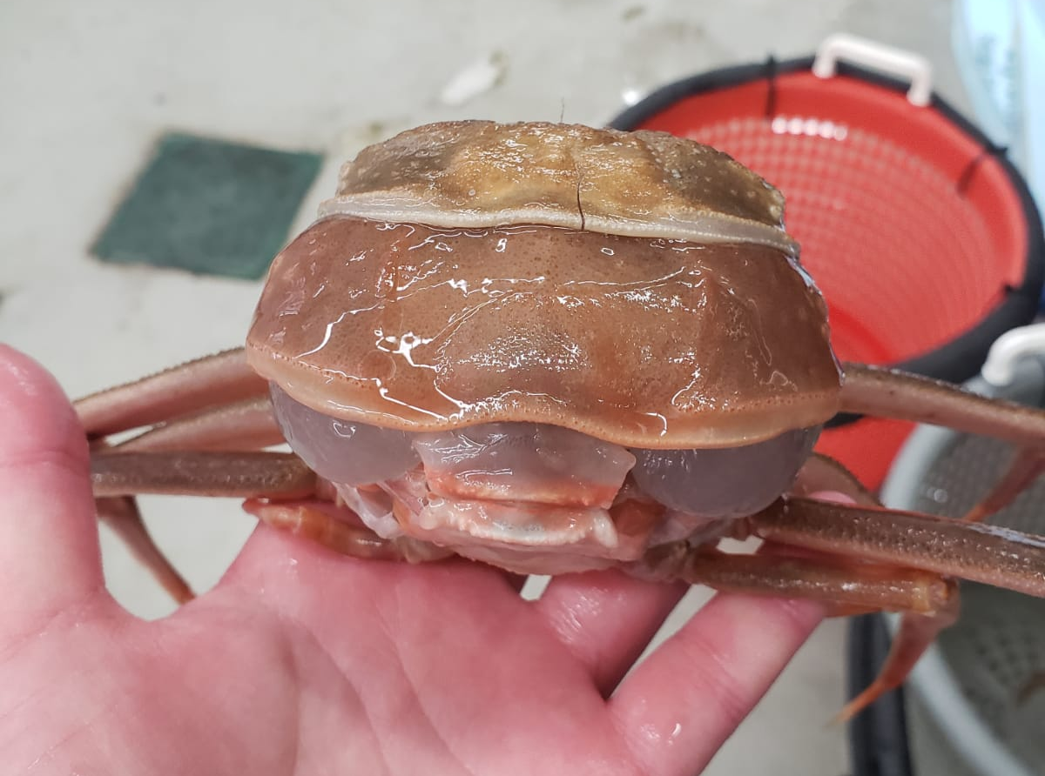
Current research updates
Growth data – samples and status
Touching base on;
BBRKC (Jie)
Snow Crab (Cody)
Tanner Crab (Buck)
Earlier update from NOAA Kodiak…
“(We) cleaned up the growth experiment today (30 days holding) and of the 184 male snow crab we held at the lab, we've got post-molt growth data on 170 males, and only 6 crab didn't molt of the 184. I haven't run the maturity cutline script yet but I'd guess at least a quarter of the molts were terminal.”

Slide 14
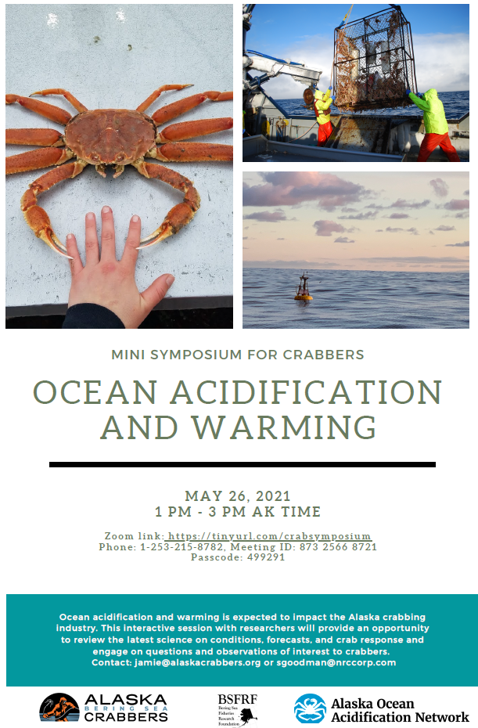
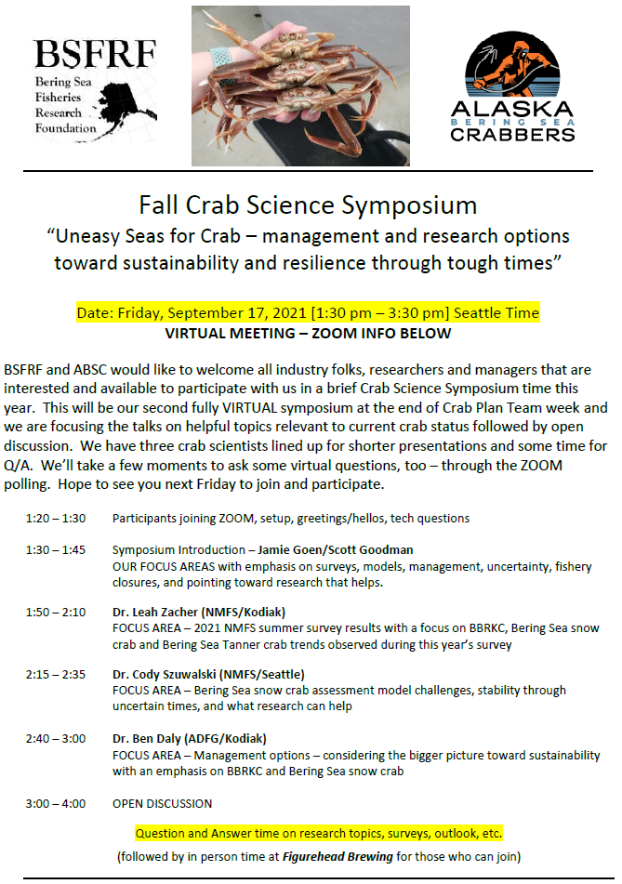
Current research updates
Opportunities for sharing

Slide 15
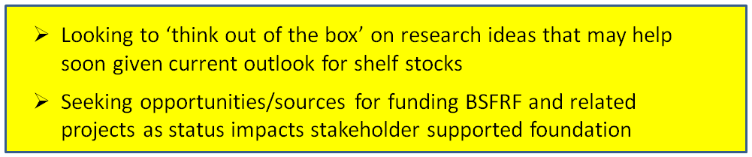
Current research updates
Post-Doc
Research/Support
Develop New
Co-op Partners
Pre-recruit
Surveys
Ocean Acifification
Research
Life History
Research
Trawl Selectivity
Research
Stock Assessment
Support
BSFRF Survey Data
Standardize - Share
Movement Research
Tagging & Monitoring
Crab Aging
Research
Growth Project
Sampling OPI/BRD
Snow Crab Cooperative
Workshop (JAN – OCT)
Discard - Handling
Mortality
Natural
Mortality
2021 Contingency Planning
Bycatch Research
BREP Projects

