Slide 1
Snow crab cont’d

Slide 4
21.1a: 20.1 + empirical availability
21.2 : 21.1a + mortality events + tighter priors on M and maturity
21.3 : 21.1a + mortality events + empirical selectivity
21.3b: 21.3 + ‘functional’ maturity

Slide 5
Model 21.1a
Model 21.2
Model 21.3
 | Pro | Con | Pro | Con | Pro | Con
Fits to survey MMB |  | Does not fit last years | Fits terminal years |  | Fits terminal years
Estimates of >101mm males |  | >triple observed
Probability of terminally molting |  | Does not reproduce observed |  | Does not reproduce observed | Closer to observed
Survey selectivity |  | Does not reproduce observed |  | Does not reproduce observed | Closer to observed
Reference points | Target exploitation rates <100% |  | Target exploitation rates <100% |  |  | Target exploitation rates ~100%
Survey size comp fit |  |  |  |  | ~90 likelihood units better
Retrospective patterns |  | Double the other models

Slide 6
If the model is not allowed to ‘reach’ to the 2018 2019 data points and decline via mortality event, it will ‘split the difference’ between 2021 and 2018-2019. This model misspecification will pull up the estimate of the final year of MMB, which would result in an overly optimistic estimate of exploitable biomass.

Slide 8
Model 21.1a
Model 21.2
Model 21.3
 | Pro | Con | Pro | Con | Pro | Con
Fits to survey MMB |  | Does not fit last years | Fits terminal years |  | Fits terminal years
Estimates of >101mm males |  | >triple observed
Probability of terminally molting |  | Does not reproduce observed |  | Does not reproduce observed | Closer to observed
Survey selectivity |  | Does not reproduce observed |  | Does not reproduce observed | Closer to observed
Reference points | Target exploitation rates <100% |  | Target exploitation rates <100% |  |  | Target exploitation rates ~100%
Survey size comp fit |  |  |  |  | ~90 likelihood units better
Retrospective patterns |  | Double the other models

Slide 11
Model 21.1a
Model 21.2
Model 21.3
 | Pro | Con | Pro | Con | Pro | Con
Fits to survey MMB |  | Does not fit last years | Fits terminal years |  | Fits terminal years
Estimates of >101mm males |  | >triple observed
Probability of terminally molting |  | Does not reproduce observed |  | Does not reproduce observed | Closer to observed
Survey selectivity |  | Does not reproduce observed |  | Does not reproduce observed | Closer to observed
Reference points | Target exploitation rates <100% |  | Target exploitation rates <100% |  |  | Target exploitation rates ~100%
Survey size comp fit |  |  |  |  | ~90 likelihood units better
Retrospective patterns |  | Double the other models

Slide 12
Model | MMB | B35 | F35 | FOFL | OFL | M | avg_rec | Status
21.1a | 69.93 | 106.87 | 1.79 | 1.4 | 35.7 | 0.29 | 92.51 | 0.65
21.2 | 26.74 | 153.42 | 1.43 | 0.37 | 7.5 | 0.27 | 106.14 | 0.17
21.3 | 41.82 | 173.36 | 4.76 | 1.15 | 17.03 | 0.3 | 146.83 | 0.24
21.3b | 32.43 | 105.01 | 0.65 | 0.15 | 3.14 | 0.3 | 146.83 | 0.3

Slide 13
Model 21.1a
Model 21.2
Model 21.3
 | Pro | Con | Pro | Con | Pro | Con
Fits to survey MMB |  | Does not fit last years | Fits terminal years |  | Fits terminal years
Estimates of >101mm males |  | >triple observed
Probability of terminally molting |  | Does not reproduce observed |  | Does not reproduce observed | Closer to observed
Survey selectivity |  | Does not reproduce observed |  | Does not reproduce observed | Closer to observed
Reference points | Target exploitation rates <100% |  | Target exploitation rates <100% |  |  | Target exploitation rates ~100%
Survey size comp fit |  |  |  |  | ~90 likelihood units better
Retrospective patterns |  | Double the other models

Slide 14
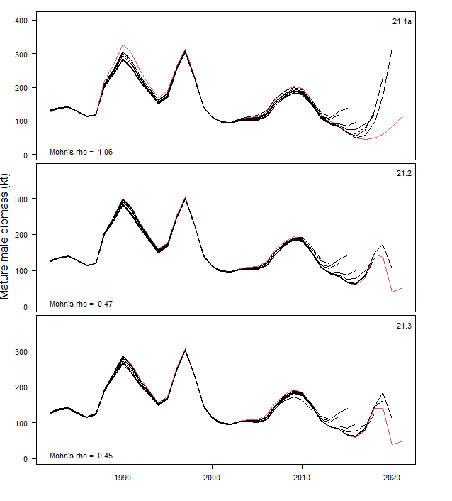
Mature male biomass at the time of survey
Model | Mohn’s rho
21.1a | 1.06
21.2 | 0.47
21.3 | 0.45

Slide 15
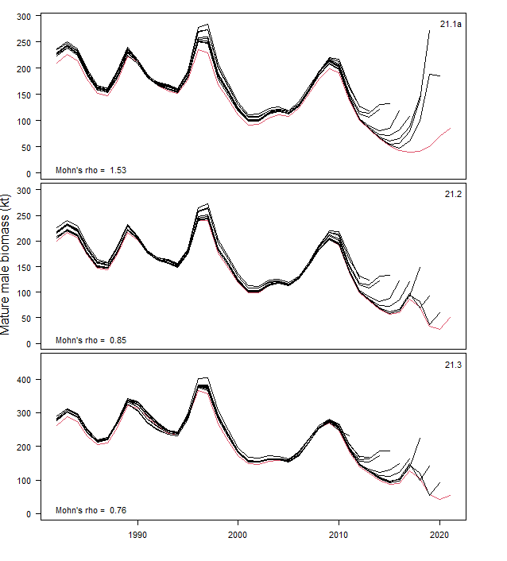
Mature male biomass at the time of mating
Model | Mohn’s rho
21.1a | 1.53
21.2 | 0.85
21.3 | 0.76

Slide 16
Reasoning for mortality event
Missing crab were not in the NBS
Survey worked as expected for Tanner crab
Slope area is tiny compared to the area occupied by the animals on the shelf, particularly in the north
Cod consumption was at all time highs in past several year
Visually identified infections of bitter crab were at all time highs recently
Bitter crab infections known to be more severe than visually identified based on focused PCR work during 2014-2017
Bottom temperatures very high in 2018 and 2019—no cold pool

Slide 17
Model 21.1a
Model 21.2
Model 21.3
 | Pro | Con | Pro | Con | Pro | Con
Fits to survey MMB |  | Does not fit last years | Fits terminal years |  | Fits terminal years
Estimates of >101mm males |  | >triple observed
Probability of terminally molting |  | Does not reproduce observed |  | Does not reproduce observed | Closer to observed
Survey selectivity |  | Does not reproduce observed |  | Does not reproduce observed | Closer to observed
Reference points | Target exploitation rates <100% |  | Target exploitation rates <100% |  |  | Target exploitation rates ~100%
Survey size comp fit |  |  |  |  | ~90 likelihood units better
Retrospective patterns |  | Double the other models

Slide 18
Model | MMB | B35 | F35 | FOFL | OFL | M | avg_rec | Status
21.1a | 69.93 | 106.87 | 1.79 | 1.4 | 35.7 | 0.29 | 92.51 | 0.65
21.2 | 26.74 | 153.42 | 1.43 | 0.37 | 7.5 | 0.27 | 106.14 | 0.17
21.3 | 41.82 | 173.36 | 4.76 | 1.15 | 17.03 | 0.3 | 146.83 | 0.24
21.3b | 32.43 | 105.01 | 0.65 | 0.15 | 3.14 | 0.3 | 146.83 | 0.3

Slide 19
Immature males survey
Mature males survey

Slide 23
CPT/SSC requests
Status quo accepted model
  NOT CONVERGED
GMACS implementation
  Needed an accepted model that works before thinking about GMACS.
Status quo with reweighted size composition data
  MI and Francis were recommended and implemented, but created large changes in the assessment output and precipitated the exploration of empirical selectivity.
Time-varying fishery selectivity
  This is actually in the final models. I coded split the retention selectivity into pre and post rationalization for the original suite of models, but did not turn off the estimation of the extra parameters and was then distracted by the .
  This is reflected in the decrease in the retained size composition likelihood component from 20.1 to 21.1 (and others).
  The upshot was a shift the retention selectivity to the right slightly—part of the increase in F35% from 20.1 to 21.1.

Slide 24
Empirical availability
// surv sel 2009 study area
sel_srvind(2,j)= srvind_q/(1+mfexp(-selsmo09ind(j)));
sel_srvind(1,j)= srvind_q_f* 1./(1.+mfexp(-1.*log(19.)*(length_bins(j)-srvind_sel50_f)/(srvind_sel95_f-srvind_sel50_f)));
sel_srvnmfs(1,j)= sel_srvind(1,j)*sel_srv3(1,j);
sel_srvnmfs(2,j)= sel_srvind(2,j)*sel_srv3(2,j);
// surv sel 2010 study area
sel_srv10ind(2,j)= srv10ind_q*1/(1+mfexp(-selsmo10ind(j)));
sel_srv10ind(1,j)= srv10ind_q_f* 1./(1.+mfexp(-1.*log(19.)*(length_bins(j)-srv10ind_sel50_f)/(srv10ind_sel95_f-srv10ind_sel50_f)));
sel_srv10nmfs(1,j)=sel_srv10ind(1,j)*sel_srv3(1,j);
sel_srv10nmfs(2,j)=sel_srv10ind(2,j)*sel_srv3(2,j);

Slide 25
Mortality events
############################
## time-varying natural mortality specs
#############################
# use_extra_m_imm : extra immature mortality added?
1
# extra_m_phase_imm : phase
5
# extra_m_len_imm_n : number of years of extra imm
2
# extra_m_yr_imm : what years have extra mortality?
2018 2019
# use_extra_m_mat : extra mature mortality added?
1
# extra_m_phase_mat : phase
5
# extra_m_len_mat_n : number of years of extra mature m
2
# extra_m_yr_mat : what years have extra mortality?
2018 2019
Transformed M to an array with dimensions for sex, maturity, and year
Specify years for mortality (2018, 2019)
All classes of M allow additional mortality in those year
  Immature
  Mature female
  Mature male
Estimated as bounded numbers between 0 and 4

