Slide 1
Pribilof Island red king crab
Cody Szuwalski
Crab Plan Team meeting
April 30, 2019

Slide 2
Overview
Biennial cycle
No directed fishery since 1998
Low mature male biomass in 2018
Potentially a new year class in 2018
Running average, random effects model, integrated model

Slide 3
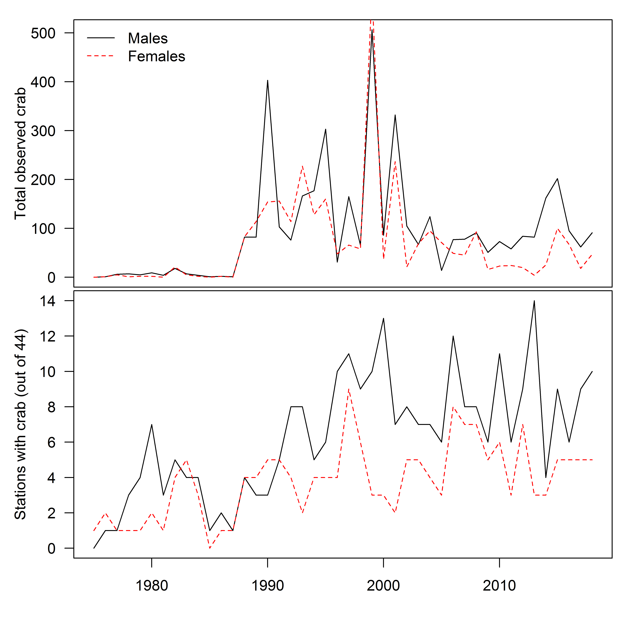

Slide 4
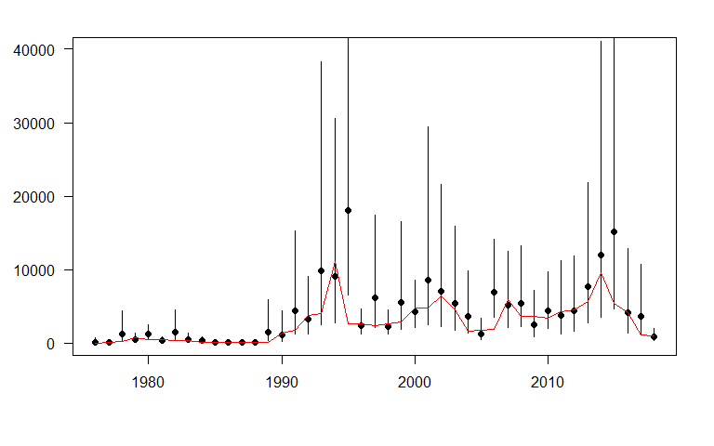
Running average

Slide 5
Random effects model
Previously there were several iterations of the model done that placed priors on the estimated process error because of convergence issues.
Error in the input
Applied original methods, model converged

Slide 6
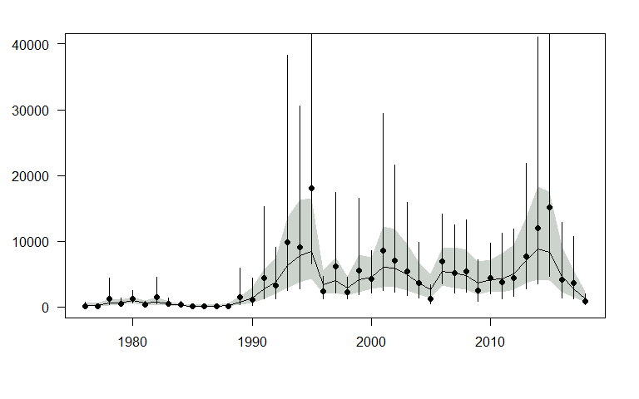

Slide 7
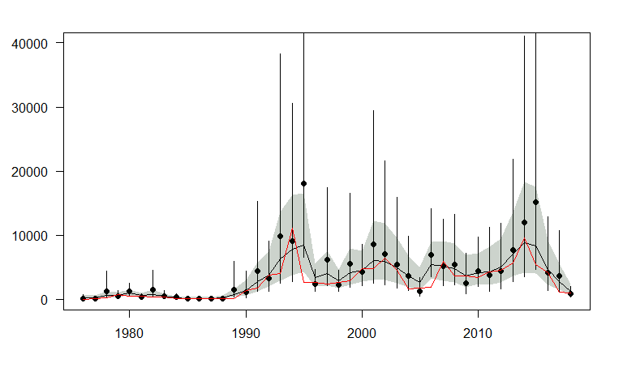

Slide 8
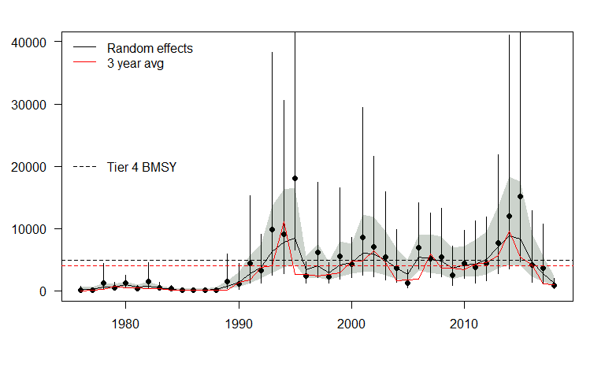
BMSY = average of MMB from 1991-present

Slide 10
Integrated assessment
Similar in structure to the snow crab assessment
5mm length bins (37.5-207.5)
Males only
Survey catchability at 1
M at 0.18

Slide 11
Included in assessment:
Source | Years
Survey index of abundance | 1975-2018
Survey length frequencies | 1975-2018
Catch in directed fishery | 1993-1998
Bycatch in groundfish trawl fishery | 1991-2017
Excluded from assessment:
Source | Years
Bycatch in crab pot fisheries | 1998-2017
Bycatch in fixed gear groundfish fishery | 1991-2017

Slide 13
Fixed
q = 1
M = 0.18
Fishery selectivity = 138mm
Survey
3/12 M
Directed fishery
Trawl bycatch
5/12 M
Molting
Growth
Mating
Recruitment
4/12 M

Slide 14
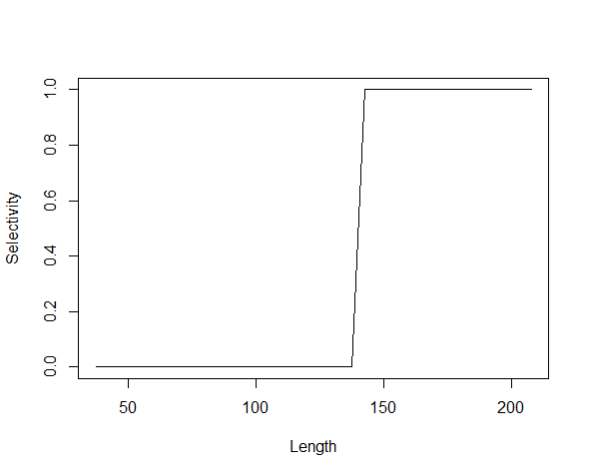
Survey
Directed fishery selectivity
(assumed)
3/12 M
Directed fishery
Trawl bycatch
5/12 M
Molting
Growth
Mating
Recruitment
4/12 M

Slide 15
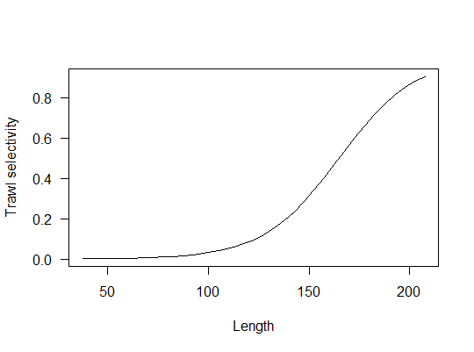
Non-pelagic trawl selectivity
(fixed to BBRKC estimates)
Survey
3/12 M
Directed fishery
Trawl bycatch
5/12 M
Molting
Growth
Mating
Recruitment
4/12 M

Slide 16
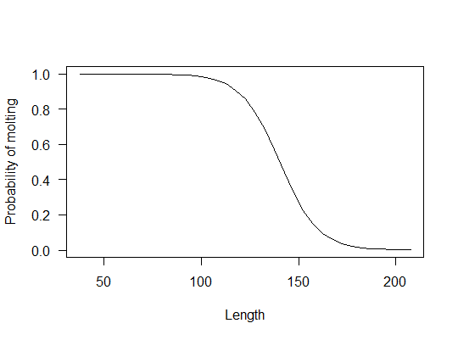
Molting probability (males)
[fixed]
Survey
3/12 M
Directed fishery
Trawl bycatch
5/12 M
Molting
Growth
Mating
Recruitment
4/12 M
Powell, G.C. 1967. Growth of king crabs in the vicinity of Kodiak Island, Alaska. Informational Leaflet 92, Alaska Department of Fish and Game, 58 p.

Slide 17
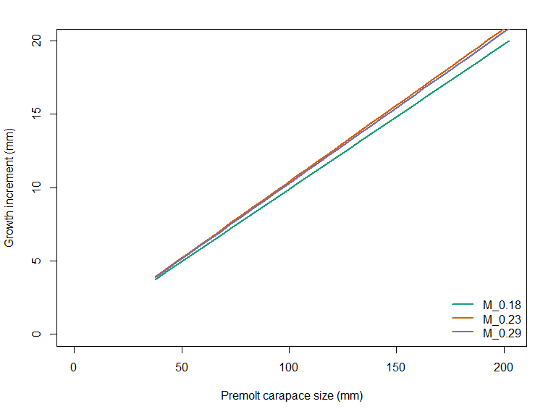
Male growth
(estimated)
Survey
3/12 M
Directed fishery
Trawl bycatch
5/12 M
Molting
Growth
Mating
Recruitment
4/12 M
reference
Notes:
Overlay probability of molting on here.

Slide 18
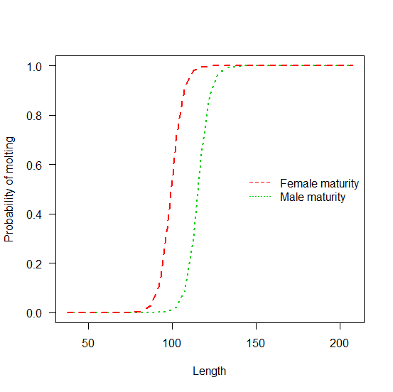
Maturity
(fixed)
Survey
3/12 M
Directed fishery
Trawl bycatch
5/12 M
Molting
Growth
Mating
Recruitment
4/12 M
reference

Slide 19
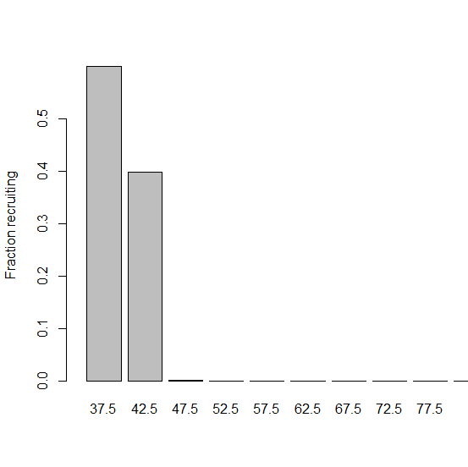
Fraction recruiting
(estimated)
Survey
3/12 M
Directed fishery
Trawl bycatch
5/12 M
Molting
Growth
Mating
Recruitment
4/12 M
Notes:
CHANGE THIS

Slide 20
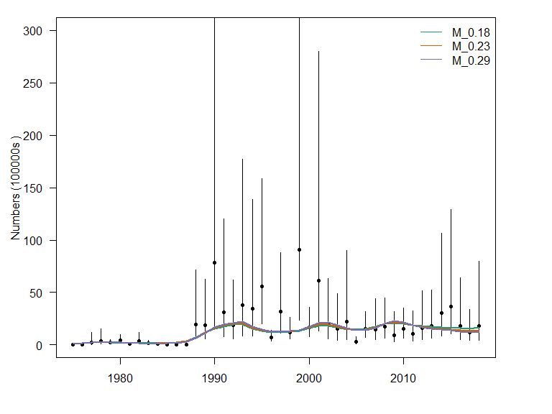

Slide 22
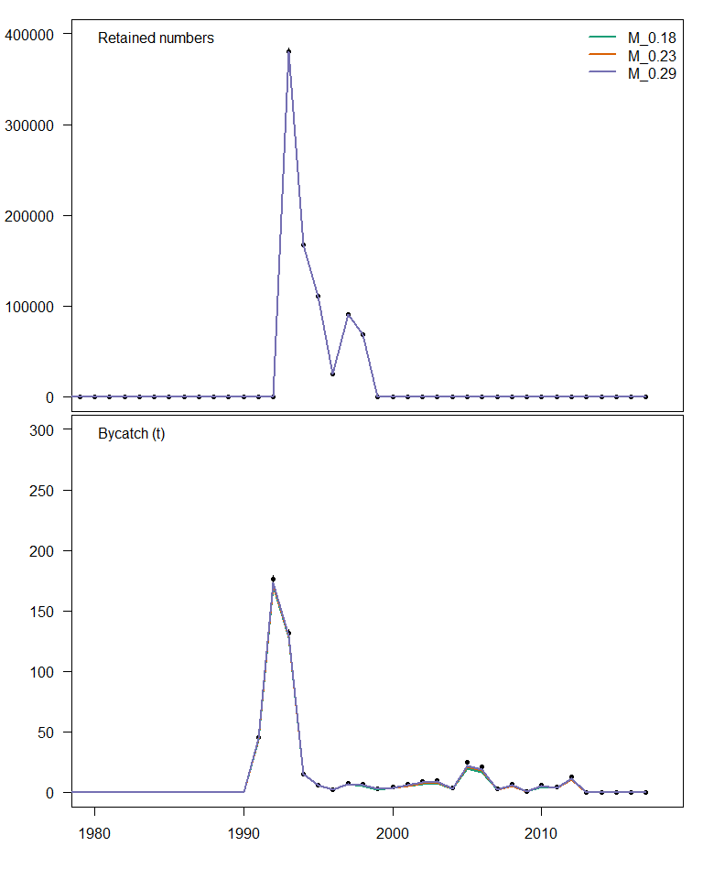

Slide 23
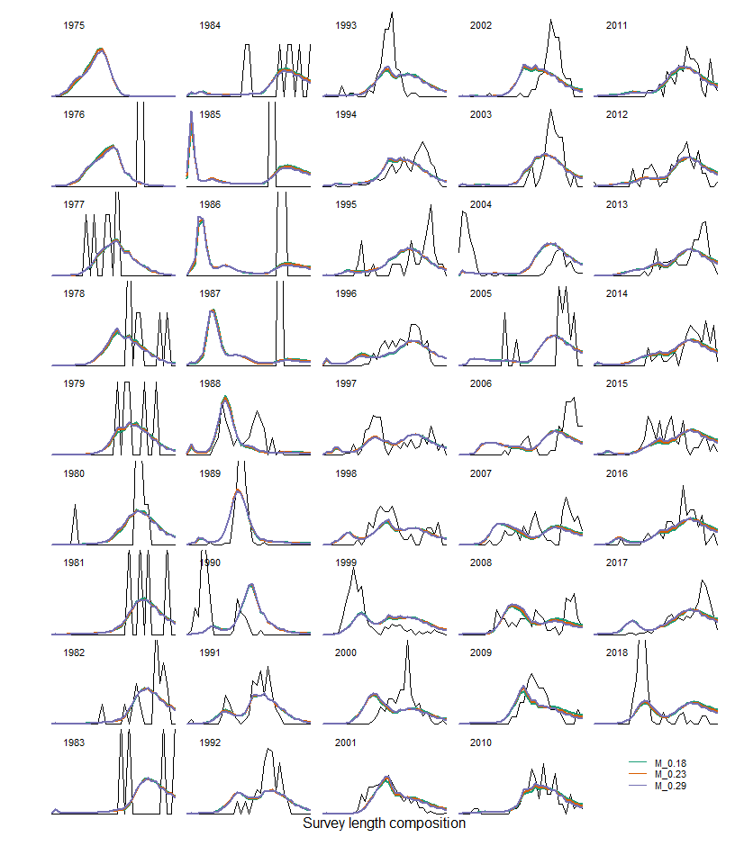

Slide 24
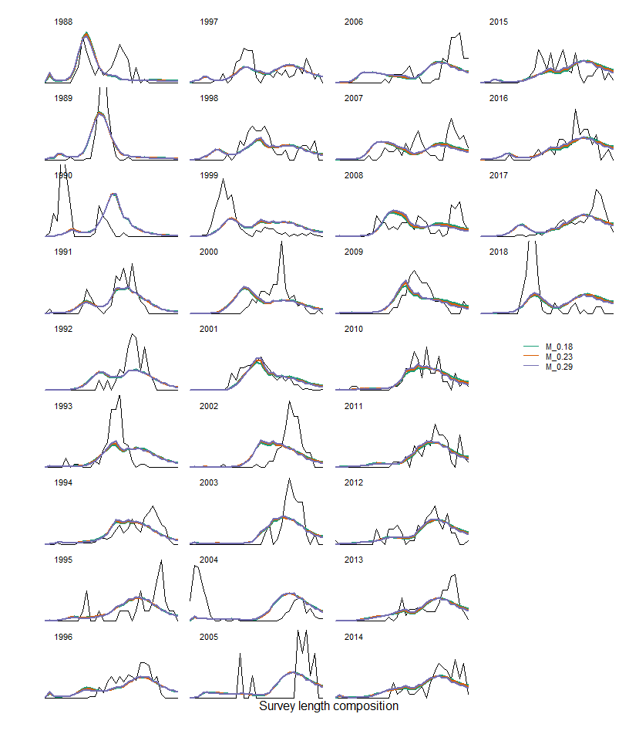

Slide 25
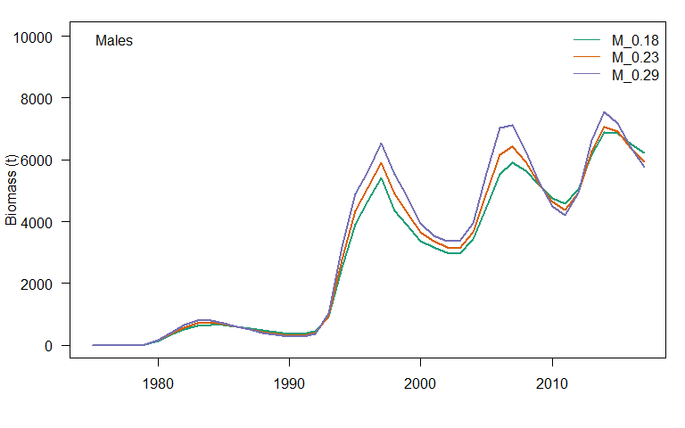

Slide 26
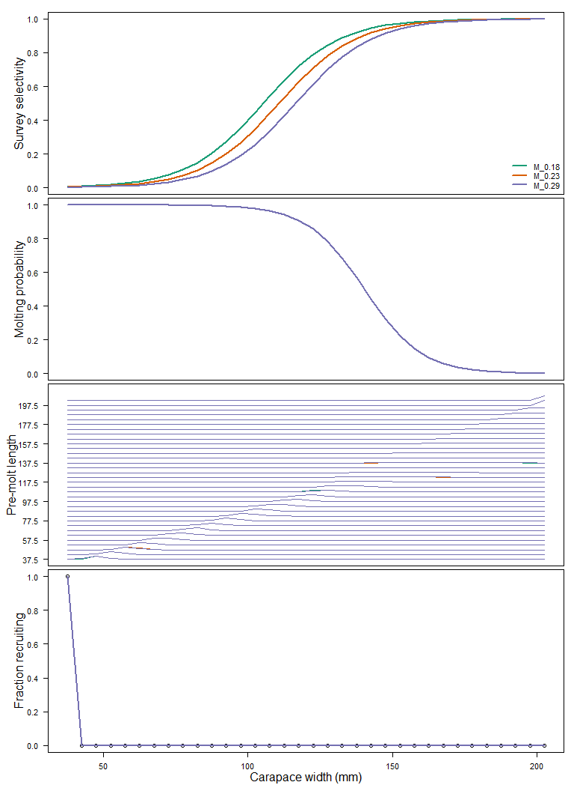
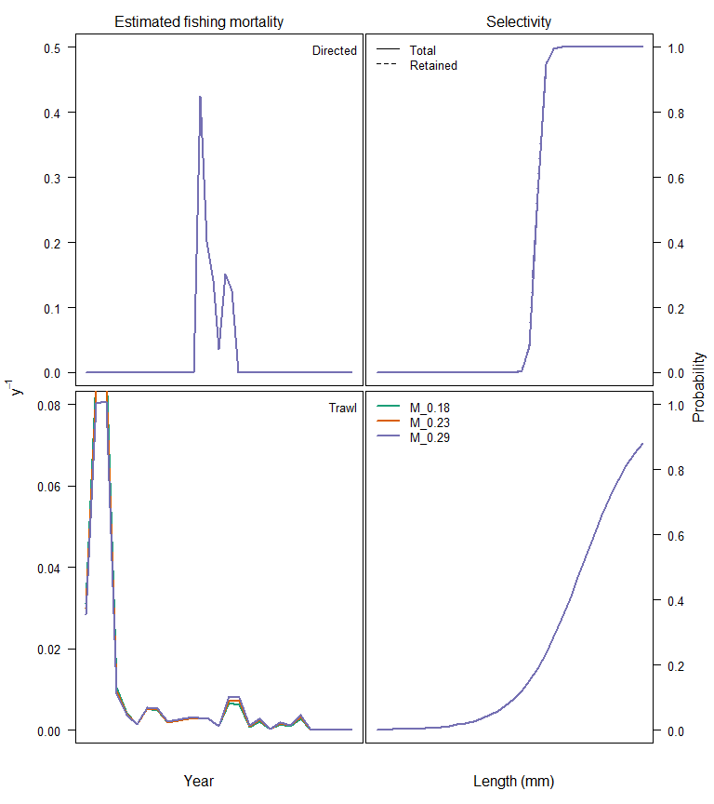

Slide 27
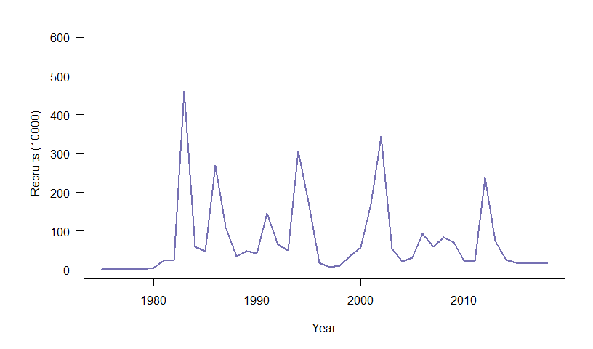

Slide 28
Why aren’t the survey data fit well?
4 big cohorts (length composition)
Constant, relatively low natural mortality
Nothing to do with the early period (1970s-1980s)
Must make the cohorts ‘fit together’

Slide 29
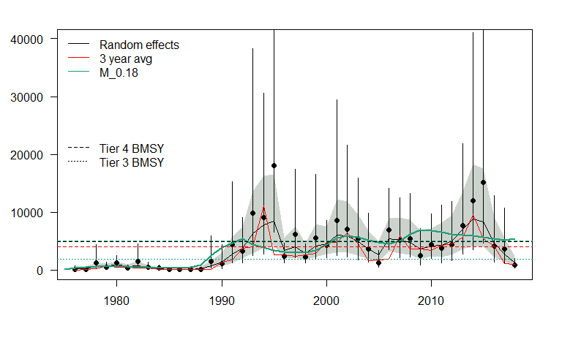

Slide 31
Integrated assessment
Random effects
Signal in length composition data is stronger than survey numbers
Data overdispersed, CVs are poisson derived, should be larger than this
Length comp gives the ‘dynamics’, survey gives the scale
Simple, few assumptions
Fits the survey biomass data better

Slide 32
Tier 3 vs. Tier 4
BMSY for Tier 4 are more of an ‘unfished’ biomass for PIRKC
Assuming FMSY = M ignores information about selectivity (which protects some of the mature population)
Tier 3 rules require that assumptions are made about population processes

