Slide 1

Alaska Regional Action Plan 2.0 for Eastern Bering Sea Climate Science
Anne Hollowed, Lewis Barnett*, Thomas Gelatt*, Alan Haynie*, Kalei Shotwell*, Elizabeth Siddon*, Robyn Angliss, Erin Fedewa, Kirstin Holsman, Janet Duffy-Anderson, Sandy Parker-Stetter, Taina Honkalehto, Stan Kotwicki, Fletcher Sewall, Phyllis Stabeno, Ellen Ward
Subject matter sub-lead
Management Oriented Synthesis (Shotwell)
Socioeconomics (Haynie)
Process Studies (Siddon)
Marine Mammals (Gelatt)
Monitoring (Barnett)

Slide 2
NOAA Fisheries Climate Science Strategy https://www.fisheries.noaa.gov/national/climate/noaa-fisheries-climate-science-strategy
1. Reference Points
2. Robust Management Strategies
Management Oriented Synthesis
Interdependent
3. Adaptive Management Processes
Socioeconomics
4. Robust Projections of Future Conditions
5. Information on Mechanisms of Change
Process Studies
6. Status, Trends and Early Warnings
Monitoring & Marine Mammals
7. Science Infrastructure to Deliver Actionable Information
Notes:
The 2015 NOAA Fisheries Climate Science Strategy identified the key information needed to help fisheries managers prepare for and respond to these changing climate and ocean conditions.
The Strategy identifies 7 critical actions TO ADDRESS THE 4 CORE QUESTIONS FROM FISHERIES MANAGERS AND OTHER DECISION MAKERS
WHATS CHANGING?
WHY IS IT CHANGING?
WHAT WILL FUTURE CONDITIONS BE?
HOW TO RESPOND?
Each level is interdependent on the others
Message – need the entire science enterprise to fulfill management information needs
Objective 1: Identify appropriate, climate-informed reference points.
Objective 2: Identify robust management strategies in a changing climate.
Objective 3: Design adaptive decision processes that incorporate and respond to changing climate conditions.
Objective 4: Identify likely future states of LMRs and resource use.
Objective 5: Identify mechanisms of climate effects on LMRs and LMR-dependent communities.
Objective 6: Track trends and provide early warnings of change.
Objective 7: Strengthen the science infrastructure needed to fulfill NOAA Fisheries mandates with changing climate conditions.

Slide 3
Writing Team Project Selection Process
Sub-leads discuss within subject matter experts
Sub-leads report back to writing team and develop text for appendix
Key Action Synthesis based on three broader themes:
  Invest in Technology
  Infrastructure
  Pathways to management including communication
Full group discussion and review of draft

Slide 4
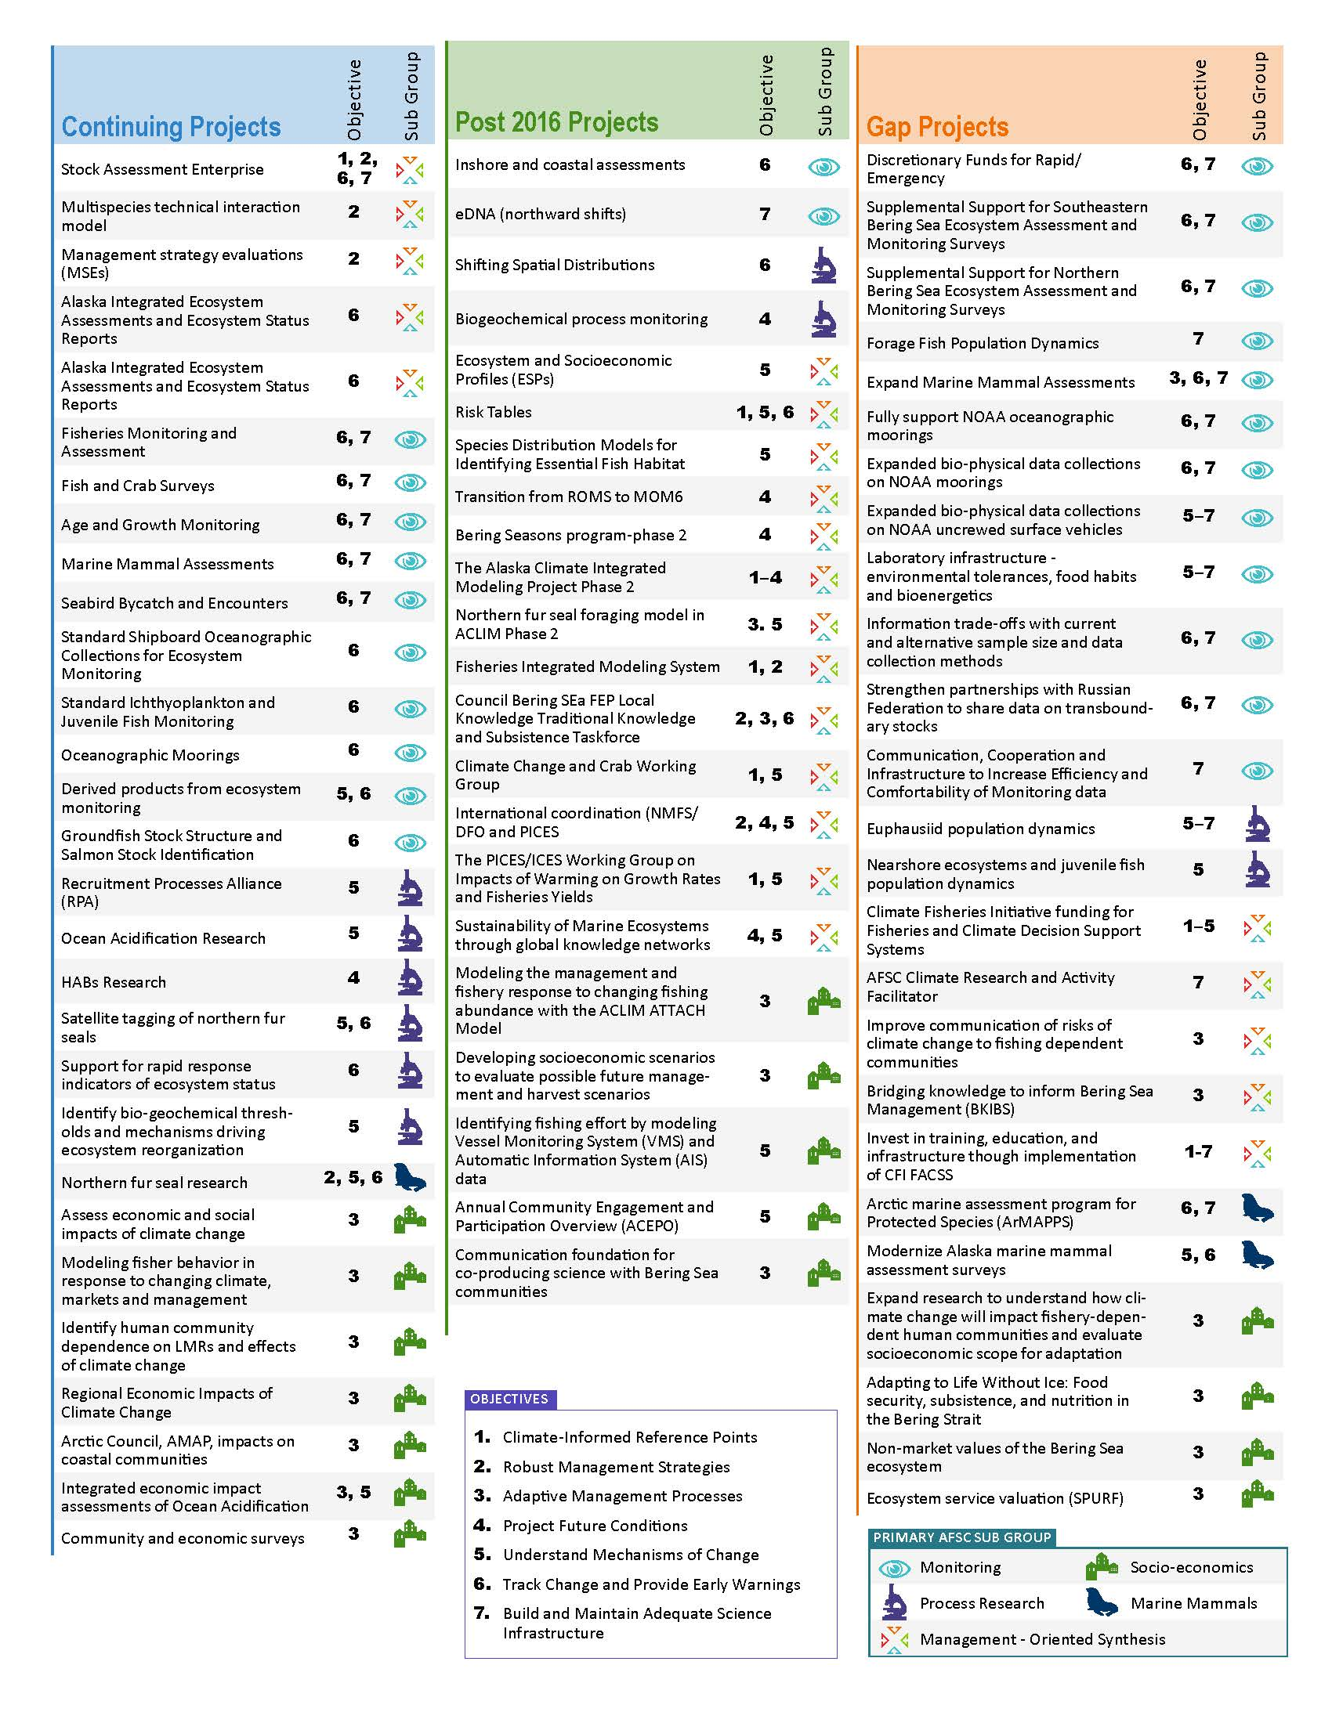
9
 | Continuing | Post-2016 | Gap
Monitoring | 10 | 2 | 12
Process Studies | 6 | 2 | 2
Management Oriented Synthesis | 4 | 14 | 5
Marine Mammals | 1 |  | 2
Socioeconomics | 7 | 5 | 4
Total | 28 | 23 | 25

Slide 5
Emerging Opportunities
NOAA’s Climate Fisheries Initiative (CFI): In response to clear evidence for the profound role of climate on fish and fisheries in the United States, NOAA launched the Climate Fisheries Initiative (CFI). The CFI enlists all NOAA line offices to provide Fisheries and Climate decision Support Systems (FACSS) in at least five US Large Marine Ecosystems (LMEs). The CFI provides the critical infrastructure to establish a permanent climate change research element to the science portfolio of NOAA.
FY22 NOAA Fisheries Survey Infrastructure: In recognition of the growing need for ongoing and expanded ecosystem linked sampling and analysis, NMFS requested a budget increase in 2022 for fisheries survey infrastructure. This increase in infrastructure funding will ensure regions like the EBS continue to be monitored and assessed into the future.

Slide 6
Emerging Opportunities
Expansion of Moored Observatories to the Northern Bering Sea. PMEL (EcoFOCI) has maintained four long-term biophysical moorings in the Bering Sea: M2 (26 years); M4 (23 years); M5 (17 years); and M8 (17 years). These moorings will continue to be maintained. In addition, a fifth site (M14) has been established north east of St. Lawrence Island. M2 and M8 have been upgraded to include cutting edge technology (Technology Box).
OAR eDNA Moorings and Shipboard Measurements (2022-2023). PMEL has submitted a funding request to OAR to continue eDNA research at the lab. The overarching goal for this proposal is to quantify changes in the Arctic (Bering and Chukchi seas) ecosystems using both moored and shipboard measurements of eDNA.

Slide 7



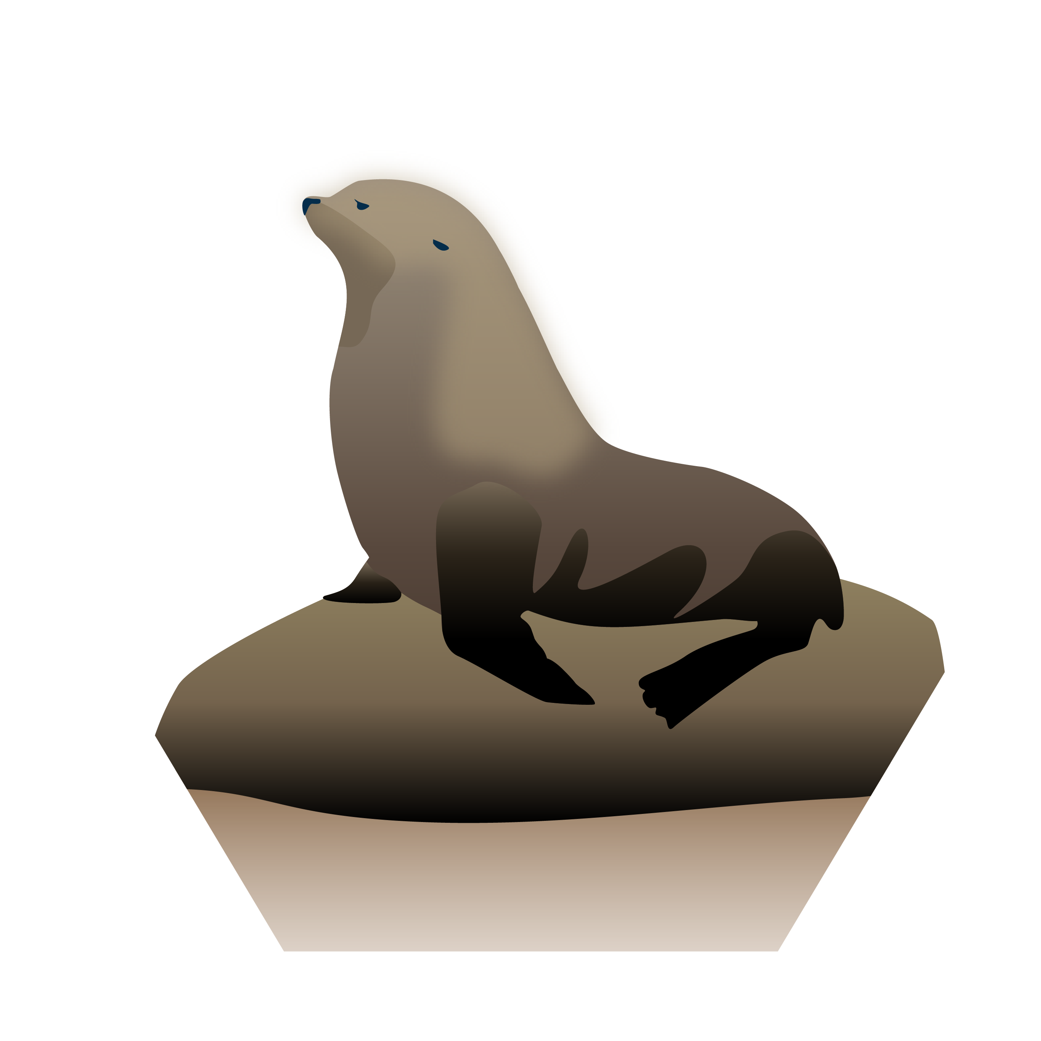


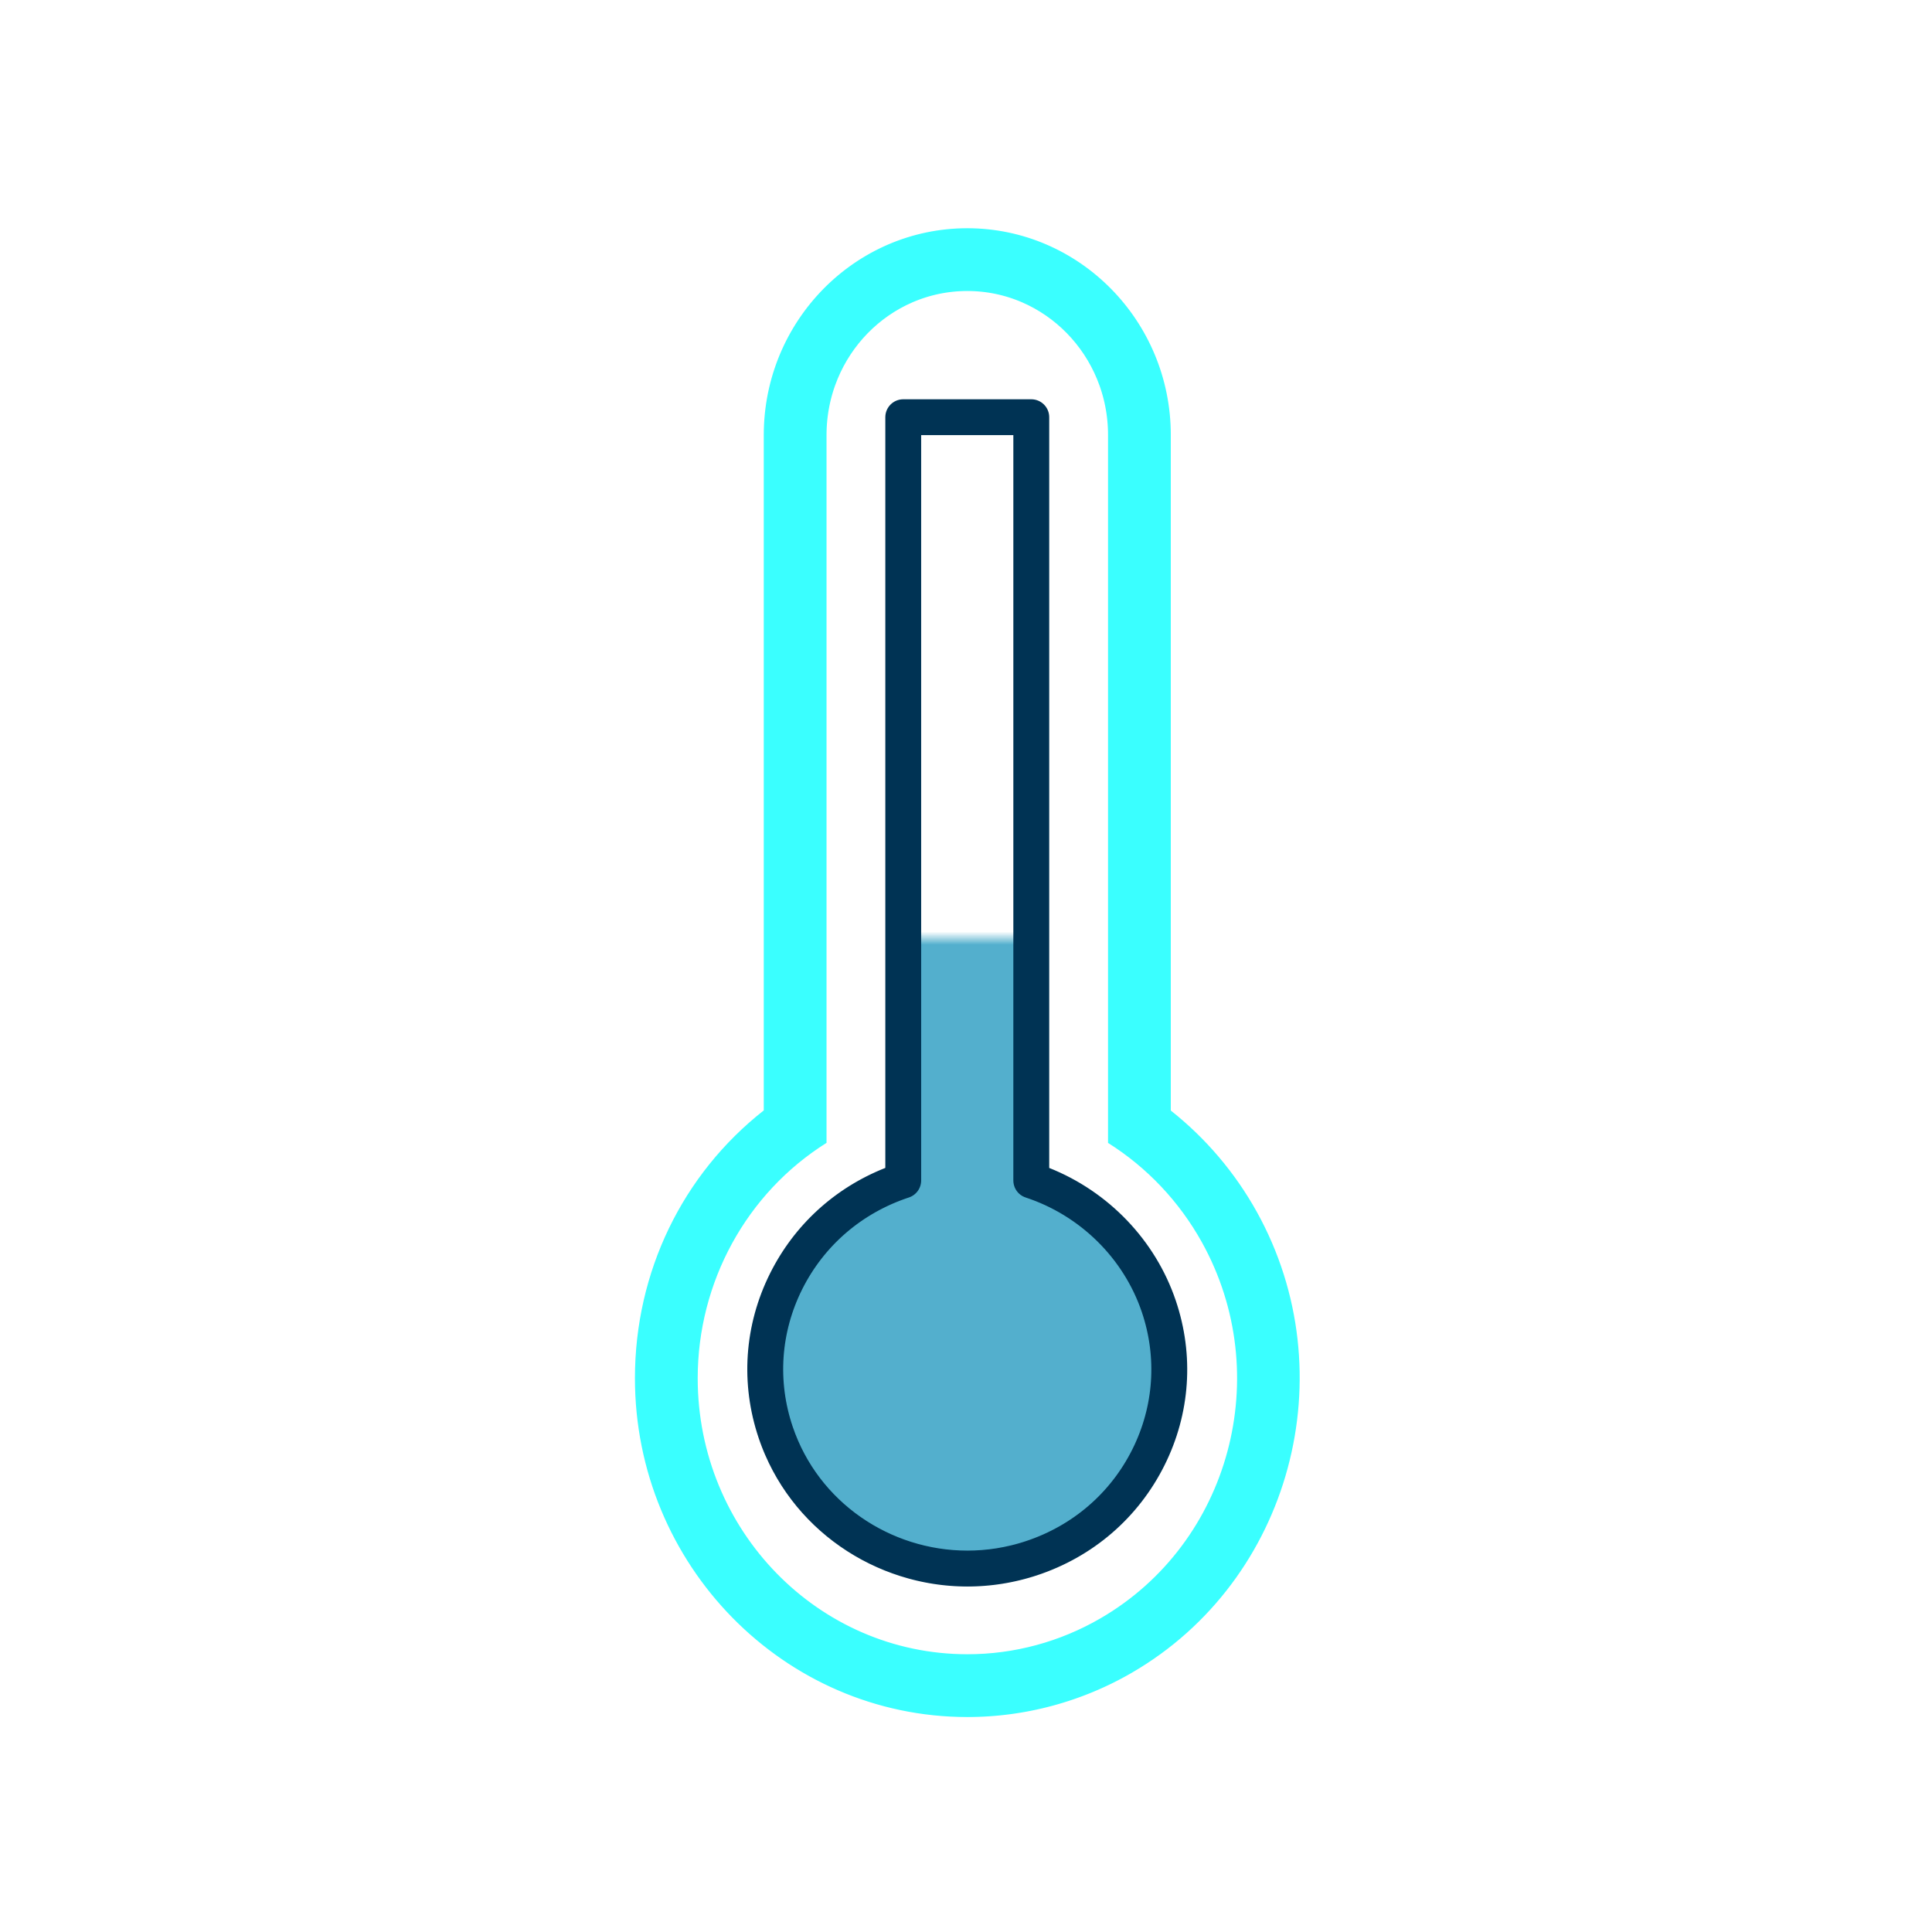



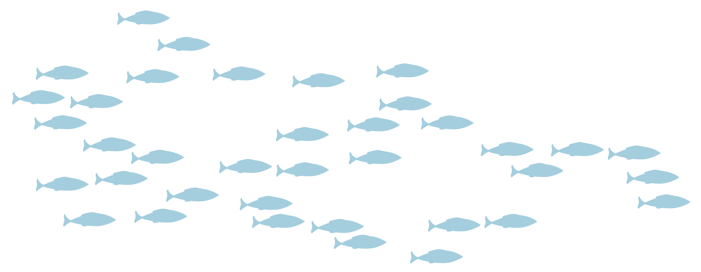
).
Expansion of Moored Observatories to the Northern Bering Sea.
OAR eDNA Moorings and Enhanced Moored and Shipboard Measurements (2022-2023)

Slide 8
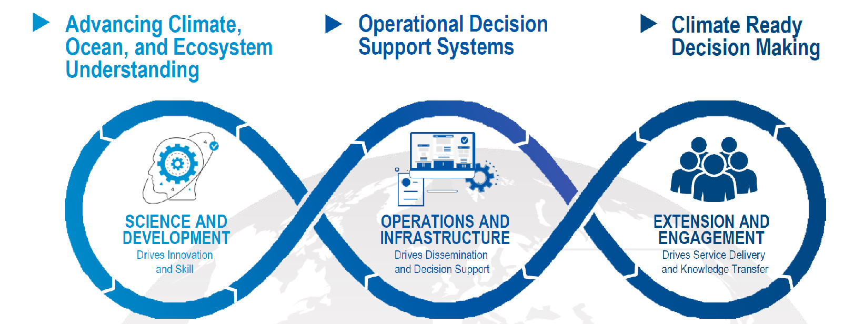
NOAA’s Climate and Fisheries Initiative
Challenge: Climate change is impacting the nation’s valuable marine and Great Lakes ecosystems, fisheries, and the communities that depend on them. These impacts are creating urgent questions that demand climate-informed answers.
Response: NOAA’s Climate Fisheries Initiative is a cross-NOAA effort which, when combined with existing programs, will enable the sustained operational ocean prediction and decision support system needed to reduce negative impacts and increase resilience of ecosystems and coastal communities
CFI Draft Implementation Approach
CFI Webpage
Notes:
Big picture challenge and response based on previous CFI documents - note that the response emphasizes “when combined with existing programs” to hit the inclusivity notes that Rick, Kirsten and others have raised. I’ve tried to do this throughout.
The intent of including the Moibus strip isn’t to go through the details, but to emphasize that the CFI proposes a comprehensive, integrated plan that extends from the science through to climate-informed decisions and enables positive feedbacks across steps.

Slide 9
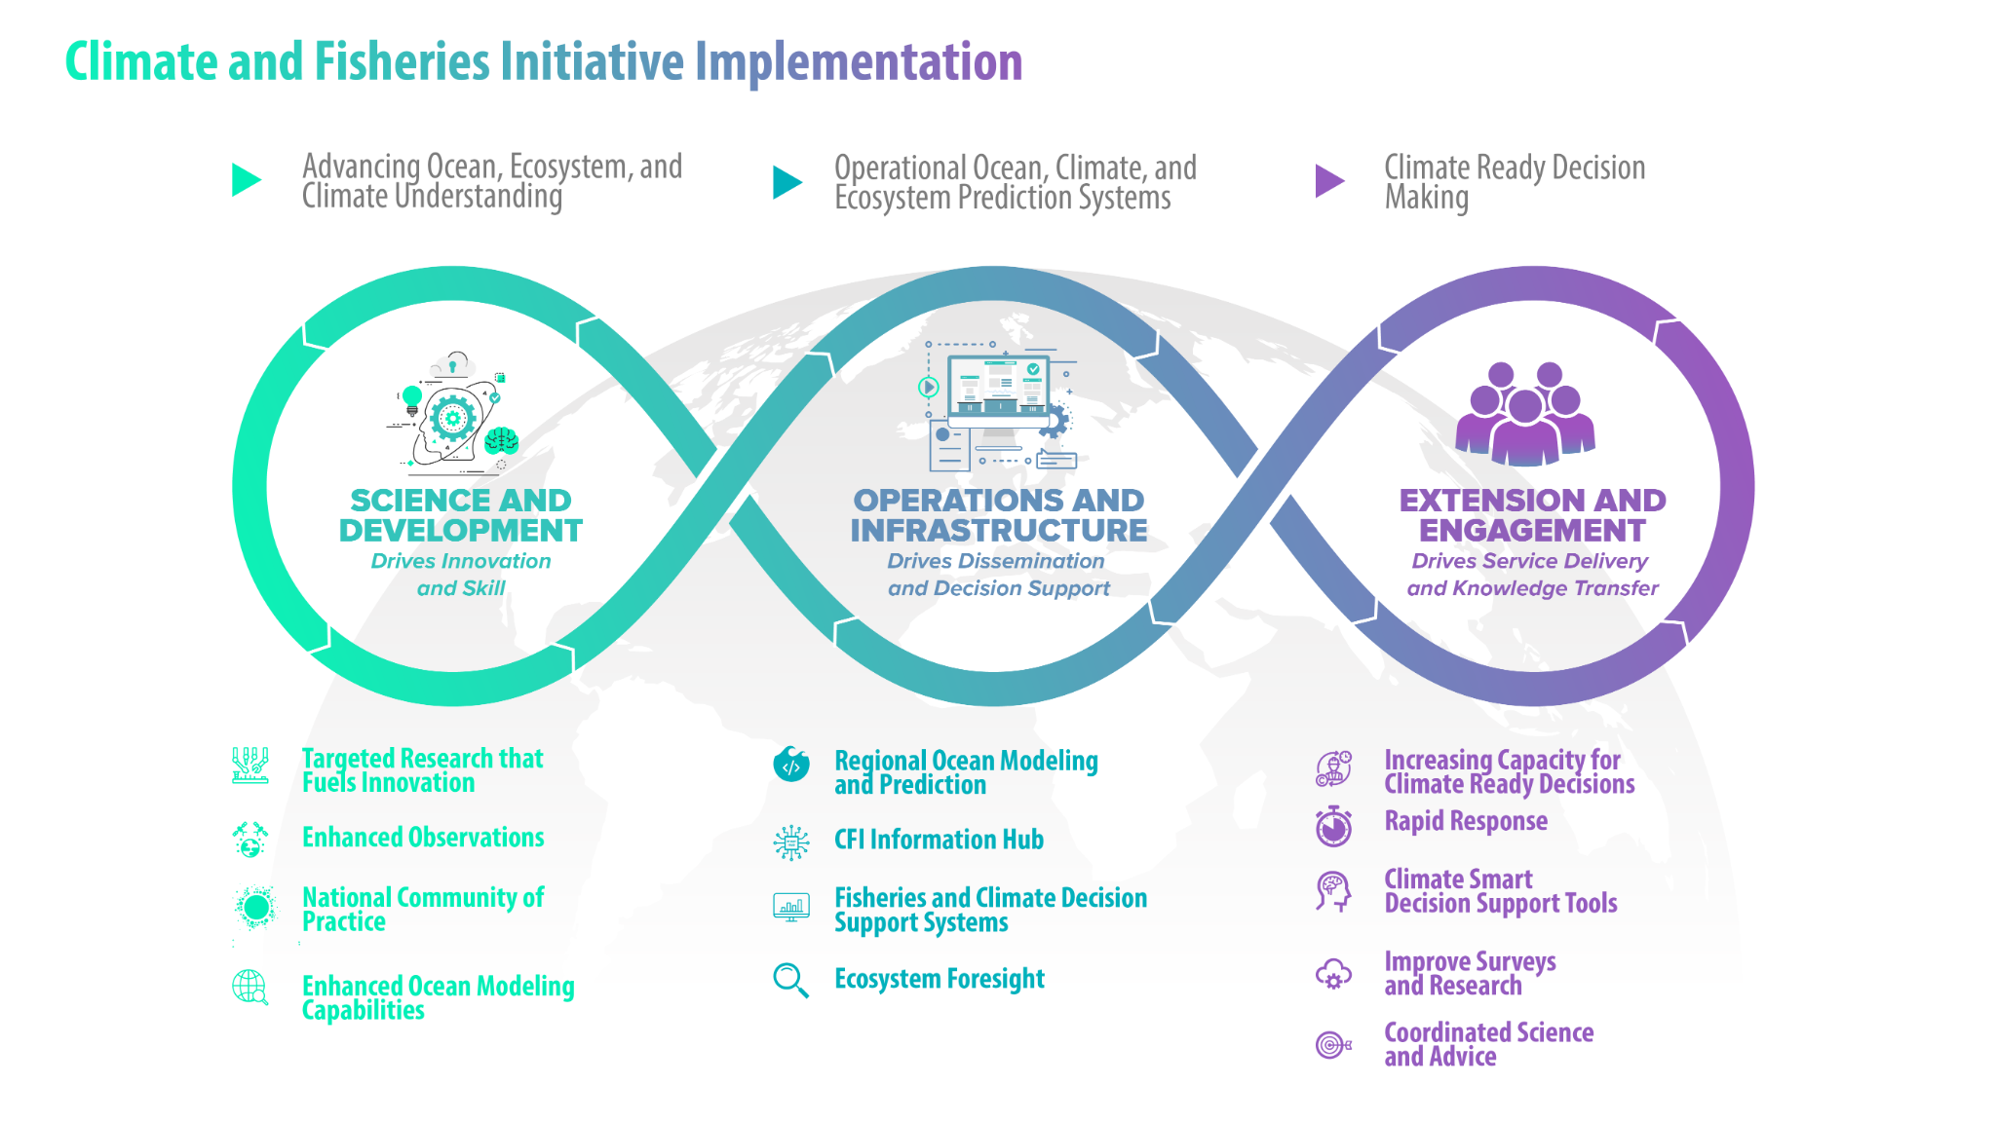
CFI End-to-End Ocean Modeling and Decision Support System
1
2
3
(FACSS)

Slide 10
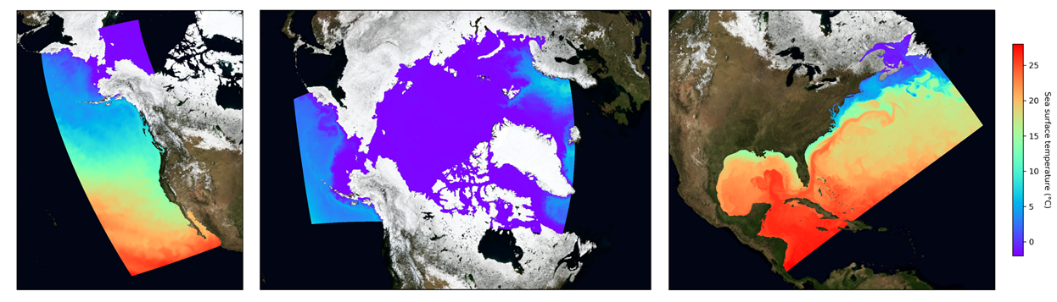
National Ocean Prediction System fueled by NOAA High Performance Computing
Prototype MOM6 coast-wide domains for seasons to decades (Great Lakes, Pacific Islands in progress)
Builds on NOAA ocean forecast (NOS) and Prediction Systems (OAR/GFDL)
Regional Ocean Modeling Teams customize products for NMFS uses
Holistic ocean/BGC predictions, expandable to earth system as needed
NOAA HPC powers predictions spanning the range of ocean futures
Robust dissemination through CFI Information Hub & national data stds

Slide 11
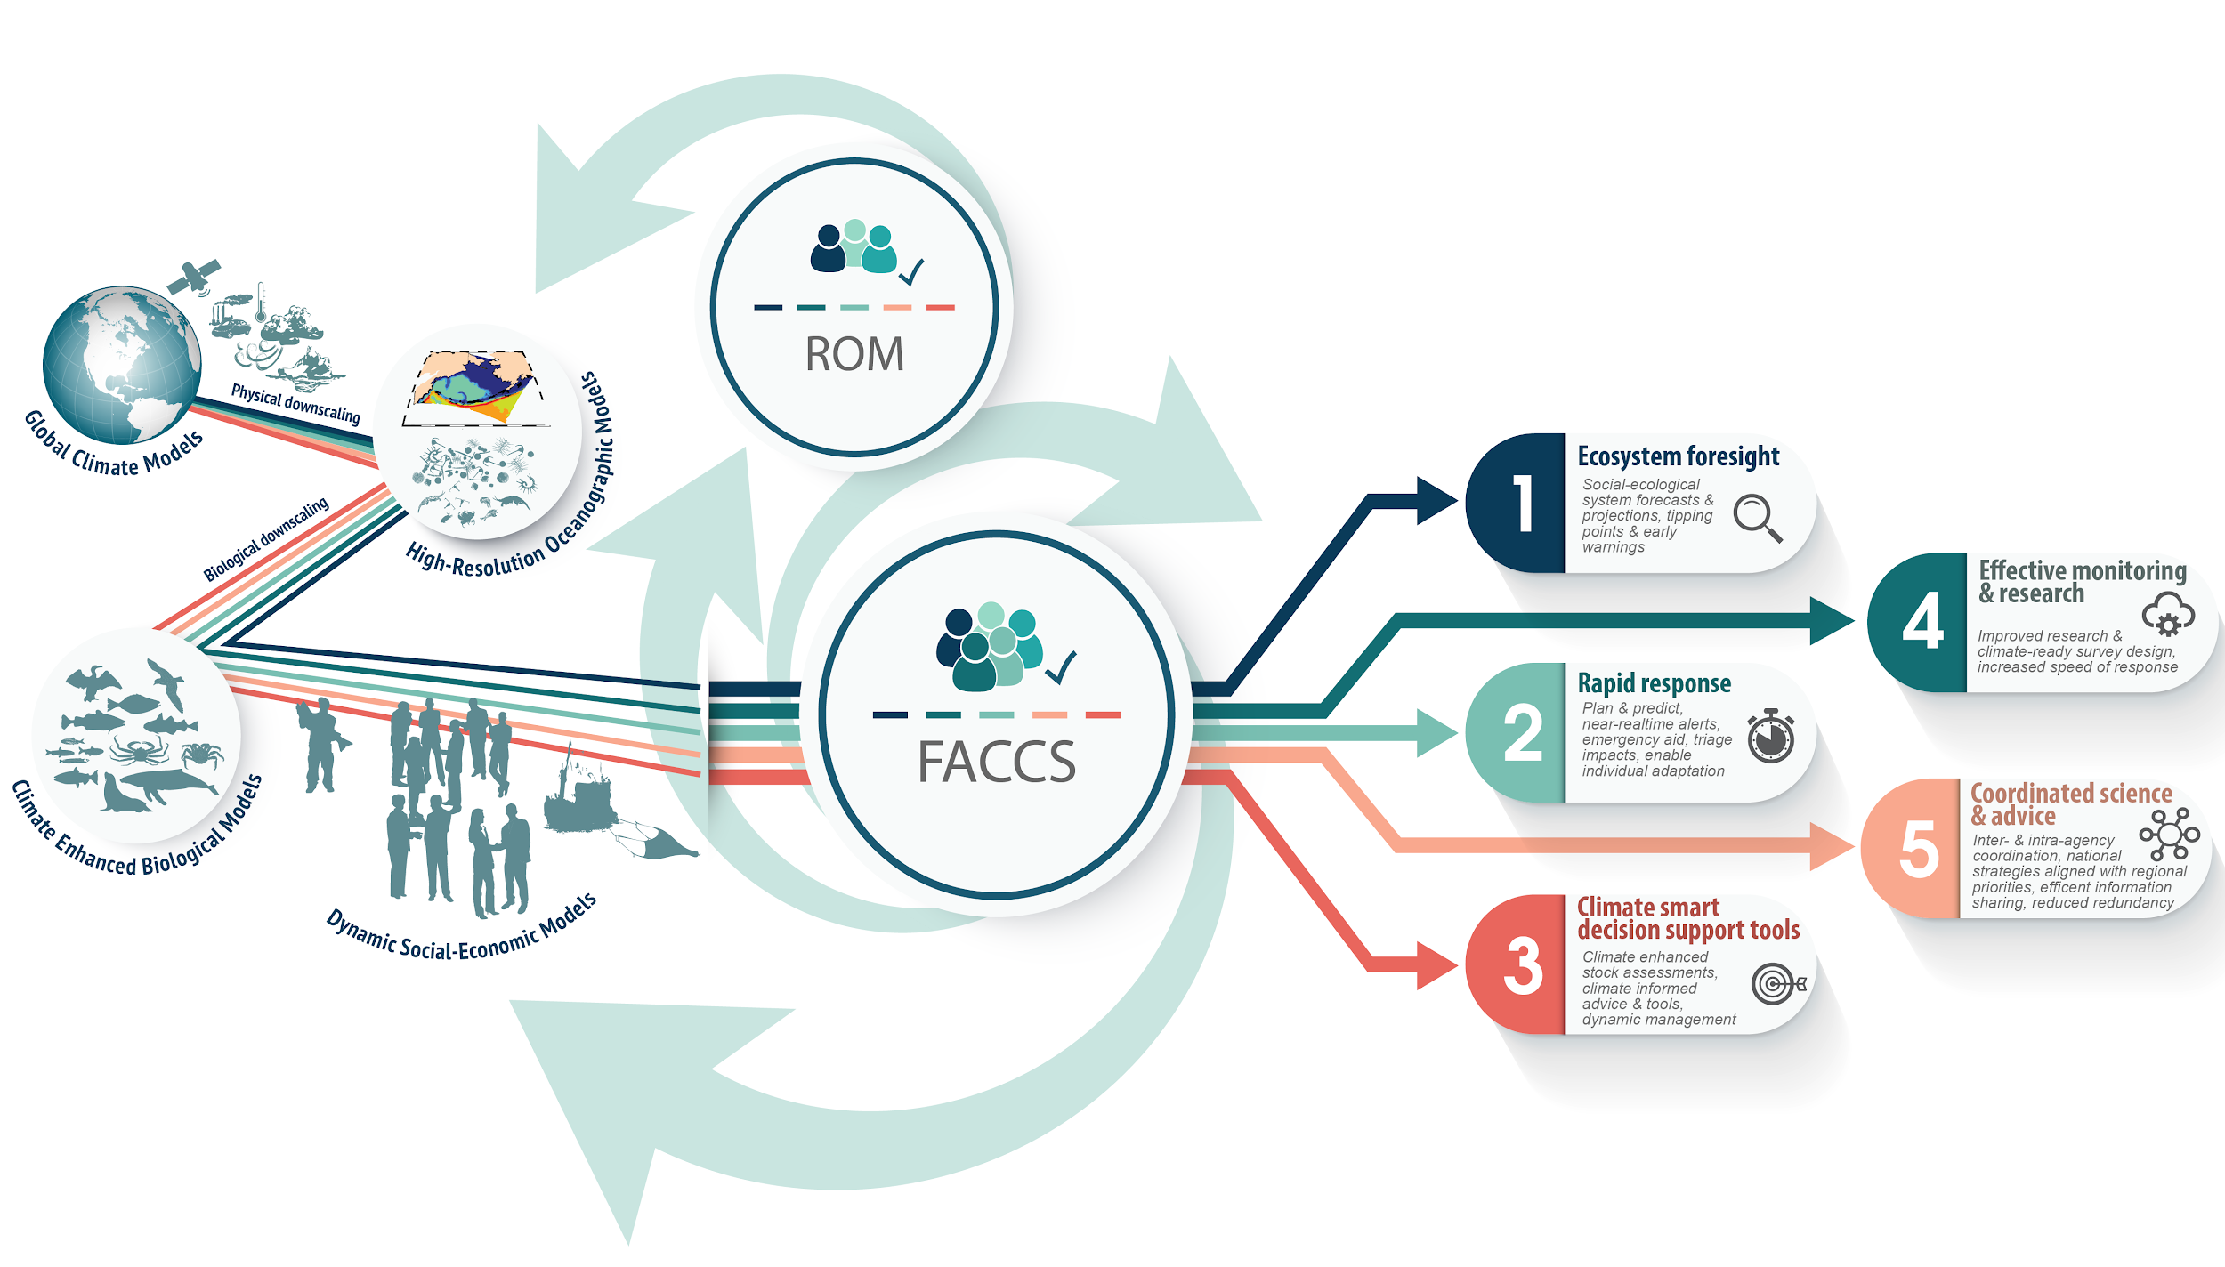
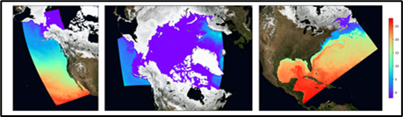

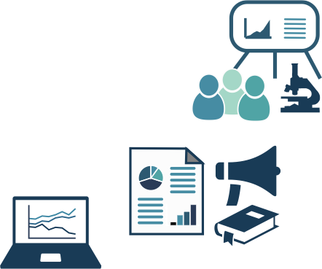
CFI Ocean Modeling and Decision Support System
CFI Info
HUB
Regional Ocean Modeling Teams
Fisheries and Climate Decision Support System
Artwork – K. Holsman
Notes:
Kirstin’s notes
----------------------------------------
Part 1:
This is the NATIONWIDE, every LME, system we can build to support each of those steps in the loop (again using the fisheries example).
Let me explain…. starting on the left hand side… this is the integrated coupled climate modeling enterprise
where we operationally generate high resolution forecasts and projections of the entire marine system in an area, from physics and phytoplankton to fish to fishing communities
The right hand side is the phenomenal climate informed advice and products and outcomes from the CFI
In the middle are regional teams of experts tasked with coordinating and generating this science to advice pathway, operationally
[NEXT SLIDE]
Part 2:
The Regional Ocean Modelers [ROM at the top] innovates and continually updates the high-res regional ocean models (OAR-NMFS)
The FACSS includes a team of regional experts that build the community of practice around climate informed management advice including partnerships with regional Councils and stakeholders, sub teams of researchers (think ALCIM and Future Seas), sustained support for research, product development, and technological & computing tools (think scripts, shared code repos, etc).
Sustained support accelerates climate informed advice to meet climate driven changes - no start and stop and spin up time, trainings etc associated with punctuated support. Sustained support is more efficient and easier to leverage.
As one coordinated, cross line office effort, innovation and product delivery is accelerated, innovation is enhanced, and improvement from user feedback is rapid.
So let’s talk a bit more about what this system produces...

Slide 12
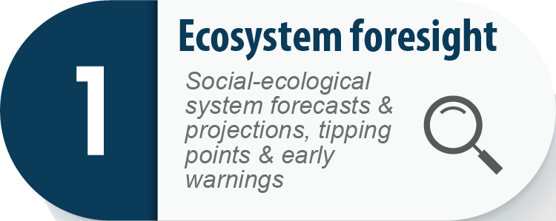
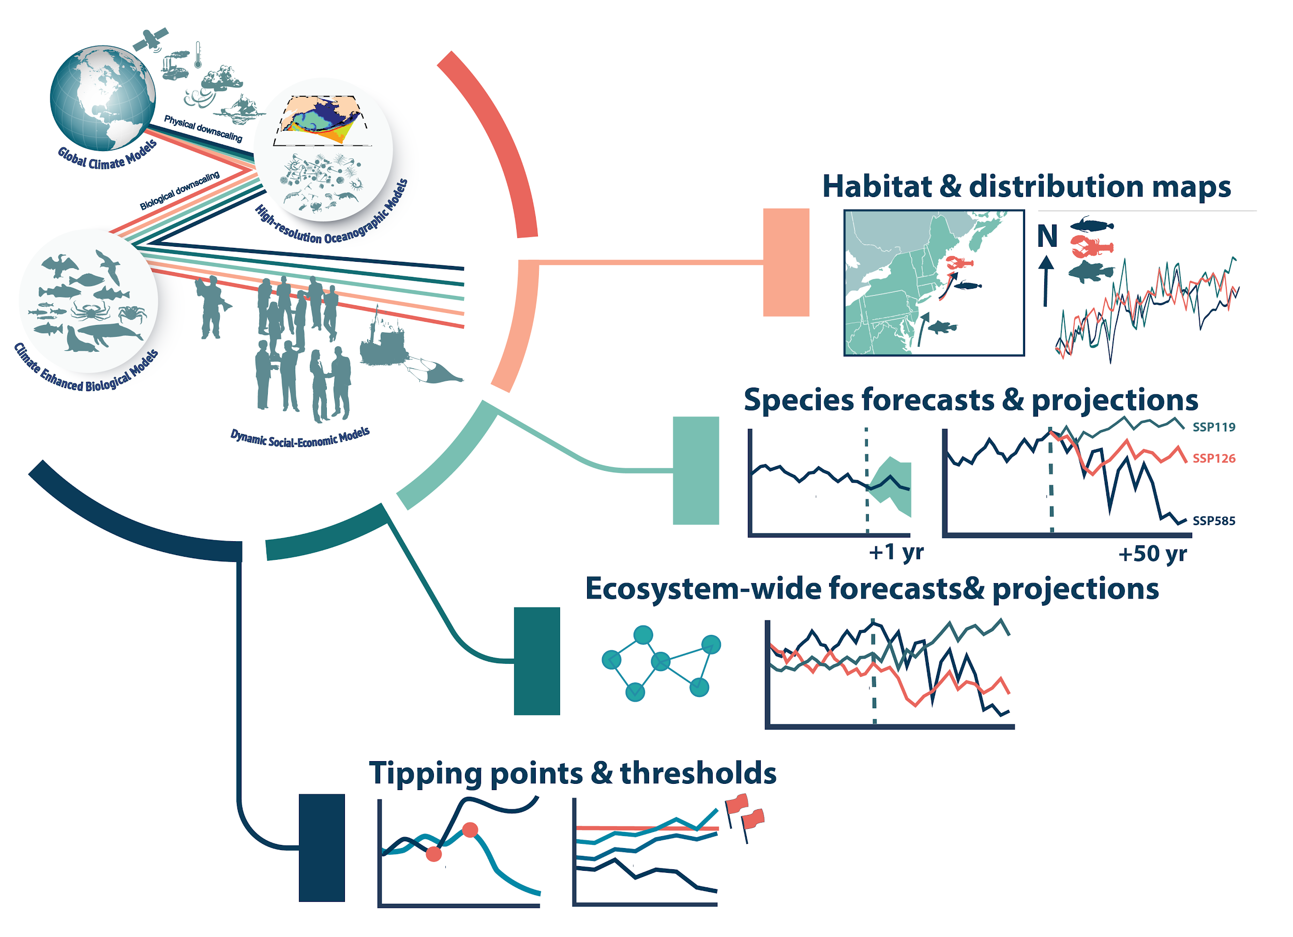
FACSS Products and Services
Dedicated product line
Operational delivery
Customized services
Artwork – K. Holsman
Notes:
Climate information HUB
Climate informed ecosystem modeling figure
Key products:
●Portal supported trajectories
●Short-term and long term ECOSYSTEM projections (ecosystems, stocks)
●socio economic harvest scenarios ??
●canned set of outputs / trajectories (versus user tailored products in 2 and 3)
●habitat projections/spatial hot spots, etc

Slide 13


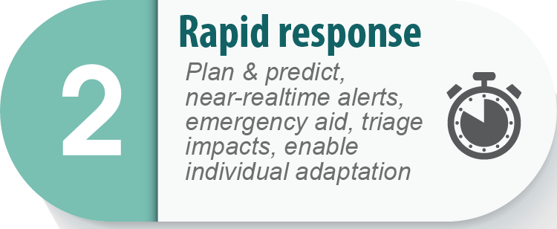


Improve Rapid Responses
Enable adaptation
Plan &
predict
Rapid Response
Planning
Preparation
Triage
Action
Triage impacts, provide aid
Assess risk
Alter & communicate
Artwork – K. Holsman
Notes:
best/ optimal management strategy (continuously changing)

Slide 14
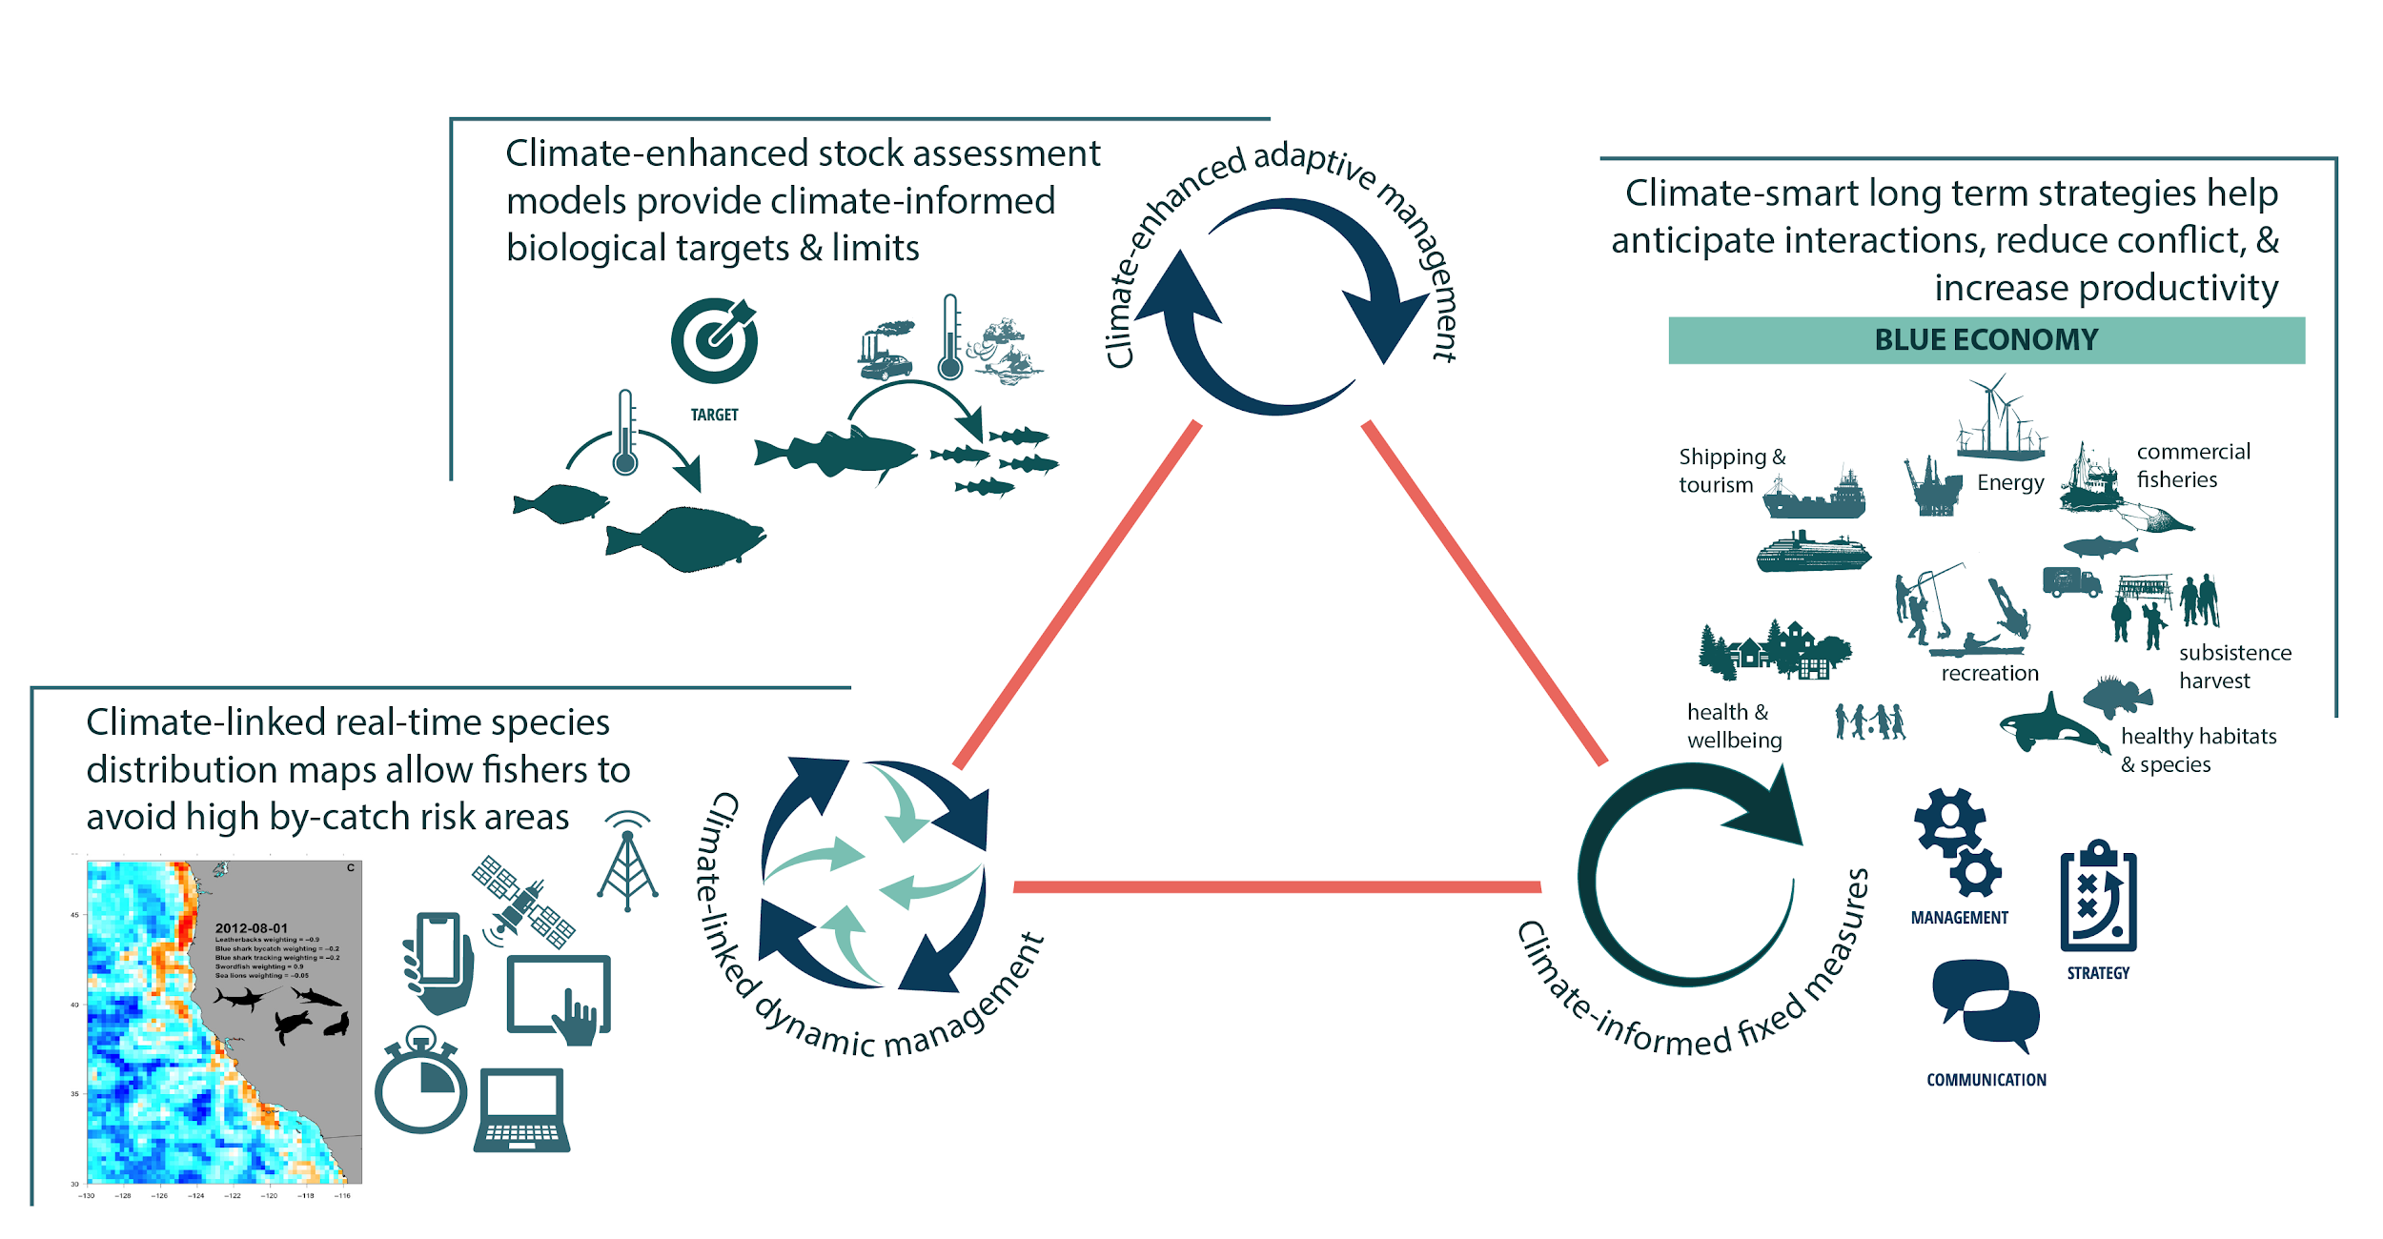
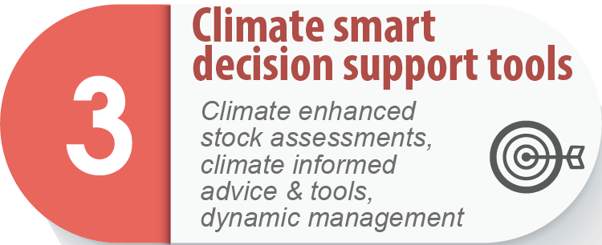
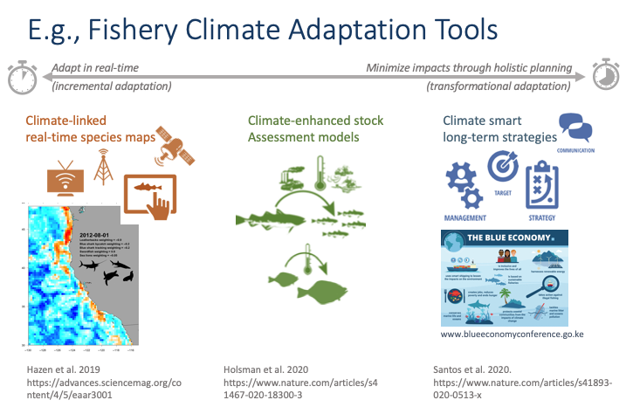
Tailored Adaptation Approaches
Holsman et al. 2020.Nature Communications 11: 4579
Optimal
Management
Portfolio
Performance
Testing
Santos et al. 2020.Nature Sustainability 3: 505-516
Hazen et al. 2018. Science Advances. 4(5) eaar3001
seasonal annual multi-decadal
Artwork – K. Holsman
Notes:
best/ optimal management strategy (continuously changing)
Dynamic: forecasts
Adaptive: 5 year predictions
Fixed: 10+ year projections

Slide 15
Scenarios
Scenario 1, the agency will continue to rely on temporary funding for multiple projects, particularly those that advance NOAA Fisheries’ ability to build fishery and climate decision support systems into the future. Lack of sampling in the slope region and irregular sampling in the NBS will reduce the agency’s ability to track impacts of climate change on LMRs. Likewise, reduced process studies and intermittent sampling of ichthyoplankton and age-0 pollock populations retard the pace at which mechanistic understanding advances.
Scenario 2, the four FY 2022 initiatives would address key infrastructure (staffing and ship-time) needed to sustainably expand surveys into the Northern Bering Sea and deliver fishery and climate decision support to fishery-dependent communities and managers. The influx of base funding will allow AFSC to grow survey teams to accommodate this new and challenging monitoring need.

Slide 16
Key Gaps in Infrastructure (RAP Levels 5-7)
Ecosystem data collection –
  (bloom timing, seasonality, species comp)
  Microzooplankton community and shifts in species composition and grazing rates
Expansion of summer acoustic surveys to inner domain
  Euphausiids
  Forage fish (juvenile Pollock)
HABs
Mechanisms underlying spatial shifts (NBS survey)
Ocean biogeochemical sampling in NBS (benthic pelagic coupling)
Climate-mediated demographic vulnerability
Predator-prey
Survey frequency for pinnipeds
Baseline information for cetaceans (ArMAPPS)

Slide 17
Key Gaps in Pathways for Fisheries and Climate Decision Support (RAP Levels 1-4)
CFI implementation across NOAA new hires
Communication
Understanding human community adaptations
Non-market conservation of BS ecosystem

Slide 18
Key Input from CPT
Missing projects in Appendix?
Missing gaps?
Are key actions complete?

