Slide 1
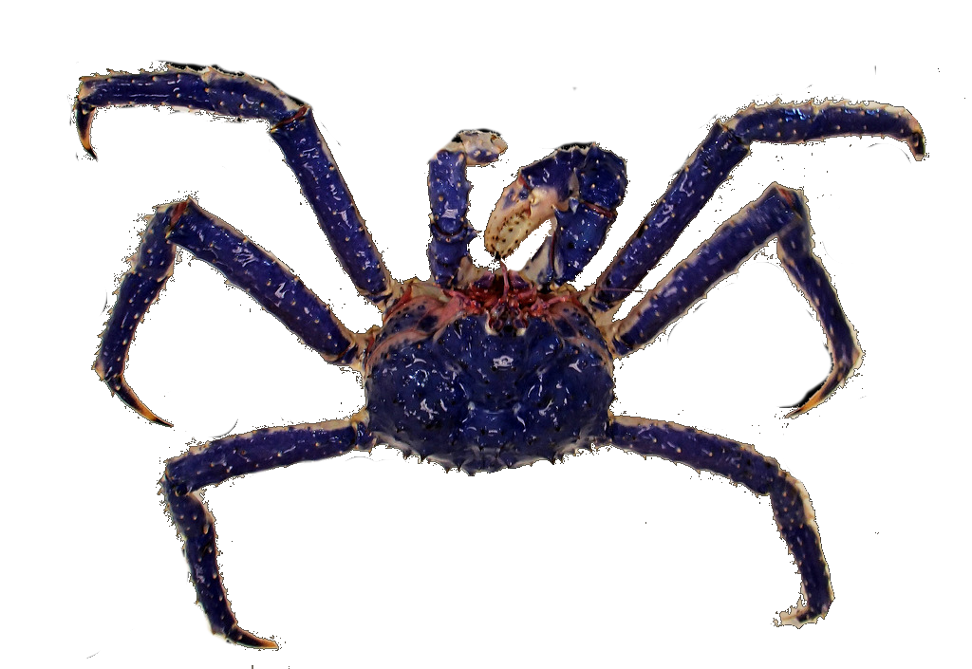


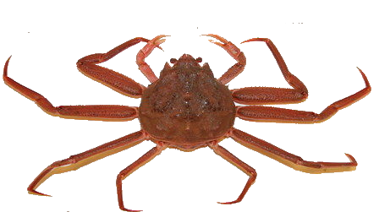
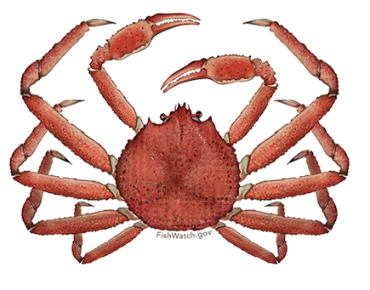
Research Priorities
2019 Crab Plan Team

Slide 2
Research priority improvements
Online database
Revised definitions
Coordination with NPRB

Slide 3
Research priority process
Onerous, time-consuming for the Plan Teams, SSC, Council
Continued frustration with the review process
Limited time … during the meeting.
Not as comprehensive as originally planned

Slide 4
Research priority process
“top ten” list
categorically exclude
  Critical Ongoing Monitoring
  Strategic

Slide 5
Research priority process
“top ten” list
categorically exclude
  Critical Ongoing Monitoring
  Strategic
  Triennial Review

Slide 6
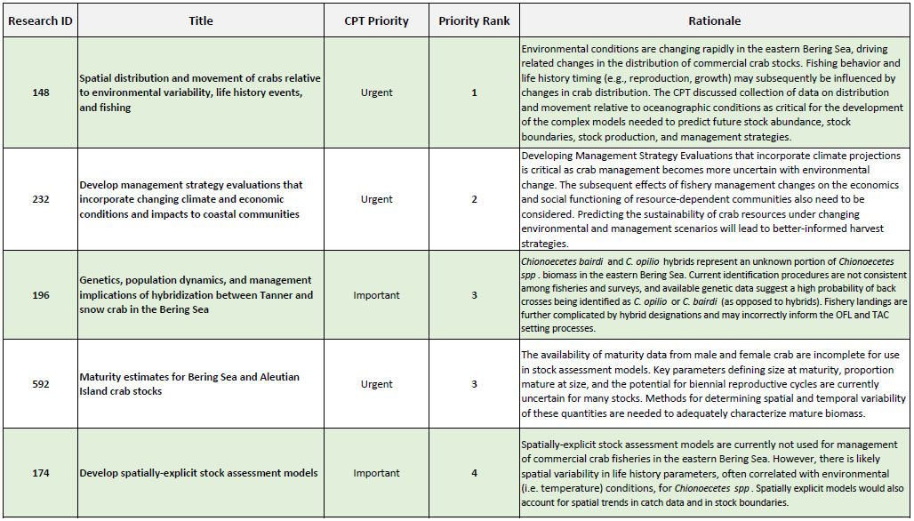
Top Crab Research Priorities – CPT 2018

Slide 7
Top Crab Research Priorities – SSC 2018

Slide 8
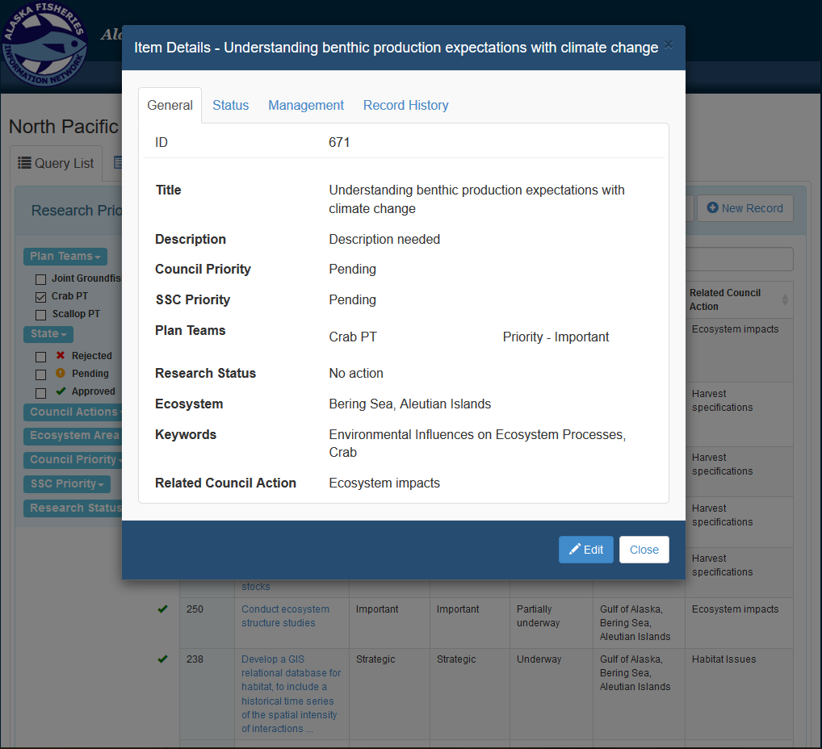
New Crab Research Priorities 2018

Slide 9
New Crab Research Priorities 2019
Research ID | Title | Description | CPT Priority | Research Status
671 | Understanding benthic production expectations with Climate change | Need description | Important | no action
New
New
New
New

Slide 10
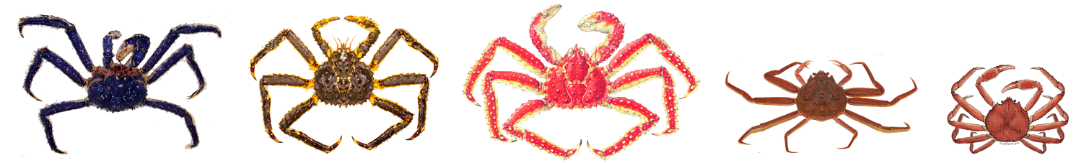
Questions / Discussion

