Slide 1

Saint Matthew Blue King Crab rebuilding progress, plans and associated assessment planning

Slide 2

Notification and implications
Council notified October 22, 2018 that the Saint Matthew blue king crab stock was overfished.
MSA requires that a rebuilding plan be prepared and implemented within 2 years
  Must specify a time frame to rebuild
  Time frame not to exceed ten years (unless this cannot be accomplished in the absence of all fishing mortality)

Slide 3

First steps for rebuilding plan= T_{min} and T_{max}
Need to specify T_{min}
  T_{min} = time the stock or stock complex to rebuild to its MSY biomass level in the absence of any fishing mortality (>50% probability)
Need to specify T_{max} (maximum time for rebuilding)
If T_{min} for the stock or stock complex is 10 years or less, then T_{max} is 10 years.
If T_{min} for the stock or stock complex exceeds 10 years, then one of the following methods can be used to determine T_{max}:
  T_{min} + one generation time. “Generation time” = average length of time between when an individual is born and the birth of its offspring,
  Time to rebuild to B_{msy} if fished at 75 percent of MFMT, or
  T_{min} multiplied by two.
In situations where T_{min} exceeds 10 years, T_{max} establishes a maximum time for rebuilding that is linked to the biology of the stock.

Slide 4
What are other (secondary) considerations for the rebuilding plan?
  Potential revisions to the State harvest strategy?
  Are there reasons to consider additional groundfish fishery measures to increase likelihood of rebuilding (habitat or other area closures)?
  Recommendations on ‘rebuilt’, 1 vs 2 years > B_{MSY}

Slide 5
January 2019
CPT discussion and recommendations
GMACs code corrected for SMBKC assessment and updated code to be used for 2019 assessment; also coded to allow for projections
Need SSC input/considerations on what is the most realistic estimate for recruitment for purposes of the rebuilding plan projections
Implications for B_{MSY} time frame

Slide 6
Analyses and Plans for Winter/Spring 2019
Assessment
Rebuilding Plan
Transfer assessment and projection code to ADFG [late Feb - Andre/ADFG]
BMSY time frame [ADFG]
  Log Recruit per spawner analysis to evaluate changes in productivity over time (similar to Jie’s BBRKC examination)
  Proposed changes to BMSY time frame: alternatives for inclusion in September final assessment
Survey data review [ADFG]
  Review of State and NMFS survey data, implications of offshore movement
  VAST application to survey data
Revised projections [Andre/Katie]
  Updated projections following Feb SSC; revised alternative projections consistent with proposed BMSY alternatives
Review of previous rebuilding plans [Diana]
  Alternatives considered
Bycatch data review [Diana/NMFS: Jason, Cathy, Krista]
  Spatial locations of groundfish bycatch
  Overlay existing area closures and review of rationale for closures
  Size and sex composition of groundfish fishery bycatch

Slide 7
CPT recommendation on recruitment and Bmsy relative to Tmin
Table 7: T_{min} for each projection version d with no directed fishing (F=0).
Projection | recruitment | B_{MSY} proxy | recruitment years | T_{min}
1 | random | 1978-2017 | 1978-2017 | 7.5 years
2 | Ricker | 1978-2017 |  | 16.5 years
3 | Beverton-Holt | 1978-2017 |  | 14.5 years
4 | random | 1978-2017 | 1996-2017 | 100+ years
5 | random | 1996-2017 | 1996-2017 | 10.5 years
6 | random | 1978-2017 | 1999-2008 | 100+ years
7 | random | 1978-2017 | 1989-2017 | 10 years

Slide 8
Previous SMBKC rebuilding plan
harvest strategy
bycatch controls
habitat protection
Other considerations
SQ 20% Mature male abundance
New harvest strategy:
  min stock threshold
  min GHL
  threshold os harvest rates
  cap on legal males
SQ
BOF gear mod measures and area closure
SQ
EFH
BOF state waters habitat protection areas
No fishing until the stock is rebuilt

Slide 9
Additional habitat protection measures
(not part of RBP)
St. Matthew Island Habitat Conservation Area
Expansion of SMIHCZ
Amd 89 to FMP implemented 2008
primary goal to protect BKC habitat
done in conjunction with much broader analysis of non-pelagic closures
Amd 94 to FMP implemented 2010
expanded eastern boundary of SMIHCZ

Slide 10
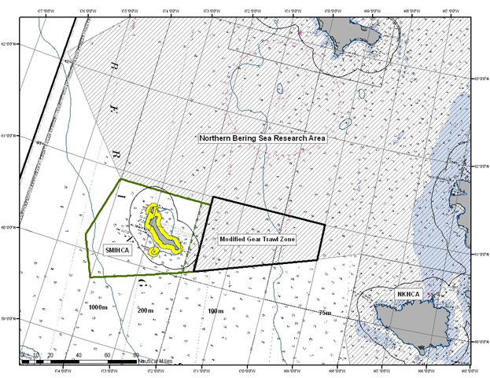
SMIHCZ including revised boundary

Slide 11
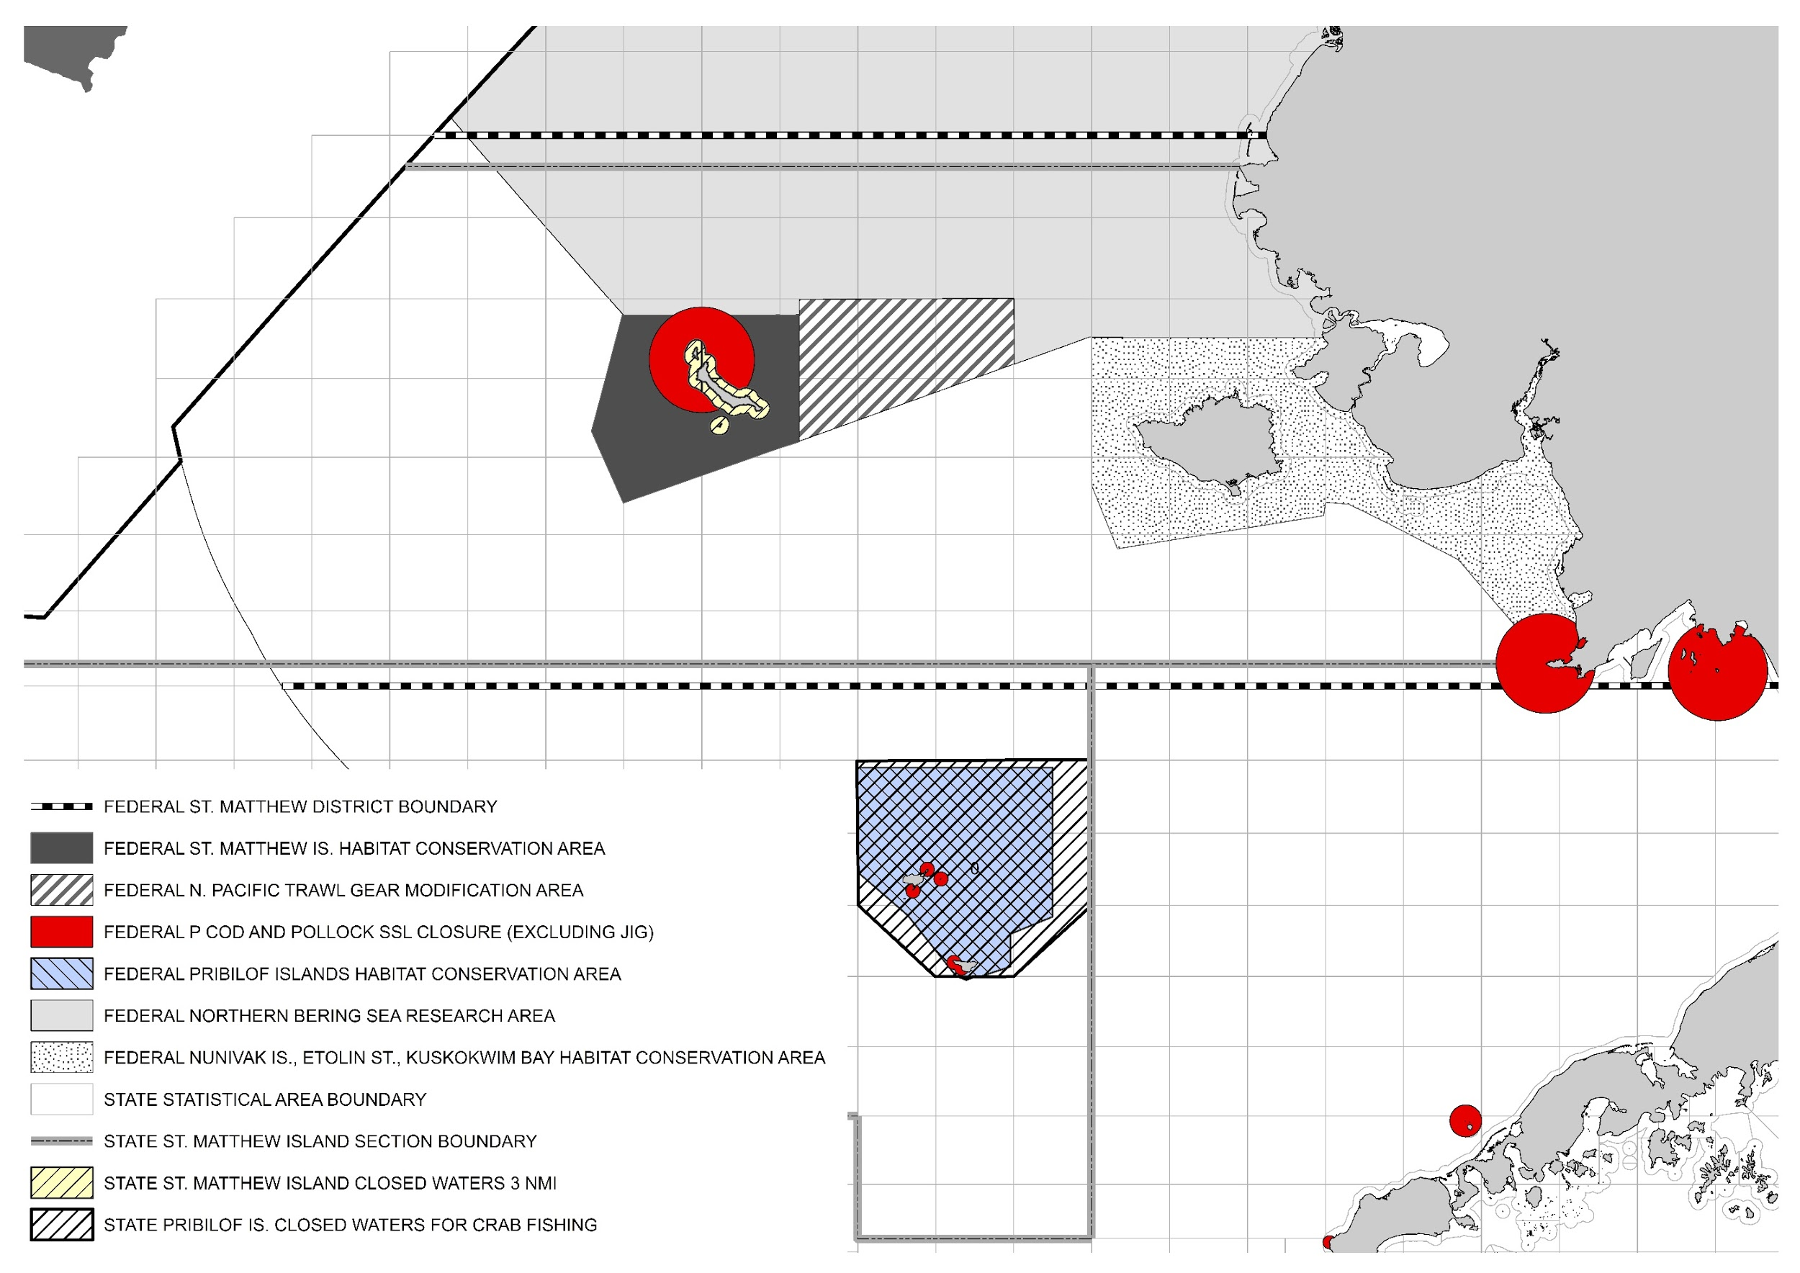
Closure Areas

Slide 12
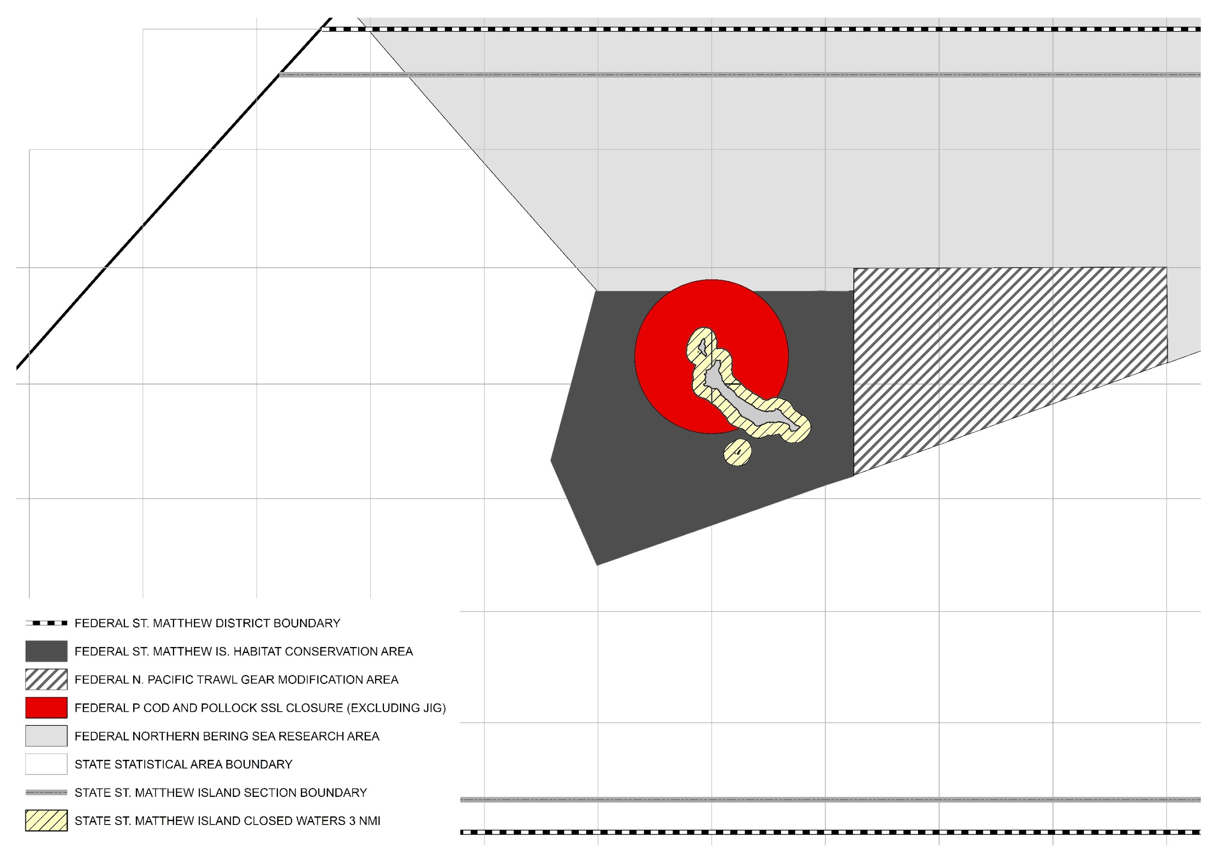
Closure Areas

Slide 13
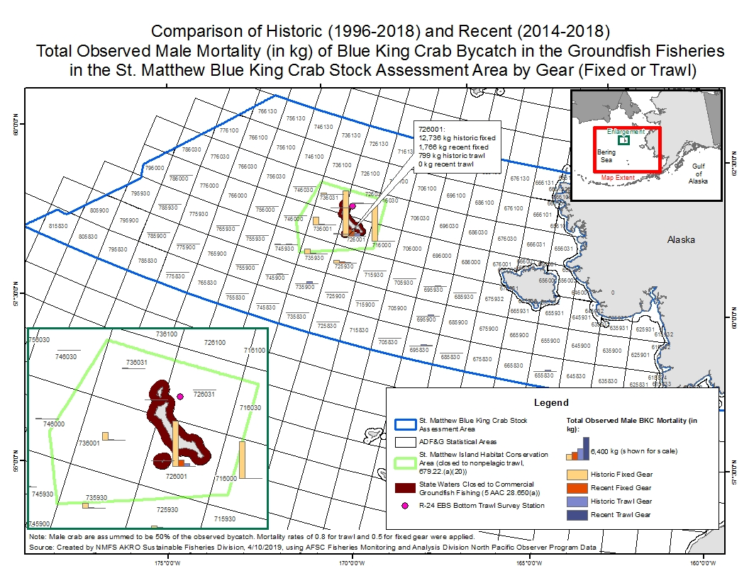
Spatial Location of Observed Groundfish Bycatch

Slide 14
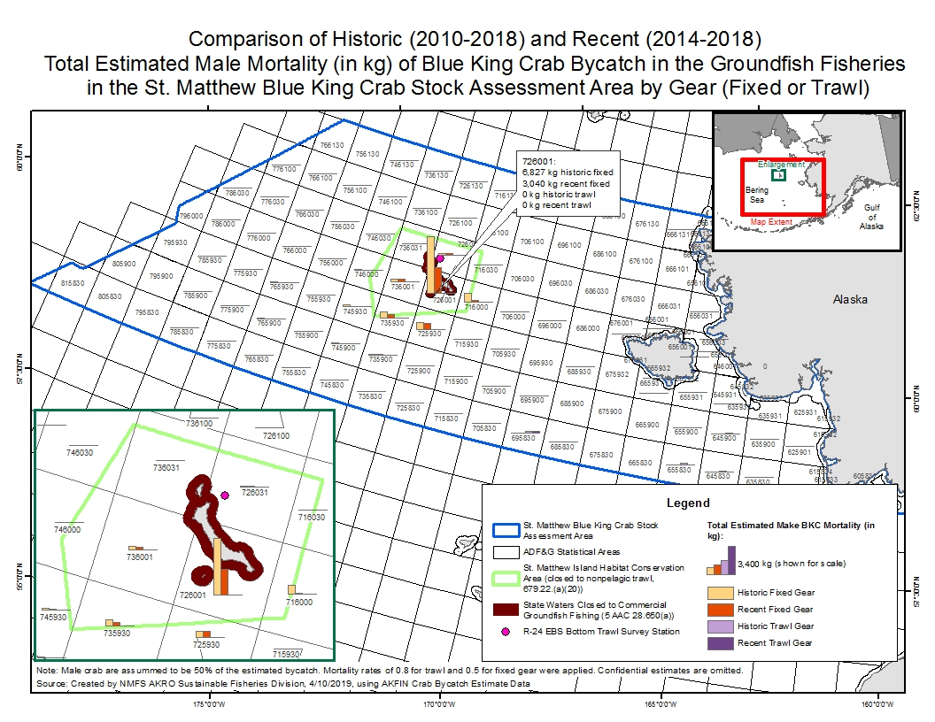
Spatial Location of Estimated Groundfish Bycatch

Slide 15
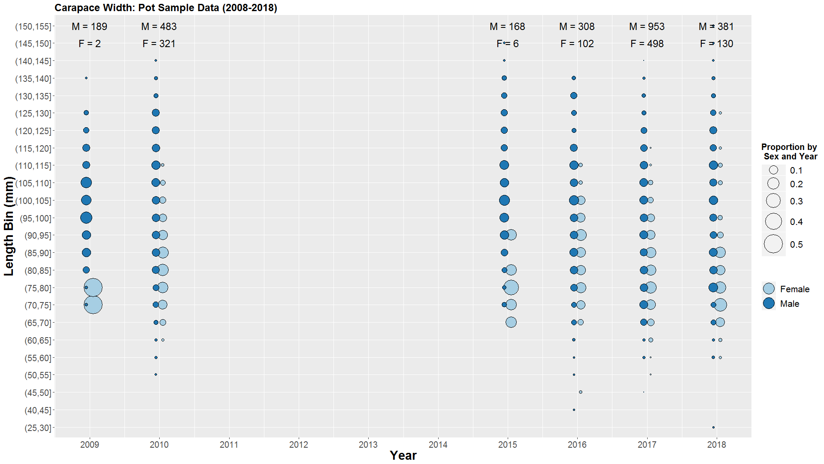

Slide 16
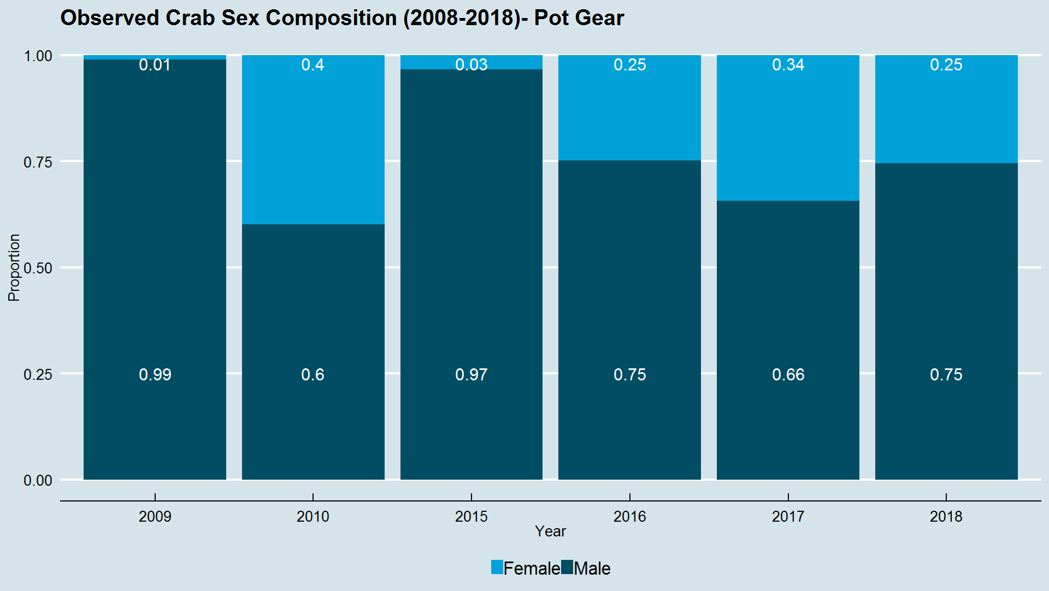

Slide 17
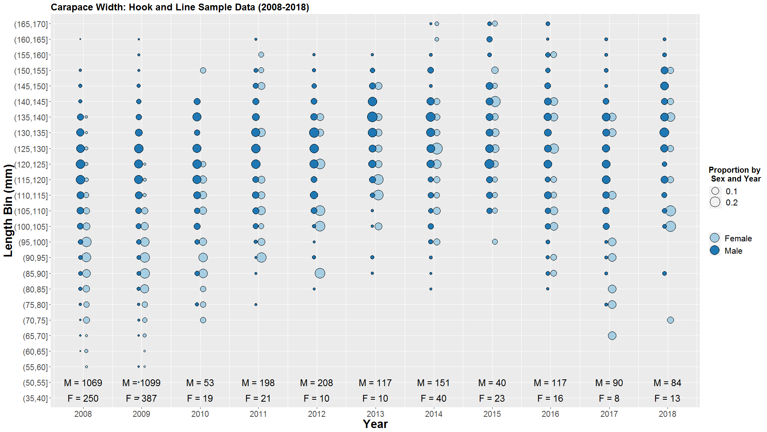

Slide 18
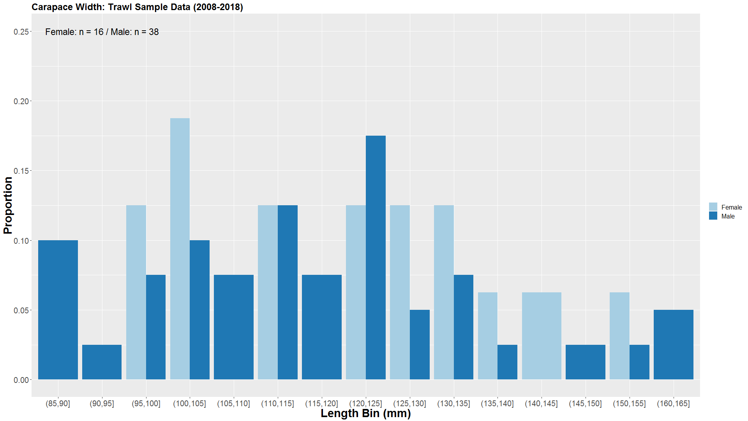

Slide 19
What should be considered in a range of alternatives?
Considerations:
harvest strategy
habitat considerations
probability of rebuilding
bycatch in groundfish fisheries
other considerations?

Slide 20
SSC review of CPT considerations on RBP; recommended approach to recruitment
GMACs: transfer of SMBKC code to ADFG (analysis and projections), updated projections based on recruitment
Bycatch data and closure review
Bmsy and Survey analyses
CPT /SSC final assessment
CPT/SSC review of initial analysis
Council initial review: change alts as needed
Council adopt P and N and alternatives for RBP
SSC reccs on assessment
May
Mar.
July–Aug.
CPT review and reccs on Bmsy and survey application for 2019 assessment
Review of bycatch and closure information; recc any alternatives as appropriate for RBP
June
Sep.–Oct.
February
Apr.
BOF mtg to discuss alternatives and harvest strategy
Draft analysis for RBP
Final assessment for SMBKC

Slide 21
Council actions 2019-2020 following initial review draft
Dec
  Council action as necessary
  Public review draft
Feb
  Council Final action
  SOC final analysis
April/October
  NMFS approval and regulations as needed
  Implementation prior to October 2020

