Slide 1
Saint Matthew blue king crab stock status and rebuilding projections
Katie Palof, Jie Zheng, Jim Ianelli, and André Punt

Slide 2
Outline
Stock status – Fall 2018
  Model in Gmacs
  Overfished but not overfishing
  Sept 2019 models – Base, 2019 data, “fit survey”, and VAST (?)
  Recruitment breakpoint analysis results
Rebuilding projections
  Assumptions and methods – RECUITMENT
  Results
  T_{min} and T_{max} ?
Notes:
Up weighting of surveys (lambda of 2 for both) to see if you can force better survey fit.

Slide 3
Current Status of Stock
Overfished but not overfishing
Poor recruitment in recent years
Table 3: Basis for OFL (1000 t) from the reference model.
Year | Tier | B_{MSY} | Biomass (MMB_{mating}) | B/B_{MSY} | F_{OFL} | ϒ | Basis for B_{MSY} | Natural mortality
2013/14 | 4b | 3.06 | 3.01 | 0.98 | 0.18 | 1 | 1978-2013 | 0.18
2014/15 | 4b | 3.28 | 2.71 | 0.82 | 0.14 | 1 | 1978-2014 | 0.18
2015/16 | 4b | 3.71 | 2.45 | 0.66 | 0.11 | 1 | 1978-2015 | 0.18
2016/17 | 4b | 3.67 | 2.23 | 0.61 | 0.09 | 1 | 1978-2016 | 0.18
2017/18 | 4b | 3.86 | 2.05 | 0.53 | 0.08 | 1 | 1978-2017 | 0.18
2018/19 | 4b | 3.48 | 1.09 | 0.31 | 0.041 | 1 | 1978-2018 | 0.18

Slide 4
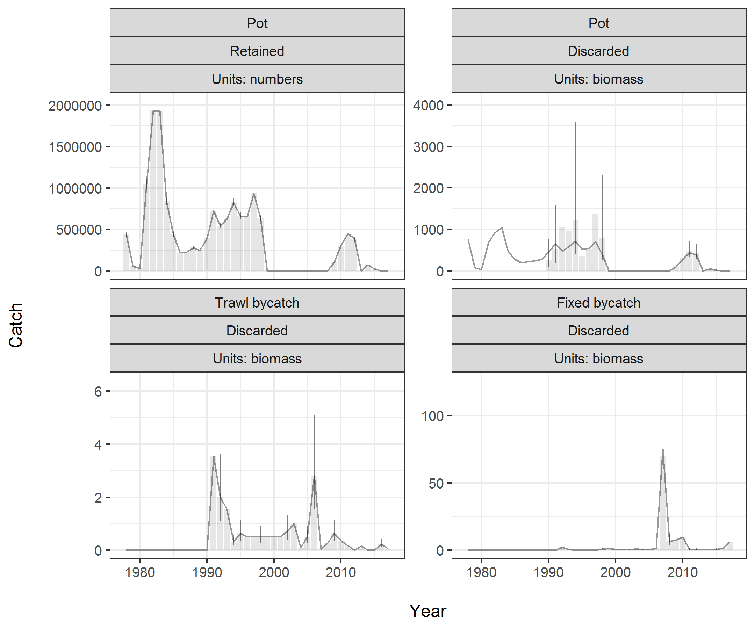
Catch

Slide 5
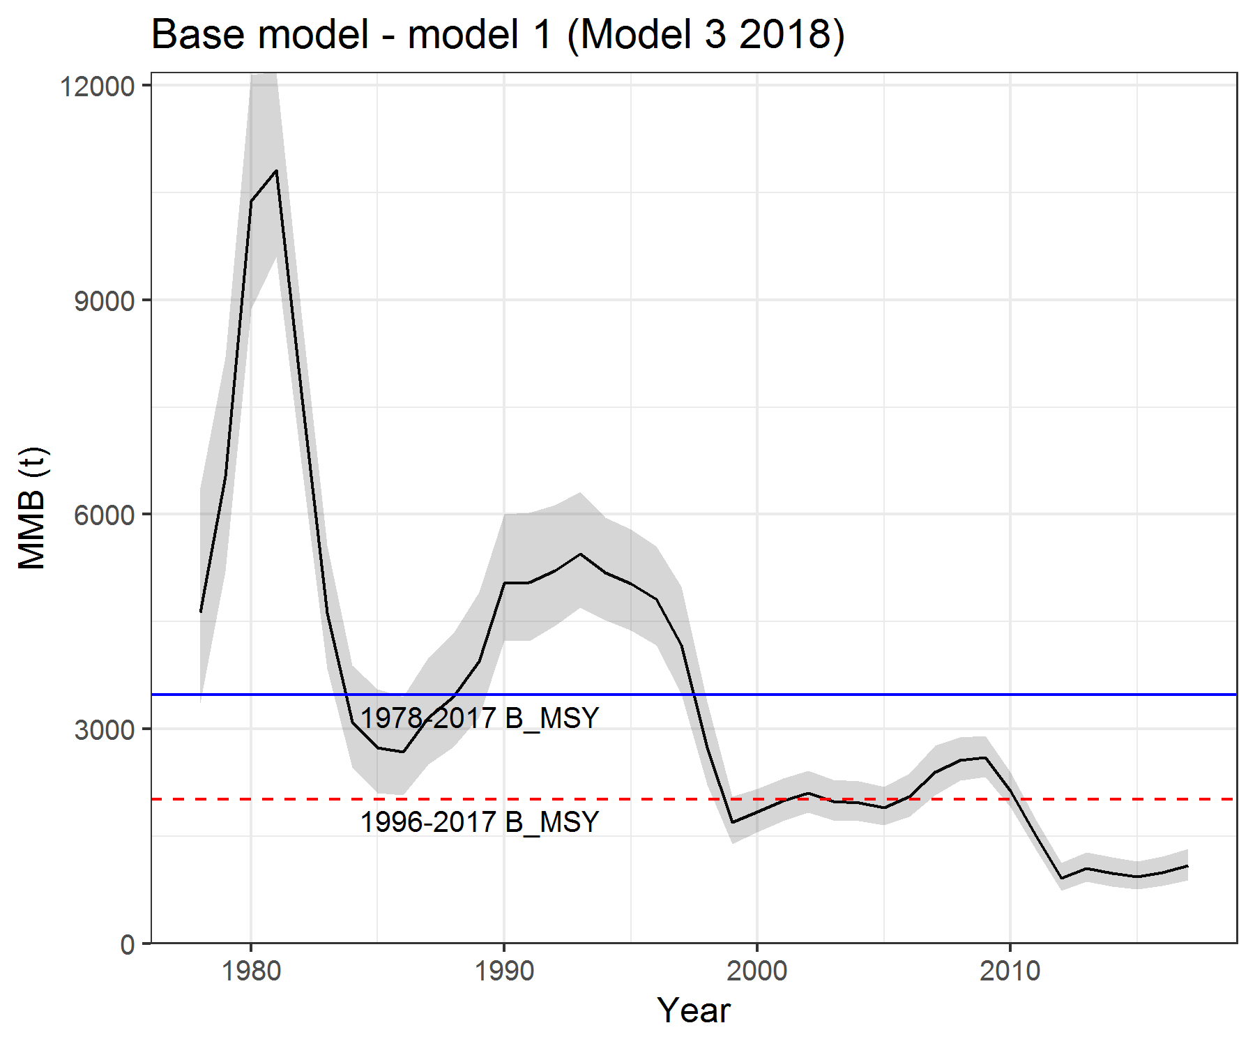
Mature male biomass
Notes:
Gray are 95 % confidence intervals

Slide 6
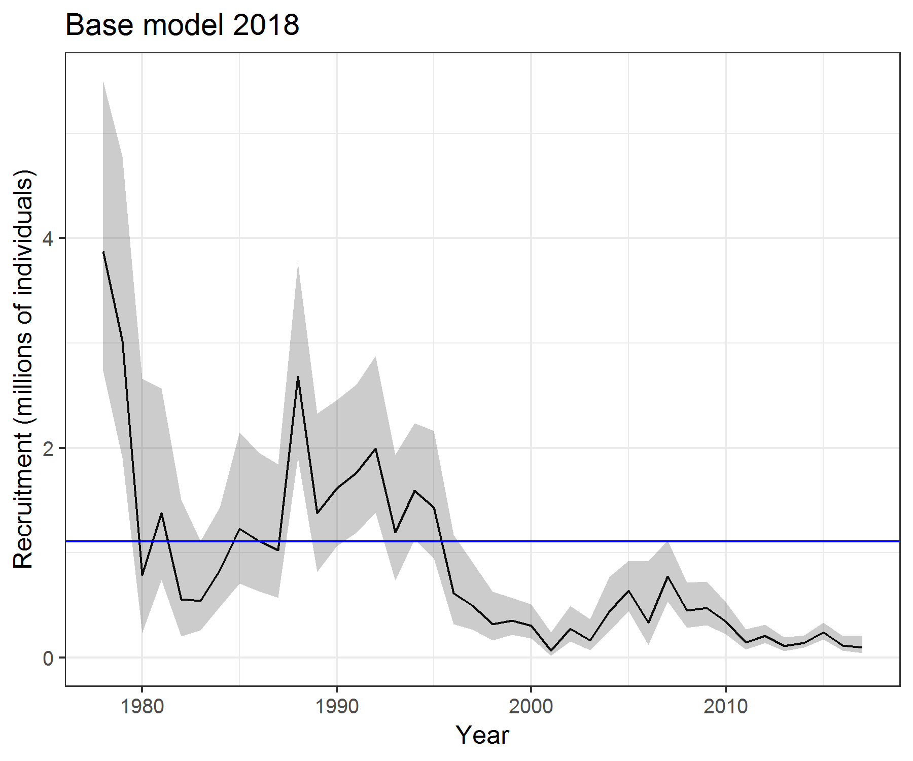
Recruitment
Show fit to surveys, etc.

Slide 7
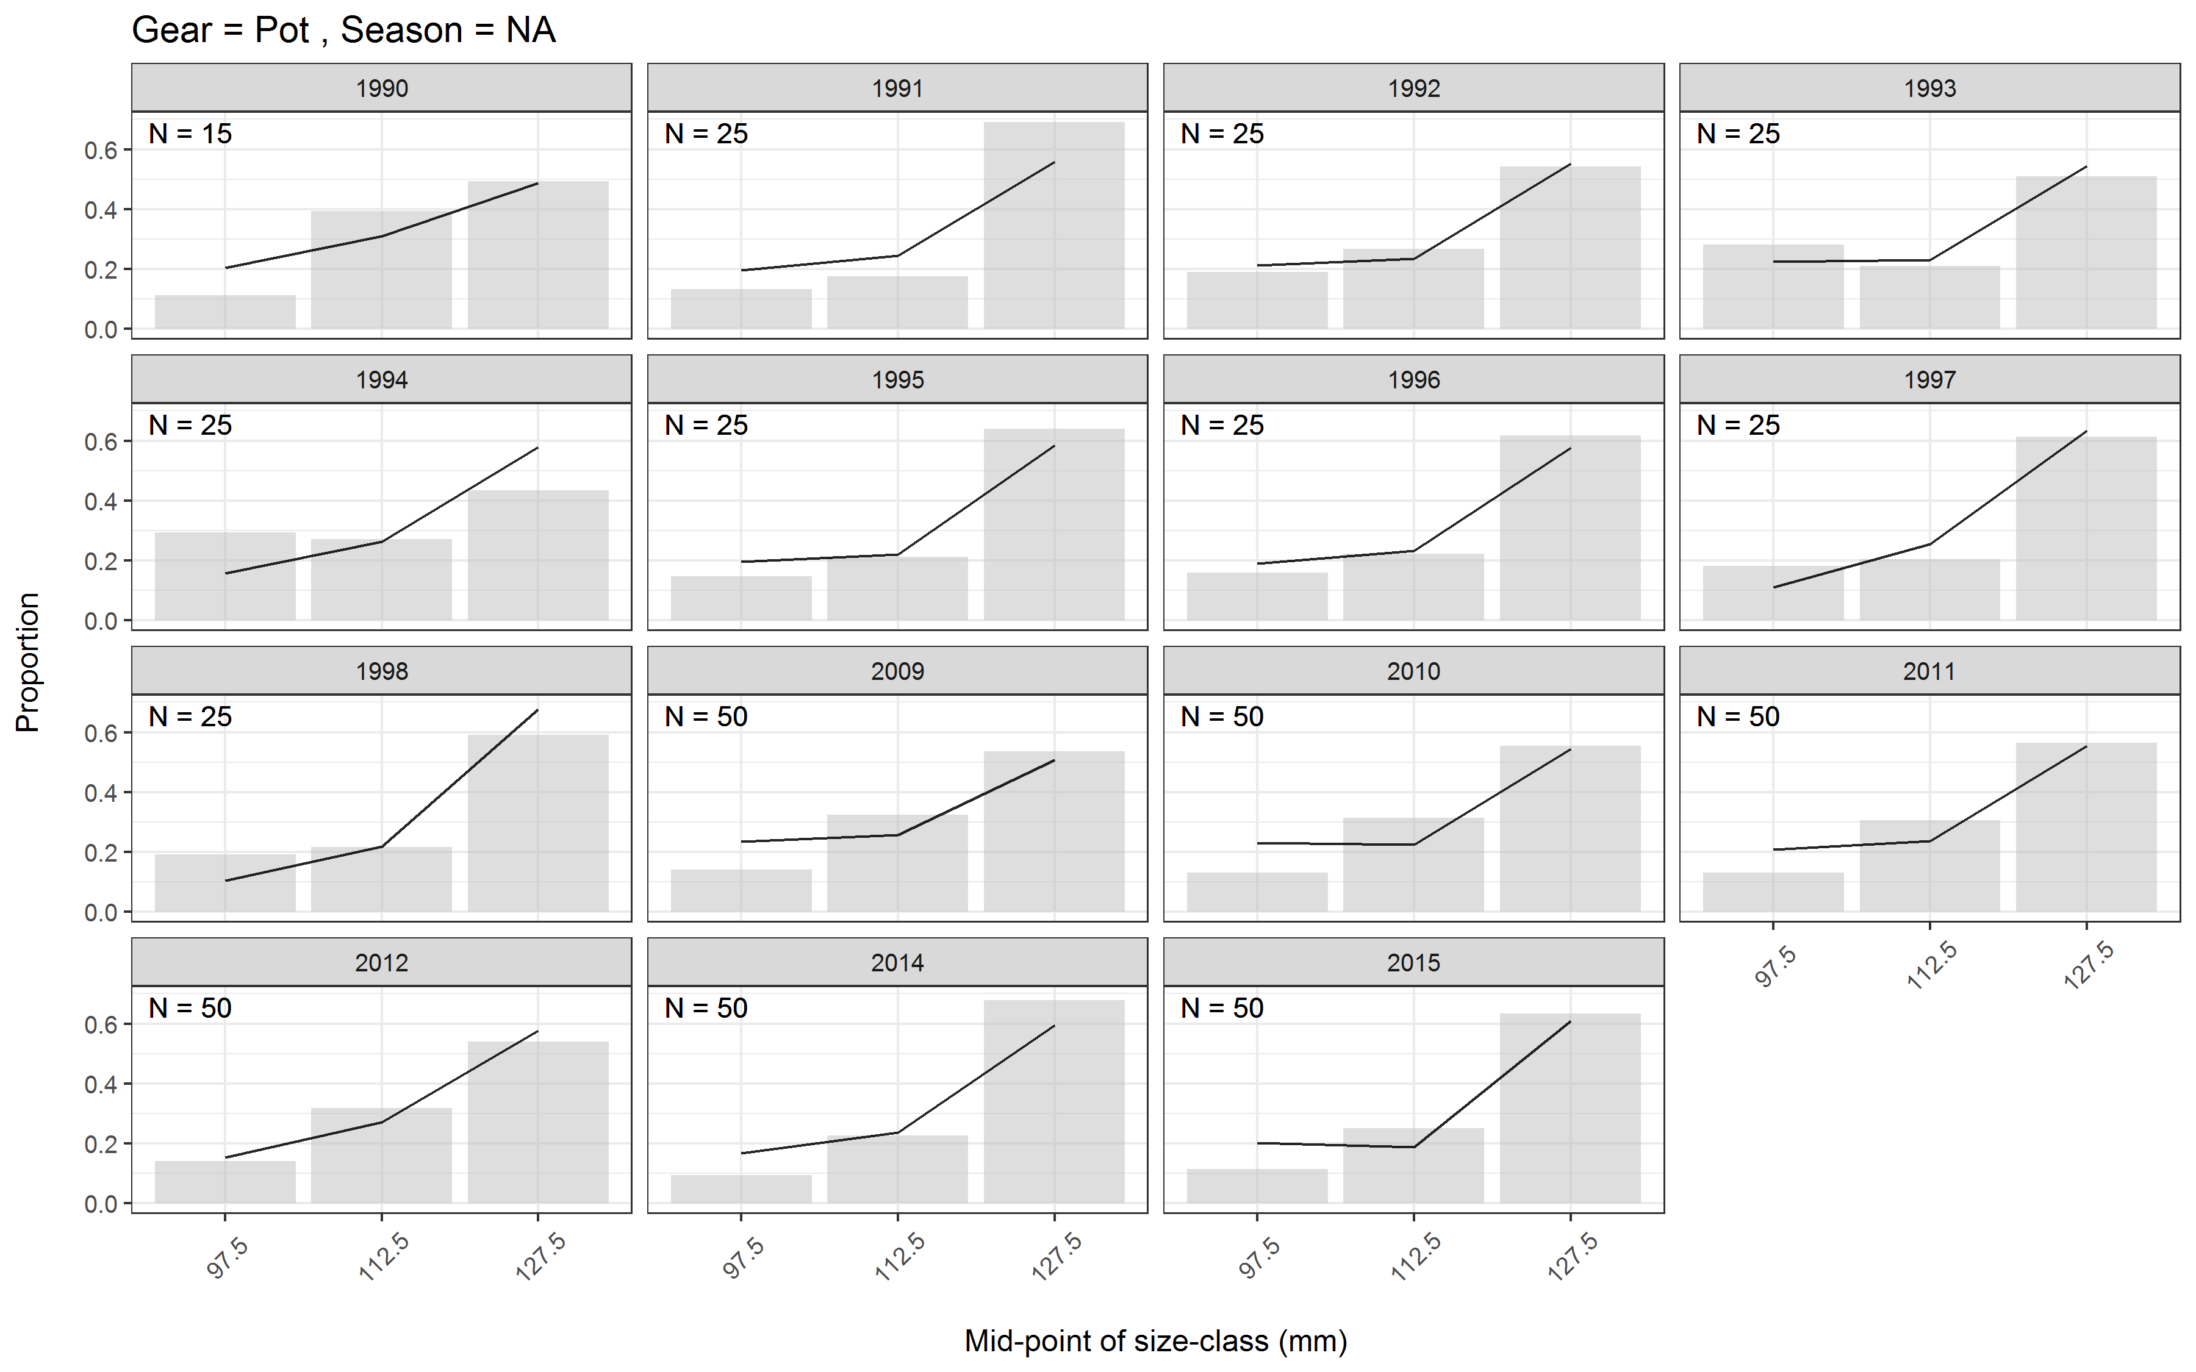

Slide 8
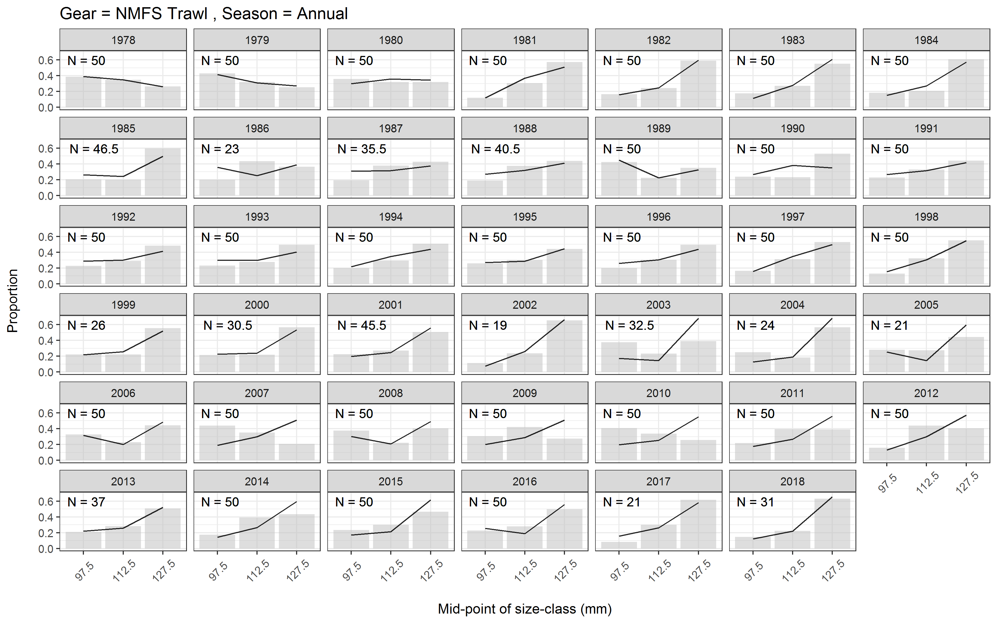

Slide 9
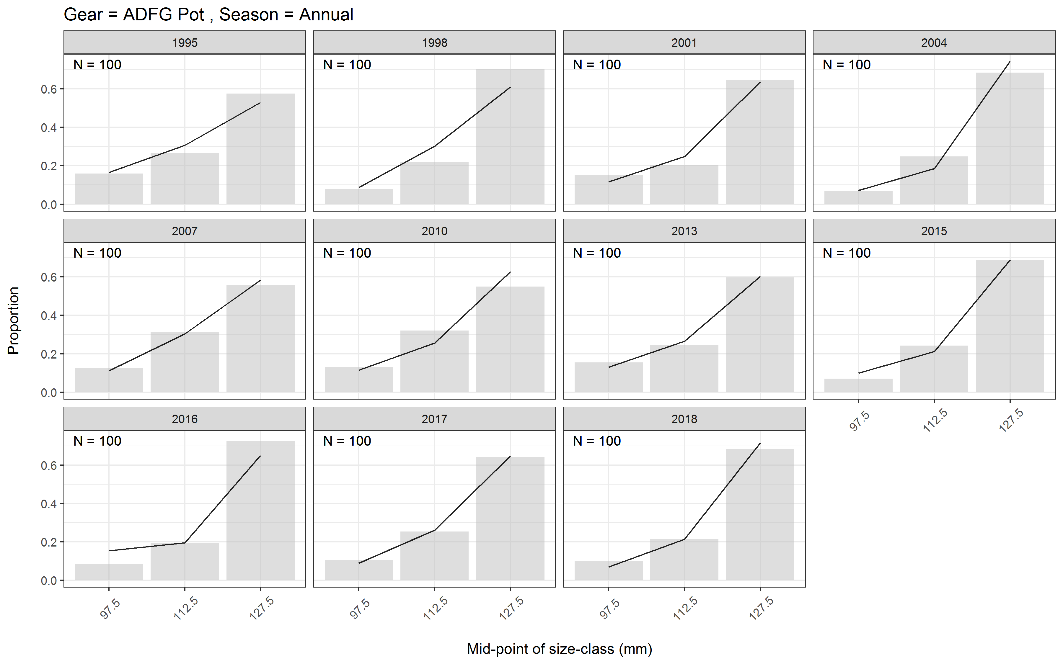

Slide 10
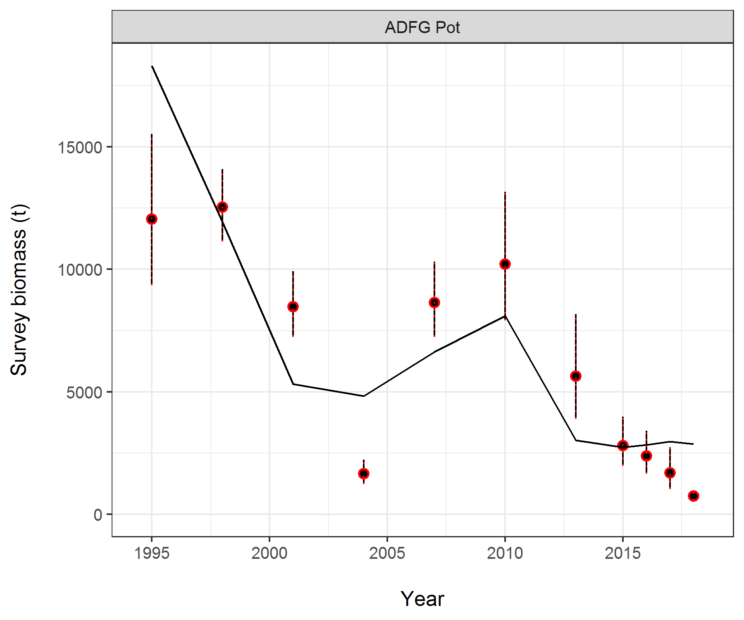
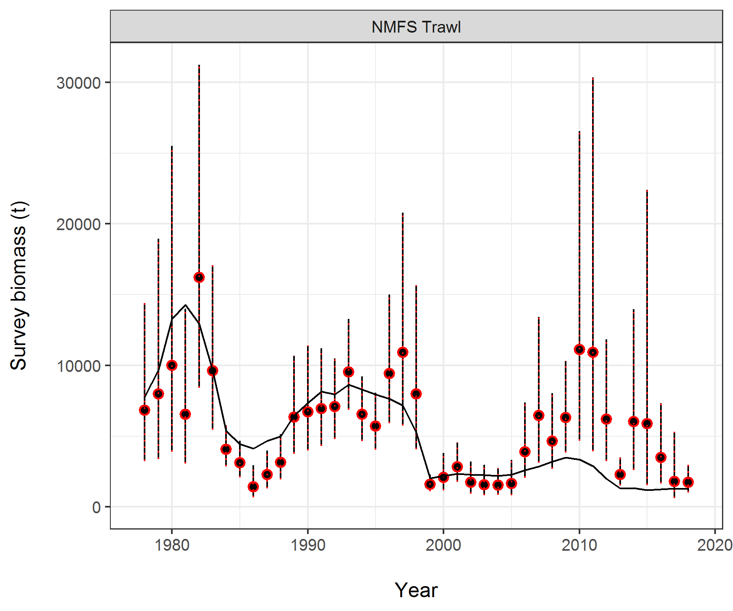
Survey fit

Slide 11
Recruitment Breakpoint analysis
Same approach as BBRKC and others (Punt et al. 2014)
Use S-R relationship to look for breakpoints in productivity
Decision points:
  Lag of 7 years to from brood year to recruitment
  Minimum number of years in a group - 5
Notes:
Punt, A.E., C.S. Szuwalski, and W. Stockhausen. 2014. An evaluation of stock-recruitment proxies and environmental change points for implementing the US Sustainable Fisheries Act. Fisheries Research 157:28-40.

Slide 12
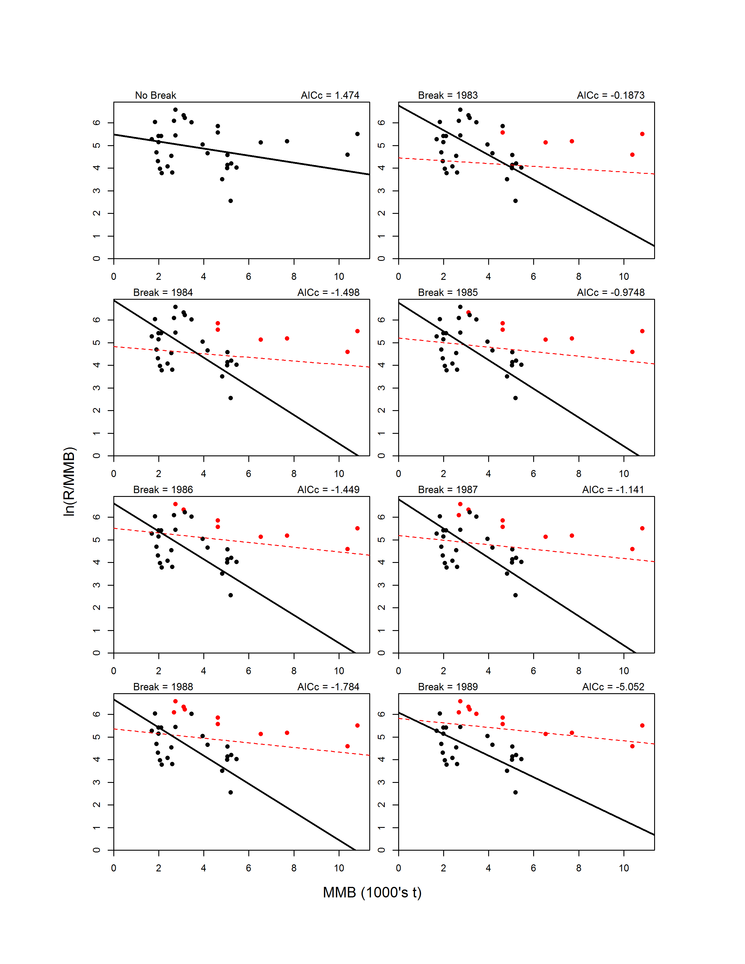
Ricker model

Slide 13
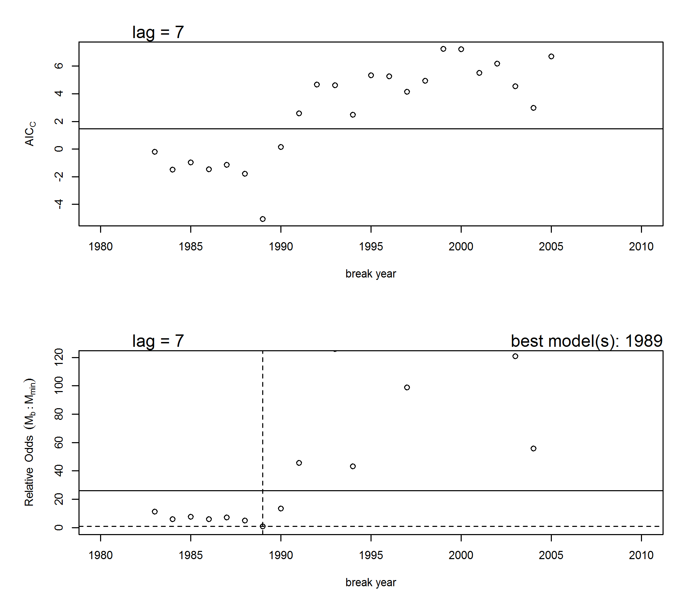
Recruitment breakpoint / productivity
ln (R/MMB)
MMB (1000’s t)
1989 brood year – 1996 recruitment
Notes:
Ricker model

Slide 14
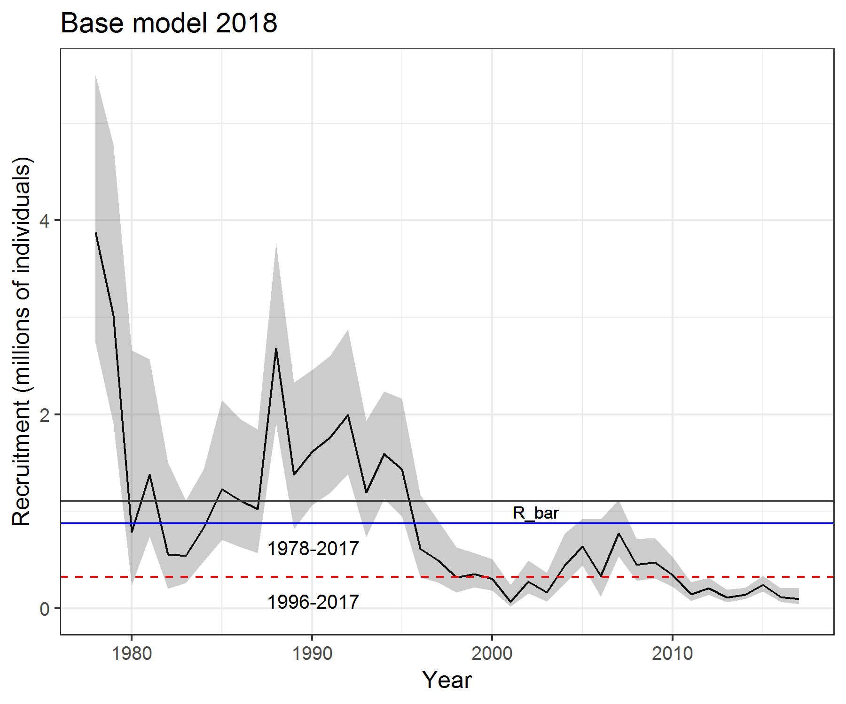
Table A5. Estimates of B_{MSY} proxy using the entire time series and model suggested breakpoint years for recruitment.
Year | Basis for B_{MSY} | B_{MSY} proxy | MSST | Biomass (MMB_{mating}) | B/B_{MSY}
2018/19 | 1978-2017 | 3.48 | 1.74 | 1.09 | 0.31
2018/19 | 1996-2017 | 2.03 | 1.015 | 1.09 | 0.53
Notes:
Figure A7. Computed B_{MSY} proxy (average mature male biomass) for the corresponding year ranges based on the 2018 assessment model with GMACS code updates.

Slide 15
Rebuilding projections
Gmacs projection module developed in Jan – uses mcmc output (.psv file)
Assumptions:
  Bycatch (does not influence rebuilding time)
  State harvest policy
  Future recruitment – KEY ASSUMPTION
    S-R (A. Punt) – Ricker or B-H
    “mean” recruitment or “random” recruitment draws

Slide 16
1 # Compute MSY? (1=Yes)
0 1 1 1 1 # Set to 0 if F35% applied to this fleet; 1 if F is to be fixed
1978 2017 # First and last year for average recruitment/MMB for Bspr calculation (Tier 3 or Tier 4)
2013 2017 # First and last year for average F for discards (computing reference points and projections)
# OFL specifications
0.35 # Target SPR ratio for Bmsy proxy.
4 # Tier
0.10 # Alpha (cut-off)
0.25 # Beta (limit)
1.00 # Gamma
0.80 # ABC-OFL buffer
0 # Produce a yield curve (1=yes; 0=no)
# Projection material
2067 # Last year of projection
2 # Number of strategies (0 for no projections)
0 0.18 # Range of F values
1 # 0 for no mortality for non-directed fleets (see input #1 above); 1=Yes
2 # Mcmc replicates per draw, 2,000 projections if mcmc is 1,000
-3423.8 # Fixed BMSY (negative number for replicate-specific) negative ignores input
# Recruitment
2 # Stock-recruitment option (1=Mean Rec;2=Ricker;3=Beverton-Holt)
7 # Time to recruitment
1978 2017 # First and last years for generating future recruitment (only used if Stock_recruitment option = 1),
0.6 # SigmaR (only used if Stock_recruitment option = 2) [0.6] –
# State strategy #state harvest control rule - hard coded
0 # Apply strategies [OFL, ABC] (1=yes;0=no), also state harvest rule if 1
0.001729630 # Mean weight to use (mature) - w is the same for mature/ legal
0.001930932 # Mean weight to use (legal)
Notes:
# is catch under F bigger than ABC, if so use ABC, is state catch bigger than ABC - use ABC otherwise use TAC
# ABC total, TAC is retained catch

Slide 17
Table 4: Projections performed with associated recruitment assumptions
Projection | recruitment | B_{MSY} proxy | recruitment years
1 | random | 1978-2017 | 1978-2017
2 | Ricker | 1978-2017
3 | Beverton-Holt | 1978-2017
4 | random | 1978-2017 | 1996-2017
5 | random | 1996-2017 | 1996-2017
6 | random | 1978-2017 | 1999-2008
7 | random | 1978-2017 | 1989-2017
Table 5: Versions for each of the projections in Table 4.
Version | Bycatch mortality | SOA harvest policy
a | 0 | no
b | present (2013-2017) | no
c | 0 | yes
d | present (2013-2017) | yes
Notes:
Will present version d for the projections.

Slide 18
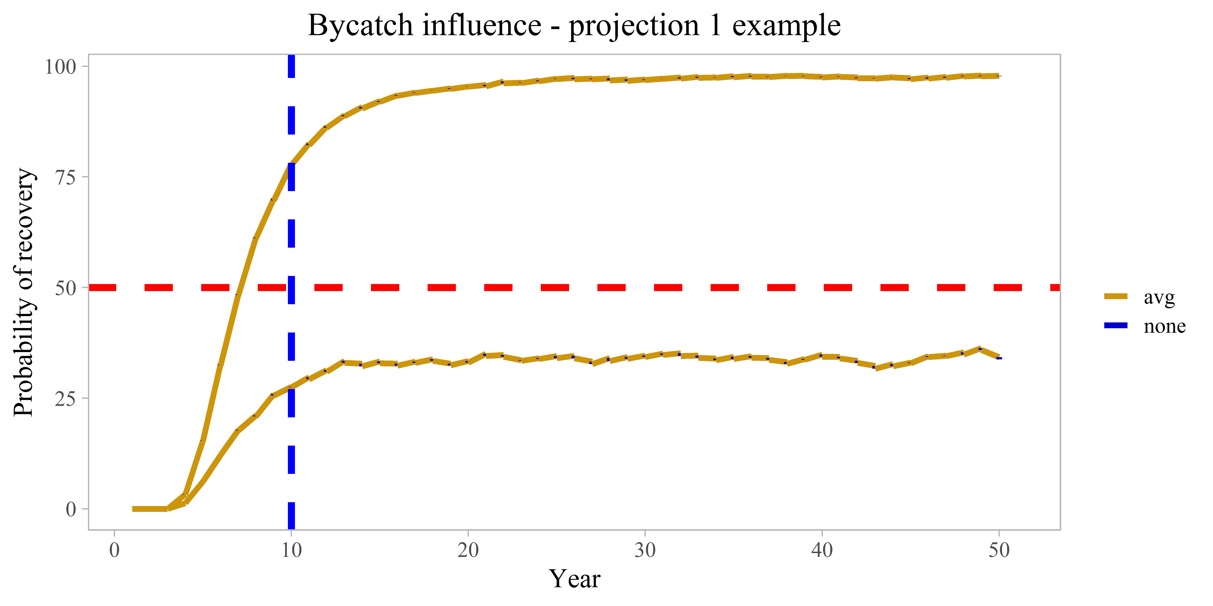
Notes:
Proj 1 a vs. b
Probability of recovery is being above Bmsy for 2 consecutive years.

Slide 19
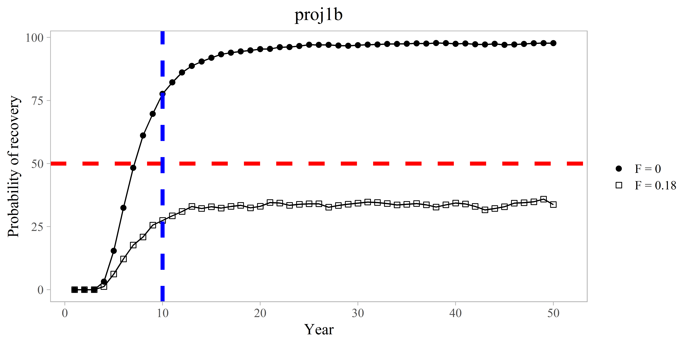
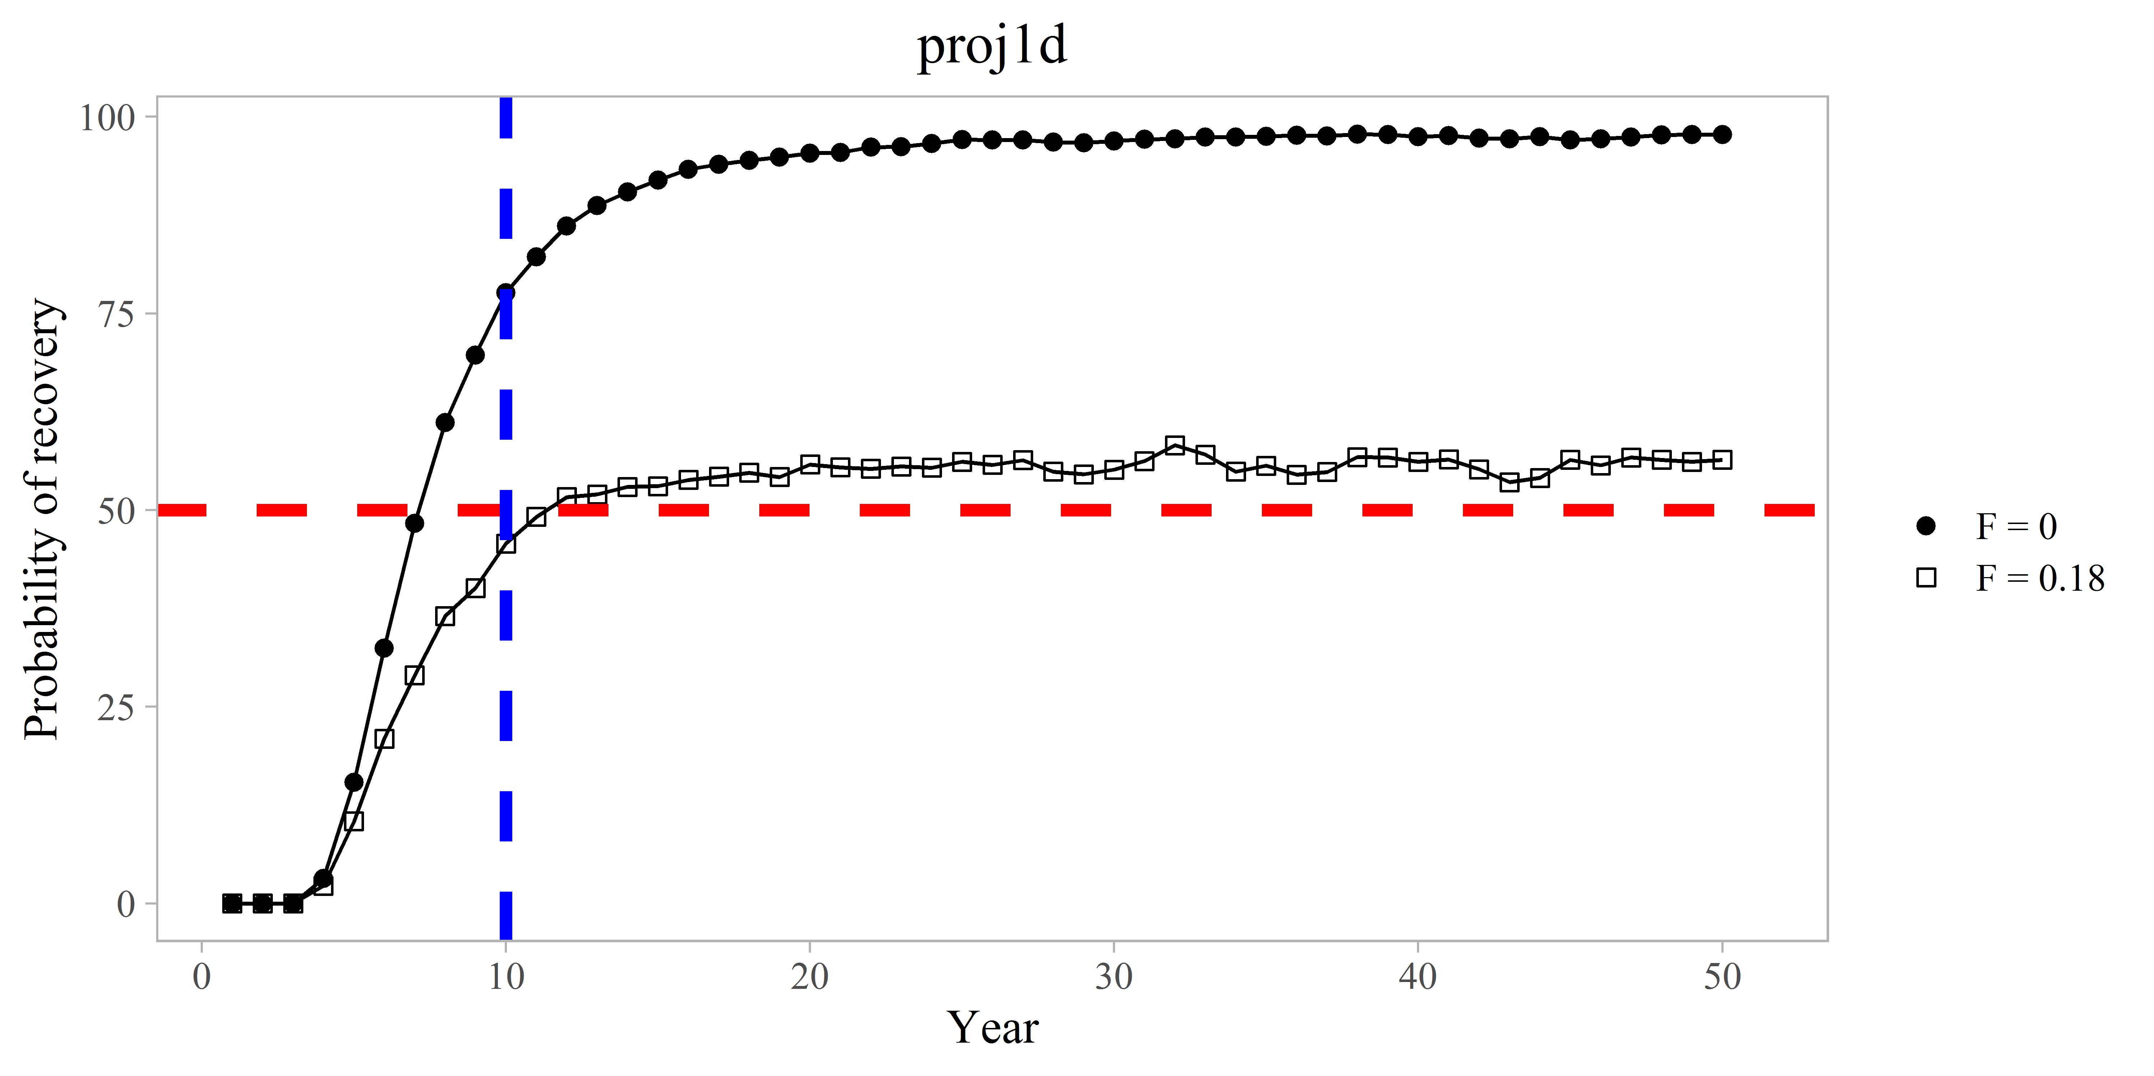
State harvest policy
b – off
d - on

Slide 20
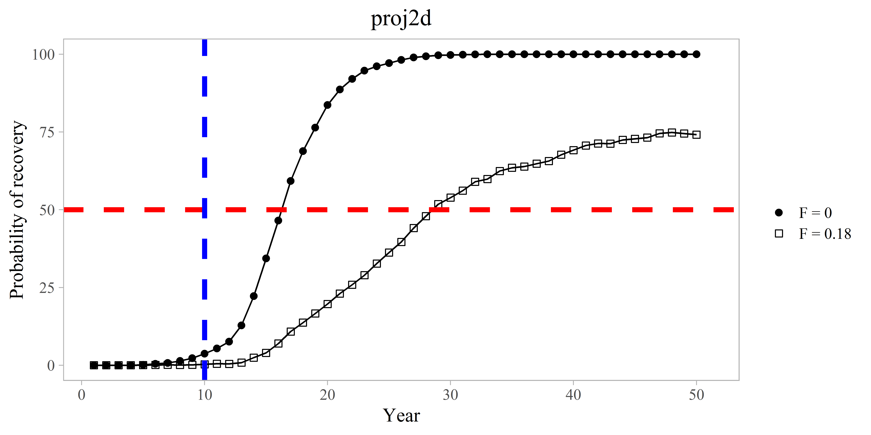
Ricker S-R relationship
Notes:
Figure 6: Comparison on by catch mortality on rebuilding probabilities using F = 0 and F = 0.18 projections
under assumptions of average recruitment for the entire time series.

Slide 21
Random Recruitment (1978-2017)
Notes:
Figure 6: Comparison on by catch mortality on rebuilding probabilities using F = 0 and F = 0.18 projections
under assumptions of average recruitment for the entire time series.

Slide 22
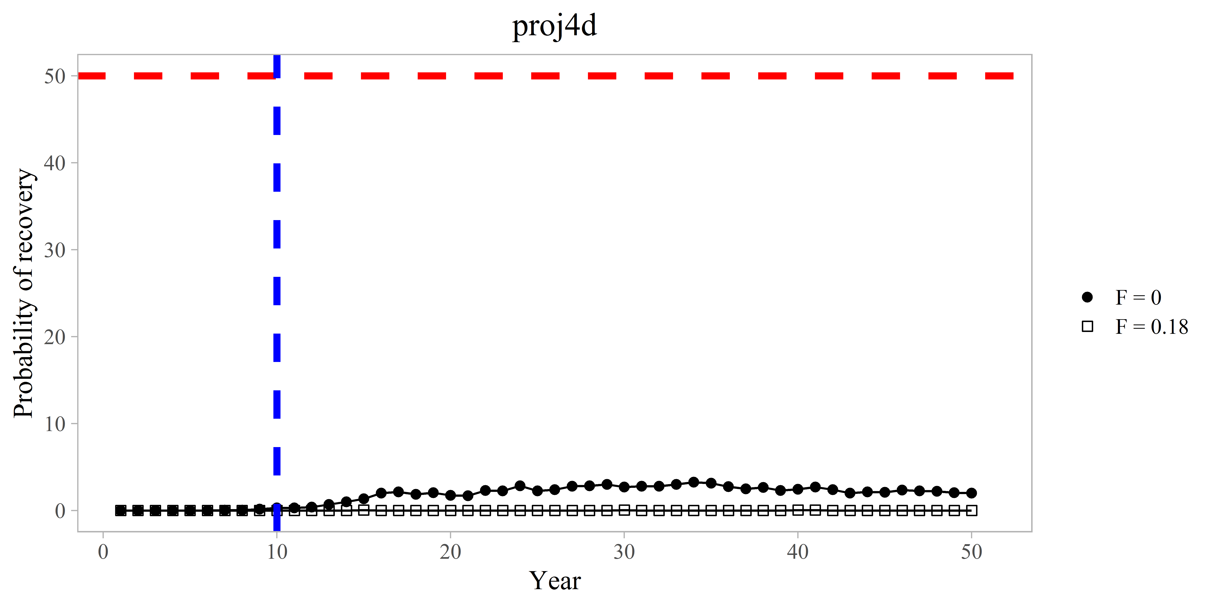
Random Recruitment (1996-2017)

Slide 23
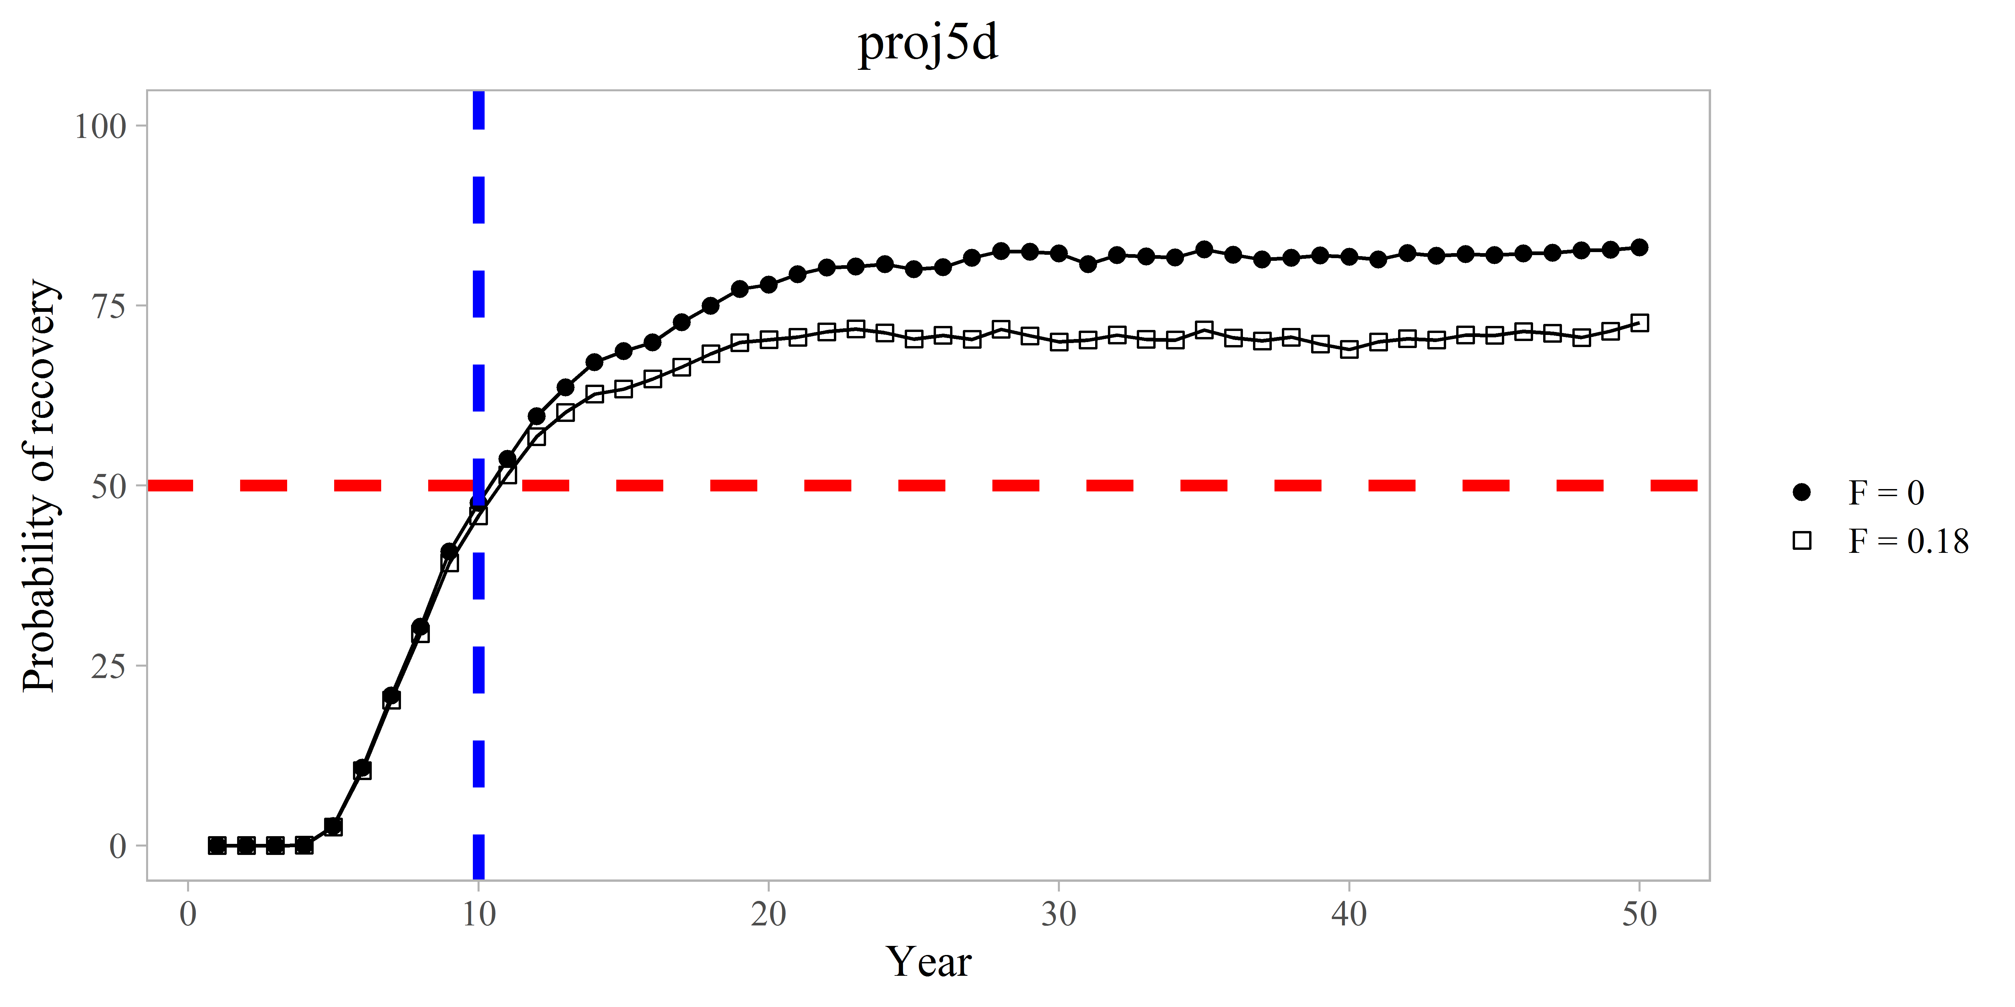
Random Recruitment (1996-2017) and B_{MSY} proxy (1996-2017)

Slide 24
T_{min} and T_{max}
Table 7: T_{min} for each projection version d with no directed fishing (F=0).
Projection | recruitment | B_{MSY} proxy | recruitment years | T_{min}
1 | random | 1978-2017 | 1978-2017 | 7.5 years
2 | Ricker | 1978-2017 |  | 16.5 years
3 | Beverton-Holt | 1978-2017 |  | 14.5 years
4 | random | 1978-2017 | 1996-2017 | 100+ years
5 | random | 1996-2017 | 1996-2017 | 10.5 years
6 | random | 1978-2017 | 1999-2008 | 100+ years
7 | random | 1978-2017 | 1989-2017 | 10 years

Slide 25
Decision points
Most probably assumption on recruitment?
Change B_{MSY} proxy years? Evidence for this?
T_{MIN} based on these choices
Weighed combinations of projections?

Slide 26
Table A5. Estimates of B_{MSY} proxy using the entire time series and model suggested breakpoint years for recruitment.
Year | Basis for B_{MSY} | B_{MSY} proxy | MSST | Biomass (MMB_{mating}) | B/B_{MSY}
2018/19 | 1978-2017 | 3.48 | 1.74 | 1.09 | 0.31
2018/19 | 1996-2017 | 2.03 | 1.015 | 1.09 | 0.53
Notes:
Figure A7. Computed B_{MSY} proxy (average mature male biomass) for the corresponding year ranges based on the 2018 assessment model with GMACS code updates.

Slide 27
T_{max} / Generation time
Age of recruitment – 7 : Generation time – 13.59
Age of recruitment – 6 : Generation time – 12.59

Slide 29
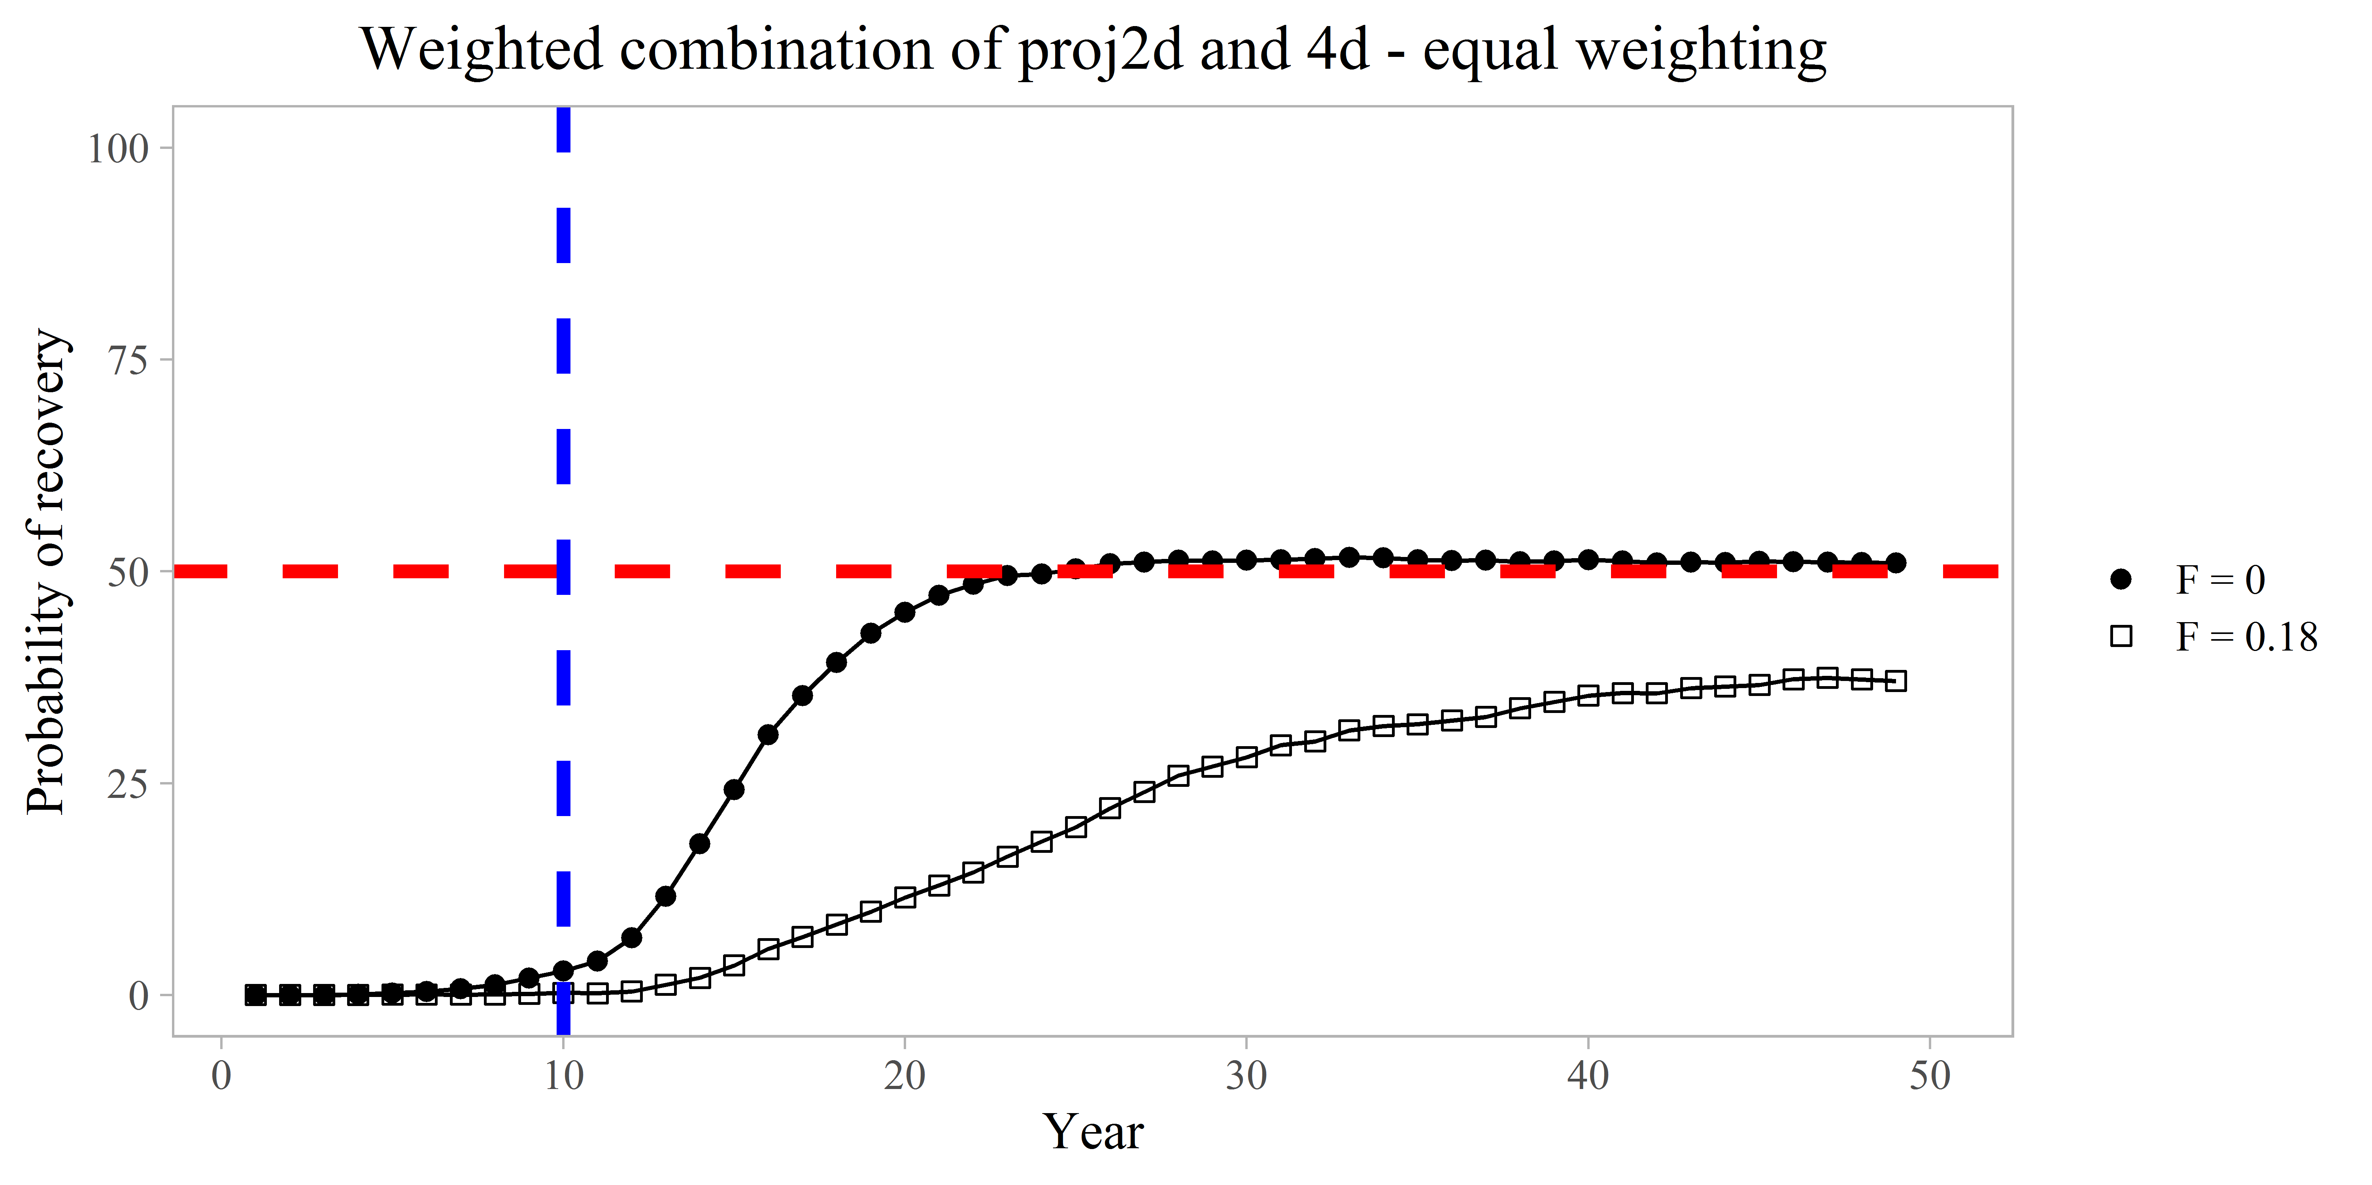
Notes:
2 is ricker S-R relationship, 4 is “random” recruitment from 1996- 2017

Slide 30
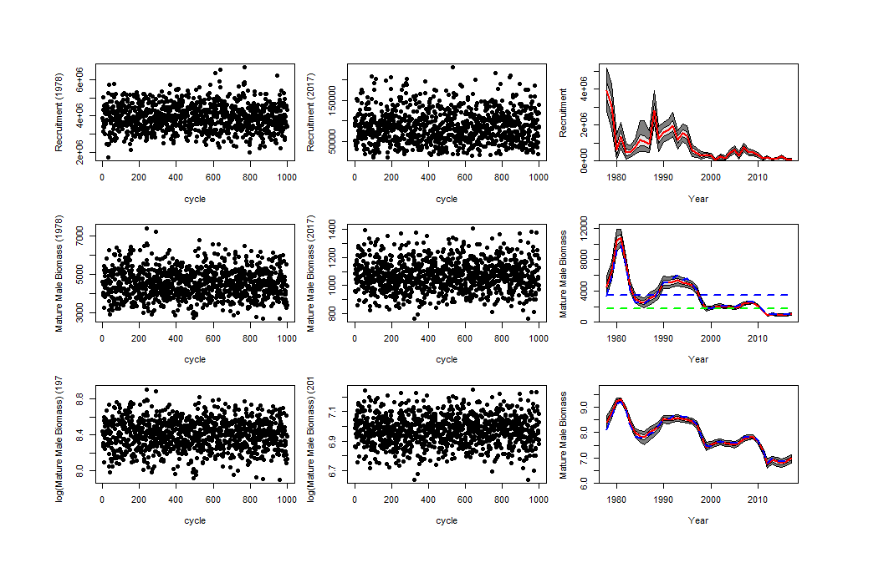
Notes:
Projection 1 mcmc output

