Slide 1

NPFMC Social Science Planning Team
Virtual Meeting on EDR Revisions
March 4, 2021
Presented by Steve Kasperski (AFSC)

Slide 2
Meeting Objectives
Discuss EDR Stakeholder Workshops and summary report
Provide recommendations to the Council on potential EDR program amendments
Discuss next steps for the SSPT

Slide 3
Agenda
Time (AKT) | Topic | Lead (rapporteur)
8:00 am | Introduction to and troubleshooting for Adobe Connect | Sarah and admin
8:05 am | Introductions, roll-call, definitions, review of assignments, and meeting objectives | Steve (Sarah)
8:30 am | Economic Data Collections and uses in other U.S. Regions | Doug Lipton (Seth)
9:00 am | EDR Workshop Report and discussion | Katie Latanich (Scott)
9:45 am | Break
10:00 am | Discussion of Crab EDR | Steve (Marysia)
11:00 am | Public Comment* | Steve (Sarah)
11:30 am | Lunch
12:30pm | Discussion of Gulf Trawl EDR | Steve (Matt)
1:00 pm | Discussion of Amendment 91 EDR | Steve (Mike F.)
1:30 pm | Discussion of Amendment 80 EDR | Steve (Kate)
2:30 pm | Break
2:45 pm | Concluding EDR discussion | Steve (Courtney)
3:15 pm | Status of other Council bodies and next steps for the SSPT | Kate/Sarah (Sam)
3:45 pm | Other business | Steve (Mike D.)
4:00 pm | Adjourn
*A public comment opportunity is scheduled for 11 am, however additional public comment may be taken during the meeting at the discretion of the chair. You can indicate your interest in providing oral comment in the chat pod during the meeting.

Slide 4
Definitions
Data element: a defined unit of information elicited in an EDR questionnaire form, which may require one or more responses (i.e., stratified by fishery).
Statistic: a quantity computed from values in a sample, for example, measures of central tendency (mean/median) and distribution (variance, skewness).
Performance metric: a statistic that represents a level of achievement of one or more specific objective(s).
Burden: Not simply the time, effort, and financial costs associated with responding to a data collection, but also the cognitive burden to report complicated statistics as well as the burden of disclosing information the respondent would rather keep private.
Data quality: Data that are fit to use for their intended purpose. It does not mean “accuracy” or “precision”.

Slide 5
General strategy for today
Please use the hand raise feature, I’ll start with SSPT members and then the public as time allows.
We will move forward on the agenda once the previous item is concluded.
Katie will provide a overview of cross-cutting themes during the morning session and then also kick off each EDR discussion with specific issues.
We’ll then review the analytical objectives of the EDRs as stated in the P&Ns
  What performance metrics are needed to meet those analytical objectives?
  Is the current EDR providing that information?
  Is that information still needed? Or should we suggest the Council reconsider the P&N?
Two new tools are available for our deliberations
  EDR information collected by each table in each EDR form (All EDR Categories.xlsx)
  Data element to performance metric mapping exercise (EDR mapping exercise.xlsx)

Slide 6
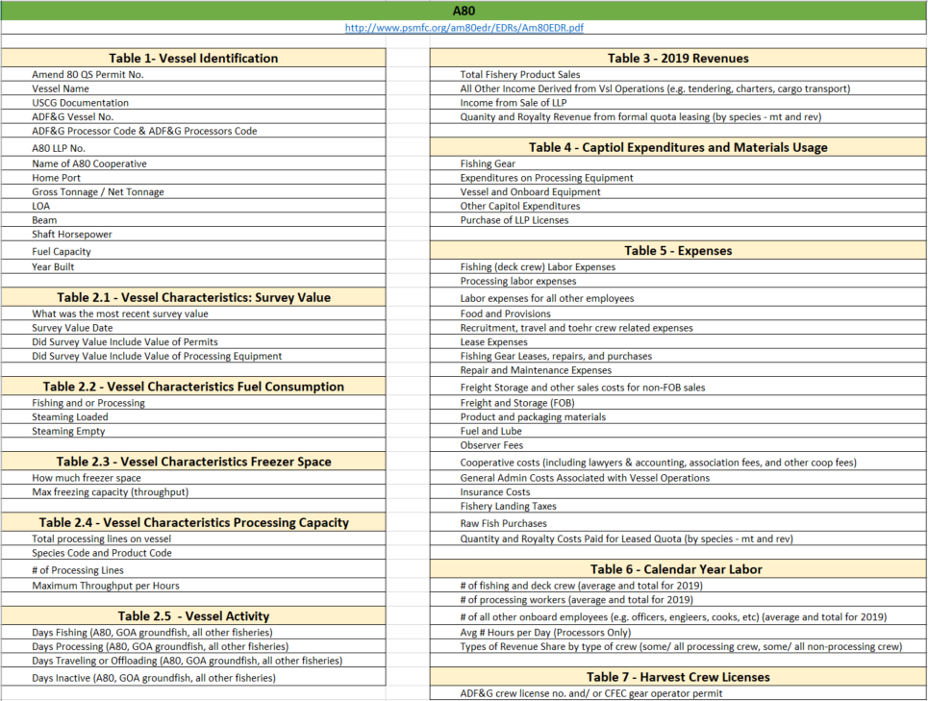
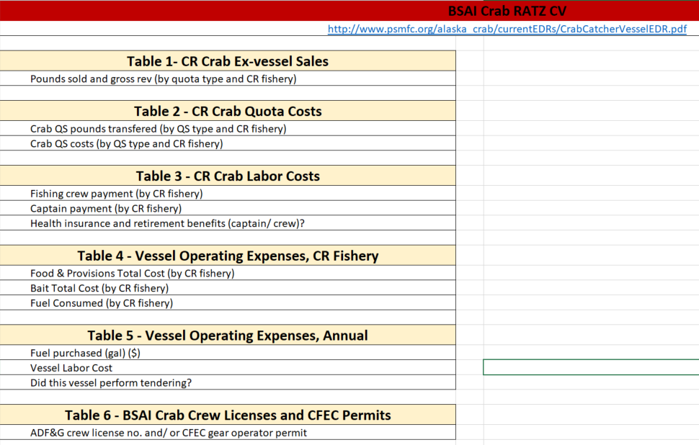
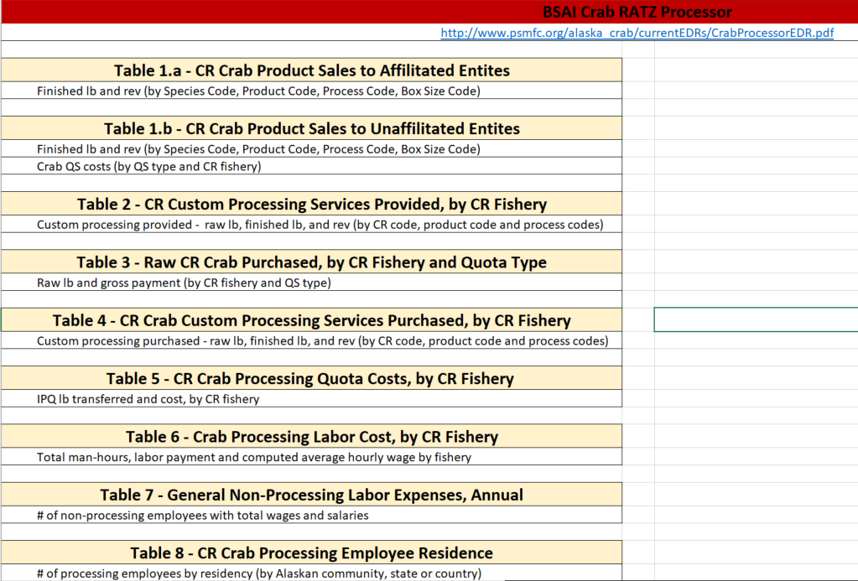
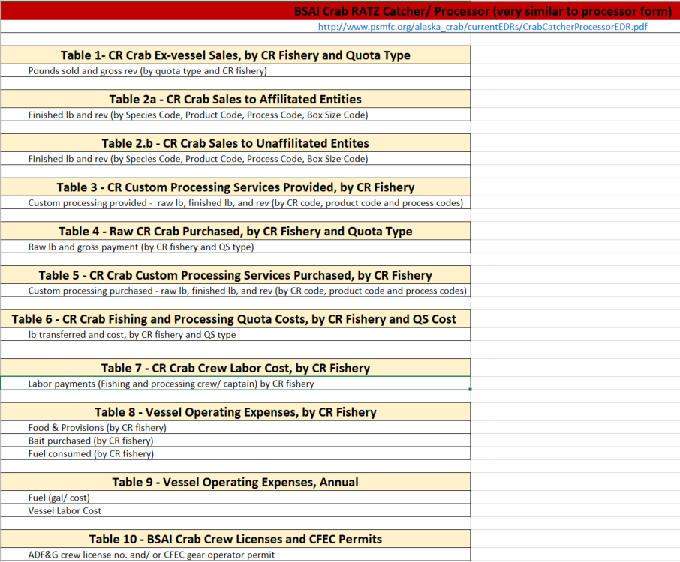
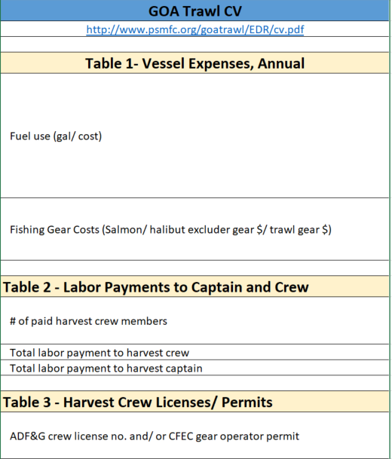
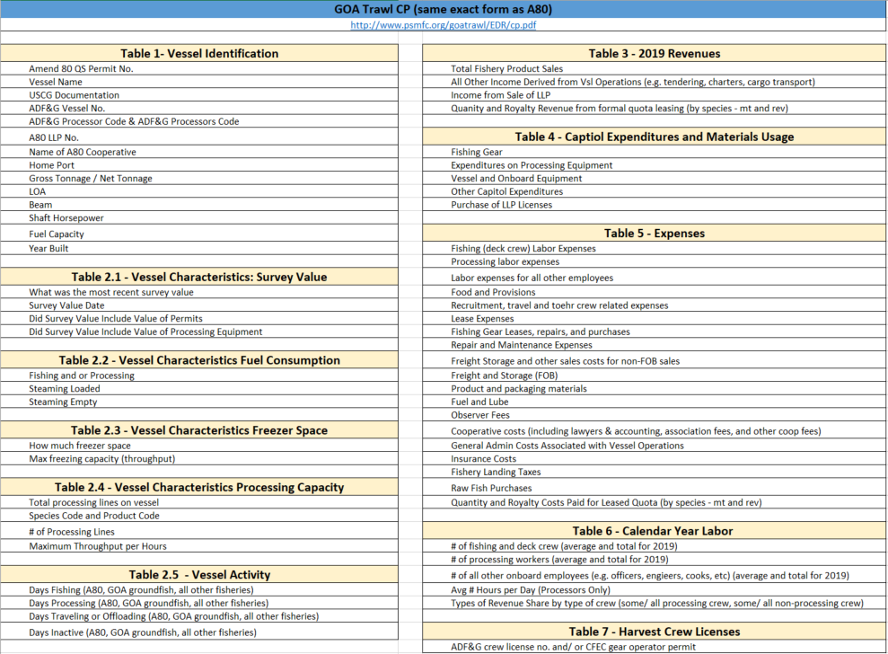
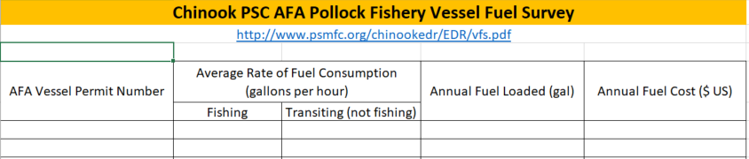
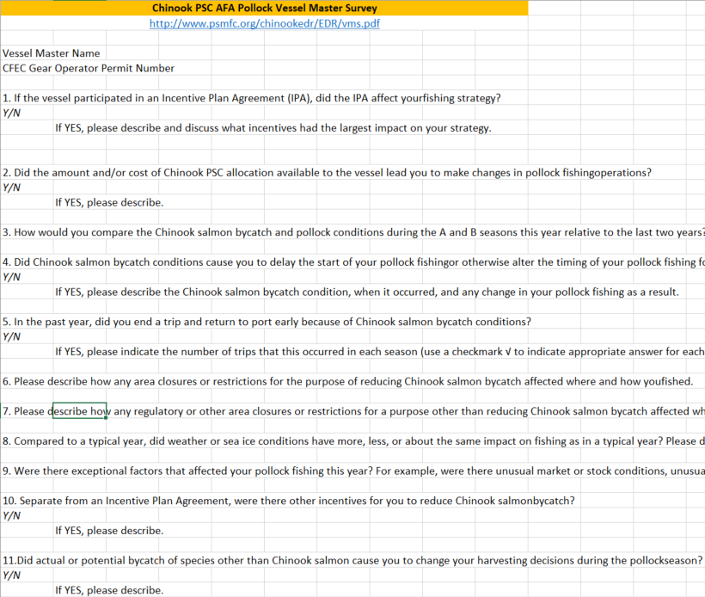
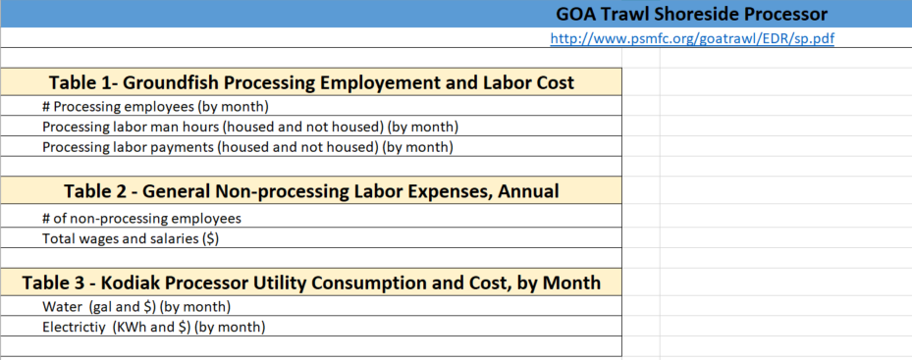
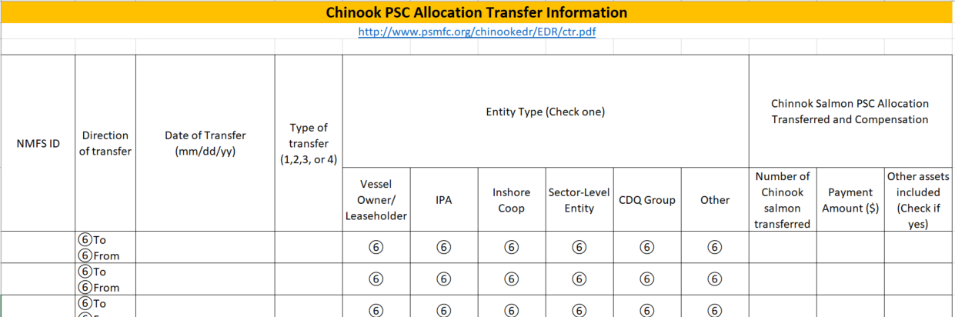
All EDR Categories.xlsx

Slide 7
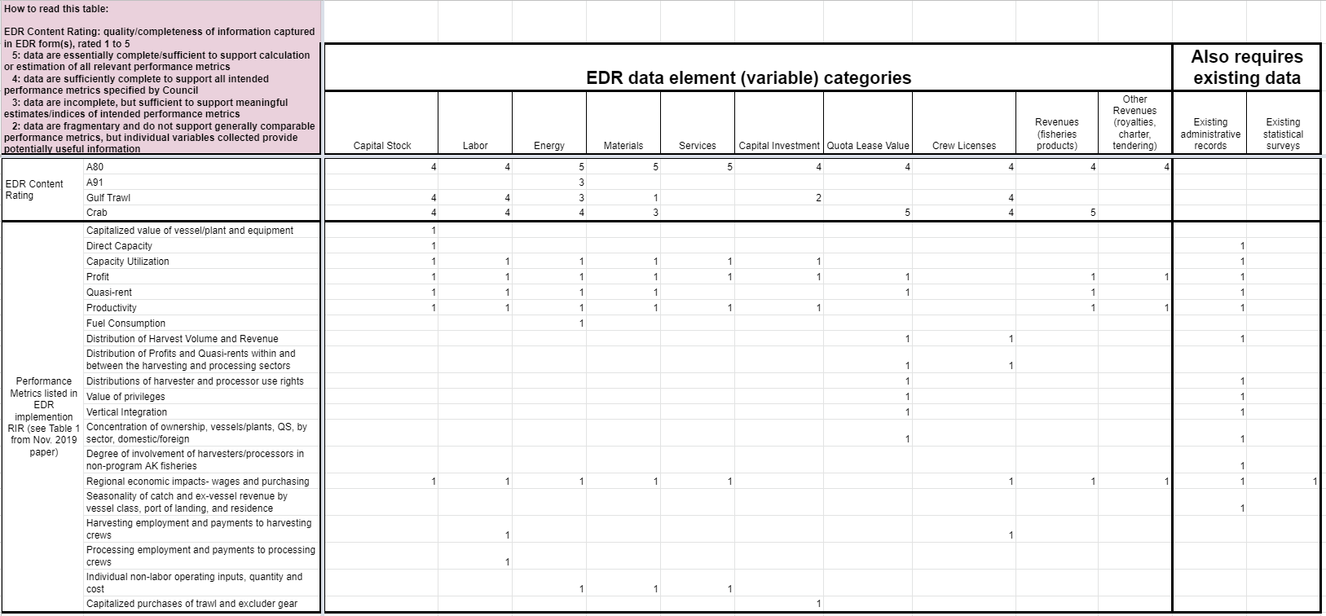
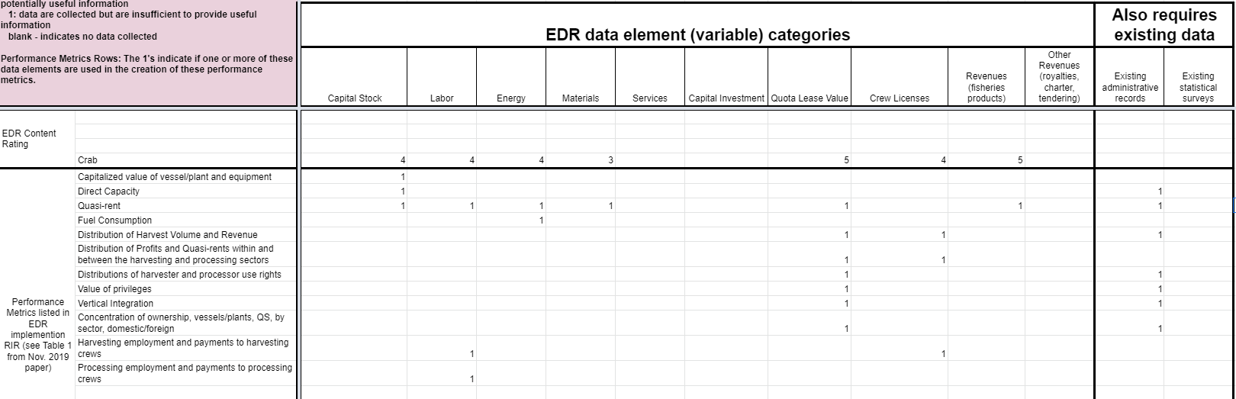
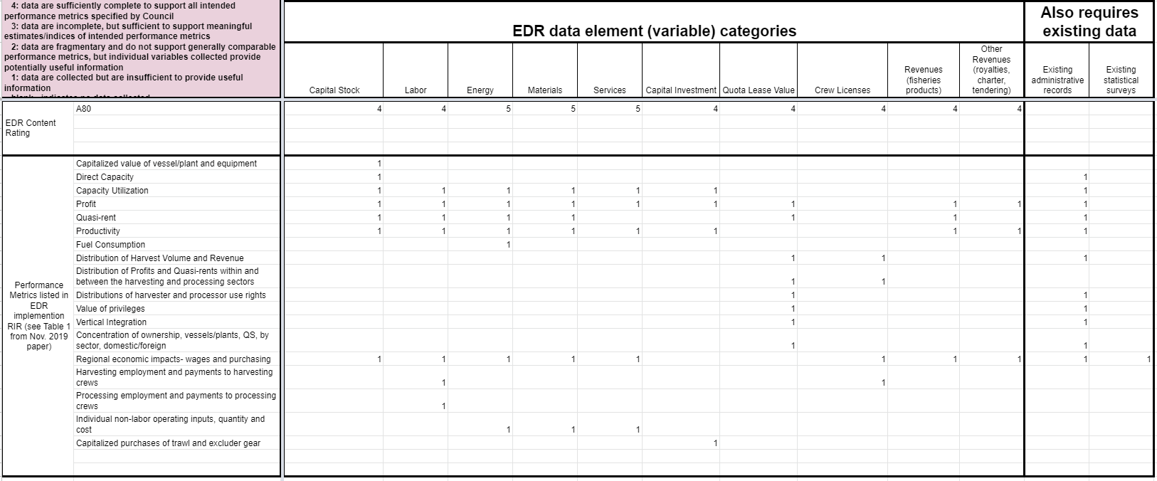
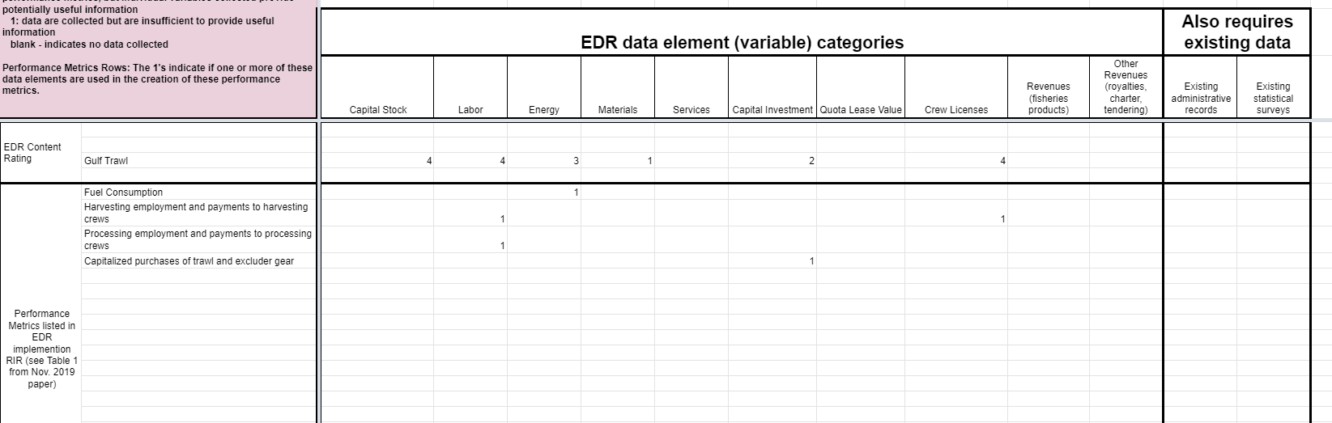
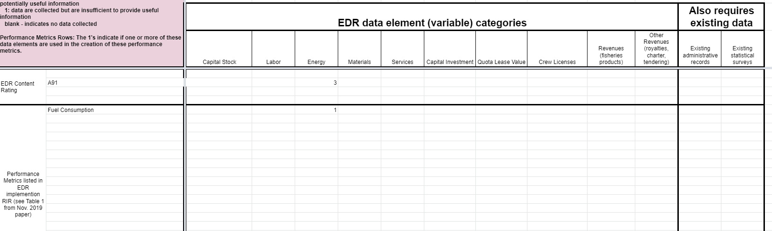
EDR mapping exercise.xlsx

Slide 8
PURPOSE AND FUNCTIONS OF STATISTICAL DATA COLLECTION
PERFORMANCE METRICS
MONITOR
Consistently measure and report performance metrics
Capture variation within populations and over time
Identify important trends
Frequency
EXPLAIN
Identify systematic change and drivers of variation
Analyze effects of management measures
Understand economic and social conditions of fisheries
Model response to changes in resource and external factors
Complexity
PREDICT
Evaluate effects of management alternatives
Forecast trends under current conditions
Anticipate effects of changing conditions

Slide 9
Existing estimates of EDR burden and cost (summarized from Tables 6 and 9 from April 2019 DP)
Program | Total annual respondents | Annual burden hours | Annual burden cost | Average annual implementation cost (2016/17)‡ | Total burden and cost per respondent per year
Crab | 95 | 1,893 | $312,345 | $262,838 | $6,054
GOA Trawl | 114 | 1,299 | $48,063 | $89,868* | $1,210/$422†
Amendment 80 | 27 | 508 | $18,796 | $66,114 | $3,415
Amendment 91 | 177 | 708 | $60,300 | $82,550 | $807
*AFSC and the NMFS Office of Science and Technology cover these costs
† industry burden and cost per respondent per year
‡ Total 2020 EDR implementation costs across all programs was $260,000, and is estimated to be $250,000 in 2021

Slide 10
EDR Collections
Management effects & Performance metrics
Crab CV EDR
Crab CP EDR
Crab Processor EDR
EFFICIENCY
Profit (revenue - total cost)
Operating profit (revenue – operating cost)
Net cost/bycatch avoided
Crab
Trawl CP EDR
A80
EQUITY
Crew share (% adjusted gross)
Quota share value ($/unit)
Ownership concentration
Vessel Fuel Survey
Compensated Transfer Report
Vessel Master Survey
A91
STABILITY
Local/Regional Employment & Income
Profitability
Capital maintenance/investment
Trawl CV EDR
Shoreside Processor EDR
GOA

