Slide 1
Economic Data Reporting (EDR)
November 2020 Stakeholder Discussions
Summary and Themes
Part 2: Themes by EDR Form
NPFMC Social Science Planning Team Meeting, 3/4/21
Katie Latanich, Facilitator

Slide 2
EDR Stakeholder Discussion Tasks
Task 1: Review EDR purpose and need
Task 2: Provide input on opportunities for consistency across EDRs
Task 3: Review EDR forms and variables

Slide 3
Cross-Cutting Themes (already reviewed)
Reminder: these came up in most or all meetings. Our review of Tasks 1 and 2 by EDR/sector includes points in addition to what we have already shared.
Task 1: Review EDR purpose and need
Context and history
Focus and scope - focused or broadly informative?
Drivers - why have EDRs?
Responsiveness - managing expectations
Duration of data collection
Task 2: Provide input on opportunities for consistency across EDRs
Linkage with purpose and need discussions
Suggests need for simplification and consistent interpretation of the information requested

Slide 4
BSAI Crab Rationalization EDR

Slide 5
Task 1: Purpose and need
Focus: 2 purpose and need statements (2002 and 2012; 2012 focuses on concerns about data quality and excessive burden
Participants’ feedback covered under cross-cutting themes
Analysts felt EDR revision process can be an opportunity to clarify or make more explicit (elements of original P&N, broader data collection objectives)
BSAI Crab EDR
Report: Pages 12-13

Slide 6
Task 2: Consistency
Covered previously under cross-cutting themes
  Closely linked to purpose and need discussion
  Suggests the need for simplification and consistent interpretation of the information being requested
BSAI Crab EDR
Report: Pages 16-17

Slide 7
Task 3: Sector-specific considerations
Topic: Quota lease costs
Analysts identified as one opportunity for improvement, for example:
  Alignment between how quota is managed and how information is reported
  Redistribute reporting burden
Feedback - easier to collect at vessel level than from shareholders
BSAI Crab EDR
Report: Page 24

Slide 8
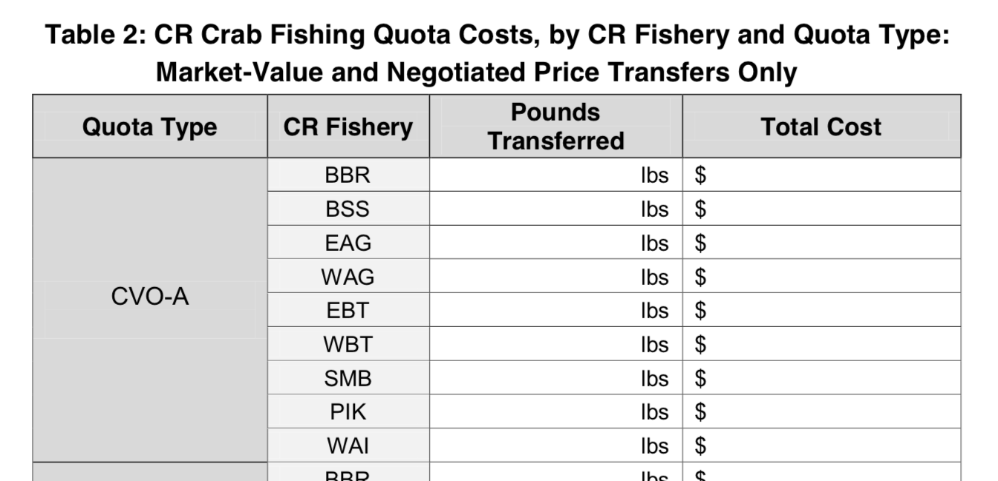
Task 3: Sector-specific considerations
Topic: Quota lease costs
Source: BSAI Crab CV EDR (excerpt)

Slide 9
Task 3: Sector-specific considerations
Topic: Complexity of ownership information
Complicated to link harvest boats with shareholders
An attribute of the fishery participants feel could be better understood
BSAI Crab EDR
Report: Page 24

Slide 10
Task 3: Sector-specific considerations
Topic: Burden of reporting by CR quota type and fishery
Tables:
  Table 1: CR Crab Ex-vessel Sales, by CR Fishery and Quota Type
  Table 2: CR Crab Fishing Quota Costs, by CR Fishery and Quota Type
  Table 4: Vessel Operating Expenses, by CR Fishery
Does add to burden but there are reasons to break down this way; also a question for the Council
BSAI Crab EDR
Report: Page 24

Slide 11
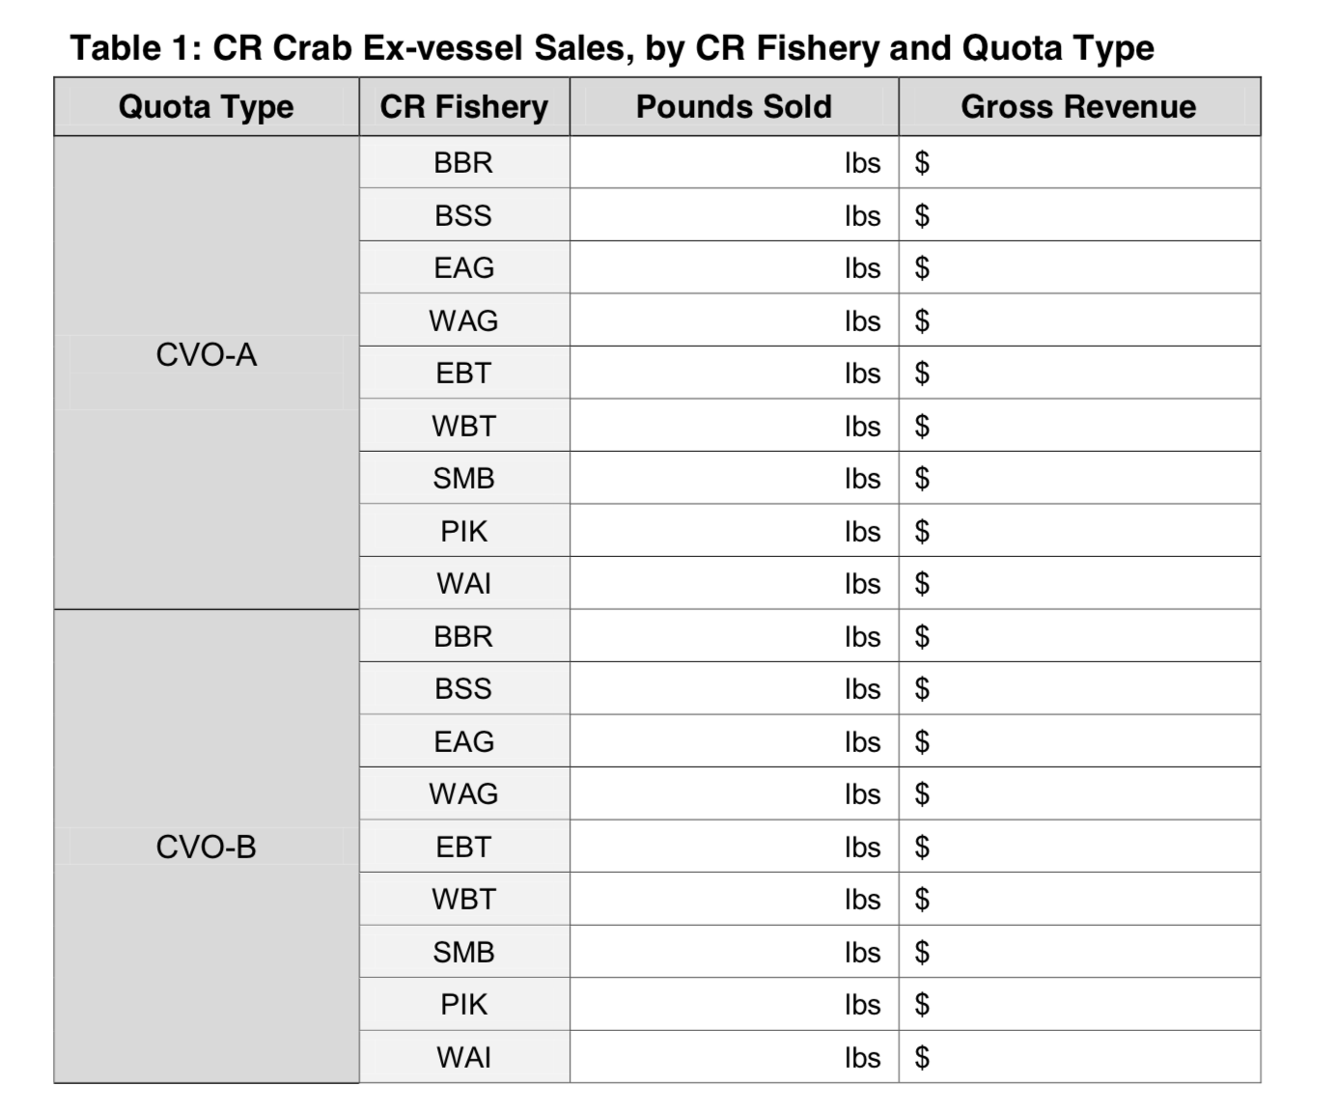
Task 3: Sector-specific considerations
Topic: Burden of reporting by CR quota type and fishery
Source: BSAI Crab CV EDR (excerpt)

Slide 12
Task 3: Sector-specific considerations
Topic: Burden of reporting by CR quota type and fishery
Tables:
  Table 1: CR Crab Ex-vessel Sales, by CR Fishery and Quota Type
  Table 2: CR Crab Fishing Quota Costs, by CR Fishery and Quota Type
  Table 4: Vessel Operating Expenses, by CR Fishery
Does add to burden but there are reasons to break down this way; also a question for the Council
BSAI Crab EDR
Report: Page 24

Slide 13
Task 3: Sector-specific considerations
Topic: Accounting for complex quota transfer situations
Examples and opportunities for clarification
  Overages and forfeitures
  Flow-through leases
Can complicate reporting “pounds sold” (Table 1) - could request in terms of pounds allocated
Respondents: “do our best” and provide explanation
  Possibility of a “check box” to prompt a follow up call
BSAI Crab EDR
Report: Pages 25-26

Slide 14
Task 3: Sector-specific considerations
Topic: Fuel costs
Tables:
  Table 4: Vessel Operating Expenses, by CR Fishery
  Table 5: Vessel Operating Expenses, Annual
Request information across CR fisheries and activities including tendering
Analysts: Simplified from earlier EDR; simpler and more consistent method, accepted methods for disaggregation of costs across fisheries
BSAI Crab EDR
Report: Page 26

Slide 15
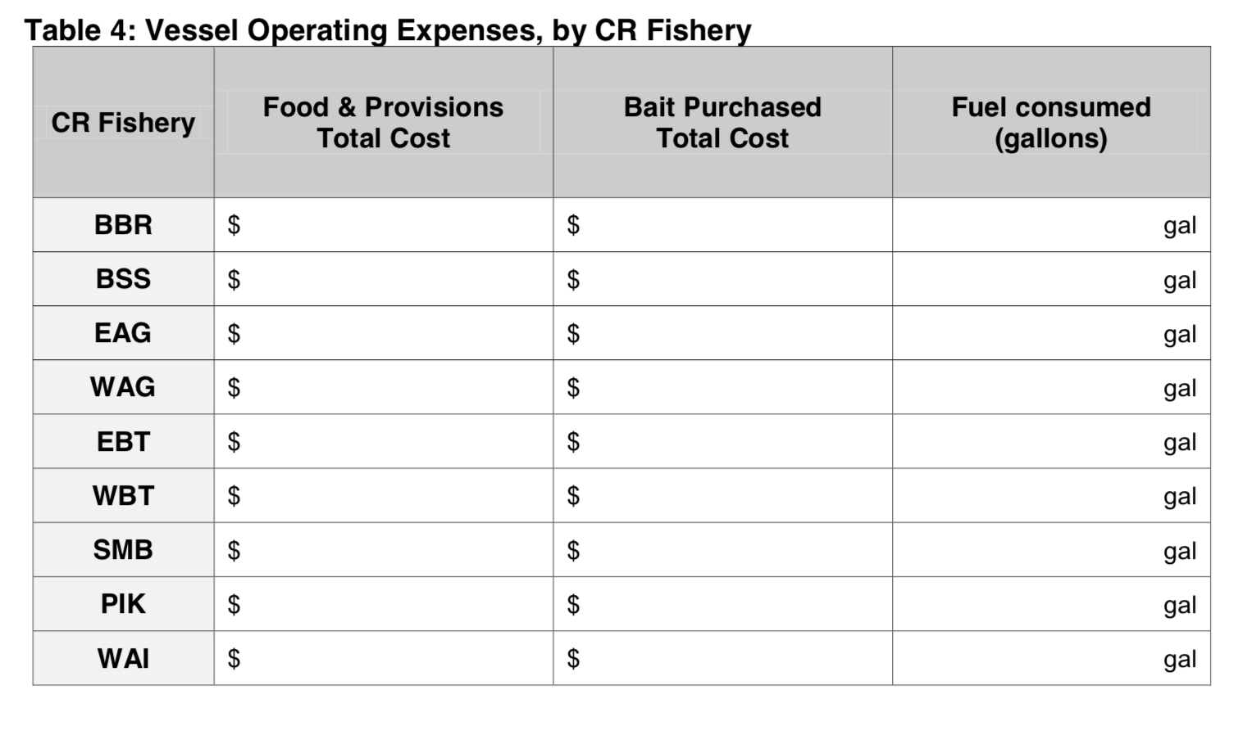
Task 3: Sector-specific considerations
Source: BSAI Crab CV EDR

Slide 16
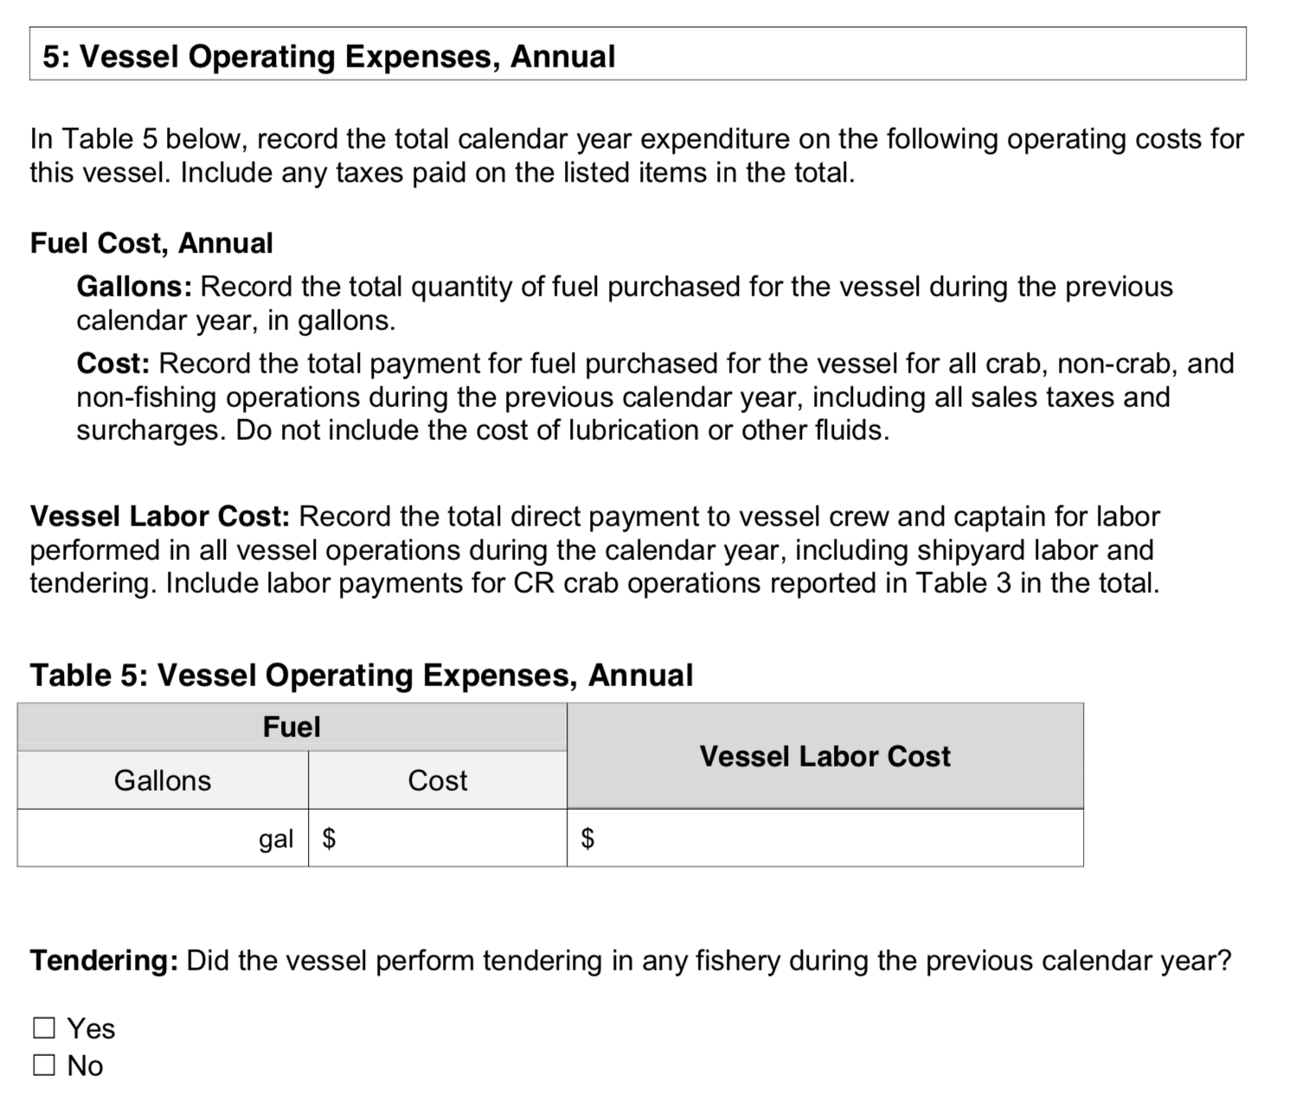
Task 3: Sector-specific considerations
Source: BSAI Crab CV EDR

Slide 17
Questions?

Slide 18
2. Gulf of Alaska Groundfish Trawl EDR

Slide 19
Task 1: Purpose and need
From purpose and need: “The Council is interested in developing a data collection program that can be established prior to the implementation of a trawl catch share program in the GOA.”
Focus: Agreement on need to revisit P&N, participants feel is no longer relevant
Other concerns:
  Data quality, consistency of interpretation
  Equity - why should this fishery have an EDR?
  Burden - not supported by cost recovery; time and opportunity cost
GOA Trawl EDR
Report: Pages 15-16

Slide 20
Task 2: Consistency
Complexity of the Gulf of Alaska region contributes to fragmentation, complicates the concept of consistency, and limits utility of data (e.g, establishing a baseline)
GOA Trawl EDR
Report: Page 18

Slide 21
Task 3: Sector-specific considerations
Broader context: Stakeholder perspective that the program should be discontinued
Two sets of issues:
  Fuel costs
  Community and crew information
GOA Trawl EDR
Report: Pages 28-30

Slide 22
Task 3: Sector-specific considerations
Topic: Fuel costs (GOA Trawl CV EDR)
Aggregation of fuel costs across fishing and non-fishing activities - why?
Utility for understanding impacts of rationalization
Inclusion of fuel-related expenses, e.g. filters
Fuel used during tendering - respondents may report differently
GOA Trawl EDR
Report: Pages 28-29

Slide 23
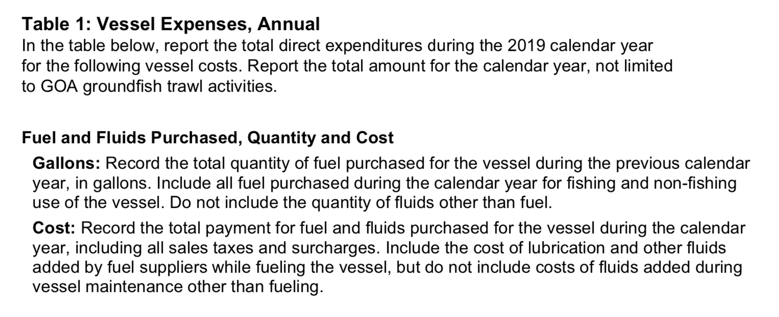
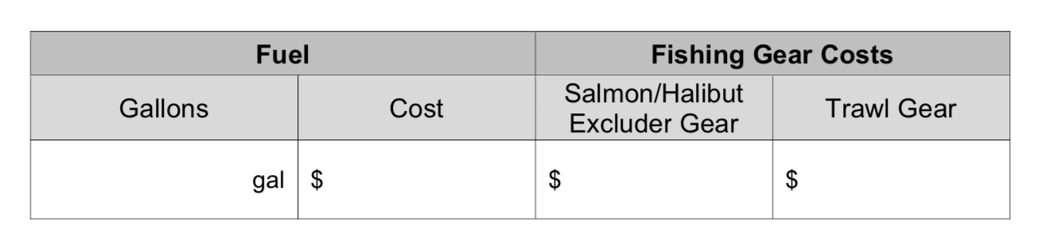
Task 3: Sector-specific considerations
Source: GOA Trawl CV EDR

Slide 24
Task 3: Sector-specific considerations
Topic: Communities and crew (general)
Utility of EDR for social impact assessment, particularly communities - limited to date though used for Central GOA Rockfish Program Reauthorization SIA; interest in Council perspective
Other points
  Gathering information from harvesting and processing sectors
  Utilizing data available from other sources
  Concern about representative picture of changing communities
GOA Trawl EDR
Report: Pages 29-30

Slide 25
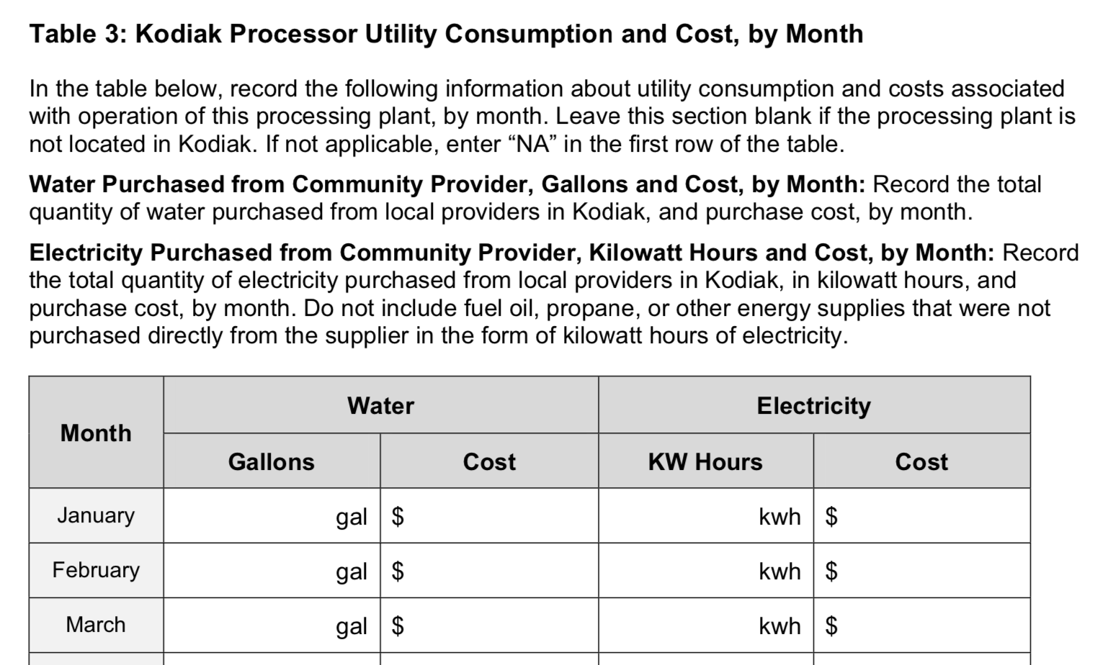
Task 3: Sector-specific considerations
Topic: Communities and crew (Shoreside Processor EDR)
Water and electricity use potentially useful but utility limited by confidentiality concerns
Source: GOA Trawl Shoreside Processor EDR
GOA Trawl EDR
Report: Page 30

Slide 26
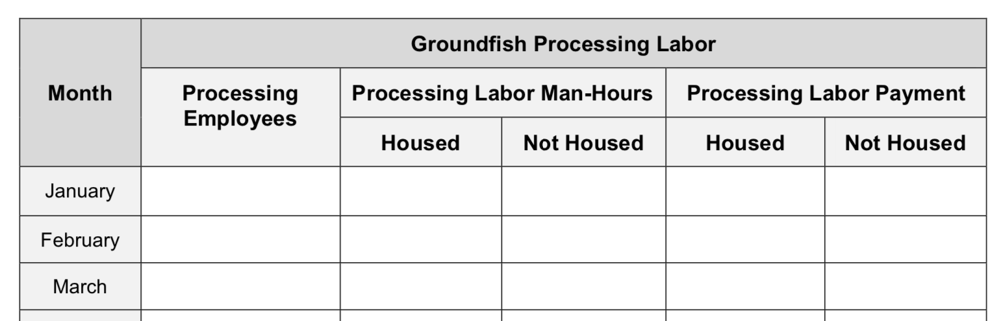
Task 3: Sector-specific considerations
Topic: Communities and crew (Shoreside Processor EDR)
Concern about limited utility due to interpretation; is breakdown of resident and non-resident labor available from other sources?
Information on number of crew family members would be valuable
Table 1: Groundfish Processing Employment and Labor Cost
Source: GOA Trawl Shoreside Processor EDR
GOA Trawl EDR
Report: Page 30

Slide 27
Questions?

Slide 28
3. Amendment 91 Chinook Salmon EDR

Slide 29
Task 1: Purpose and need
Agreement on need to revisit P&N, participants feel is no longer relevant
2 areas of focus
  Relationship between EDRs and annual Incentive Plan Agreements
  Feasibility of gaining insight into complex bycatch avoidance behavior
Amendment 91 EDR
Report: Pages 13-15

Slide 30
Task 1: Purpose and need
Issue: Relationship between EDRs and annual Incentive Plan Agreements
Perceived as duplicative
Lack of feedback on IPA reports
“Study and verify” wording implies lack of trust (“The data collection program will also provide data for the agency to study and verify conclusions drawn by industry in the IPA annual reports”)
Whether EDRs designed with knowledge of what would be included in IPA annual reports (different perspectives)
Amendment 91 EDR
Report: Pages 13-14

Slide 31
Task 1: Purpose and need
Issue: Feasibility of gaining insight into complex bycatch avoidance behavior
Compensated transfer report not used and does not align with industry practice
Vessel master survey and vessel fuel survey forms (Addressed later under Task 3)
Managing expectations - existing EDR data not sufficiently detailed to answer specific complex questions or inform predictive models
Amendment 91 EDR
Report: Pages 14-15

Slide 32
Task 2: Consistency
Agreement that this program is different than other EDRs and existing P&N does not align with the concept of consistency
One interpretation of consistency - consistent economic information across catch share programs including AFA
  Industry not in favor of consistency for assessing different programs/P&Ns; AFA a Congressionally mandated program
  Analysts noted use of EDR data to fulfill requirements, impacts of fragmentation to utility (e.g. BSAI Pacific cod mothership action)
Amendment 91 EDR
Report: Page 18

Slide 33
Task 3: Sector-specific considerations
Overall focus
Broader context: stakeholder view that P&N is no longer relevant and should be discontinued; don’t see potential for small changes to reduce burden
Additional discussion of Vessel Master Survey and Vessel Fuel Surveys (also came up under Task 1) - insight into complex bycatch avoidance behavior
Amendment 91 EDR
Report: Pages 27-28

Slide 34
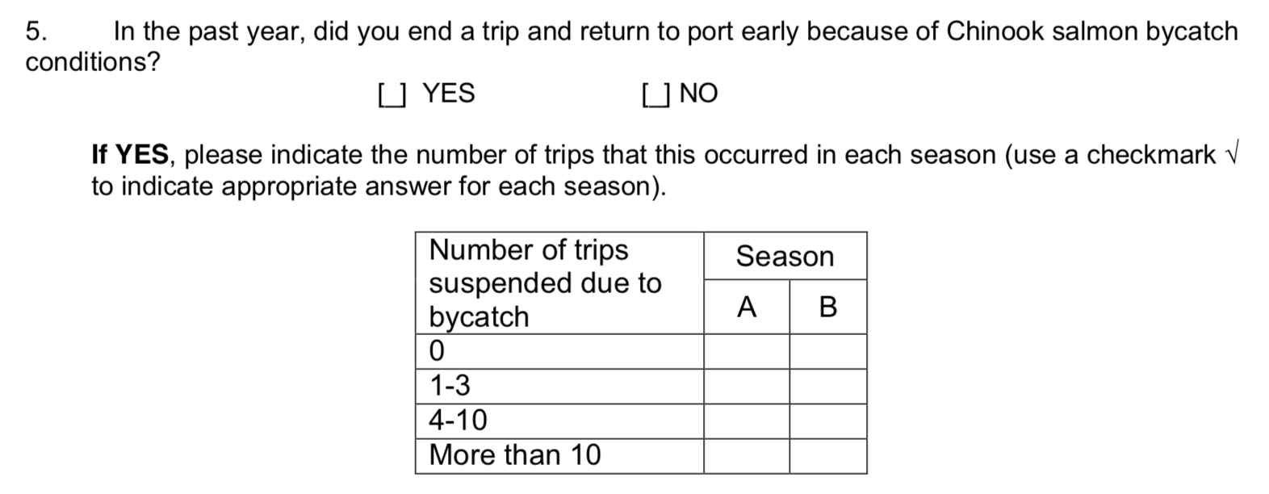
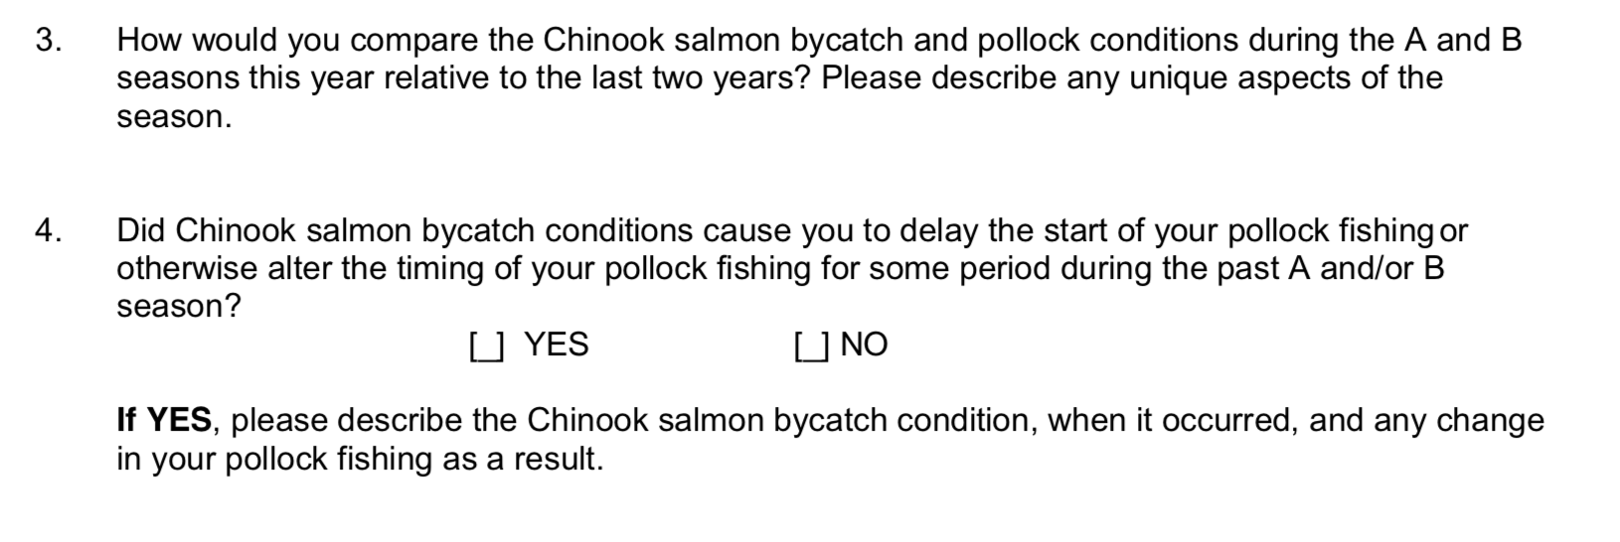
Task 3: Sector-specific considerations
Topic: Vessel Master Survey
Source: Amendment 91 Vessel Master Survey (excerpt)

Slide 35
Task 3: Sector-specific considerations
Topic: Vessel Master Survey
Analysts: data collection has not functioned as intended, primarily survey design
  Vessel movement data not available
  Vessels may move/incur costs for multiple reasons, not just a high bycatch tow
Discussion of ideas for adjusting survey protocol
Utility of survey for providing descriptive context for stock assessment
Concerns about duplication and data gaps
Amendment 91 EDR
Report: Pages 27-28

Slide 36
Questions?

Slide 37
4. Amendment 80 EDR

Slide 38
Task 1: Purpose and need
2 areas of focus
Assessing incremental economic impacts of bycatch reduction measures over time
Focus of EDR: impacts of bycatch reduction or broader economic performance?
Amendment 80 EDR
Report: Pages 11-12

Slide 39
Task 1: Purpose and need
Issue: Assessing incremental economic impacts of bycatch reduction measures over time
PSC reductions ongoing, not a one-time change
Relevance to Council’s consideration of area-based Pacific halibut management
  Utility for predicting impacts
  Broader focus is on practicability
Amendment 80 EDR
Report: Pages 11-12

Slide 40
Task 1: Purpose and need
Issue: Focus of EDR: impacts of bycatch reduction or broader economic performance?
P&N references bycatch reduction and broader utility
Concerns related to narrower focus on bycatch - level of detail, variables that change infrequently, utility of some variables unclear
Managing expectations and assigning causality
If Council considers changing P&N, broader focus on general trends in economic performance may be appropriate
Amendment 80 EDR
Report: Pages 11-12

Slide 41
Task 1: Purpose and need
Amendment 80 EDR, June 2006
The purpose of the data collection program is to understand the economic effects of the Amendment 80 program on vessels or entities regulated by this action, and to inform future management actions. The data is needed to assess whether Amendment 80 addresses some goals in the problem statement to mitigate, to some degree, the costs associated with bycatch reduction. Data will be used by Council and agency staff, recognizing that confidentiality is of extreme importance.
Economic data collected under this program include employment data by vessel collected to determine the labor amounts and costs for the sector. In addition, revenue and cost data by vessel will be collected to evaluate trends in returns to the sector that may be compared with elements of the Amendment 80 program, such as bycatch reduction measures.

Slide 42
Task 2: Consistency
Covered previously under cross-cutting themes
  Closely linked to purpose and need discussion
  Suggests the need for simplification and consistent interpretation of the information being requested
Amendment 80 EDR
Report: Pages 16-17

Slide 43
Task 3: Sector-specific considerations
Overall focus
In-depth discussion of opportunities for streamlining and clarifying
Focus on variables that change infrequently
Amendment 80 EDR
Report: Page 21

Slide 44
Task 3: Sector-specific considerations
Topic: Components of burden
Some EDR information can be exported from accounting software
Some information tracked specifically for EDRs
Other contributors to burden:
  Calculations (e.g. freezer capacity)
  Detailed tracking (e.g. fuel consumption)
  Compiling with explanatory notes
Amendment 80 EDR
Report: Page 21

Slide 45
Task 3: Sector-specific considerations
Topic: Fields that change infrequently
Table 1 Vessel Identification
Table 2.1 Vessel Characteristics - Survey Value
Table 2.2 Vessel Characteristics - Fuel Consumption
Table 2.3 Vessel Characteristics - Freezer Space
Table 2.4 Vessel Characteristics - Processing Capacity
Reasons for changes
Vessel or permit changing hands
Updated survey
Vessel changes - e.g. repower, lengthen, changes to factory or equipment
Amendment 80 EDR
Report: Pages 21-22

Slide 46
Task 3: Sector-specific considerations
Topic: Fields that change infrequently
Ideas for reducing burden (suggested by analysts):
  Request information periodically
  Pre-populate fields
  Link with capital expenditures
Ideas for fields that could be interpreted and calculated differently
  Link to more clearly defined metrics
  Derive from other data
Amendment 80 EDR
Report: Pages 21-22

Slide 47
Task 3: Sector-specific considerations
Topic: Reporting capital expenditures
Relates to Tables 1 and 2.1 -2.4 as well as:
  Table 4: Capital Expenditures and Materials Usage
  Table 5: Expenses
Issues: Differentiating between...
  Investment and depreciation
  Capital expenditures and routine repair/maintenance
  Routine and out-of-scale expenditures
Amendment 80 EDR
Report: Pages 22-23

Slide 48
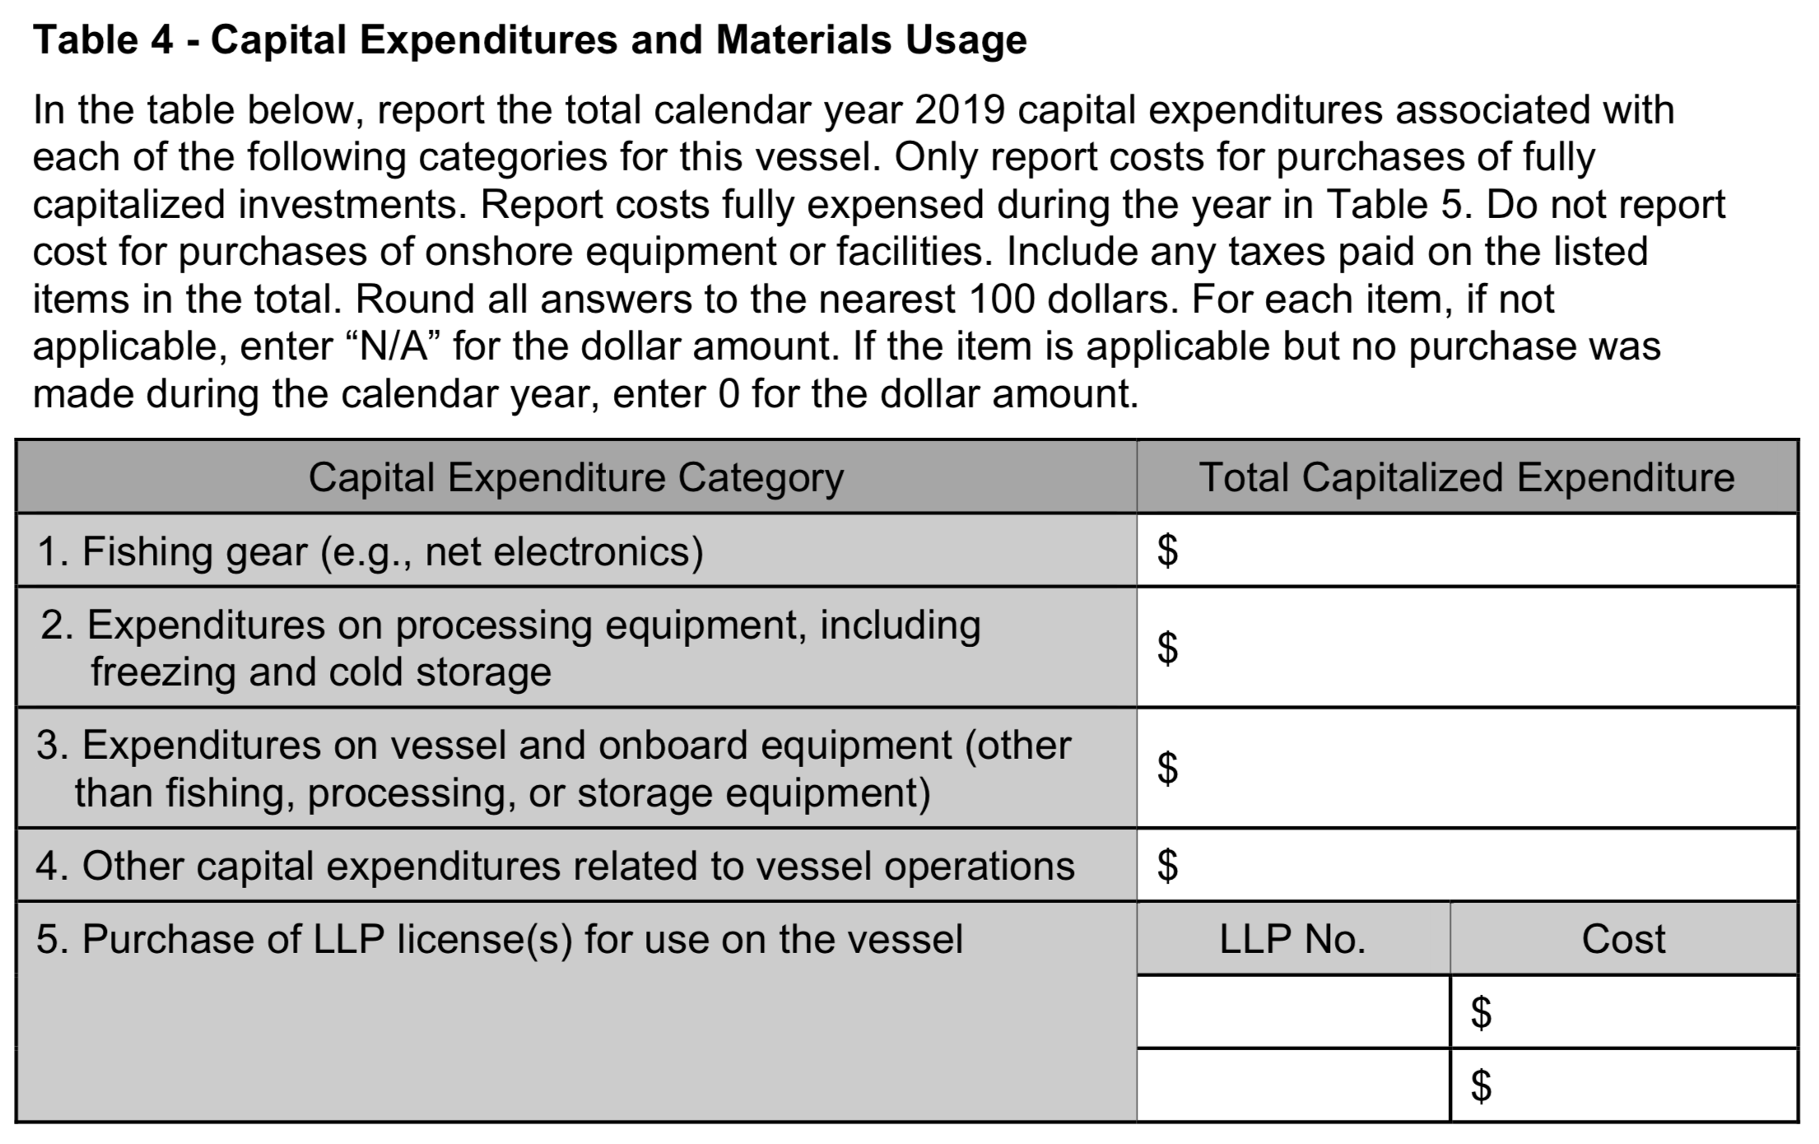
Task 3: Sector-specific considerations
Topic: Reporting capital expenditures
Source: Amendment 80 EDR

Slide 49
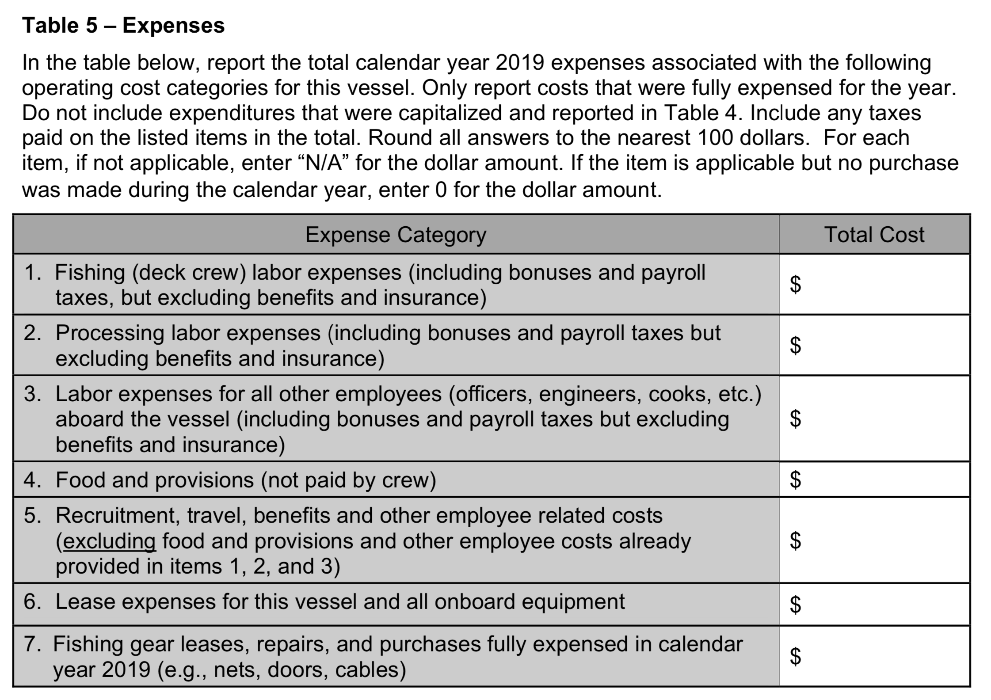
Task 3: Sector-specific considerations
Topic: Reporting capital expenditures
Source: Amendment 80 EDR (excerpt; Table 5 continues)

Slide 50
Task 3: Sector-specific considerations
Topic: Reporting capital expenditures
Ideas for clarifying and streamlining
Adjust frequency (e.g. every 3 or 5 years)
  Would add to burden, but feasible - fixed asset data tracked for tax purposes
  Trends in expenses over time may be important
Provide additional context (e.g., optional follow-up interview)
Pre-populating fields - raised concerns about data confidentiality and custody
Amendment 80 EDR
Report: Pages 22-23

Slide 51
Task 3: Sector-specific considerations
Other topics
Covid-19 expenses - are they captured?
  Takes time to change EDR fields
  Additional guidance could be provided
  Changes to operating costs could be interpreted with qualitative input from submitters
Communities - economic contributions of CP sector
  Burdensome to link purchases with communities - other approaches? (E.g. estimate by AK borough?)
Amendment 80 EDR
Report: Pages 23-24

Slide 52
Questions?

