Slide 1

NPFMC Salmon Bycatch Committee Chum Salmon Discission Paper Overview
NPFMC Salmon Bycatch Committee
November 28, 2022
Diana L. Stram, Ph.D
Senior Scientist, North Pacific Fishery Management Council

Slide 2
Some background:
October 2021 Council motion
1) An updated bycatch impact (AEQ) analysis which includes current genetic stock identification information and an updated age/length composition for Chinook salmon along with estimates of how many Chinook salmon taken as bycatch in the Bering Sea pollock fishery would have returned to Western Alaska Chinook salmon stock groupings. The analysis should include a PSC harvest rate analysis and an estimate of the Chinook salmon bycatch impacts to each specific stock grouping at the current cap levels and at actual bycatch levels in recent years. The Council also requests that the report include recommendations to evaluate impacts of chum salmon bycatch in the pollock fishery with currently available data.
2) A stock status update of Western Alaska Chinook and chum salmon stocks.
In addition, the Council requests staff write a letter to the Secretary of State to request help to identify levels and stock composition of bycatch of salmon in waters outside of the jurisdiction of the United States. The Council requests staff write a letter in support of recent requests to the Secretary of Commerce for increased and dedicated funding for salmon research, observation, and monitoring, including on the lifecycle of salmon species in the freshwater, nearshore, and marine environments, and the effects that environmental changes are having on salmon throughout their lifecycle.

Slide 3
Presentations to the Council in June 2022
Salmon stock status and research updates
  Stock status update for WAK Chinook and chum
  AFSC overview of salmon research and mandates
  ADF&G overview of ongoing research and plans
BSAI and GOA salmon genetics reports
  BSAI Chum salmon bycatch genetics from 2020-2021
  Chinook salmon genetics 2020 (BSAI and GOA)
Update on ongoing genetics works and plans
  AFSC progress and plans
Bering Sea Chinook Adult Equivalency and Impact rate report; staff recommendation for assessing chum impacts
  Update on 2015/2018 report; changes noted in age/length updates and maturity estimates
  Staff feedback on assessing chum bycatch impacts
Salmon Excluder final report
Reports from the IPAs (3)
SeaShare update

Slide 4

Research updates:
NOAA and ADF&G

Slide 5
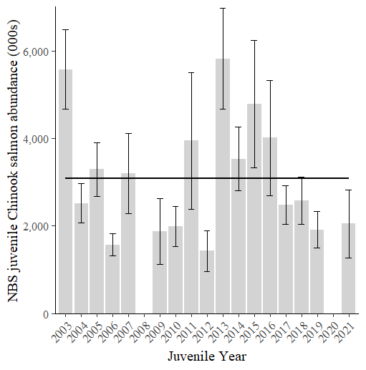

Juvenile Chinook salmon abundance
Abundance of Juvenile Chinook has been below average since 2017
Smaller than average size during recent warm years
Notes:
Juvenile Chinook salmon have been an important part of the survey and research has focused on Yukon River Chinook salmon as they account for over 80% of the juveniles in the NBS.
We know that Yukon River Chinook salmon are important to subsistence fisheries within Alaska and the Yukon Territory, and they are also important to international treaty negotiations between US and Canada in the Yukon River, and they are also important to bycatch in the Bering Sea pollock fisheries.
Juvenile Chinook salmon were distributed in the nearshore stations of the survey. This distribution was atypical for Chinook salmon as they have tend to be more broadly distributed across the survey area.
The figure on the right shows how the abundance of juvenile Chinook salmon has changed over time and includes the abundance estimate from the 2021 survey. Juvenile abundance was below average in 2021 and has been below average since 2017.

Slide 6
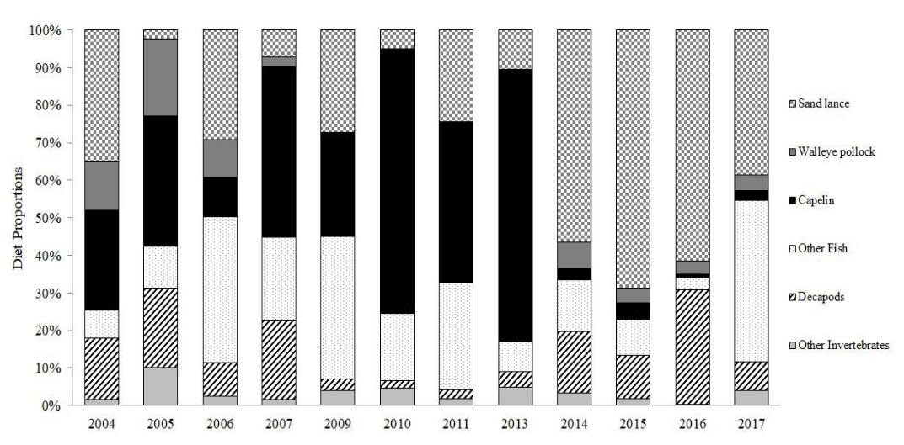

Juvenile Chinook Salmon Diet
cool
very warm
Sandlance
Capelin
Capelin, a high quality prey, are absent from Chinook salmon diet during recent warm years.
Other Fish
Small Crab

Slide 7
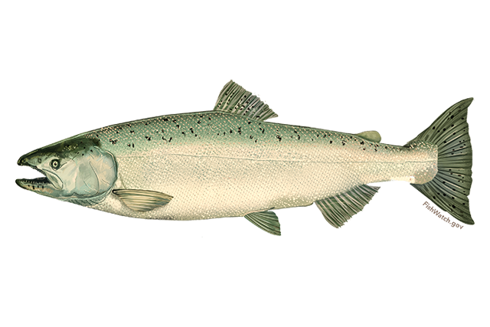
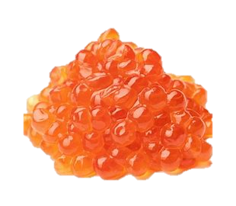
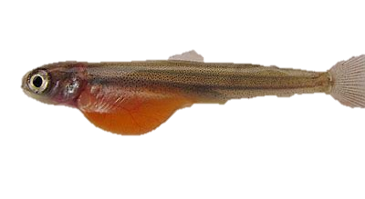
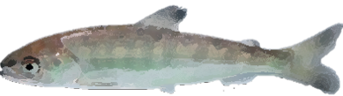
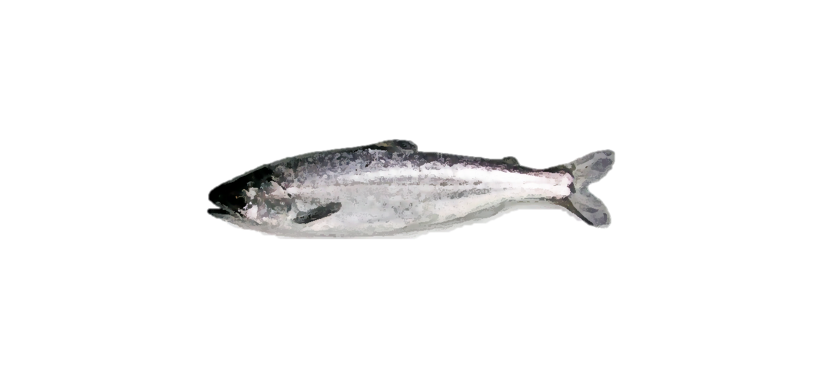
RIVER
Future run size of Yukon Chinook is determined very early in their life – before their first winter at sea
~2 years
~3 months
OCEAN

Slide 8
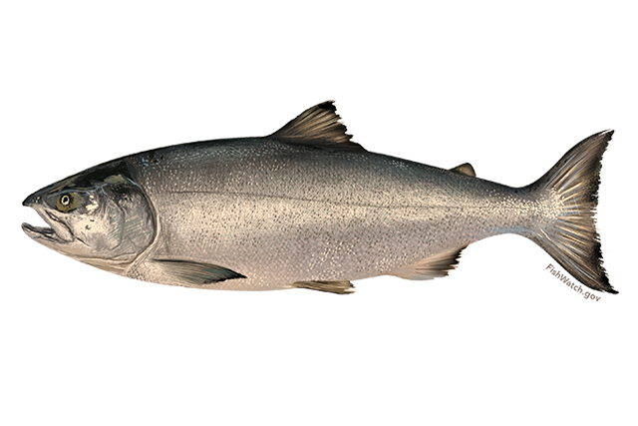
RIVER
Yukon fall chum salmon runs also seem to be driven by factors early in life…
……until 2016
~1 year
~3 months
OCEAN

Slide 9
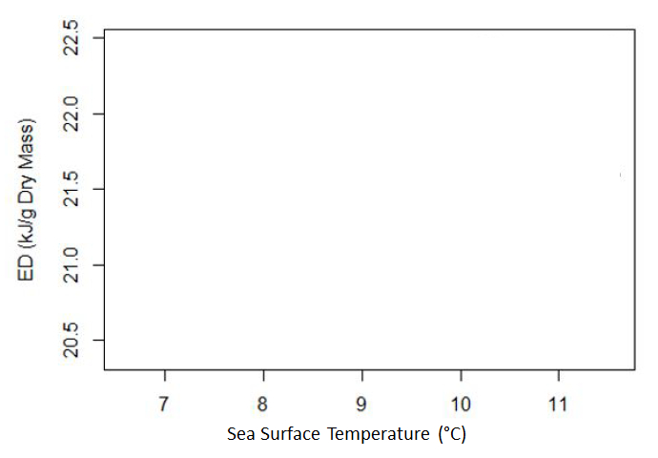
Juvenile Chinook
Stored Energy
Juvenile Chum
Ocean Temperature

Slide 10
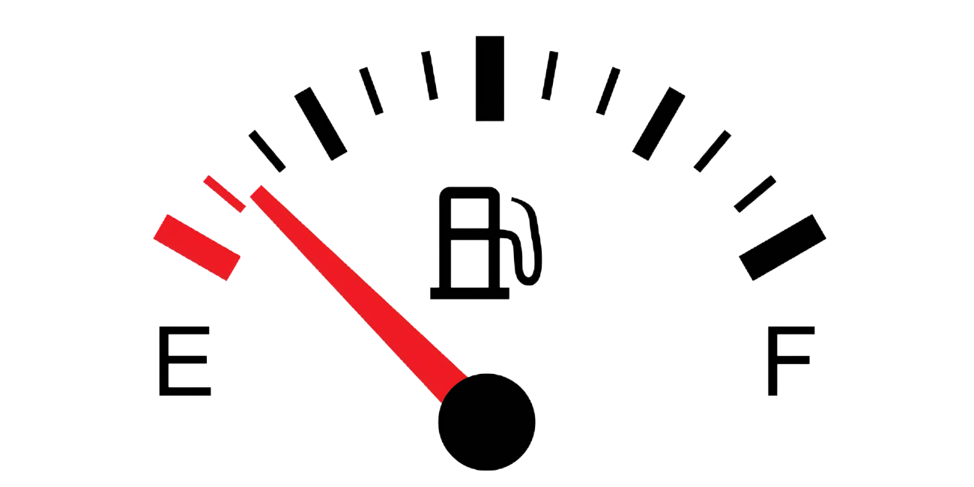

Slide 11
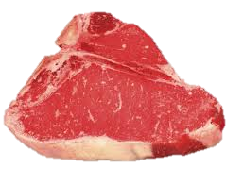
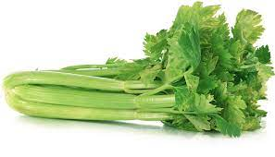

Slide 12
Brief history of actions related to Chinook and chum salmon bycatch management

Slide 13
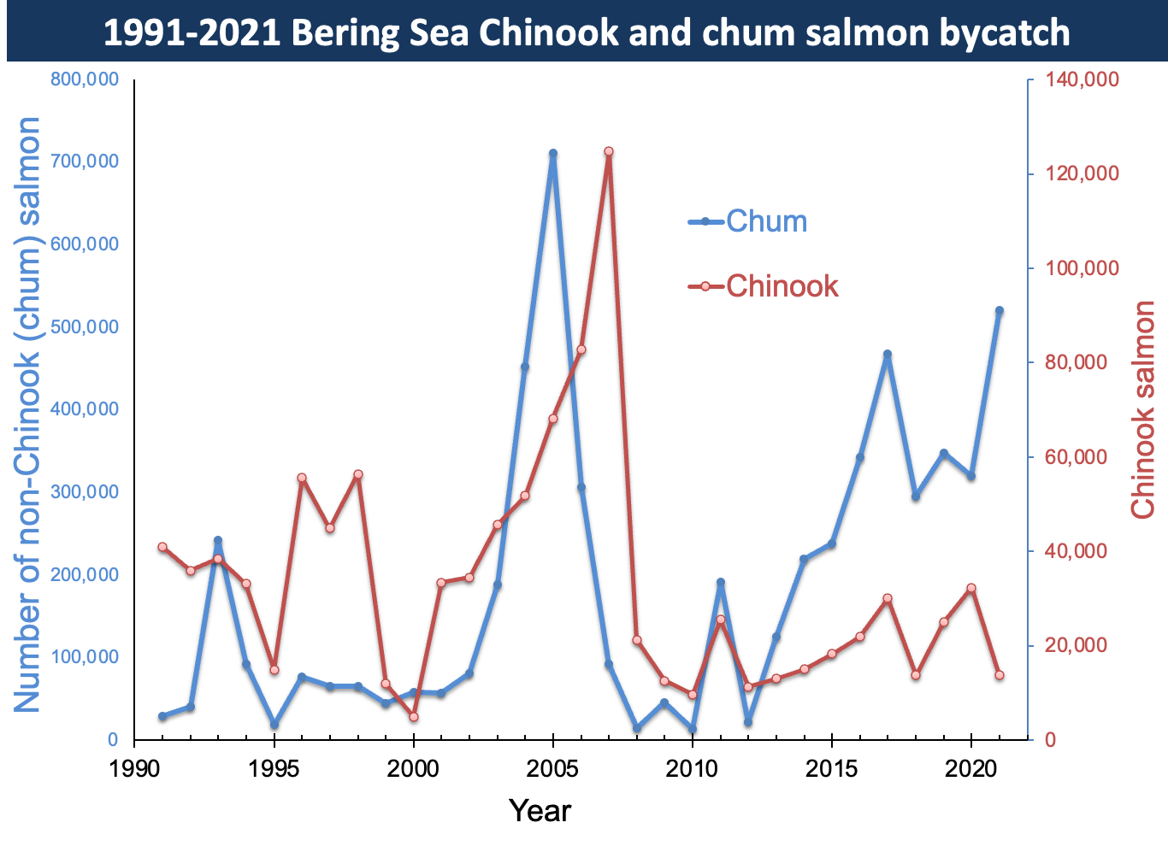

Slide 14
Time area closures:
salmon savings areas

Slide 15
Council develops A84 as an interim measure while further chum bycatch mitigation measures considered
Indications that SSAs dated and exacerbating bycatch

Slide 16
Focus shifts from chum to Chinook.
Multiple SSC bycatch workshops;
Council Bycatch Committee to assist in developing cap levels

Slide 17
Development of A91 and extensive outreach to WAK communities
Final action A91 2009

Slide 18
2011 implementation of A91; systematic genetic sampling, census requirement for salmon accounting
Council develops chum bycatch measures; tables in 2012 due to concerns of undermining recent Chinook measures

Slide 19
Implementation of A110; developed in response to continued low Chinook in WAK and the need for stronger vessel level incentives in IPA structure; chum measures included as part of IPA requirements

Slide 20
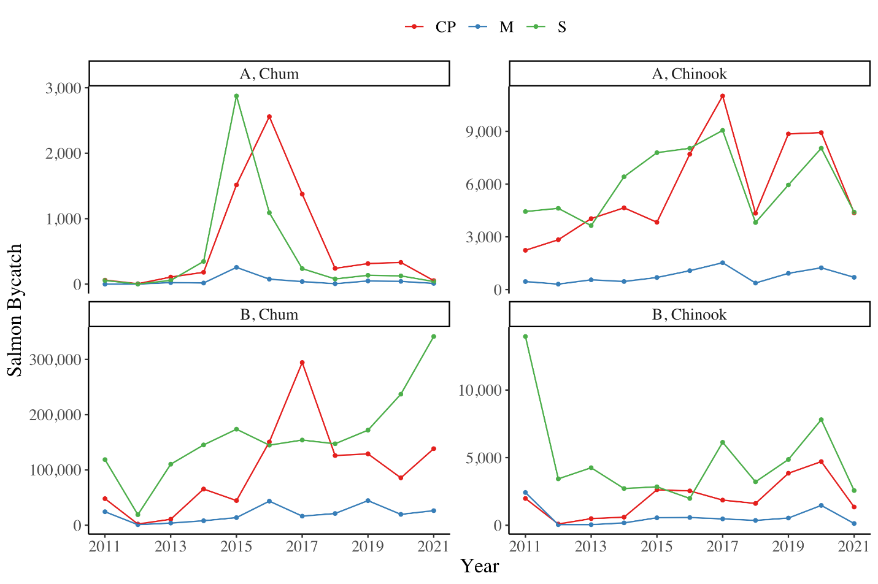

Slide 21
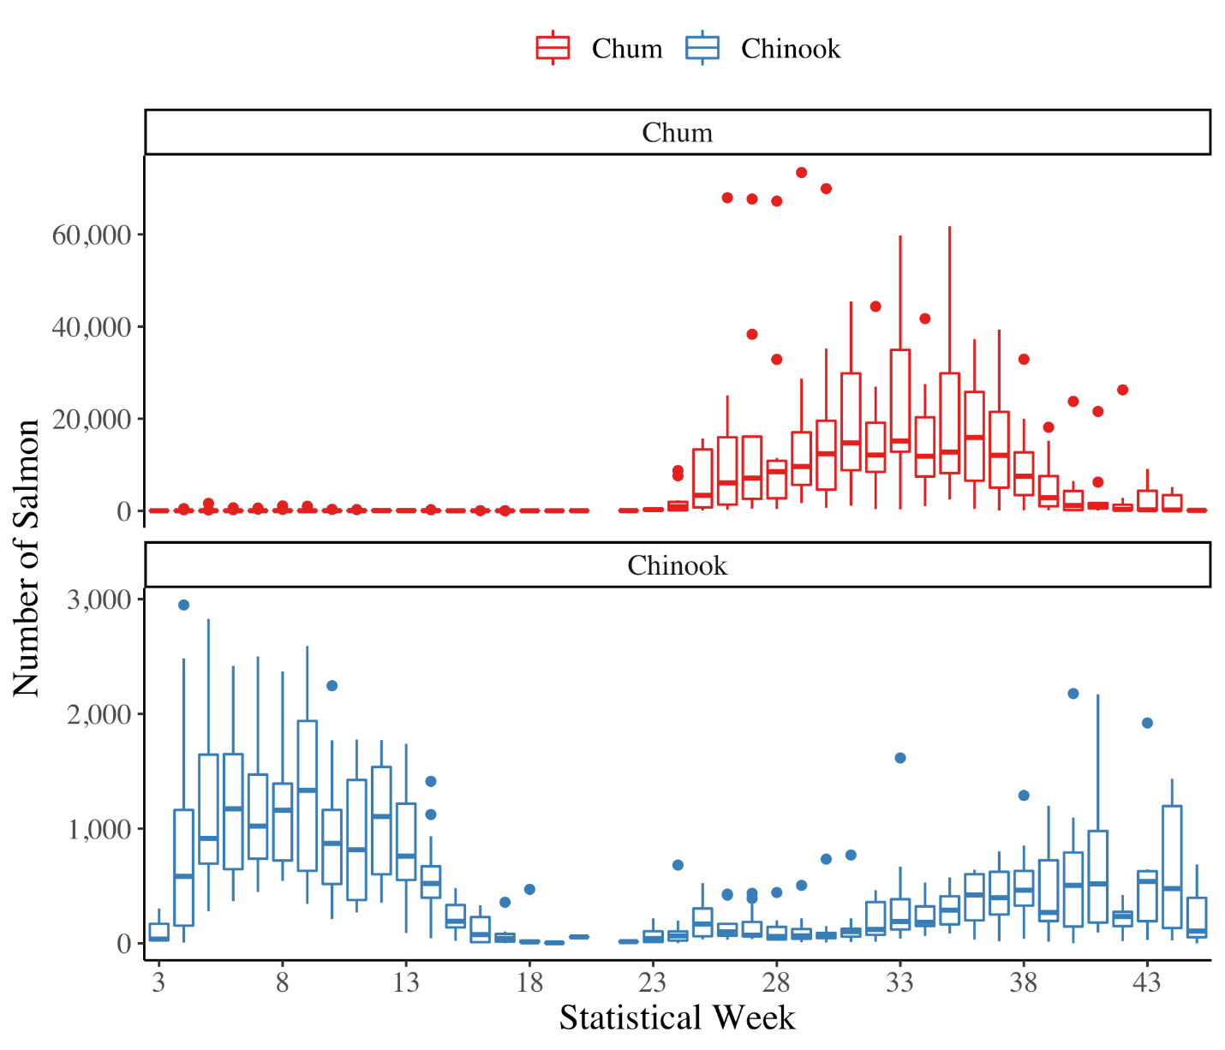

Slide 22
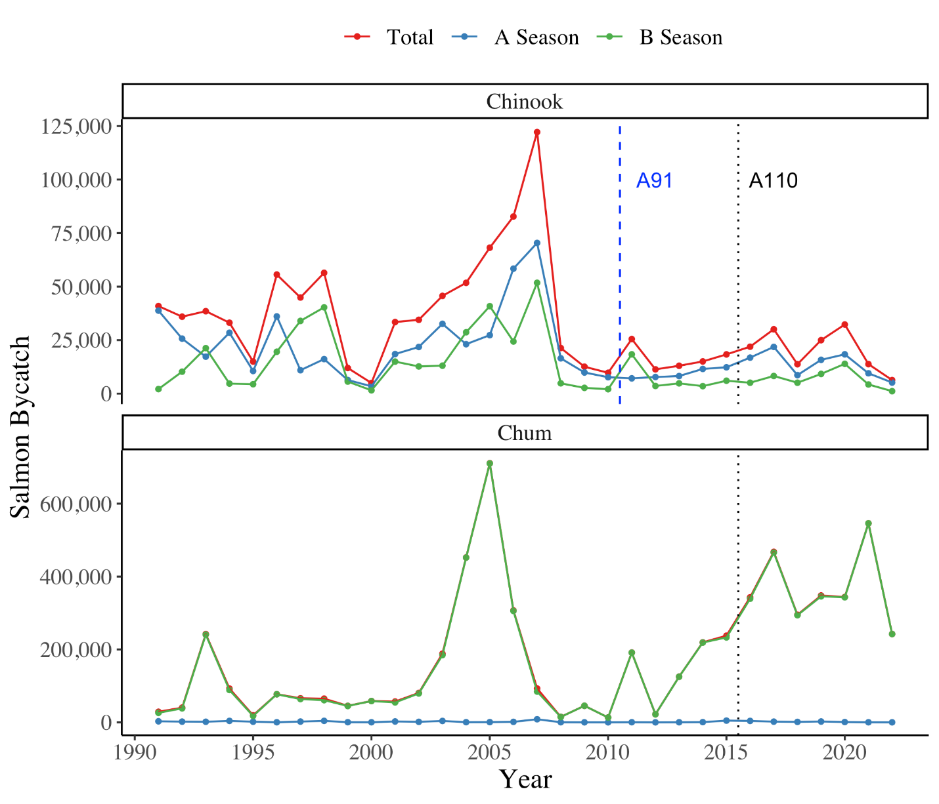

Slide 23
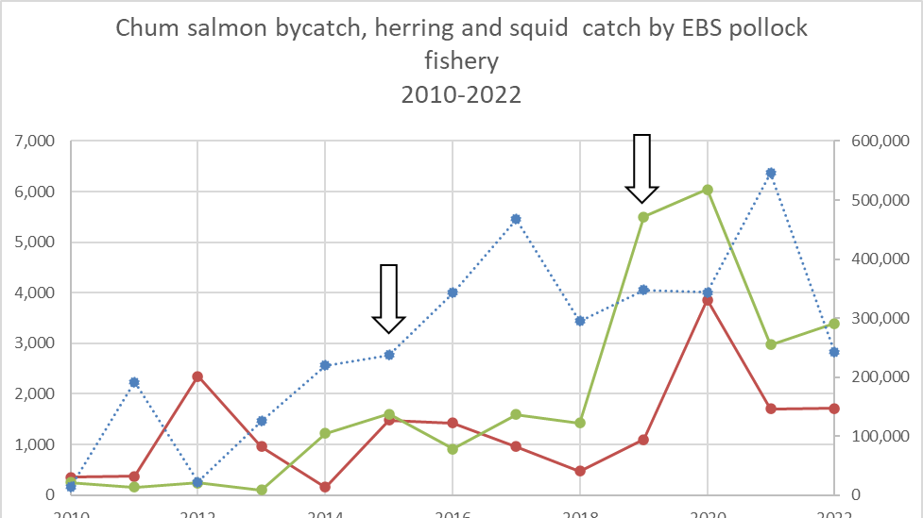

Slide 24
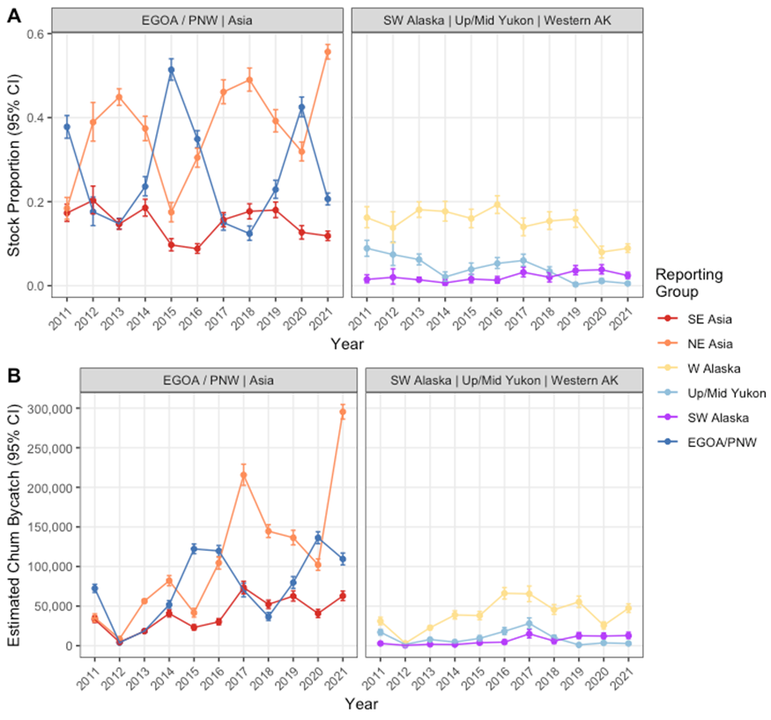
Chum salmon bycatch genetics

Slide 25
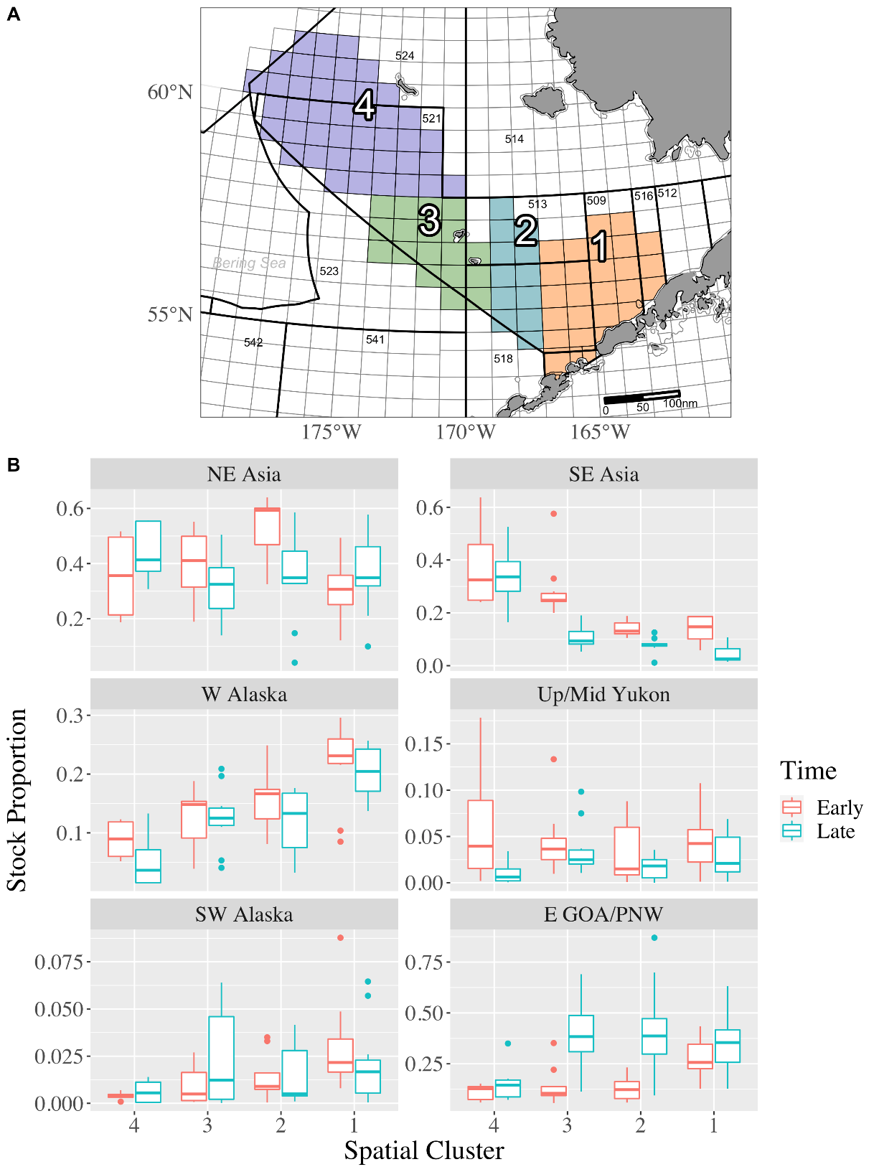
Early versus late season differences

Slide 26
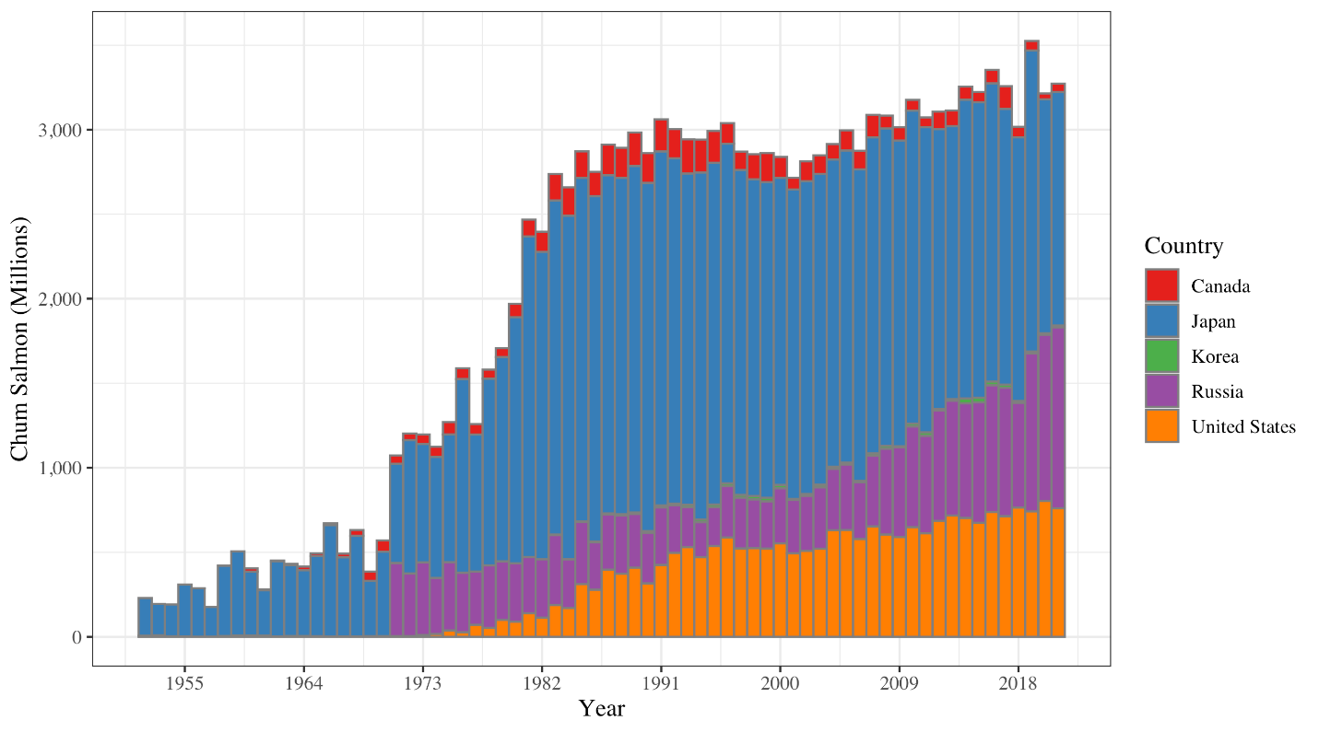
Hatchery releases

Slide 27
Western Alaska stock status

Slide 28
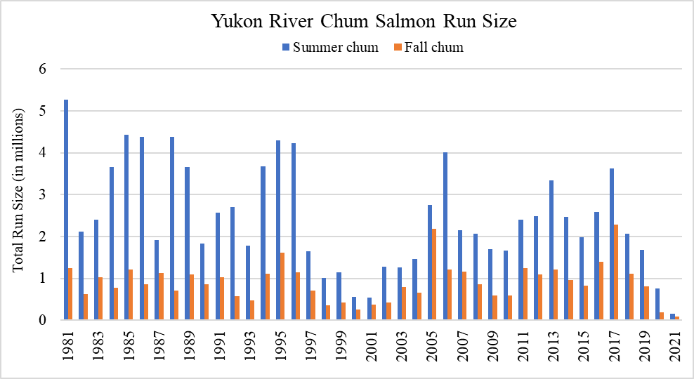

Slide 29
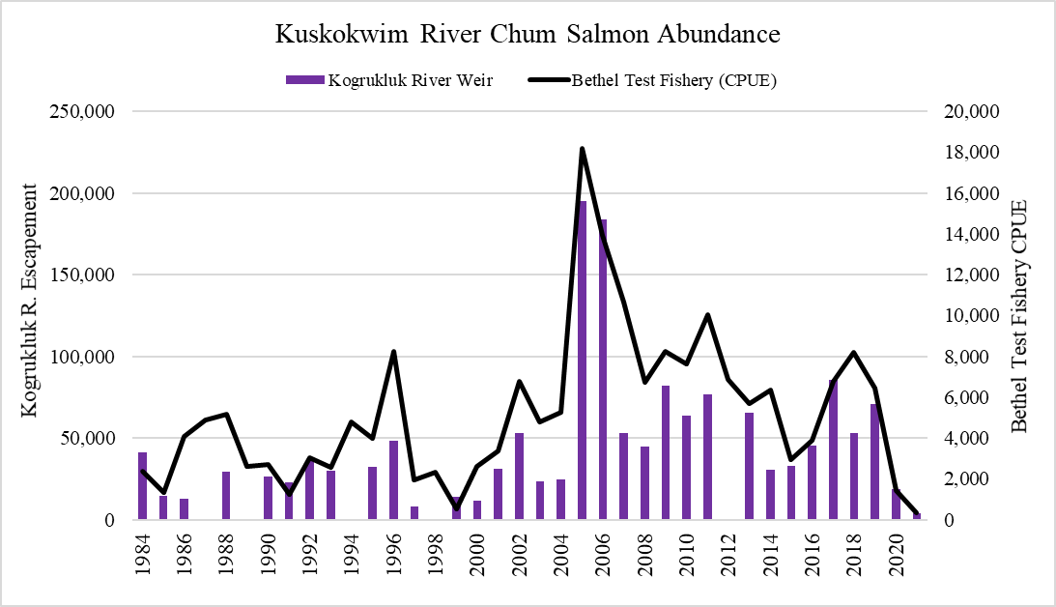

Slide 30
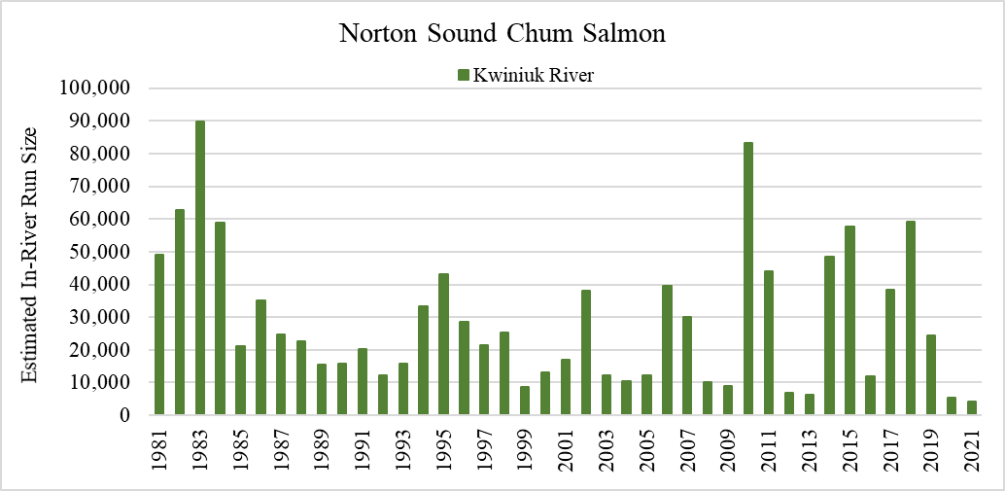

Slide 31
What is next?
November
First meeting of Committee in November to review Chum Discussion paper
If Task Force recommendations available also to be reviewed
December
Council meeting:
Review Chum discussion paper and Committee recommendations
Follow up meeting of committee after overall Bycatch Task Force Recommendations available

