Slide 1
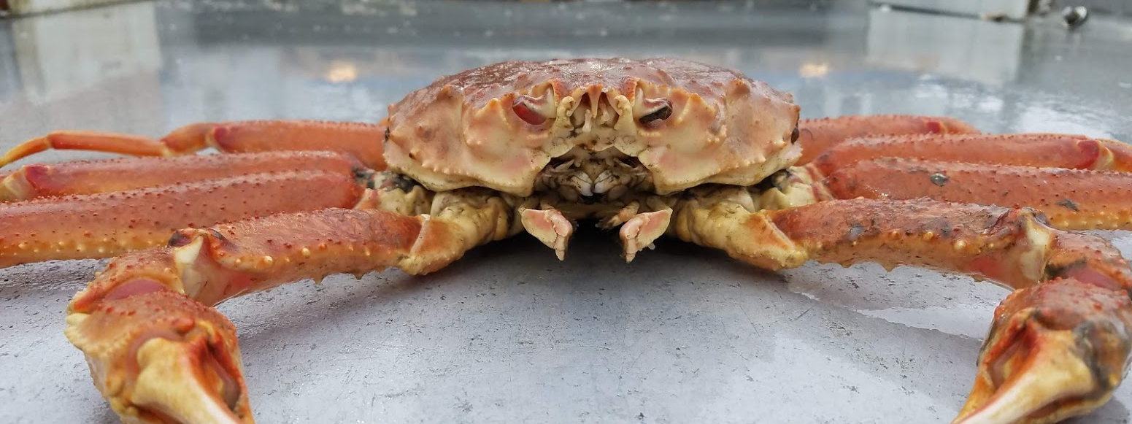
Tanner Crab MSE Update
Madison Shipley
Master’s Research
January CPT 2019

Slide 2
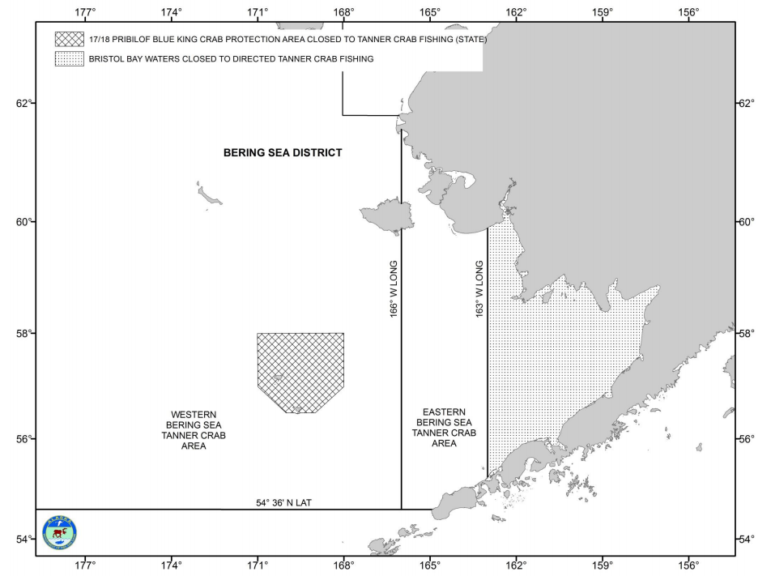
Tanner Crab Stock Background
Established in 1961
Spit into two districts
  East and West, split by 166° W
Managed under FMP
Annual NMFS Survey and Assessment
Notes:
C bairdi
Cooperative Research includes selectivity, growth

Slide 3
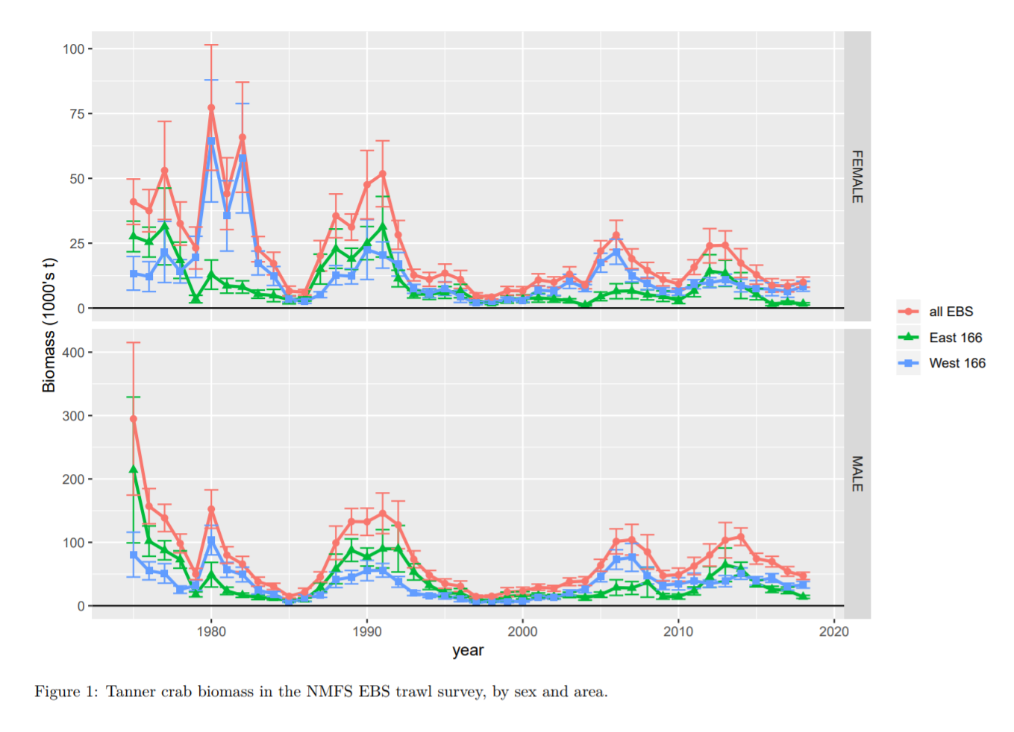


Overview
Highly variable population due to high recruitment variability
Since 1974, the fishery has been closed 34.8% of the time
Stockhausen 2018

Slide 4
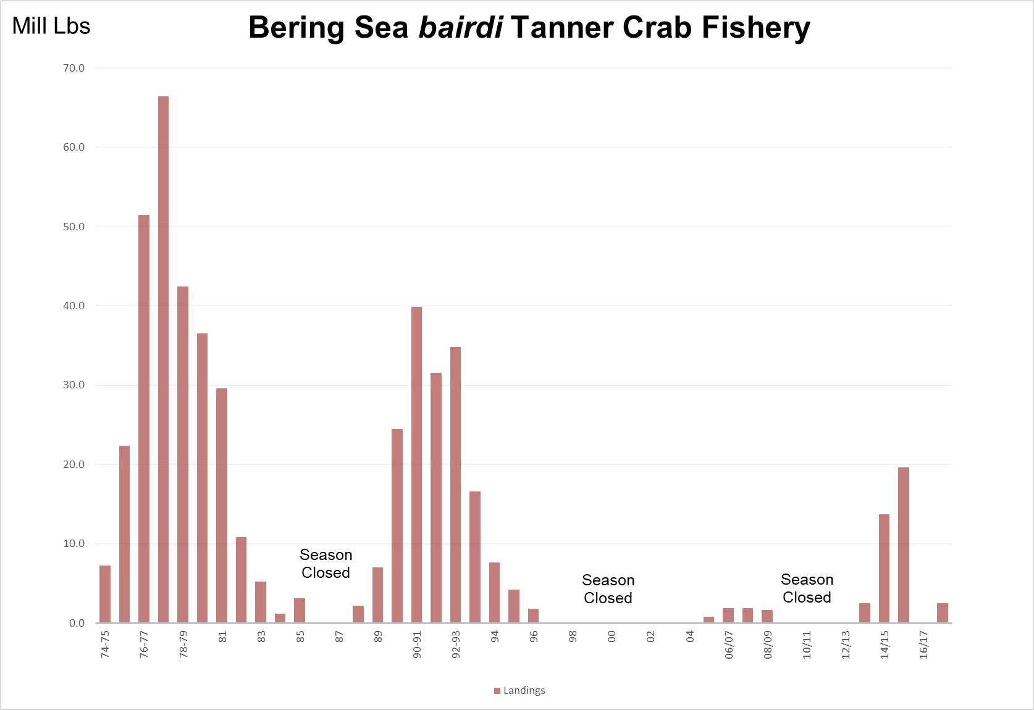
Notes:
Cyclic patterns driven by highly variable recruitment events
15 closure years since ’74 US directed fishery (15/44 years) (~1/3 of the time)

Slide 5
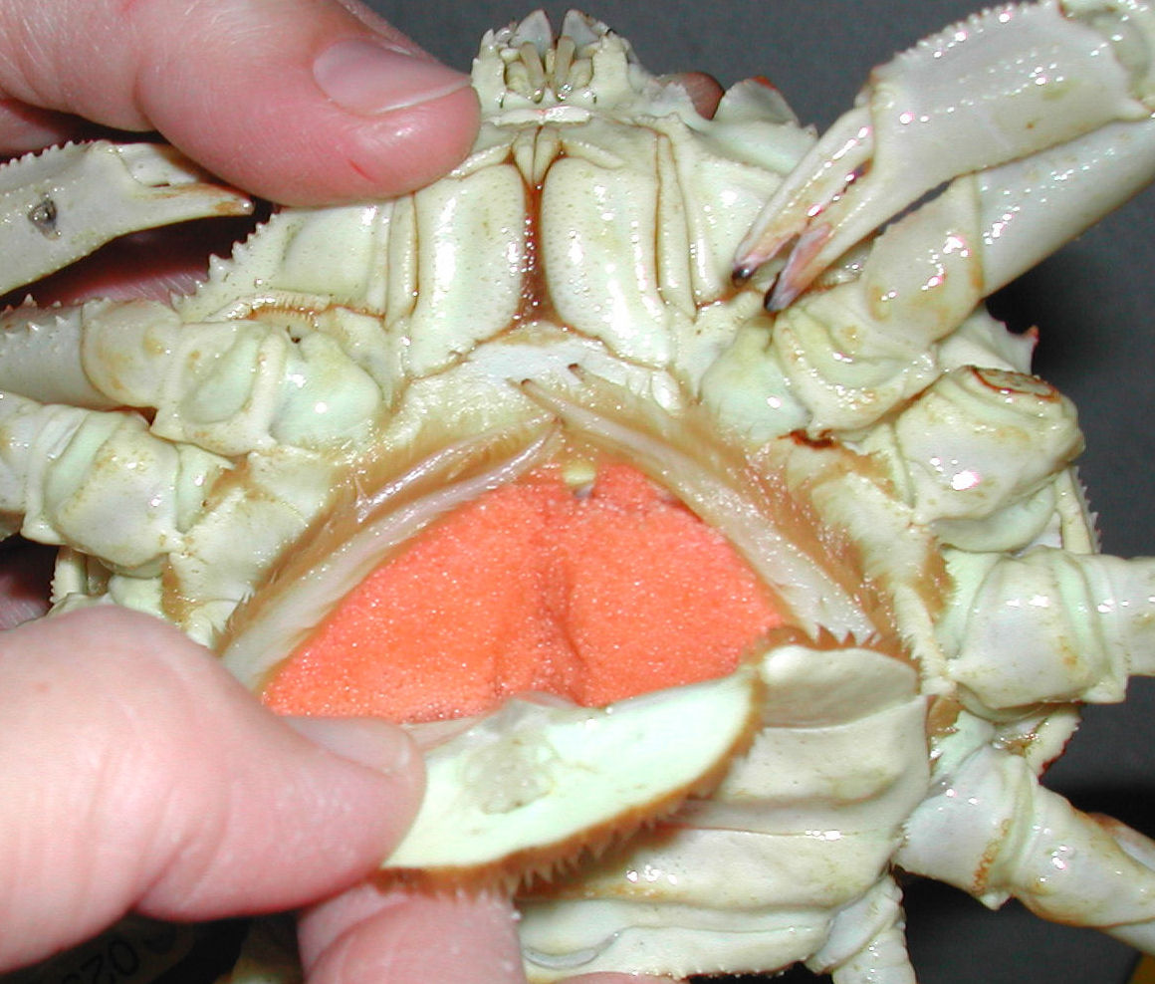
East and West Total Allowable Catches (TACs)
Total Pounds
Notes:
FIX PLOTS
Highlight 20million pound fishery to 0

Slide 6
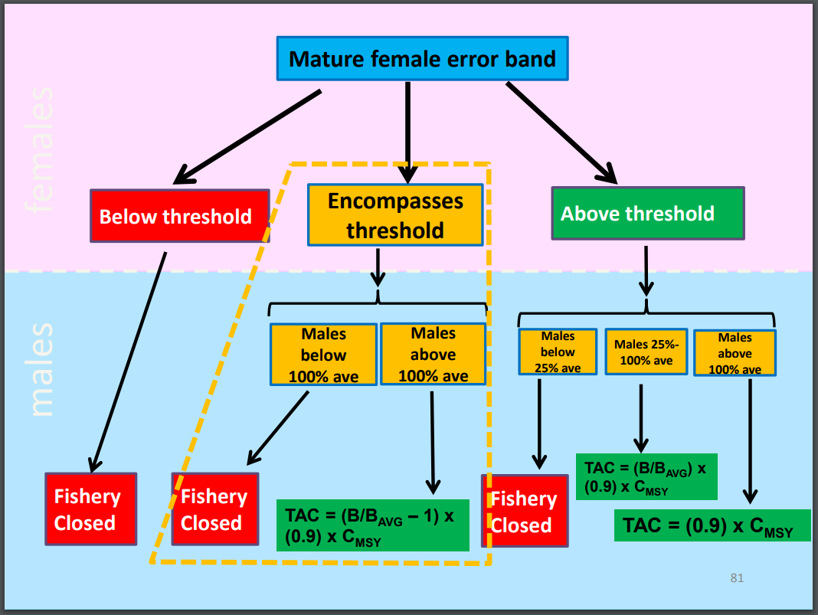
Current Harvest Control Rule
Diagram Credit Ben Daly ADF&G
Notes:
Actual Harvest Control rules

Slide 7
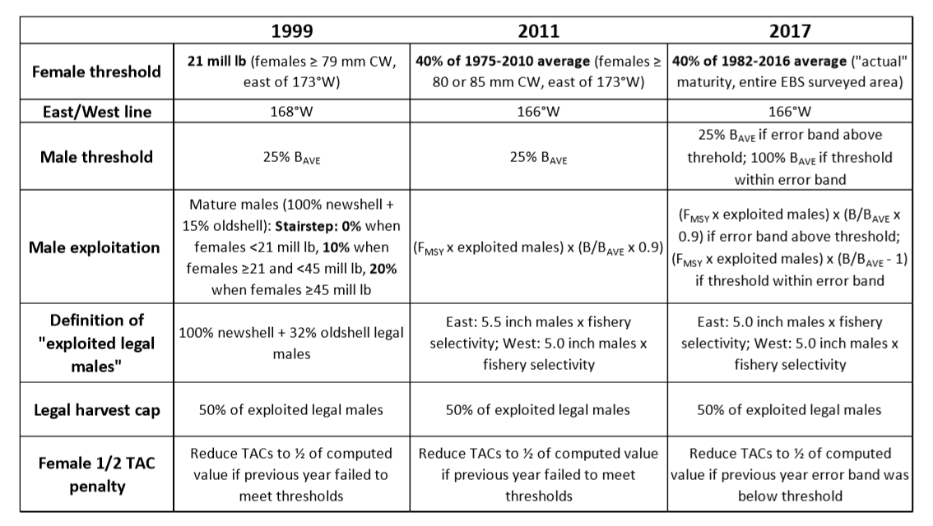


Harvest Control Rule Edits
Notes:
Initial threshold 1974-2010
Changed to 1982-2016
Maturity definition changed
Changed to include error (estimate above = open, within = conditional, below = closed)

Slide 8
How appropriate is the inclusion of females in the Harvest Control Rule?

Slide 9
How should the Tanner crab Harvest Strategy be Revised?
Notes:
Questions on the scientific validity on the current harvest control rules
Move away from band aid fixes

Slide 10
Objectives?
Understand
How females in the HCRs will effect projected populations and harvest
Inclusion or exclusion of females in Harvest Control Rules to be tested
Evaluate
Fishery Resilience
Inform
Performance metrics for Harvest Strategy Evaluation
e.g. probability of stock closure, catch variability

Slide 11
What is Management Strategy Evaluation?
A tool that allows for simulated fishery projections under varied conditions (in this case, harvest options) and looks at performance metrics as a way of evaluating performance of harvest options relative to fishery objectives
Objectives and Methods
Performance Metrics
Harvest Control Rules
Coordination with ADFG
Notes:
HCR factors to look at:
Re-specification of Spawning Stock Biomass
Combining metrics to create “red flag” system
Sliding control rule replacing hard thresholds
Other?

Slide 12
Objectives and Methods
Performance Metrics
Harvest Control Rules
Coordination with ADFG

Slide 13




What are the Objectives?
Bairdi Ad Hoc Group
Implement New Management Strategy
Use Strategy
Revise with new Objectives
What are the Performance Metrics?
Use or Revise Strategy
Bairdi Ad Hoc Group
Run Simulations
Revise with new Harvest Strategy
Discuss Results
Bairdi Ad Hoc Group
What Strategies is being tested?
Notes:
Re evaluate in terms of question

Slide 14
Model Set Up
MSE
2018 Assessment
Y = 2018/19
PARS
Operating Model
Data for year Y (generated)
2018 Data
Parameters
1) Set Recruitment
2) New Parameter Value from Estimation model:
Fishery Capture Rate (F) for year Y
Estimation model
OFL/ABC
OFL/ABC for year Y+1
TAC (Catch)
Y = Y+1
TAC (Catch) for year Y+1
Notes:
See to the two left bottom boxes – not in red

Slide 15
Operating Model
Fits catch for upcoming Year
Projects population forward one year
Creates new Fishery Data file
Creates new Survey Data File
Notes:
What is the “new model configuration”

Slide 16
Estimation Model
Calculates OFL/ABC
Calculates TAC based on HCR being Tested
Feeds updated TAC into the Operating Model
Notes:
Id remove the first box because that is just a kluge to get the F for the OPERATING MODEL

Slide 17
Each Harvest Control Rule
Projections of 100 years
100 simulations

Slide 18
Survey Data Simulation
Survey data through 2018 will be the same for each simulation
For 2019+ survey data simulated with observation error within each simulation

Slide 19
Simulation Walk Through

Slide 20
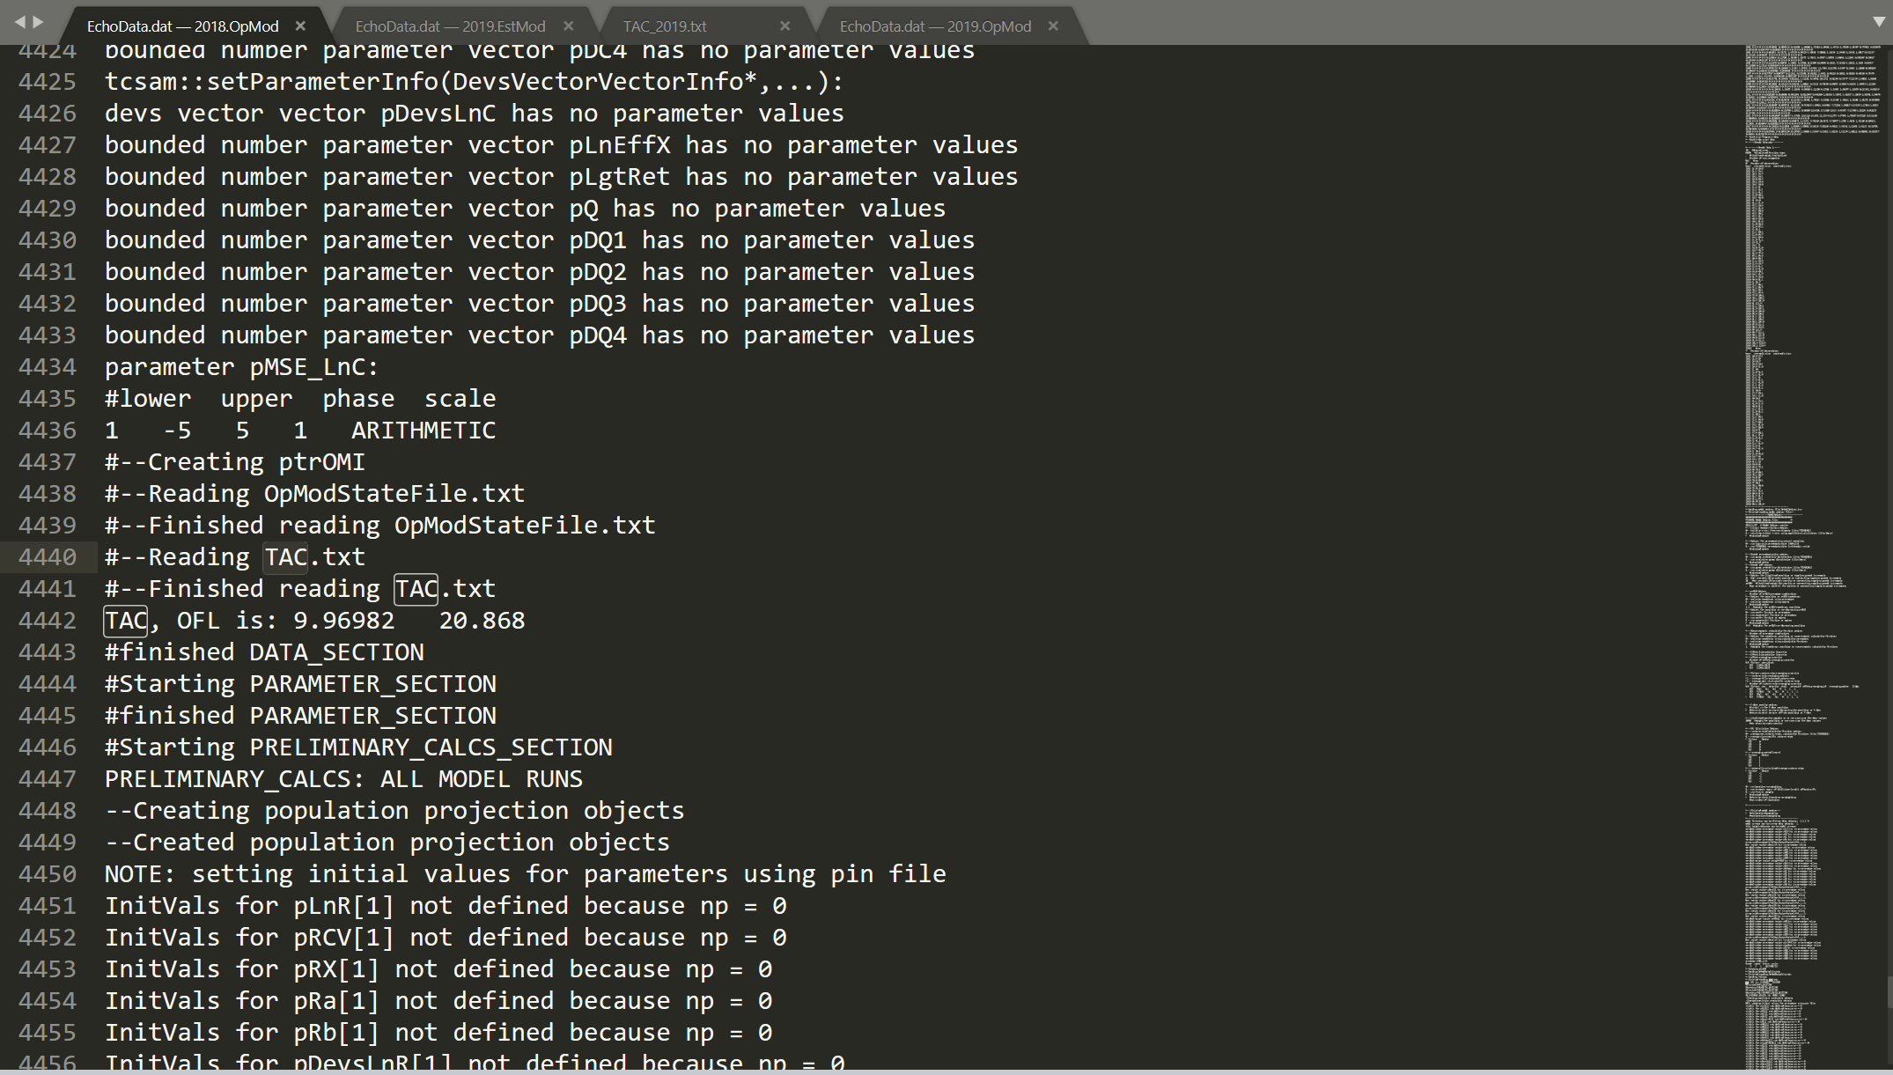
2018 Operating Model

Slide 21
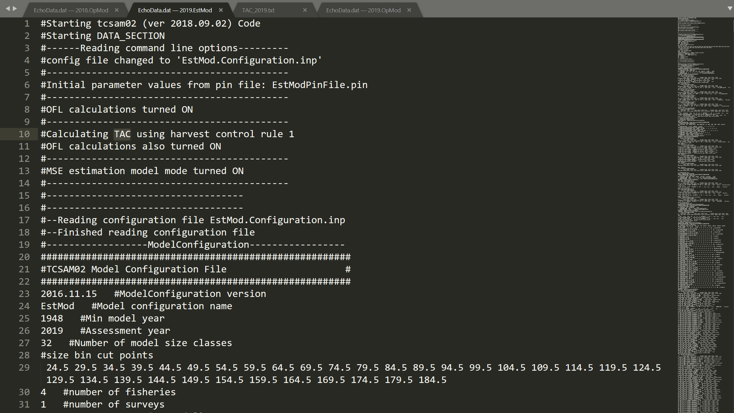
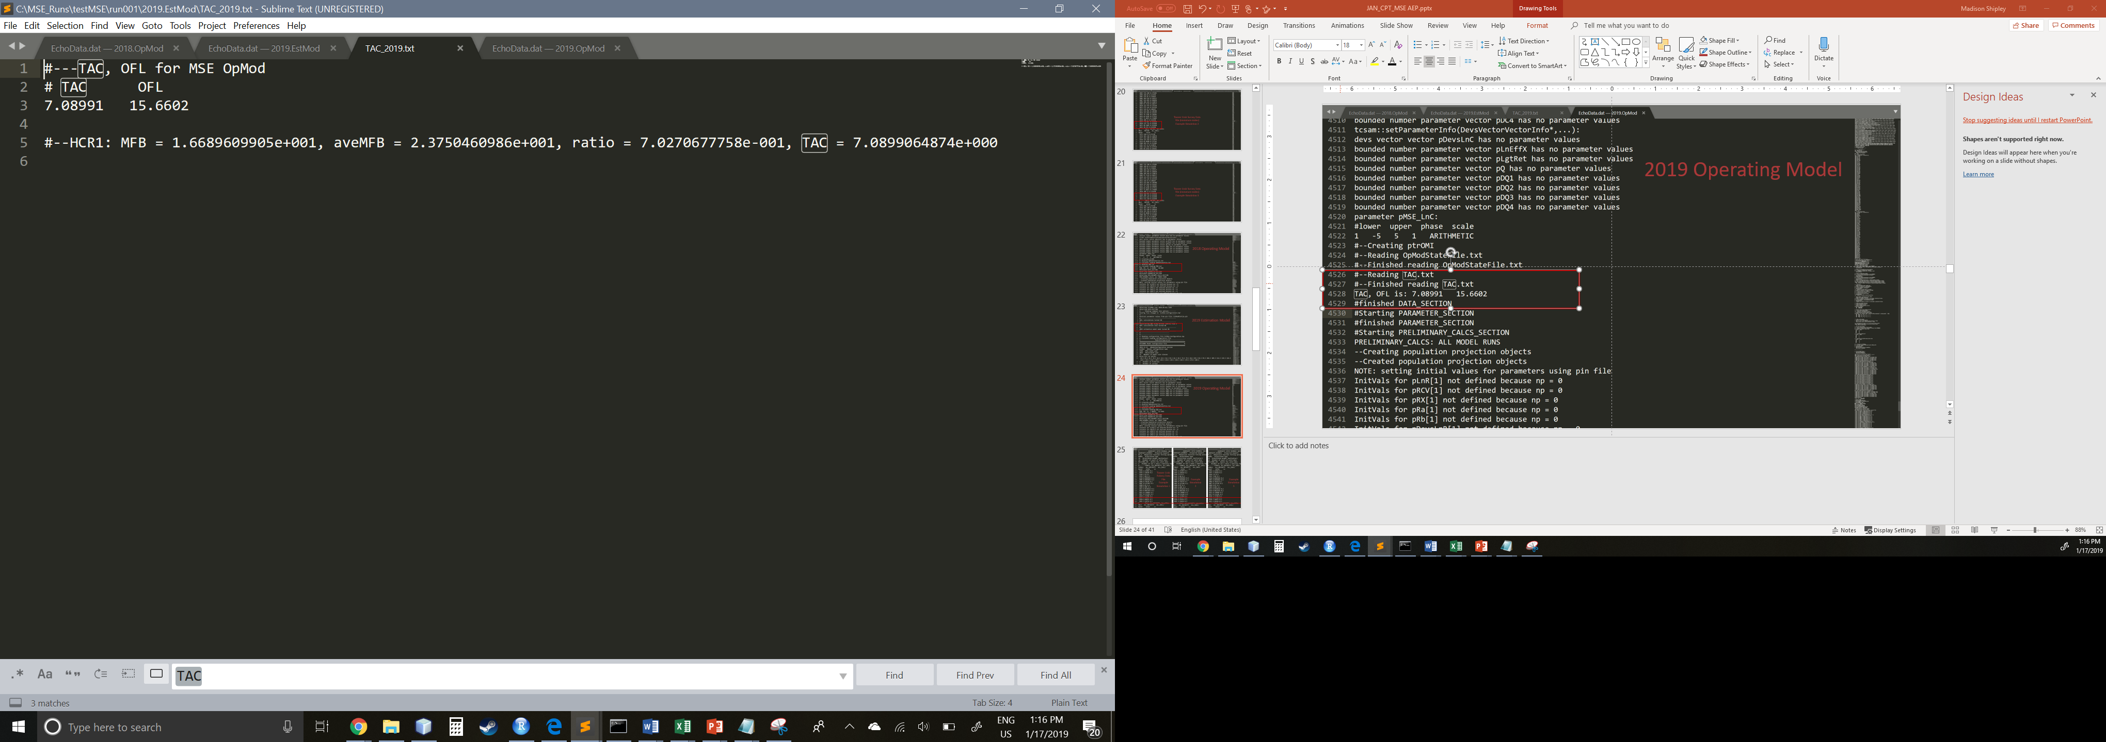
2019 Estimation Model

Slide 22
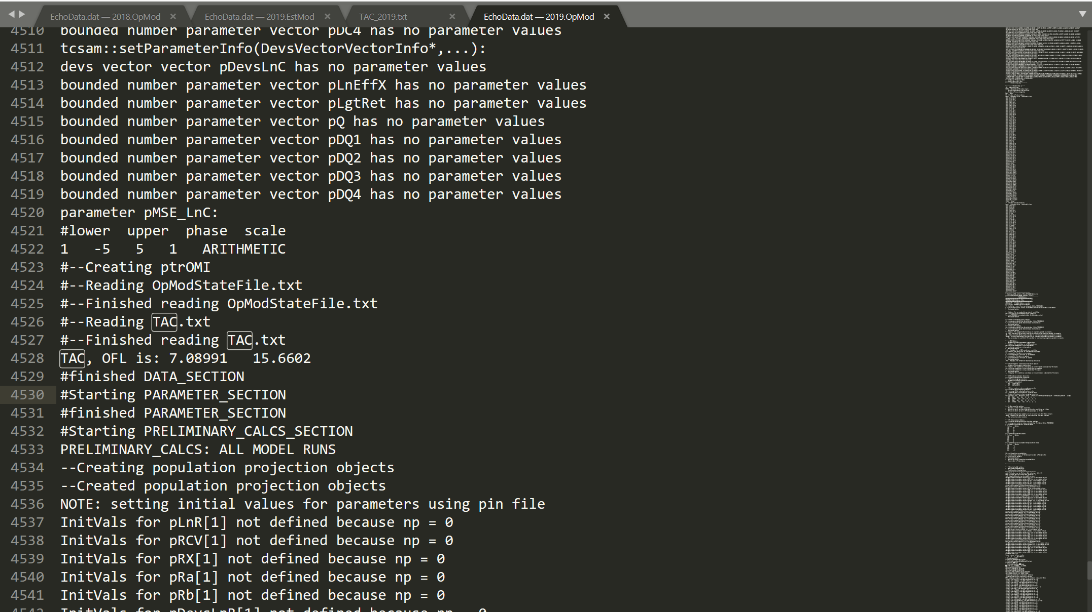
2019 Operating Model

Slide 23
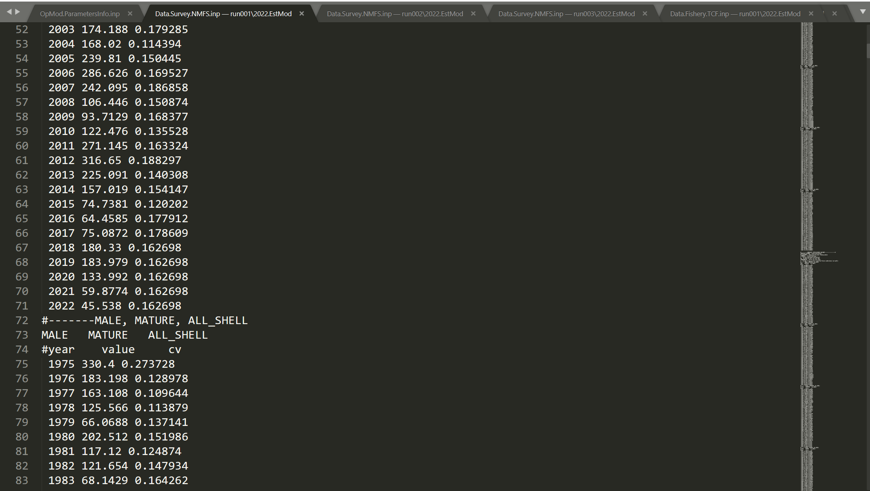
Tanner Crab Survey Data File (immature males)
Example Simulation 1

Slide 24
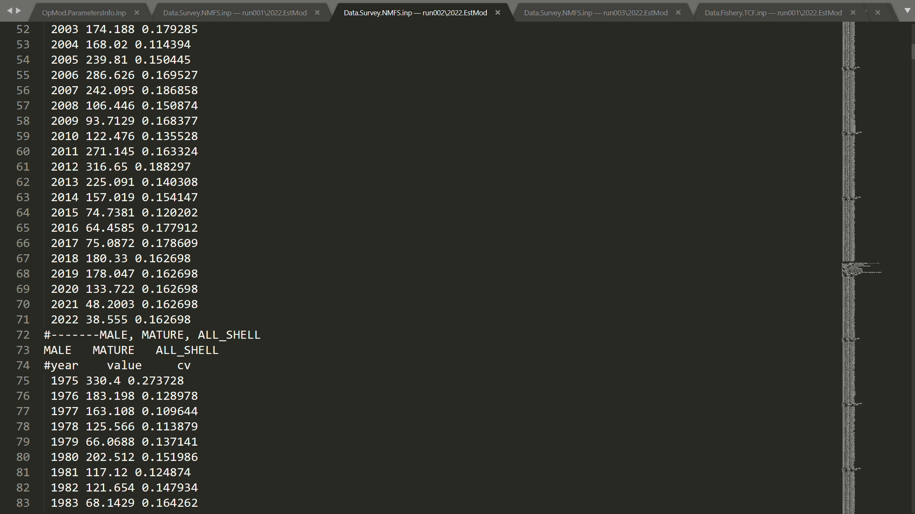
Tanner Crab Survey Data File (immature males)
Example Simulation 2

Slide 25
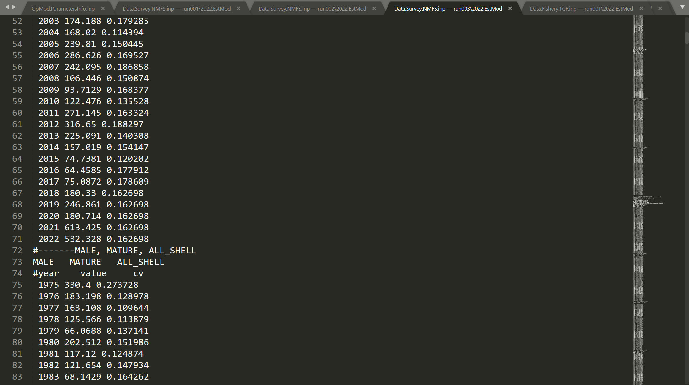
Tanner Crab Survey Data File (immature males)
Example Simulation 3

Slide 26
Objectives and Methods
Performance Metrics
Harvest Control Rules
Coordination with ADFG

Slide 27
Performance Metrics
    TAC distribution
      Max TAC and Average TAC
        Distribution of the maximum and average TACs for each harvest control will help identify a general range of TACs for comparison.
      The probability of the TAC falling within a pre-specified range (say, 5-15 million lbs combined east and west).
      Probability TAC < 5, >5, >10, >15, >20million lbs.
    Exploitation rates distribution
      Distributions of the TAC expressed relative to the mature male biomass, the exploitable legal male biomass, and preferred size male biomass.
    Relative Discards distribution
      Distributions for estimated discards from directed and non-directed fisheries.
    The probability of one, two, three, four, five, and five+ years of consecutive fishery closure.
    The probability of mature male biomass (MMB) falling below 25% of the long-term average (0.25 MMB_{ave}).
    The probability of MMB falling below the long-term average.
    The probability of mature female biomass (MFB) falling below the long-term average (MFB_{ave}).
    Annual TAC variability
      How much does the TAC change from year to year.
    The probability of the TAC exceeding the ABC.
      How often is the TAC larger than the ABC computed using the estimation model.
        Includes estimates of bycatch mortality
        How often was a TAC set that exceeded the ABC computed using operating model.
        Includes estimates of bycatch mortality
    The probability of the TAC exceeding the OFL (same as above).
      Includes estimates of bycatch mortality
Notes:
TOO DENSE – split into 2 slides
This slide is very full, and this is because when looking at Performance Metrics, it’s better to have as much information as possible and pair down and prioritize as you go
The next couple slides break things down

Slide 28
Biological Metrics
Probabilities of hitting certain biological reference points
    The probability of MMB falling below 25% of the long-term average (0.25 MMB_{ave})
      Fishery closes in HCRs
    The probability of MMB falling below the long-term average
      Rate of exploitation in HCRs change
    The probability of MFB falling below the long-term average (MFB_{ave})
      When females included in HCRs change the level of exploitation on males

Slide 29
Economic Metrics
TAC, Exploitation Rates, and Discard summary statistics
The probability of one, two, three, four, five, and five+ years of consecutive fishery closure
Consideration of trade off between higher TAC levels and chance of closure

Slide 30
2 Years
8 Years
4 Years
1 Year
Notes:
Cyclic patterns driven by highly variable recruitment events
15 closure years since ’74 US directed fishery (15/44 years) (~1/3 of the time)

Slide 31
Economic Metrics
TAC, Exploitation Rates, and Discard summary statistics
The probability of one, two, three, four, five, and five+ years of consecutive fishery closure
Consideration of trade off between higher TAC levels and chance of closure
Annual TAC variability
The probability of TAC being less than or equal to 5, 10, 15, and 20million lbs.
The probability of the TAC exceeding the ABC and OFL

Slide 32
Objectives and Methods
Performance Metrics
Harvest Control Rules
Coordination with ADFG

Slide 33
The TAC is always constrained not to exceed 50% of estimated Effective Legal Males (ELM)
ELM defined as Males > 127mm

Slide 34
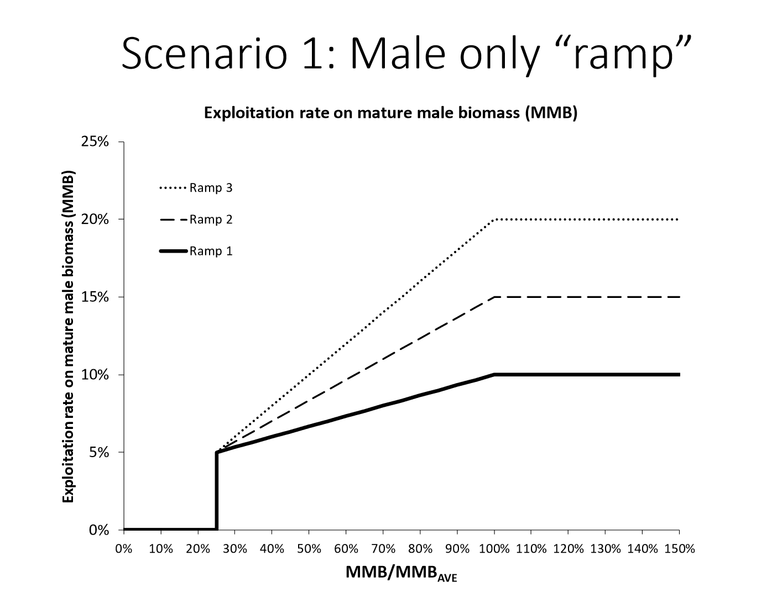

Slide 35
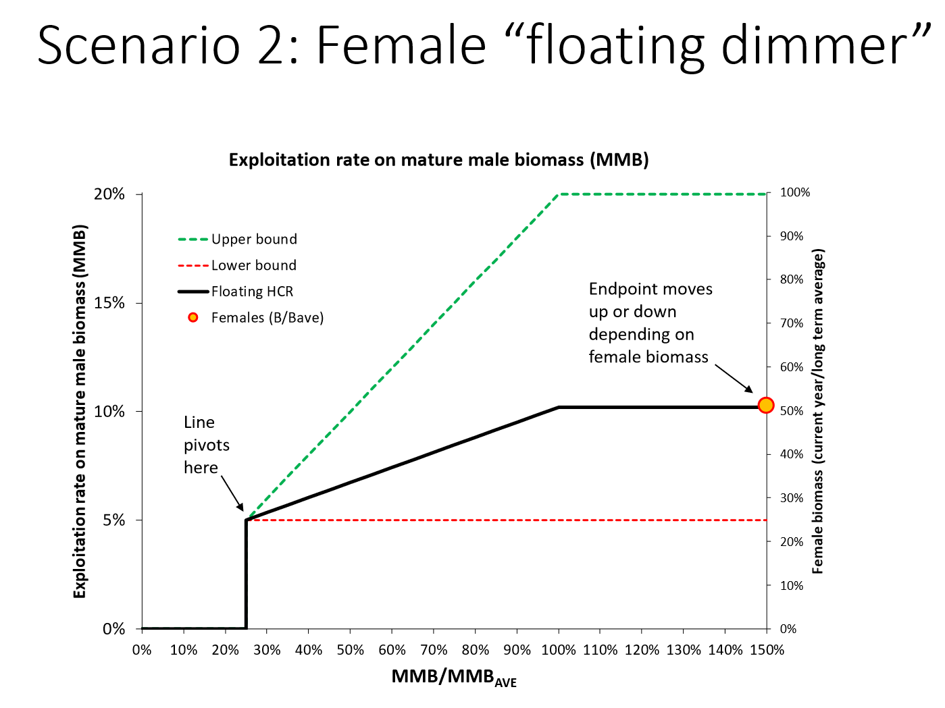

Slide 36
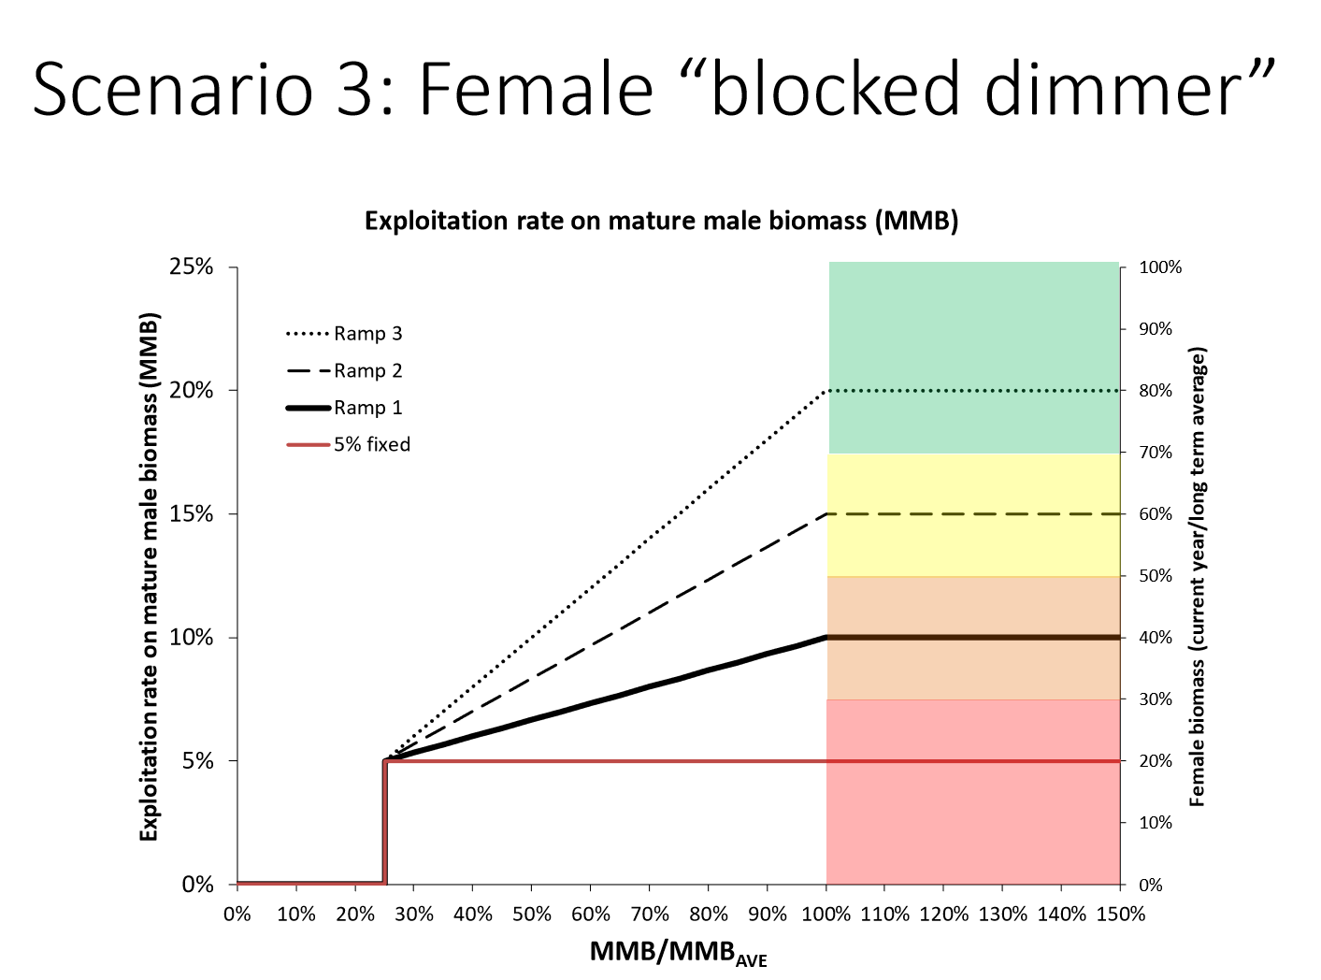

Slide 37
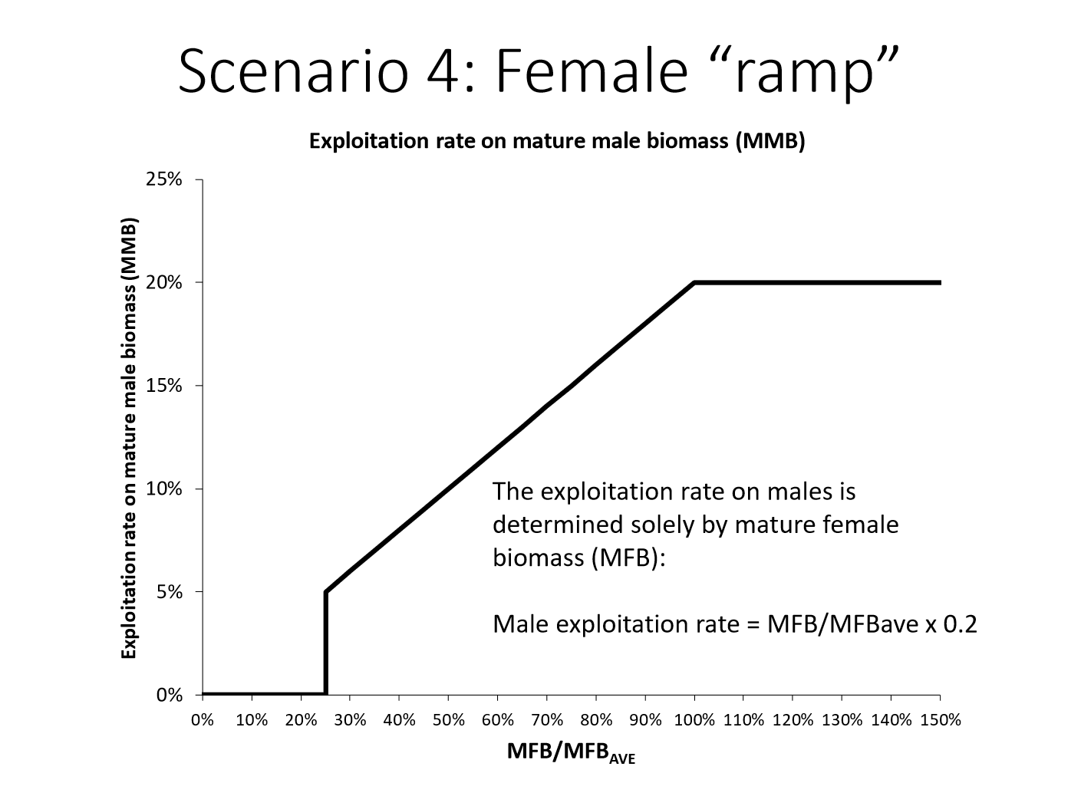

Slide 38
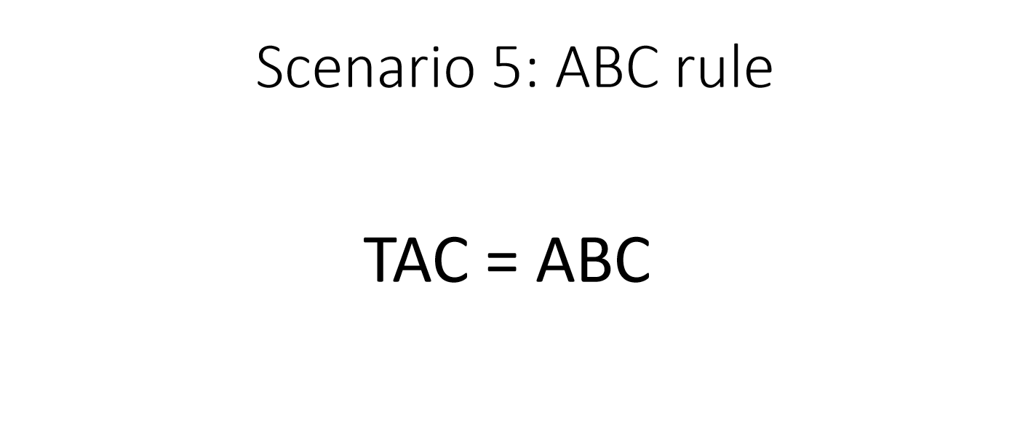

Slide 39
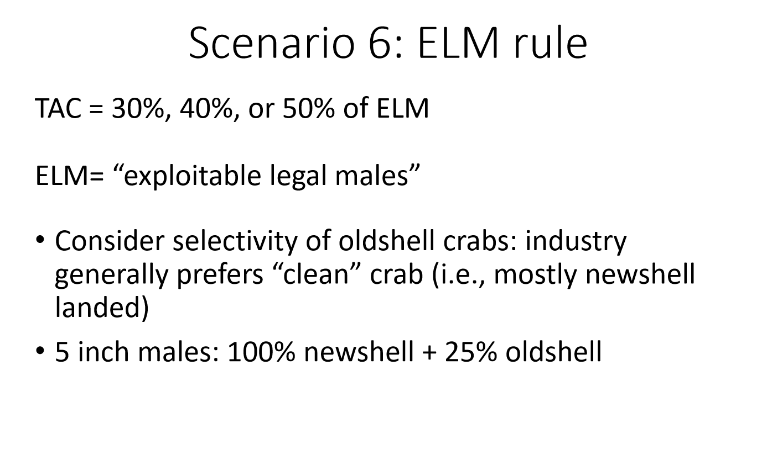

Slide 40
Schedule
Winter 2019
Update Operating Model and Run Simulations
Spring 2019
Analysis and Preliminary Results and Write Up
Apr. 2019
Framework Place Holder for Board of Fish
Sep. 2019
Presentation of Results to ADFG and CPT
Sep. 2019
White Paper Full Draft
Mar. 2020
Selected HCR Presented to Board of Fish

Slide 41






Thank You! Questions and Comments?
Notes:
Thank cooperative research partners and emphasize the importance and unique opportunity this partnership affords me as a grad student and the resource as a whole

