Slide 1
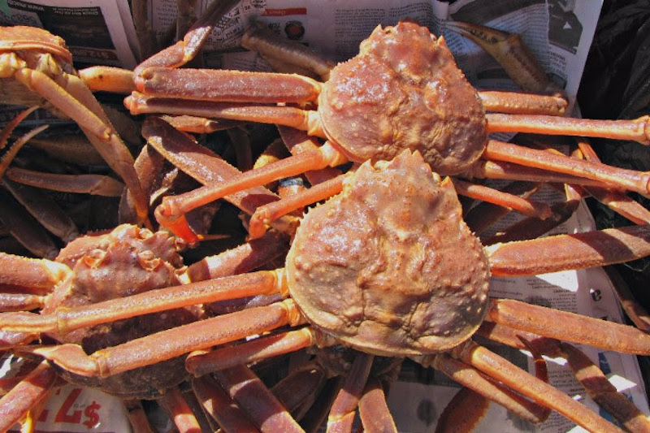

Ecosystem &
Socioeconomic
Profile
Snow Crab Request for Indicators (RFI)
January 2022 Crab Plan Team Update
ESP Contributors: Kerim Aydin, Buck Stockhausen, Kalei Shotwell,, Kelly Kearny, Mike Litzow, Jens Nielsen, Darren Pilcher, Jon Richar, Pam Jensen and Jordan Watson
Notes:
RFI: Standardized template for initializing an ESP and formalizes indicator requests and contributions for a full snow crab ESP next year

Slide 2

Overview
Request for Indicators (RFI) Overview
Review draft indicators for snow crab
  Proposed ecosystem indicators
  Proposed socioeconomic indicators
CPT input on proposed indicators
Notes:
Emphasis- feedback on methodology/proposed indicators/any missing indicators vrs showing trends in indicators

Slide 3
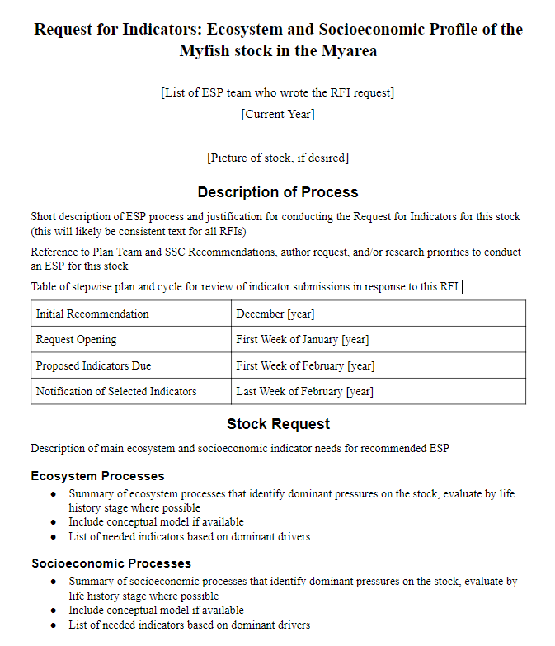
Request for Indicators (RFI)
RFI: Initializes an ESP and formalizes indicator requests
Description of the request process
Request: stock ecosystem and socioeconomic needs
Contributions: data fields and submission instructions
Review and Responsibilities: teams & contributor roles, use and credit
Notes:
RFI: Standardized template for initializing an ESP and formalizes indicator requests and contributions for a full snow crab ESP next year
The RFI starts with a description of the request process and the timing of the cycle. The next section is the main request for the specific ESP being developed that year and this will be developed by the ESP team. It first summarizes the ecosystem and socioeconomic processes that identify the dominant pressures on the stock, by life history stage where possible, then lists the needed indicators based on those dominant pressures. This is basically the bulk of the metrics assessment and gives the ESP teams a jump on creating the ESP document. Also, if a conceptual model can be built, then this would also be included in the RFI. The next section is the directions for how and what to provide if you contribute an indicator. This links to the AKFIN submission tool and goes through the required data fields and instructions for submission. The RFI ends with guideline criteria on how the indicators will be reviewed, and what the roles are for the ESP teams and the contributor. There is also information on how the contributed indicator will be used and acknowledged. The RFI also establishes the line of sight required between the ESP teams and the contributors as the ESP is developed.

Slide 4
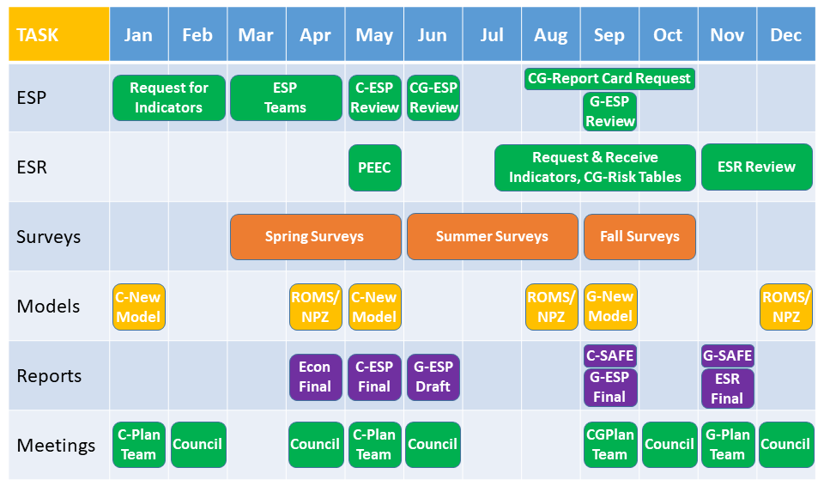
ESP Timeline
C = Crab, G = Groundfish
Notes:
The ESP process and product fit within an annual schedule that is aligned with the annual harvest specification process for the crab and groundfish fisheries in Alaska. In this 12 month timeline graphic we have mapped out the general annual process for conducting ESPs, ESR, Surveys, Models, primary related Reports, and the standard Council Meetings. Note that since crab and groundfish are on separate cycles, we have denoted a crab item with a C and a groundfish item with a G.
ESP Schedule begins with request for indicators (RFI) in January and is separated from fall stock assessments and coordinated with ESR indicator requests
Three ESP Report templates: 1.) Full template completed when ESP initiated, ~5 years, 2.) Partial template is reduced and based on SAFE format, potentially initiated for a “red flag” response, and 3) Report card template is simple and for annual update. So to summarize: RFI’s will be released for snow crab, BBRKC and SMBKC this winter. Full ESP presented for snow crab in May, and report card updates in September with current year indicators for all three stocks

Slide 5
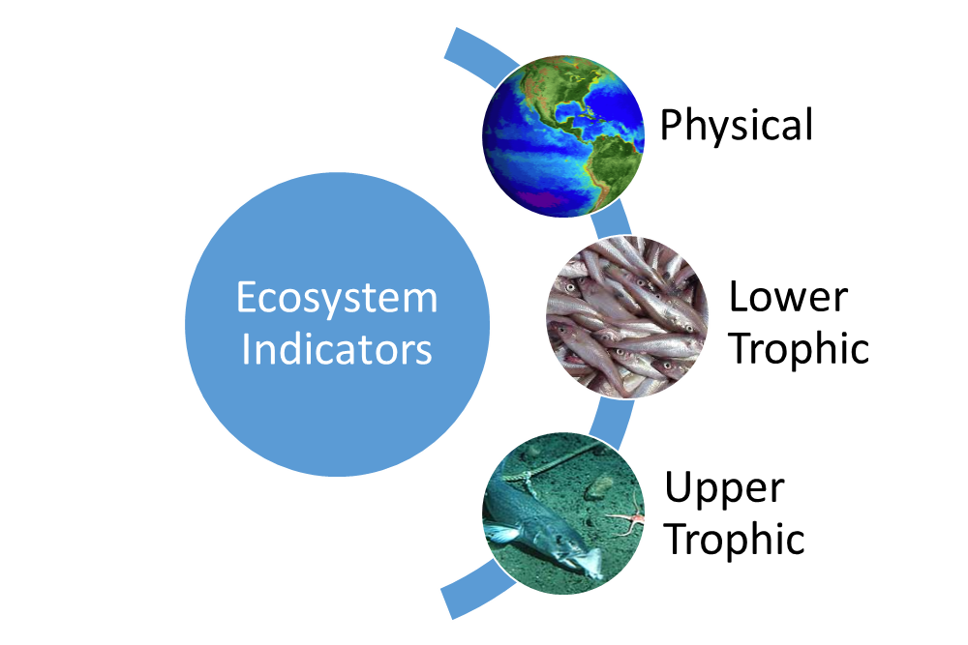
Draft Ecosystem Indicators
-
Arctic Oscillation (climate model)
Cold pool extent (BTS)
Sea-ice extent/retreat (satellite)
Production (chlorophyll a, satellite)
Intermolt duration (BTS)
Settlement success (IBM)
Hatch spring bloom overlap (BTS, sat)
Benthic prey biomass (BTS)
Snow crab recruit condition (BTS)
Snow crab area occupied (BTS)
Temperature of occupancy (BTS)
Snow crab center of distribution (BTS)
Pcod consumption of snow crab
Pcod-snow crab spatial overlap (BTS)
Female snow crab size at maturity (BTS)
Male snow crab recruit biomass (BTS)
Snow crab disease prevalence (BTS)
+
+
+
-
+
+
+
+
-
-
-
+
+
-
Notes:
Suite of proposed snow crab ecosystem indicators with data sources for each indicator in parentheses. I’ll go through most of these indicators in the following slides, but they are also outlined in the RFI document. Indicators grouped into 3 categories and the +/- signs indicate the proposed directional relationship between the indicator and snow crab
AO example: Poor snow crab recruitment is associated with positive values of the Arctic Oscillation.

Slide 6
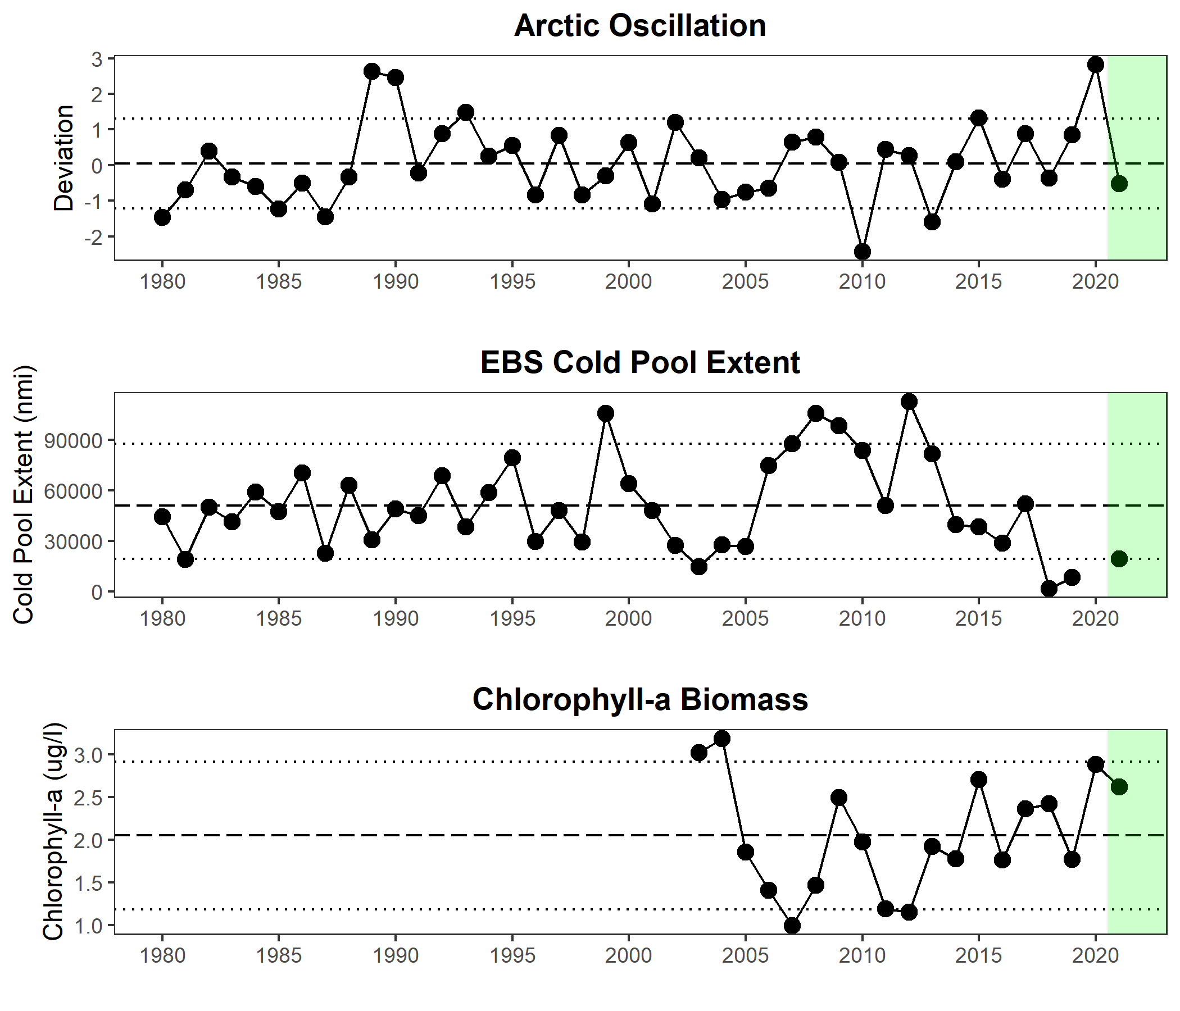
Physical Indicators Time series Trend Mechanistic Link
Arctic Oscillation |  | Poor snow crab recruitment associated with positive values of the AO
Cold pool extent |  | Availability of cold water habitat is critical for juvenile snow crab predator refuge
Chl-a biomass |  | Larval growth and survival dependent on high concentrations of diatoms
Notes:
Table shows mechanistic understanding for why we may have selected a given indicator given a hypothesized or published link with snow crab recruitment or productivity
Spring chlorophyll-a biomass: April-June average chlorophyll-a biomass within the north middle shelf of the EBS; calculated with 8-day composite data from MODIS satellites aggregated by BSIERP region

Slide 7
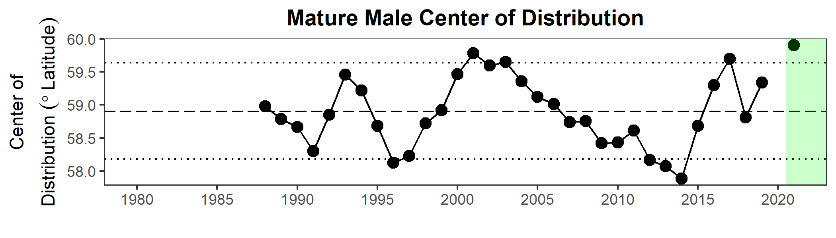
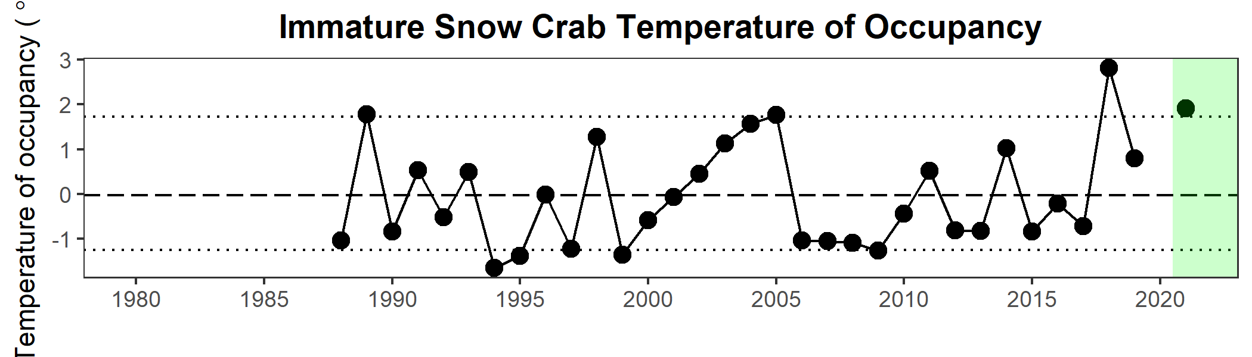
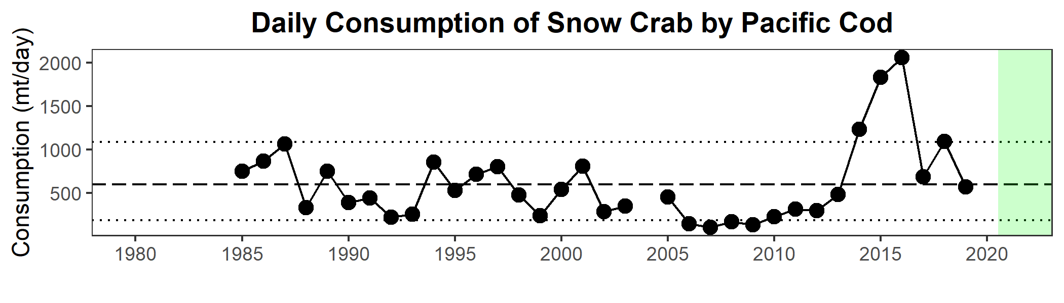
Upper Trophic Level Indicators Time series Trend Mechanistic Link
Snow crab center of distribution |  | Shifts in the spatial extent of snow crab are driven by bottom temperatures and cold pool dynamics
Snow crab temperature of occupancy |  | Immature snow crab are highly sensitive to bottom temperatures
Pacific cod consumption of snow crab |  | Pacific cod predation is a major source of immature snow crab mortality
Notes:
Mature male COD shown (CPUE-weighted average latitude), also mention area occupied here as a potential spatial indicator
Snow crab temperature of occupancy: Mean bottom temperature weighted by immature snow crab CPUE at each station of the EBS summer bottom trawl survey
Population-level estimates of snow crab predation: The daily summer consumption of snow crab by Pacific cod in the EBS, estimated from Pacific cod diet compositions, EBS trawl survey CPUE, and temperature adjusted length-specific maximum consumption rates

Slide 8
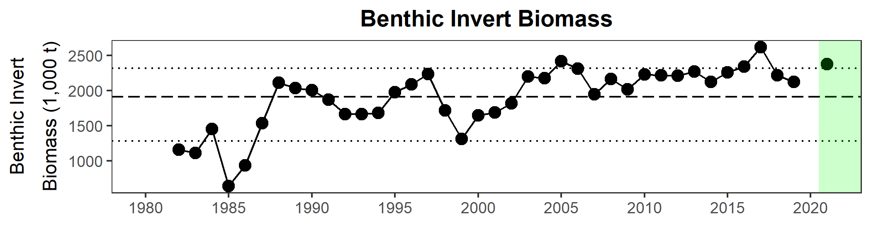
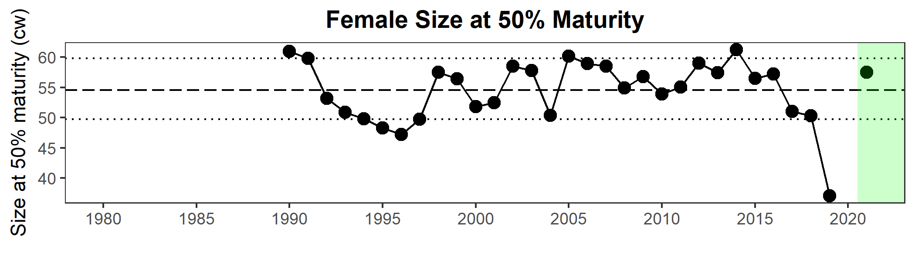
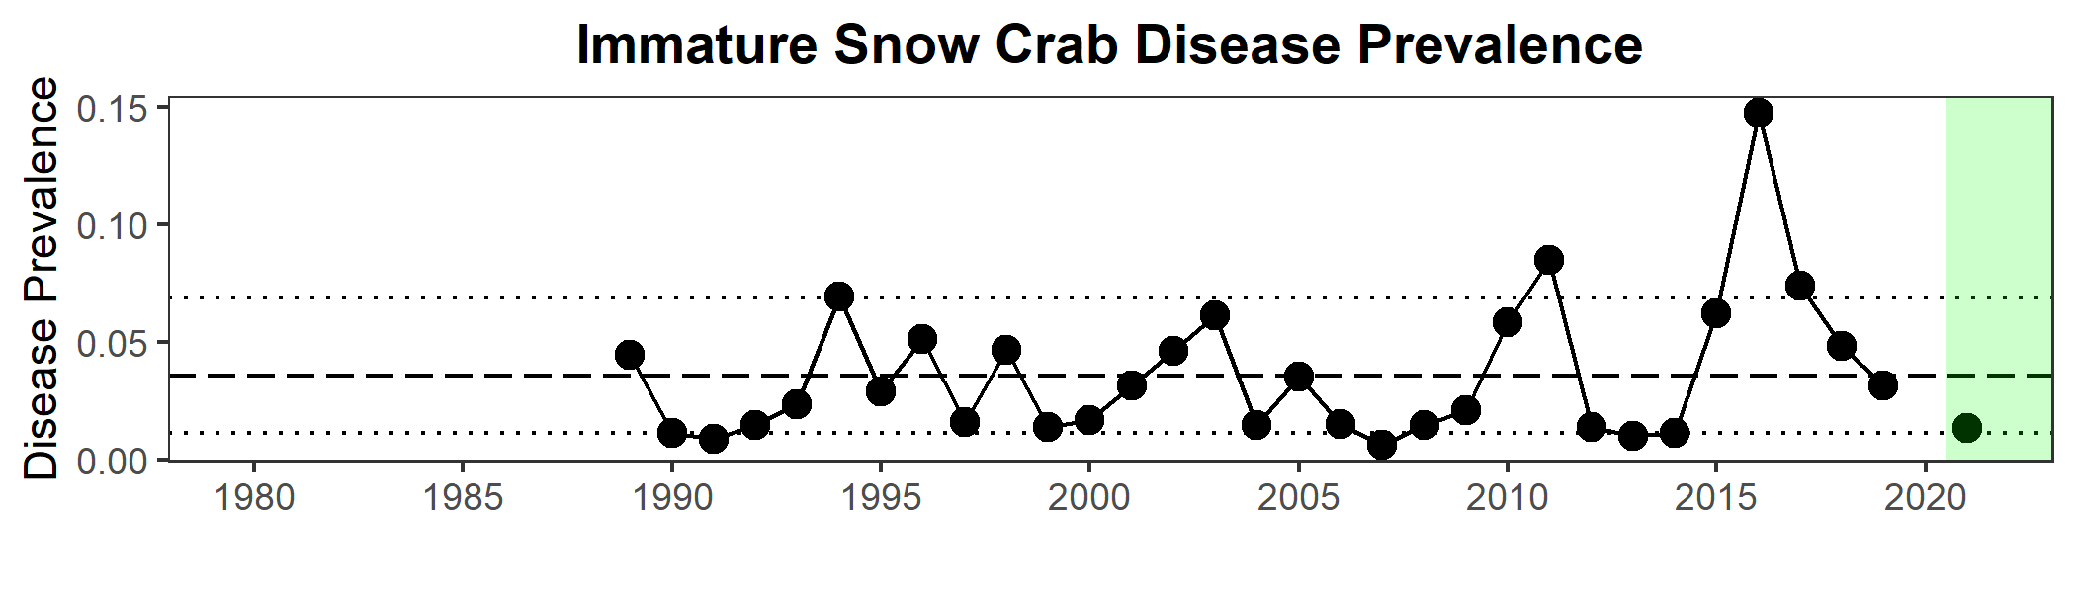
Upper Trophic Level Indicators Time series Trend Mechanistic Link
Benthic prey biomass |  | Benthic prey availability may drive patterns in growth, energetic condition and survival
Female snow crab size at maturity |  | Fecundity increases with female size, suggesting that size at maturity is indicative of reproductive potential
Bitter crab syndrome visual prevalence |  | Infection with bitter crab syndrome is often fatal in snow crab, and disease progression accelerates in warmer waters
Notes:
Female snow crab size at maturity: Mean carapace width of female snow crab at 50% probability of maturation, as determined from maturity curves developed from EBS bottom trawl survey data

Slide 9
Proposed ecosystem indicators in development
Hatch-spring bloom overlap
Snow crab settlement success (IBM)
Snow crab larval intermolt duration (IBM)
Winter cod predation (observer stomach scans)
Pacific cod-snow crab spatial overlap (BTS)
Bitter crab syndrome prevalence (PCR assays)
Snow crab recruit condition index (Lipid analysis/Brix)
Larval snow crab abundance (EcoFOCI larval surveys)
Indicators derived from ABSC Skipper Survey
Notes:
Snow crab hatch-spring bloom index: Temporal overlap between spring bloom timing and hatch dates estimated from temperature-dependent embryo development rates. In warm years, the spring bloom occurs in April-June and overlaps with peak snow crab hatching, likely increasing larval survival
Settlement success index: Measure of “successful” individuals settled in benthic nursery habitat (25-150 m depth) from individual based model simulations
Intermolt duration index: Predicted time spent in early benthic instars using laboratory derived temperature-dependent development rates and simulations from a spatially explicit biophysical individual based model. Stage duration is inversely related to temperature so warm years result in more rapid growth rates, shorter intermolt duration and less time spent in vulnerable early life stages

Slide 10
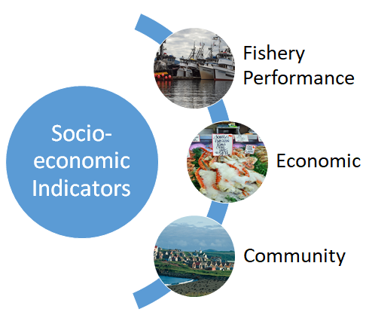
Draft Socioeconomic Indicators
Center of gravity (snow crab fishery)
Catch-per-unit-effort (snow crab fishery)
Total potlifts (snow crab fishery)
Number active vessels (snow crab fishery)
Incidental catch of snow crab
Ex-vessel value (snow crab fishery)
Ex-vessel price/lb (snow crab fishery)
Ex-vessel revenue share (snow crab fishery)
No community indicators proposed
Notes:
Brian talked about the economic indicators on Monday and mentioned efforts to integrate economic SAFE and ESP products. No community indicators proposed in an effort to emphasize those indicators that are most closely associated with the health and condition of the stock

Slide 11
Discussion
Are the suggested ecosystem and socioeconomic indicators appropriate for snow crab?
Are there any other indicators we should include in the snow crab RFI and May 2022 ESP?
Is there any feedback on the Request for Indicators (RFI) approach and/or ESP schedule for crab?

Slide 12
Proposed Snow Crab Indicators
Snow crab conceptual model
Ecosystem Indicators
Socioeconomic Indicators
Arctic Oscillation (climate model)
Cold pool extent (BTS)
Sea-ice extent/retreat (satellite)
Production (chlorophyll a, satellite)
Intermolt duration (BTS)
Settlement success (IBM)
Hatch-spring bloom overlap (BTS, sat)
Benthic prey biomass (BTS)
Snow crab recruit condition (BTS)
Snow crab area occupied (BTS)
Temperature of occupancy (BTS)
Snow crab center of distribution (BTS)
Pcod consumption of snow crab
Pcod-snow crab spatial overlap (BTS)
Female snow crab size at maturity (BTS)
Male snow crab recruit biomass (BTS)
Snow crab disease prevalence (BTS)
Center of Gravity (snow crab fishery)
Catch-per-unit-effort (snow crab fishery)
Total potlifts (snow crab fishery)
Number active vessels (snow crab fishery)
Incidental catch of snow crab
Ex-vessel value (snow crab fishery)
Ex-vessel price/lb (snow crab fishery)
Ex-vessel revenue share (snow crab fishery)
Notes:
Proposed indictors to be included in 2022 ESP

Slide 13
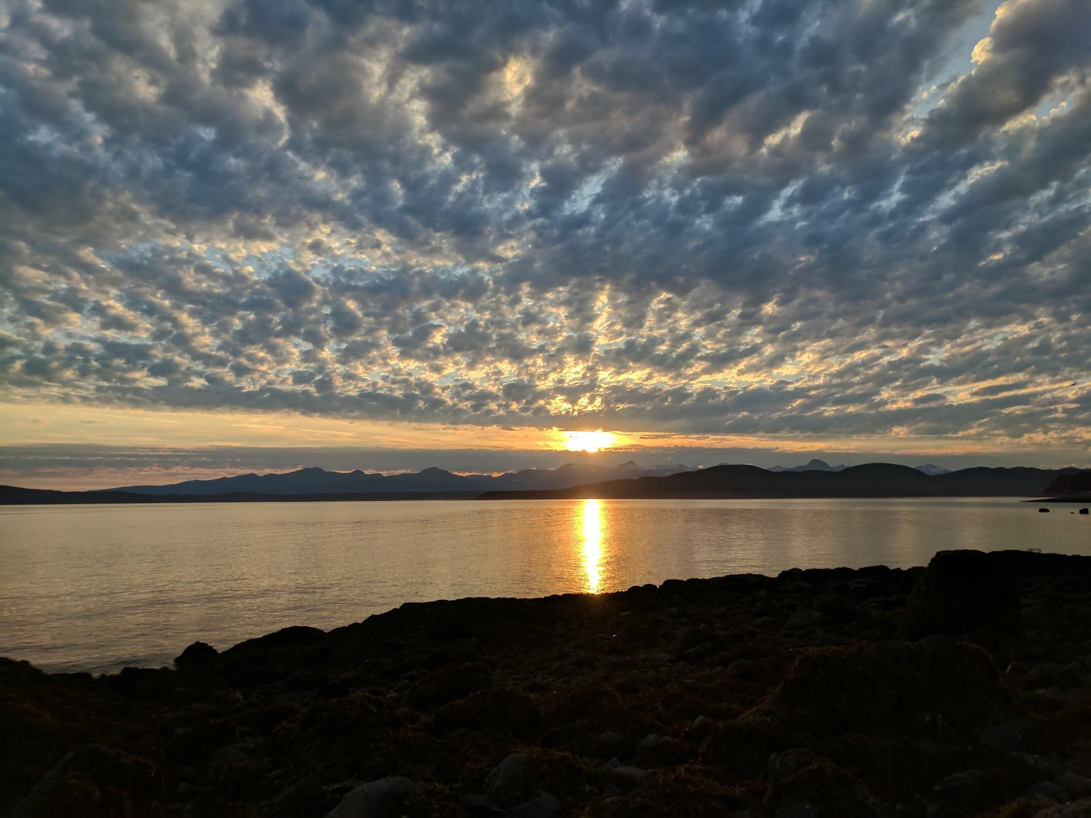
Questions?

