Slide 1

Snow crab rebuilding plan considerations

Slide 2
Discussion items for snow crab rebuilding plan
Status of projections for Tmin and Tmax [Cody]
Additional considerations for rebuilding plan”
  Bycatch in groundfish fisheries?
    Trawl limit under COBLZ
    Fixed gear no limit
  Habitat considerations?
Discussion paper for February to help Council draft alternatives (any additional considerations to alternatives on Tmin and Tmax)
  Working draft is posted on the CPT meeting agenda with highlights data needed prior to the Council meeting

Slide 3
Incidental Snow Crab Catch in BSAI Groundfish Fisheries
Alaska Region
September 2021
Krista Milani

Slide 4
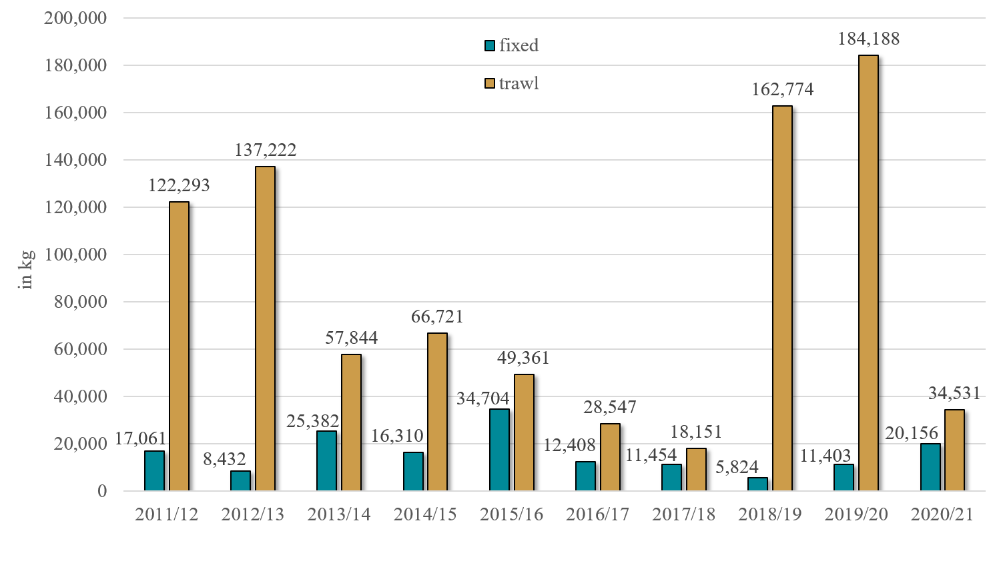
Bering Sea Snow Crab Incidental Catch in Groundfish Fisheries
Pot and hook-and-line Pacific cod fishing accounts for most BSS bycatch in the fixed gear category with about 75% coming from pot gear.
Hook-and-line Pacific cod fishing is spread out throughout the stock area.
Pot Pacific cod fishing is concentrated on the north side of Unimak Island to Port Moller.

Slide 5
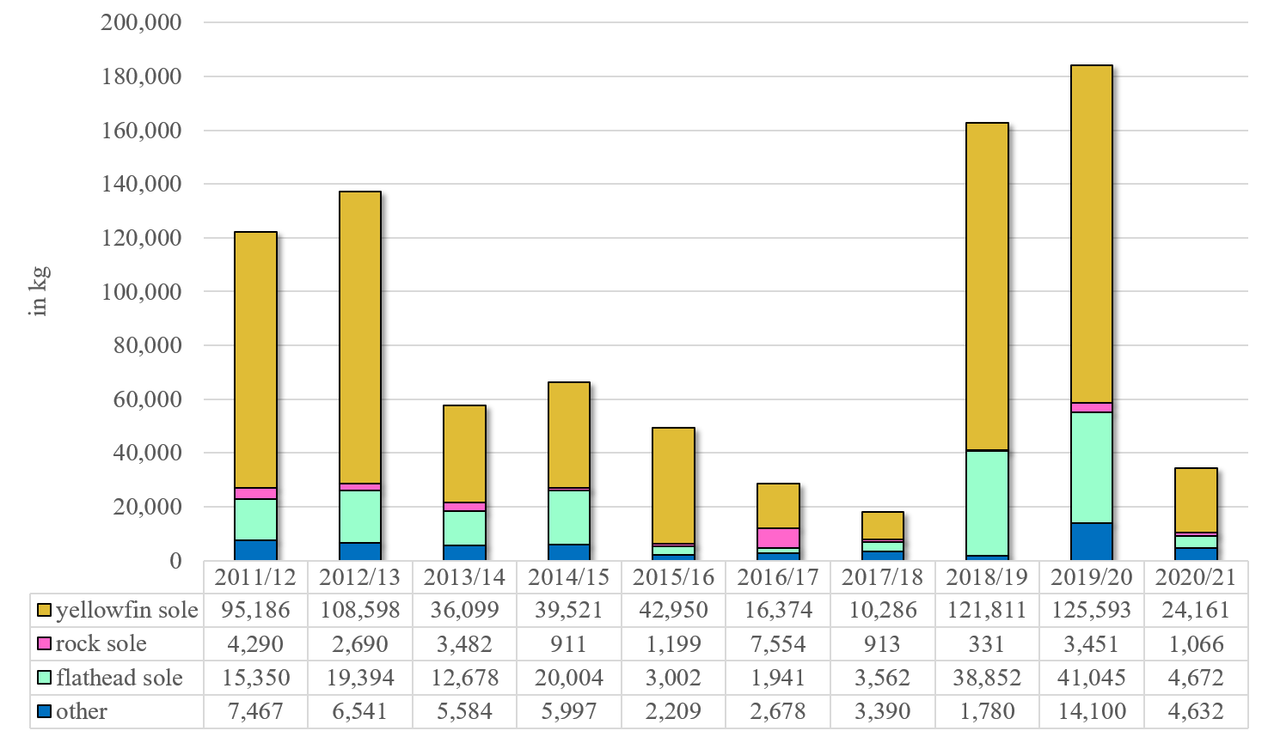
Bering Sea Snow Crab Trawl Incidental Catch by Trip Target
2018/19 and 2019/20 increased BSS bycatch in the yellowfin fishery was due mainly to increased yellowfin sole fishing in the area above the Pribilof Islands.
“Other” species includes: Alaska plaice, arrowtooth flounder, Atka mackerel, Greenland turbot, Kamchatka flounder, other flatfish, Pacific cod, rockfish, and pollock.

Slide 6
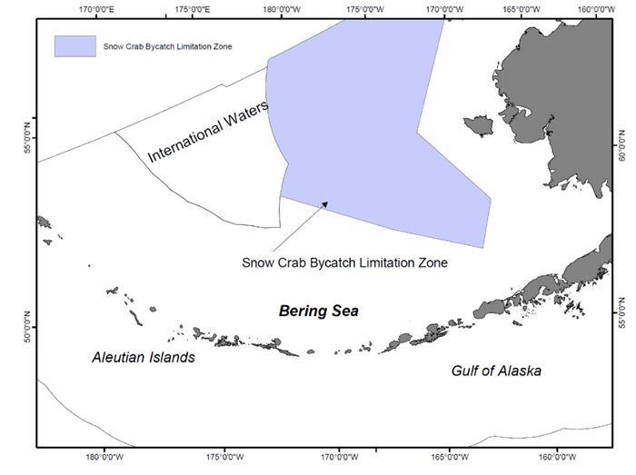
EBS Snow Crab Bycatch Limitation Zone (COBLZ)

Slide 7
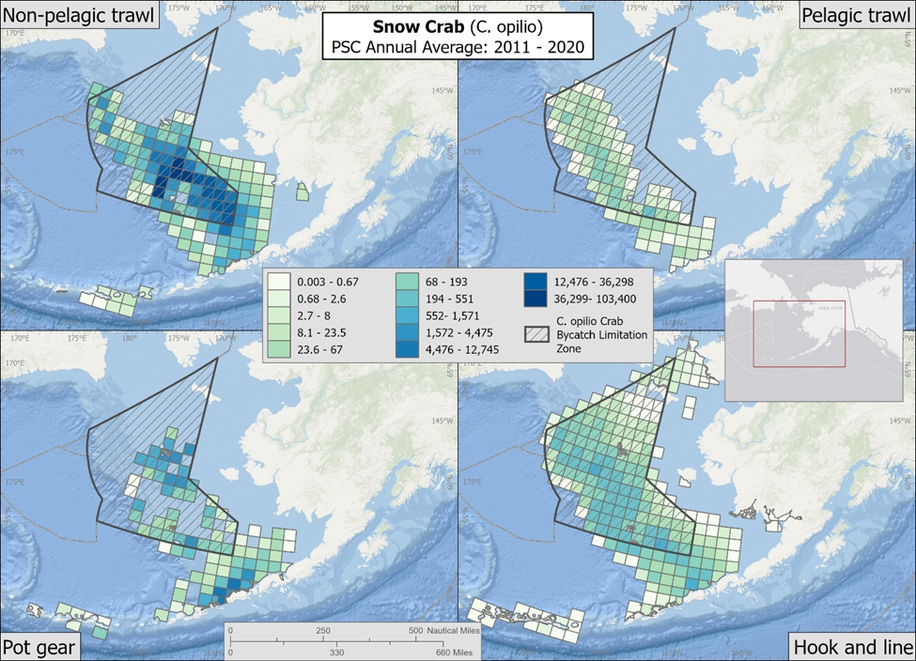
EBS snow crab PSC/bycatch (average annual # of crab) by gear type, 2011-2020
NPT PSC occurred primarily in the southeast portion of the COBLZ, and extends northwest throughout the zone and primarily east and south of the COBLZ
Pelagic trawl gear follows a similar spatial patter but to small magnitude
PSC in pot gear is distributed throughout the southern two-thirds of the COBLZ and southeast border of COBLZ along the AI
HAL gear has the largest spatial distribution, which is likely due to the spatial distribution of effort in the HAL fisheries

