Slide 1
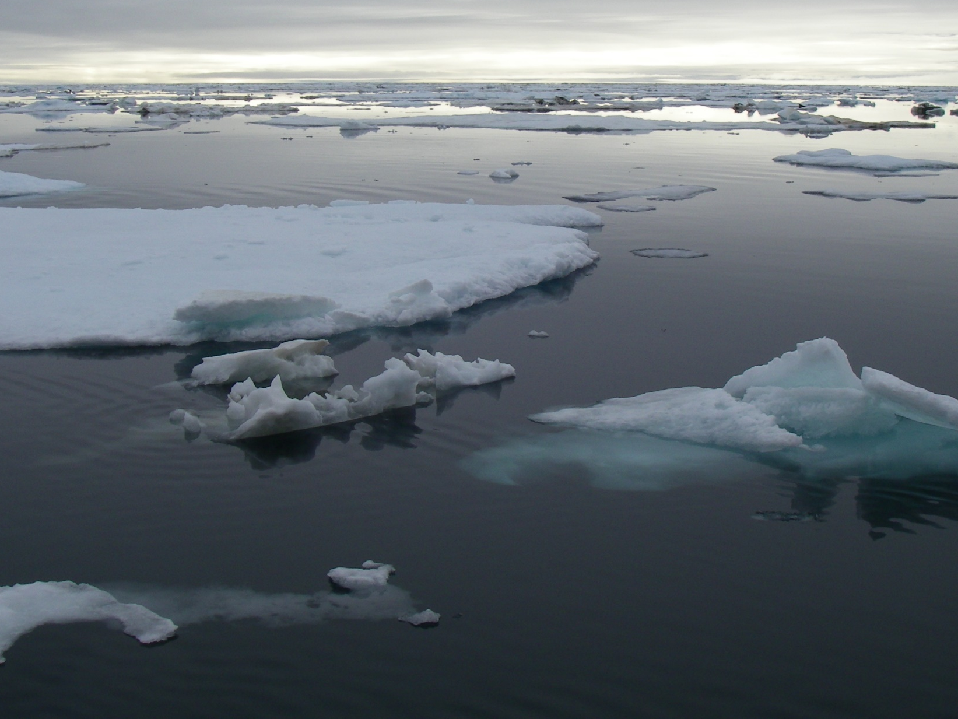
Regional Action Plan for the Chukchi and Beaufort Seas
James T. Thorson, Robyn Angliss, Mabel Baldwin-Schaeffer, Peter Boveng, Louise Copeman, Alex De Robertis, Stan Kotwicki, Esther Goldstein, Libby Logerwell, Maggie Mooney-Seus, Ellen Ward, George A. Whitehouse, Sarah Wise

Slide 2
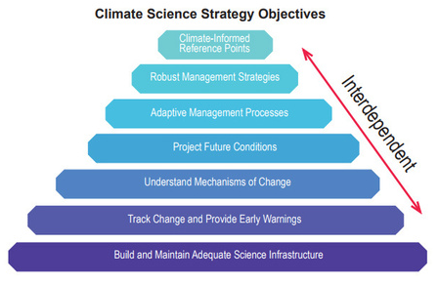
What is the Arctic RAP
The Arctic RAP is:
A regional process to implement, envision, discuss, communicate, and track activities responding to the NOAA Fisheries Climate Science Strategy (NFCSS)
An AFSC-led document that can be used to:
  Prioritize reimbursable funding for activities in the plan (RWP, NCRP, EFH)
  Identify areas where researchers can collaborate within AFSC and with external partners
  Develop agreement regarding key science gaps in the Arctic
Five AFSC planning categories for all RAPs:
Monitoring
Process research
Management-oriented synthesis
Marine mammals
Socio-economic and human dimensions

Slide 3
What is the Arctic RAP
The Arctic RAP is not …
A budgeting document to allocate or prioritize base funding
A staffing plan to allocate FTE labor
An inventory of everything AFSC is doing in the Arctic
A process to prioritize what should be cut, or which suggested activities are more or less important

Slide 4
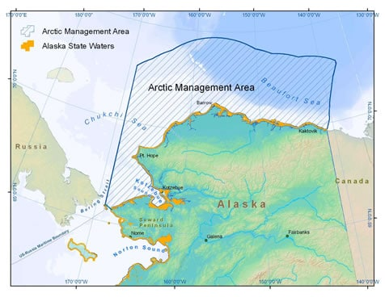
Where is the Arctic RAP?
Chukchi and Beaufort Seas
US exclusive economic zone (not Alaska State waters)
Development process
All programs invited to nominate representatives
Convene two virtual seminars with presentation from all representatives
Consensus agreement about “sub-lead” for aeach AFSC category
Open-invite (“opt-out”) process to identify potential activities
Sub-leads identify top 2-3 priorities for activities
Lead author and sub-leads discuss, edit, merge, and modify as needed
Re-circulate for input from all programs and AK Regional Office

Slide 5
In the Arctic RAP, we envision:
  a targeted portfolio of monitoring, process research and synthesis efforts including lower trophic, fish, marine mammal, and human components of the ecosystem that would occur from 2022-2024.
  developing a collaborative research environment in which discussions and partnerships with Alaska Natives communities is a central element, so that the next Arctic Regional Action Plan can involve components that are co-produced with Alaska Native communities. 2022-2024
Two sections:
  Inventory of previous and on-going ecosystem monitoring programs
  Recommended future activities (11)

Slide 6
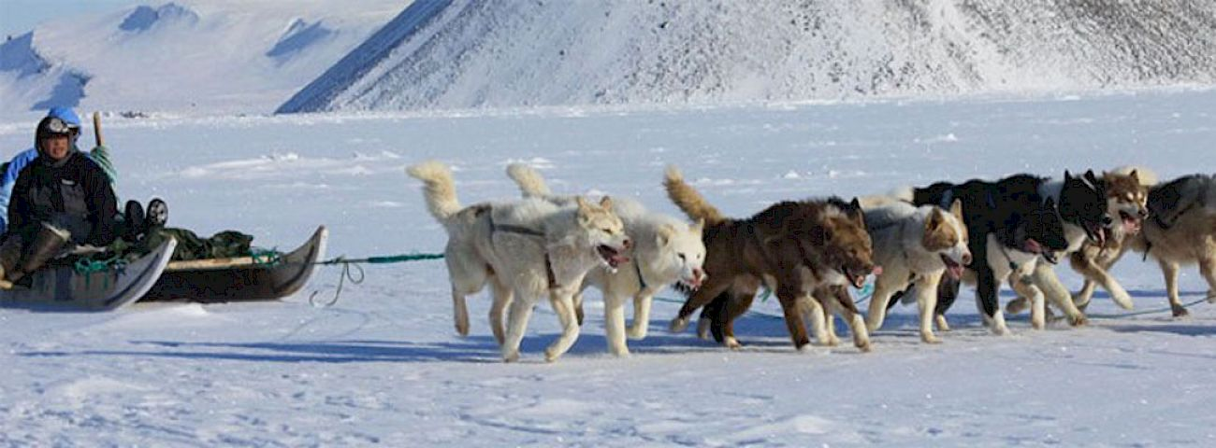
Future Activities
Bridging knowledge to inform Arctic Management
Goals:
Promote interdisciplinary partnerships;
Document Indigenous Conceptual Models;
Demonstrate collaborative methods.

Slide 7
Future Activities
2. Communications To Support Co-Producing Science with Arctic Communities
Goals:
Conduct radio interviews and local newspaper features;
Develop educational efforts targeting students, teachers and parents in the communities.
Use NMFS communications platforms to highlight collaborative efforts

Slide 8
Future Activities
3. Local Knowledge, Traditional Knowledge, and Subsistence Taskforce for Arctic Region
Goals:
Convene Arctic LKTKS Task force

Slide 9
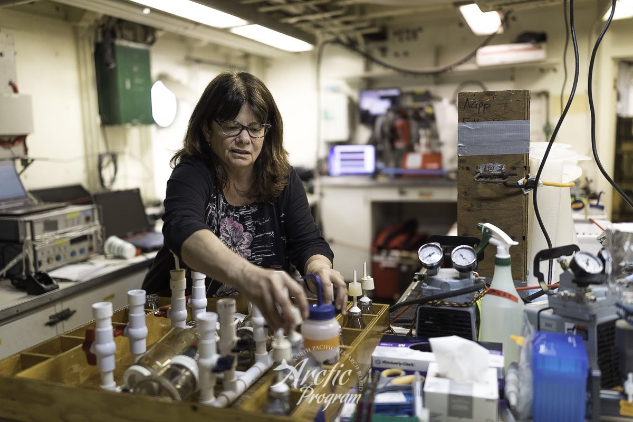
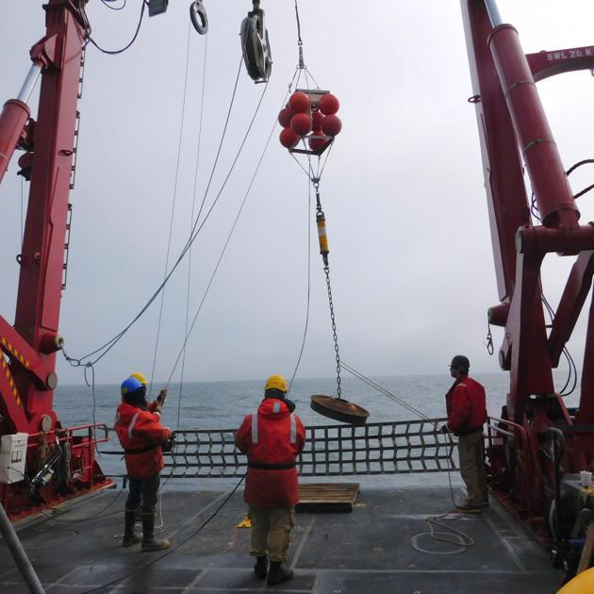
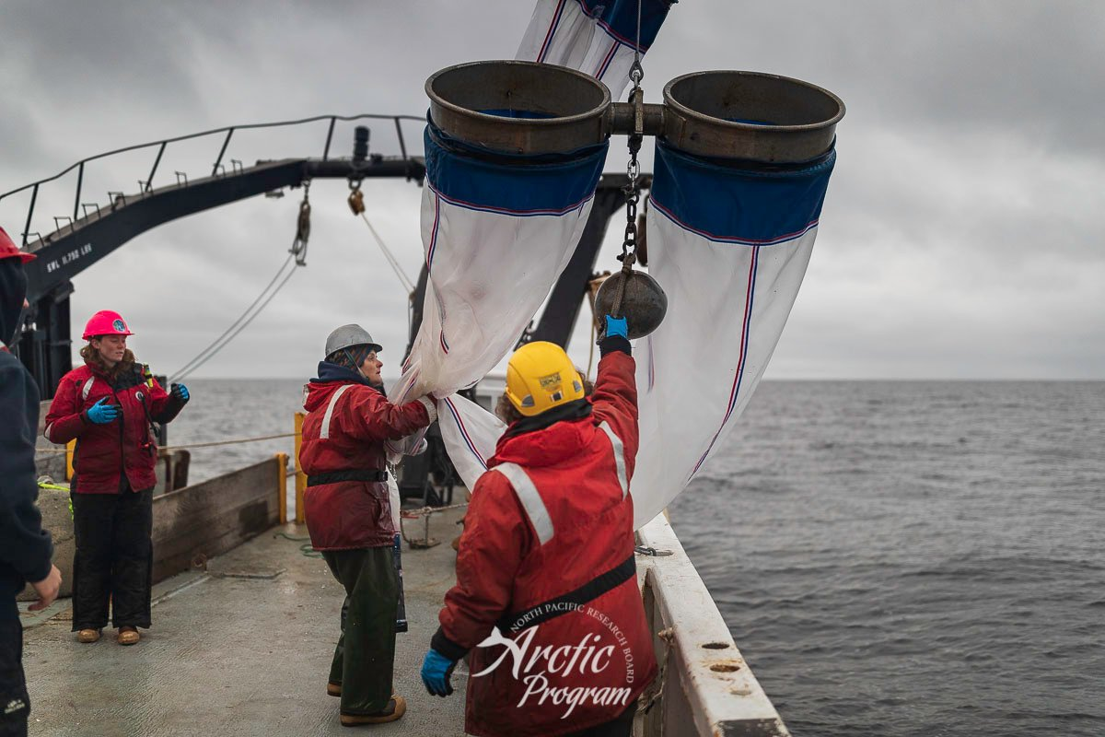
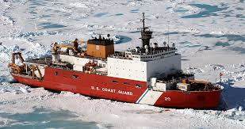
Future Activities
Expand involvement with Distributed Biological Observatory (DBO)
Goals:
Add beam trawls
Extend exploratory large-mesh trawling
Add benthic respirometer
Add environmental DNA

Slide 10
Future Activities
Predicting HABs and juvenile snow crab status using satellite-based ocean color
Goals:
Develop a phytoplankton community size structure algorithm,
Advance a specific algorithm for the detection of small photosynthetic bacteria (Synechococcus),
Develop an algorithm for diatom abundance and
Explore satellite metrics to predict HAB prevalence and juvenile crab abundance

Slide 11
Future Activities
6. Overwinter survival of gadids
Goals:
Predict impact of summing warming on juvenile condition
Predict impact of condition on overwinter survival

Slide 12
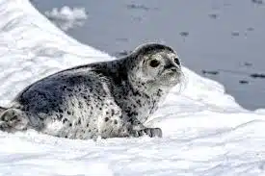
Future Activities
Vessel-based cetacean survey of the Chukchi Sea
Goals
Maintain and improve passive acoustics;
Develop and implement vessel and/or aerial survey

Slide 13
Future Activities
8. Trophic roles of ice seals
Goals:
Estimate seasonal prey requirements
Expand to total ice-seal consumption

Slide 14
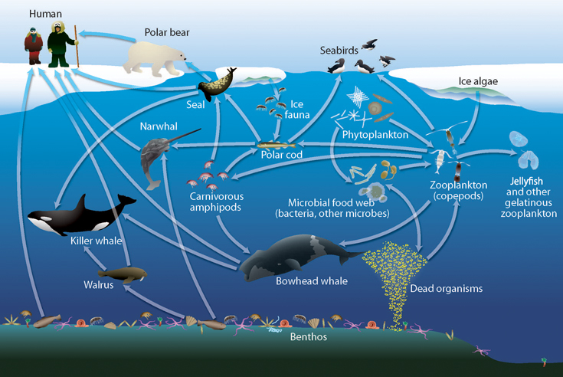
Future Activities
Arctic Ecosystem Status Report
Goals:
Update the Arctic ESR during 2022-2024

Slide 15
Future Activities
10. Expand Arctic Ecosystem Modelling
Goals:
Update Chukchi food web model
Develop Beaufort food web model
Compare system-level optimum yield across all Alaska ecosystems
Spatio-temporal synthesis model for survey planning:

Slide 16
Future Activities
Bottom trawl and acoustic-trawl survey to detect northward distribution shifts
Goals:
Develop survey design
Conduct short gear trial
Implement combined sampling effort

Slide 17
Acknowledgements
Authors:
James T. Thorson, Robyn Angliss, Mabel Baldwin-Schaeffer, Peter Boveng, Louise Copeman, Alex De Robertis, Stan Kotwicki, Esther Goldstein, Libby Logerwell, Maggie Mooney-Seus, Ellen Ward, George A. Whitehouse, Sarah Wise
Discussions:
Duane Stevenson, Johanna Vollenweider, Ryan McCabe, Diana Baetscher, Lisa Eisner, Jon Richar, John Bengston, and Cody Szuwalski
Edits:
Gretchen Harrington, Jodi Pirtle, Anne Marie Eich, Joseph Krieger, Greg Balogh, Suzie Teerlink, Marina Cucuzza, Jay Peterson, Bob Foy, Ron Felthoven, and Dana Hanselman
Alternative figure:
Elizabeth Siddon and Jordan Watson

