Slide 1
VAST modelling: Discuss applicability to crab assessments
May 3, 9-10am, Anchorage AK
Alaska Fisheries Science Center
James Thorson

Slide 2
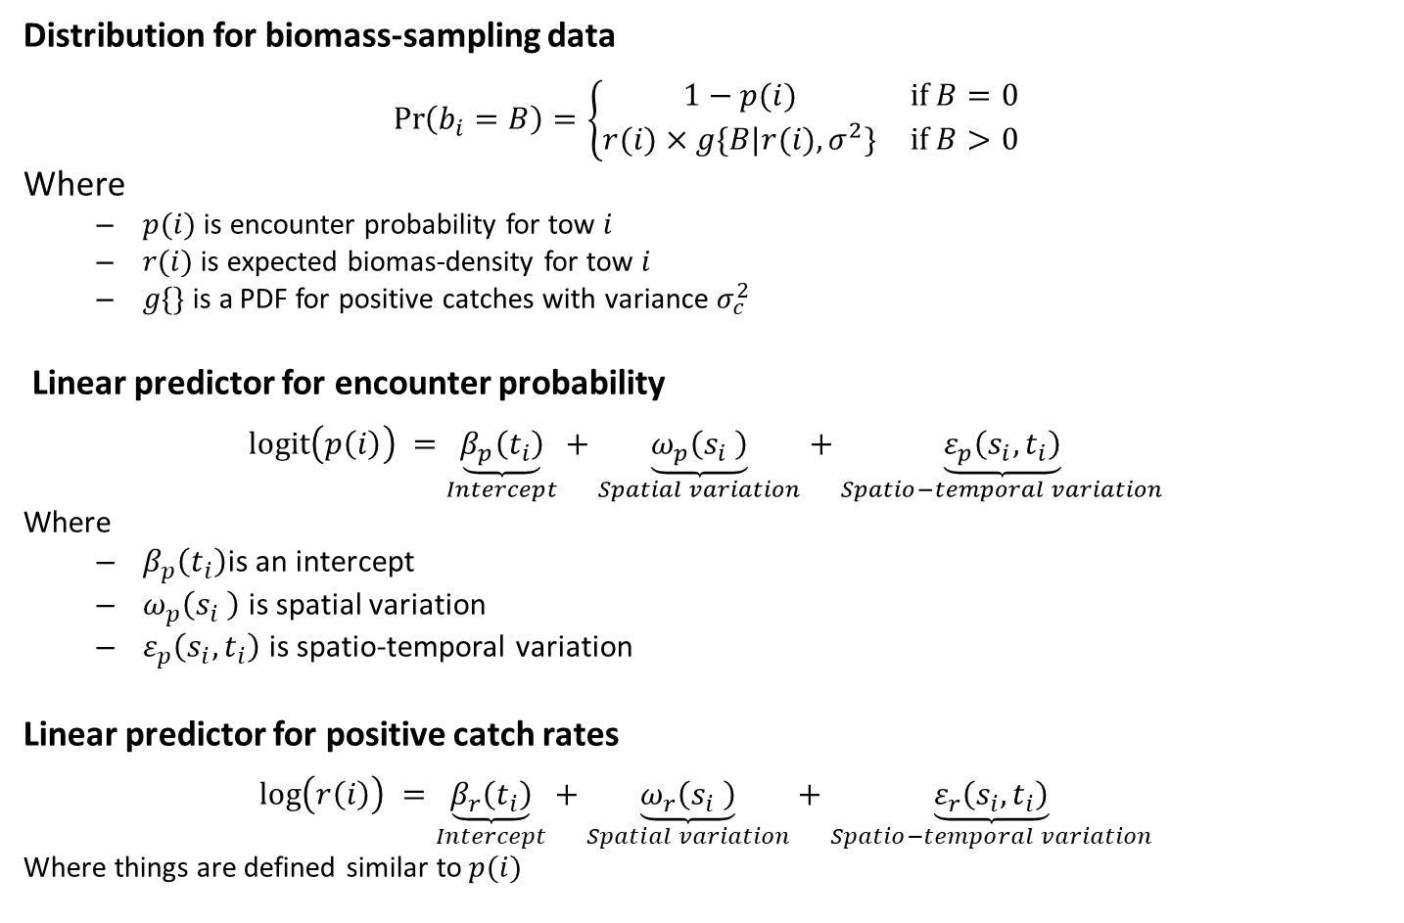
Vector autoregressive spatio-temporal model
Distribution for biomass-sampling data
$$\operatorname{Pr}\left(b_{i}=B\right)=\left\{\begin{matrix}1−p(i) & if B=0 \\ r(i)×g\{\left.B|r(i),σ^{2}\}\right. & if B>0\end{matrix}\right.$$
Where
  $p(i)$ is encounter probability for tow $i$
  $r(i)$ is expected biomas-density for tow $i$
  $g\{\}$ is a PDF for positive catches with variance $σ_{c}^{2}$
Linear predictor for encounter probability
$$logit\left(p\left(i\right)\right) =\underset{Intercept}{\underbrace{β_{p}\left(t_{i}\right)}}+\underset{Spatial variation}{\underbrace{ω_{p}\left(s_{i} \right)}}+\underset{Spatio−temporal variation}{\underbrace{ε_{p}\left(s_{i},t_{i}\right)}}$$
Where
  $β_{p}\left(t_{i}\right)$is an intercept
  $ω_{p}\left(s_{i} \right)$ is spatial variation
  $ε_{p}\left(s_{i},t_{i}\right)$ is spatio-temporal variation
Linear predictor for positive catch rates
$$log\left(r\left(i\right)\right) =\underset{Intercept}{\underbrace{β_{r}\left(t_{i}\right)}}+\underset{Spatial variation}{\underbrace{ω_{r}\left(s_{i} \right)}}+\underset{Spatio−temporal variation}{\underbrace{ε_{r}\left(s_{i},t_{i}\right)}}$$
Where things are defined similar to $p(i)$

Slide 3
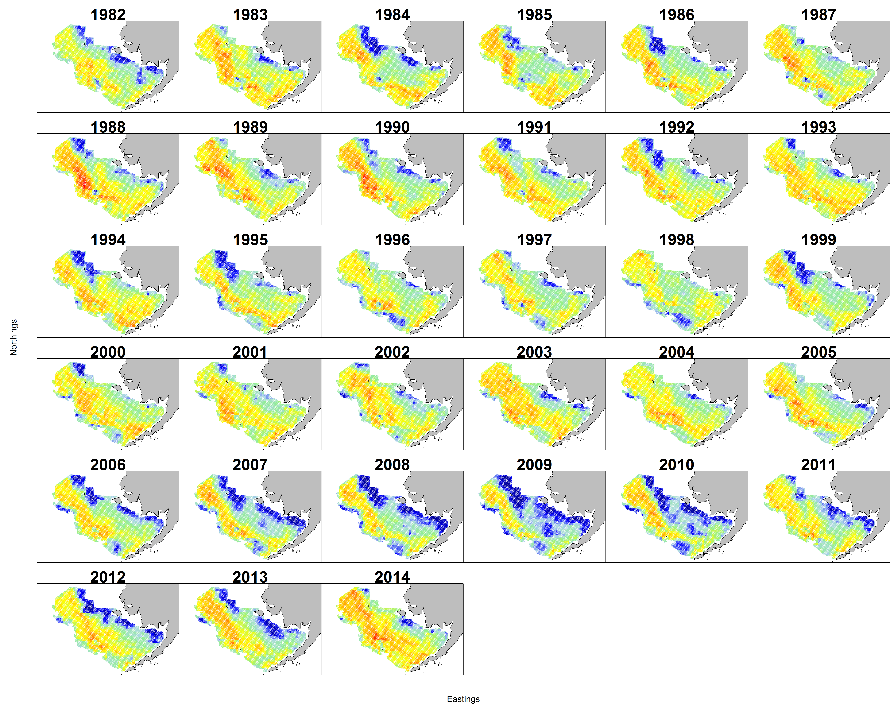
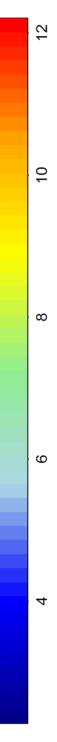
Walleye pollock density in Eastern Bering Sea
(ln kg. per square km.)

Slide 4
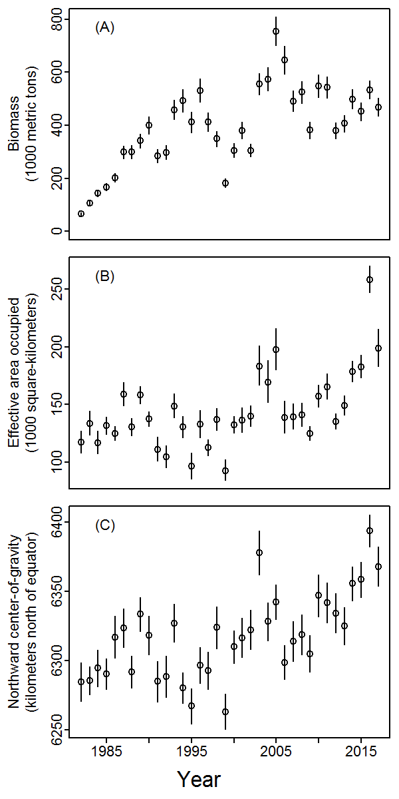
arrowtooth in EBS
Single-species index model
Index of abundance (A)
Area occupied (B)
Center of gravity (C)

Slide 5
Decisions needed when using VAST
Spatial domain for model
  Try to model entire area for management
Which categories to include
  As few as necessary for purpose of study
What data to analyze: biomass, counts, or encounter?
  Depends upon availability; often useful to combine data types
Including spatial and spatio-temporal components
  Include spatial (average distribution) and spatio-temporal (annual distribution shifts) if possible
Choosing spatial smoother and resolution
  Develop regional terms-of-reference for applications

Slide 6
Decisions needed when using VAST
Number of spatial / spatio-temporal factors
  In multivariate model, select based on “scree plot”
Temporal correlations
  Include except when output should be independent among years (e.g., index standardization)
Including density/habitat covariates
  Include if it explains a large portion of variability
Including catchability covariates
  Important for non-standardized data (e.g., fishery CPUE)
Treating area swept as effort offset
  Often preferable to analyzing survey catch divided by effort

Slide 7
Decisions needed when using VAST
11. Including vessel effects
  In multivariate model, select based on “scree plot”
Choosing link functions and distributions
  Recommend Poisson-link delta model for biomass
  Recommend zero-inflated lognormal Poisson for counts
Calculating derived quantities
  Calculate biomass, area, and center-of-gravity indices for inspection
Bias correction
  Only calculate what’s necessary (because its slower)
Model selection
  Recommend using AIC (but verdict is still out)

Slide 8
Benefits and drawbacks of VAST
Benefit (ranked large to small)
Combine multiple data streams (to avoid bias arising from differences in area-sampled)
Disciplined approach to spatially unbalanced data (propagates variance without “ignoring” missing data)
Account for portion of variance associated with randomized sample location
Improve “statistical efficiency” (decrease standard errors) for limited data
Drawback | Response to drawback
Potential to introduce bias | Simulation suggests that bias in trend and scale are small
Results are model-based (so affected by user decisions) | Pre-define terms of reference (TOR)
Complicated to use and explain | Simplified user-interface in progress
Many decisions to make | Decision guidance

Slide 9
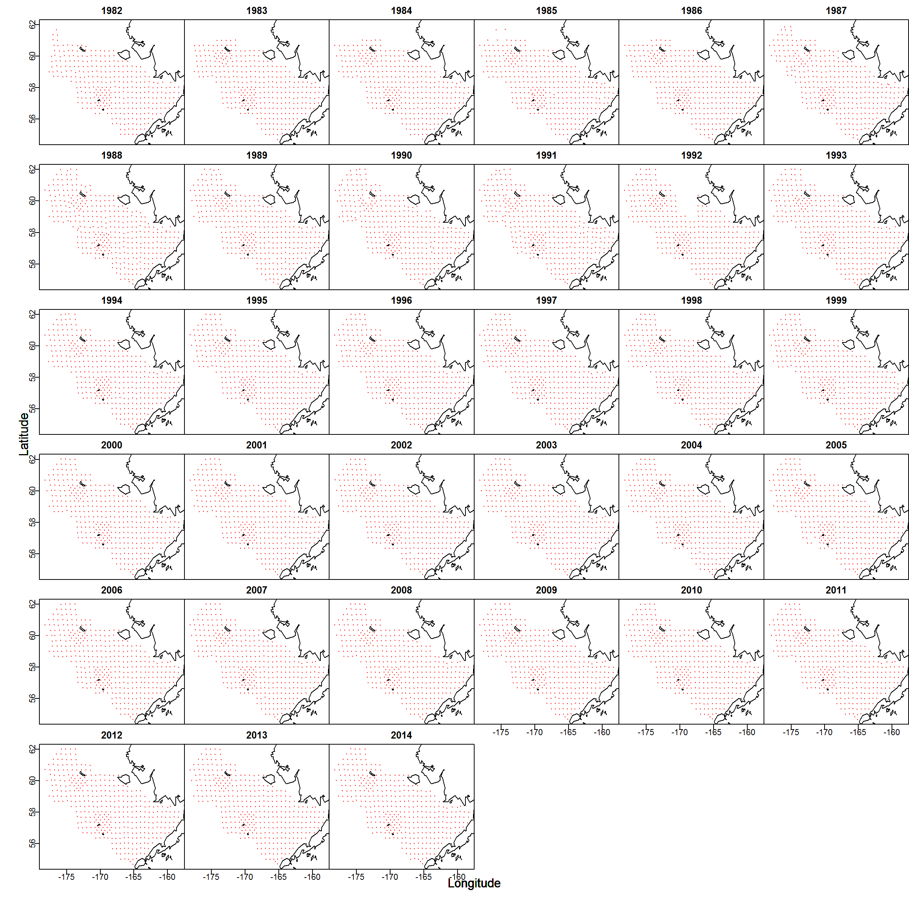
Diagnostics
Advice: Inspect spatial distribution of data

Slide 10
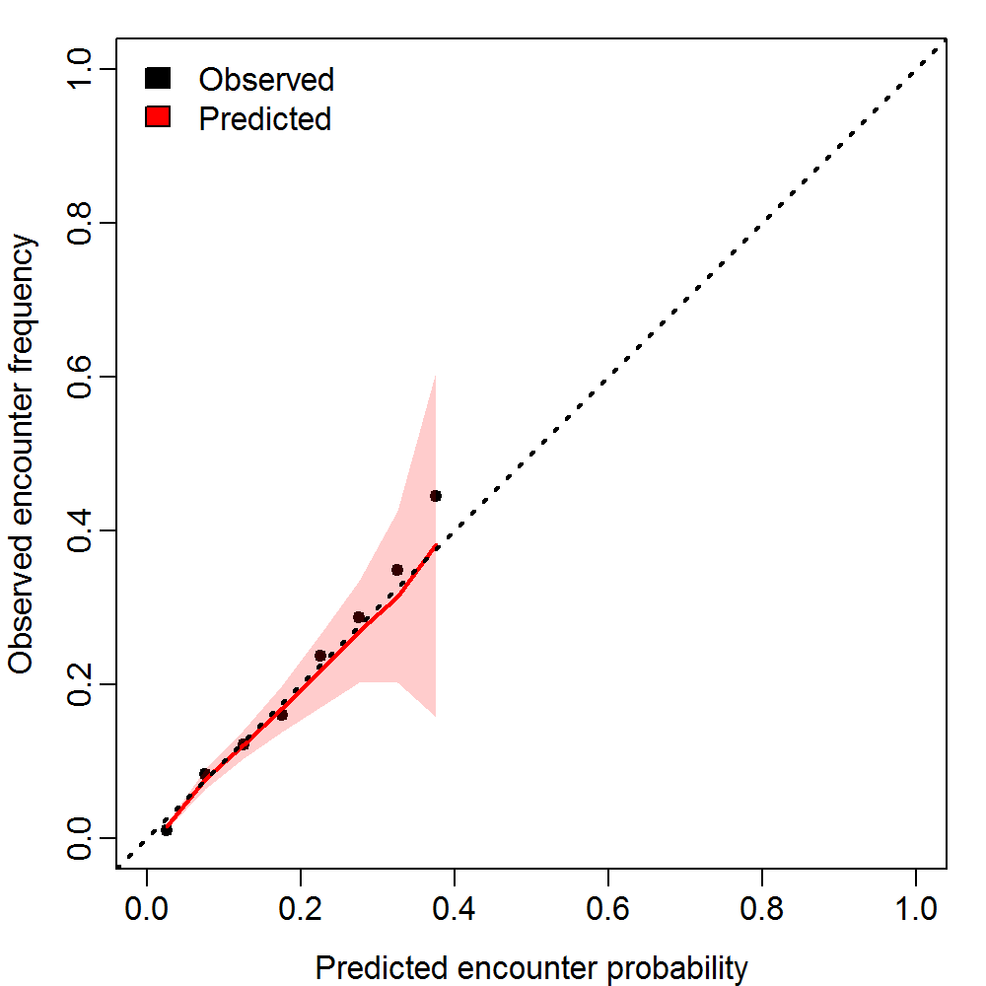
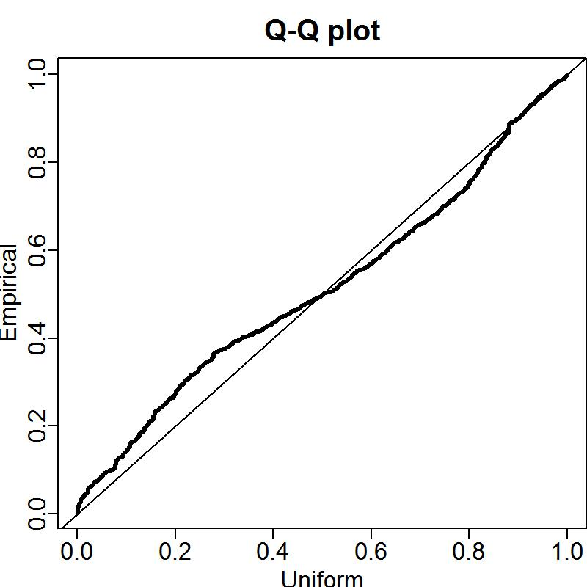
Diagnostics
Encounter probability vs. frequency
Quantile-quantile plot for positive catch rates

Slide 11
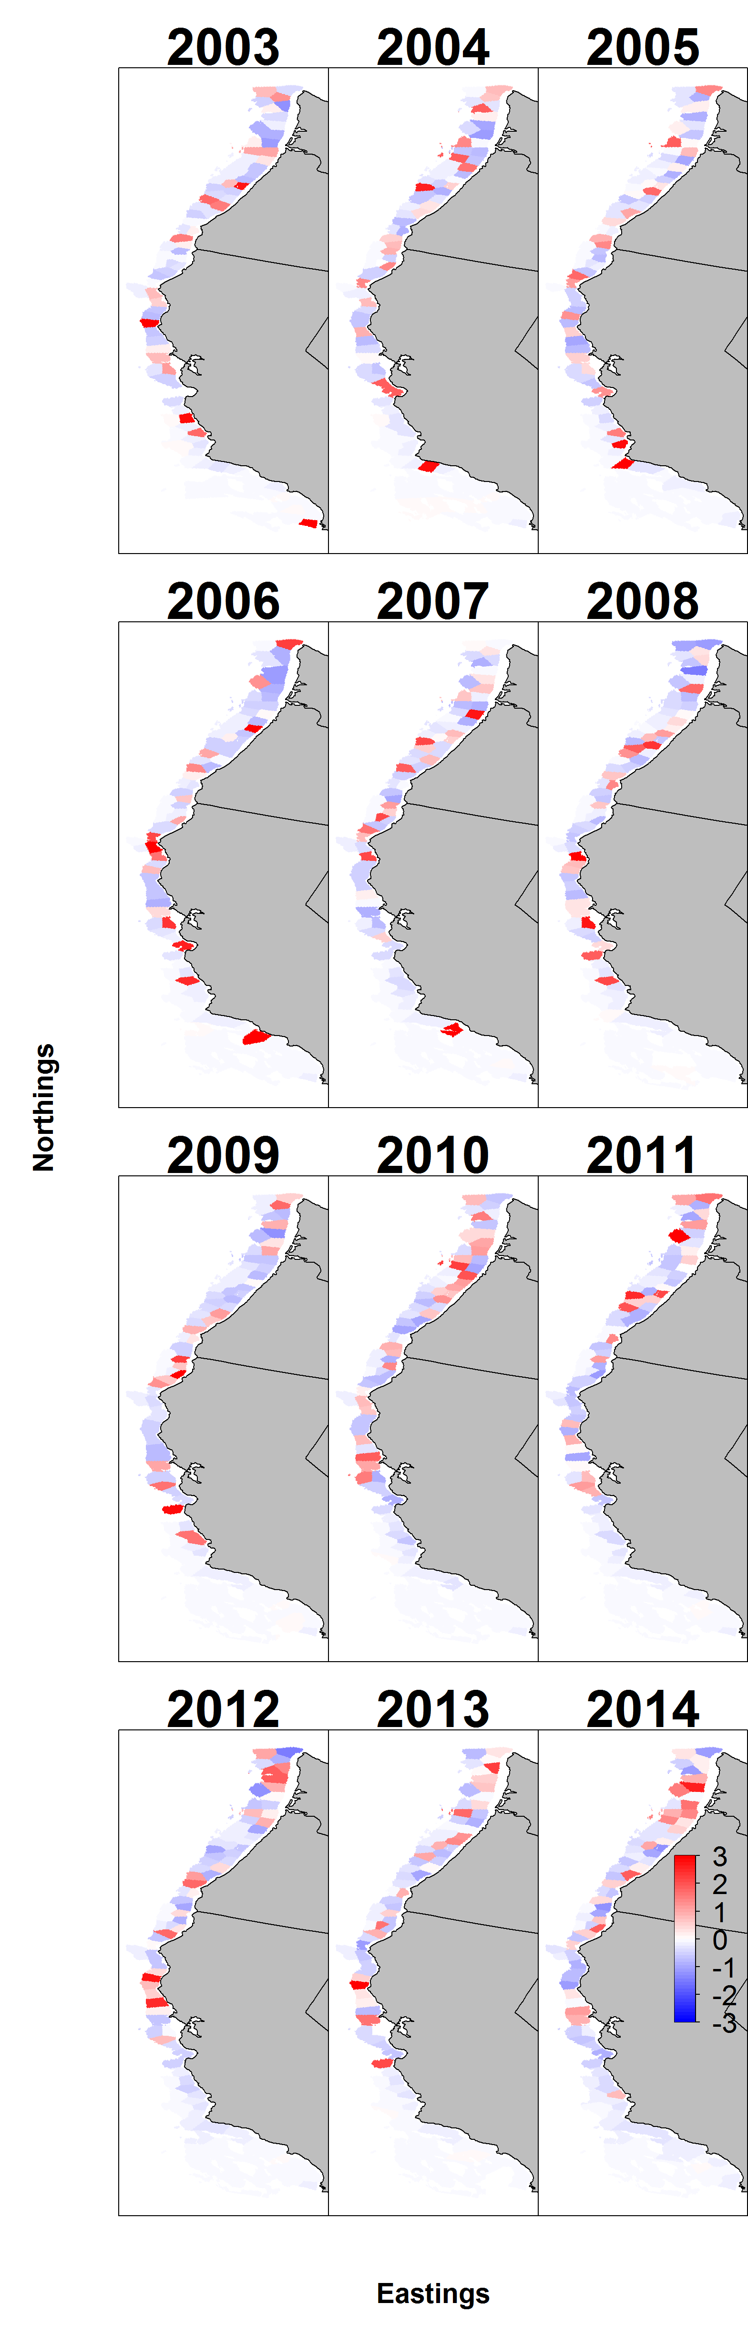
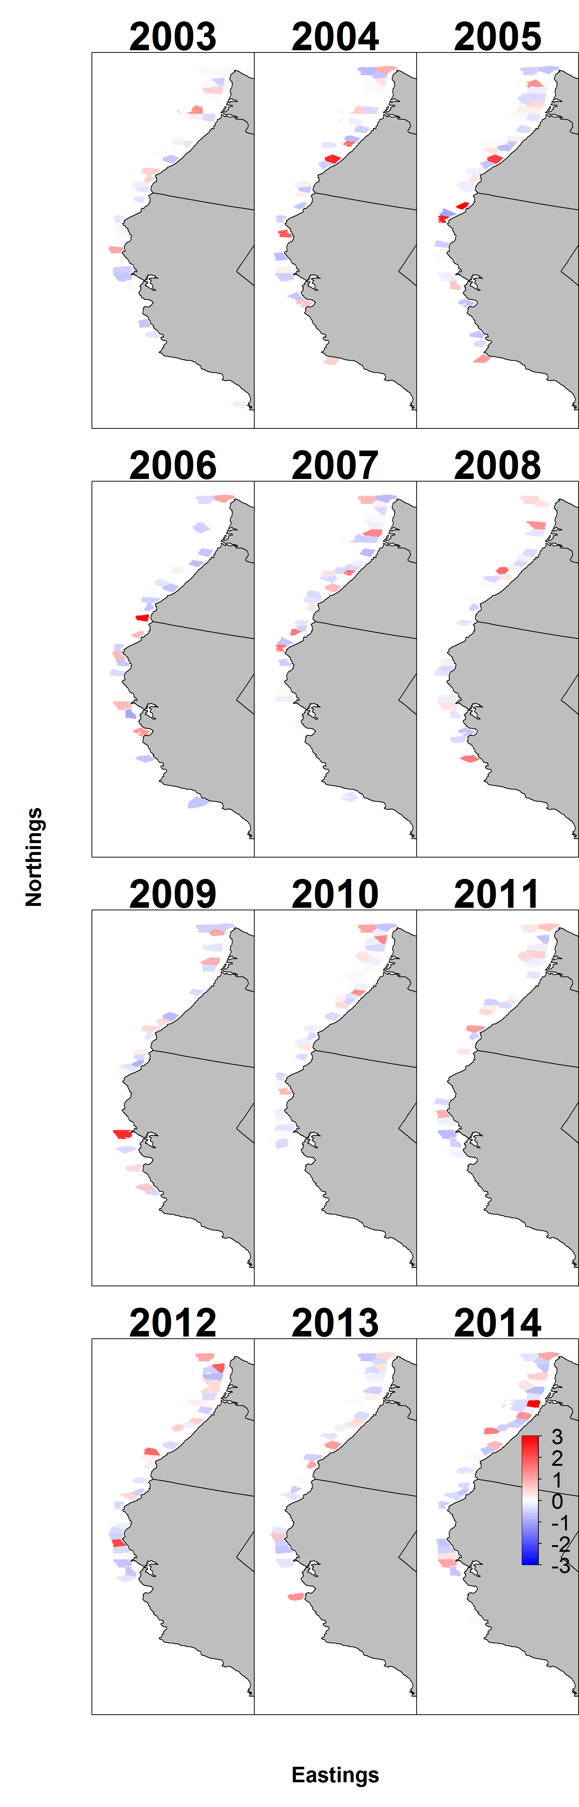
Pearson residuals for encounter
Pearson residuals for positive catch rates

Slide 12
Advice – Look at bounds and gradients
 | Param | starting_value | Lower | MLE | Upper | final_gradient
39 | beta2_ct | 9.21962 | -50 | 7.516834 | 50 | 2.20E-10
40 | beta2_ct | 9.21962 | -50 | 8.739776 | 50 | -1.49E-10
41 | beta2_ct | 9.21962 | -50 | 7.843733 | 50 | 1.06E-09
42 | beta2_ct | 9.21962 | -50 | 8.534672 | 50 | 1.02E-09
43 | beta2_ct | 9.21962 | -50 | 8.097048 | 50 | 1.03E-09
44 | beta2_ct | 9.21962 | -50 | 8.458756 | 50 | 3.47E-10
45 | beta2_ct | 9.21962 | -50 | 8.286936 | 50 | -1.06E-10
46 | beta2_ct | 9.21962 | -50 | 8.242662 | 50 | 2.49E-11
47 | beta2_ct | 9.21962 | -50 | 8.045717 | 50 | 9.28E-10
48 | beta2_ct | 9.21962 | -50 | 8.170187 | 50 | 3.41E-11
49 | beta2_ct | 9.21962 | -50 | 8.06304 | 50 | 9.76E-10
50 | beta2_ct | 9.21962 | -50 | 8.212494 | 50 | -5.63E-10
51 | beta2_ct | 9.21962 | -50 | 8.008228 | 50 | -1.80E-10
52 | beta2_ct | 9.21962 | -50 | 7.516414 | 50 | -7.77E-10
53 | beta2_ct | 9.21962 | -50 | 7.730084 | 50 | -2.10E-10
54 | beta2_ct | 9.21962 | -50 | 7.886746 | 50 | 2.17E-10
55 | beta2_ct | 9.21962 | -50 | 7.662614 | 50 | -5.12E-10
56 | beta2_ct | 9.21962 | -50 | 7.40508 | 50 | 7.91E-10
57 | beta2_ct | 9.21962 | -50 | 8.197652 | 50 | -7.12E-10
58 | beta2_ct | 9.21962 | -50 | 8.165989 | 50 | -2.23E-10
59 | beta2_ct | 9.21962 | -50 | 7.847344 | 50 | -2.63E-09
60 | beta2_ct | 9.21962 | -50 | 8.542195 | 50 | 1.28E-10
61 | beta2_ct | 9.21962 | -50 | 7.982901 | 50 | -1.07E-09
62 | beta2_ct | 9.21962 | -50 | 7.832611 | 50 | -4.09E-10
63 | beta2_ct | 9.21962 | -50 | 7.129841 | 50 | -1.78E-10
64 | beta2_ct | 9.21962 | -50 | 6.996498 | 50 | 4.58E-10
65 | beta2_ct | 9.21962 | -50 | 6.544465 | 50 | -1.44E-09
66 | beta2_ct | 9.21962 | -50 | 6.056259 | 50 | 8.04E-10
67 | beta2_ct | 9.21962 | -50 | 7.290846 | 50 | 1.02E-09
68 | beta2_ct | 9.21962 | -50 | 7.545933 | 50 | 5.06E-10
69 | beta2_ct | 9.21962 | -50 | 7.247531 | 50 | -1.24E-09
70 | beta2_ct | 9.21962 | -50 | 7.513136 | 50 | 1.12E-09
71 | beta2_ct | 9.21962 | -50 | 8.565377 | 50 | -9.49E-10
72 | L_omega2_z | -0.58178 | -50 | -1.10638 | 50 | -9.35E-09
73 | L_epsilon2_z | -0.45241 | -50 | -1.12348 | 50 | 1.43E-07
74 | logkappa2 | -0.10536 | -6.01012 | -4.53498 | -2.57395 | 3.22E-08
75 | logSigmaM | 1.609438 | -50 | 0.168158 | 10 | -2.42E-07
 | Param | starting_value | Lower | MLE | Upper | final_gradient
1 | ln_H_input | 0 | -50 | 0.231528 | 50 | -6.19E-08
2 | ln_H_input | 0 | -50 | -0.96568 | 50 | -8.88E-08
3 | beta1_ct | -4.64096 | -50 | 4.120475 | 50 | 2.44E-09
4 | beta1_ct | -4.64096 | -50 | 4.228782 | 50 | 1.90E-09
5 | beta1_ct | -4.64096 | -50 | 4.322799 | 50 | -5.30E-10
6 | beta1_ct | -4.64096 | -50 | 5.093036 | 50 | 4.60E-09
7 | beta1_ct | -4.64096 | -50 | 5.428053 | 50 | -5.17E-08
8 | beta1_ct | -4.64096 | -50 | 4.105238 | 50 | -2.95E-09
9 | beta1_ct | -4.64096 | -50 | 5.056347 | 50 | 4.29E-09
10 | beta1_ct | -4.64096 | -50 | 4.168261 | 50 | -5.53E-09
11 | beta1_ct | -4.64096 | -50 | 4.333523 | 50 | 7.79E-09
12 | beta1_ct | -4.64096 | -50 | 5.989274 | 50 | -1.02E-08
13 | beta1_ct | -4.64096 | -50 | 4.524008 | 50 | 3.45E-09
14 | beta1_ct | -4.64096 | -50 | 5.265399 | 50 | 3.09E-09
15 | beta1_ct | -4.64096 | -50 | 5.646847 | 50 | -9.95E-11
16 | beta1_ct | -4.64096 | -50 | 4.886118 | 50 | 3.52E-09
17 | beta1_ct | -4.64096 | -50 | 5.073619 | 50 | 4.40E-09
18 | beta1_ct | -4.64096 | -50 | 4.753279 | 50 | 5.61E-09
19 | beta1_ct | -4.64096 | -50 | 4.996536 | 50 | 4.81E-09
20 | beta1_ct | -4.64096 | -50 | 6.218751 | 50 | 1.38E-09
21 | beta1_ct | -4.64096 | -50 | 5.124685 | 50 | -3.66E-09
22 | beta1_ct | -4.64096 | -50 | 5.706784 | 50 | -8.00E-09
23 | beta1_ct | -4.64096 | -50 | 4.80919 | 50 | 4.36E-09
24 | beta1_ct | -4.64096 | -50 | 4.534566 | 50 | 6.15E-09
25 | beta1_ct | -4.64096 | -50 | 5.45406 | 50 | -1.36E-09
26 | beta1_ct | -4.64096 | -50 | 4.746618 | 50 | 4.78E-09
27 | beta1_ct | -4.64096 | -50 | 4.572286 | 50 | 8.21E-09
28 | beta1_ct | -4.64096 | -50 | 4.198098 | 50 | 1.19E-08
29 | beta1_ct | -4.64096 | -50 | 2.877037 | 50 | 1.34E-08
30 | beta1_ct | -4.64096 | -50 | 3.426151 | 50 | 8.29E-09
31 | beta1_ct | -4.64096 | -50 | 2.986486 | 50 | 5.37E-09
32 | beta1_ct | -4.64096 | -50 | 4.659832 | 50 | 4.15E-09
33 | beta1_ct | -4.64096 | -50 | 4.656848 | 50 | 7.09E-09
34 | beta1_ct | -4.64096 | -50 | 5.18952 | 50 | 4.60E-09
35 | beta1_ct | -4.64096 | -50 | 6.231048 | 50 | 1.60E-09
36 | L_omega1_z | -0.83795 | -50 | -1.94641 | 50 | 1.61E-07
37 | L_epsilon1_z | 1.037078 | -50 | 0.975252 | 50 | -3.53E-07
38 | logkappa1 | -0.10536 | -6.01012 | -4.12041 | -2.57395 | 4.33E-07

Slide 13
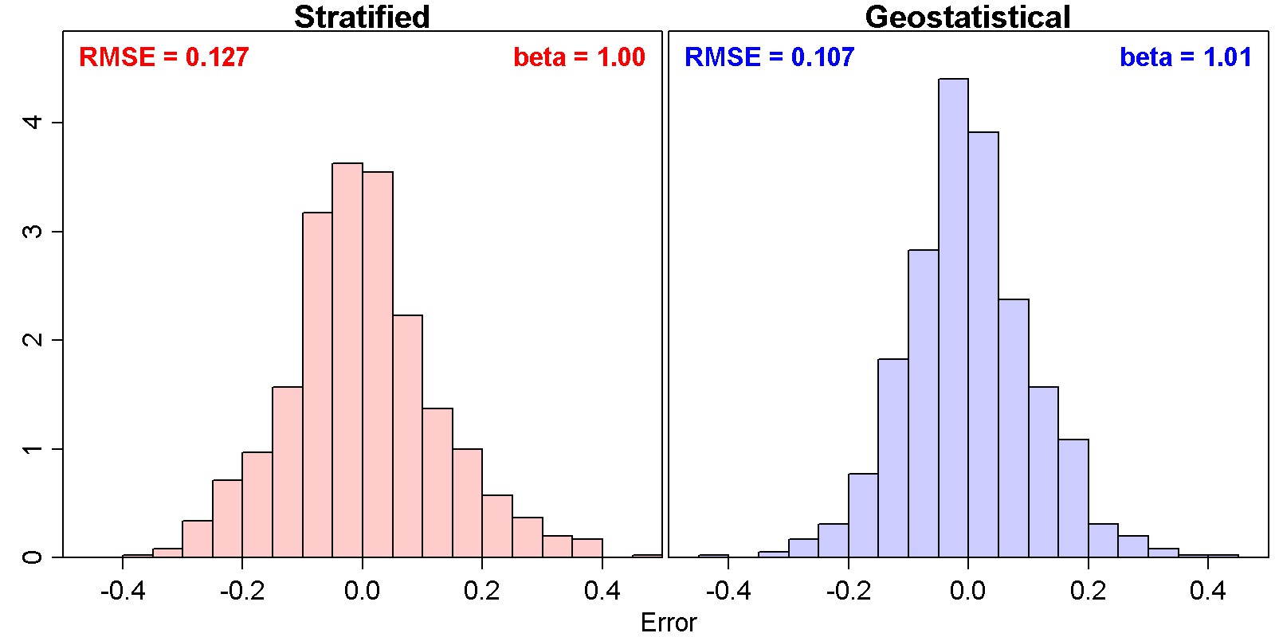
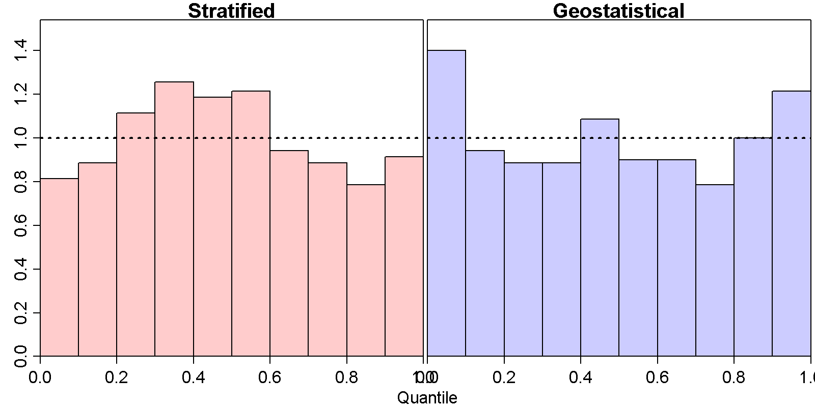
VAST estimates abundance indices precisely
Neither model has badly calibrated intervals

Slide 14
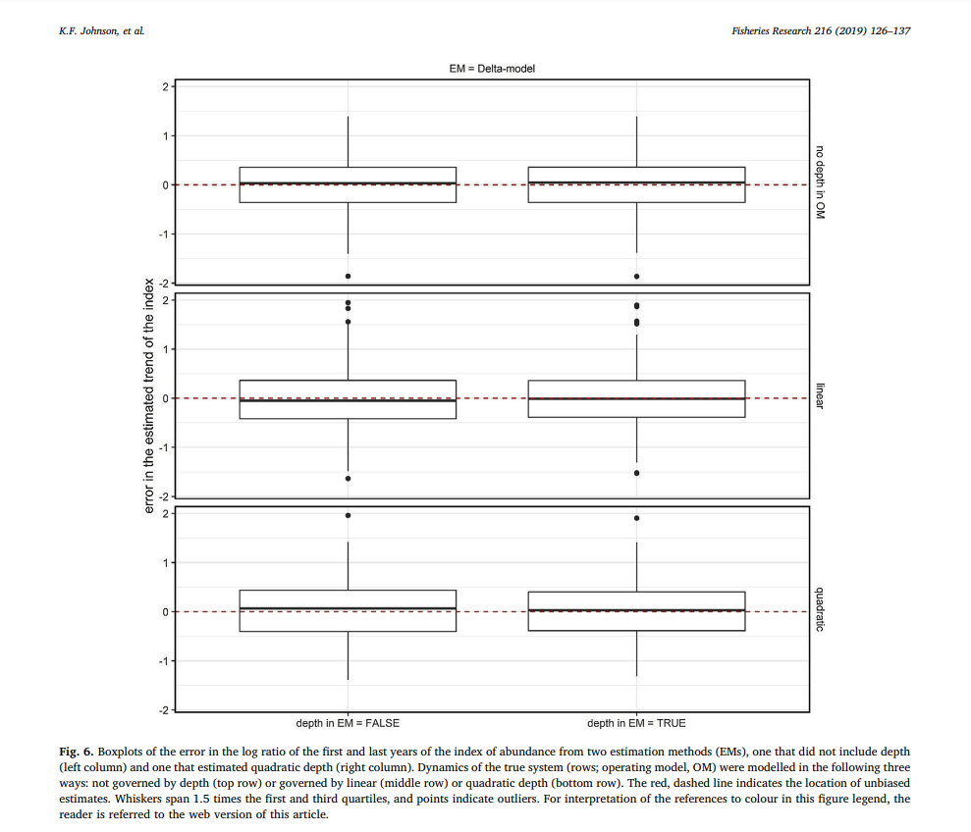

Slide 15
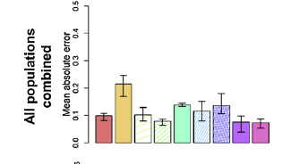
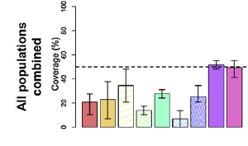
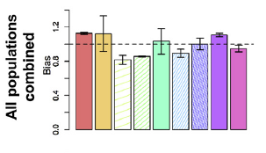
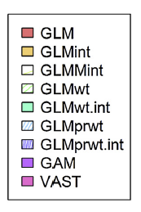
Mean absolute error
(low is good)
Confidence interval coverage
(50% is good)
Slope between log(true) and log(estimated) index (1.0 is good)
Grüss, Walter, Babcock, Forrestal, Thorson, Lauretta, & Schirripa. (2019). Evaluation of the impacts of different treatments of spatio-temporal variation in catch-per-unit-effort standardization models. Fisheries Research, 213, 75–93. https://doi.org/10.1016/j.fishres.2019.01.008

Slide 16
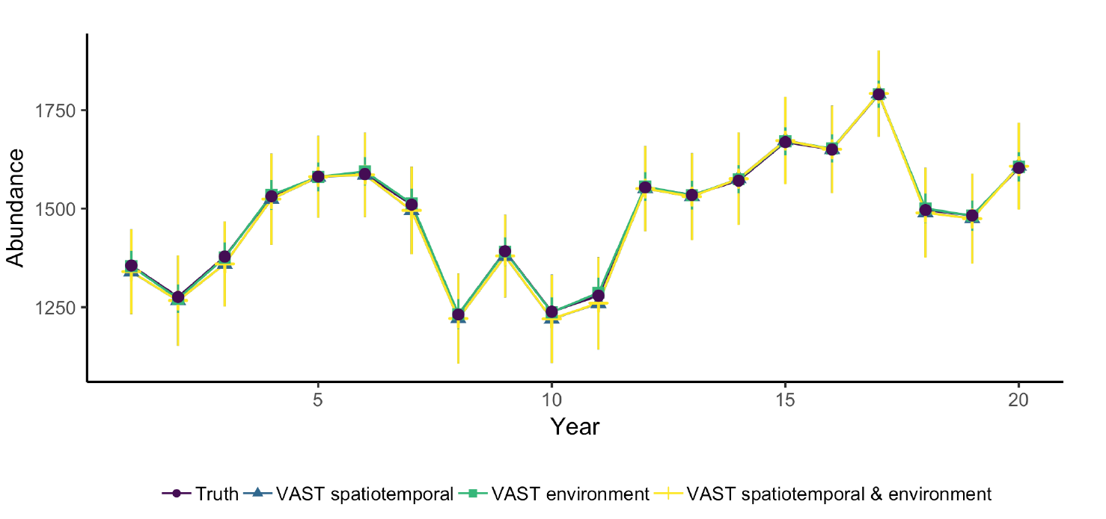
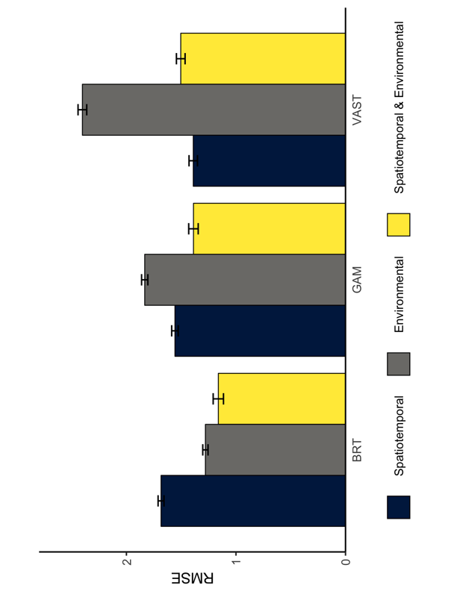
Brodie, Thorson, Carroll, Hazen, Bograd, Haltuch, … Selden. (In revision). Pattern or Process: considering space, time, and the environment in species distribution models. Ecography.

Slide 17
Acknowledgements
Assistance
Jason Conner
Stan Kotwicki
Jon Richar
Code:
Kasper Kristensen
Hans Skaug
TMB development team
Funding:
2014. Habitat Assessment Improvement Plan RFP.
In-kind support: NWFSC, AFSC

