Slide 1

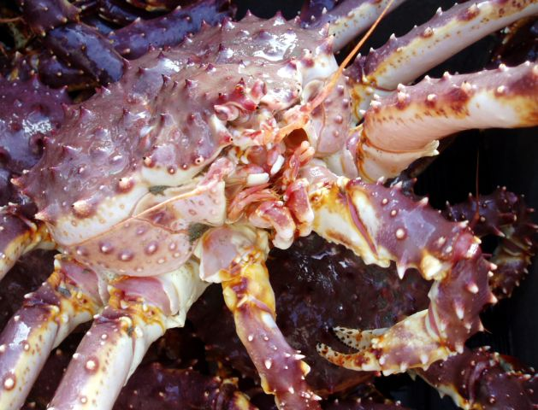
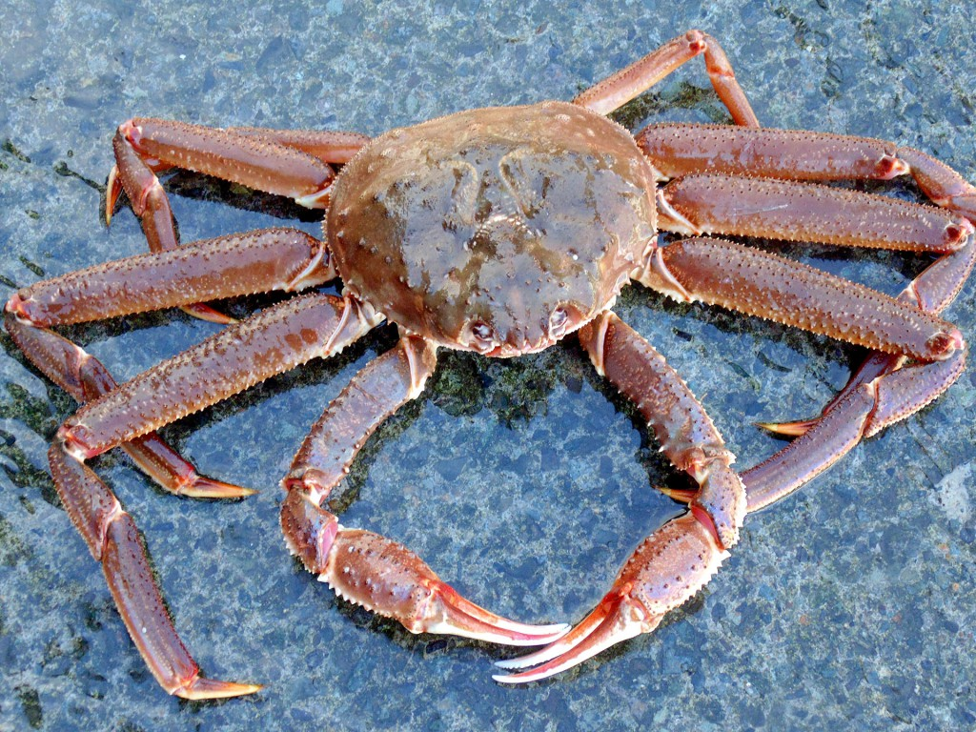
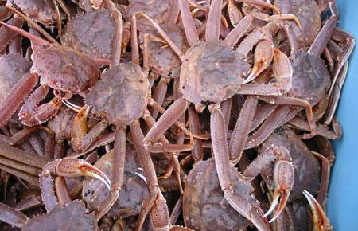
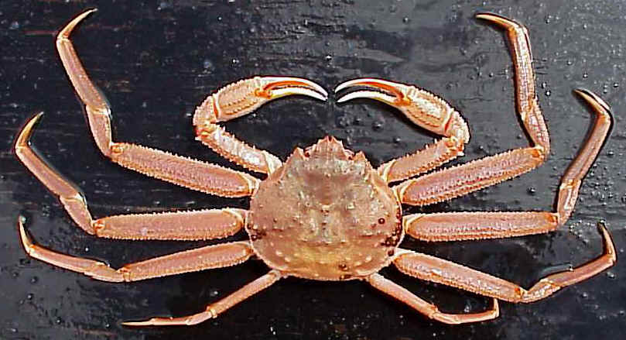
To VAST or not to VAST? Comparison of a spatio-temporal approach to a design based methodology for deriving crab population estimates.
Jonathan Richar
Jon.richar@noaa.gov

Slide 2
Design based approach-description and issues
Design-based is Shellfish SAPs current standard
Population estimates calculated by strata based on mean CPUE within a given strata multiplied by strata area, then summed
Design assumes random distributions across stock ranges
Problem: crab are NOT randomly distributed
  Spatial correlation
  High catch stations may account for disproportionate percentage of total # caught
Potential bias in population estimates, CIs

Slide 3
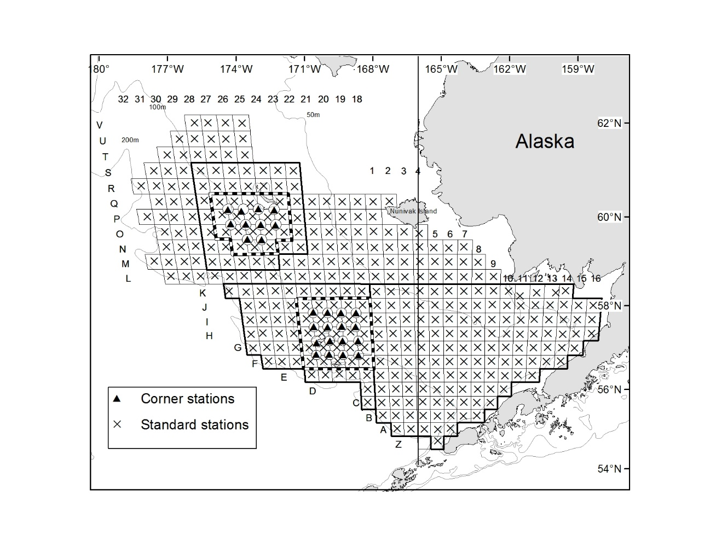
EBS survey grid and strata

Slide 4
Spatio-temporal approach - VAST
Jim covered the technical details, but….
Applies delta-generalized linear mixed models within a spatio-temporal context
Incorporates predictors for probability of encounter, and catch-rate given encounter
  Both allow for spatial and spatio-temporal variation
Calculates density estimates at knots based on adjacent station sample values
  Knots control resolution
  Estimates extrapolated to surface using mesh/grid approximation
  User defines maximum distance that estimates are extrapolated from samples. Densities estimated across extrapolation region
    Predefined extrapolation regions included with VAST package
    Custom extrapolation areas may be defined based on user provided sampling grid
Relative to design based estimates, VAST estimates and statistics are less affected by spatial variation

Slide 5
Caveats for what you’re about to see (and hear)
Data are very early, very preliminary results from a project assessing best settings for VAST model as applied to EBS crab, and comparing subsequent VAST and design based output
Numbers presented here are not final and will change before the end
I’m a VAST neophyte and still very much learning the ropes

Slide 6
Data and settings
Examined Bristol Bay red king crab, Eastern and Western District Bairdi, EBS Opilio
Design based: biomass estimates as provided to stock assessment authors in August 2018, and reported in 2018 crab tech memo.
VAST: Biomass at station data produced as an intermediate step in creation of design based estimates.
  No covariates (depth, NBT, etc.)
  Conventional delta model
  Mesh based spatial approximation
  #Knots: 100 for BBRKC, 120 for E166 Bairdi, 150 for W166 Bairdi, 150 for EBS opilio
    Computational limitations
  For custom extrapolation regions, used 20 km maximum extrapolation distance

Slide 7
Comparison of biomass trends

Slide 8
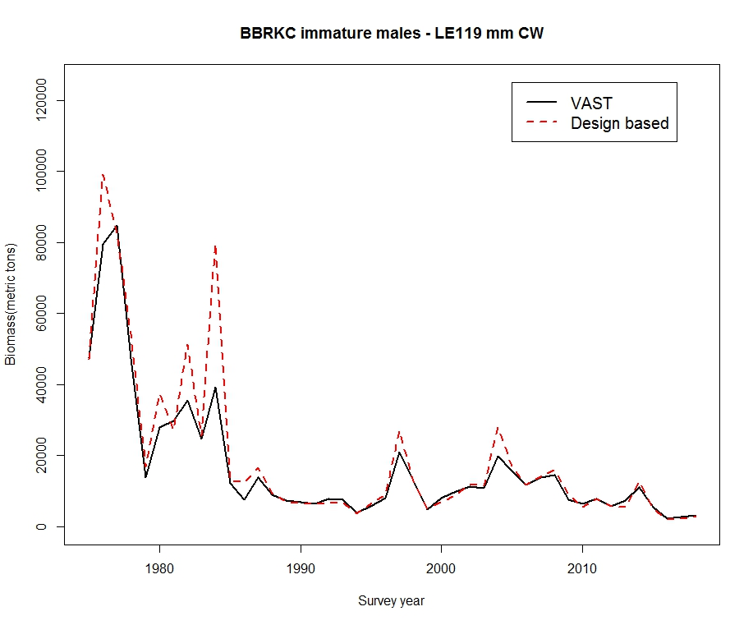
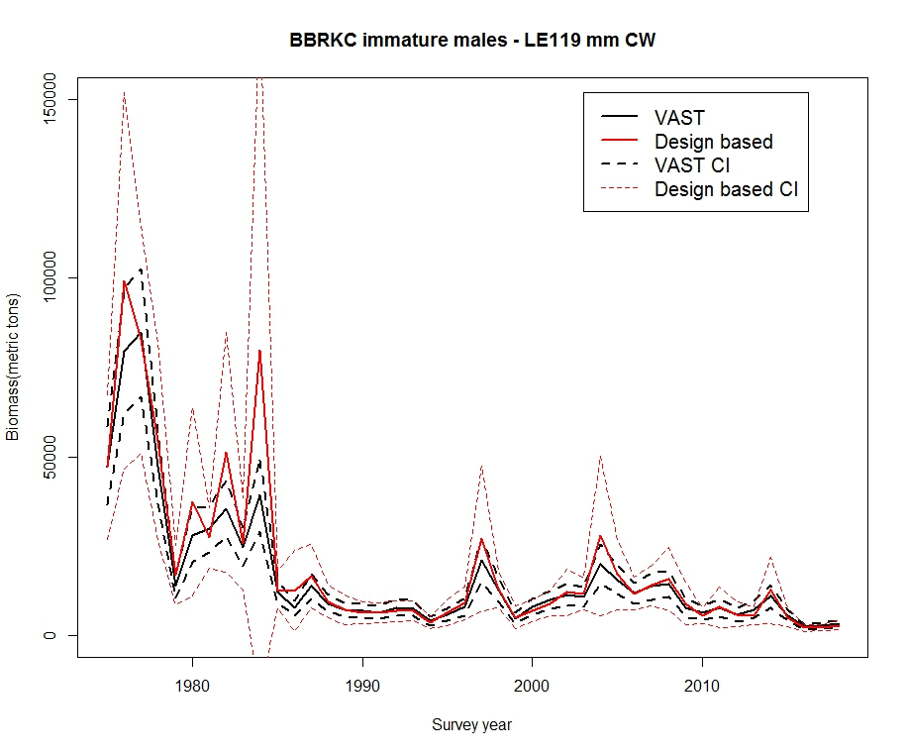
Bristol Bay red king crab males –immature

Slide 9
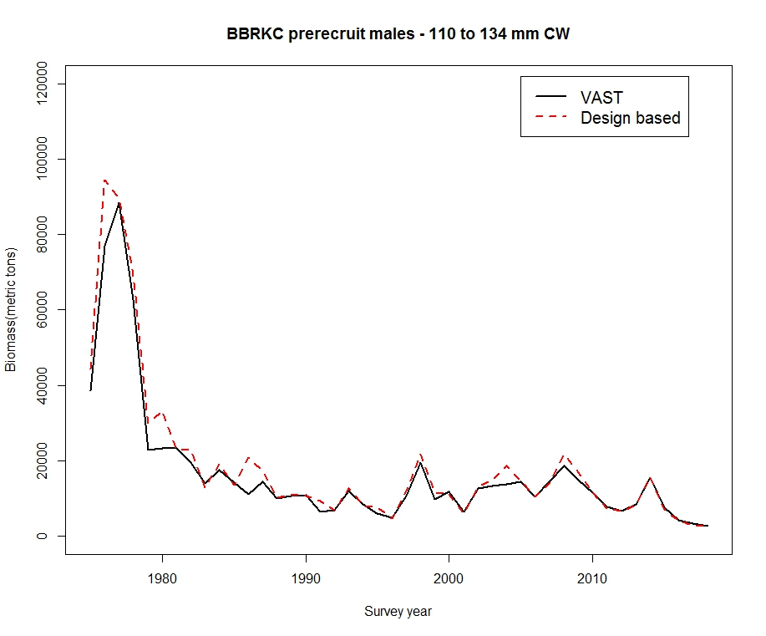
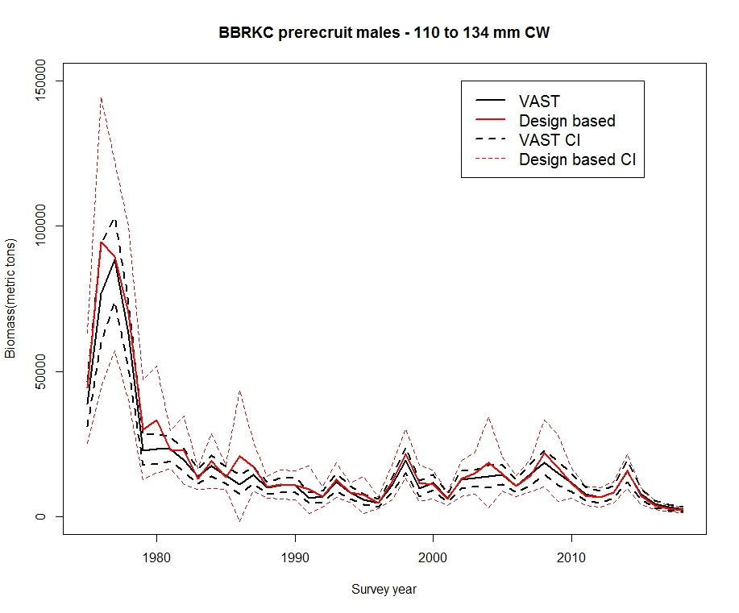
Bristol Bay red king crab males –prerecruits

Slide 10
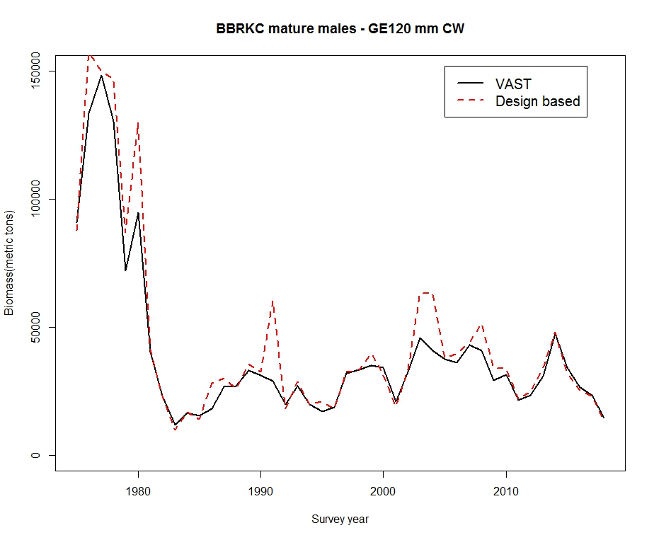
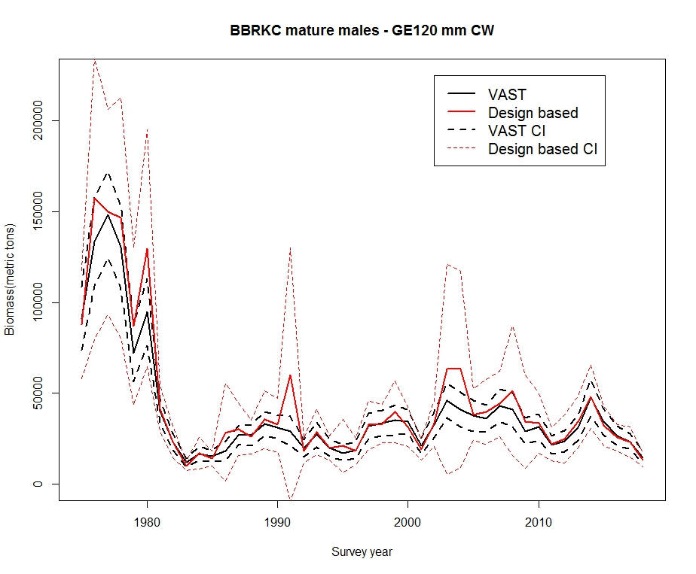
Bristol Bay red king crab males -mature

Slide 11
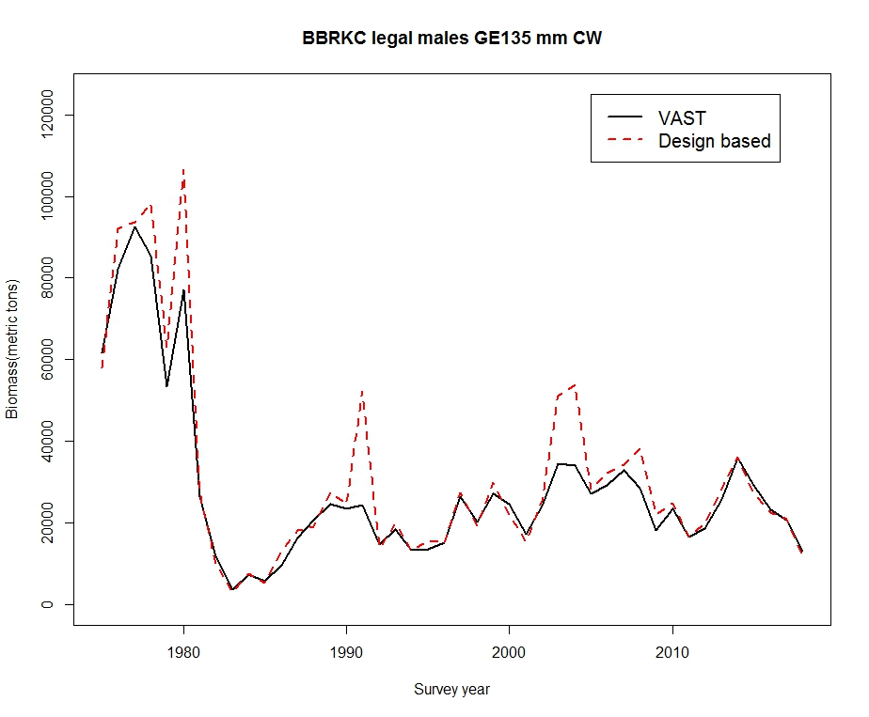
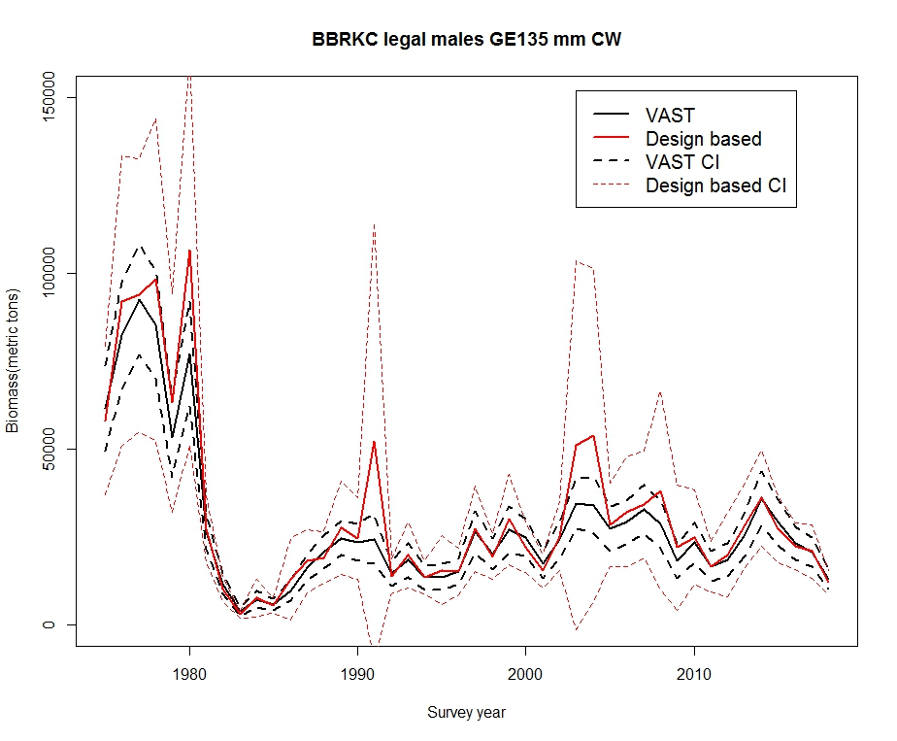
Bristol Bay red king crab males -legal

Slide 12
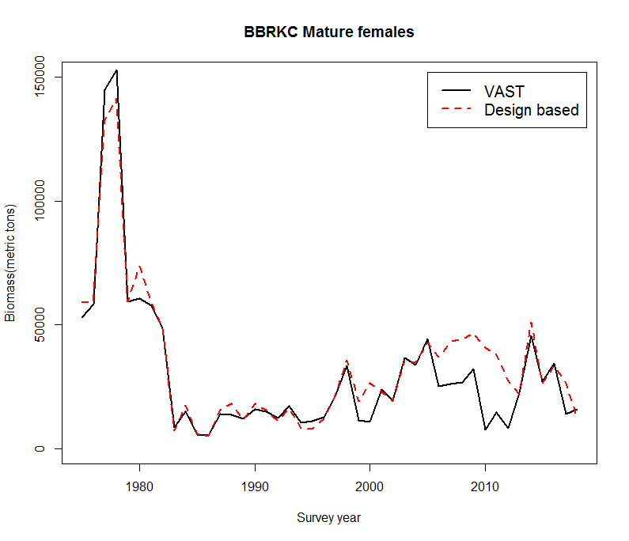
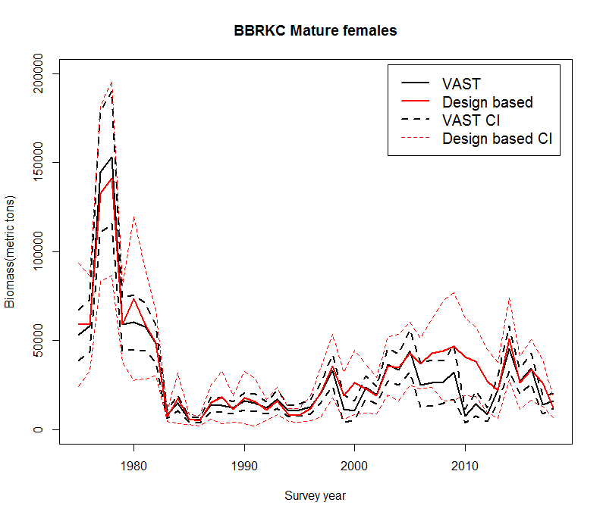
Bristol Bay red king crab females -mature
Retow years

Slide 13
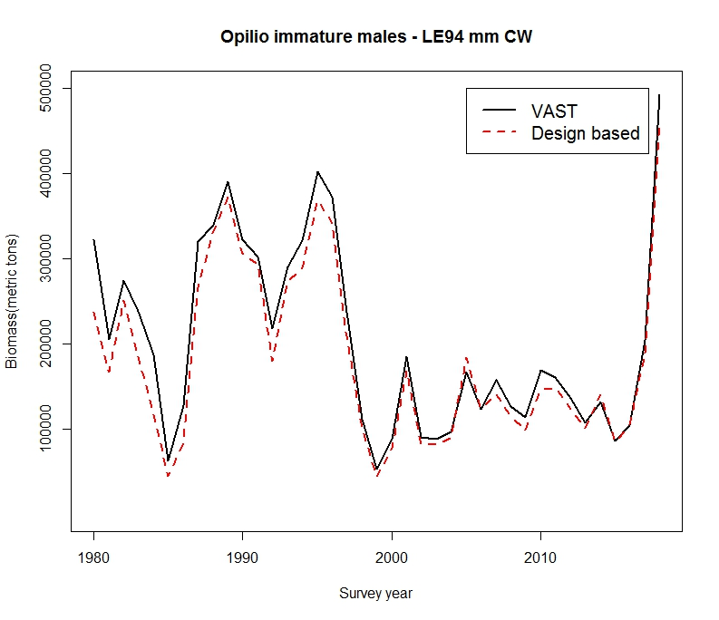
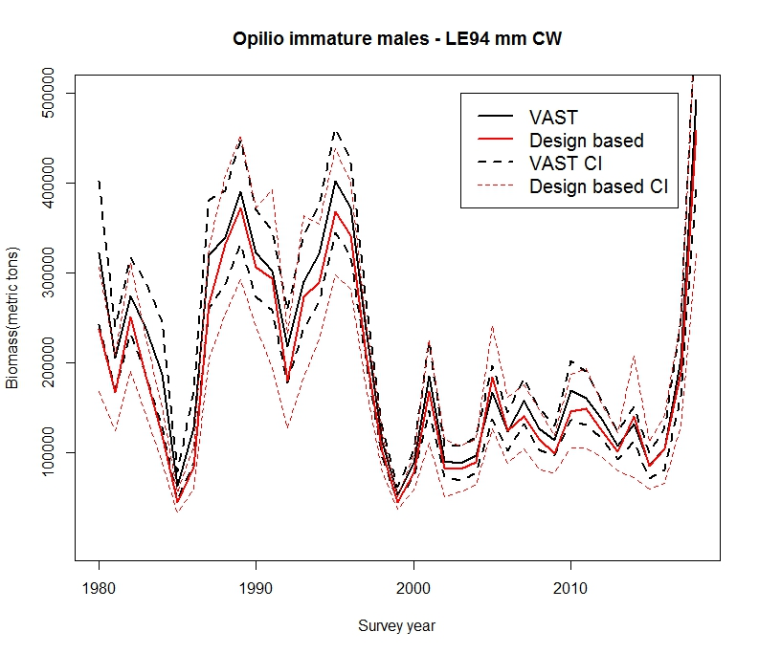
Opilio crab males - immature

Slide 14
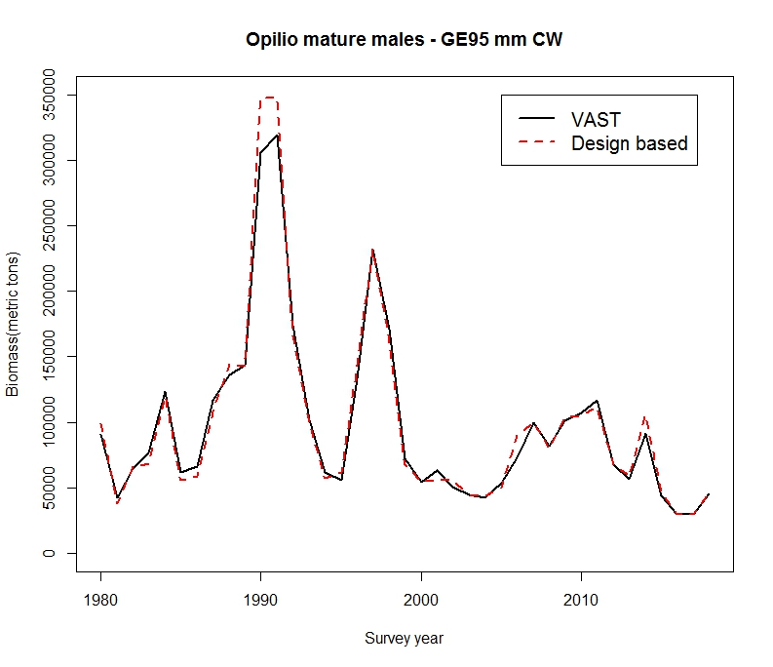
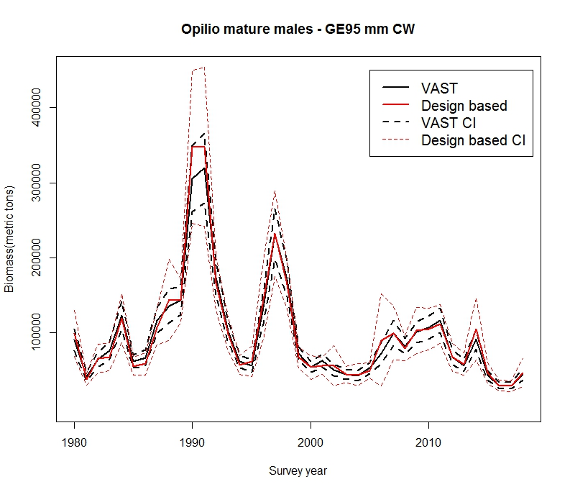
Opilio crab males - mature

Slide 15
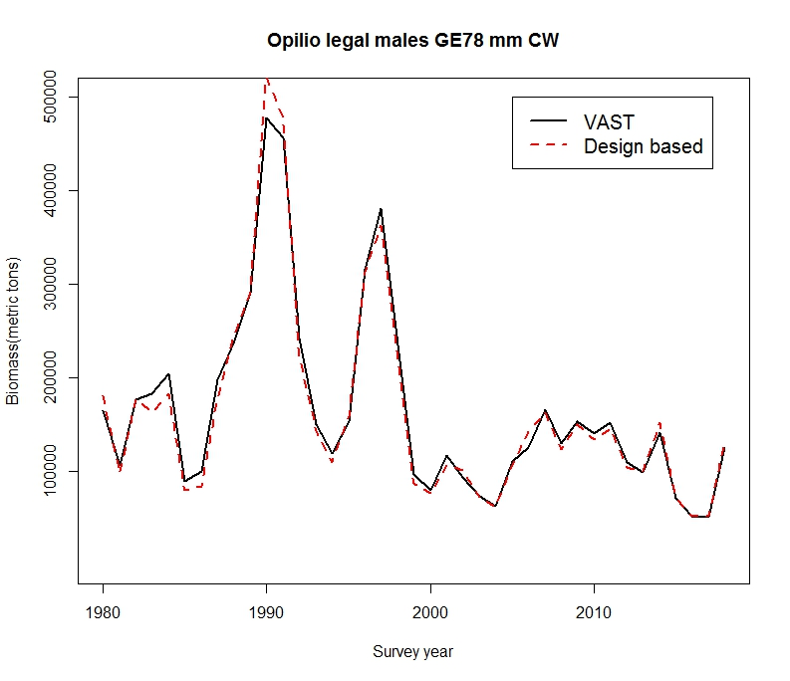
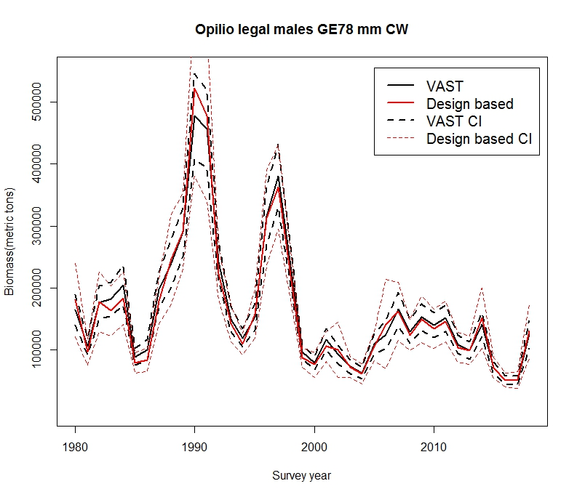
Opilio crab males - legal

Slide 16
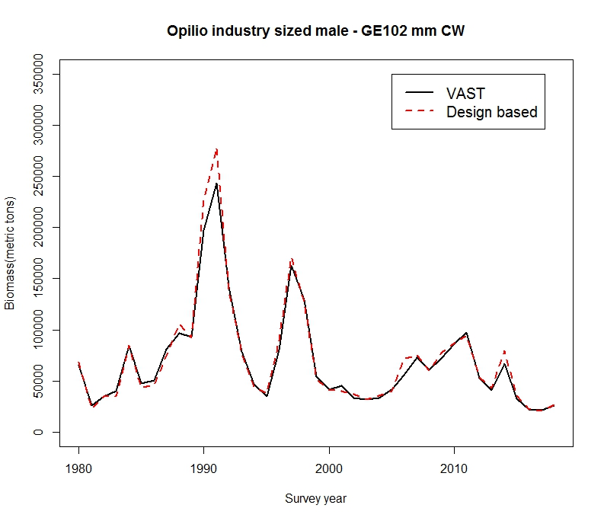
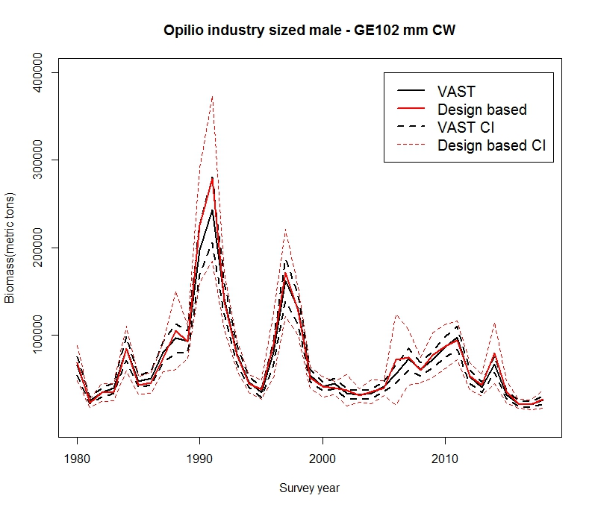
Opilio crab males - industry-preferred

Slide 17
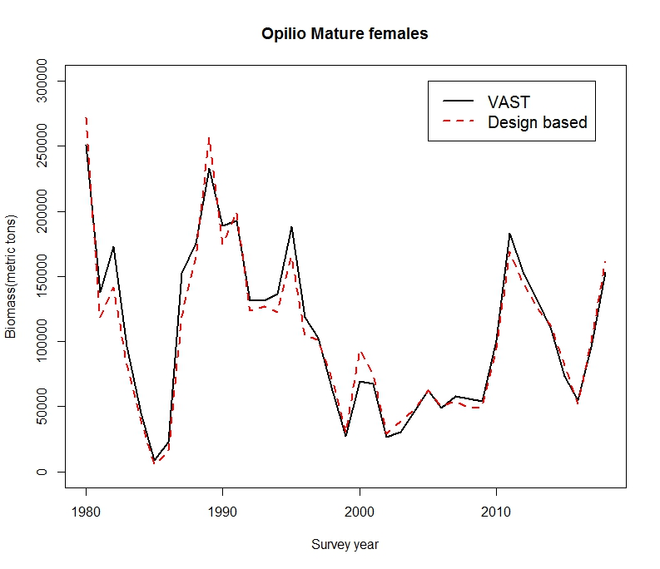
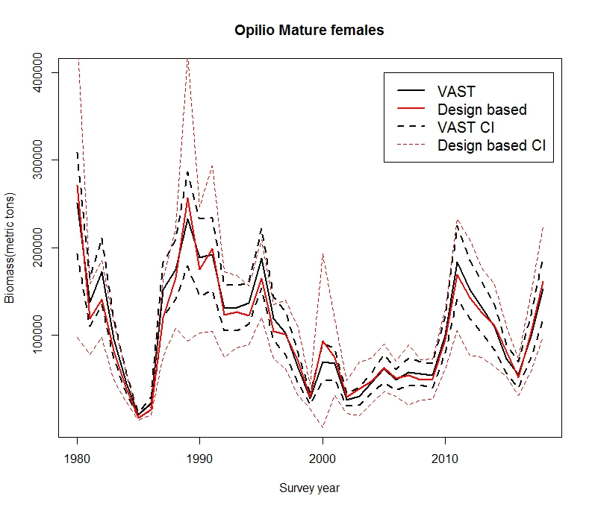
Opilio crab females - mature

Slide 18
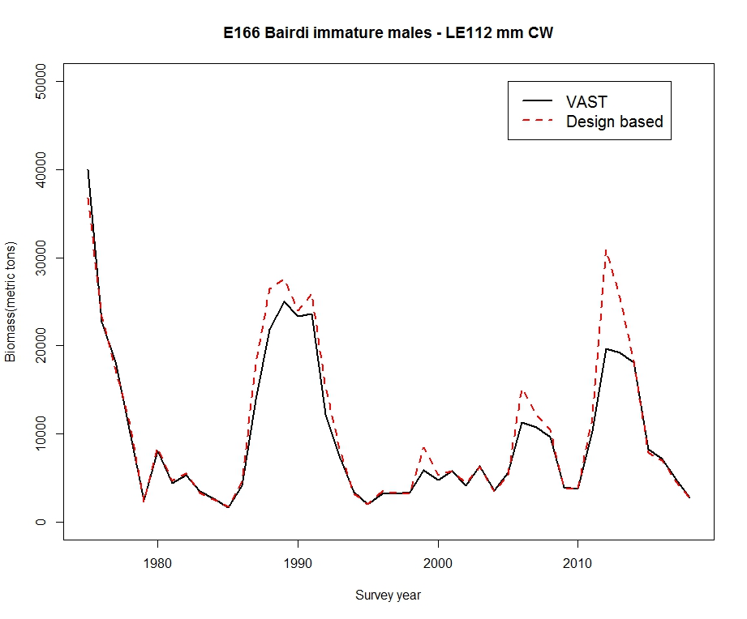
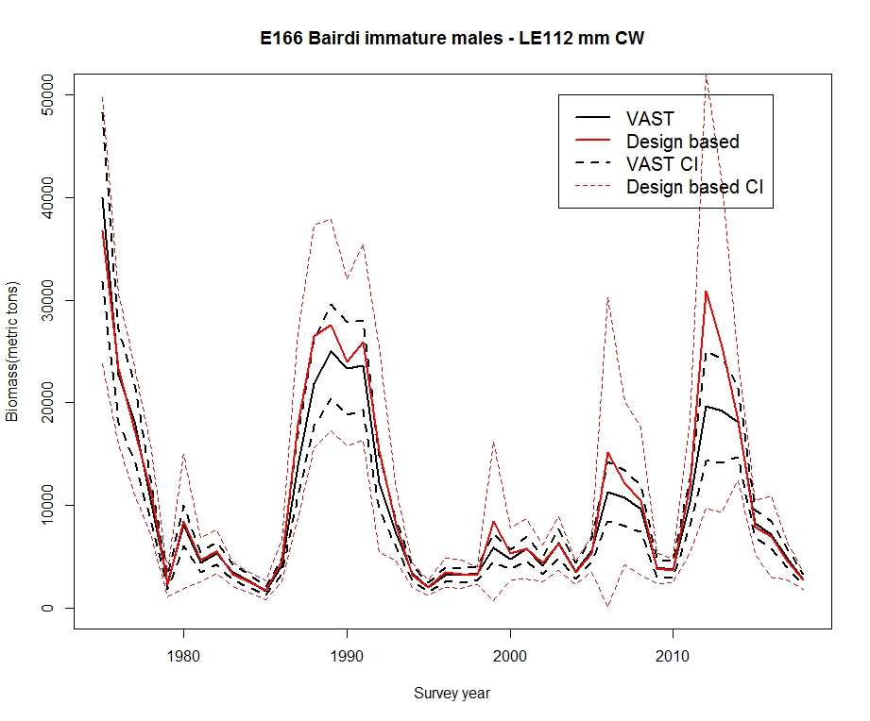
Eastern district Bairdi crab males - immature

Slide 19
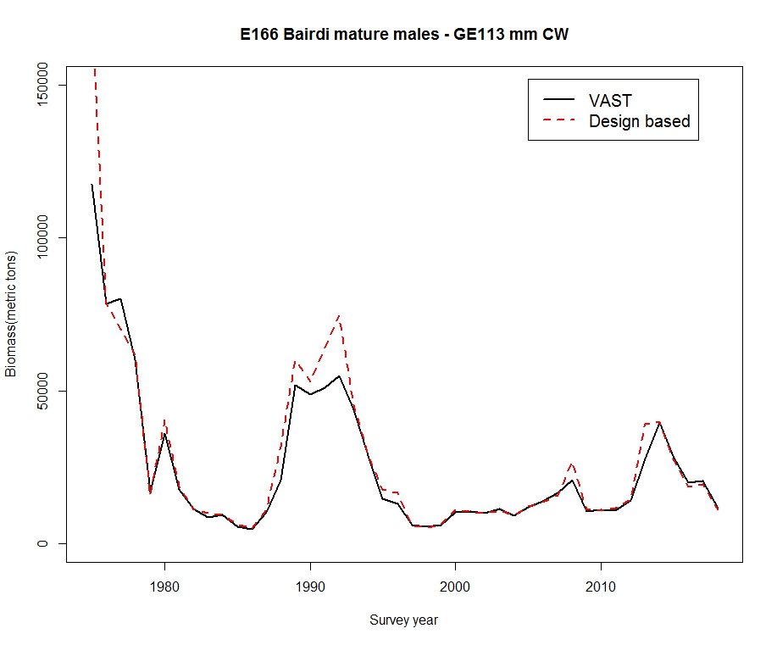
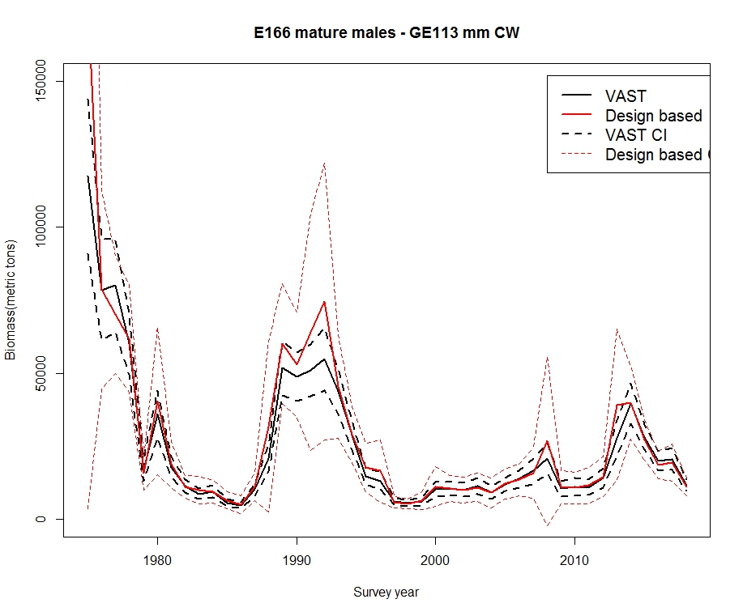
Eastern district Bairdi crab males - mature

Slide 20
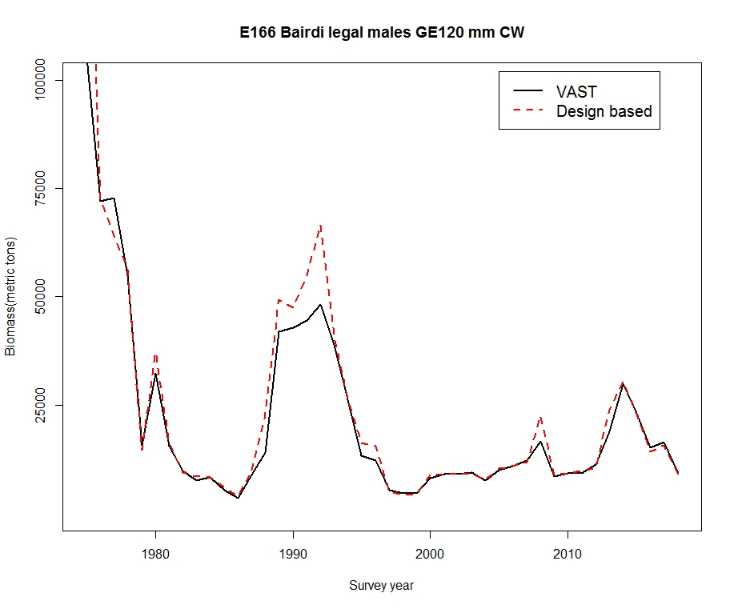
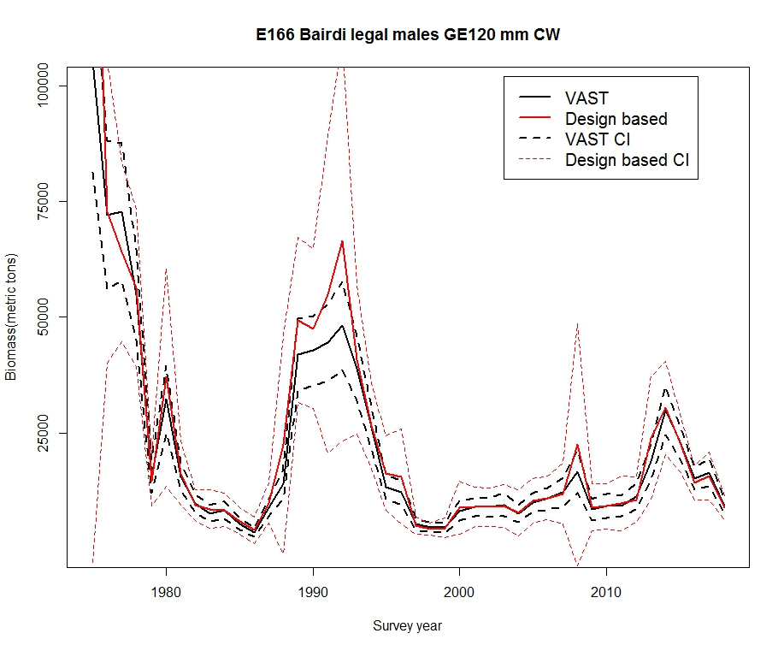
Eastern district Bairdi crab males - legal

Slide 21
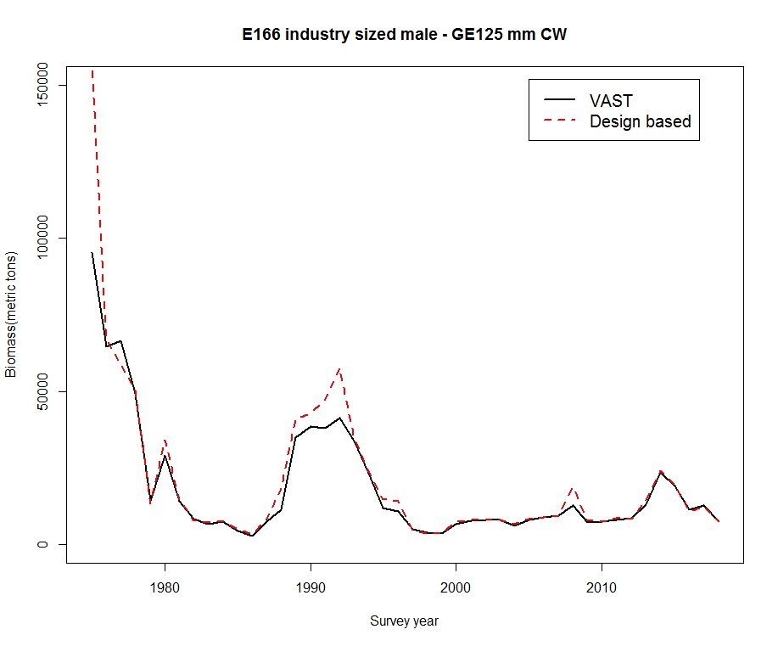
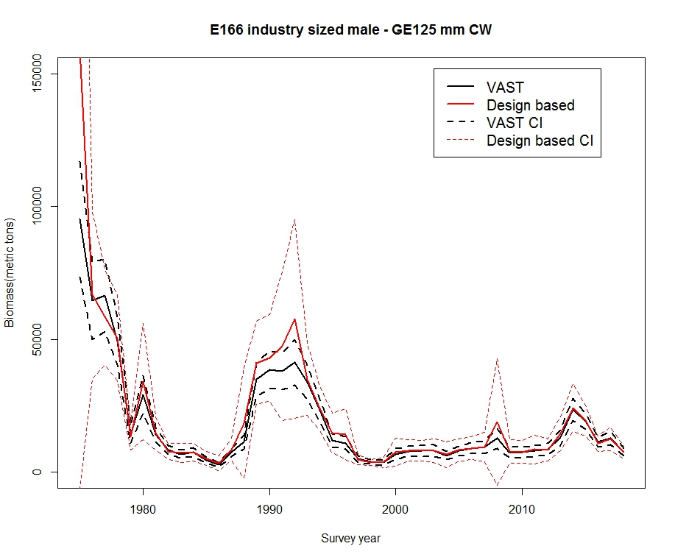
Eastern district Bairdi crab males – industry preferred

Slide 22
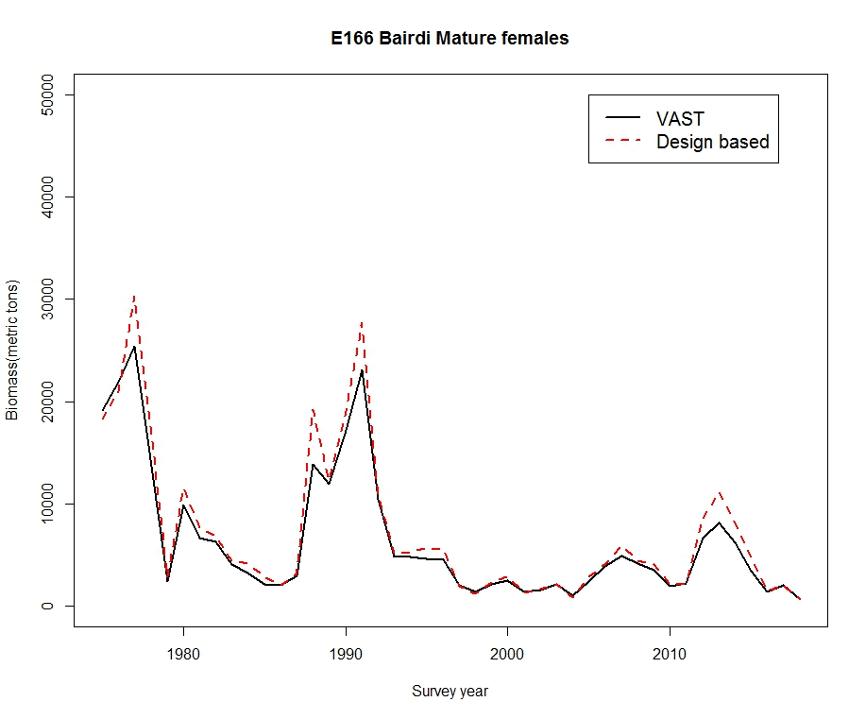
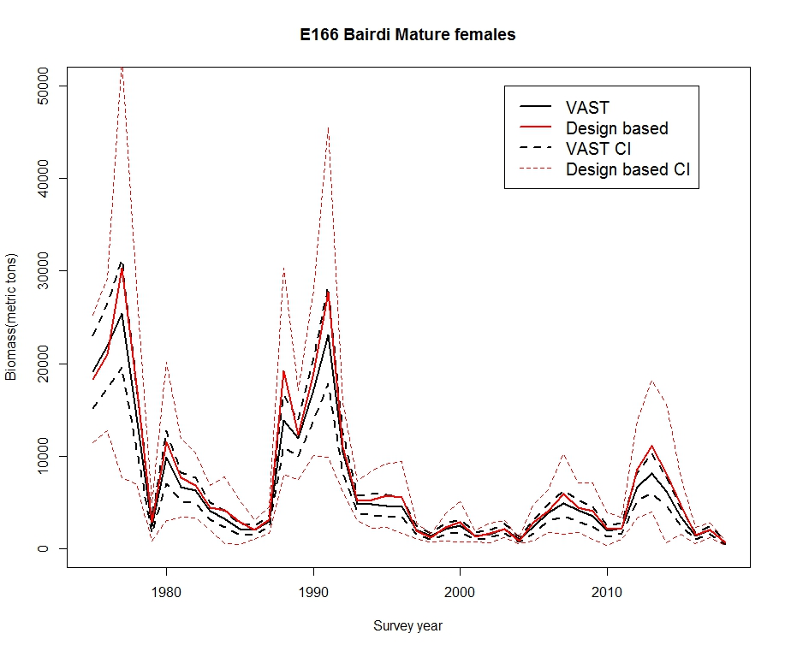
Eastern district Bairdi crab females -mature

Slide 23
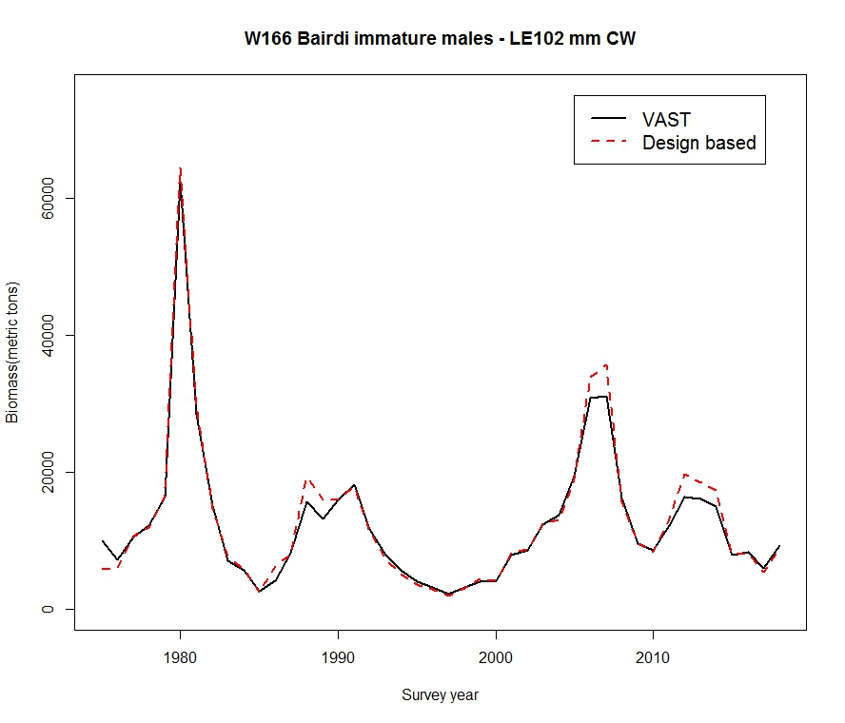
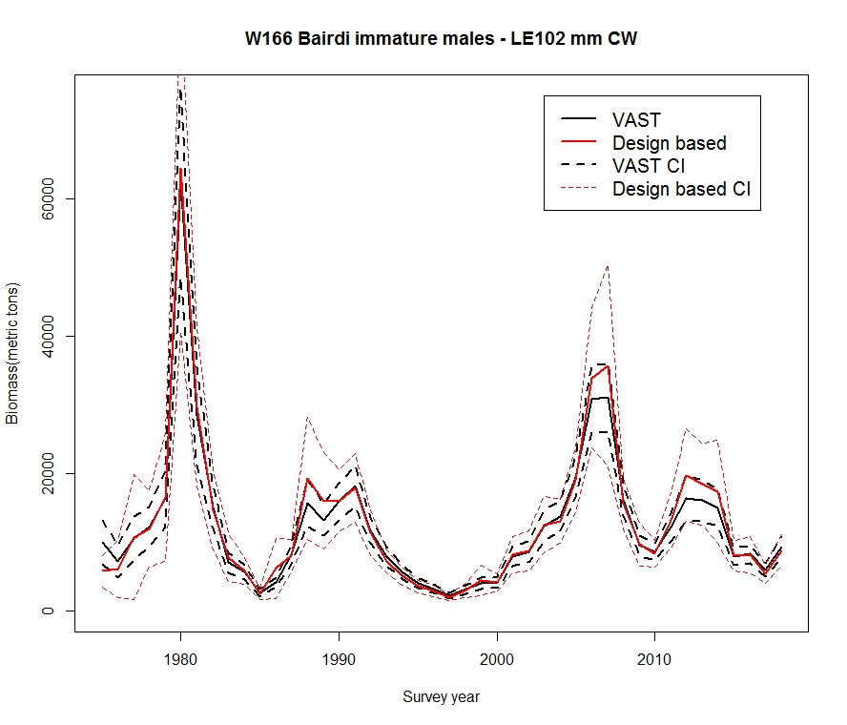
Western district Bairdi crab males -- immature

Slide 24
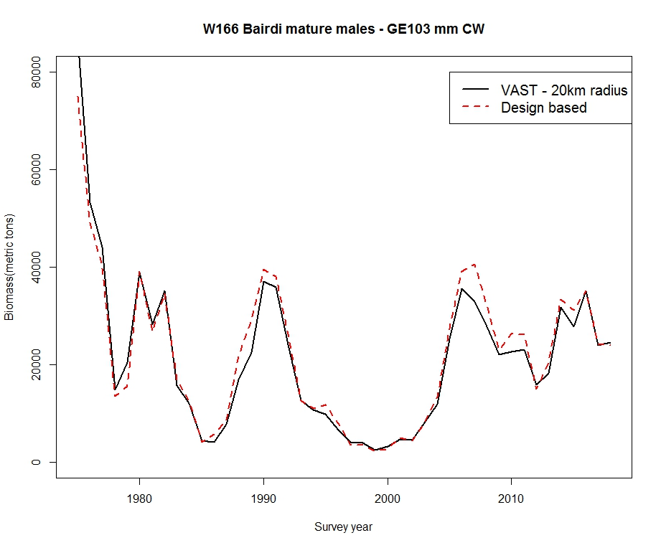
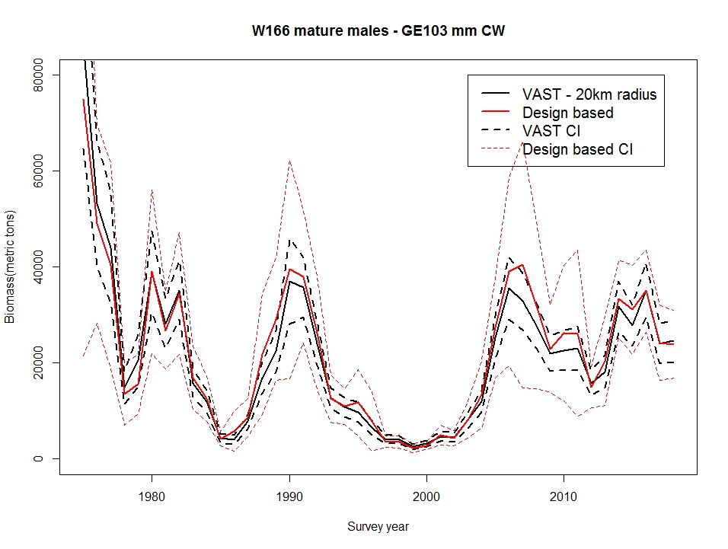
Western district Bairdi crab males -- mature

Slide 25
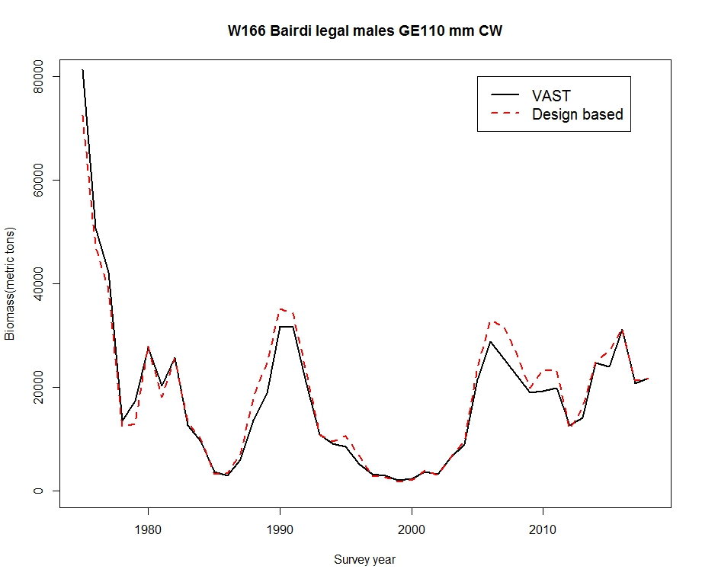
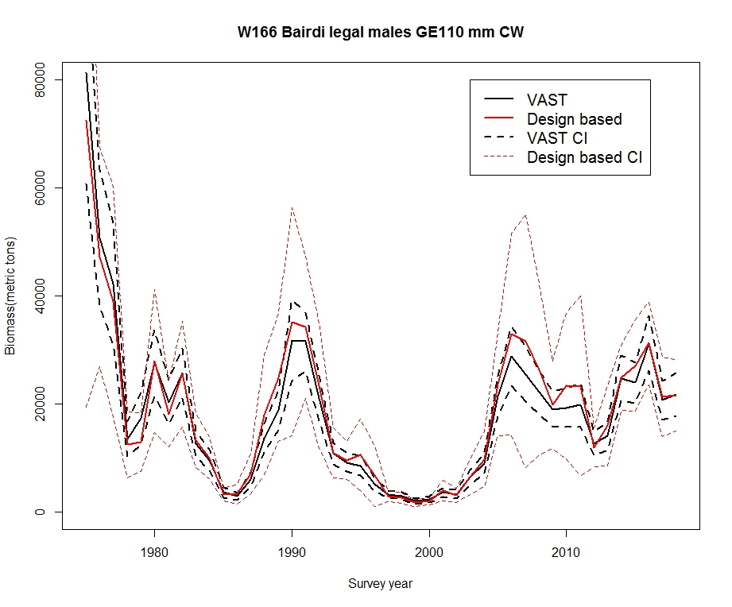
Western district Bairdi crab males -- legal

Slide 26
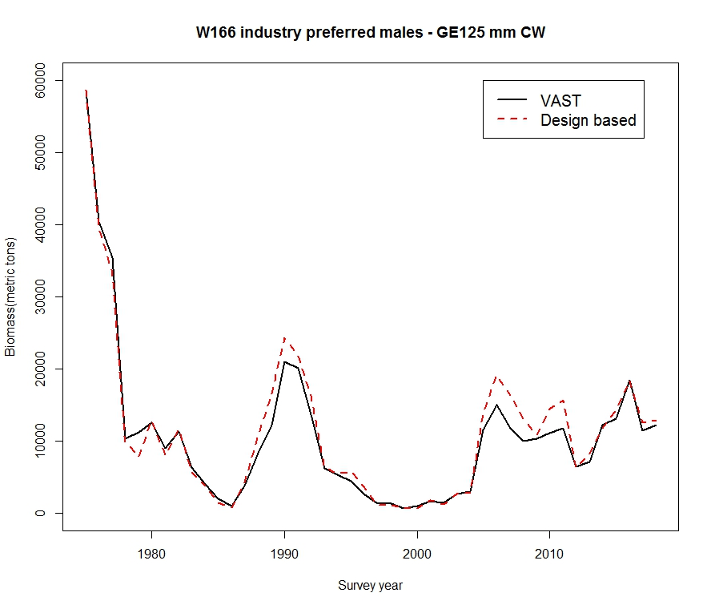
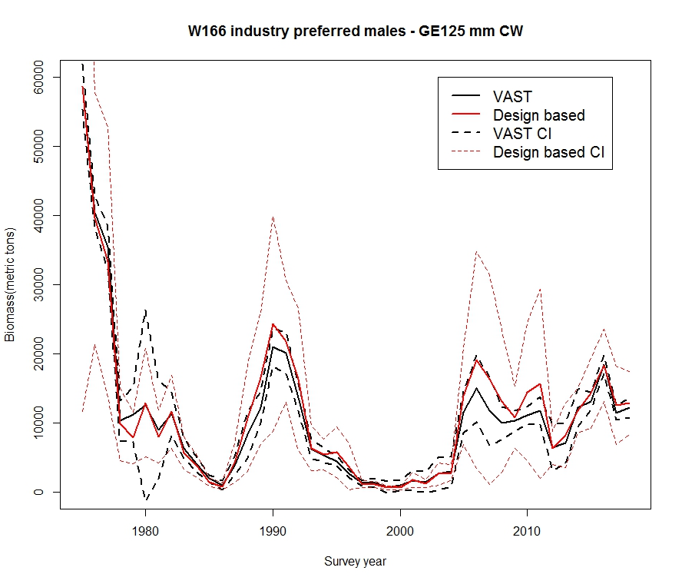
Western district Bairdi crab males – industry-preferred

Slide 27
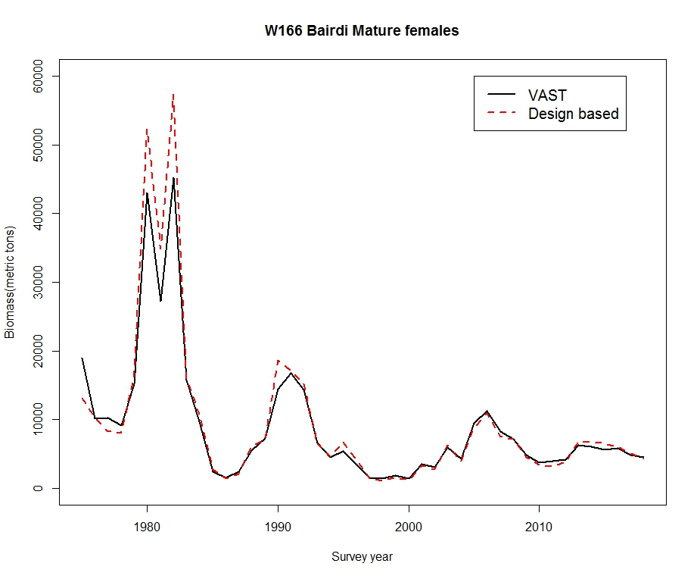
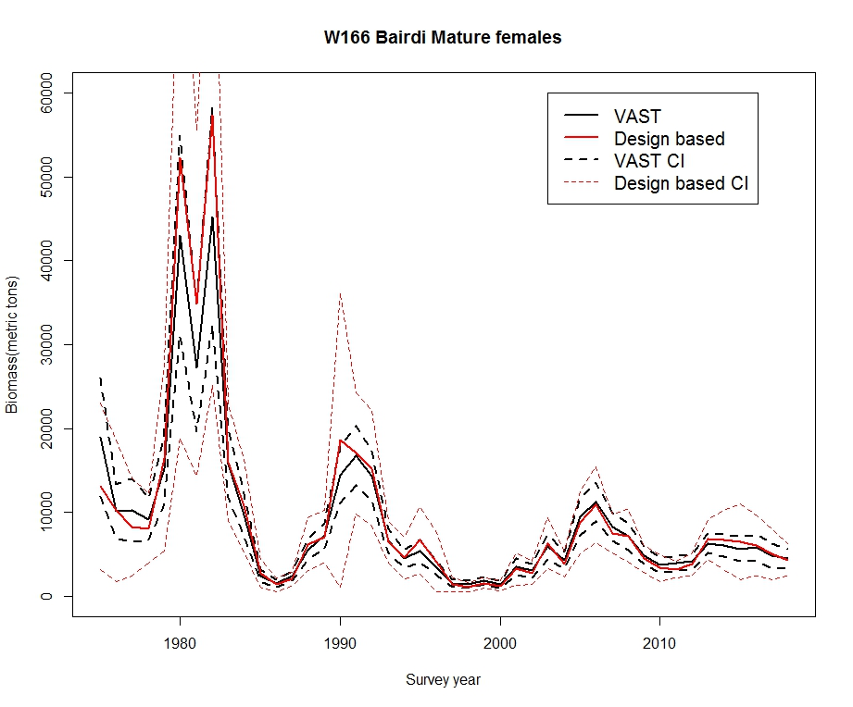
Western district Bairdi crab females -- mature

Slide 28
Biomass comparison take-aways
As promised, VAST CIs much tighter than those derived from design based
Trends were similar but VAST population estimates typically smaller than design based
Because of modeling procedure?
  Model specifications?
  Inadequate number of knots -> low model resolution?

Slide 29
Discrepancies cont.
Disparities in strata areas/areas over which estimates calculated?
    VAST area always slightly different
      Bairdi and RKC: Custom region defined by station grid and with data extrapolated based on radius from station centroid
      Opilio used EBS region/strata included with VAST
    BBRKC: VAST area = 54882 nmi^2 vs. 54536 for design based
    E166 Bairdi: VAST area = 48785.04 nmi^2 vs. 48120
    W166 Bairdi VAST area = 93557.14 nmi^2 vs 92230
    Opilio: VAST area = 144560.023 nmi^2 vs. 145964 for design based
    For Bairdi, RKC VAST estimates larger than would be the case if used same area as design based
    In contrast, for opilio, VAST estimates were likely smaller than if used same area as design based
Notes:
And for the final complication, there were disparities

Slide 30
Model diagnostics

Slide 31
Model diagnostics presented
Catch rate Pearson residuals
  Spatially extrapolated residuals for catch rate model component
  Scale and regional trends
Encounter rate Pearson residuals
  Spatially extrapolated residuals for encounter rate model component
  Again, scale and regional trends
Modeled encounter probability vs. actual
  Does prediction interval encompass observations, esp. at extremes?
Positive catch rate Q-Q plots
  Signs of skew/error distribution inadequacies?

Slide 32
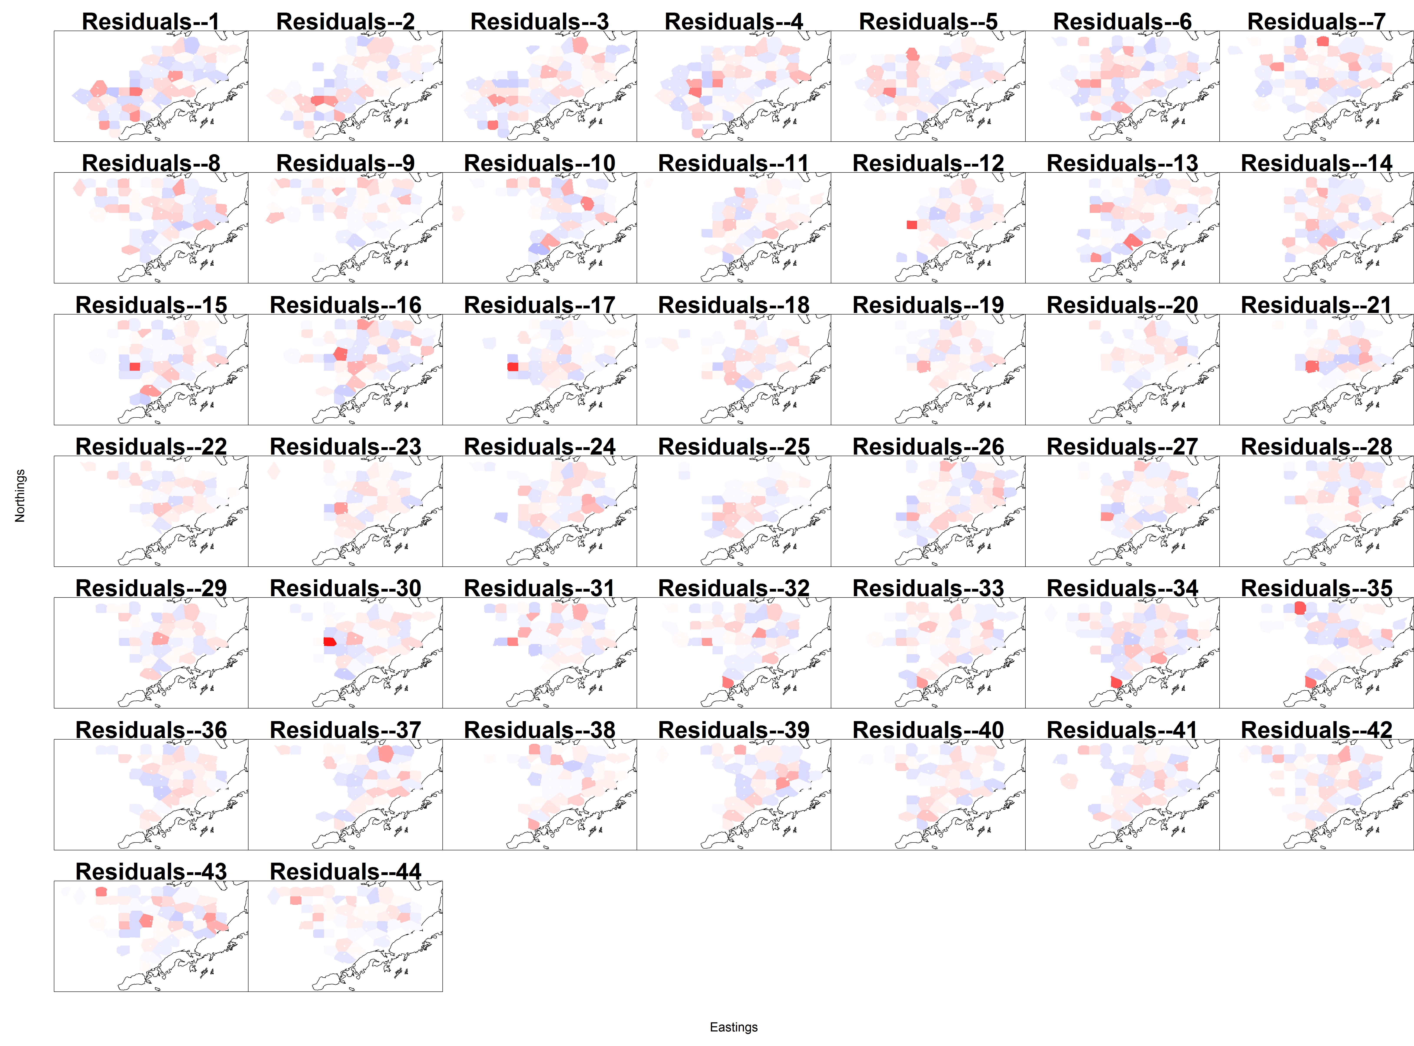
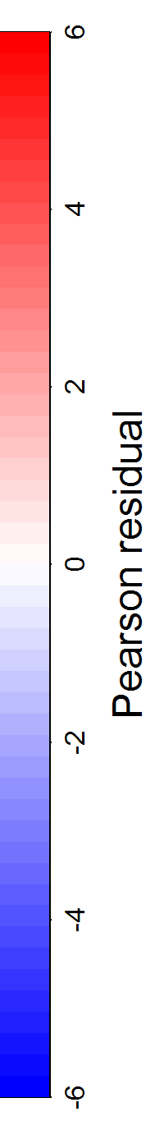
Red king crab, mature male (GE120) catch rate Pearson residuals

Slide 33
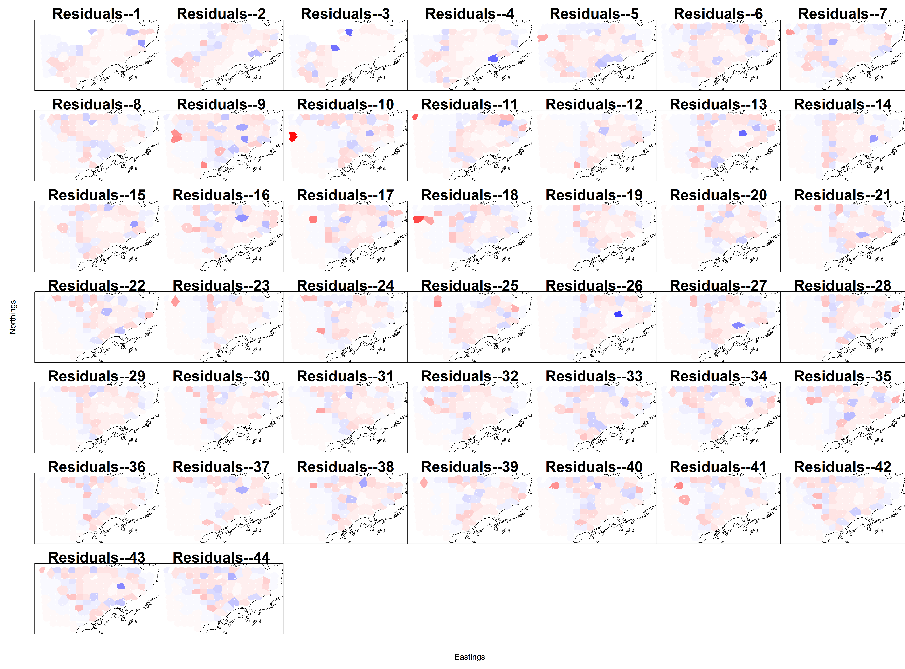
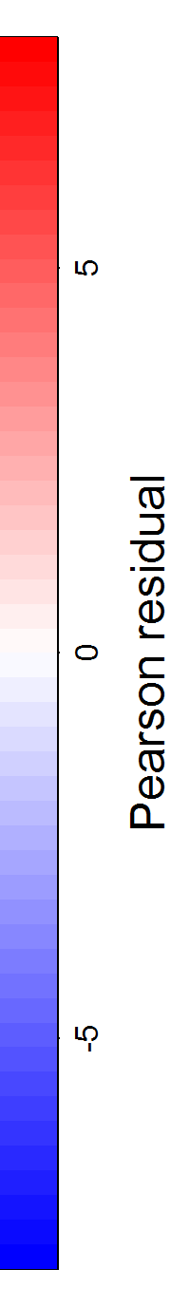
Red king crab, mature male (GE120) encounter rate Pearson residuals

Slide 34
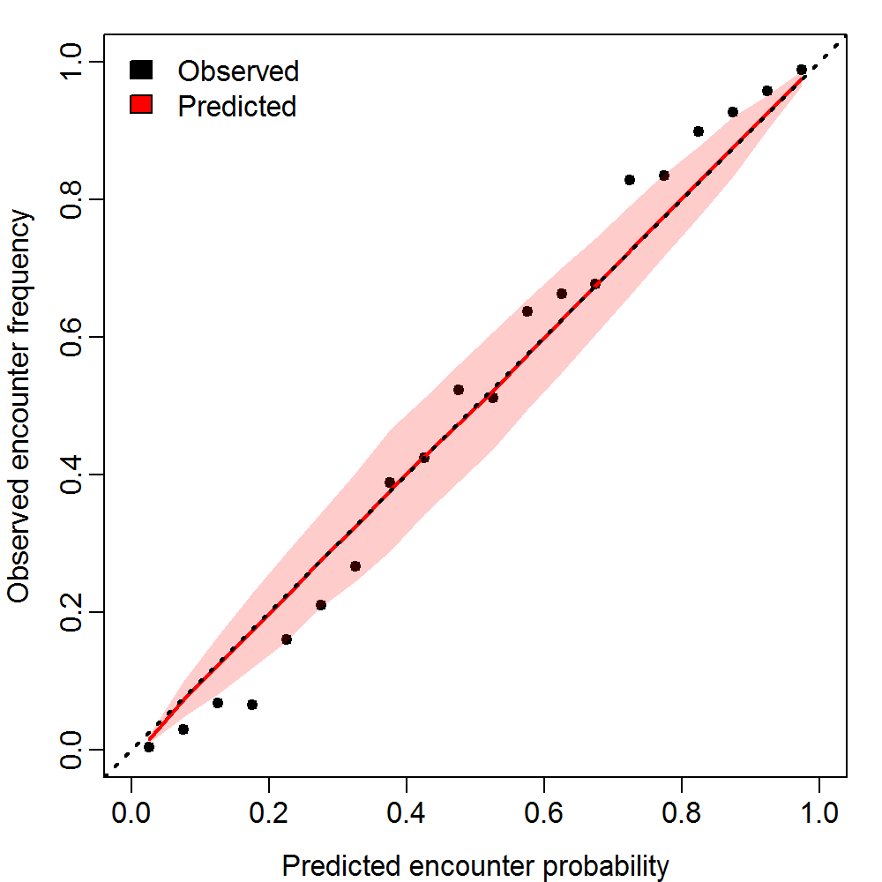

RKC GE120 encounter probability
Catch rate Q-Q plot
Extremes exceed prediction interval
Error distribution thin tailed
Slightly right skewed

Slide 35

Red king crab, legal male (GE135) catch rate Pearson residuals

Slide 36

Red king crab, legal male (GE135) encounter rate Pearson residuals

Slide 37



RKC GE 135 encounter probability
Catch rate Q-Q plot

Slide 38


Eastern district Bairdi crab, mature male (GE113) catch rate Pearson residuals

Slide 39


Eastern district Bairdi crab, mature male (GE113) encounter rate Pearson residuals

Slide 40



E166 Bairdi GE113 encounter probability
Catch rate Q-Q plot

Slide 41

Eastern district Bairdi crab, legal male (GE120) catch rate Pearson residuals

Slide 42

Eastern district Bairdi crab, legal male (GE120) encounter rate Pearson residuals

Slide 43


Western district Bairdi crab, mature male (GE103) catch rate Pearson residuals

Slide 44


Western district Bairdi crab, mature male (GE103) encounter rate Pearson residuals

Slide 45


W166 Bairdi GE103 encounter probability
Catch rate Q-Q plot

Slide 46


Western district Bairdi crab, legal male (GE110) catch rate Pearson residuals

Slide 47


Western district Bairdi crab, legal male (GE110) encounter rate Pearson residuals

Slide 48


Opilio crab, mature male (GE95) catch rate Pearson residuals

Slide 49


Opilio crab, mature male (GE95) encounter rate Pearson residuals

Slide 50


Opilio, GE 95 encounter probability
Catch rate Q-Q plot

Slide 51

Opilio crab, industry preferred male (GE102) catch rate Pearson residuals

Slide 52


Opilio crab, industry preferred male (GE102) encounter rate Pearson residuals

Slide 53
Diagnostics summary
Decent model fits.
However……
  Possible indications of regional trends in some years
  Some model difficulty with high/low encounter probabilities
  Positive catch rate Q-Q plots “thin tailed”—extremes somewhat underpopulated relative to distribution assumptions, particularly on low ends
    Some skew
Overall: Diagnostics are concerning
  Defer to Jim on this
Many more diagnostic plots (and parameter estimate tables) that were not included here —happy to share via email with interested parties

Slide 54
Overall take home
VAST is promising
Offers pronounced improvements in CIs in every case examined, across species and size groups.
Time series tracked each other well
  Some discrepancies
However, very computationally intensive (Opilio runs presented here took ~45 minutes for one size group..ie males GE102).
Lack of standardization of analysis area between VAST and design-based complicates comparison and interpreting differences between estimates at this point.
Model diagnostics…
My take: Useful, but not as yet a panacea
  But ask again in a couple months…..

Slide 55

I’m sorry Dave, I can’t answer that
jon.richar@noaa.gov

