Slide 1
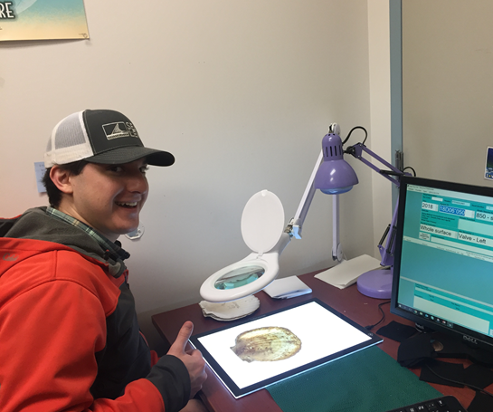
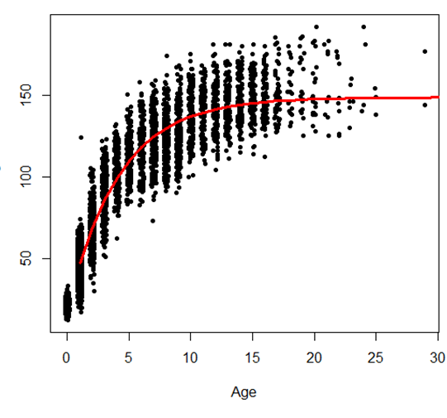
Weathervane Scallop Age Updates
2018 and 2019 aged
Trained 4 age readers in 2019
Performed at least 30% QA/QC reads and investigated 2019 outliers
Working on a direct connection between the Kodiak database and the ADU database
Area | 2018 | 2019 | Total
Yakutat | 1467 | 1880 | 3347
Kodiak | 1408 |  | 1408
Central | 296 | 232 | 528
Total | 3171 | 2112 | 5283

Slide 2
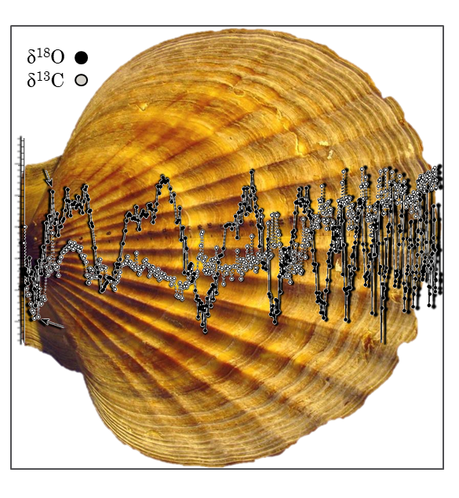
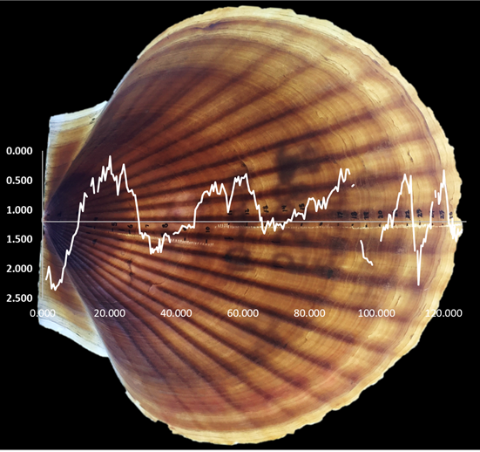
Age Validation: ¹⁸O & ¹³C
Put together historically collected values with images of shell
Verified interpretation with Moss landing researcher
 ¹⁸O matched the external banding pattern on most specimens
More sampling should be done
  Small sample sizes across area
  Validate nonannual checks
  Address sampling issues (epibionts/ core depth)

Slide 3
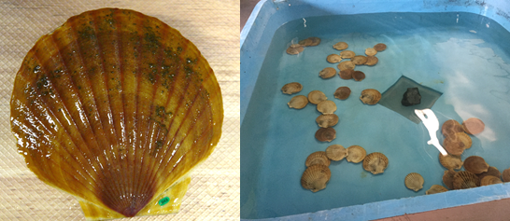
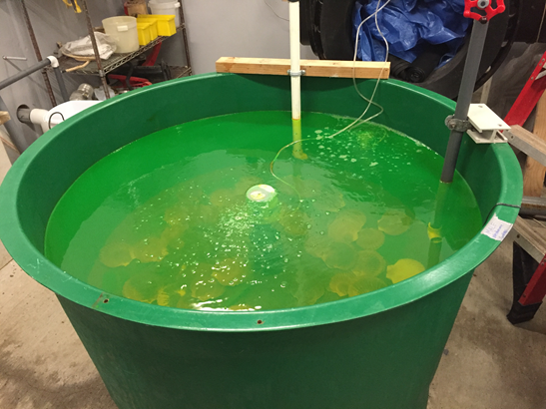
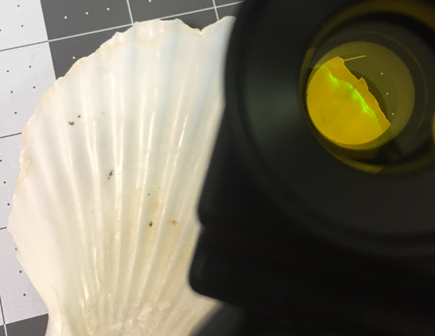
Age Validation: Growth Study
Collaboration with NOAA TSMRI and ADF&G
Goals
  Timing of annulus formation
  Growth rates
  Calcein staining methods
  Spawn timing
  Mariculture
Monthly height measurements and images
Calcein and overall survival is good, but current mariculture practices do not supporting growth

Slide 4
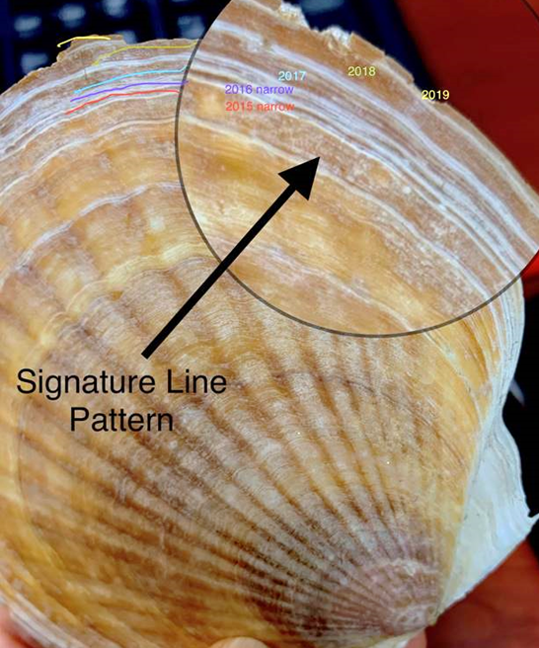
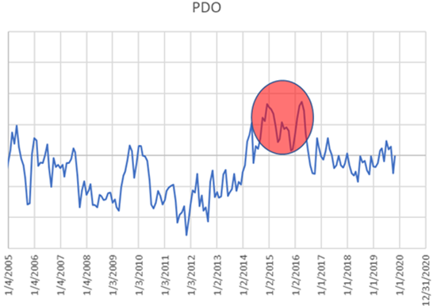
Age Corroboration:
Cross-dating
  Track signature lines
    Abnormally wide or narrow growth bands
    Look for consistency across samples
  Can help estimate edge loss, identify checks
Narrow 2015/2016 in 2019 survey
Continue tracking/identifying signatures and record these in the database
Measure increments and relate these to climate data

Slide 5
Further Work
Validate size of first annulus
  Cohort analysis of small scallops caught across month
  Results of isotope analysis
Expand annual validation
  Isotope analysis
    Collect CTD data with scallops
    Apply for grant funding
Continue growth and calcein study with feed and water quality treatments
Continue tracking/identifying signatures

