Slide 1

Canaries of the Arctic: the collapse of snow crab in the eastern Bering Sea
Cody Szuwalski (and many others)
January Crab Plan Team
2022

Slide 2
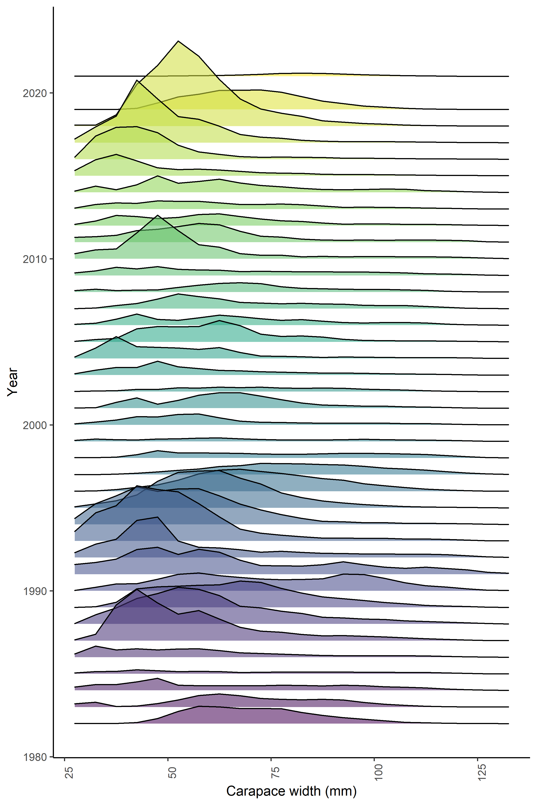
Record lows
Snow crab is ‘overfished’ and survey abundances were the lowest on record.
Size group | 2021 biomass (kt) | Previous low (kt) | Overfished declaration (1999)
>101 mm | 12.4 | 20.7 (2016) | 52.0
>24 mm | 73.5 | 99.8 (1985) | 111.5
>77 mm | 60.1 | 51.7 (2016) | 87.1
>94 mm | 24.4 | 29.4 (2016) | 67.4

Slide 3
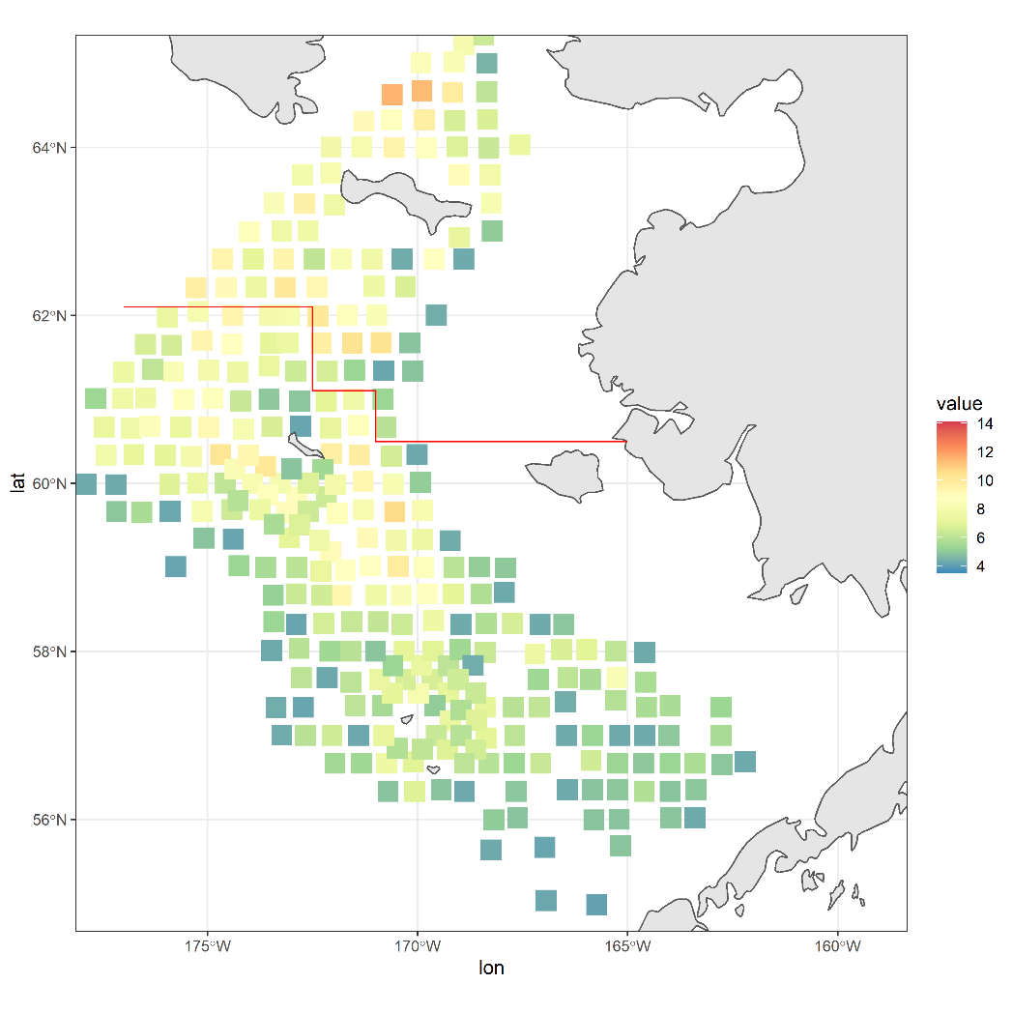
Hypotheses
The crab are alive:
  Crab moved into the northern Bering Sea
  Crab are in the eastern Bering Sea, but the survey didn’t see them
  Crab moved off of the shelf
  Crab moved into Russian waters
The crab are dead:
  Predation
  Disease
  Temperature effects
  Fishery effects
  Cannibalism
??
2021: 45 mm ≤ Carapace width ≤ 85 mm
2021 adopted assessment model included mortality events in 2018 and 2019

Slide 4
Estimated time-varying natural mortality
Models will soak up variability in other processes (e.g. catchability or growth) with confounded processes
Catchability is known to vary

Slide 5
Catchability varied spatially with respect to sediment and depth
Snow crab distribution varies over time
So, catchability likely varies over time
This does not consider the potential for crab back and forth over the northern Bering Sea border to contribute to changes in catchability over time.

Slide 6
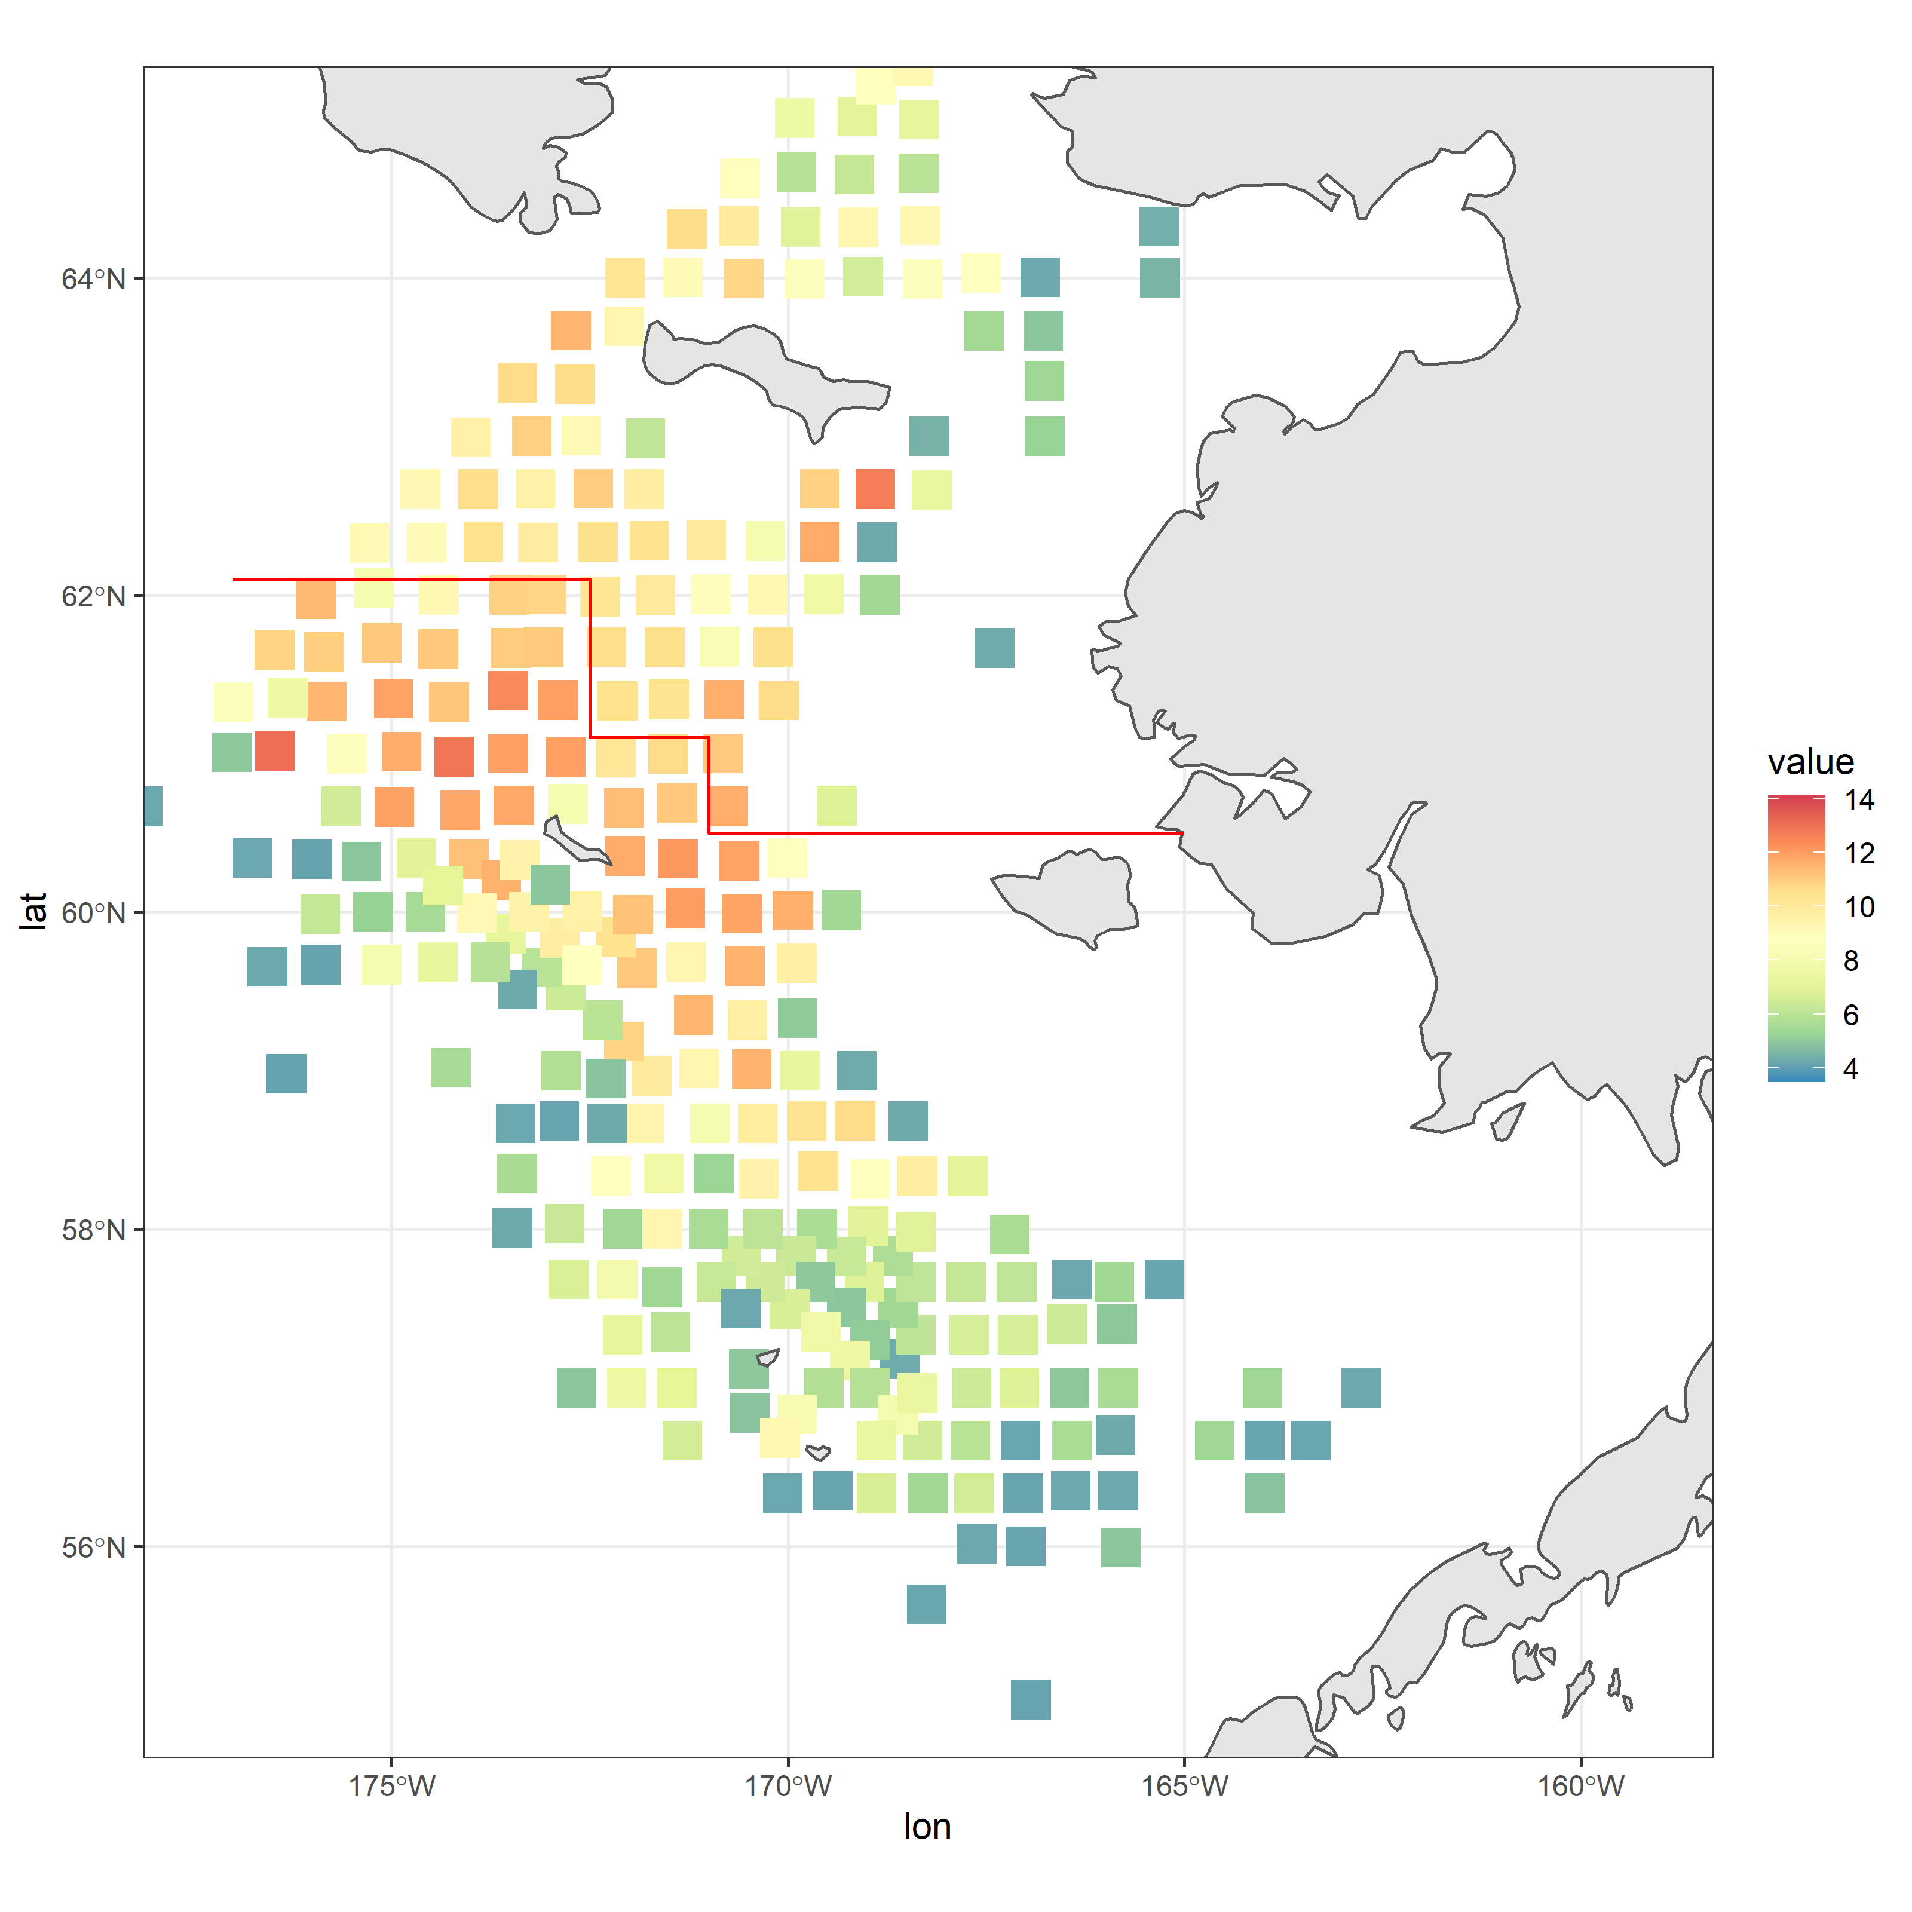
2017
45 mm ≤ Carapace width ≤ 85 mm

Slide 7
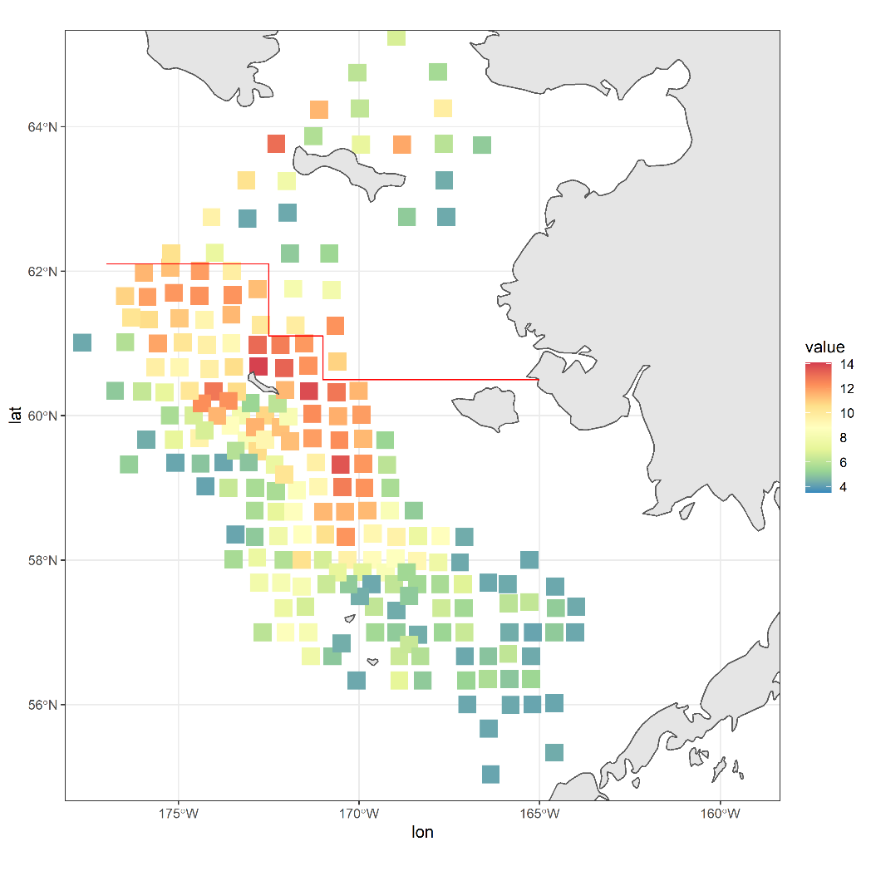
2018
45 mm ≤ Carapace width ≤ 85 mm

Slide 8
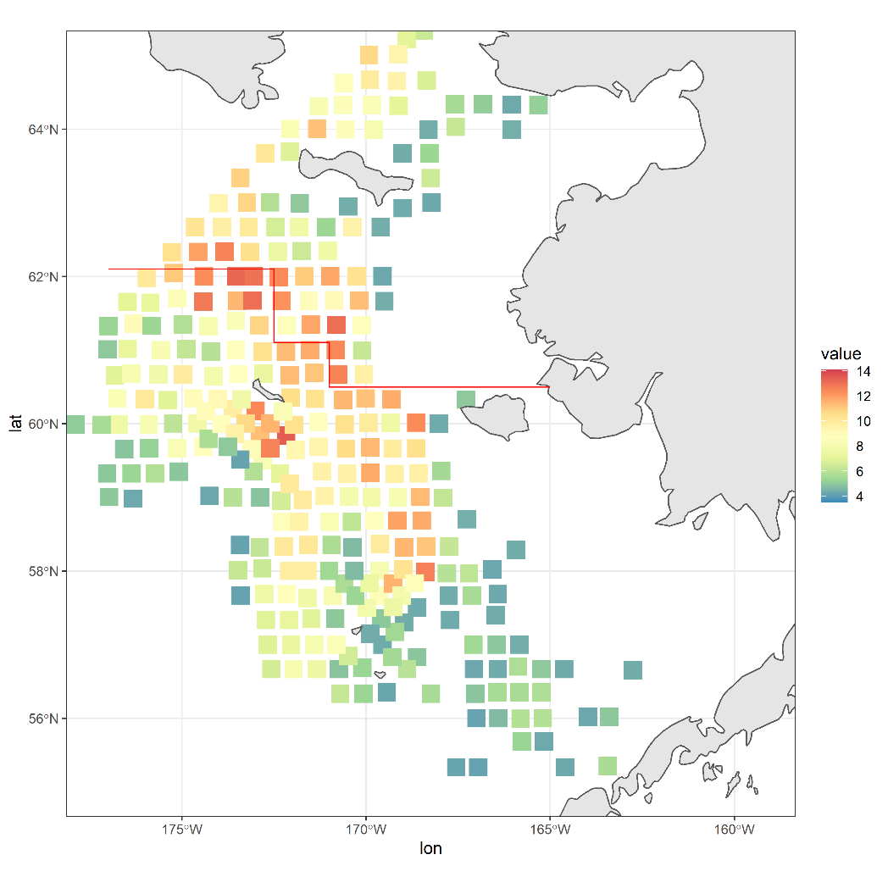
2019
45 mm ≤ Carapace width ≤ 85 mm

Slide 9
How have mortality and catchability varied over time?
What drives variability in mortality and catchability?

Slide 10
Estimate maturity and year-specific mortality and catchability
Correlate changes in estimated mortality and catchability with potentially related phenomena
Sanity checks, sensitivities, gripes about modeling framework
Future work

Slide 11
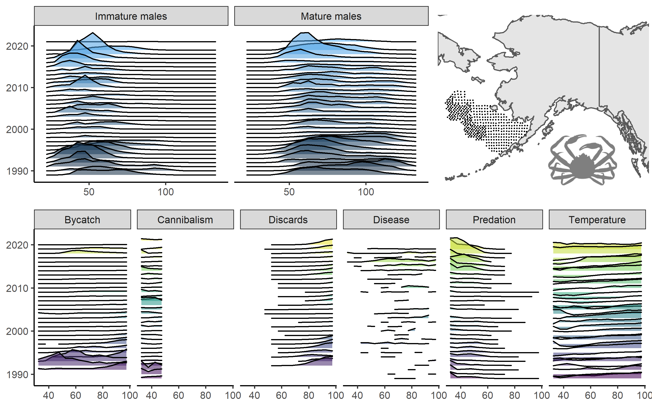
Data

Slide 12
Population dynamics model
Goal: explain the observed changes in immature and mature male abundance by estimating recruitment, mortality, and catchability
Details
Spans 1989 to 2021 (survey coverage consistent then)
Male only
Sizes 30-95mm carapace width, 5 mm size bins
Fit to immature and mature indices of abundance (not biomass) + size composition data
Estimated parameters
  Initial numbers for immature and mature males
  Mean mortality for immature and mature males
  Yearly deviations for mortality and survey catchability by maturity state (why?)
  Yearly recruitment
  Proportion of recruitment falling in the first size bins (size bin 2 gets 1-p)
Fixed processes
  Growth
  Survey selectivity derived from BSFRF data
  Yearly probability of having undergone terminal molt data
Rationale discussed

Slide 13
Likelihood | Form | Weighting
Abundance | Lognormal | CV (0.11,0.41)
Size composition | Multinomial | 50
Prior on average M | Normal | Mean=0.271, Sigma=0.10
Penalty on M devs | Normal | Sigma = 0.10
Smoothness penalty on M | Second difference | 1
Smoothness penalty on q | Second difference | 1

Slide 14
Model process | Status quo | Simplified
Time span | 1982-2021 | 1989-2021
Data sources fit | NMFS and BSFRF MMB, FMB, Survey size composition, retained catch, discard, and bycatch | NMFS immature and mature male abundance and size composition
Size range | 30-135 mm carapace width | 30-95 mm carapace width
Recruitment | First 5 size bins, proportions fixed | First 2 size bins, proportions estimated
Mortality | Natural and fishing mortality split out; 4 natural mortality parameters estimated (sex and maturity state) | Total mortality estimated yearly by maturity state
Growth | Specified based on growth increment data; discretized and renormalized gamma function for variance around mean increment | Specified based on growth increment data; discretized and renormalized normal distribution function for variance around mean increment
Sexes | Male and female | Male
Maturity | Average probability of having undergone terminal molt estimated | Yearly probability of having undergone terminal molt input; average used when data unavailable
Survey catchability | Two eras estimated informed by BSFRF data | Yearly parameter estimated by sex
Survey selectivity | Logistic, two eras | Non-parametric, one era

Slide 15
Why estimate growth, selectivity, and maturity outside the model?
Unmodelled time-variation in a process can impact the estimates of other confounded processes.
Sainte-Marie’s work that shows growth increment is conservative
BSFRF data gives us a good idea of selectivity
Maturity is actually ‘observed’ (with caveats related to shell condition)

Slide 16
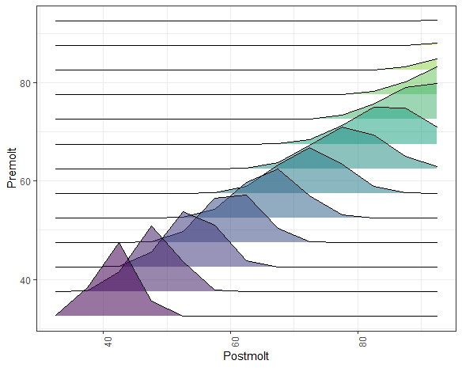
Growth, selectivity, and maturity
Growth increments based on all available growth data
Crab can ‘outgrow’ the model—some of the sums of the rows of the transition matrix equal less than 1.
Discretized and renormalized normal distributions used for the variance around size increment.

Slide 17
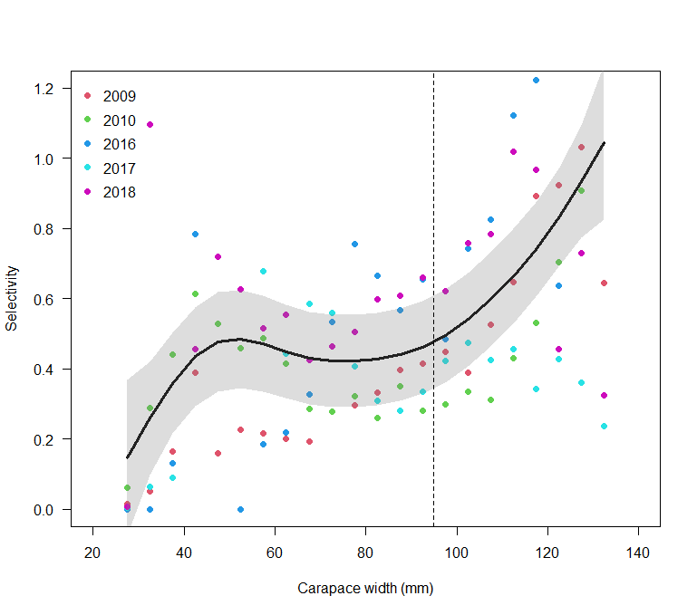
Growth, selectivity, and maturity
Survey selectivity based on a GAM fit to the BSFRF data at size
Estimated yearly catchability scales this curve up and down
Vertical line is the end point of the crab in the model

Slide 18
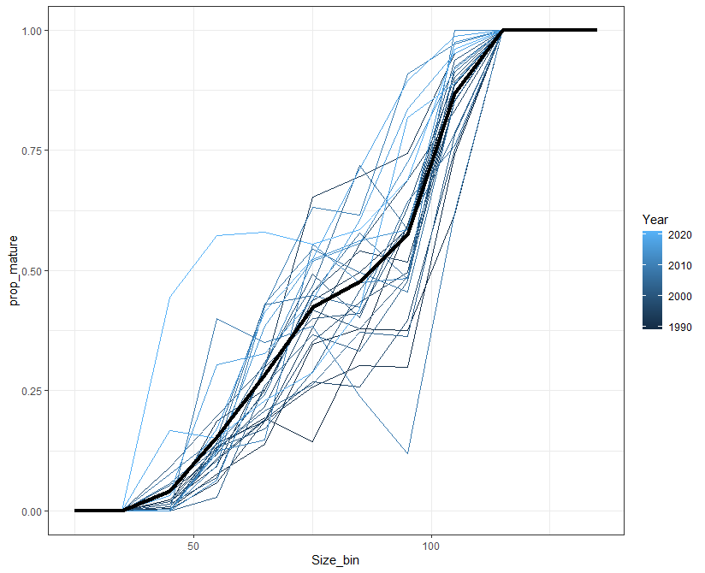
Growth, selectivity, and maturity
Chela height measurements used to calculate the proportion of new shell males having undergone terminal molt
Changes over time
Status quo assessment estimates the average ogive, but here they are input as data

Slide 19
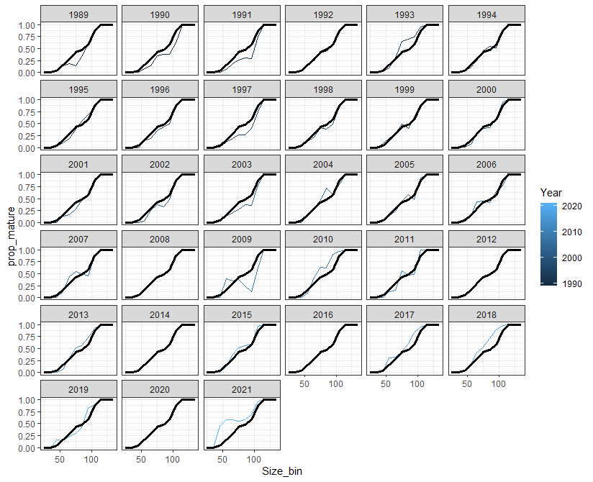
Growth, selectivity, and maturity
Chela height measurements used to calculate the proportion of new shell males having undergone terminal molt
Changes over time
Status quo assessment estimates the average ogive, but here they are input as data

Slide 20
for(int year=styr;year<endyr;year++)
{
// mortality
for (int size=1;size<=size_n;size++)
{temp_imm(size) = imm_n_size_pred(year,size) * exp(-1*0.5*exp( nat_m(year,size)));
temp_mat(size) = mat_n_size_pred(year,size) * exp(-1*0.5*exp( nat_m_mat(year,size)));}
// growth
trans_imm = size_trans * temp_imm;
// recruitment
trans_imm(1) += exp(log_recruits(year))*prop_rec(year);
trans_imm(2) += exp(log_recruits(year))*(1-prop_rec(year));
// maturity and mortality
for (int size=1;size<=size_n;size++)
{imm_n_size_pred(year+1,size) = (trans_imm(size) * (1-prop_term_molt(year,size))) * exp(-1*0.5*exp( nat_m(year,size)));
mat_n_size_pred(year+1,size) = (trans_imm(size) * prop_term_molt(year,size) + temp_mat(size)) * exp(-1*0.5*exp(nat_m_mat(year,size)));}
}
MORTALITY
GROWTH
RECRUITMENT
MATURITY

Slide 21
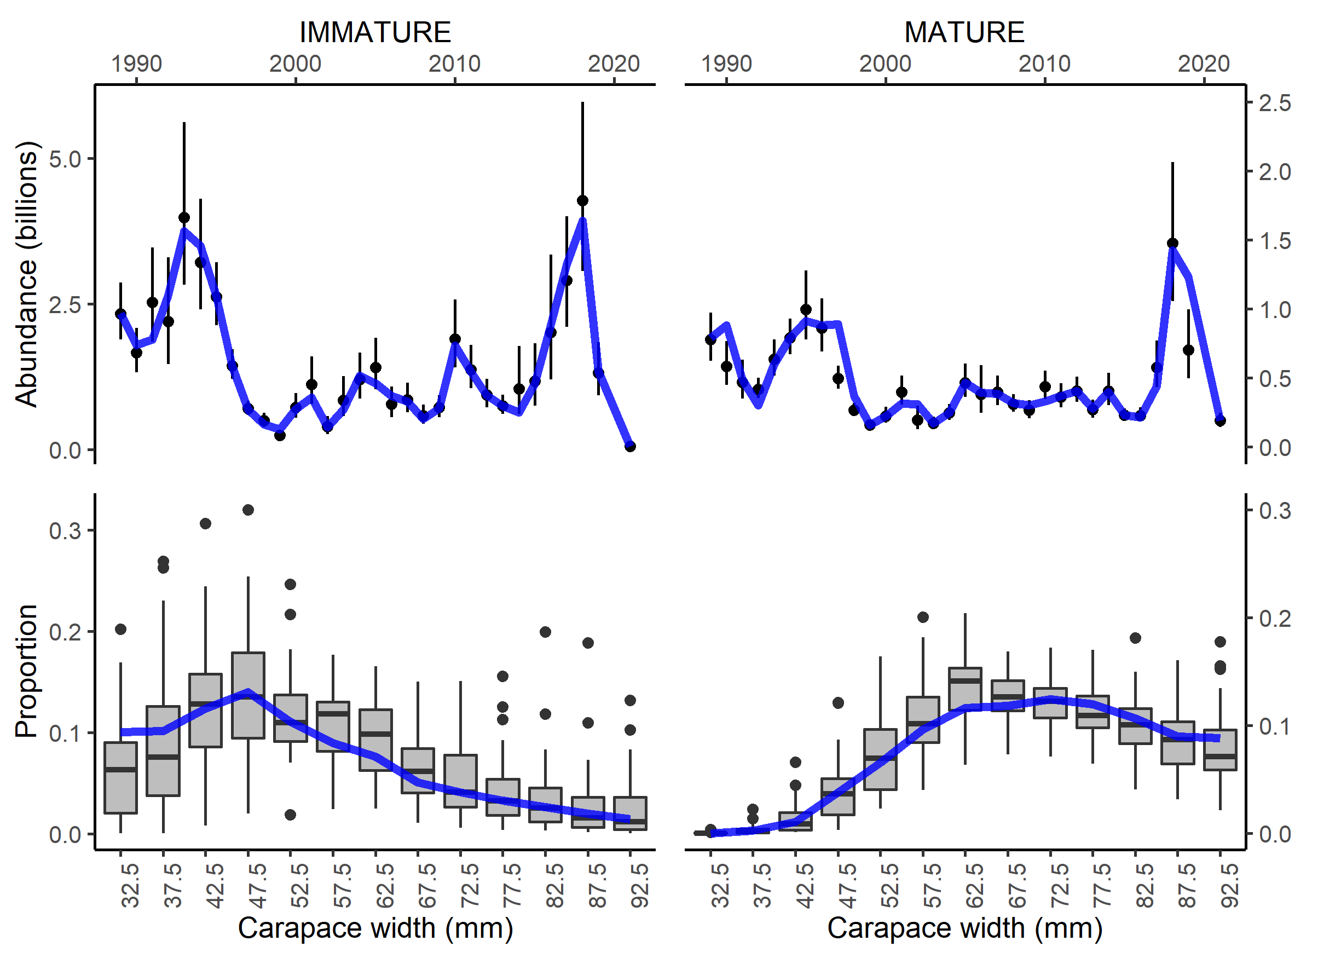
Model fits
No evidence for non-convergence (max gradient component < -0.009, positive-definite hessian)

Slide 22
“Why would you think you can estimate these processes together at all?!”

Slide 23
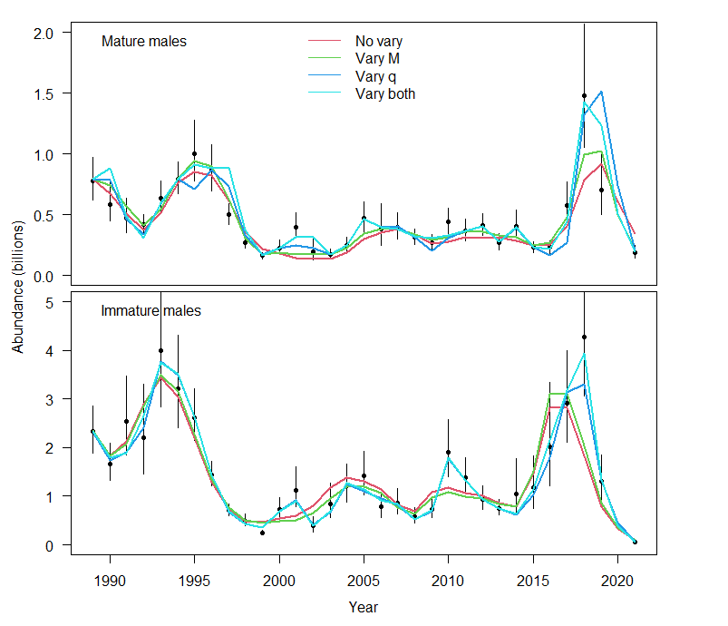
Recruitment: new small crab
Mortality: changes in abundance are permanent
Catchability: changes are ‘reversible’
This unfortunately makes it difficult to know what cause changes in the terminal year…but preserves the possibility that historical catchability and mortality could be estimated.

Slide 24
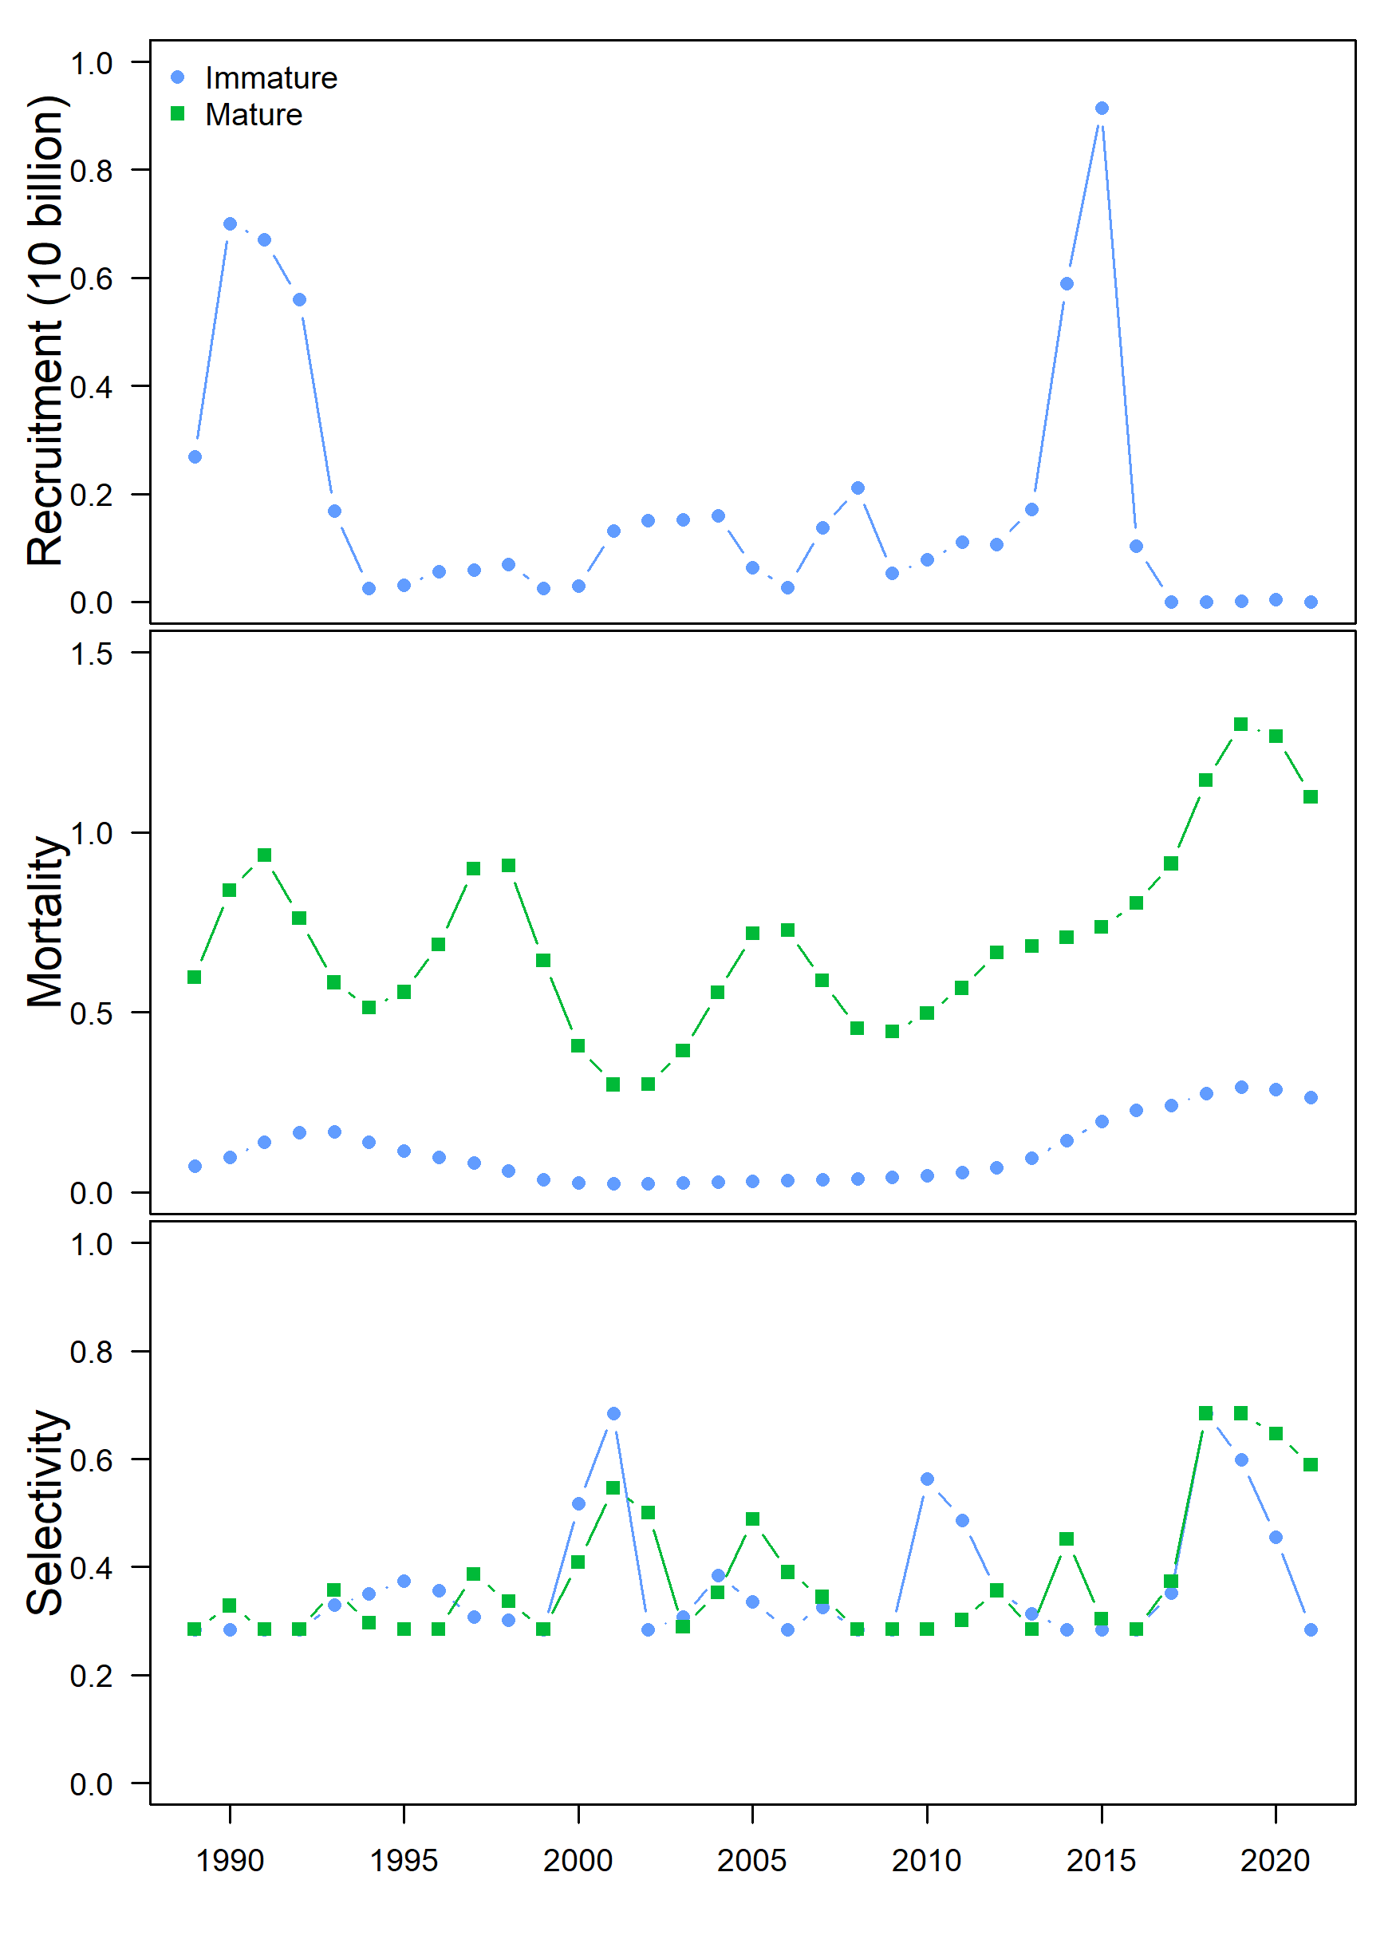
Estimated population processes
Recruitment
  Estimates very similar to the status quo assessment
  Note the last five years of estimated recruitment…
Mortality
  Mature mortality much higher and more variable than immature
  Recruitment enters the model half way through the year and only in first two size bins
  Variability in immature M could be ‘soaked up’ by changes in estimates of recruitment (explore)
Catchability
  Variability is similar between mature and immature, but not identical

Slide 25
Data

Slide 26
Covariates: units are important
Bycatch & discards were in numbers at size
  Divided these numbers at size by the predicted numbers at size from the population dynamics model to make it more comparable with the estimated mortality rates
  Retained catch not included: very little and also highly correlated with discards
Cannibalism
  Proportion of the density of small crab overlapping with predator times
  Density of large crab in the overlapping area
Disease
  Prevalence (i.e. number of crab visually identified as infected)
Predation
  Tons consumed per day
  Divided this by the biomass (check this) at size predicted at size from the population dynamics model
Temperature
  Average temperature occupied by size

Slide 32
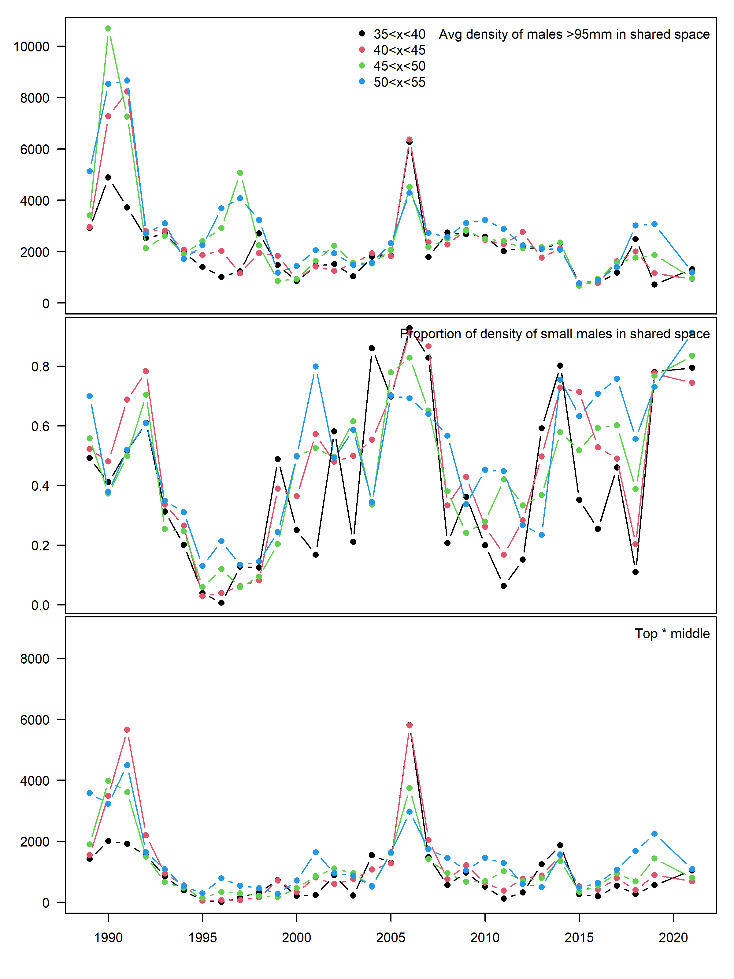
Cannibalism index
Risk = threat * vulnerability * consequence
Threat = density of large crab
Vulnerability = proportion of density of small crab co-occurring with large crab
Consequence = death

Slide 33
Covariates: units are important
Bycatch & discards were in numbers at size
  Divided these numbers at size by the predicted numbers at size from the population dynamics model to make it more comparable with the estimated mortality rates
  Retained catch not included: very little and also highly correlated with discards
Cannibalism
  Proportion of the density of small crab overlapping with predator times
  Density of large crab in the overlapping area
Disease
  Prevalence (i.e. number of crab visually identified as infected)
Predation
  Tons consumed per day
  Divided this by the biomass (check this) at size predicted at size from the population dynamics model
Temperature
  Average temperature occupied by size

Slide 34
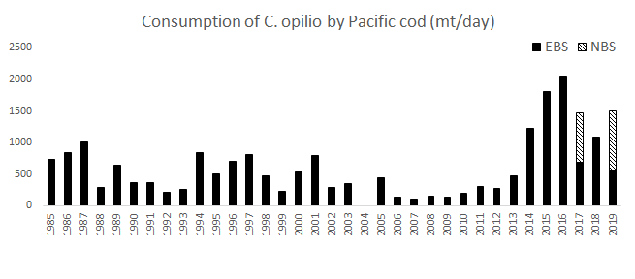
Provided by Kerim Aydin

Slide 35
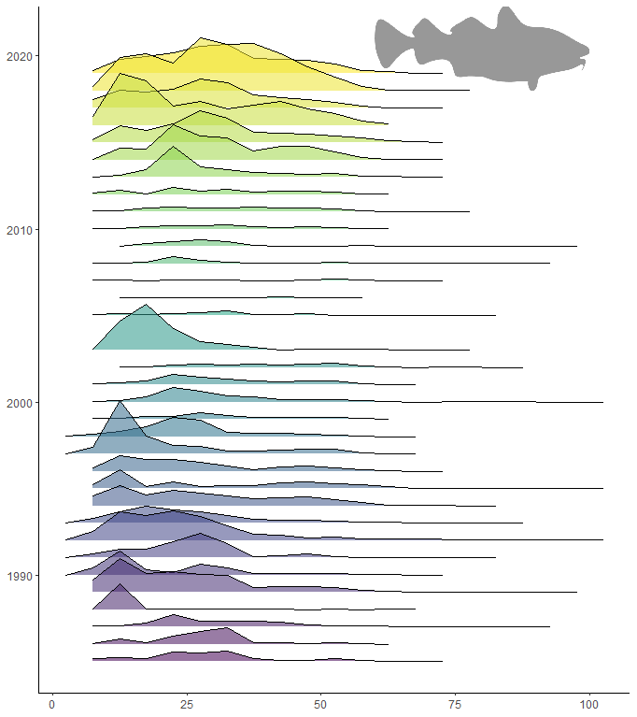
Provided by Kerim Aydin

Slide 36
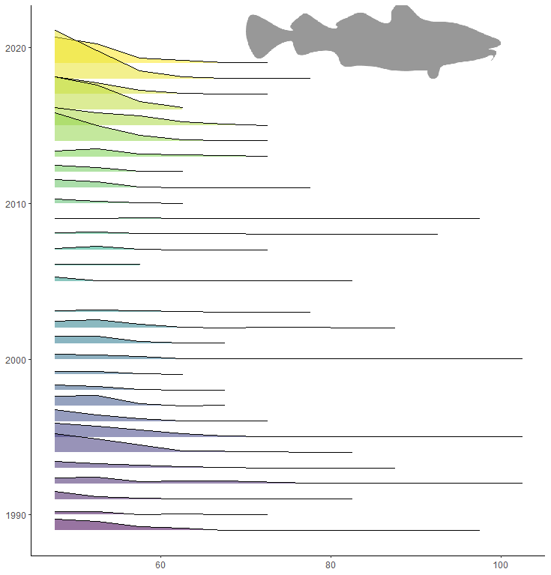
Provided by Kerim Aydin

Slide 37
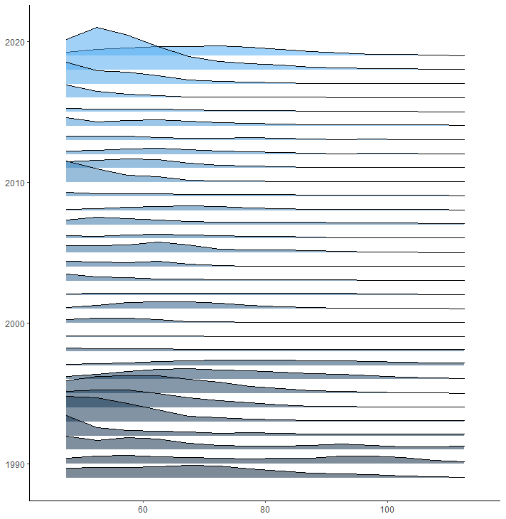


Slide 39
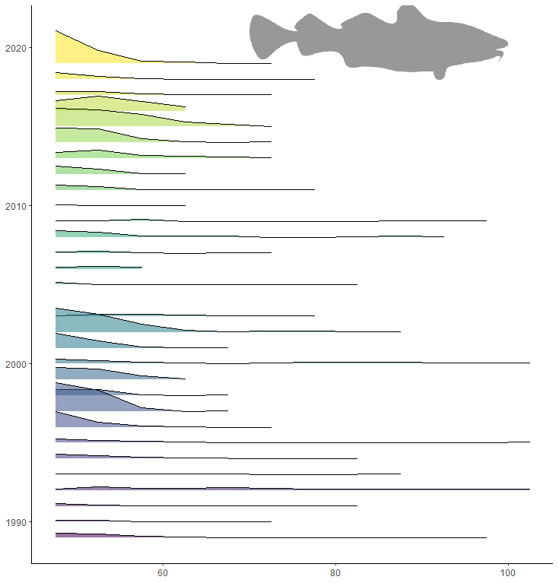

Slide 40
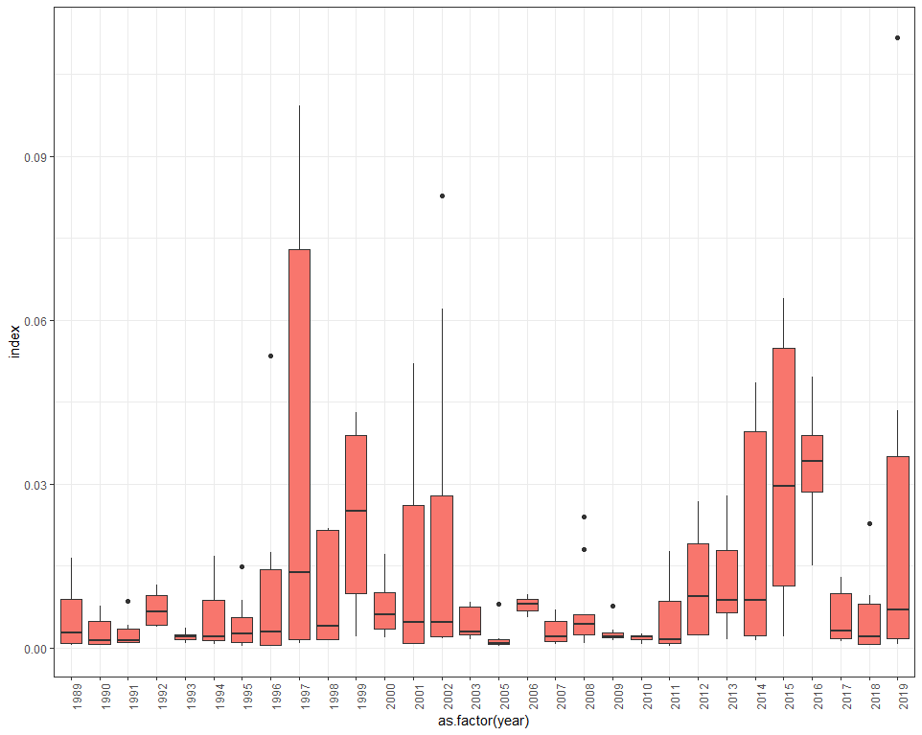
Provided by Kerim Aydin

Slide 41
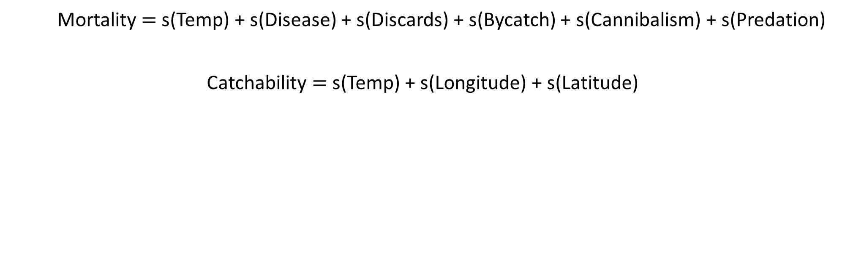
Mortality $=$s(Temp) + s(Disease) + s(Discards) + s(Bycatch) + s(Cannibalism) + s(Predation)
Catchability $=$s(Temp) + s(Longitude) + s(Latitude)

Slide 42
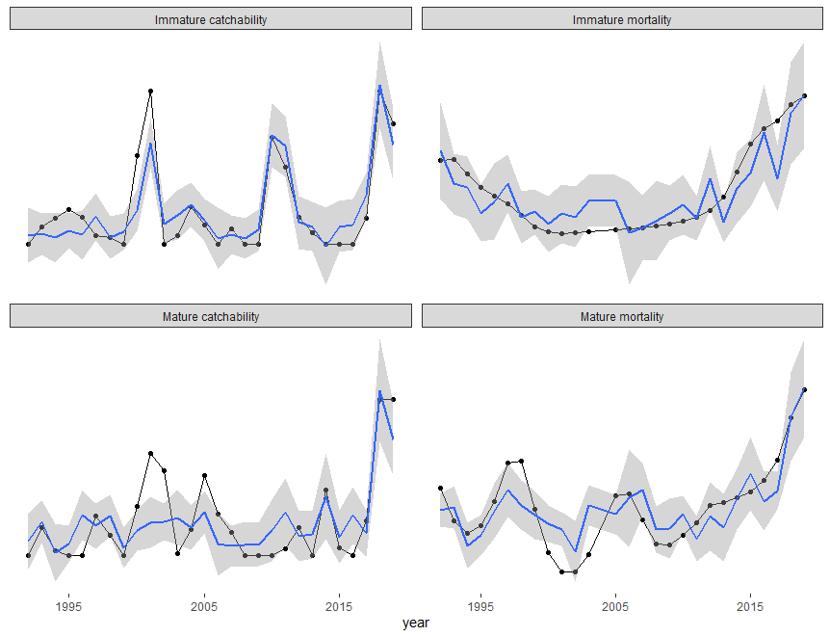
Deviance explained = 82%
Deviance explained = 76.3%
Deviance explained = 62.2%
Deviance explained = 70.1%

Slide 43
Leave one out cross-validation
Systematic refitting of the model with one year of data removed
Performed to assess the robustness of modeling outcomes to data-availability

Slide 44
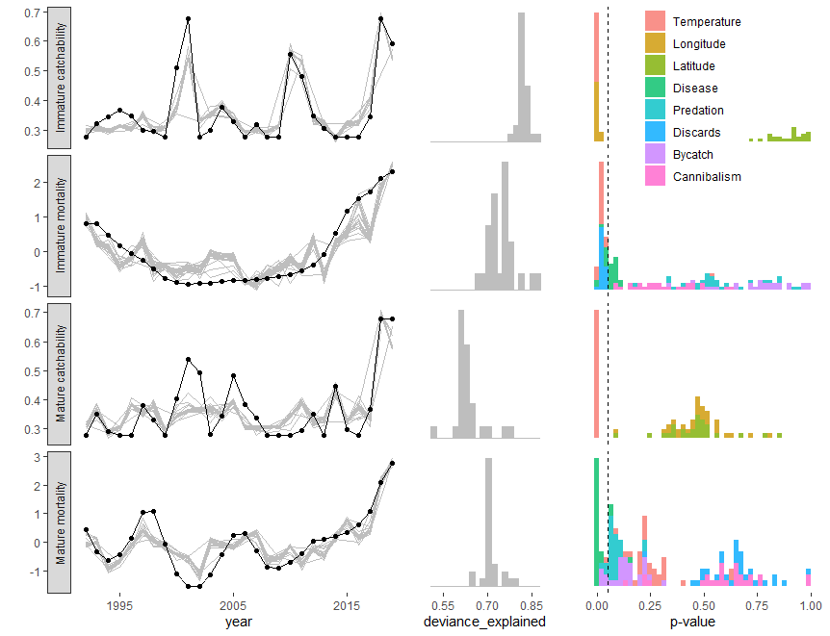
Temperature
Longitude
Temperature
Discards
Disease
Temperature
Disease
Bycatch
Predation
Temperature

Slide 45
Marvel for a moment at how tidy the story is…
Process | Correlates | Deviance explained
Immature mortality | Temperature, discards, disease | 76.3%
Mature mortality | Disease, bycatch, predation, temperature | 70.1%
Immature catchability | Temperature, longitude | 82%
Mature catchability | Temperature | 62%
(but…there’s always a but…)

Slide 46
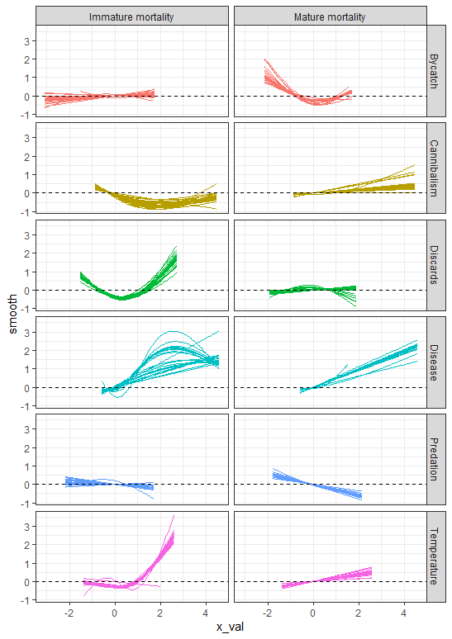
Immature mortality
Temperature
  Higher temperature related to higher mortality
Disease
  Higher disease prevalence related to higher mortality
Discards
  Lowest discards associated with higher mortality than medium discards?
If disease is a problem, why don’t we see it in the fishery?
Are the crab just dying before the fishery occurs?
Why is it the best predictor of mature mortality and not immature?

Slide 47
Mature mortality
Disease
  Higher disease related to higher mortality
Bycatch
  Lower bycatches related to higher mortality?
Temperature
  Higher temperature related to higher mortality
Predation
  Lower predation related to higher mortality?
If disease is a problem, why don’t we see it in the fishery?
Are the crab just dying before the fishery occurs?
Why is it the best predictor of mature mortality and not immature?

Slide 48
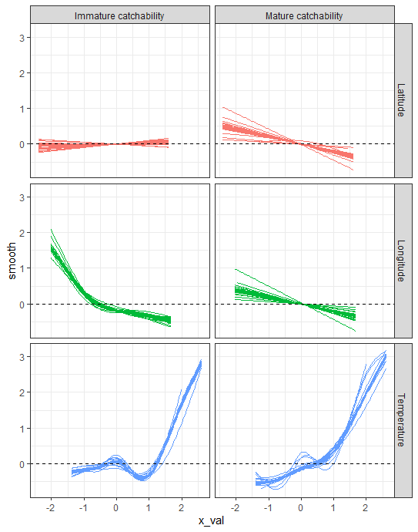
Immature catchability
Temperature
  Higher temperature related to higher catchability
Longitude
  Higher catchability related to centroid of abundance farther west

Slide 49
Mature catchability
Temperature
  Higher temperature related to higher catchability

Slide 50
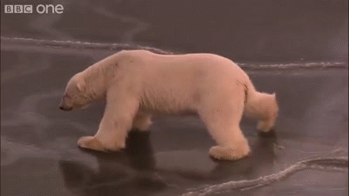
A tentative, trepidatious summary
 | Temp | Disease | Discard | Bycatch | Long
Immature Mortality | + | + | +
Mature Mortality | + | + |  | ?
Immature Catchability | + |  |  |  | -
Mature Catchability | +

Slide 51
Population dynamics models
Are these estimates credible?
  Standard errors can be somewhat large…
  MCMC for trajectories of M and q?
How do the assumptions influence the results?
  Sensitivities to weighting, priors, and smoothness penalties
  Explore information criteria as method for selecting smoothness penalty?
  Need to consider how to calculate effective degrees of freedom from a smoothed vector of estimated M or q
How well can these processes be estimated at all?
  Simulation testing with operating model that can allow catchability and mortality to vary singly and together

Slide 52
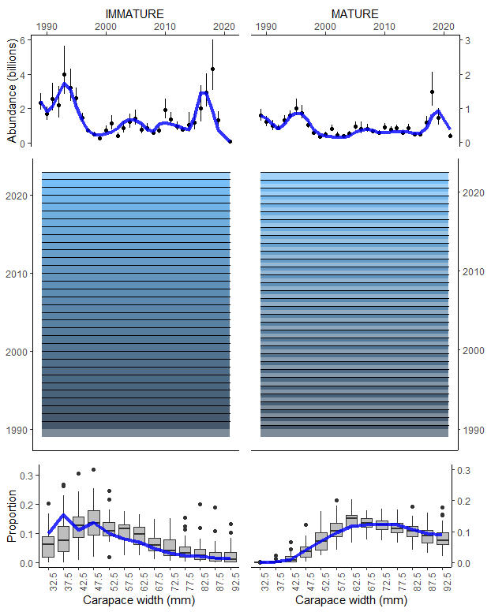
Inference model
Model selection
  Some of the covariates have unintuitive smooths—remove them or something else?
Consideration of the uncertainty in estimated M and q
  Another state-space model?
Auto-correlated time series
  ‘Improves’ in-sample prediction…but usually not out-of-sample
Why GAMs?
  Non-linearities and (originally) 2-d smooths

Slide 53
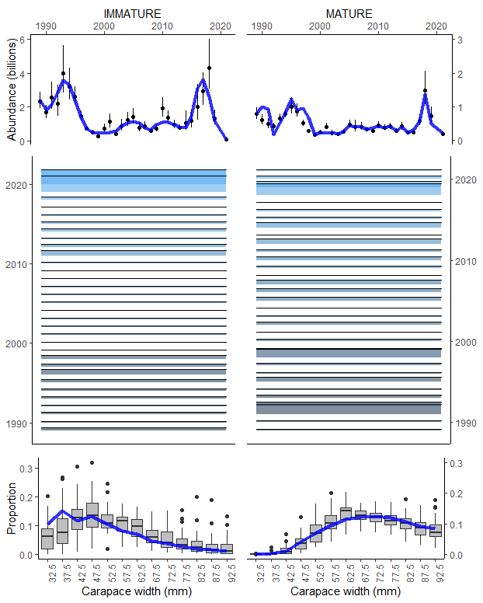
Inference model
Model selection
  Some of the covariates have unintuitive smooths—remove them or something else?
Consideration of the uncertainty in estimated M and q
  Another state-space model?
Auto-correlated time series
  ‘Improves’ in-sample prediction…but usually not out-of-sample
Why GAMs?
  Non-linearities and (originally) 2-d smooths

Slide 54
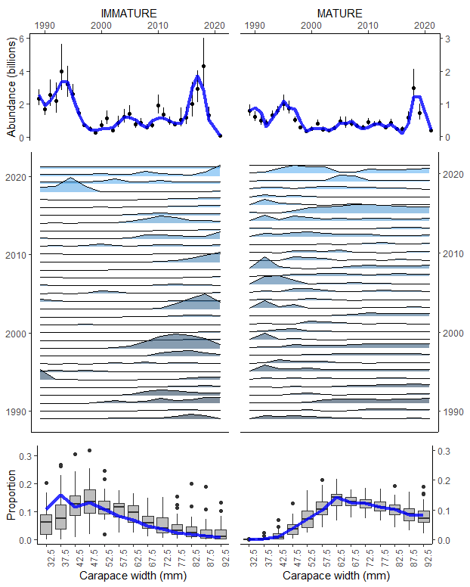
Inference model
Model selection
  Some of the covariates have unintuitive smooths—remove them or something else?
Consideration of the uncertainty in estimated M and q
  Another state-space model?
Auto-correlated time series
  ‘Improves’ in-sample prediction…but usually not out-of-sample
Why GAMs?
  Non-linearities and (originally) 2-d smooths

Slide 55
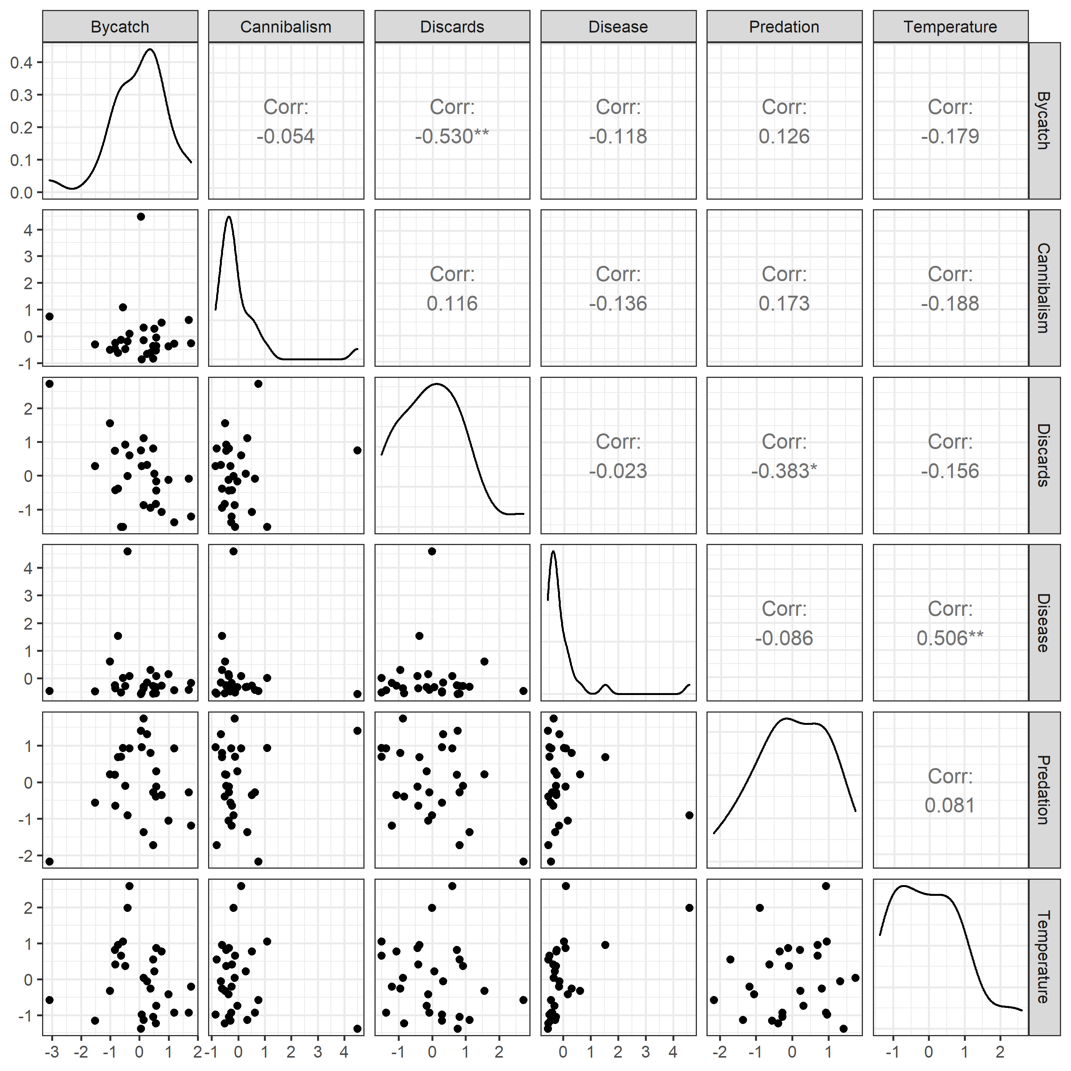
Correlations among variables
Disease and temperature are highly correlated
Higher temperature might cause disease
Disease will not cause higher temperatures
Discards and bycatch are negatively correlated
Could it be that the odd significant smooth between mortality and bycatch is actually reflecting discards?

Slide 56
To do list (in order…but soliciting feedback)
Simulation to see if time-varying q and M can be estimated with these data
Sensitivity analyses for assumptions, priors, and penalties (e.g. smaller sigmas for prior on M to see if discrepancy between immature and mature mortality can be shrunk)
Think about model selection
Methods for selecting smoothness penalties
Methods for incorporating variance into the inference model
Test ‘covariates as fleet’ model
Do all of this again, but estimating size and year specific m and q…

Slide 57
“Cody, why didn’t you just do covariates as fleets to begin with?”
PROS | CONS
Propagates variances | Painful to code splines, interactions, and interacting splines in ADMB
Decreases the possibility of spurious relationships (i.e. you can easily specify that increasing predation can ONLY cause increases in mortality) | Need to know something about scale…but you’re also estimating scale. The 2 step approach is somewhat agnostic about scale (e.g. ‘when X is high, Y is high’).
 | Need to specify discard and bycatch mortalities
 | Some covariates difficult to build into the model (which ones)

Slide 58
