Slide 1
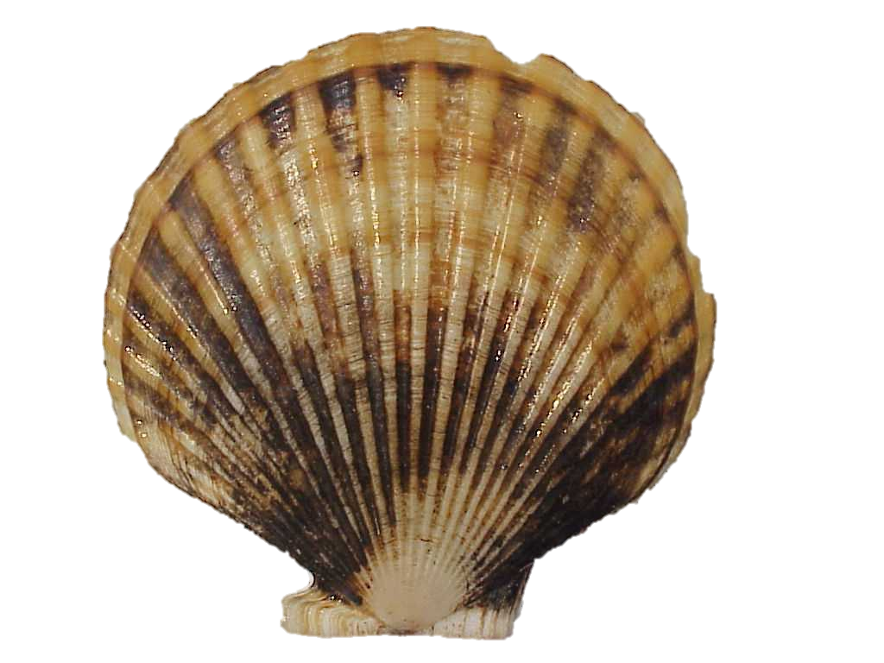

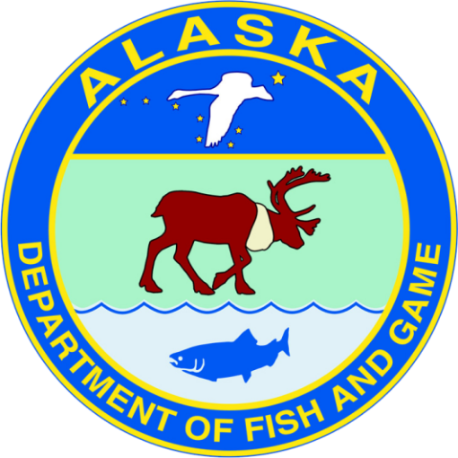
Yakutat Area D Scallop Fishery Update
Andrew Olson, andrew.olson@alaska.gov
Scallop Plan Team
February 19, 2020
Image Source: afsc.noaa.gov
Notes:
So we have some exciting new research we’ll be conducting over the next couple of years. We’ll be looking at size selectivity of sablefish in pots using varying sizes of escape rings

Slide 2

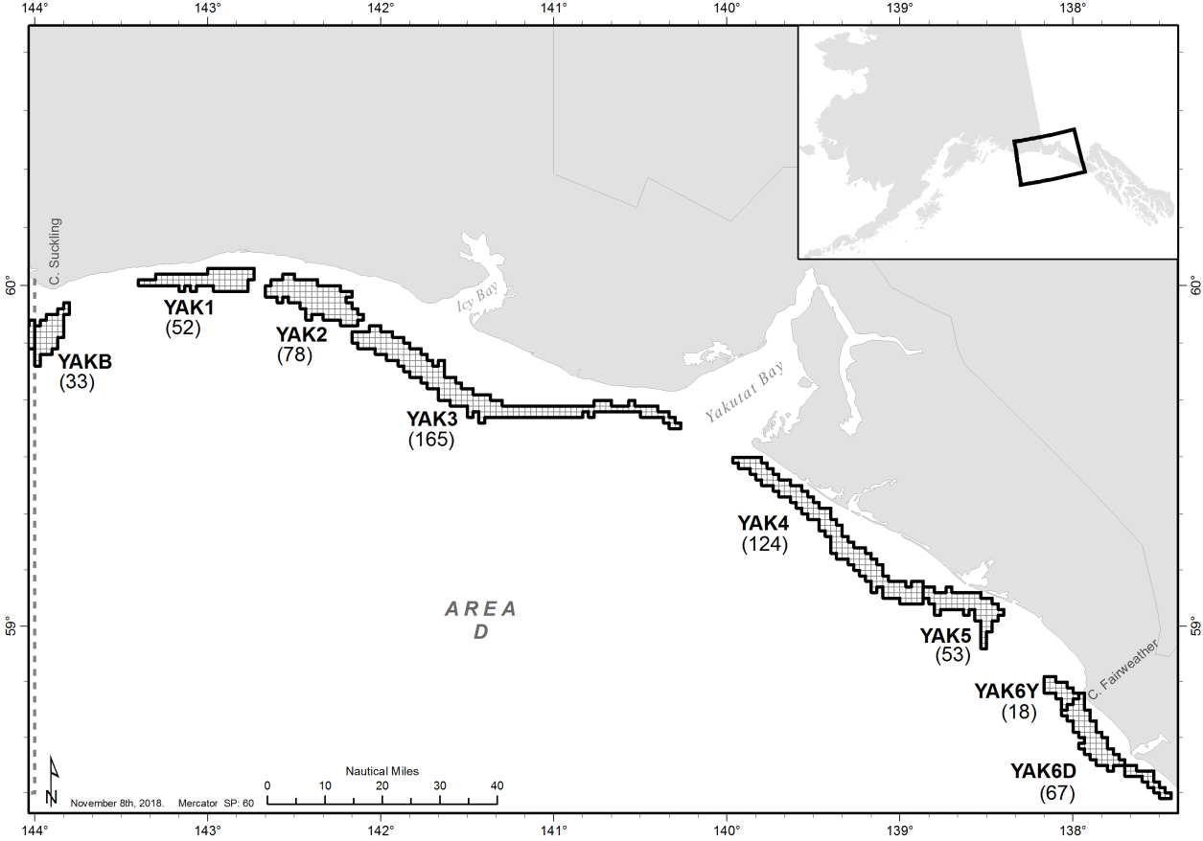

Slide 3
2019/2020 Season
GHL increased from 145K to 155K lbs (meat weight);
Fishery CPUE near historic high in 2018/2019 season
Fishery CPUE decreased 31% from 2018/19–2019/20
2 vessels participated
GHL not fully harvested

Slide 4
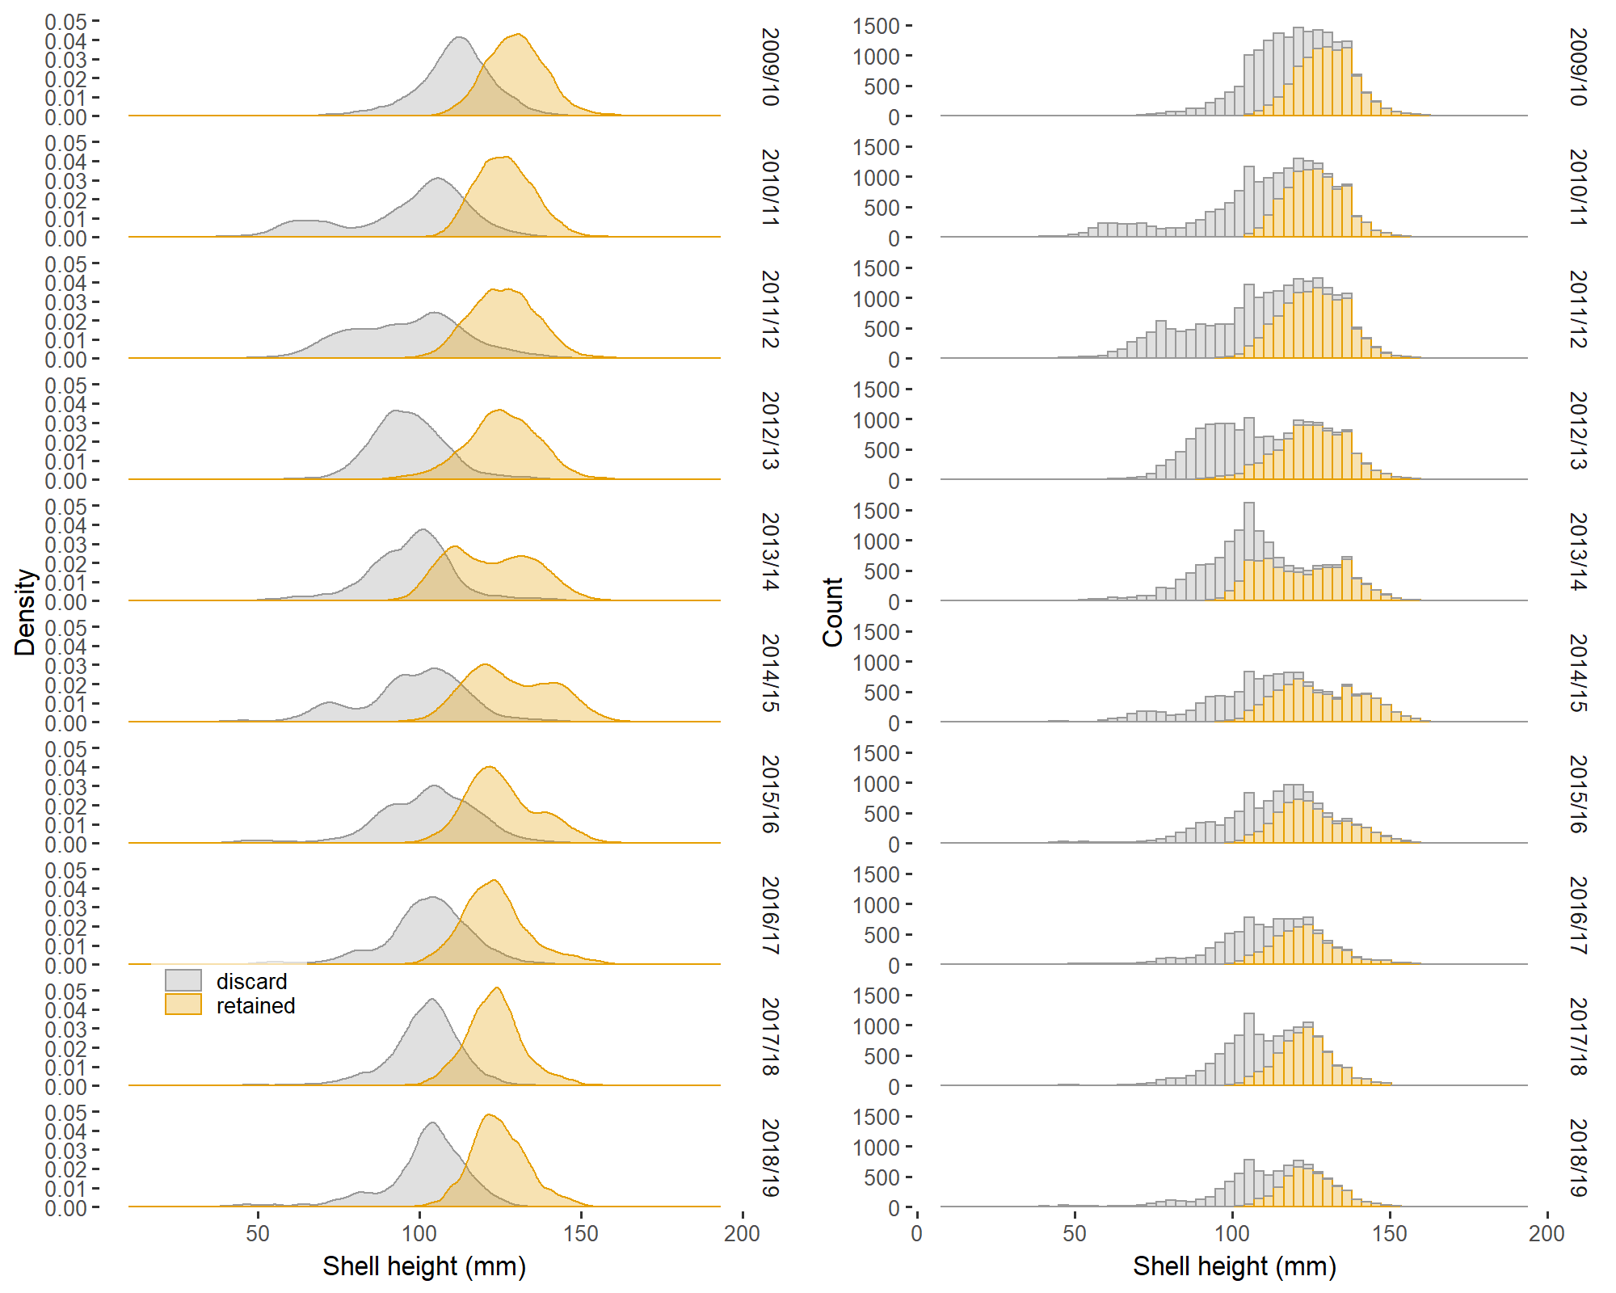
Observer Shell Height
Distribution of shell height has narrowed in recent seasons;

Slide 5
Questions?

