Slide 1
ESA
Section 7 Consultation Process for
Council Actions
Alaska Region

Slide 2
Action Agency Responsibilities
ESA Section 7(a)(2):
“Each agency shall… insure that any action authorized, funded or carried out by such agency (action agency) is not likely to jeopardize the continued existence of any endangered species or threatened species or result in the destruction or adverse modification of habitat of such species which is determined by the secretary to be critical.”
U.S. Department of Commerce | National Oceanic and Atmospheric Administration | NOAA Fisheries | Page 2

Slide 3
2013 MAFAC Recommendations for ESA Section 7 Consultations on MSA Fishery Management Actions
Sustainable Fisheries is the Action Agency
& May Work with the Council to:
Include scientific and commercial data on fishery impacts; incorporate Council data in SF analyses
Identify changes to fishery practices to minimize impacts on listed species or critical habitat
Consider Council input on any reasonable & prudent alternatives
U.S. Department of Commerce | National Oceanic and Atmospheric Administration | NOAA Fisheries | Page 3

Slide 4
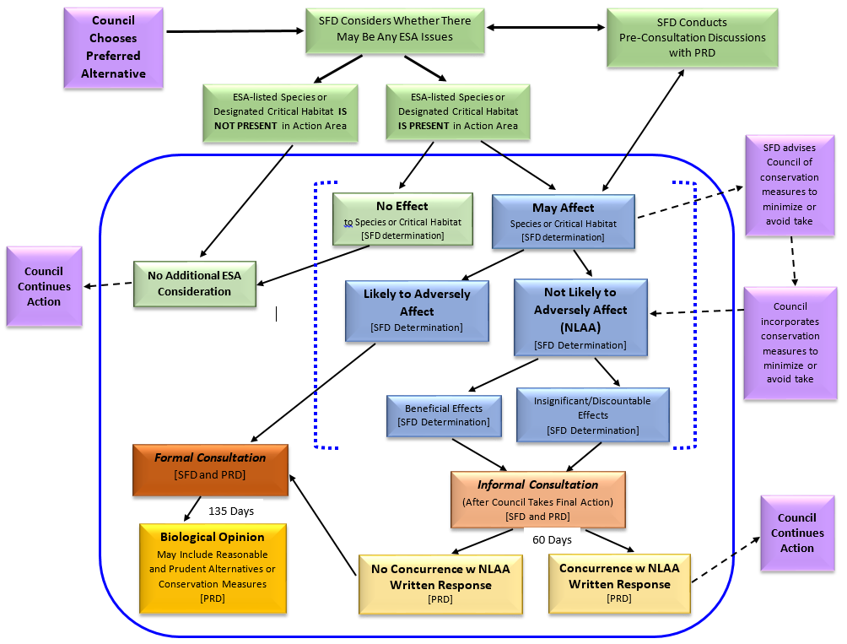
ESA Consultation Process

Slide 5
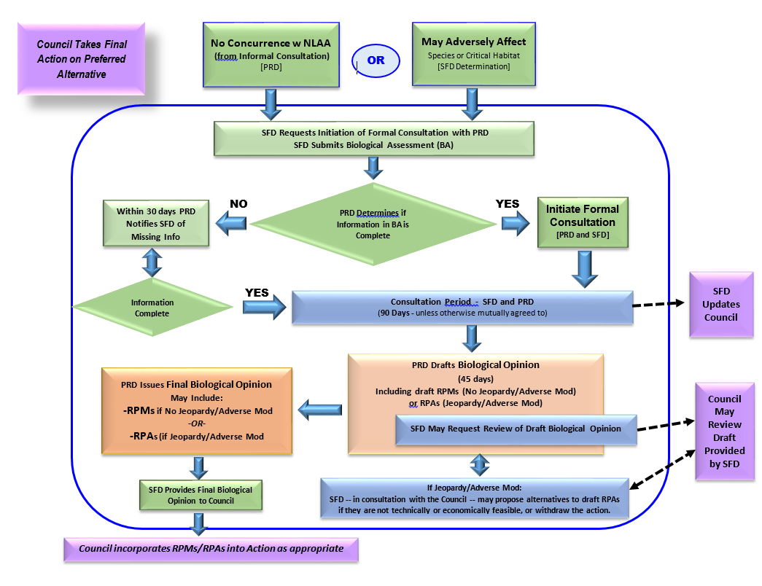
ESA Section 7 - Formal Consultation

Slide 6
If a Biological Opinion with a jeopardy conclusion containing Reasonable and Prudent Alternative(s) is issued, the action agency MAY:
Adopt the reasonable and prudent alternative(s);
Decide not to undertake the project (e.g., deny the permit);
Request an exemption from the Endangered Species Committee (established under section 7(e) of the Act);
Reinitiate consultation based on modification of the action or development of a reasonable and prudent alternative not previously considered; or
Choose to take other action if it believes, upon review of the biological opinion and best available scientific information, that the action satisfies section 7(a)(2).
Regardless of what action the agency chooses, the agency must notify the Service of its final decision.

Slide 7
Reasonable and Prudent Measures and implementing terms and conditions are actions:
Intended to minimize the impact of incidental take.
Those conditions are conveyed to the action agency in the form of an incidental take statement (ITS).
Non-discretionary, and must be undertaken by the agency so that they become binding conditions of any grant or permit issued to an applicant for the exemption in section 7(o)(2) to apply.
If the agency refuses to implement RPMs, then it must be informed that the protective provision of the ITS may not apply, and both entities could be held responsible for any take that occurs as a result of the action.

