Slide 1
Bristol Bay Red King Crab Assessment in Fall 2021
J. Zheng, M.S.M. Siddeek, & K.J. Palof
ADF&G, Juneau

Slide 2
Response to CPT Comments
Response to CPT Comments (from May 2021):
“The CPT was concerned that the ‘information’ content of the data with respect to natural mortality could be related to strong assumptions elsewhere in the model, and recommended further exploration of natural mortality after September and suggested attending the June 2021 CAPAM workshop on natural mortality, which may provide some insights into best practices. A large increase in estimated natural mortality would likely increase fishing mortality reference points, with management implications.”
Response: We will continue to examine M in May 2022. Estimated M values in the length-based crab models tend to have higher values than the other approaches, and confounding among estimated M, survey selectivity/catchability, and recruitment in a length-based model makes it difficult to accurately estimate M in the model.
“The CPT recommended presenting Models 19.3d, 19.3e, and 19.3g in September with updated data.”
Response: We ran these three models as well as another model suggested by the SSC for September 2021.

Slide 3
Response to CPT Comments
Response to CPT Comments (from May 2021):
“The CPT was interested in more exploration of the retrospective patterns, which seem to have increased since the last assessment despite no new data being added. Reported Mohn’s rhos were starting to reach concerning magnitudes in the proposed models?”
Response: The catch and bycatch updates make the retrospective patterns slightly worse than before. Higher than expected BSFRF survey biomass during 2007-2008 and 2013-2016 and NMFS survey biomass in 2014 likely caused these biases. Also, much lower than expected NMFS survey biomass during 2018-2019 and 2021 results in lower biomass estimates in 2020 and 2021. The biases for total abundance are much smaller than mature male biomass. High natural mortality during 2018-19 reduces these upward biases for model 21.2. We will examine the retrospective patterns further in May 2022.
“Model 19.3c probably should have been labeled model 21.0, given the large change in inputs?”
Response: To avoid confusion, we do not change the model label this time. The year in the model label will be changed when the major model changes, such as the model suggested by the SSC in June 2021, which is named as model 21.0 in the draft SAFE report in September 2021.
“When calculating the probability of being overfished via MCMC, it is necessary to calculate B35% for each draw to compare the MMB from that draw. If this is not done, the comparison is not consistent.”
Response: We have followed this recommendation.

Slide 4
Response to CPT Comments
Response to CPT Comments (from September 2020):
“Include a table in the assessment document providing estimates of M for all scenarios.”
Response: Included them in Table 7.
“Include a table in the assessment document that provide the differences in likelihood values between the base model and each alternative model scenario considered a candidate for status determination.”
Response: Added (Table 5c).

Slide 5
Response to CPT Comments
Response to CPT Comments (from September 2020):
“Evaluate different approaches to constraining the terminal year estimate of recruitment for the purpose of developing projections.”
Response: We plan to compare three approaches to constraining the terminal year estimate of recruitment for the purpose of developing projections:
Average of recent low recruitment period excluding the terminal year (8 years),
Average of the period used to estimate B_{35%},
Increase in the weight on annual recruitment variation & sex ratio.
Since the current GMACS version cannot carry work on (1) and (2), we examine only (3) in this report. Overall, changes in penalties on recruitment deviation and sex ratio have very minor impacts on terminal recruitment estimates.

Slide 6
Response to SSC Comments
Response to SSC Comments (from October 2020):
“Next year’s assessment should estimate the probability that the stock is currently in the overfished condition.”
Response: Included it in Figure 31.
“Information should be provided on the prevalence of crab bycatch excluders being used in the pot cod fishery, and whether the excluders influence the length composition of bycatch.”
Response: Will try to collect these data and analyze them in the future. Right now, very limited data are available.
“The SSC also endorses the Alaska Bering Sea Crabber’s request to include raw numbers used for PSC limits in a table in the BBRKC SAFE consistent with EBS snow crab (see Table 11 in the EBS snow crab SAFE), if it is practical to do so.”
Response: Included it in this report for years 2010-2021 in Table 8.
“The SSC looks forward to future analyses of the use of VAST estimates for this stock assessment including diagnostics and better-fitting error distributions.”
Response: Included VAST results and diagnostics in Appendix E and used VAST-estimated survey biomass in model 19.3g in September 2021.

Slide 7
Response to SSC Comments
Response to SSC Comments (from June 2021):
“The SSC supports exploring more modern methods for estimating natural mortality, but notes that this method still relies strongly on the maximum age for BBRKC. The SSC recommends continued research to validate the ages for this stock.”
Response: We agree with this suggestion. The maximum age was determined by old tagging data, and due to funding and personnel constraint, age validation for BBRKC is more like a long-term goal than a short-term project.
“The likelihood profile suggests that the values of M for male and female might be similar and that the current difference may be because of the constraint of base M to a low value. When M is misspecified, it can be the cause of a strong positive retrospective pattern, which BBRKC has. The SSC would have liked to have seen compositional fits and a retrospective analysis for model 19.6 or some model with a higher M value, particularly to see if it fits the plus group better. Despite the increase in F35%, there was not a commensurate increase in OFL. An exploration of the underlying reasons for this outcome is needed.”
Response: Based on our past modelling, when M values for males and females are estimated separately, estimated M values tended to be always higher for females than for males. The likelihood profile was created through fixing M values for males and estimating M values for females, and when the fixed M values for males were very high, estimated M values for females tended to be similar to M values for males. We will conduct a retrospective analysis for model 19.6 and present compositional fit results in May 2022. The increase in F35% but not a commensurate increase in OFL is due to reduction of mature male biomass caused by the high M.

Slide 8
Response to SSC Comments
Response to SSC Comments (from June 2021):
“In addition to the CPT recommended models (19.3d, 19.3e, and 19.3g), the SSC recommends a simplified version of model 19.3d that estimates one natural mortality parameter across sex and time, and one shared catchability and selectivity curve for the NMFS trawl survey to help make several selectivity parameters better defined.”
Response: We named this as model 21.0 and included it in the September 2021 assessment.
“The SSC requests that the current crab management zones be included in the maps of VAST model-derived spatial distributions of BBRKC.”
Response: We have asked Dr. Jon Richar to add the current crab management zones to the VAST spatial plots.
“The SSC also looks forward to the summary report from the March 2021 CIE Review for this stock.”
Response: The summary report of the 2021 CIE review is included in Appendix F.

Slide 9
CIE Review Summary
Three independent experts: Drs. Yong Chen, Nick Caputi, and Billy Ernst
Many good recommendations:
1. Addressing large retrospective patterns: identifying temporal trends and/or time blocks of parameters, such as natural mortality and survey catchability.
Response: Model 21.2 is a small step. Further future work.
2. Survey performance/efficacy and selectivity curve evaluations in term of changes in distributions over time, and the stock area evaluation.
Response: Potential ADF&G tagging study; examination of RKC north of Bristol Bay.
3. Evaluating commercial catch, effort, and CPUE for crab distributions, fishery performance relative to the trawl survey results and on impacts on survey timing and survey availability.
Response: Always looking at commercial CPUE and catch spatial distributions. Starting CPUE standardization for potential use in the model.

Slide 10
CIE Review Summary
4. Extending estimates of sizes-at-50% maturity for females and examining the impacts of changes on mature female biomass estimates.
Response: Will do.
5. A model run just using data from 1985 to avoid high natural mortality during the early 1980s.
Response: We did it before and will do it again in 2022.
6. Conducting new tagging study to update the outdated tagging/return data used in the assessments.
Response: We agree with this recommendation. Hopefully, tagging study will be conducted for BBRKC in the future.

Slide 11
Data types and ranges used for the stock assessment

Slide 12
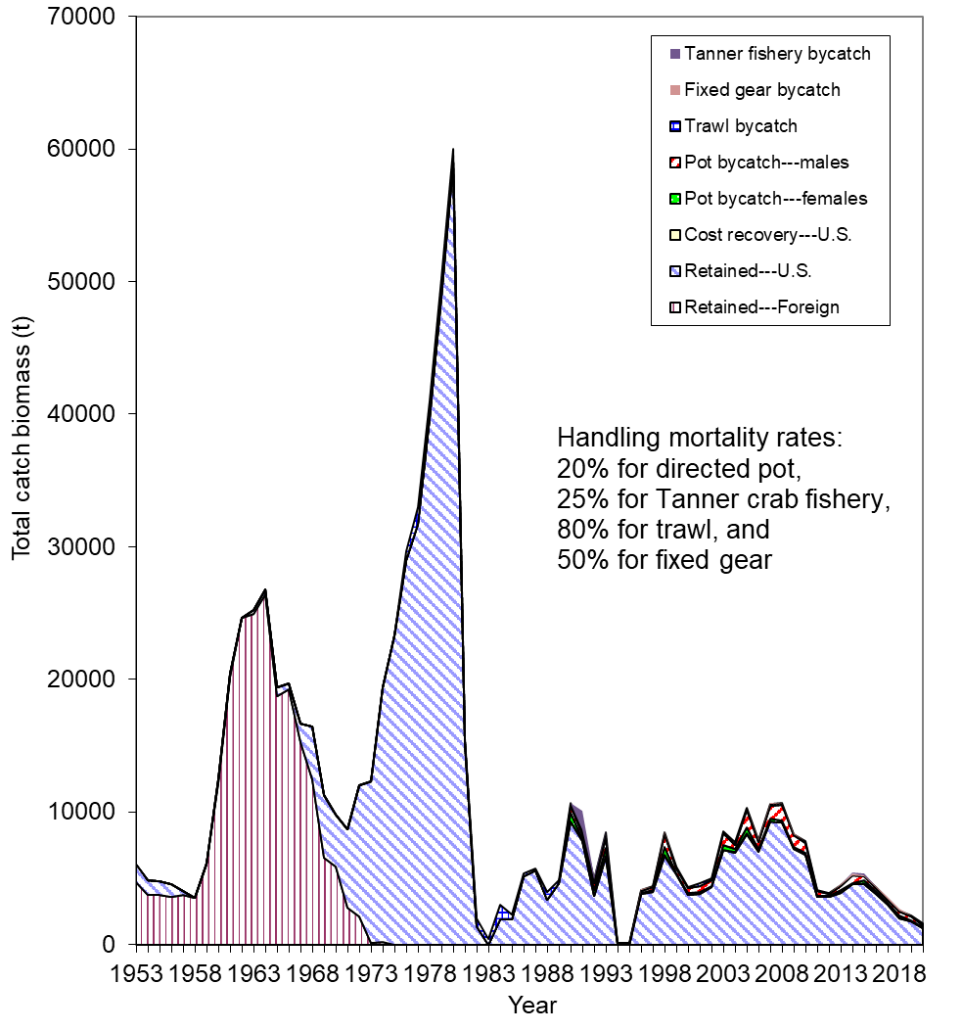
Retained catch biomass and bycatch mortality biomass (t) for Bristol Bay red king crab from 1953 to 2020

Slide 13
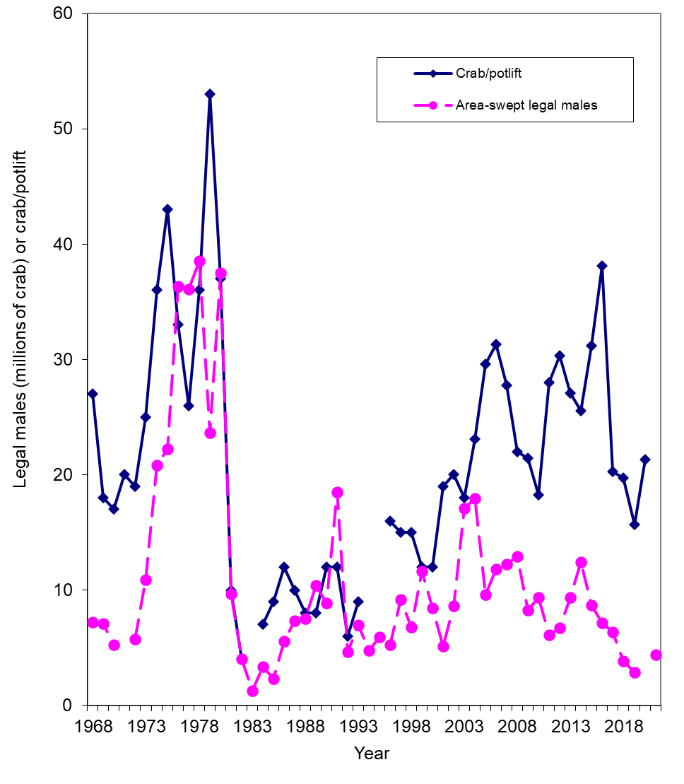
Comparison of survey legal male abundances and catches per unit effort for Bristol Bay red king crab from 1968 to 2021.

Slide 14
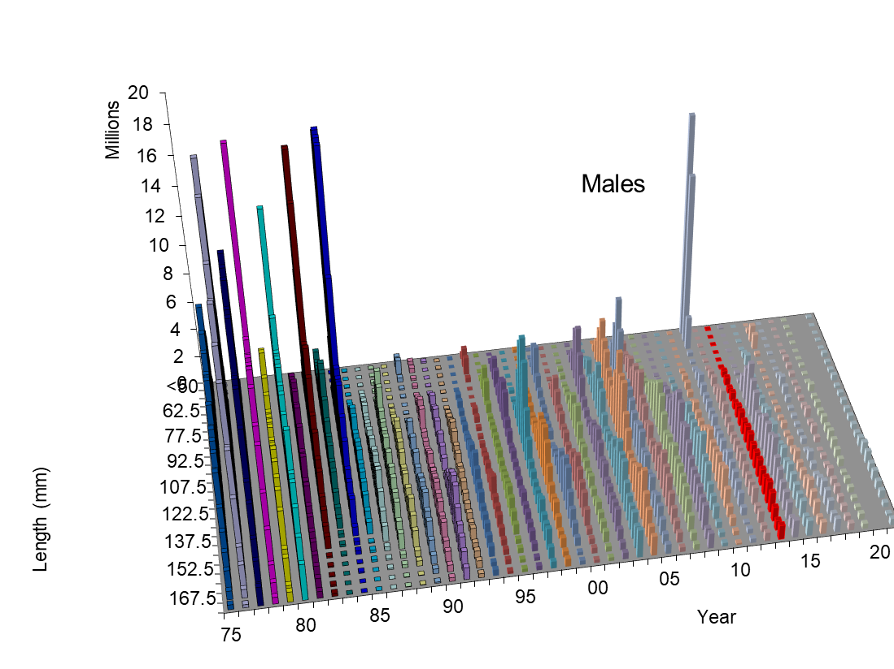
NMFS survey data

Slide 15
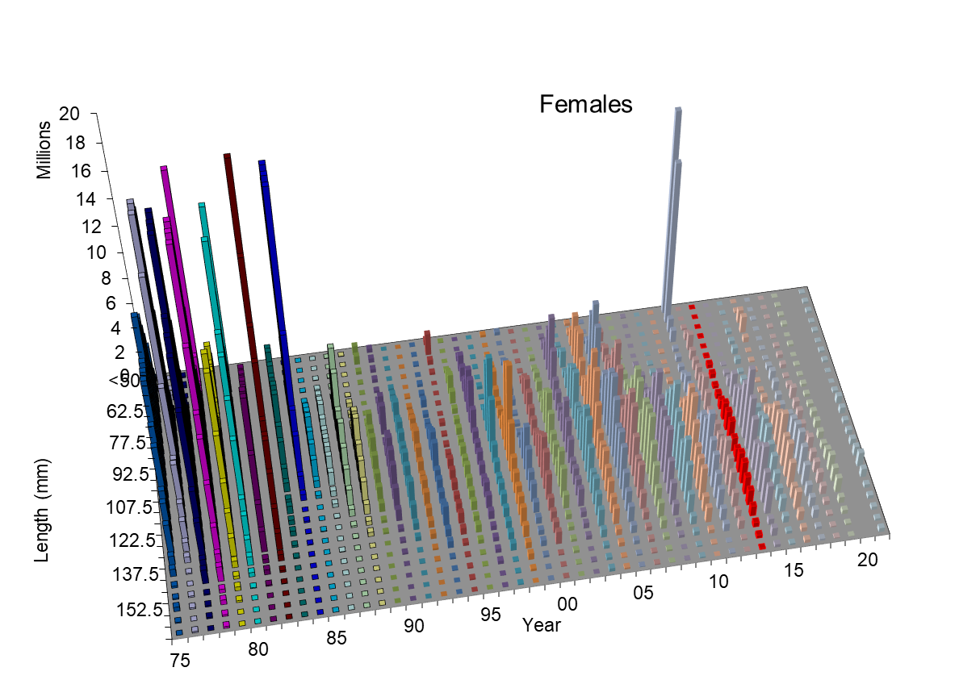
NMFS survey data

Slide 16
Model Scenarios
Six models:
  19.3d: the same as the base model 19.3 in September 2020 except for
    Updating/standardizing the observer data in the directed pot and Tanner crab fisheries,
    Changing the maximum cap of effective sample size from 100 to 150 for the retained catch and total males in the directed pot fishery.
    Fishing effort data used to estimate red king crab bycatch in years before the observer data in the Tanner crab fishery are changed from east of 163⁰ W to east of 166⁰ W,
    Five more years of length composition data with relatively small observed sample sizes from the Tanner crab fishery are also included.
  19.3e: the same as model 19.3d except for males and females to have different NMFS trawl survey catchabilities.
  19.3g: the same as model 19.3d except that VAST-estimated NMFS survey trawl biomass and CV are used.

Slide 17
Model Scenarios
Six models:
  21.0 (suggested by the SSC): the same as model 19.3d except for estimating one natural mortality parameter across sex and time, and one shared catchability and selectivity curve for the NMFS trawl survey to help make several selectivity parameters better defined. For consistency, one selectivity curve is estimated for the BSFRF trawl survey as well.
  21.1: the same as model 19.3d except for one shared catchability and selectivity curve for the NMFS trawl survey and one selectivity curve for the BSFRF trawl survey.
  21.2: the same as model 21.1 except for estimating an additional time block (2018-2019) of natural mortality parameter. There is only one additional estimated parameter since the female natural mortality is scaled relative to the male natural mortality.

Slide 18
Comparison of Models
Model | Male M | Female M | Updated obs. estimates | Max cap of ret. & total male ESS | VAST | Diff. sele. By sex | Diff. Q by sex
19.3d | 80-84: M1, others: 0.18 | c*male M | Y | 150 | N | Y | N
19.3e | 80-84: M1, others: 0.18 | c*male M | Y | 150 | N | Y | Y
19.3g | 80-84: M1, others: 0.18 | c*male M | Y | 150 | Y | Y | N
21.0 | Constant M | = male M | Y | 150 | N | N | N
21.1 | 80-84: M1, others: 0.18 | c*male M | Y | 150 | N | N | N
21.2 | 80-84: M1, 2018-19:M2, others: 0.18 | c*male M | Y | 150 | N | N | N

Slide 19
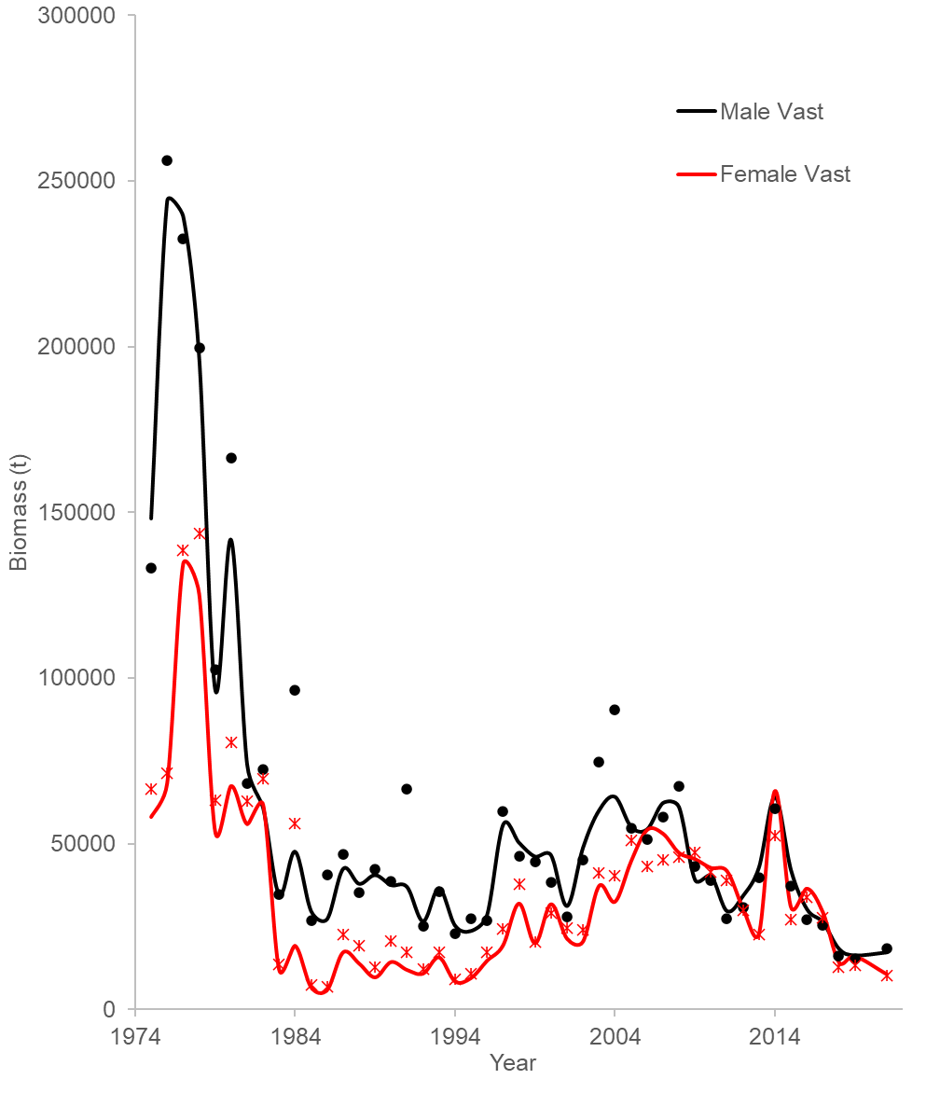
Comparison of area-swept and VAST-estimated survey biomasses for Bristol Bay red king crab from 1975 to 2021

Slide 20
Comparisons of area-swept estimates of male and female NMFS survey biomass and model prediction for model estimates in 2021 under five models. The error bars are plus and minus 2 standard deviations of model 19.3d.

Slide 21
Comparisons of area-swept estimates of male and female NMFS survey biomass and model prediction for model estimates in 2021 under two models. The error bars are plus and minus 2 standard deviations of model 19.3g.
VAST estimated biomass.
Note that model 19.3d fits area-swept biomasses, not these VAST biomasses.

Slide 22
Comparisons of total survey biomass estimates by the BSFRF survey and six models (upper plot: males; lower plot: females). The error bars are plus and minus 2 standard deviations of model 19.3d.

Slide 23
Comparisons of mature male biomass on Feb. 15 under eight models.
Estimated trawl survey catchabilities:
Model Q
19.3d 0.967
19.3e 0.925/0.944
19.3g 0.957
21.0 0.998
21.1 0.964
21.2 0.963

Slide 24
Standardized residuals of total NMFS survey biomass
19.3d
21.1

Slide 25
Comparisons of observed and predicted catch mortality biomass under six models. Mortality biomass is equal to caught biomass times a handling mortality rate.

Slide 26
Comparisons of observed and predicted bycatch mortality biomass under six models.
Mortality biomass is equal to caught biomass times a handling mortality rate.

Slide 27
Comparison of estimated M and directed pot fishing mortality over time

Slide 28
Estimated selectivities (including catchability) of NMFS trawl survey during 1982-2021 with six models

Slide 29
Estimated selectivities (including Q) of NMFS trawl survey
19.3d
21.1

Slide 30
Estimated selectivities of BSFRF trawl survey during 2007-08 and 2013-2016 with six models

Slide 31
Fisheries selectivities and retained proportions
19.3d
21.1

Slide 32
Molting Probabilities
19.3d
21.1

Slide 33
Comparison of area-swept and model estimated NMFS survey length frequencies of Bristol Bay male red king crab by year under four models.

Slide 34
Comparison of area-swept and model estimated NMFS survey length frequencies of Bristol Bay female red king crab by year under three models.

Slide 35
Comparison of area-swept and model estimated BSFRF survey length frequencies of Bristol Bay red king crab by year under four models.

Slide 36
Comparison of observer and model estimated retained length frequencies of Bristol Bay male red king crab by year in the directed pot fishery under four models.

Slide 37
Comparison of observer and model estimated total length frequencies of Bristol Bay male red king crab by year in the directed pot fishery under four models.

Slide 38
Comparison of observer and model estimated discarded length frequencies of Bristol Bay female red king crab by year in the directed pot fishery under three models.

Slide 39
Comparison of observer and model estimated discarded length frequencies of Bristol Bay male red king crab by year in the groundfish trawl fisheries under four models.

Slide 40
Comparison of observer and model estimated discarded length frequencies of Bristol Bay female red king crab by year in the groundfish trawl fisheries under four models.

Slide 41
Comparison of observer and model estimated discarded length frequencies of Bristol Bay male red king crab by year in the groundfish fixed gear fisheries under four models.

Slide 42
Comparison of observer and model estimated discarded length frequencies of Bristol Bay female red king crab by year in the groundfish fixed gear fisheries under four models.

Slide 43
Comparison of observer and model estimated discarded length frequencies of Bristol Bay red king crab by year in the Tanner crab pot fishery under four models.

Slide 44
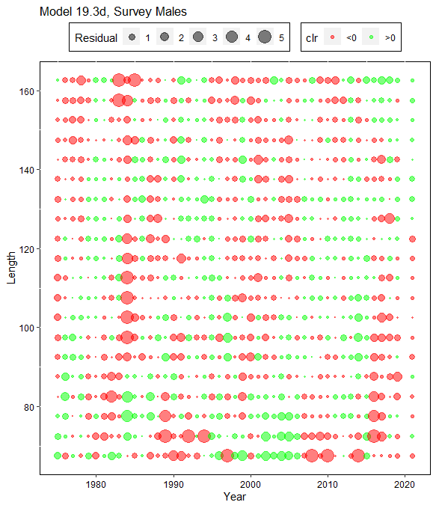

Comparison of residuals of proportions of NMFS survey male red king crab by year and carapace length (mm)

Slide 45
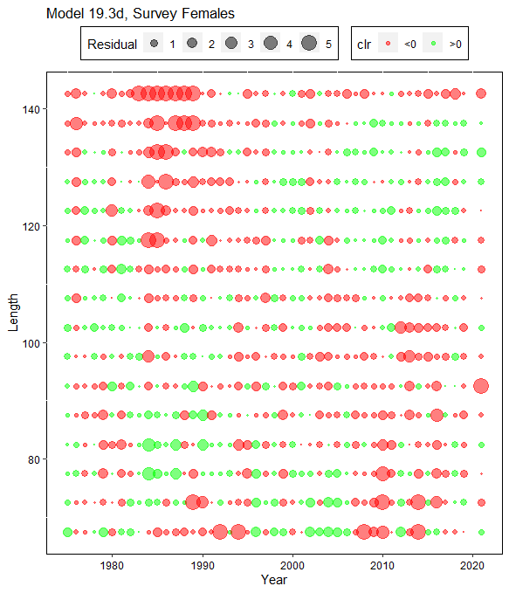
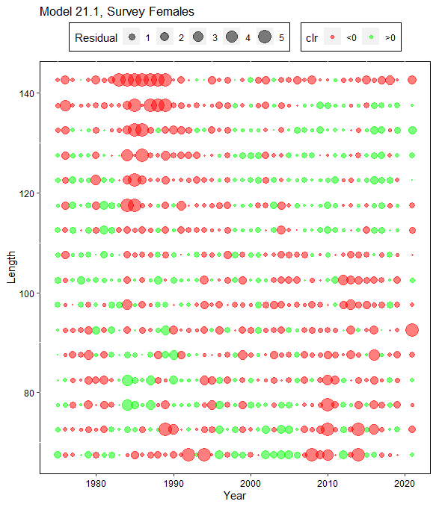
Comparison of residuals of proportions of NMFS survey female red king crab by year and carapace length (mm)

Slide 46
Models
 |  | 19.3d | 19.3e | 19.3g | 20.0 | 21.1 | 21.2
Pot-ret-catch |  | -59.59 | -59.21 | -52.90 | -60.47 | -59.74 | -59.73
Pot-totM-catch |  | 27.90 | 28.68 | 32.44 | 20.47 | 27.61 | 27.60
Pot-F-discC |  | -53.95 | -53.96 | -53.94 | -53.90 | -53.95 | -53.95
Trawl-discC |  | -62.37 | -62.37 | -62.35 | -61.78 | -62.36 | -62.36
Tanner-M-discC |  | -43.54 | -43.54 | -43.54 | -43.53 | -43.54 | -43.54
Tanner-F-discC |  | -43.48 | -43.48 | -43.47 | -21.47 | -43.48 | -43.47
Fixed-discC |  | -34.65 | -34.65 | -34.65 | -34.65 | -34.65 | -34.65
Traw-suv-bio |  | -34.66 | -30.57 | 117.60 | 82.38 | -34.10 | -38.81
BSFRF-sur-bio |  | -3.43 | -3.84 | -5.79 | -3.85 | -3.40 | -4.08
Pot-ret-comp |  | -3871.79 | -3872.05 | -3873.16 | -3876.30 | -3872.23 | -3872.84
Pot-totM-comp |  | -2301.77 | -2301.08 | -2297.08 | -2300.31 | -2302.59 | -2302.64
Pot-discF-comp |  | -1395.01 | -1394.97 | -1393.02 | -1387.87 | -1394.84 | -1395.02
Trawl-disc-comp |  | -5712.62 | -5712.65 | -5716.18 | -5598.54 | -5714.29 | -5716.37
TC-disc-comp |  | -1275.92 | -1275.68 | -1273.77 | -1277.98 | -1275.74 | -1275.91
Fixed-disc-comp |  | -3291.18 | -3291.12 | -3285.99 | -3274.23 | -3290.39 | -3289.60
Trawl-sur-comp |  | -6855.26 | -6853.95 | -6848.57 | -6587.49 | -6847.63 | -6844.54
BSFRF-sur-comp |  | -850.21 | -849.64 | -849.69 | -790.02 | -844.38 | -843.74
Recruit-dev |  | 68.69 | 68.62 | 69.30 | 56.81 | 69.20 | 69.32
Recruit-sex-R |  | 75.61 | 75.66 | 75.65 | 76.01 | 75.35 | 75.36
Log_fdev=0 |  | 0.00 | 0.00 | 0.00 | 0.18 | 0.00 | 0.00
M-deviation |  | 44.09 | 44.06 | 44.44 | 0.00 | 43.88 | 45.68
Sex-specific-R |  | 0.13 | 0.14 | 0.20 | 0.13 | 0.01 | 0.01
Ini-size-struct. |  | 31.86 | 31.62 | 31.08 | 28.73 | 30.60 | 30.67
PriorDensity |  | 297.95 | 293.59 | 295.23 | 233.24 | 267.59 | 265.61
Tot-likelihood |  | -25343.2 | -25344.5 | -25168.1 | -24874.4 | -25363.1 | -25367.0
Tot-likeli-no-PD |  | -25641.2 | -25638.1 | -25463.3 | -25107.6 | -25630.7 | -25632.6
Tot-parameter |  | 372 | 373 | 372 | 365 | 366 | 367
MMB_{35%} |  | 24707.6 | 25067.8 | 25449.3 | 16606.1 | 24236.5 | 24450.2
MMB-terminal |  | 14874.0 | 15466.8 | 16791.5 | 9345.92 | 14946.7 | 12631.0
F_{35%} |  | 0.292 | 0.293 | 0.294 | 0.730 | 0.293 | 0.292
F_{ofl} |  | 0.163 | 0.169 | 0.183 | 0.375 | 0.168 | 0.135
OFL |  | 2151.73 | 2311.14 | 2768.39 | 2655.35 | 2225.06 | 1518.38
ABC |  | 1613.80 | 1733.36 | 2076.29 | 1991.51 | 1668.80 | 1138.79
Q-male |  | 0.967 | 0.925 | 0.957 | 0.998 | 0.964 | 0.963
Q-female | 0.967 |  | 0.944 | 0.957 | 0.998 | 0.964 | 0.963
Highlighted cells in yellow color show prior density values and total negative likelihood values without prior density.
Highlighted cells in red color show values not comparable to the other models.

Slide 47
Differences between models
Highlighted cells in red color show values not comparable to the other models.

Slide 48
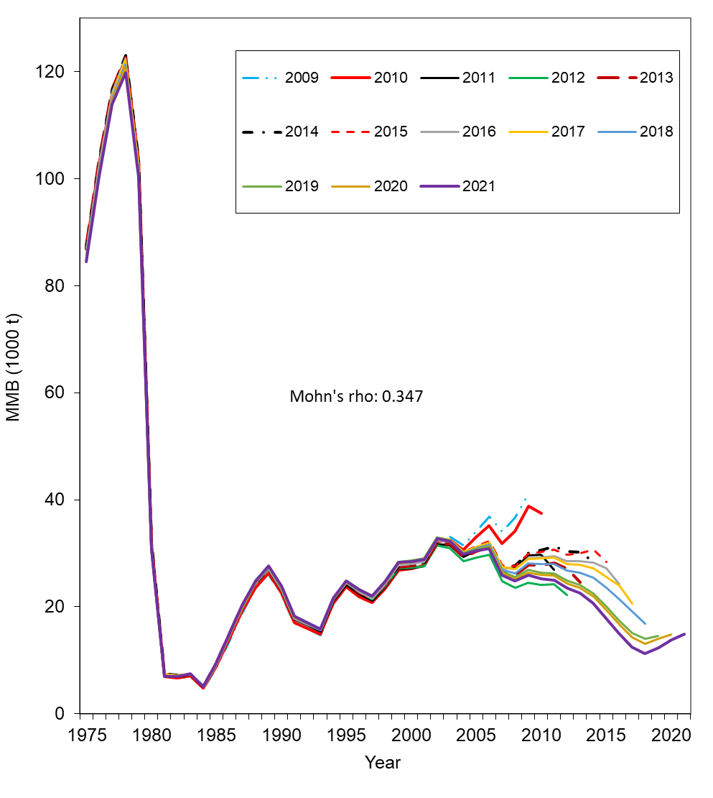
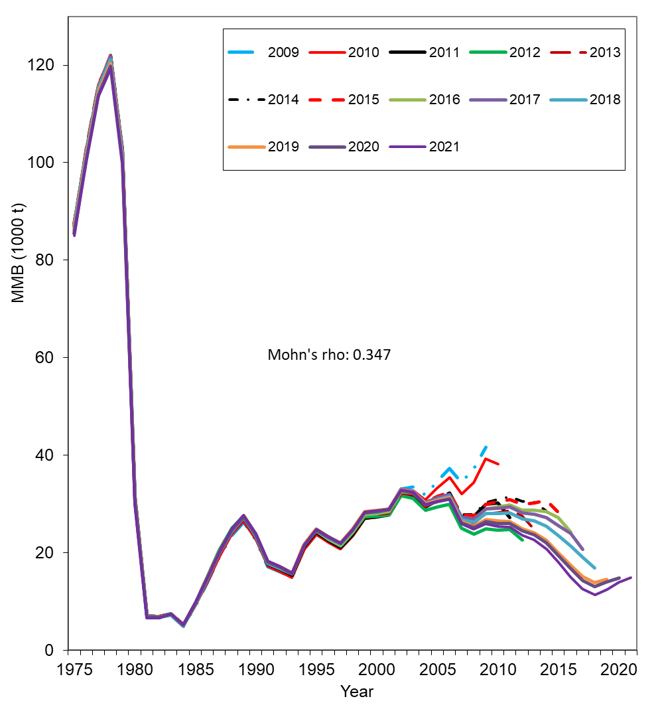
Comparison of hindcast estimates of MMB for models 19.3d and 21.1 from 1975 to 2021 made with terminal years 2009-2021
Model 19.3d
Model 21.1

Slide 49
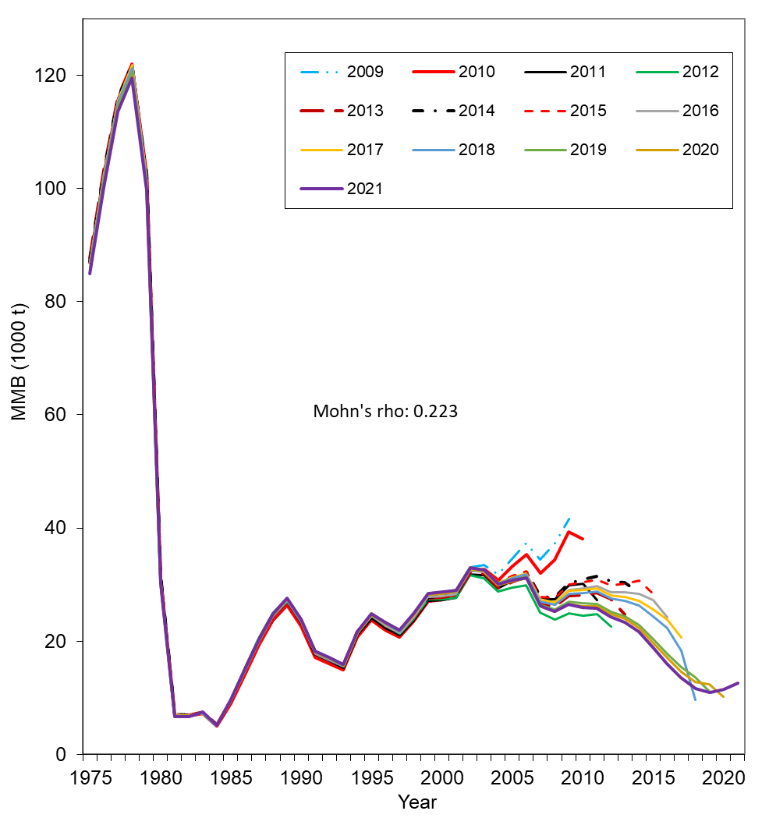
Comparison of hindcast estimates of MMB for models 21.1 and 21.2 from 1975 to 2021 made with terminal years 2009-2021
Model 21.1
Model 21.2

Slide 50
Estimated recruitment time series during 1976-2021 with models 19.3d, 21.1, and 21.0.

Slide 51
Model 19.3d
Model 21.1

Slide 52
Histogram of estimated mature male biomass on Feb. 15, 2022, under models 19.3d and 21.1 with the MCMC approach.
Model 19.3d
Model 21.1

Slide 53
Cumulative probabilities of estimated ratios of MMB in 2021 to corresponding estimated B_{35%} values under models 19.3d and 21.1 with the MCMC approach. About 0.6% probability is below the estimated minimum thresholds for model 21.1.
Model 19.3d
Model 21.1

Slide 54
Cumulative probabilities of estimated ratios of MMB in 2021 to corresponding estimated B_{35%} values under models 19.3g and 21.2 with the MCMC approach. About 38.1% probability is below the estimated minimum thresholds for model 21.2.
Model 19.3g
Model 21.2

Slide 55
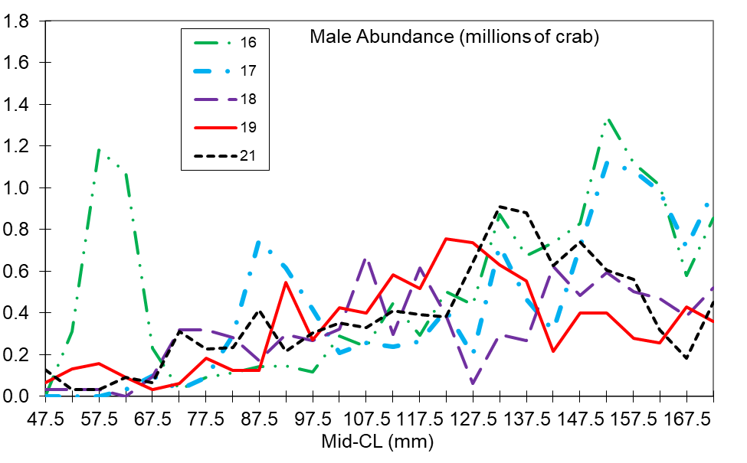

Slide 56
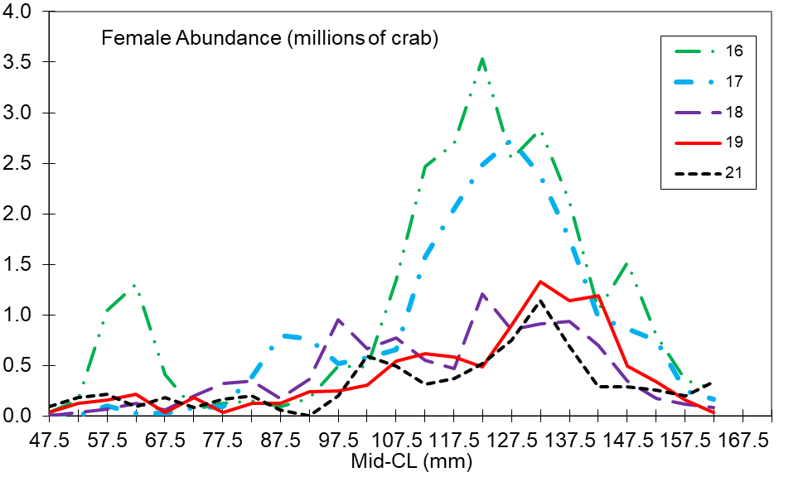

Slide 57
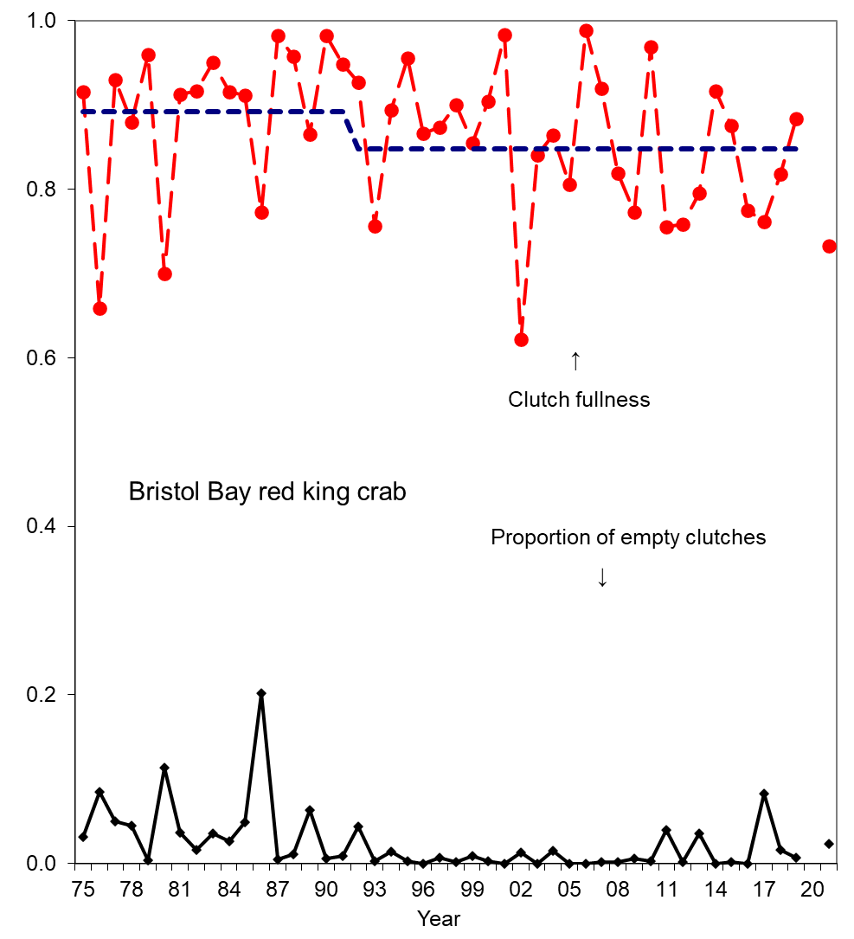
Average clutch fullness and proportion of empty clutches of newshell (shell conditions 1 and 2) mature female crab >89 mm CL from 1975 to 2021 from survey data. Oldshell females were excluded.

Slide 58
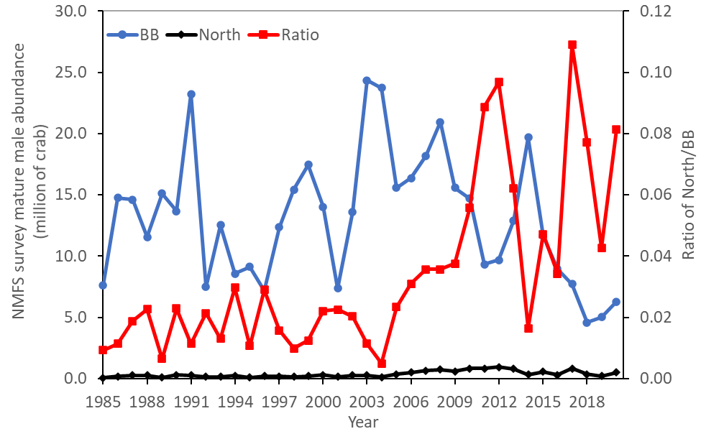
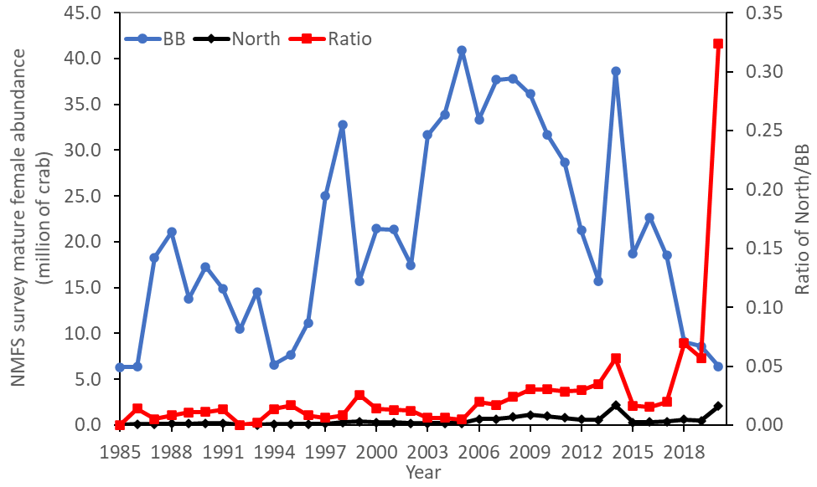
Comparisons of NMFS survey area-swept estimates of mature male and female abundances in Bristol Bay area (BB) and north of Bristol Bay area (North) during 1985-2021.

Slide 59
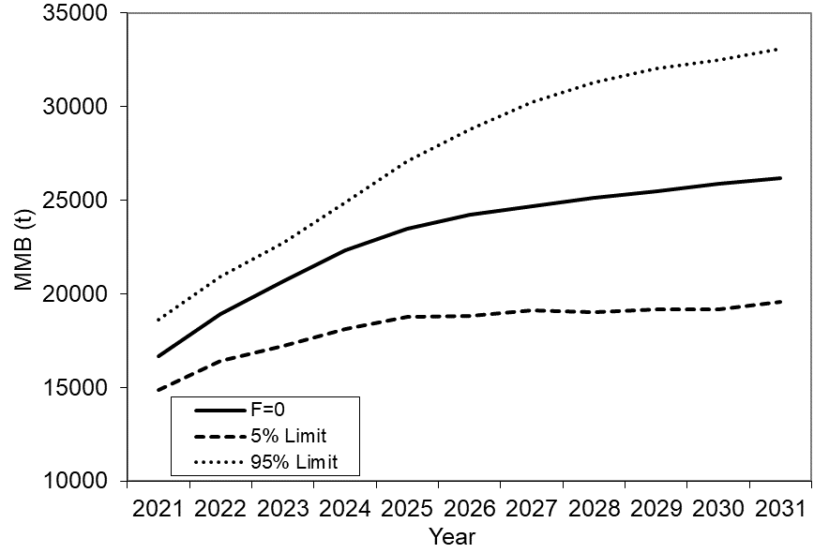
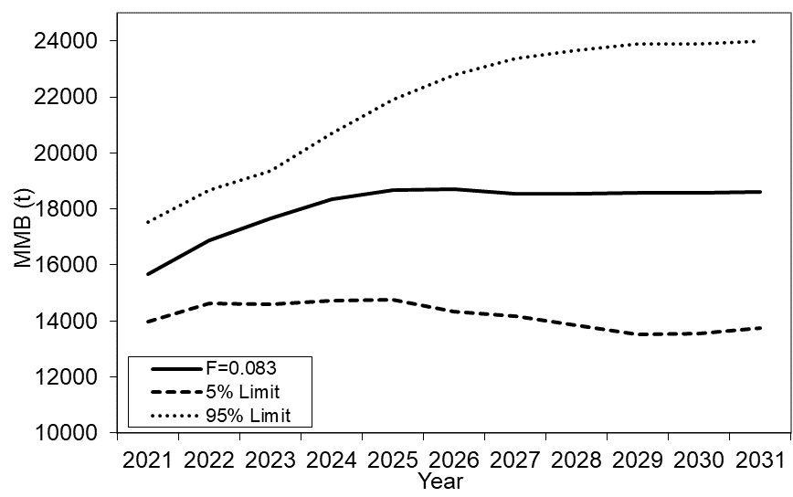
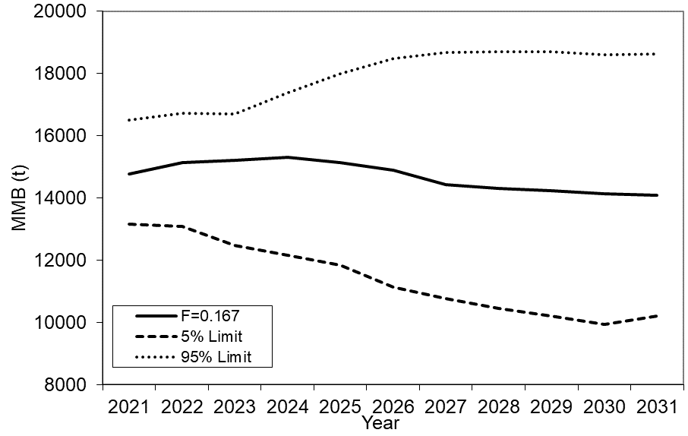
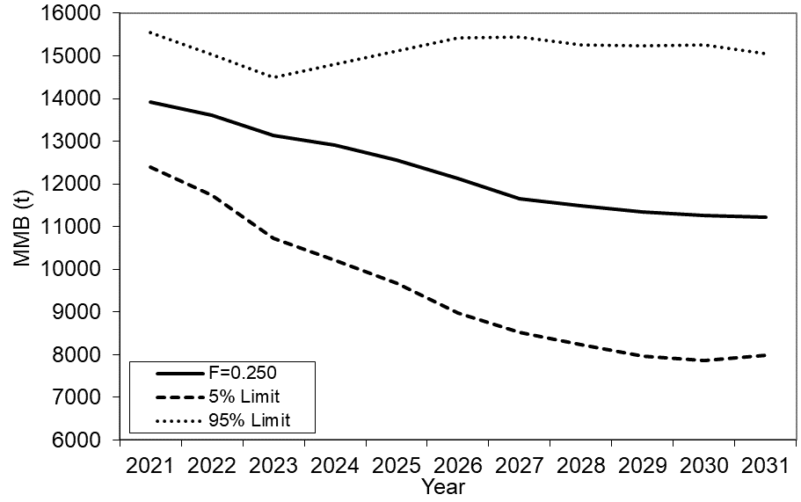
Projected median mature male biomass with four F values. Input parameter estimates are based on model 19.3d. Random selection from estimated recruitments during 2013-2020

Slide 60
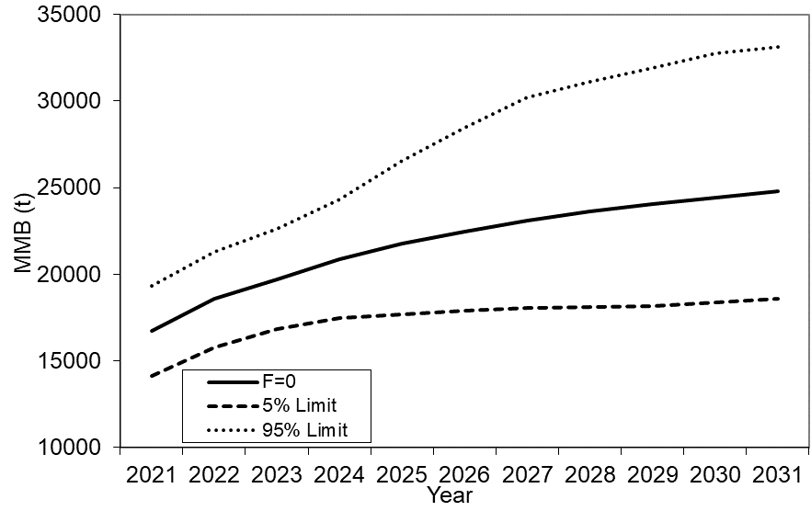
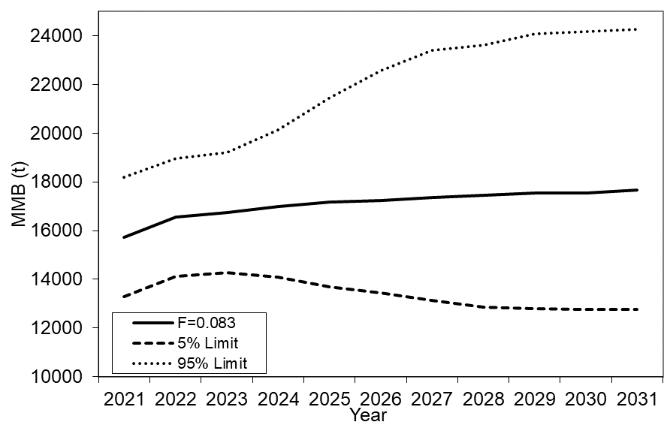
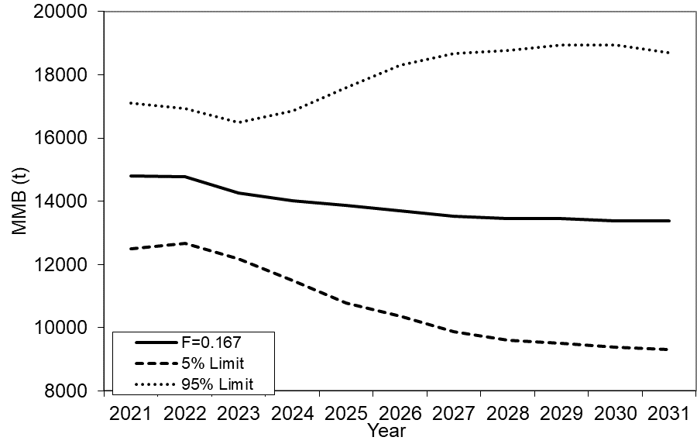
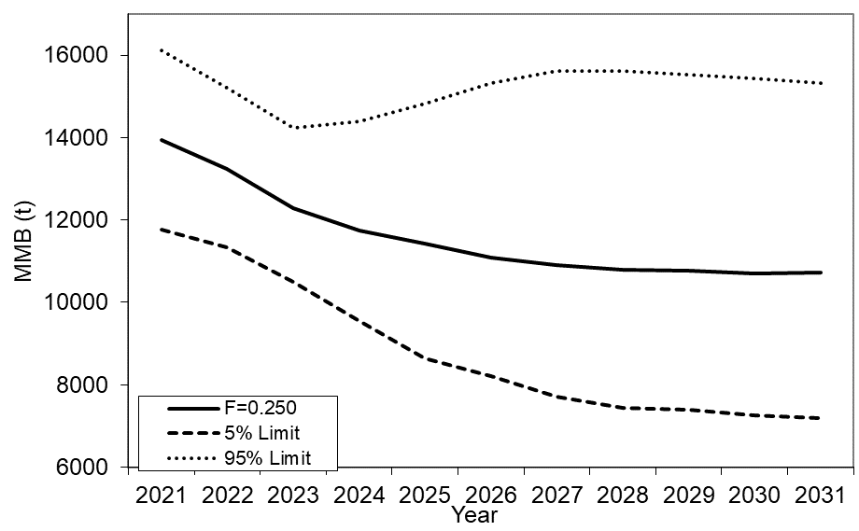
Projected median mature male biomass with four F values. Input parameter estimates are based on model 21.1. Random selection from estimated recruitments during 2013-2020

Slide 61
Summary
Model 21.2 has the highest total likelihood value due to the additional high natural morality block during 2018-2019. Model 21.0 does not fit the NMFS survey data well with a very low likelihood value.
Among six models, models 19.3d, 19.3e, and 21.1 are very similar in terms of model results. Model 21.1 has 6 or 7 parameters less than models 19.3d and 19.3e.
Absolute mature male biomasses for all six models have a similar trend over time, and differences are very small except for model 21.0 with higher or lower biomass estimates in different periods, for model 19.3g (VAST) with higher biomass estimates during recent 15 years, and for model 21.2 with lower biomass estimates during 2018-2021.
Higher biomass estimates during recent years for VAST model 19.3g than other models are resulted from higher survey biomass estimates in recent years by VAST.
The stock is not overfished in 2021 with all six models and is not likely “approaching an overfished condition” with at least five out of six models.
At the end of 10 years, projected mature male biomass is below B35% for all models with a fishing mortality of 0.083 or higher. Projected biomass is expected to decline during the next few years with fishing mortality of 0.25.
Large print: These projections would be affected by future recruitment and natural mortality assumptions.

Slide 62
Recommendations
Models 19.3d, 19.3e, and 21.1 have similar model results, while model 21.1 has six or seven less parameters. Model 21.1 seems to be less confounding as well. Thus, model 21.1 is preferred over models 19.3d and 19.3e.
Biomass estimates by model 19.3g (VAST) result in somewhat changes in temporal trend, potentially increasing overfishing risk. Further study is needed to find out the causes of this temporal shift of VAST estimates. Model 21.0 does not fit the data well. We suggest not adopting these two models for the time being.
Model 21.2 is interesting and if we are willing to accept another time block of M, it is a strong candidate to be the base model.
Overall, we recommend model 21.1 as the base model for overfishing definition determination in September 2021 due to fewer parameters, less confounding, and acceptable data fittings, although model 21.2 is a viable alternative.

Slide 63
Status and catch specifications (1,000 t) (model 21.1):
Year | MSST |  | Biomass (MMB) | TAC | Retained Catch | Total Catch | OFL | ABC
2017/18 |  | 12.74^{A} | 24.86^{A} | 2.99 | 3.09 | 3.60 | 5.60 | 5.04
2018/19 |  | 10.62^{B} | 16.92^{B} | 1.95 | 2.03 | 2.65 | 5.34 | 4.27
2019/20 |  | 12.72^{C} | 14.24^{C} | 1.72 | 1.78 | 2.22 | 3.40 | 2.72
2020/21 |  | 12.12^{D} | 13.96^{D} | 1.20 | 1.26 | 1.57 | 2.14 | 1.61
2021/22 |  |  | 14.95^{D} |  |  |  | 2.23 | 1.67
Basis for the OFL: Values are in 1,000 t (model 21.1):
Year | Tier |  | B_{MSY} | Current MMB | B/B_{MSY} (MMB) | F_{OFL} |  | Years to define B_{MSY} | Natural Mortality
2017/18 |  | 3b | 25.1 | 21.3 | 0.85 | 0.24 | 1984-2017 |  |  | 0.18
2018/19 |  | 3b | 25.5 | 20.8 | 0.82 | 0.25 | 1984-2017 |  |  | 0.18
2019/20 |  | 3b | 21.2 | 16.0 | 0.75 | 0.22 | 1984-2018 |  |  | 0.18
2020/21 |  | 3b | 25.4 | 14.9 | 0.59 | 0.16 | 1984-2019 |  |  | 0.18
2021/22 |  | 3b | 24.2 | 14.9 | 0.62 | 0.17 | 1984-2020 |  |  | 0.18

Slide 64
Thanks

