Slide 1
Bristol Bay Red King Crab Assessment in Fall 2021
J. Zheng, M.S.M. Siddeek, & K.J. Palof
ADF&G, Juneau

Slide 2
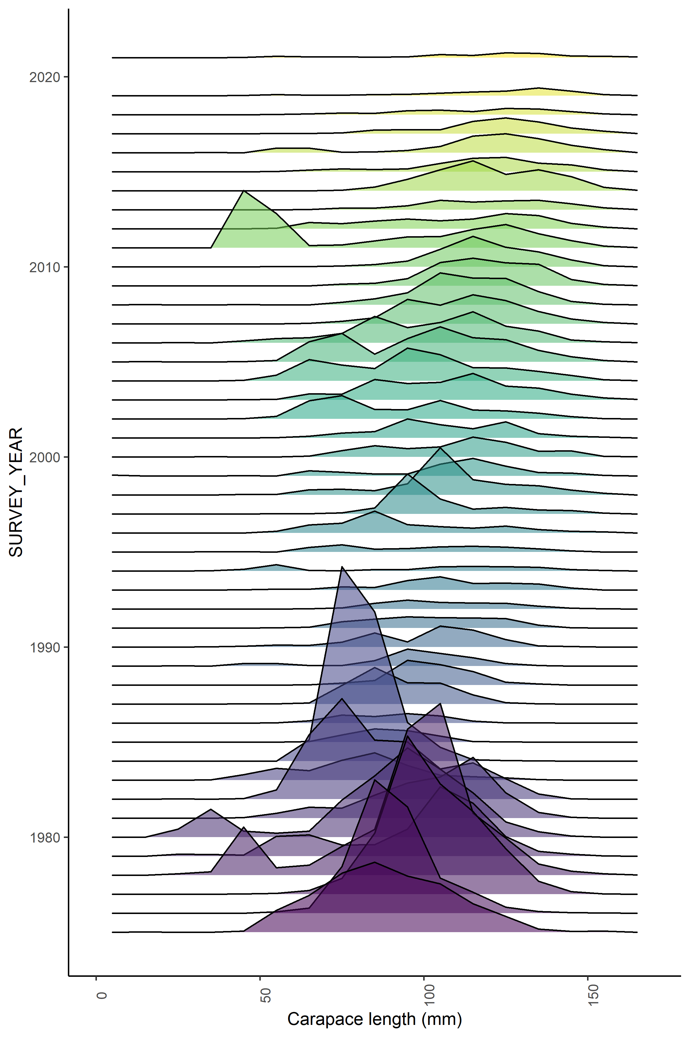
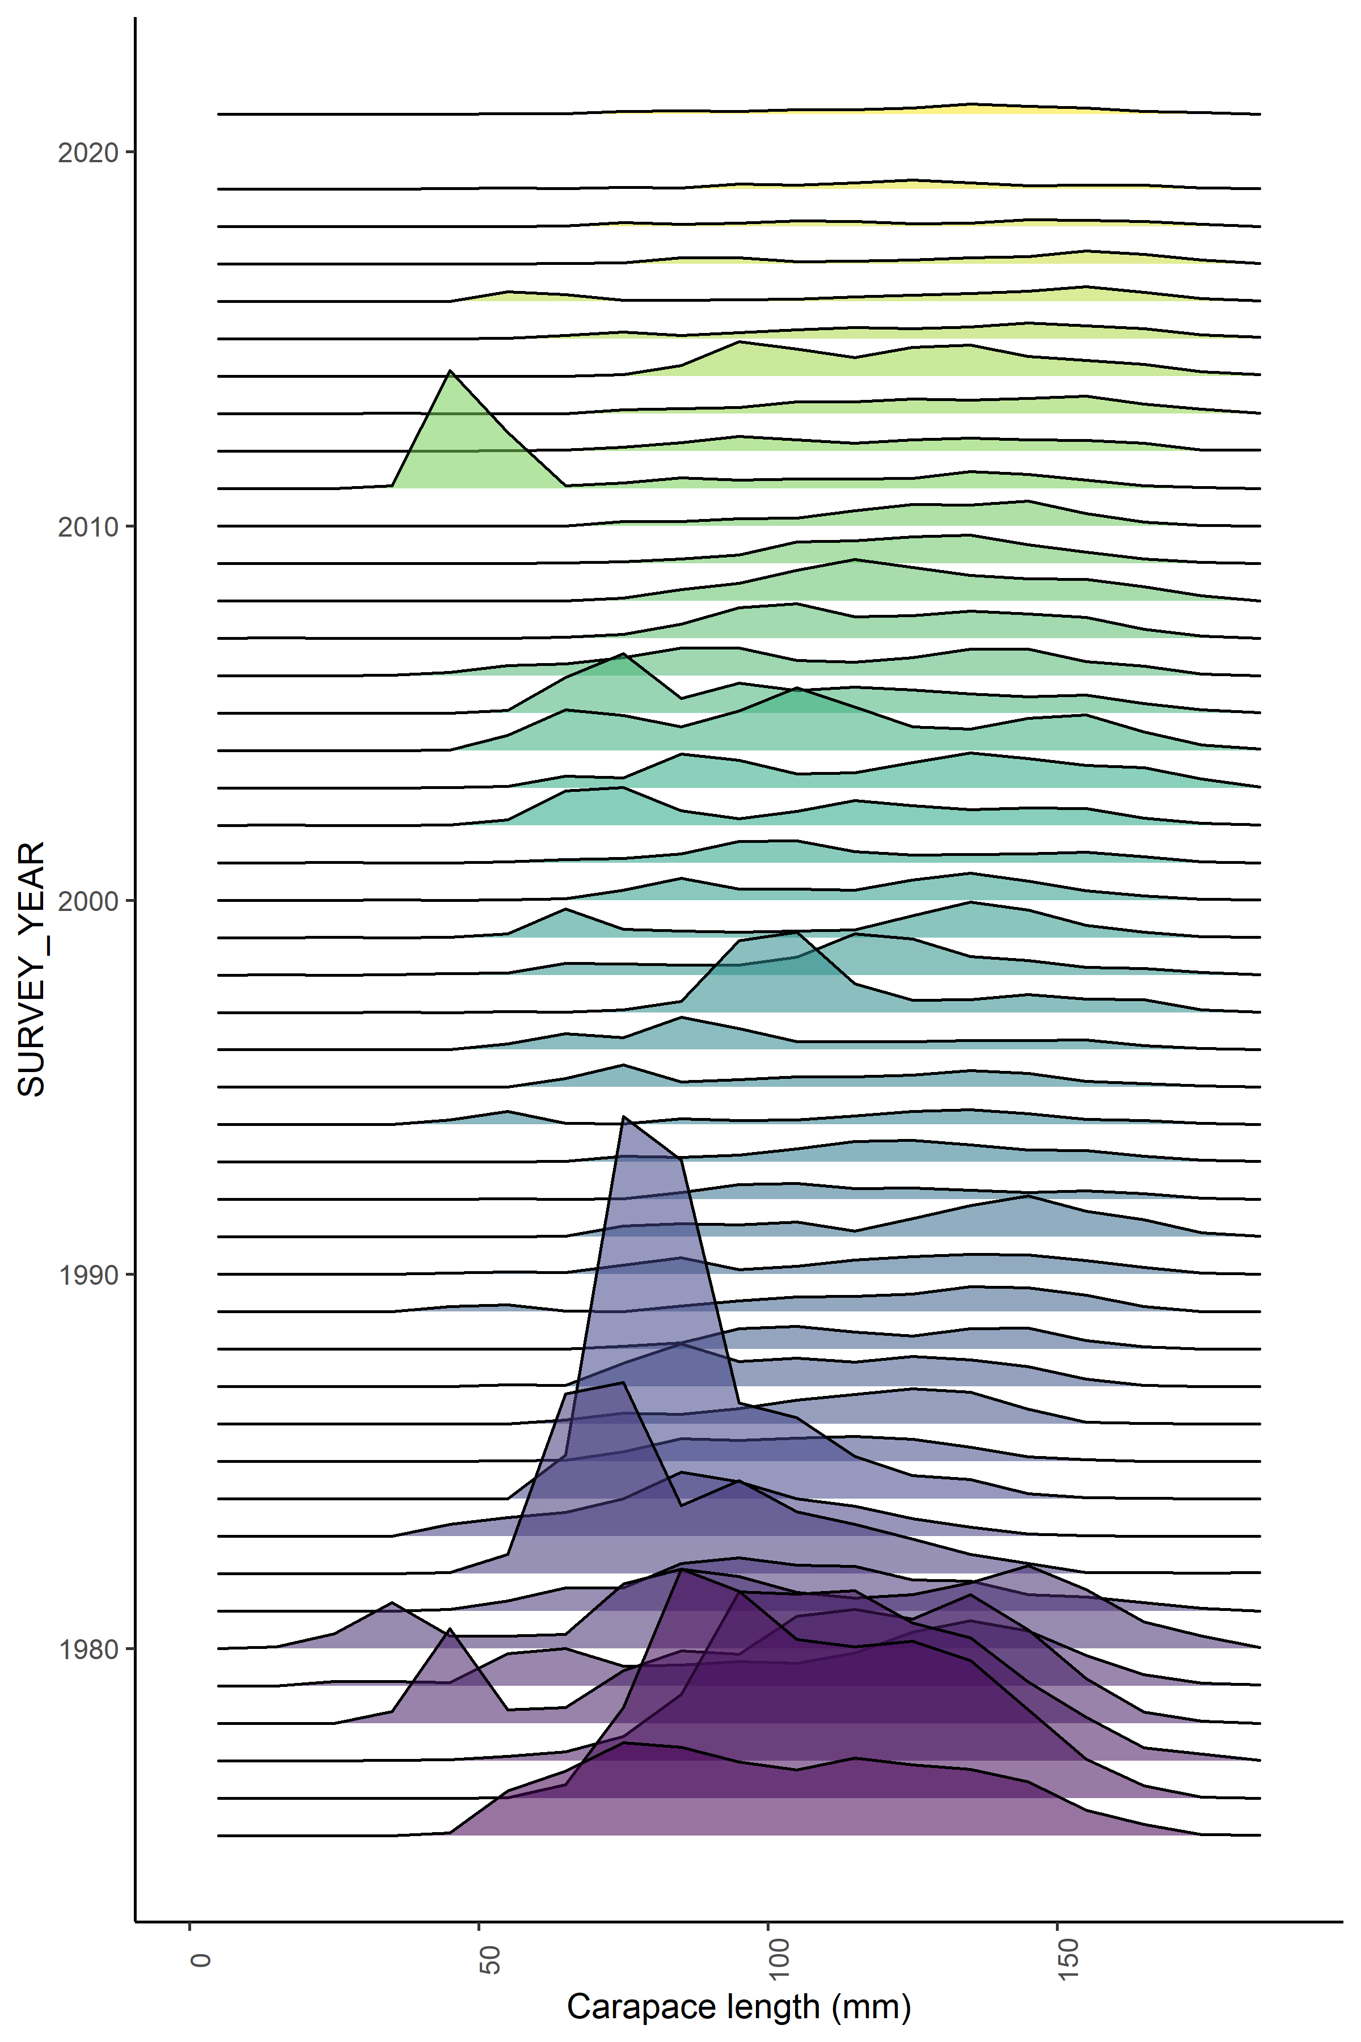
NMFS female survey data
NMFS male survey data

Slide 3
Model 19.3d
Approaching overfished
condition during 2021-2024

Slide 4
Model 19.3g
Approaching overfished
condition during 2021-2024

Slide 5
Model 21.1
Approaching overfished
condition during 2021-2024

Slide 6
Model 21.2
Approaching overfished
condition during 2021-2024

Slide 7
Status and catch specifications (1,000 t) (model 21.1):
Year | MSST |  | Biomass (MMB) | TAC | Retained Catch | Total Catch | OFL | ABC
2017/18 |  | 12.74^{A} | 24.86^{A} | 2.99 | 3.09 | 3.60 | 5.60 | 5.04
2018/19 |  | 10.62^{B} | 16.92^{B} | 1.95 | 2.03 | 2.65 | 5.34 | 4.27
2019/20 |  | 12.72^{C} | 14.24^{C} | 1.72 | 1.78 | 2.22 | 3.40 | 2.72
2020/21 |  | 12.12^{D} | 13.96^{D} | 1.20 | 1.26 | 1.57 | 2.14 | 1.61
2021/22 |  |  | 14.95^{D} |  |  |  | 2.23 | 1.78
Basis for the OFL: Values are in 1,000 t (model 21.1):
Year | Tier |  | B_{MSY} | Current MMB | B/B_{MSY} (MMB) | F_{OFL} |  | Years to define B_{MSY} | Natural Mortality
2017/18 |  | 3b | 25.1 | 21.3 | 0.85 | 0.24 | 1984-2017 |  |  | 0.18
2018/19 |  | 3b | 25.5 | 20.8 | 0.82 | 0.25 | 1984-2017 |  |  | 0.18
2019/20 |  | 3b | 21.2 | 16.0 | 0.75 | 0.22 | 1984-2018 |  |  | 0.18
2020/21 |  | 3b | 25.4 | 14.9 | 0.59 | 0.16 | 1984-2019 |  |  | 0.18
2021/22 |  | 3b | 24.2 | 14.9 | 0.62 | 0.17 | 1984-2020 |  |  | 0.18

