Slide 1
Currencies of management
CPT
January 12, 2022

Slide 2
Points for discussion
F35% as a reference point
Currency of management (MMB)
Morphometric vs. functional maturity
The big question

Slide 3
Size composition re-weighting was recommended by CPT, SSC, CIE
  Tried both McAllister-Ianelli (1998) and Francis (2011) reweighting for size composition, but neither produced viable models (for slightly different reasons)
Empirical selectivity lead to different shapes for the probability of having undergone terminal molt
Different shapes for the probability of having undergone terminal molt resulted in much larger F35% because more of the mature population was ‘protected’ by the size preference of the fishery

Slide 4
Estimated population processes
Population process | 21.1a | 21.2 | 21.3
Mature male biomass
Survey selectivity |  |  | ~
Probability of maturing
Fishing mortality
Recruitment
Natural mortality
Status
Size-comp reweighting gives fits similar to the logistic curve estimated in Somerton and Otto (1998)
Free selectivity ‘wants’ higher selection around 50 mm carapace width than in the BSFRF data
Remarkably consistent pattern in experimental data

Slide 5
Estimated population processes
Population process | 21.1a | 21.2 | 21.3
Mature male biomass
Survey selectivity |  |  | ~
Probability of maturing |  |  | ~
Fishing mortality
Recruitment
Natural mortality
Status
Reweighting the size composition data produced much higher probabilities of terminal molt than all other models.

Slide 6
Estimated population processes
Population process | 21.1a | 21.2 | 21.3
Mature male biomass
Survey selectivity |  |  | ~
Probability of maturing |  |  | ~
Fishing mortality
Recruitment
Natural mortality
Status
Bold blue is size composition reweighting
Purple is 21.3; green is 21.2, red is 21.1

Slide 7
Data source | 21.1a | 21.2 | 21.3
Survey biomass |  | X | X
Growth | ~ | ~ | ~
Catch | ~ | ~ | ~
Retained size comp | ~ | ~ | ~
Total size comp | ~ | ~ | ~
Bycatch size comp | ~ | ~ | ~
BSFRF size comp | ~
Survey size comp (imm M)
Survey size comp (imm F) |  |  | ~
Survey size comp (mat M)
Survey size comp (mat F) |  |  | ~
Population process | 21.1a | 21.2 | 21.3
Mature male biomass
Survey selectivity |  |  | ~
Probability of maturing |  |  | ~
Fishing mortality
Recruitment |  | ~ | ~
Natural mortality |  | ~ | ~
Status
In terms of fits to data and population processes, model 21.3 is a clear winner in my opinion.

Slide 8
Target fishing mortality (F35) of 4.76 translates to an exploitation rate of 99.2%
(F35 = 1.43 is 76%)
This means that almost all males >101mm could be harvested in a given year.

Slide 9
Maybe a high F35% is appropriate?
Dungeness crab seem to do ok with high Fs, given size limits and seasons are appropriate (Richardson, 2020)
Laboratory studies show small males can fertilize females (e.g. Watson, 1972 in which a 61 mm male successfully mated with a female that molted from 64 mm to 74 mm).
Richerson, K. et al. 2020. Nearly half a century of high but sustainable exploitation in the Dungeness crab fishery.

Slide 10
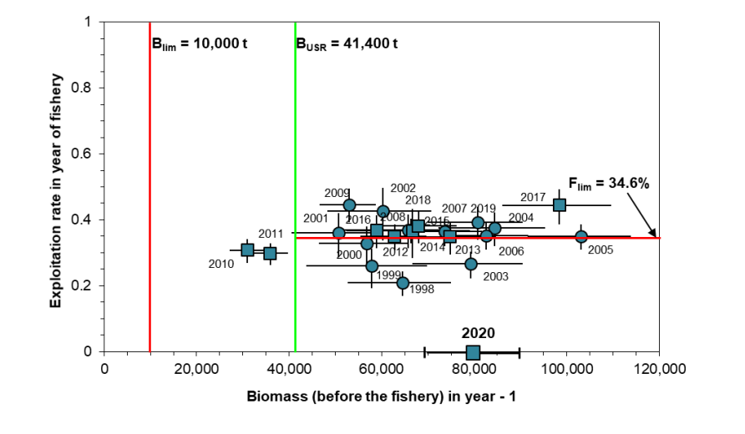
Maybe F35% isn’t appropriate?
Other productive snow crab fisheries have somewhat lower Fs (see Gulf of St Lawrence →)
Functional maturity in situ appears to be >95mm carapace width (Conan and Comeau, 1986; Ennis et al., 1988)

Slide 11
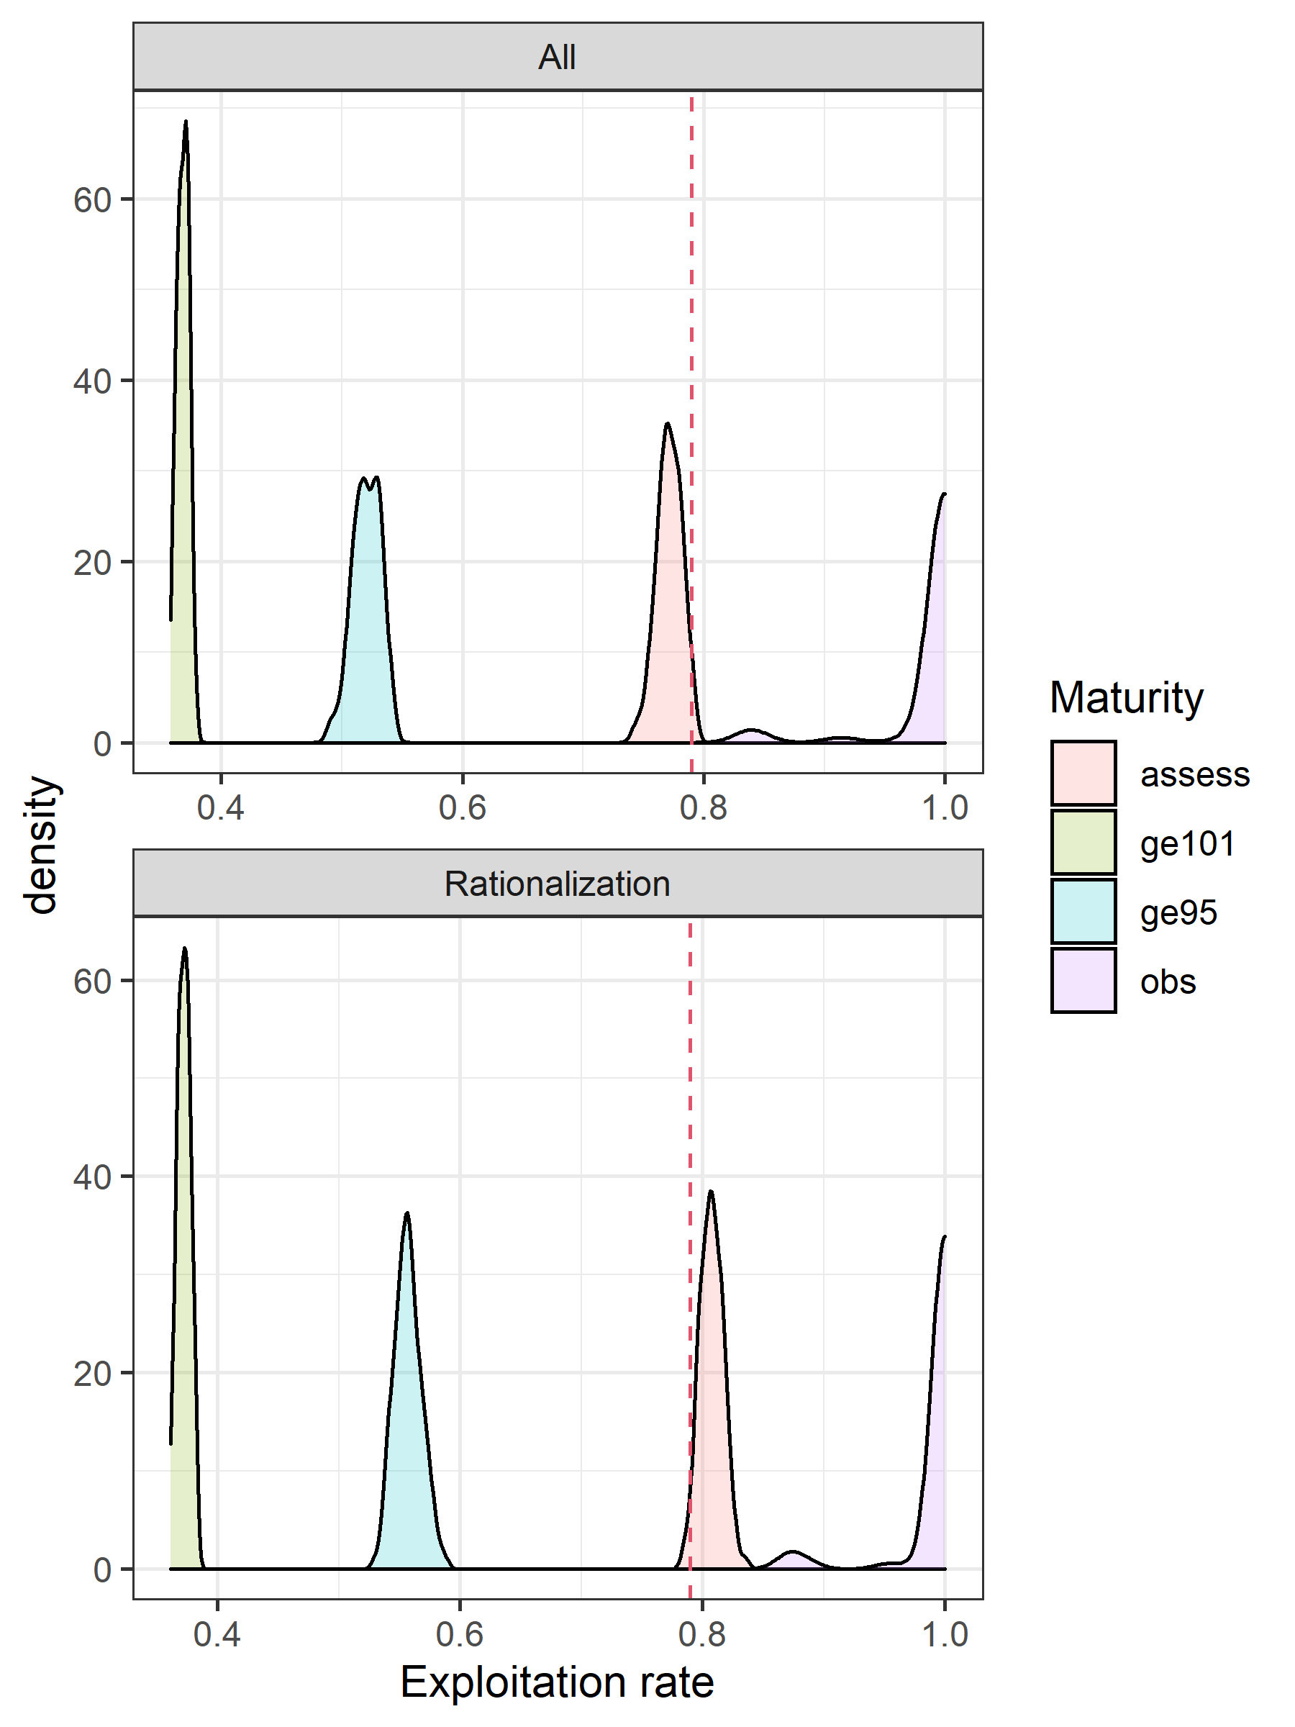
Other management possibilities
Change the currency of management from ‘morphometric maturity’ to ‘functional maturity’
A potential definition for ‘functional maturity’ could be >95mm carapace width given work in Canada
This mirrors what the king crab stocks do

Slide 12
What do we do if we select a model that describes the population processes and dynamics of a stock in an ‘ideal’ manner, but produces management advice that allows 100% of exploitable biomass to be harvested?

