Slide 1
2023 Bering Sea and Aleutian Islands forage report
C Szuwalski, E Yasumiishi, A Andrews, A Dimond, J Murphy, E Farley, and E Siddon

Slide 2
Background
Odd years
Not an assessment
Bottom trawl surveys and BASIS surface water survey
Bottom trawls provide a poor representation of most of these species
No consistent message across species

Slide 3
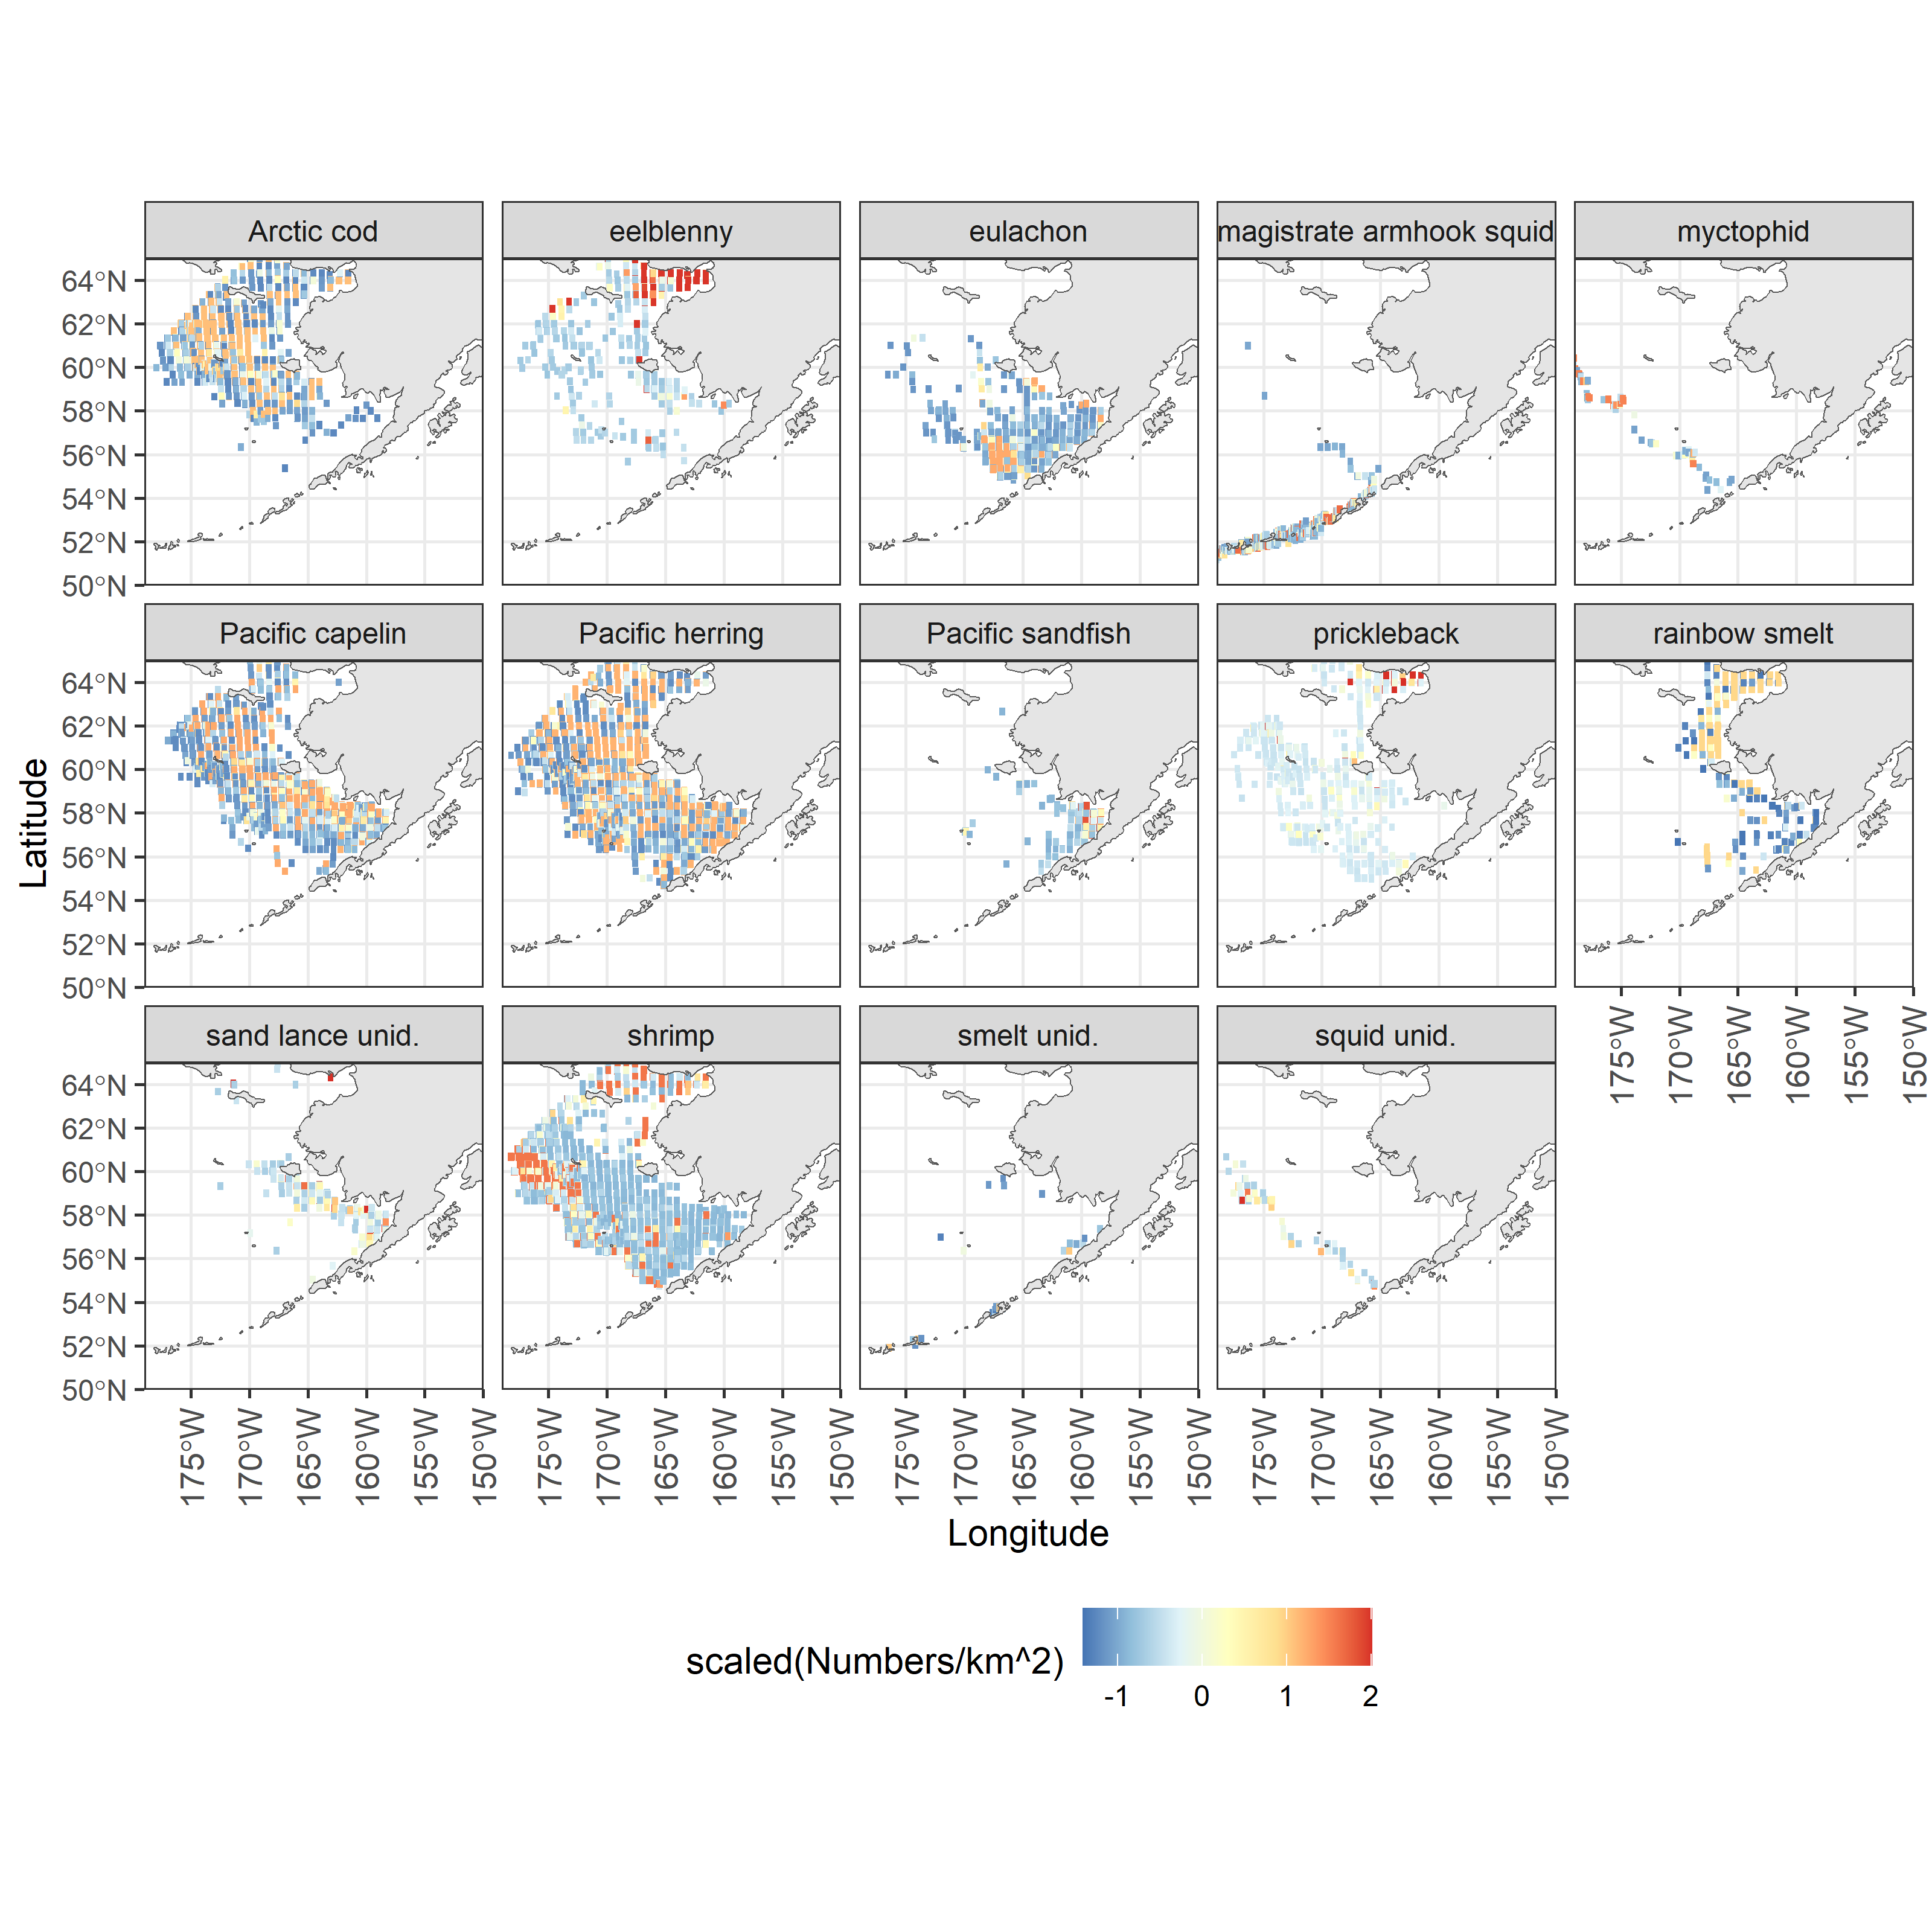

Slide 4
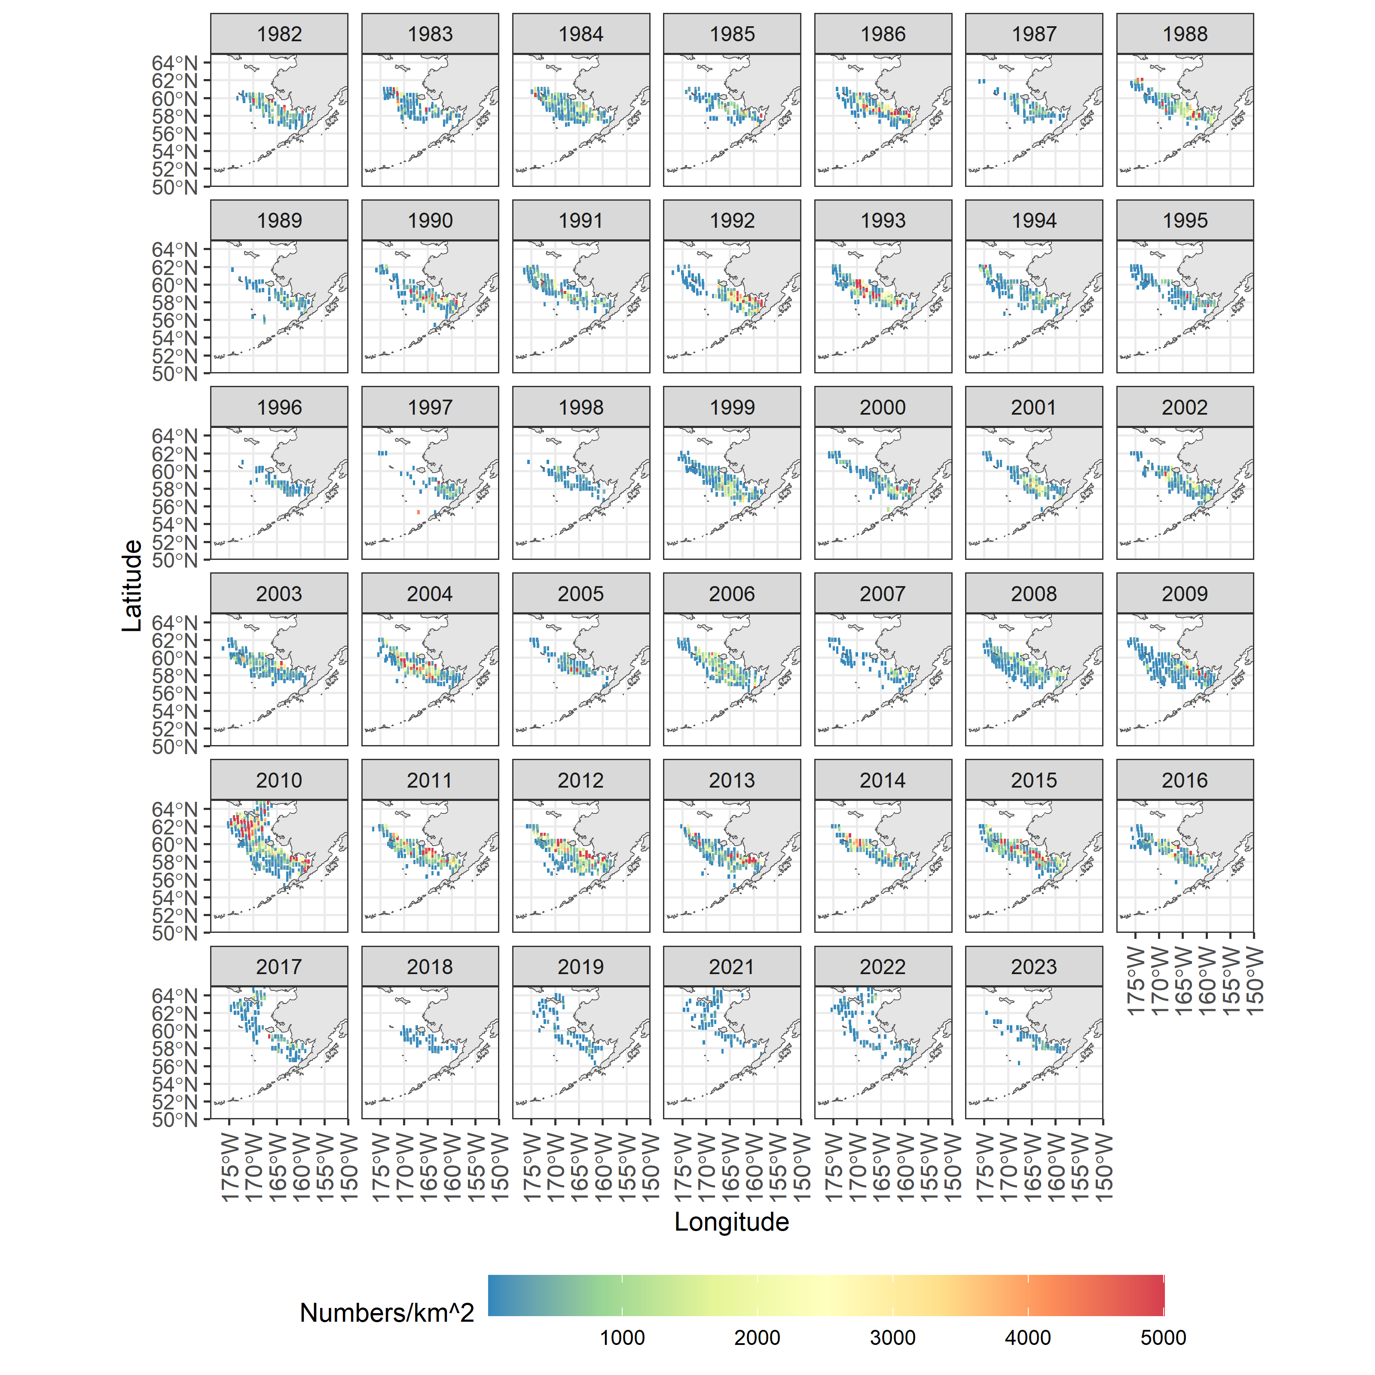
Species/group | Prevalence | Density
Pacific capelin
Eulachon
Rainbow smelt
Sand lance
Sandfish
Pricklebacks
Eelblennies
Herring
Squid
Shrimp
Map of distribution of prevalence and density from the all BSAI surveys for Pacific capelin (zoom for detail).

Slide 5
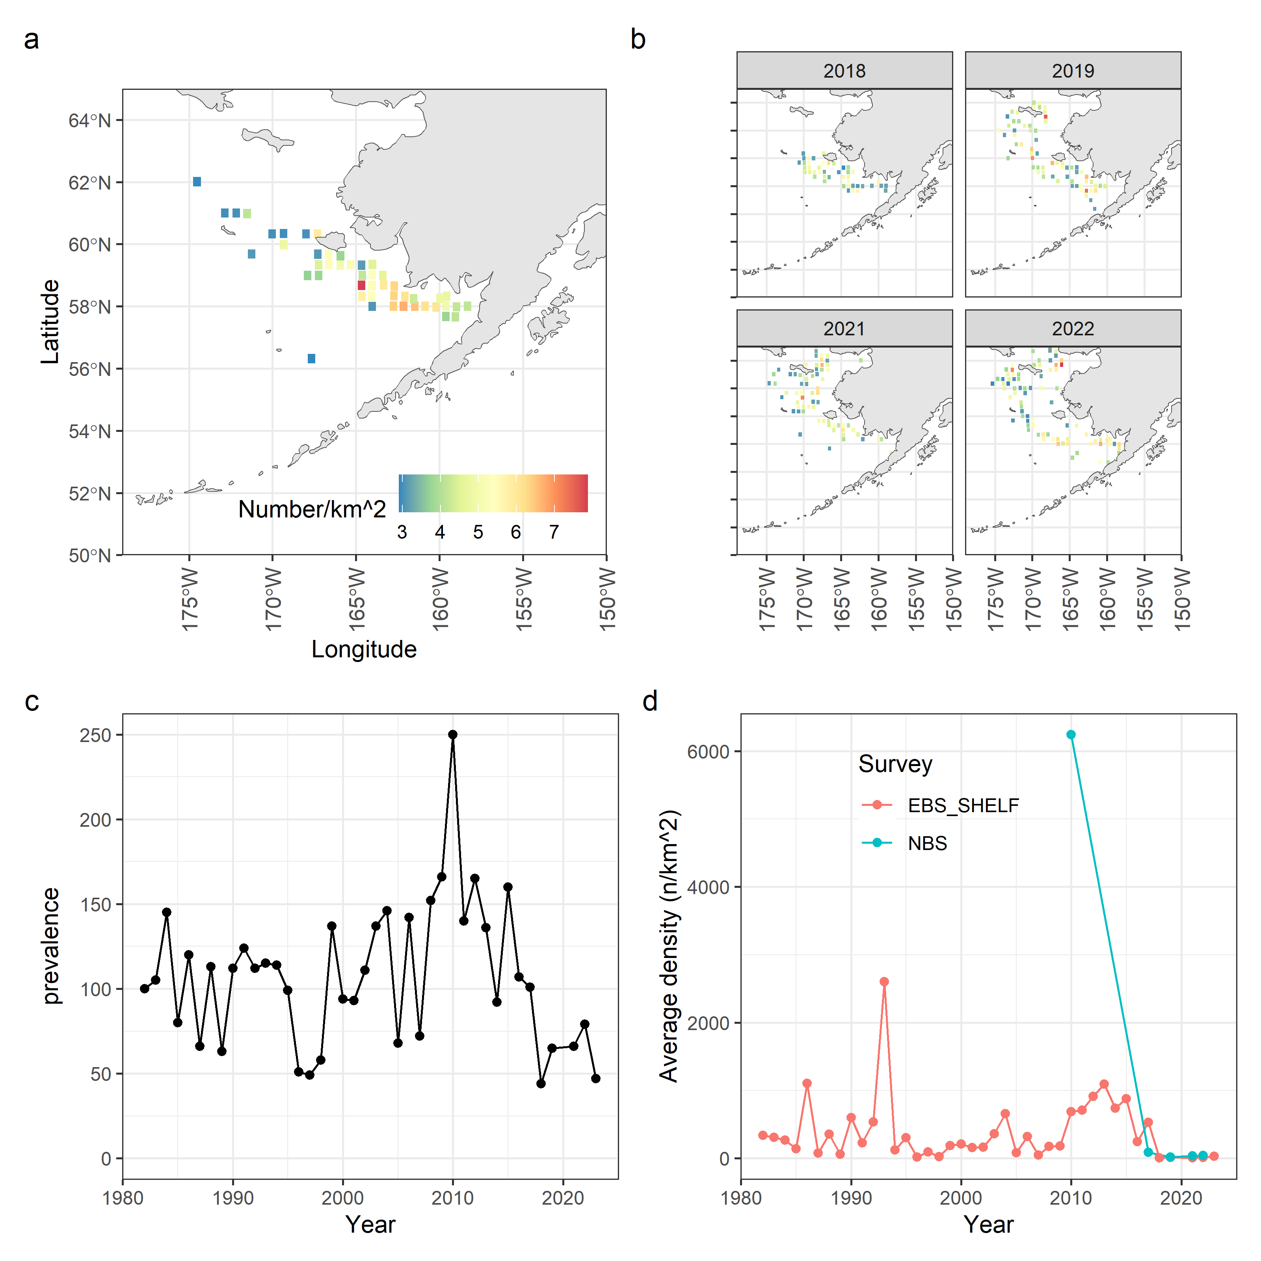
Species/group | Prevalence | Density
Pacific capelin
Eulachon
Rainbow smelt
Sand lance
Sandfish
Pricklebacks
Eelblennies
Herring
Squid
Shrimp
Pacific capelin survey data. Spatial density in BSAI surveys (a), spatial densities in the previous four years for which survey data was available (b), prevalence in terms of the number of survey stations that returned positive tows for this species (c), and average densities split by survey location in the BSAI (d).

Slide 6
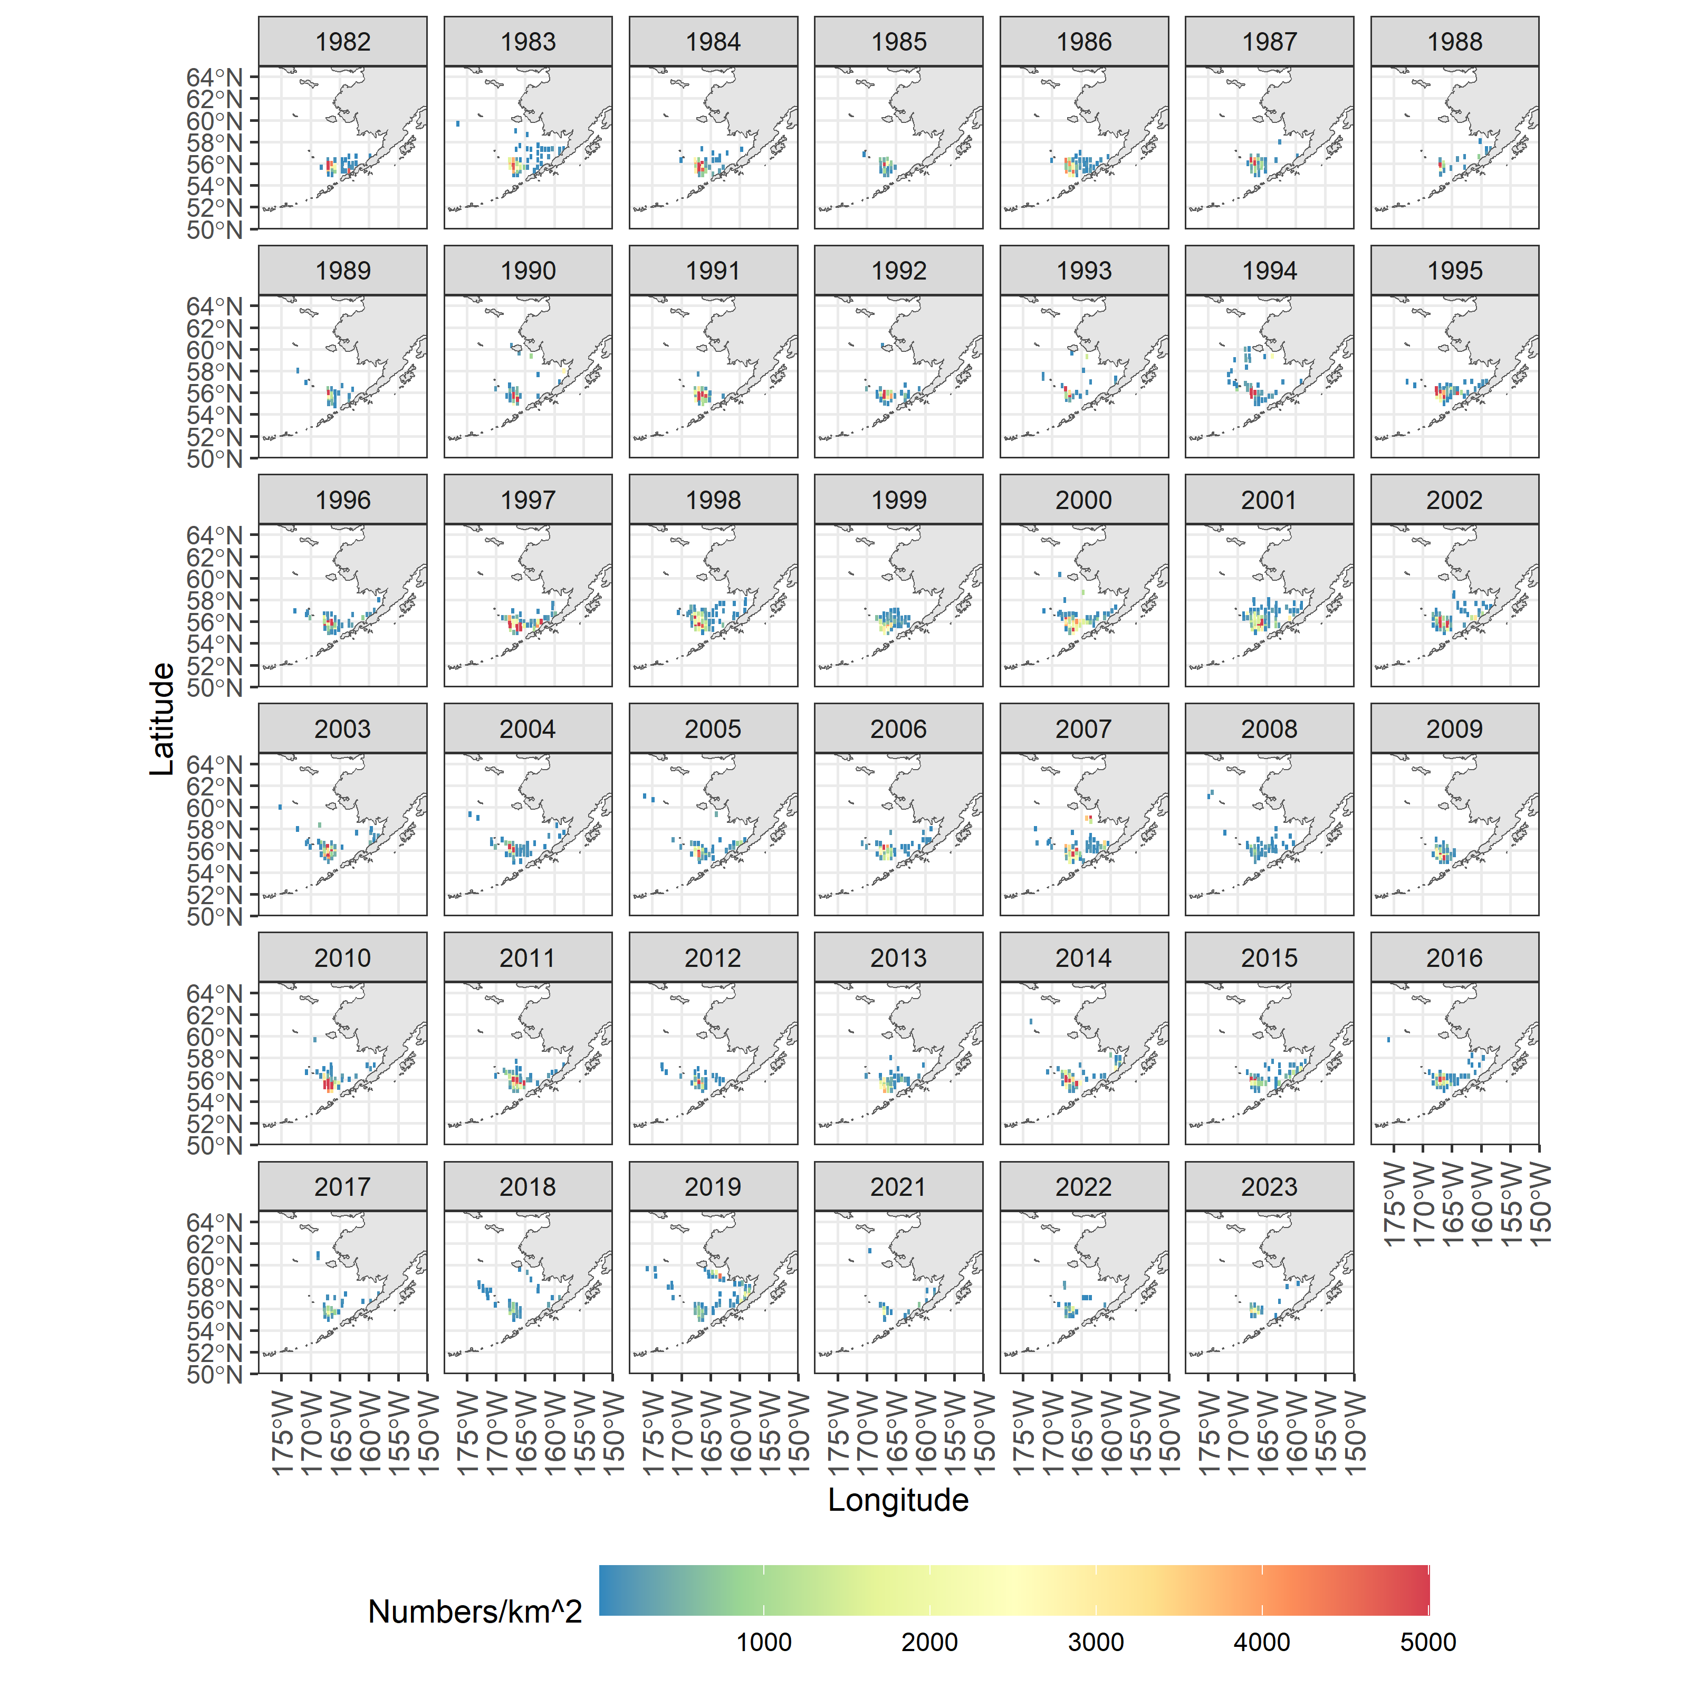
Species/group | Prevalence | Density
Pacific capelin
Eulachon
Rainbow smelt
Sand lance
Sandfish
Pricklebacks
Eelblennies
Herring
Squid
Shrimp
Species/group | Prevalence | Density
Pacific capelin
Eulachon
Rainbow smelt
Sand lance
Sandfish
Pricklebacks
Eelblennies
Herring
Squid
Shrimp
Map of distribution of prevalence and density from the all BSAI surveys for eulachon (zoom for detail).

Slide 7
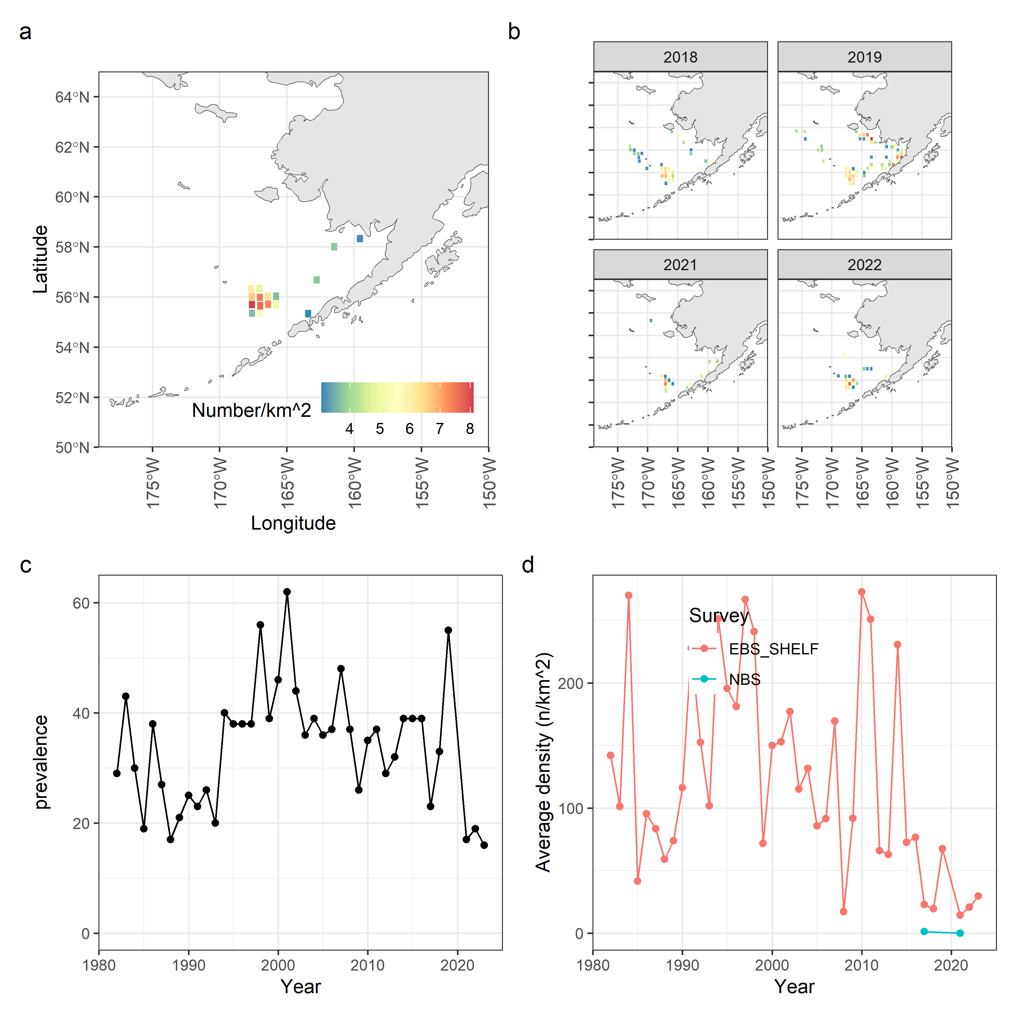
Species/group | Prevalence | Density
Pacific capelin
Eulachon
Rainbow smelt
Sand lance
Sandfish
Pricklebacks
Eelblennies
Herring
Squid
Shrimp
Species/group | Prevalence | Density
Pacific capelin
Eulachon
Rainbow smelt
Sand lance
Sandfish
Pricklebacks
Eelblennies
Herring
Squid
Shrimp
Eulachon survey data. Spatial density in BSAI surveys (a), spatial densities in the previous four years for which survey data was available (b), prevalence in terms of the number of survey stations that returned positive tows for this species (c), and average densities split by survey location in the BSAI (d).

Slide 8
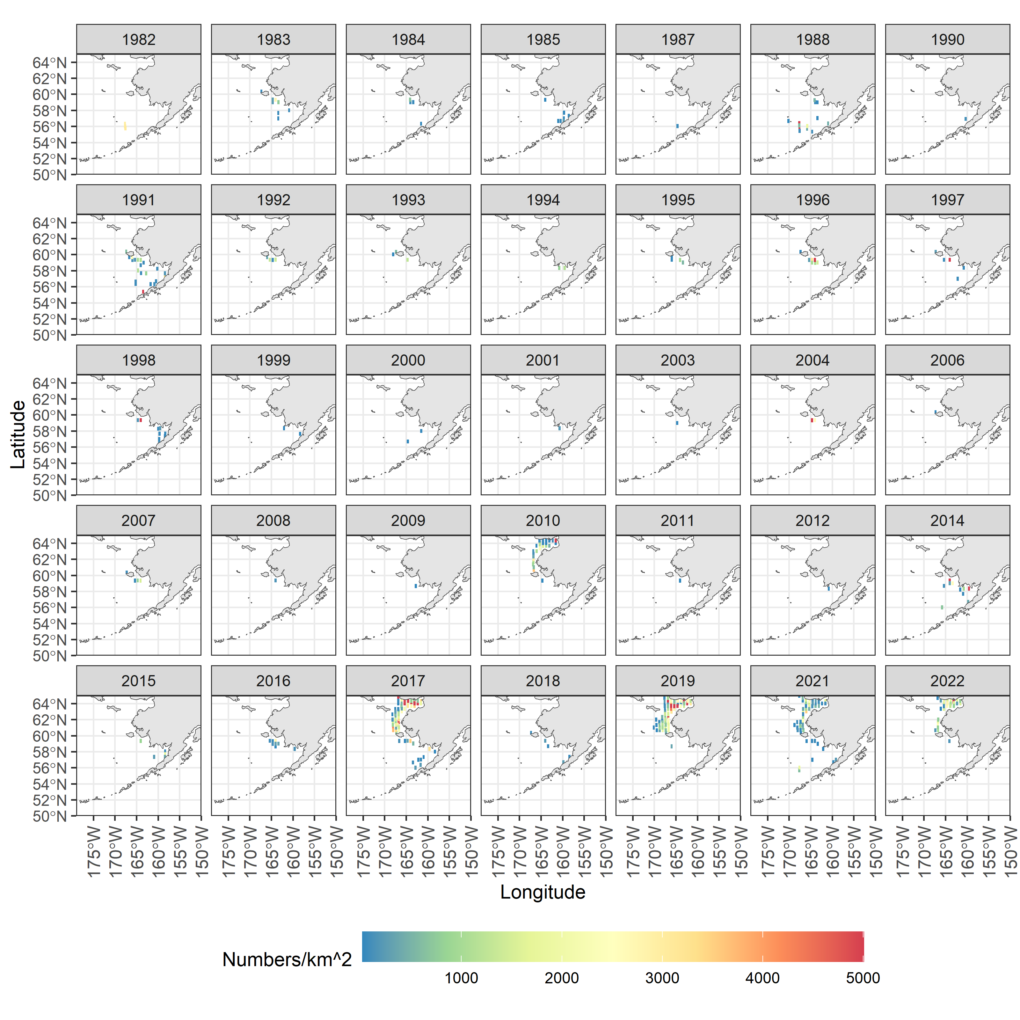
Species/group | Prevalence | Density
Pacific capelin
Eulachon
Rainbow smelt
Sand lance
Sandfish
Pricklebacks
Eelblennies
Herring
Squid
Shrimp
Species/group | Prevalence | Density
Pacific capelin
Eulachon
Rainbow smelt
Sand lance
Sandfish
Pricklebacks
Eelblennies
Herring
Squid
Shrimp
Species/group | Prevalence | Density
Pacific capelin
Eulachon
Rainbow smelt
Sand lance
Sandfish
Pricklebacks
Eelblennies
Herring
Squid
Shrimp
Map of distribution of prevalence and density from the all BSAI surveys for rainbow smelt(zoom for detail).

Slide 9
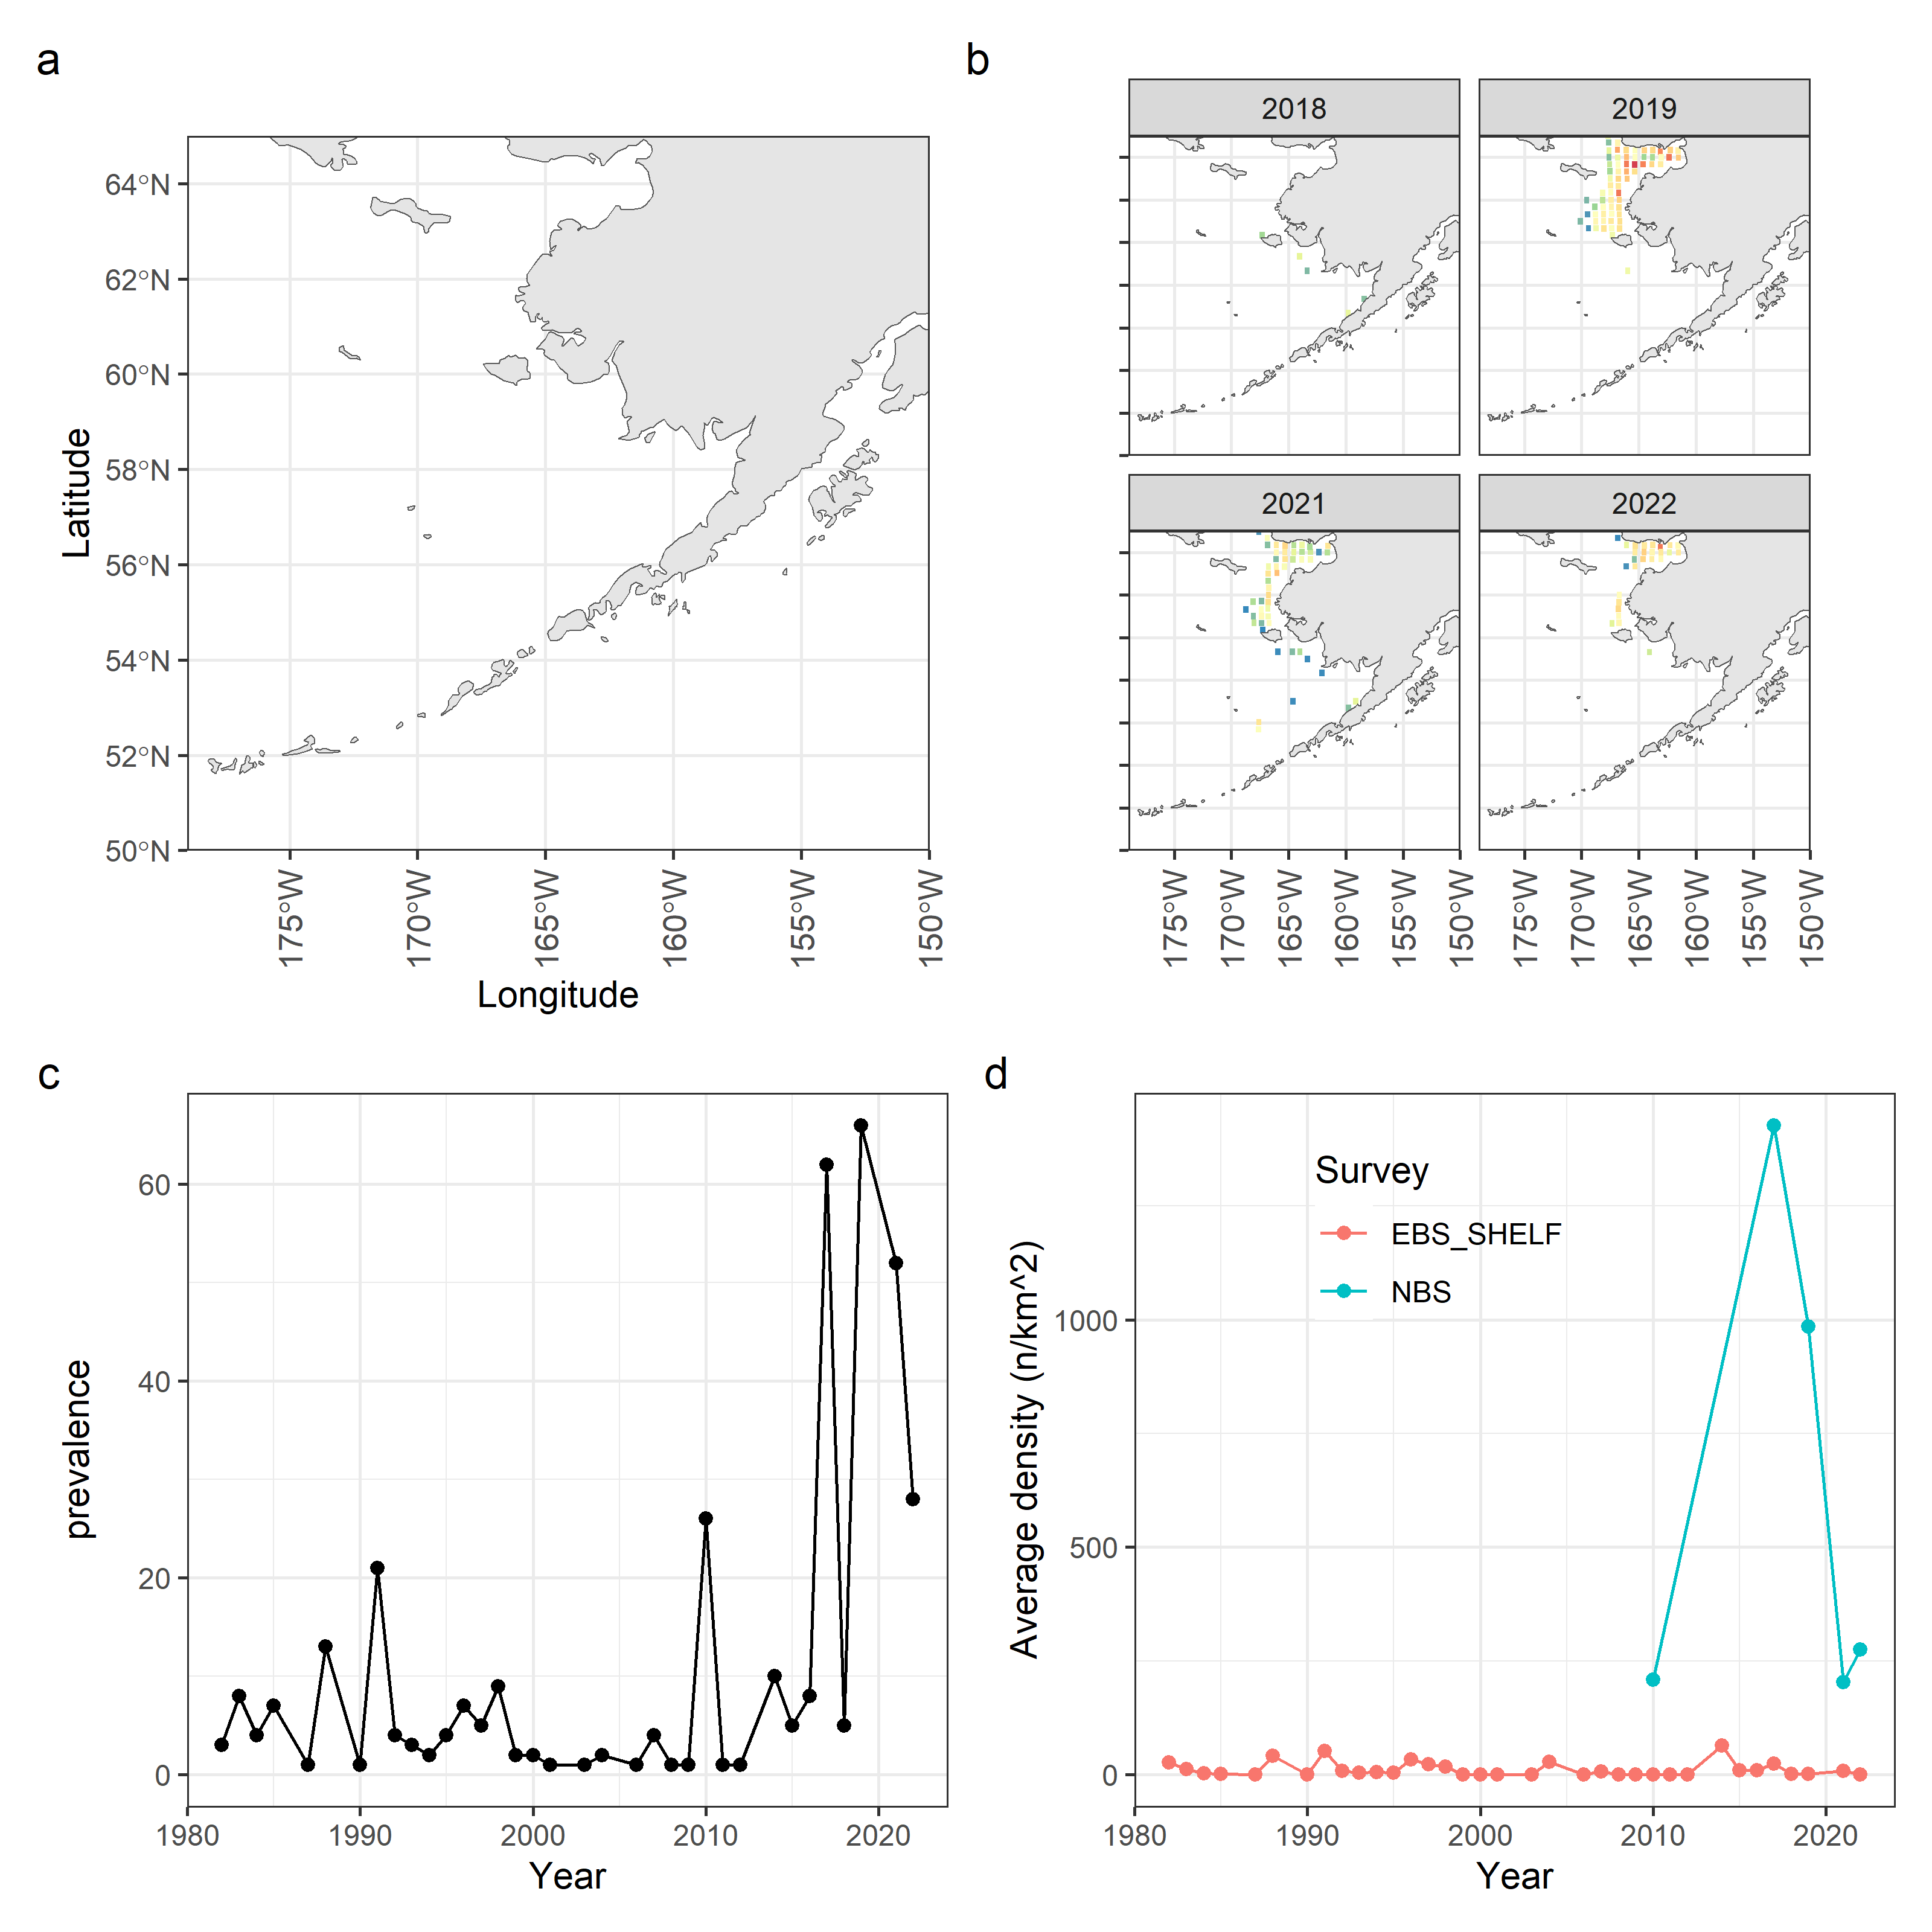
Species/group | Prevalence | Density
Pacific capelin
Eulachon
Rainbow smelt
Sand lance
Sandfish
Pricklebacks
Eelblennies
Herring
Squid
Shrimp
Species/group | Prevalence | Density
Pacific capelin
Eulachon
Rainbow smelt
Sand lance
Sandfish
Pricklebacks
Eelblennies
Herring
Squid
Shrimp
Rainbow smelt survey data. Spatial density in BSAI surveys (a), spatial densities in the previous four years for which survey data was available (b), prevalence in terms of the number of survey stations that returned positive tows for this species (c), and average densities split by survey location in the BSAI (d).

Slide 10
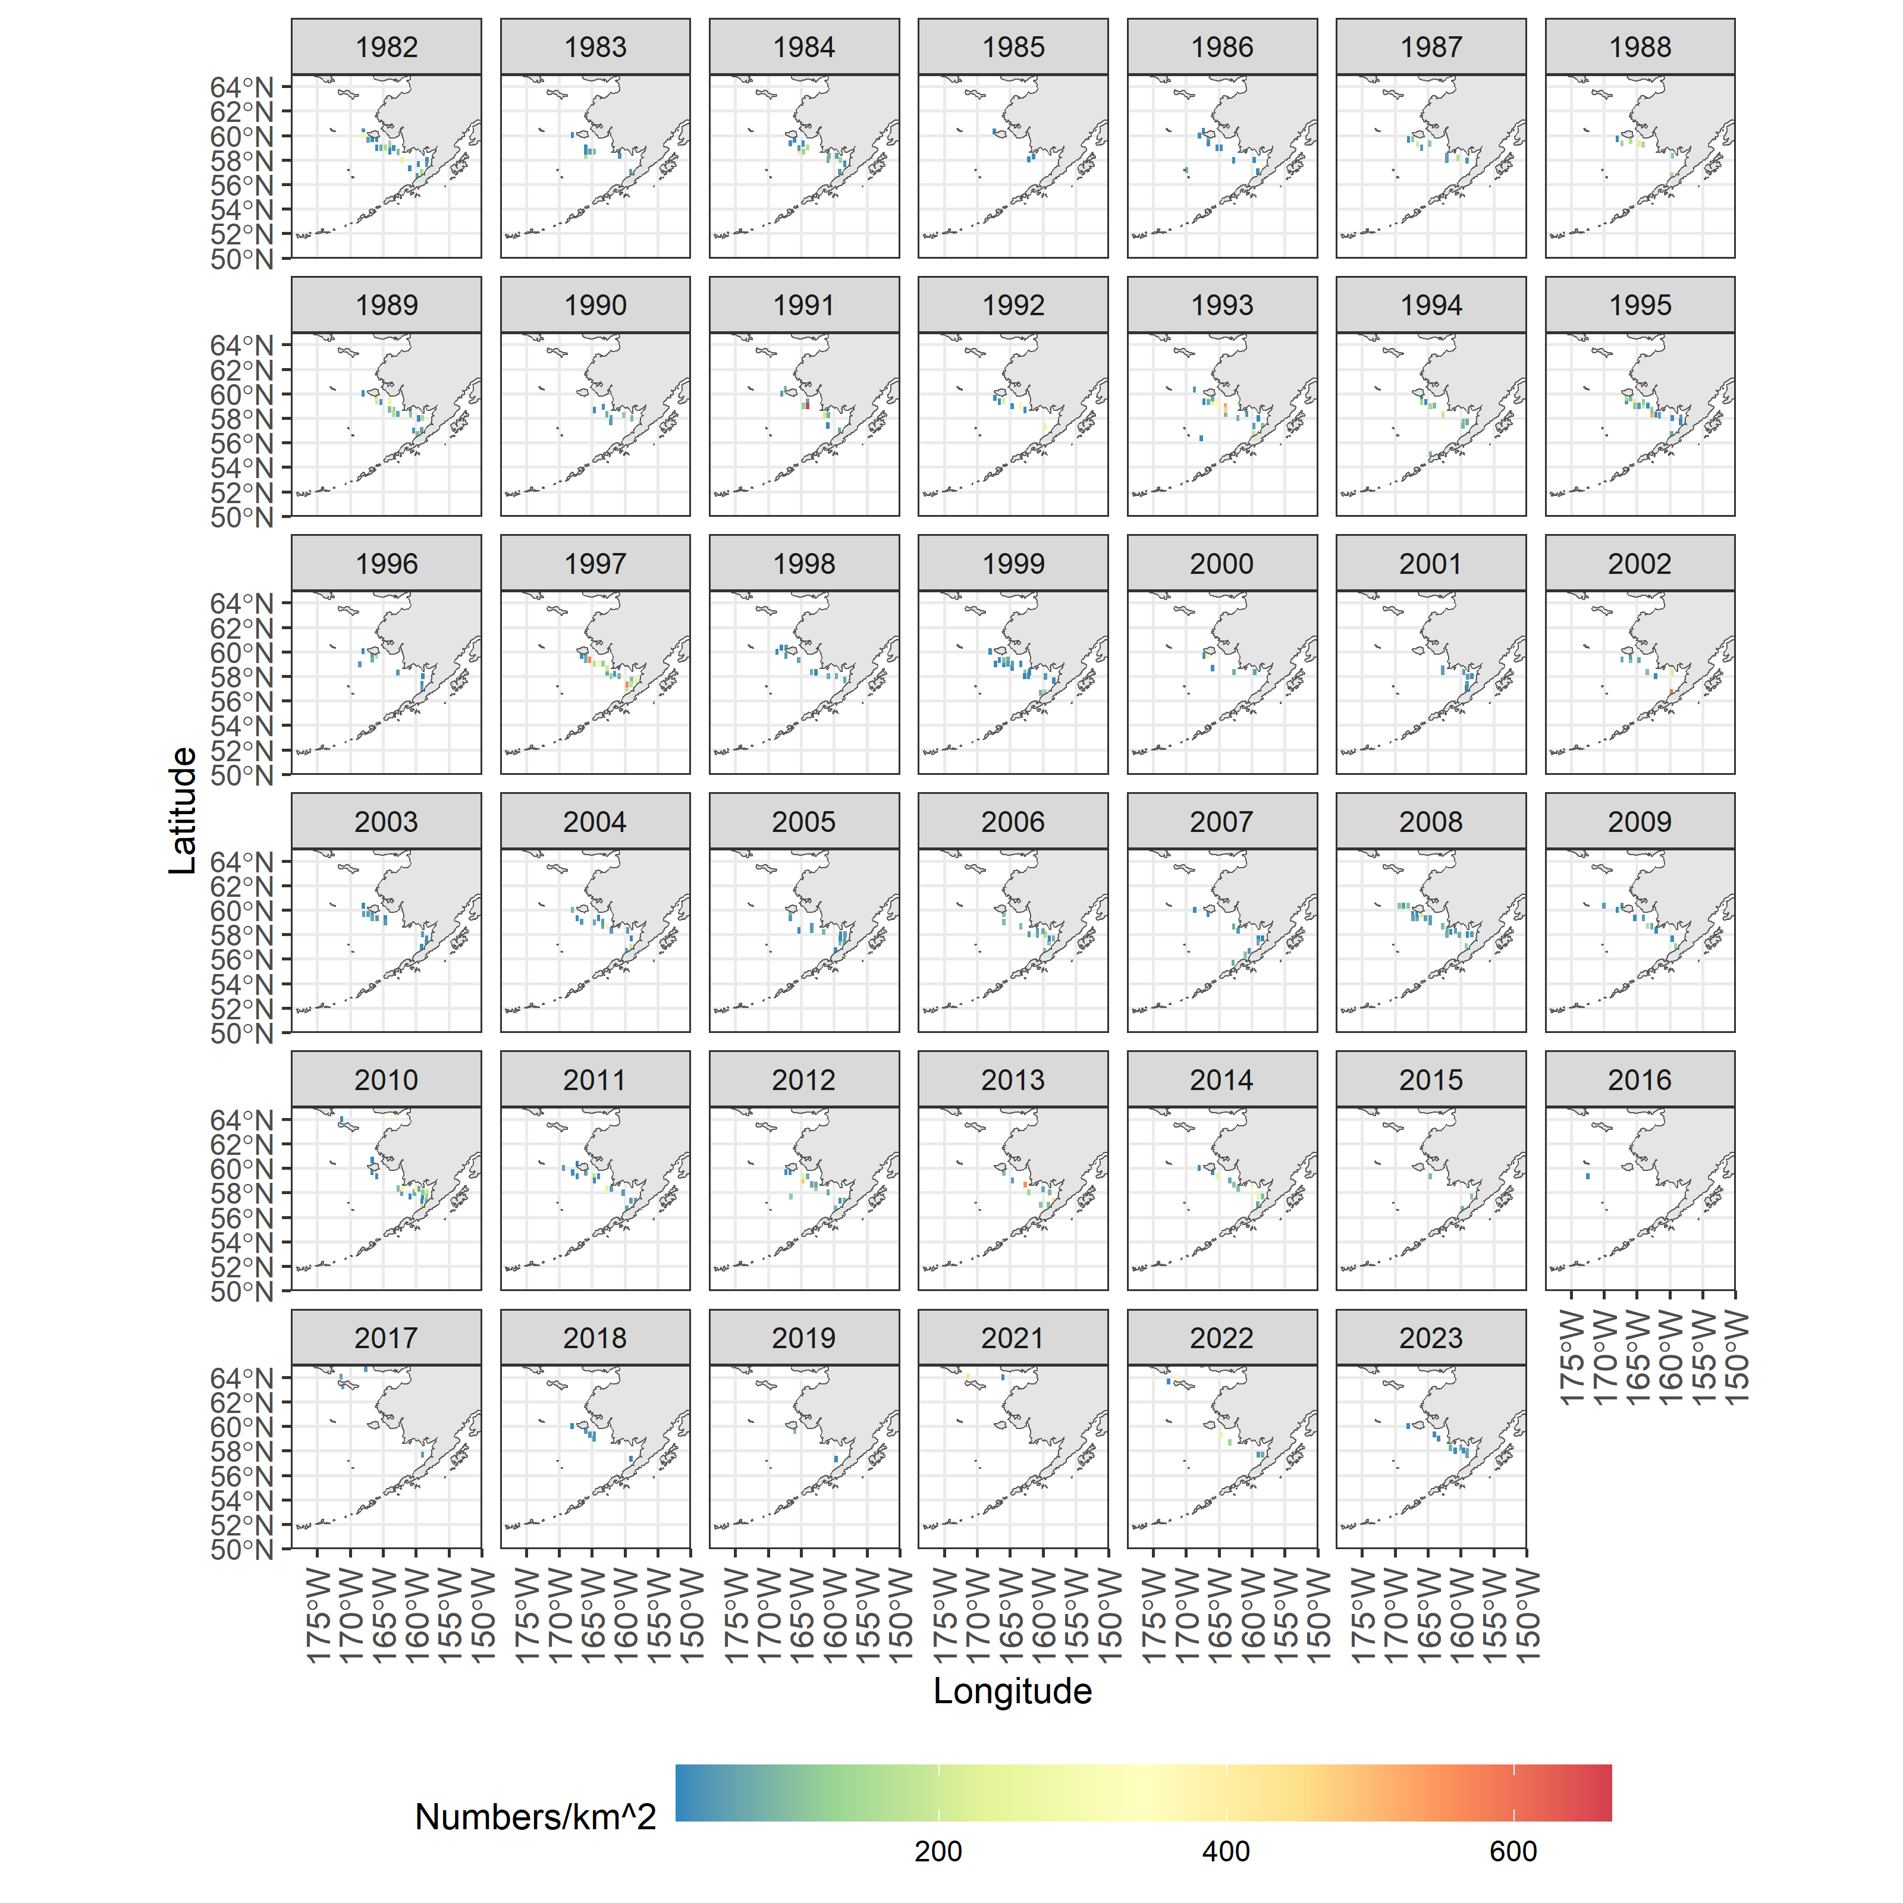
Species/group | Prevalence | Density
Pacific capelin
Eulachon
Rainbow smelt
Sand lance
Sandfish
Pricklebacks
Eelblennies
Herring
Squid
Shrimp
Species/group | Prevalence | Density
Pacific capelin
Eulachon
Rainbow smelt
Sand lance
Sandfish
Pricklebacks
Eelblennies
Herring
Squid
Shrimp
Map of distribution of prevalence and density from the all BSAI surveys for rainbow smelt(zoom for detail).

Slide 11
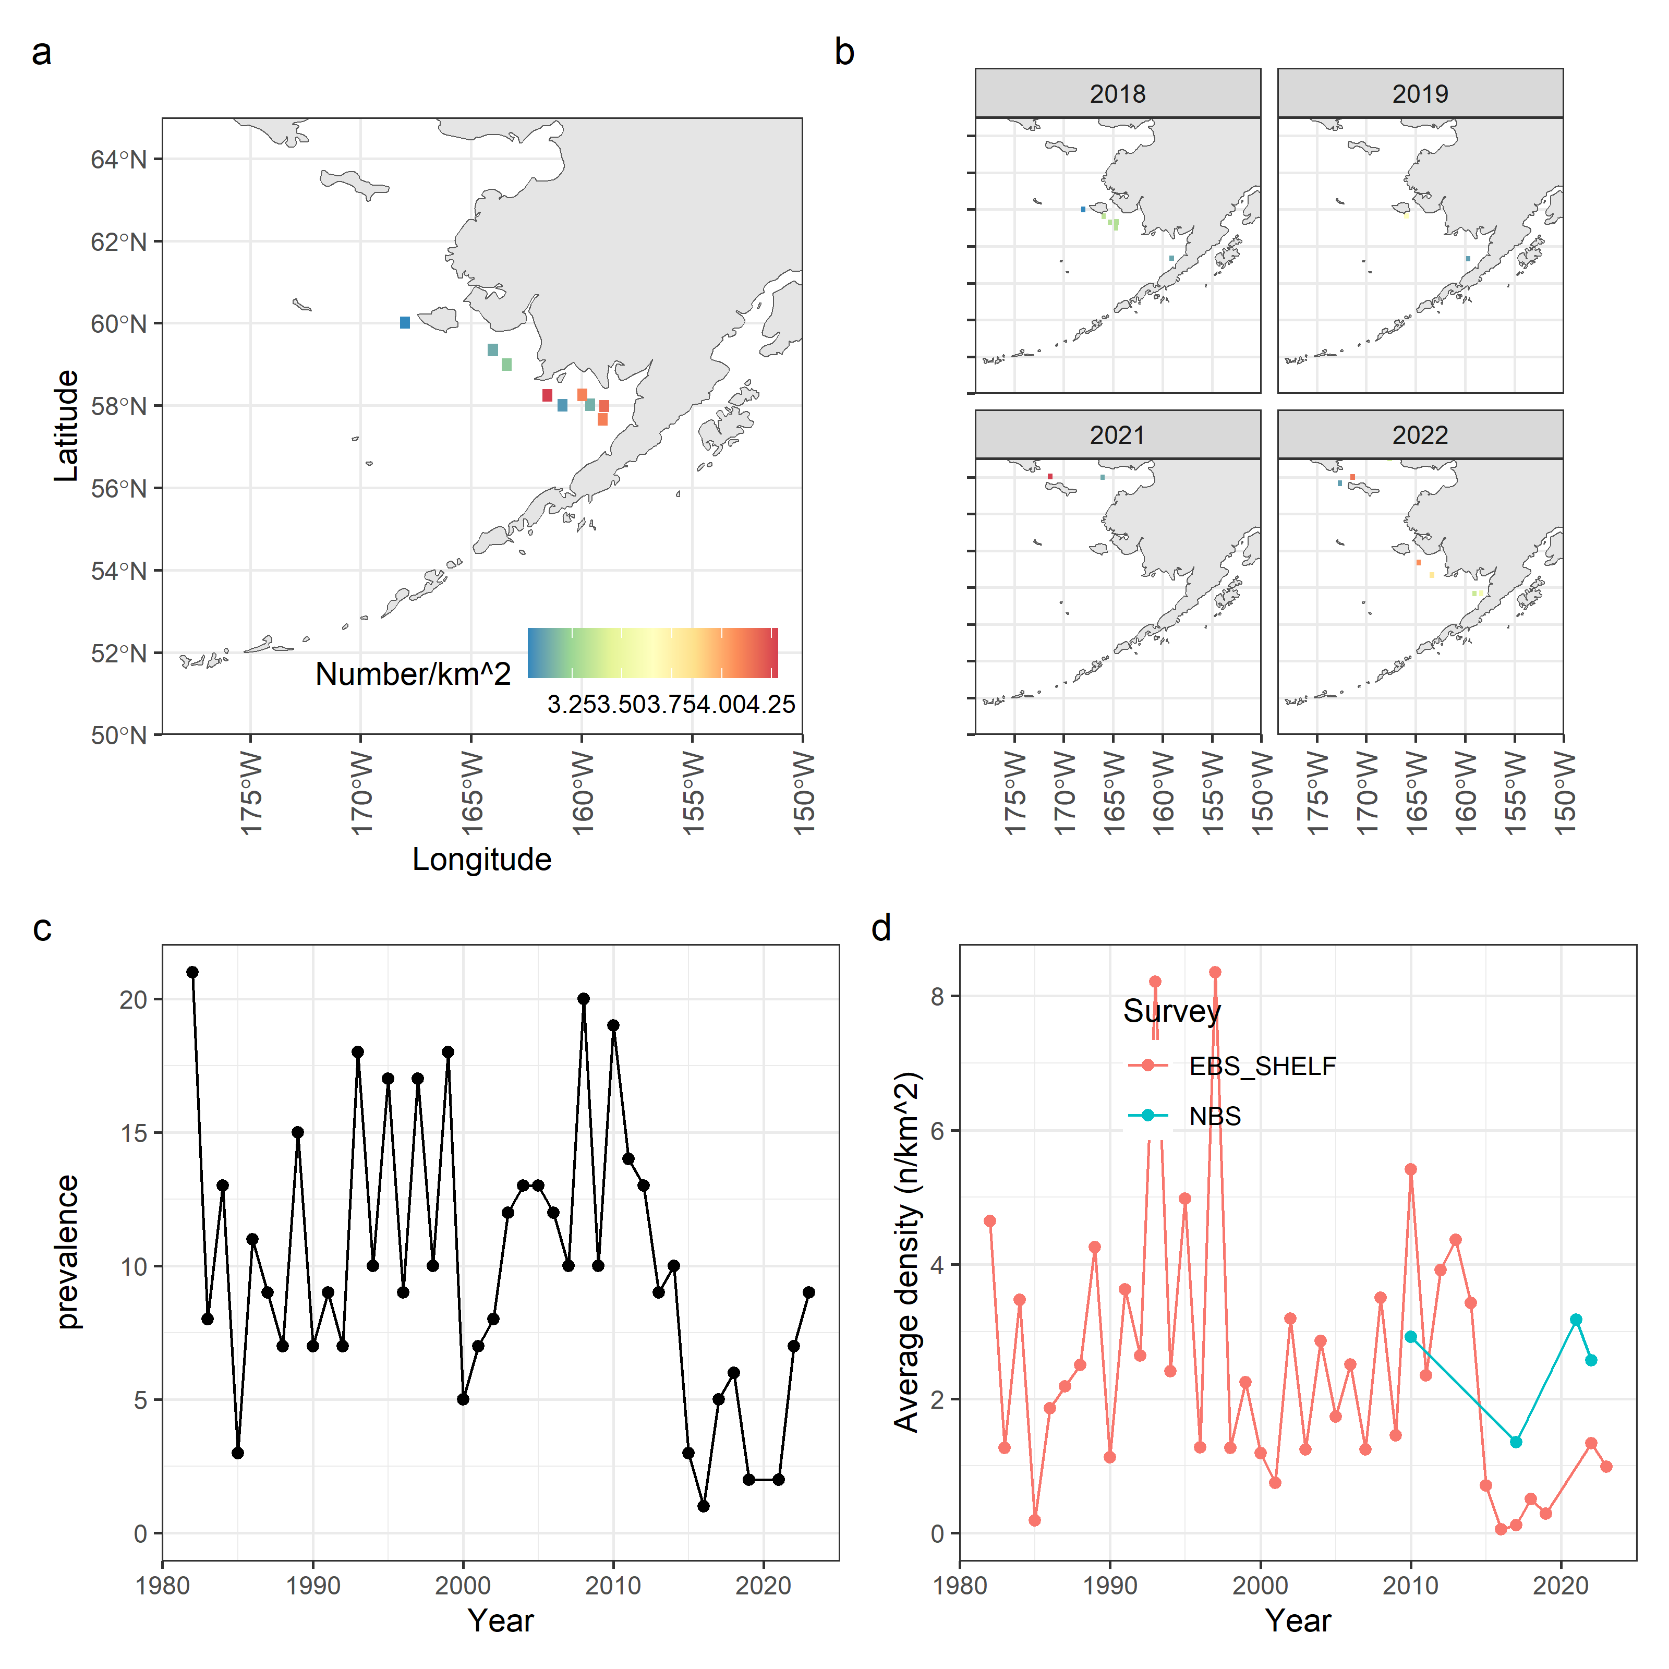
Species/group | Prevalence | Density
Pacific capelin
Eulachon
Rainbow smelt
Sand lance
Sandfish
Pricklebacks
Eelblennies
Herring
Squid
Shrimp
Species/group | Prevalence | Density
Pacific capelin
Eulachon
Rainbow smelt
Sand lance
Sandfish
Pricklebacks
Eelblennies
Herring
Squid
Shrimp
Pacific sand lance survey data. Spatial density in BSAI surveys (a), spatial densities in the previous four years for which survey data was available (b), prevalence in terms of the number of survey stations that returned positive tows for this species (c), and average densities split by survey location in the BSAI (d).

Slide 12
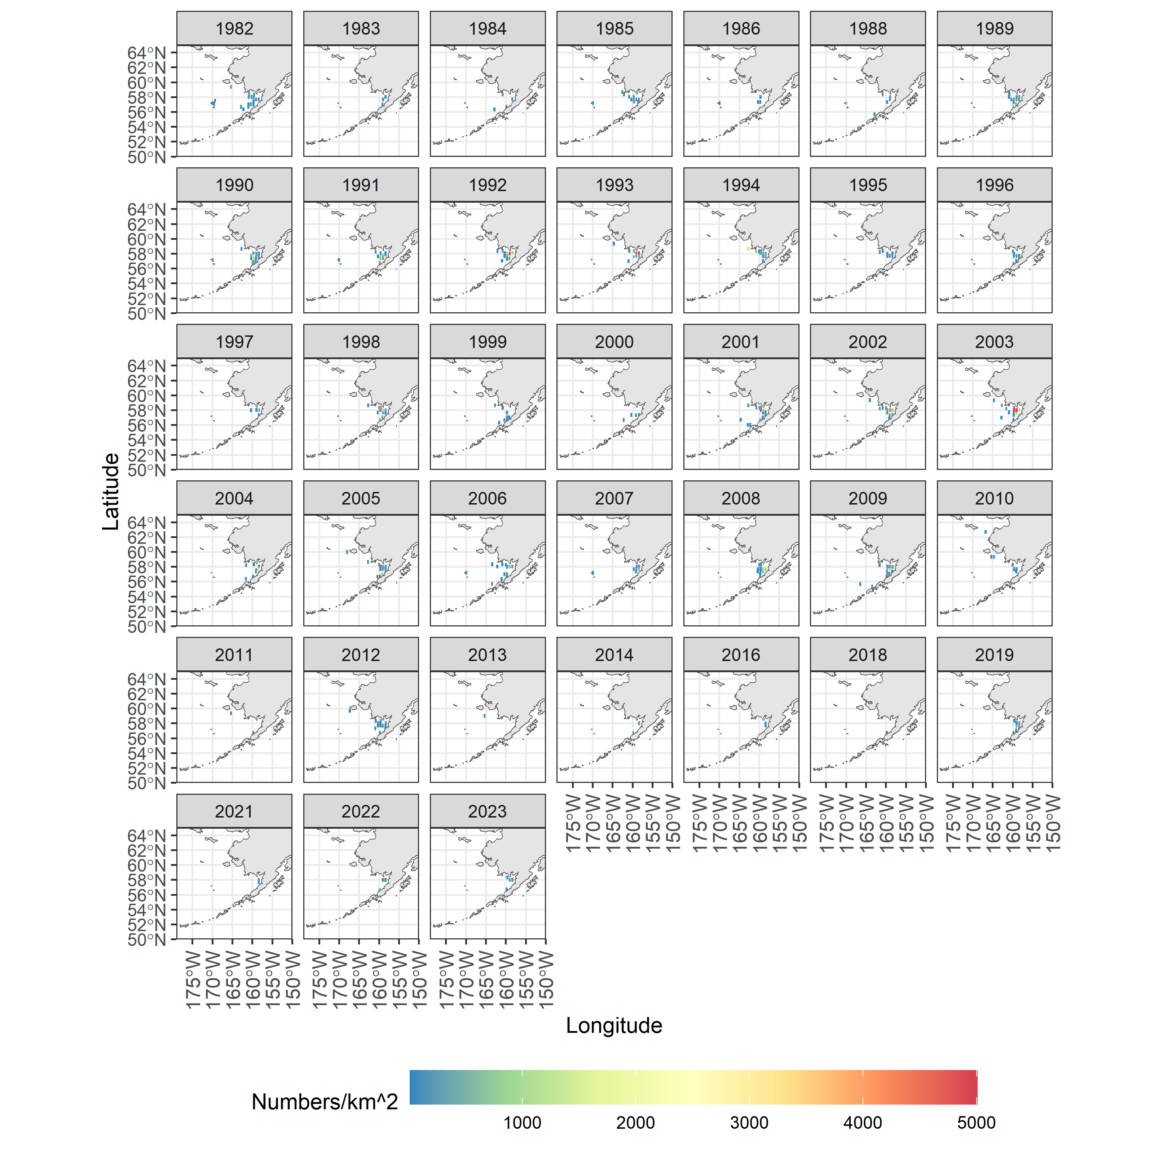
Species/group | Prevalence | Density
Pacific capelin
Eulachon
Rainbow smelt
Sand lance
Sandfish
Pricklebacks
Eelblennies
Herring
Squid
Shrimp
Species/group | Prevalence | Density
Pacific capelin
Eulachon
Rainbow smelt
Sand lance
Sandfish
Pricklebacks
Eelblennies
Herring
Squid
Shrimp
Map of distribution of prevalence and density from the all BSAI surveys for Pacific sandfish(zoom for detail).

Slide 13
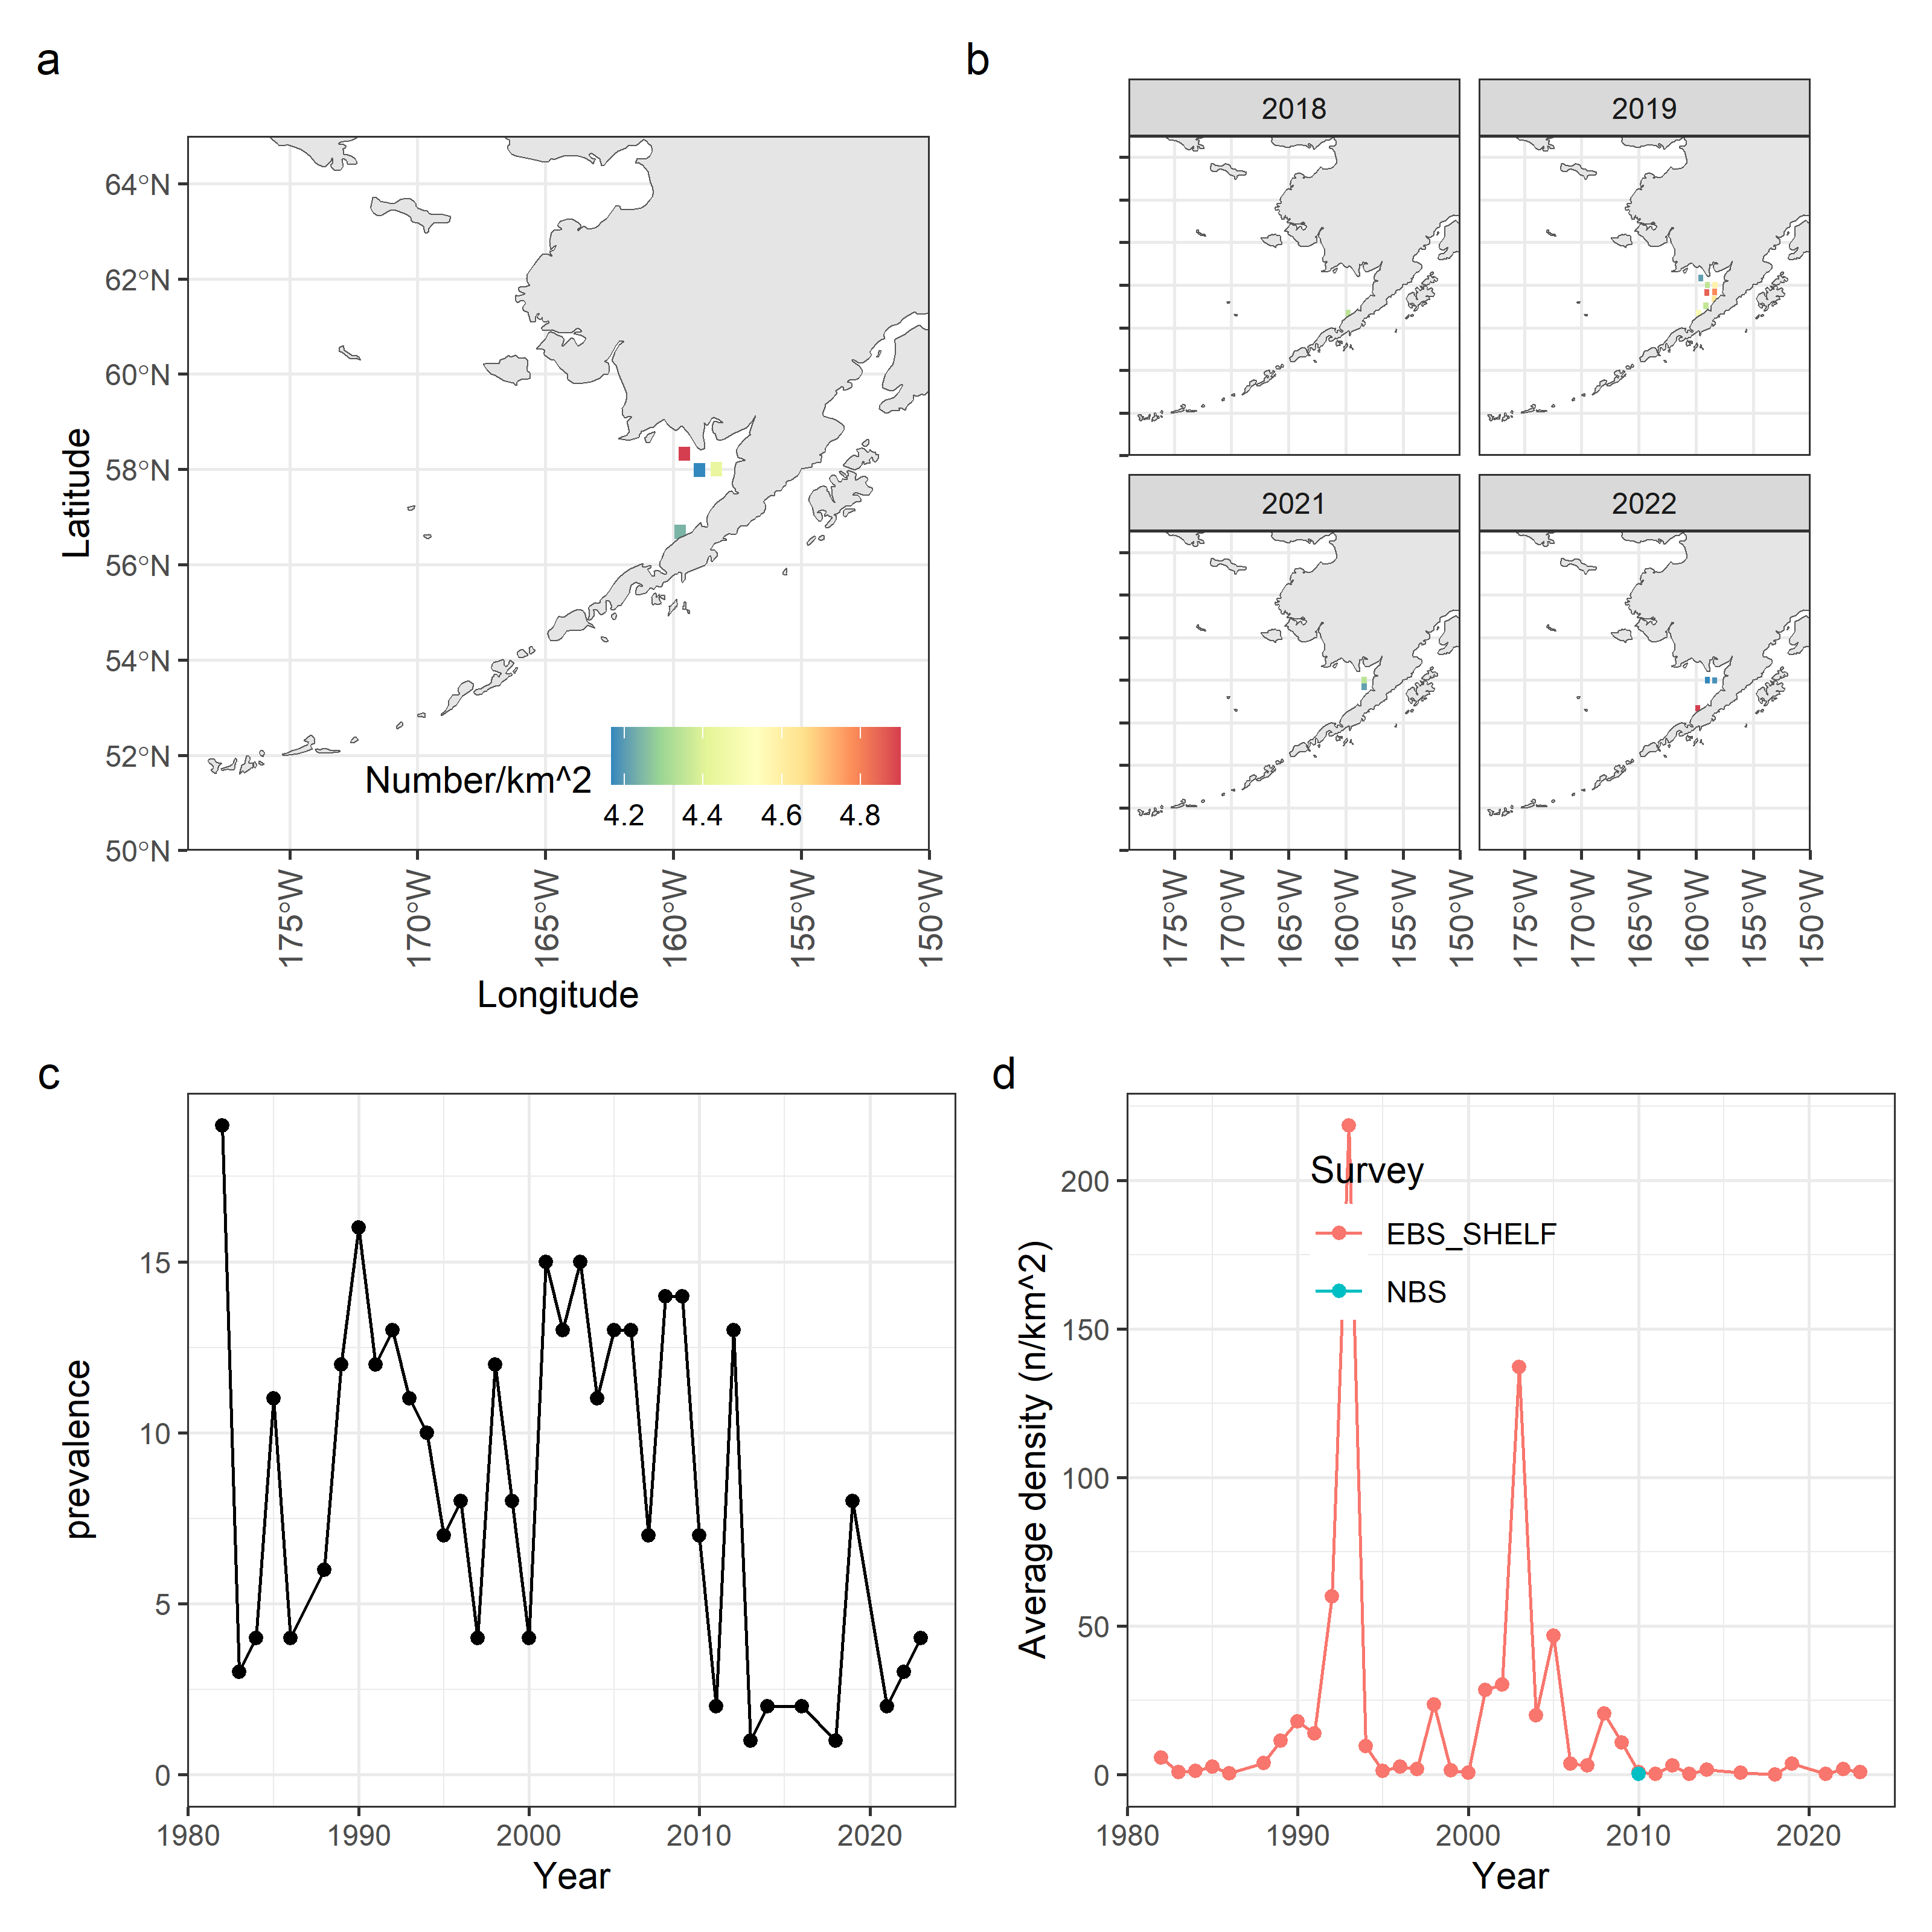
Species/group | Prevalence | Density
Pacific capelin
Eulachon
Rainbow smelt
Sand lance
Sandfish
Pricklebacks
Eelblennies
Herring
Squid
Shrimp
Species/group | Prevalence | Density
Pacific capelin
Eulachon
Rainbow smelt
Sand lance
Sandfish
Pricklebacks
Eelblennies
Herring
Squid
Shrimp
Pacific sandfish survey data. Spatial density in BSAI surveys (a), spatial densities in the previous four years for which survey data was available (b), prevalence in terms of the number of survey stations that returned positive tows for this species (c), and average densities split by survey location in the BSAI (d).

Slide 14
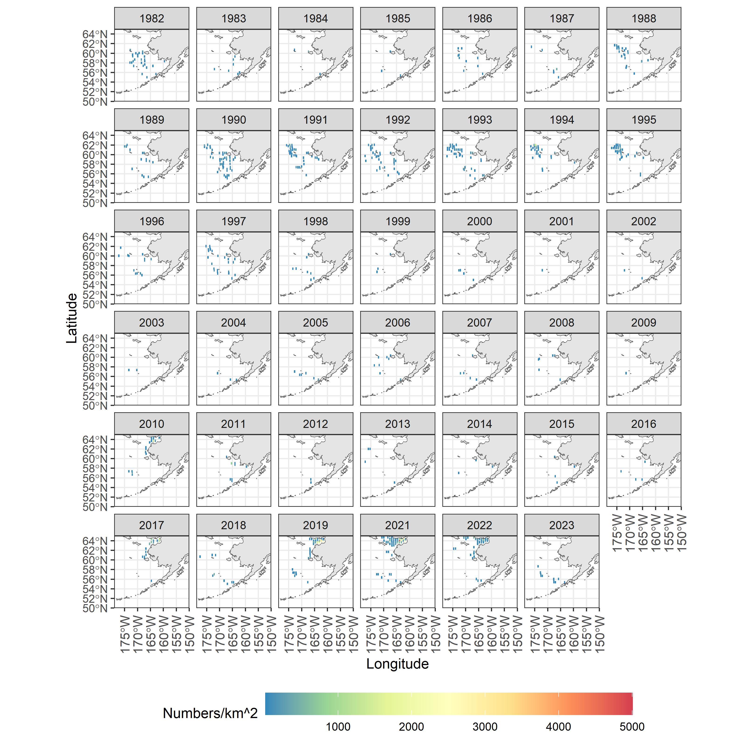
Species/group | Prevalence | Density
Pacific capelin
Eulachon
Rainbow smelt
Sand lance
Sandfish
Pricklebacks
Eelblennies
Herring
Squid
Shrimp
Species/group | Prevalence | Density
Pacific capelin
Eulachon
Rainbow smelt
Sand lance
Sandfish
Pricklebacks
Eelblennies
Herring
Squid
Shrimp
Map of distribution of prevalence and density from the all BSAI surveys for pricklebacks (zoom for detail).

Slide 15
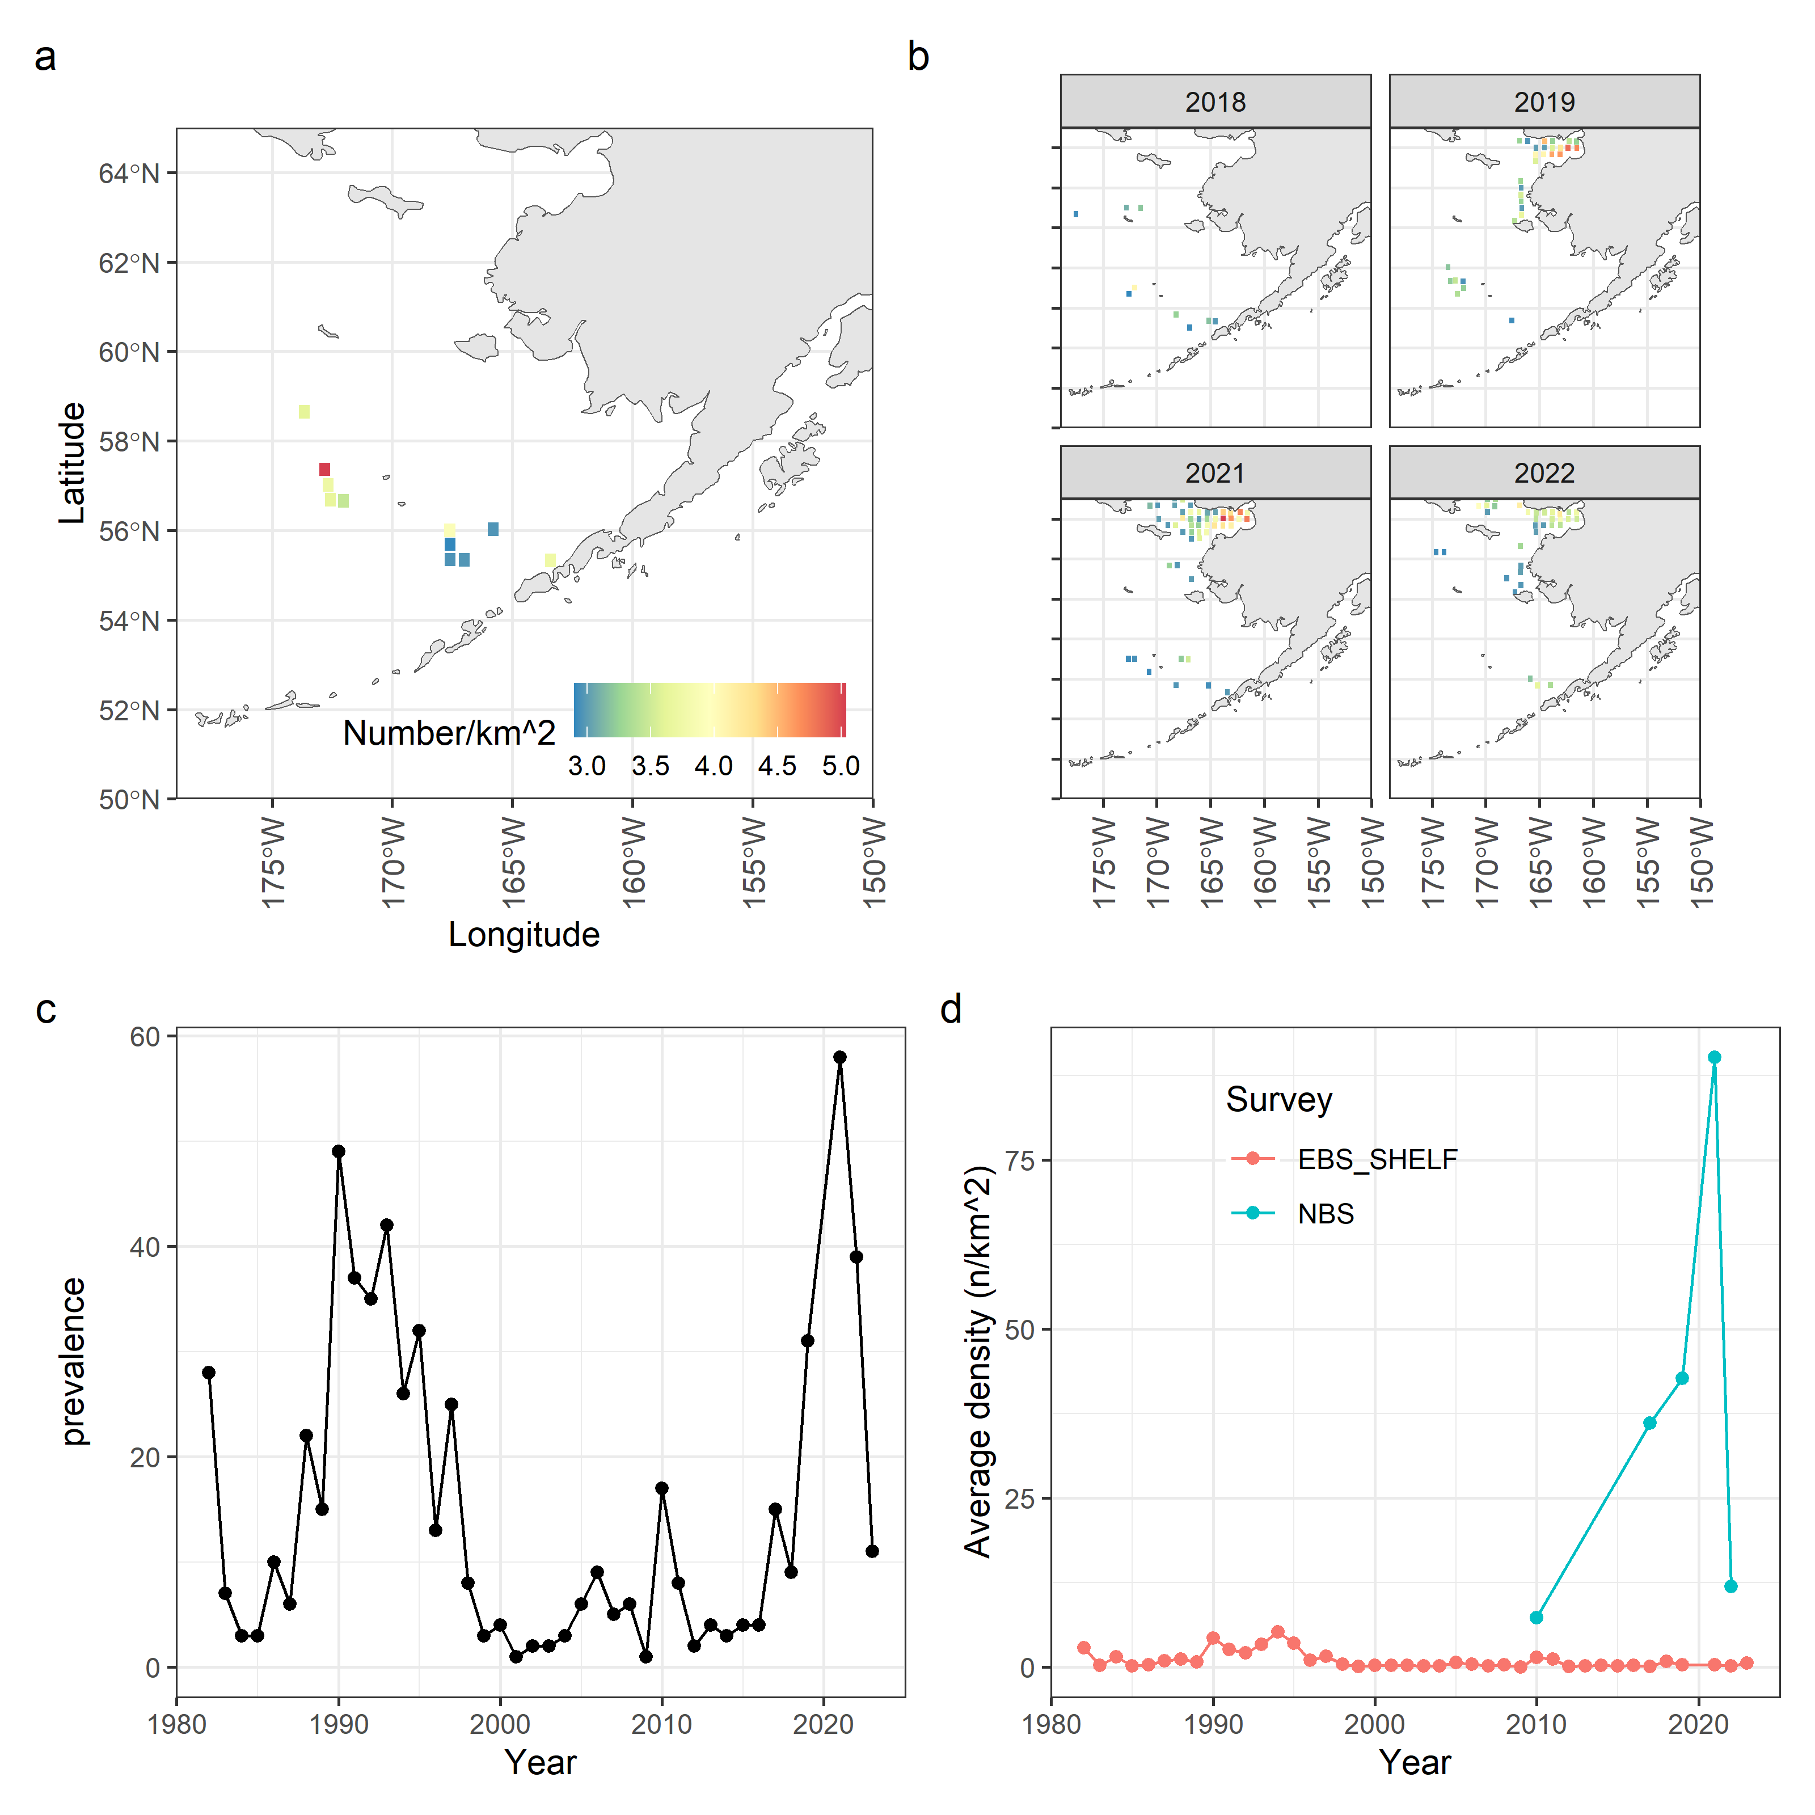
Species/group | Prevalence | Density
Pacific capelin
Eulachon
Rainbow smelt
Sand lance
Sandfish
Pricklebacks
Eelblennies
Herring
Squid
Shrimp
Species/group | Prevalence | Density
Pacific capelin
Eulachon
Rainbow smelt
Sand lance
Sandfish
Pricklebacks
Eelblennies
Herring
Squid
Shrimp
Prickleback survey data. Spatial density in BSAI surveys (a), spatial densities in the previous four years for which survey data was available (b), prevalence in terms of the number of survey stations that returned positive tows for this species (c), and average densities split by survey location in the BSAI (d).

Slide 16
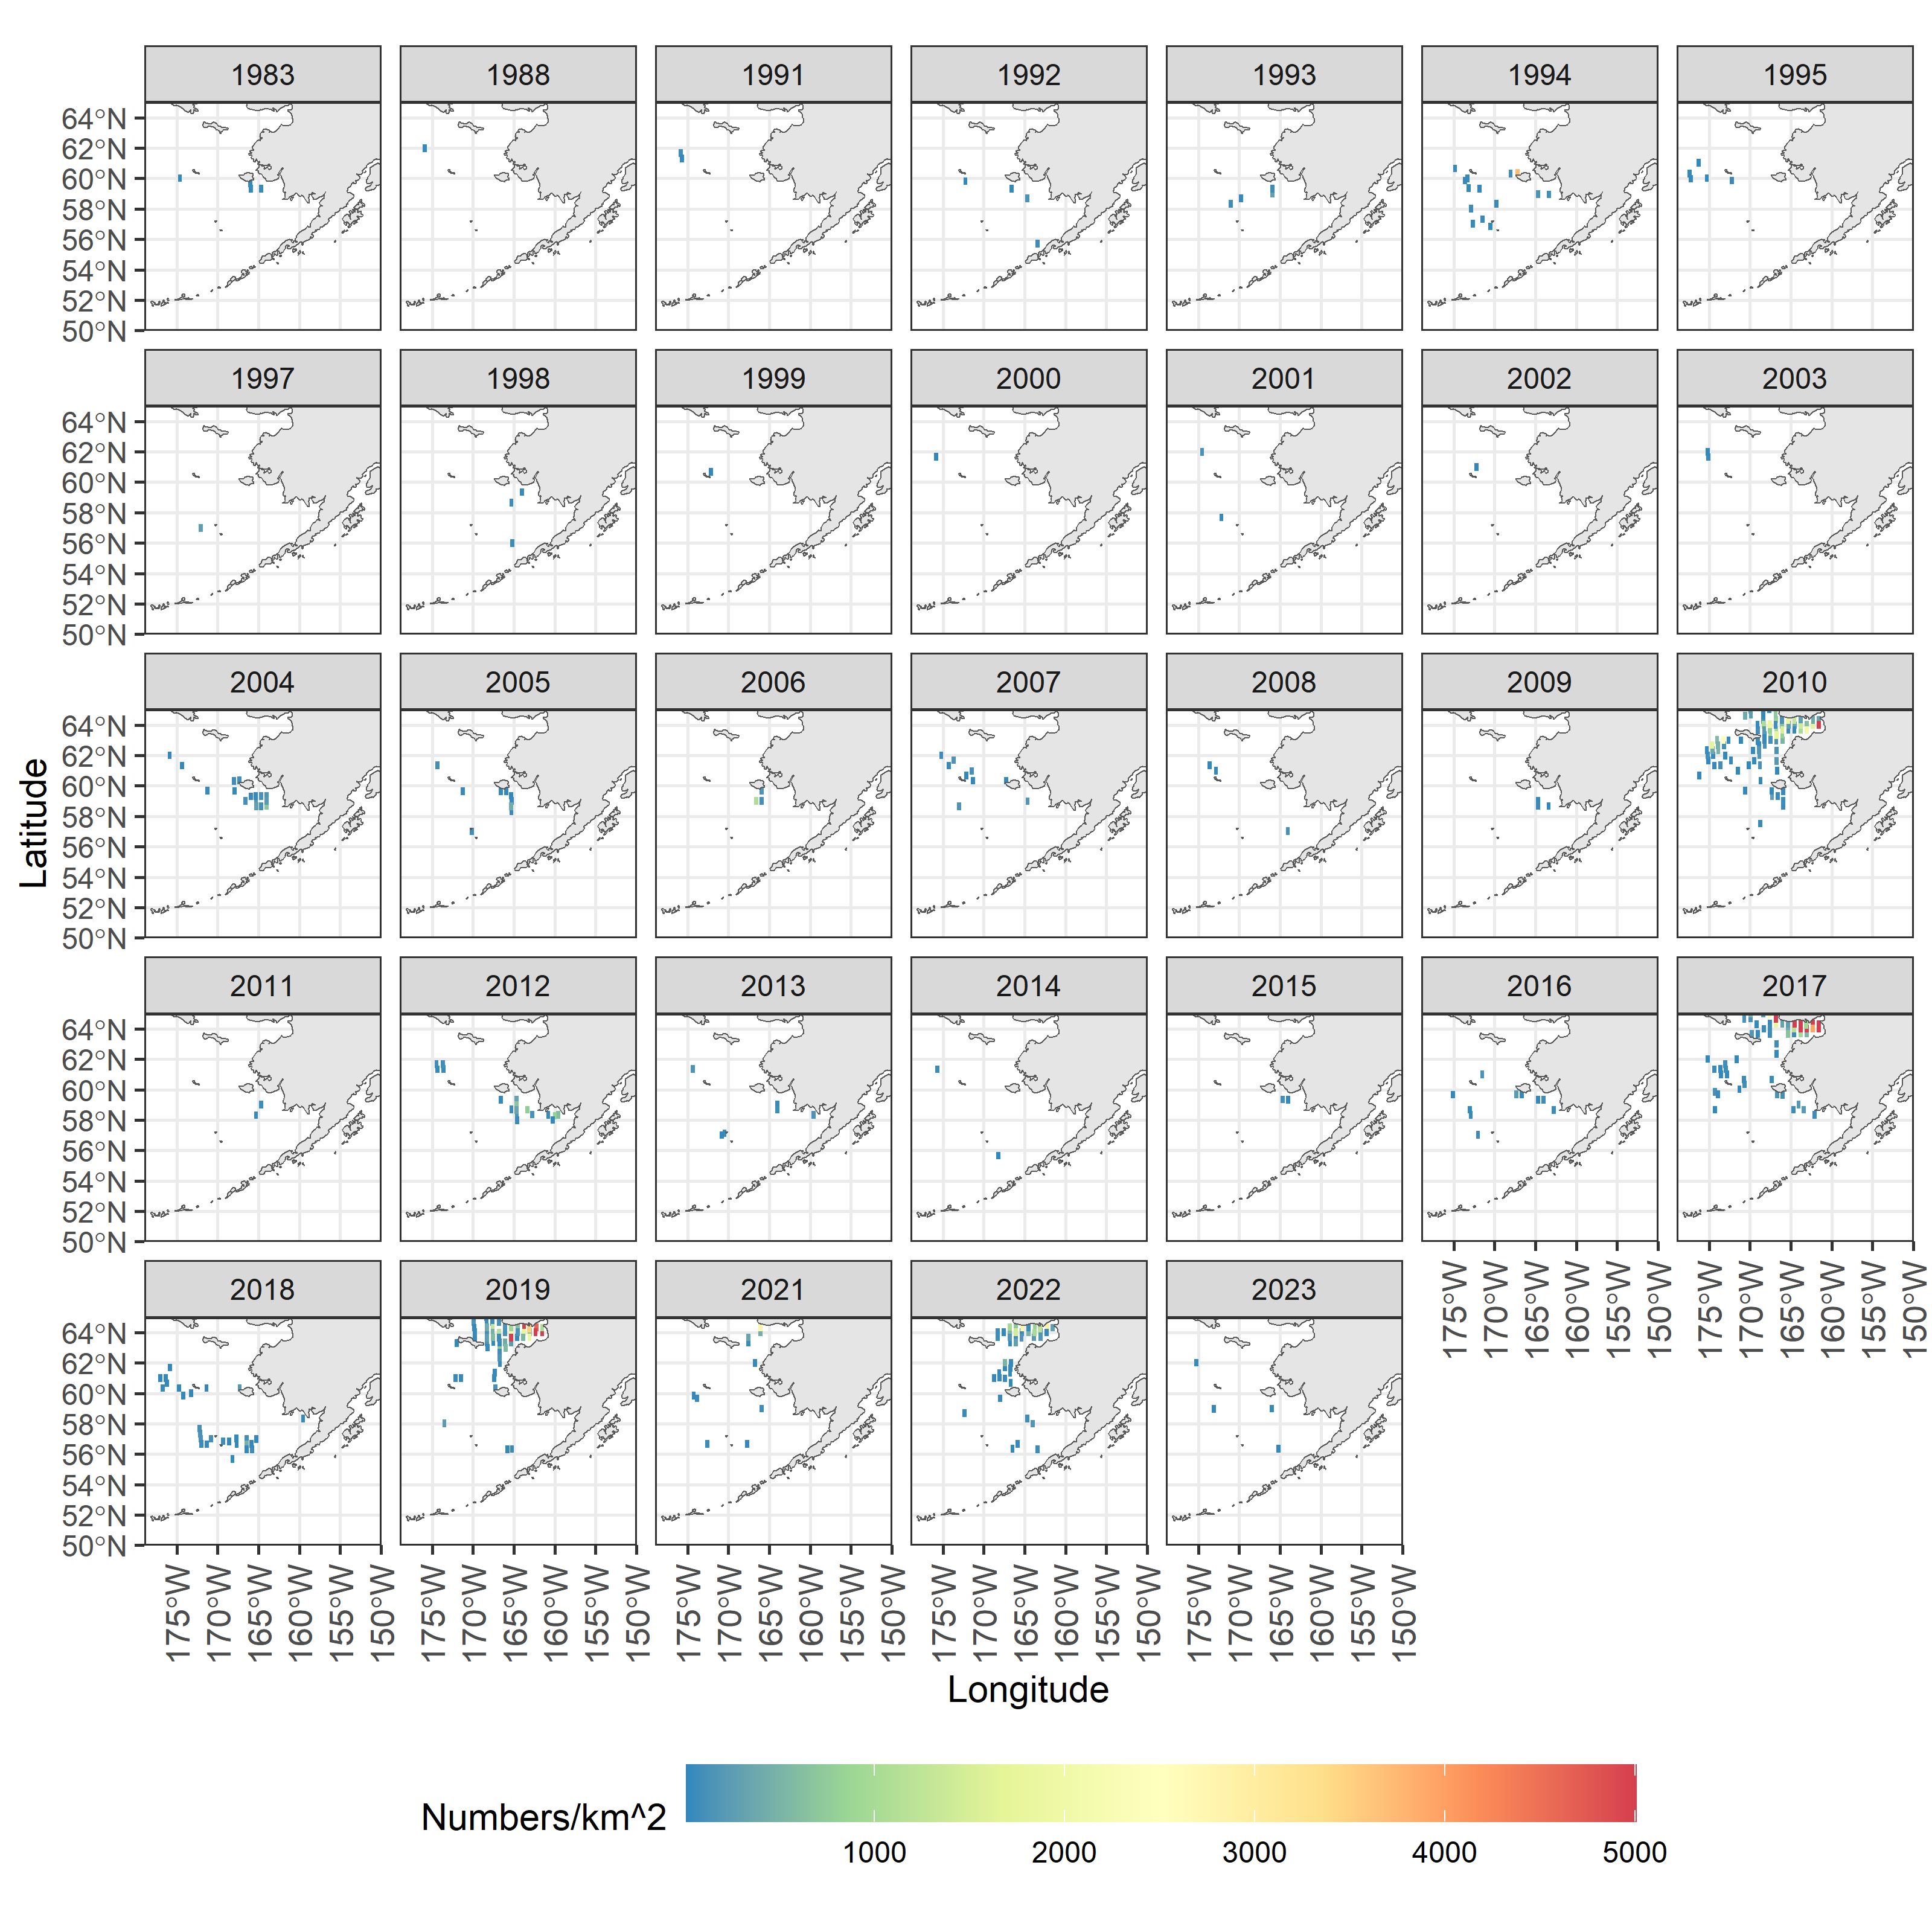
Species/group | Prevalence | Density
Pacific capelin
Eulachon
Rainbow smelt
Sand lance
Sandfish
Pricklebacks
Eelblennies
Herring
Squid
Shrimp
Species/group | Prevalence | Density
Pacific capelin
Eulachon
Rainbow smelt
Sand lance
Sandfish
Pricklebacks
Eelblennies
Herring
Squid
Shrimp
Map of distribution of prevalence and density from the all BSAI surveys for eelblennies (zoom for detail).

Slide 17
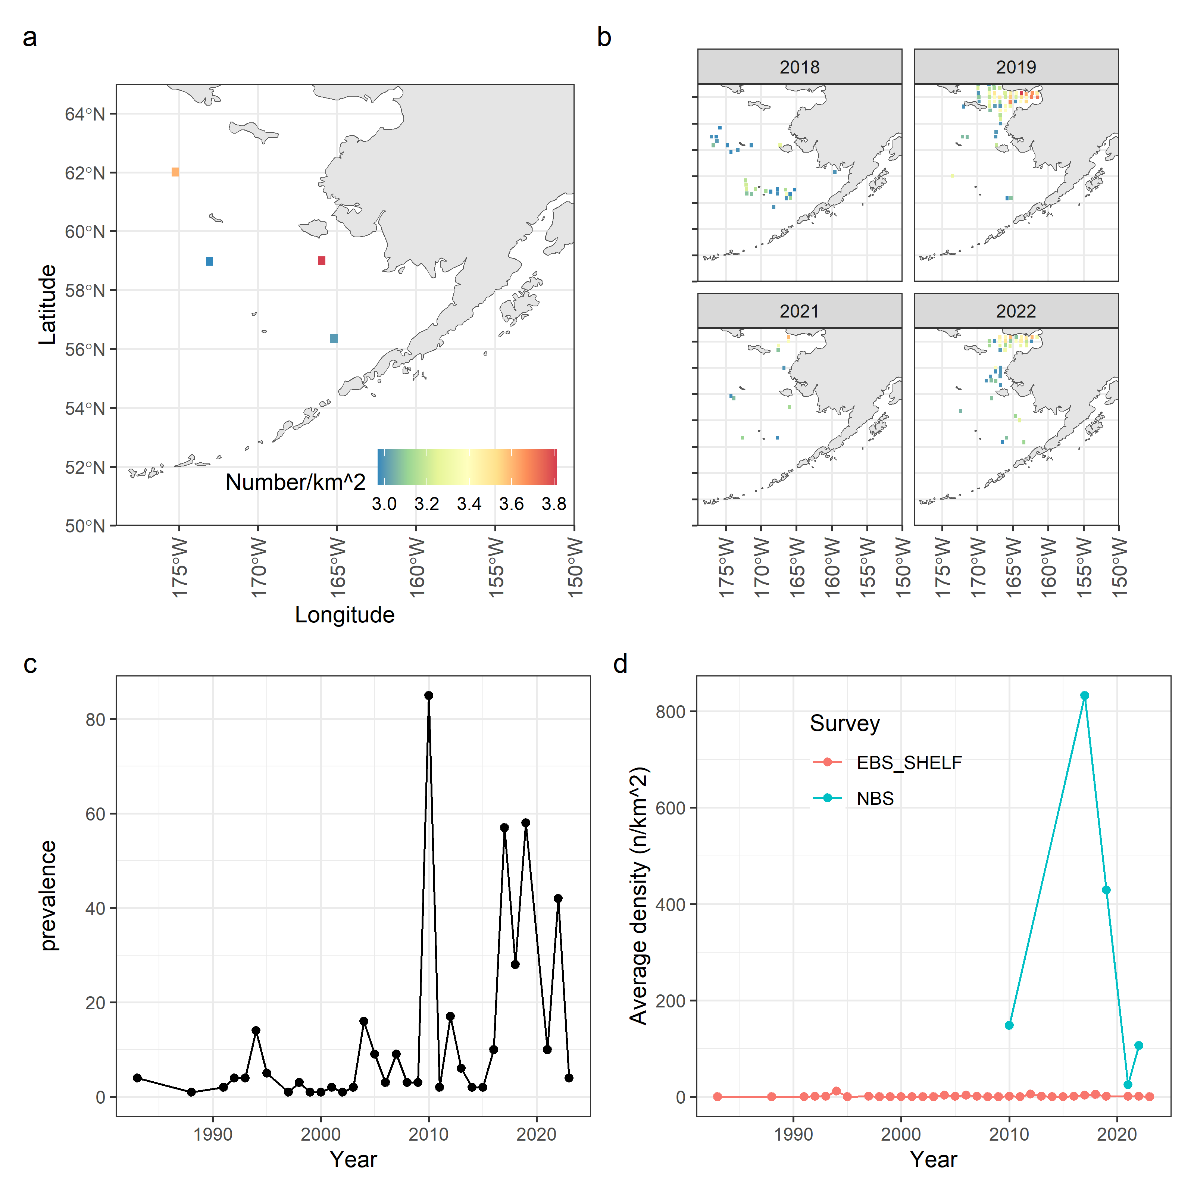
Species/group | Prevalence | Density
Pacific capelin
Eulachon
Rainbow smelt
Sand lance
Sandfish
Pricklebacks
Eelblennies
Herring
Squid
Shrimp
Species/group | Prevalence | Density
Pacific capelin
Eulachon
Rainbow smelt
Sand lance
Sandfish
Pricklebacks
Eelblennies
Herring
Squid
Shrimp
Eelblenny survey data. Spatial density in BSAI surveys (a), spatial densities in the previous four years for which survey data was available (b), prevalence in terms of the number of survey stations that returned positive tows for this species (c), and average densities split by survey location in the BSAI (d).

Slide 18
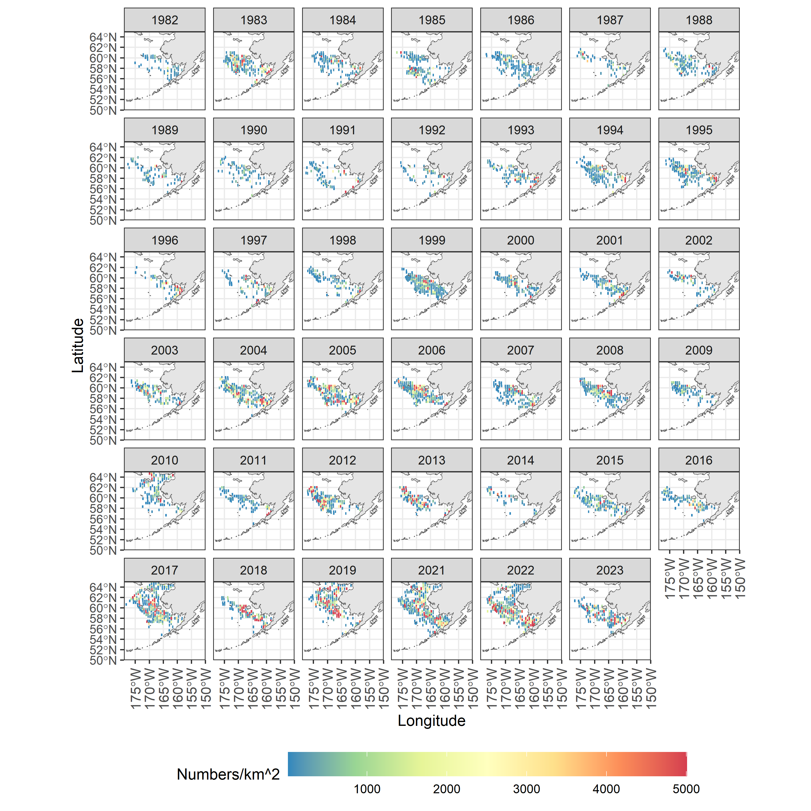
Species/group | Prevalence | Density
Pacific capelin
Eulachon
Rainbow smelt
Sand lance
Sandfish
Pricklebacks
Eelblennies
Herring
Squid
Shrimp
Species/group | Prevalence | Density
Pacific capelin
Eulachon
Rainbow smelt
Sand lance
Sandfish
Pricklebacks
Eelblennies
Herring
Squid
Shrimp
Map of distribution of prevalence and density from the all BSAI surveys for Pacific herring (zoom for detail).

Slide 19
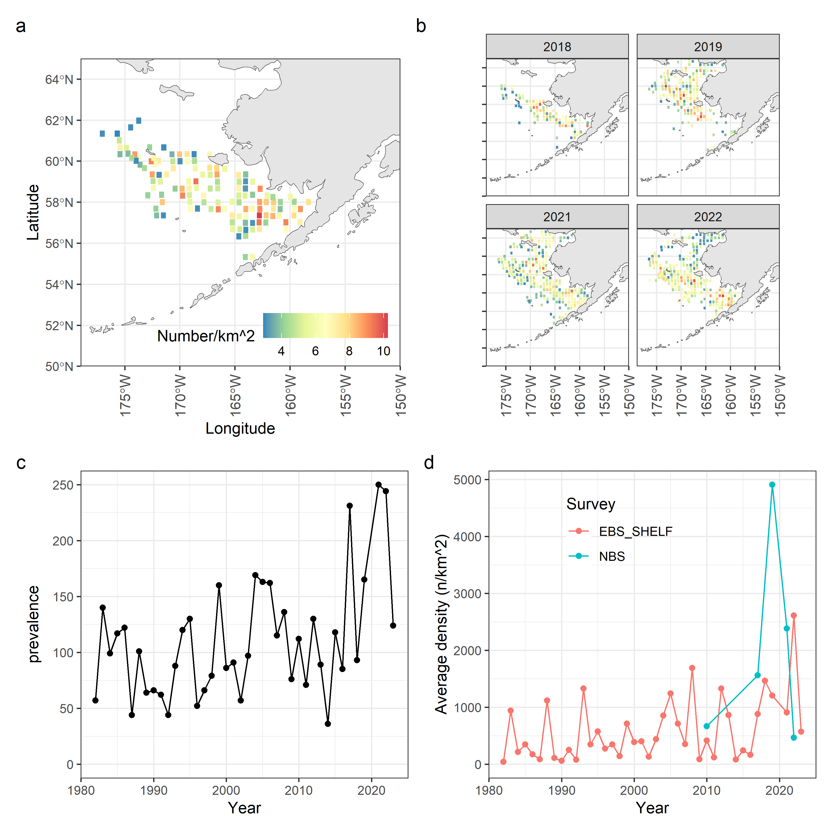
Species/group | Prevalence | Density
Pacific capelin
Eulachon
Rainbow smelt
Sand lance
Sandfish
Pricklebacks
Eelblennies
Herring
Squid
Shrimp
Species/group | Prevalence | Density
Pacific capelin
Eulachon
Rainbow smelt
Sand lance
Sandfish
Pricklebacks
Eelblennies
Herring
Squid
Shrimp
  Pacific herring survey data. Spatial density in BSAI surveys (a), spatial densities in the previous four years for which survey data was available (b), prevalence in terms of the number of survey stations that returned positive tows for this species (c), and average densities split by survey location in the BSAI (d).

Slide 20
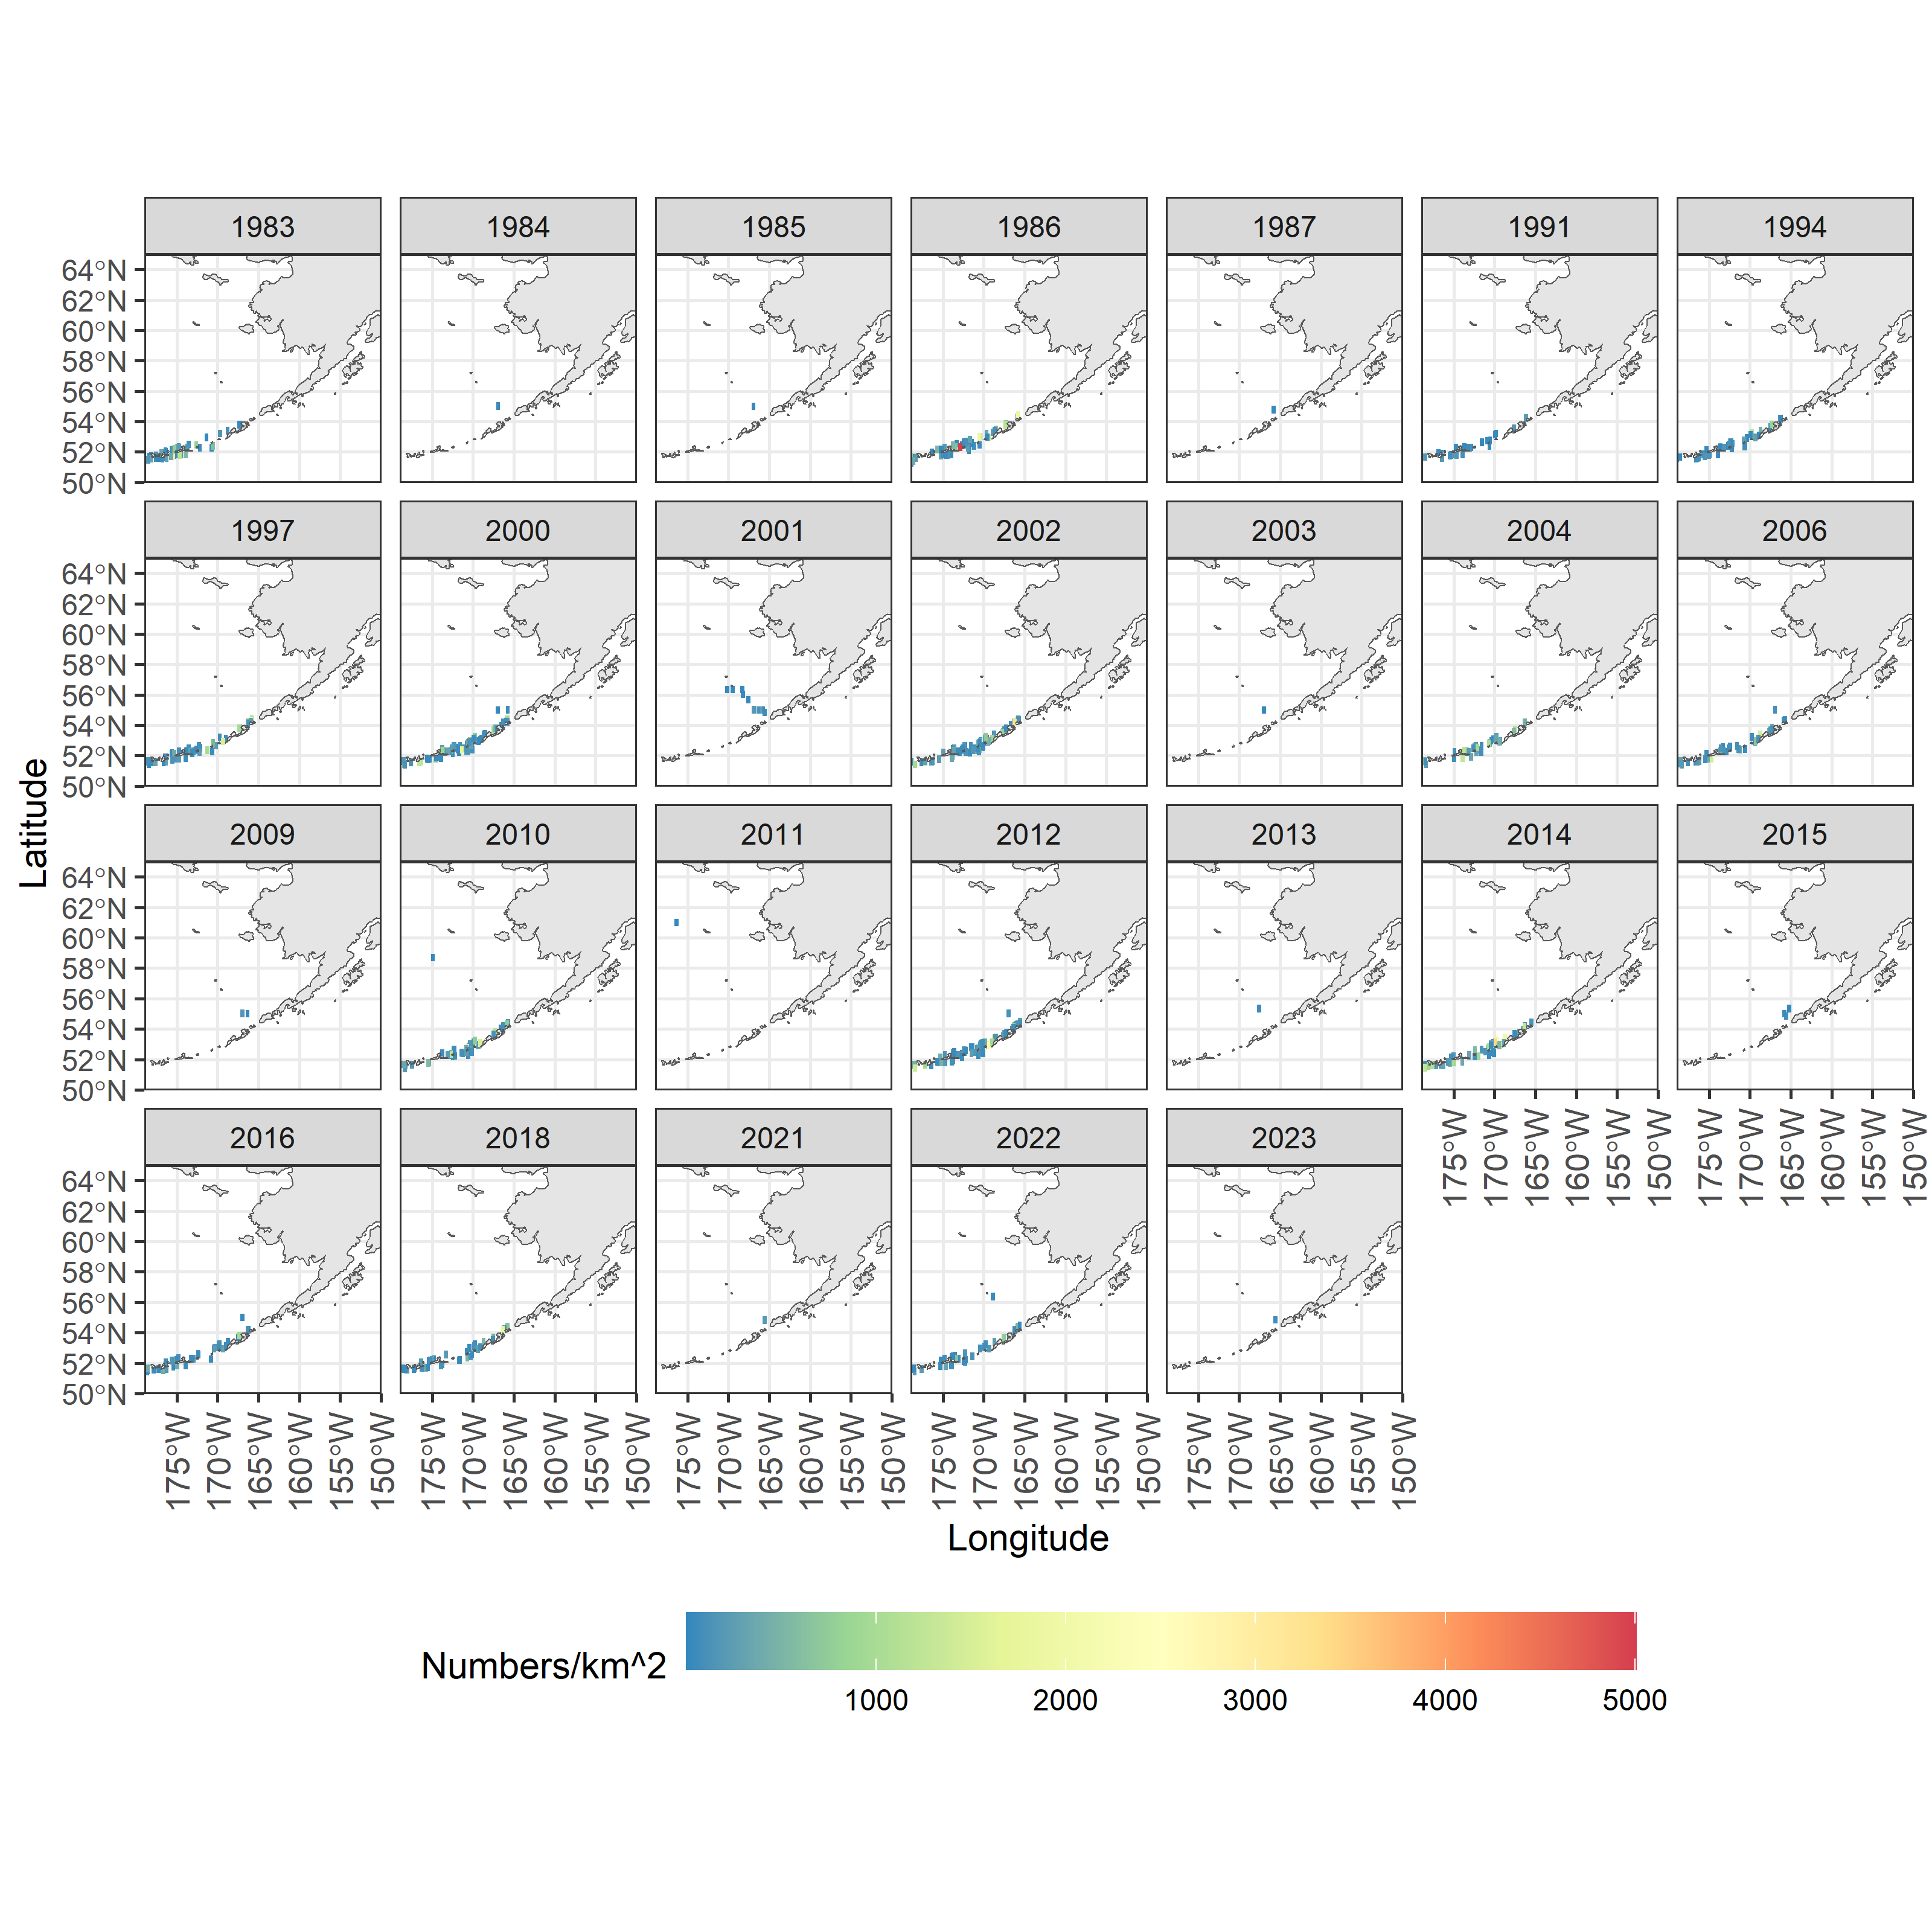
Species/group | Prevalence | Density
Pacific capelin
Eulachon
Rainbow smelt
Sand lance
Sandfish
Pricklebacks
Eelblennies
Herring
Squid
Shrimp
Species/group | Prevalence | Density
Pacific capelin
Eulachon
Rainbow smelt
Sand lance
Sandfish
Pricklebacks
Eelblennies
Herring
Squid
Shrimp
Map of distribution of prevalence and density from the all BSAI surveys for squid (zoom for detail).

Slide 21
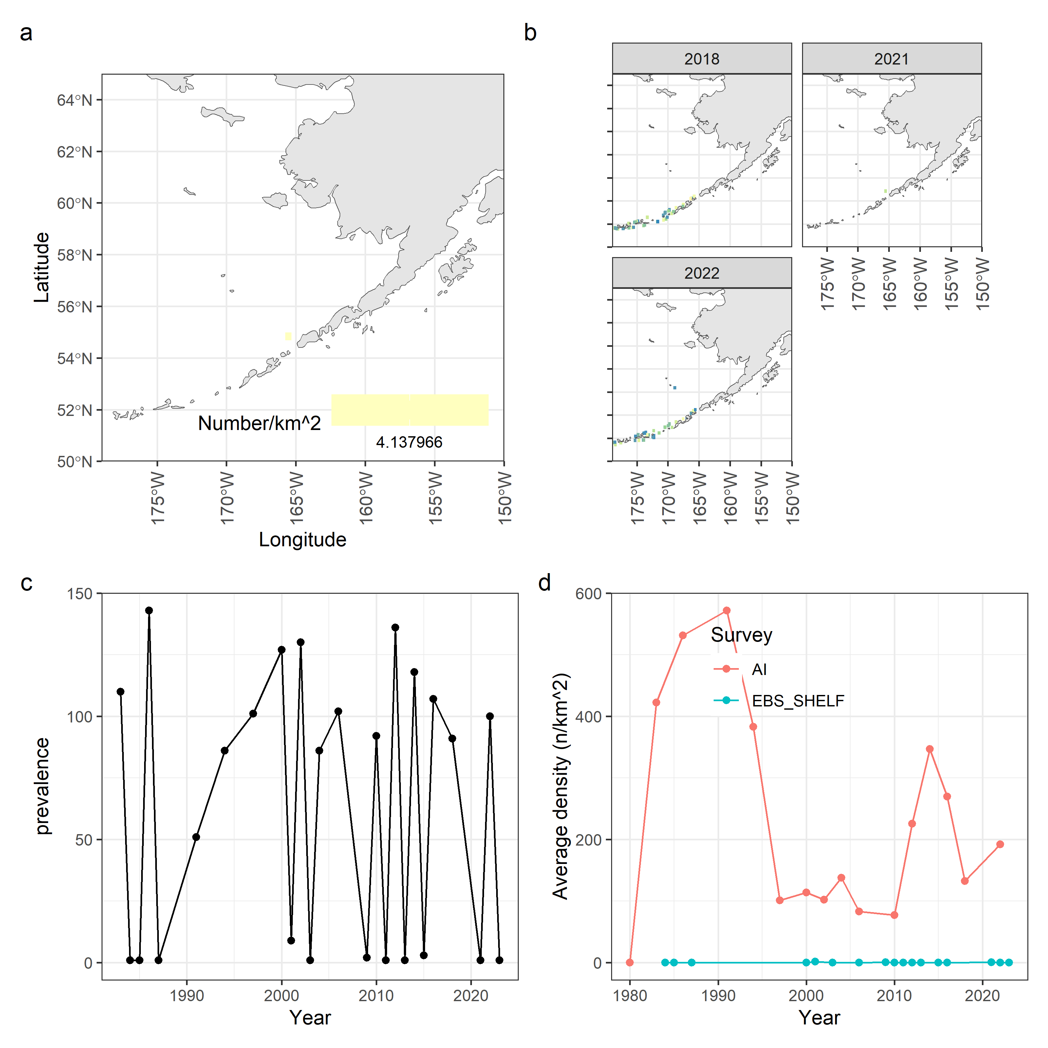
Species/group | Prevalence | Density
Pacific capelin
Eulachon
Rainbow smelt
Sand lance
Sandfish
Pricklebacks
Eelblennies
Herring
Squid
Shrimp
Species/group | Prevalence | Density
Pacific capelin
Eulachon
Rainbow smelt
Sand lance
Sandfish
Pricklebacks
Eelblennies
Herring
Squid
Shrimp
Squid survey data. Spatial density in BSAI surveys (a), spatial densities in the previous four years for which survey data was available (b), prevalence in terms of the number of survey stations that returned positive tows for this species (c), and average densities split by survey location in the BSAI (d).

Slide 22
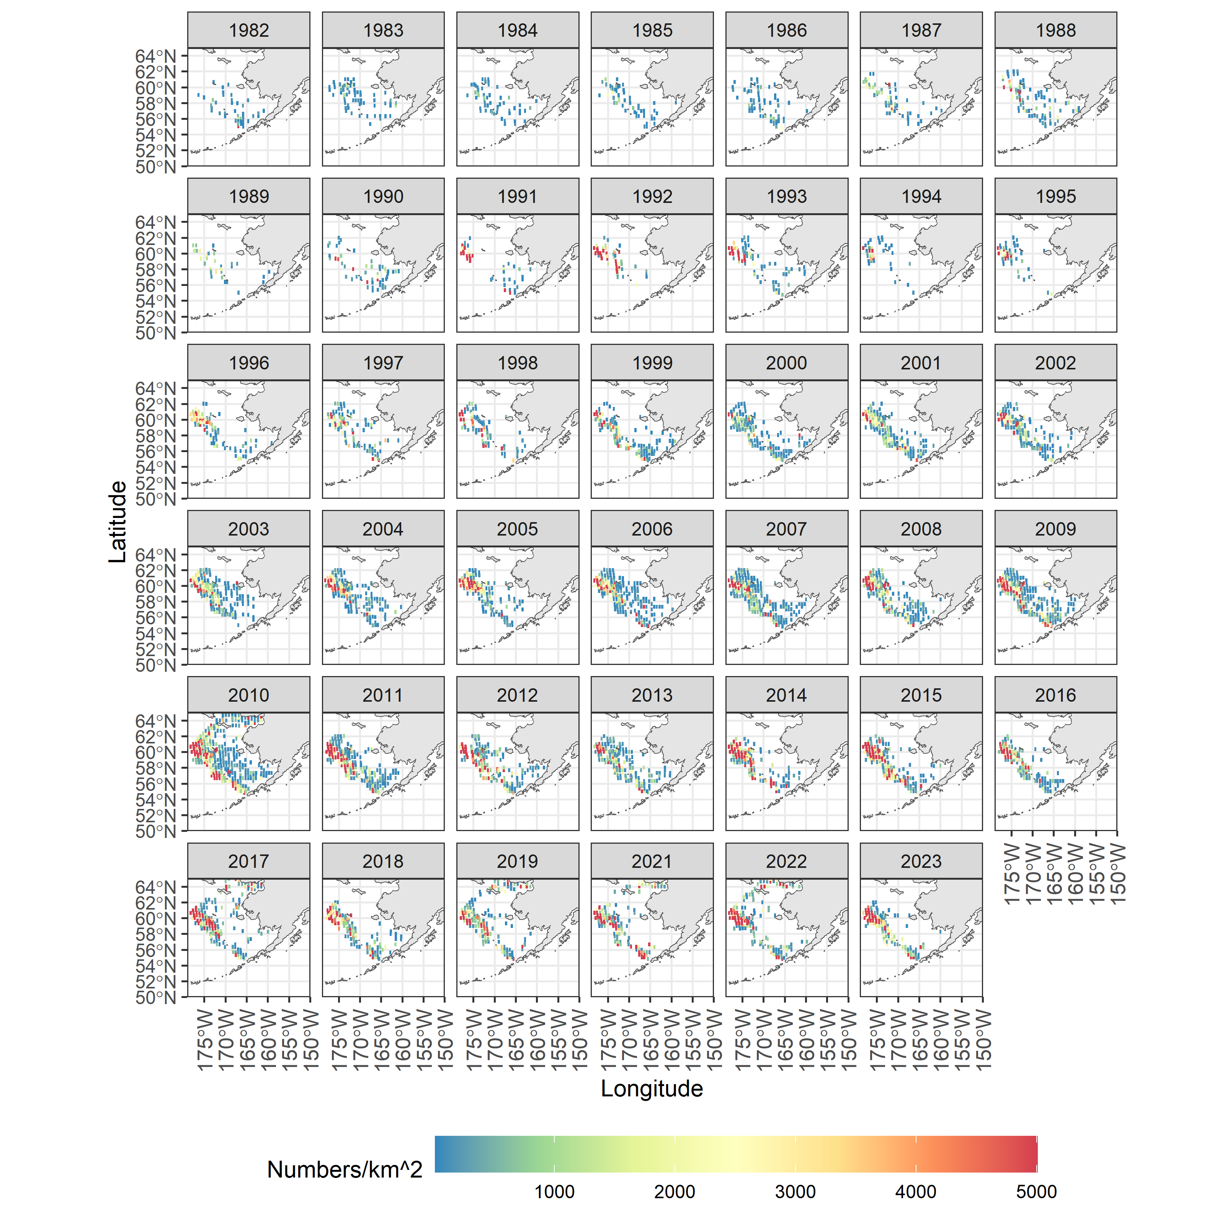
Species/group | Prevalence | Density
Pacific capelin
Eulachon
Rainbow smelt
Sand lance
Sandfish
Pricklebacks
Eelblennies
Herring
Squid
Shrimp
Species/group | Prevalence | Density
Pacific capelin
Eulachon
Rainbow smelt
Sand lance
Sandfish
Pricklebacks
Eelblennies
Herring
Squid
Shrimp
Map of distribution of prevalence and density from the all BSAI surveys for shrimp (zoom for detail).

Slide 23
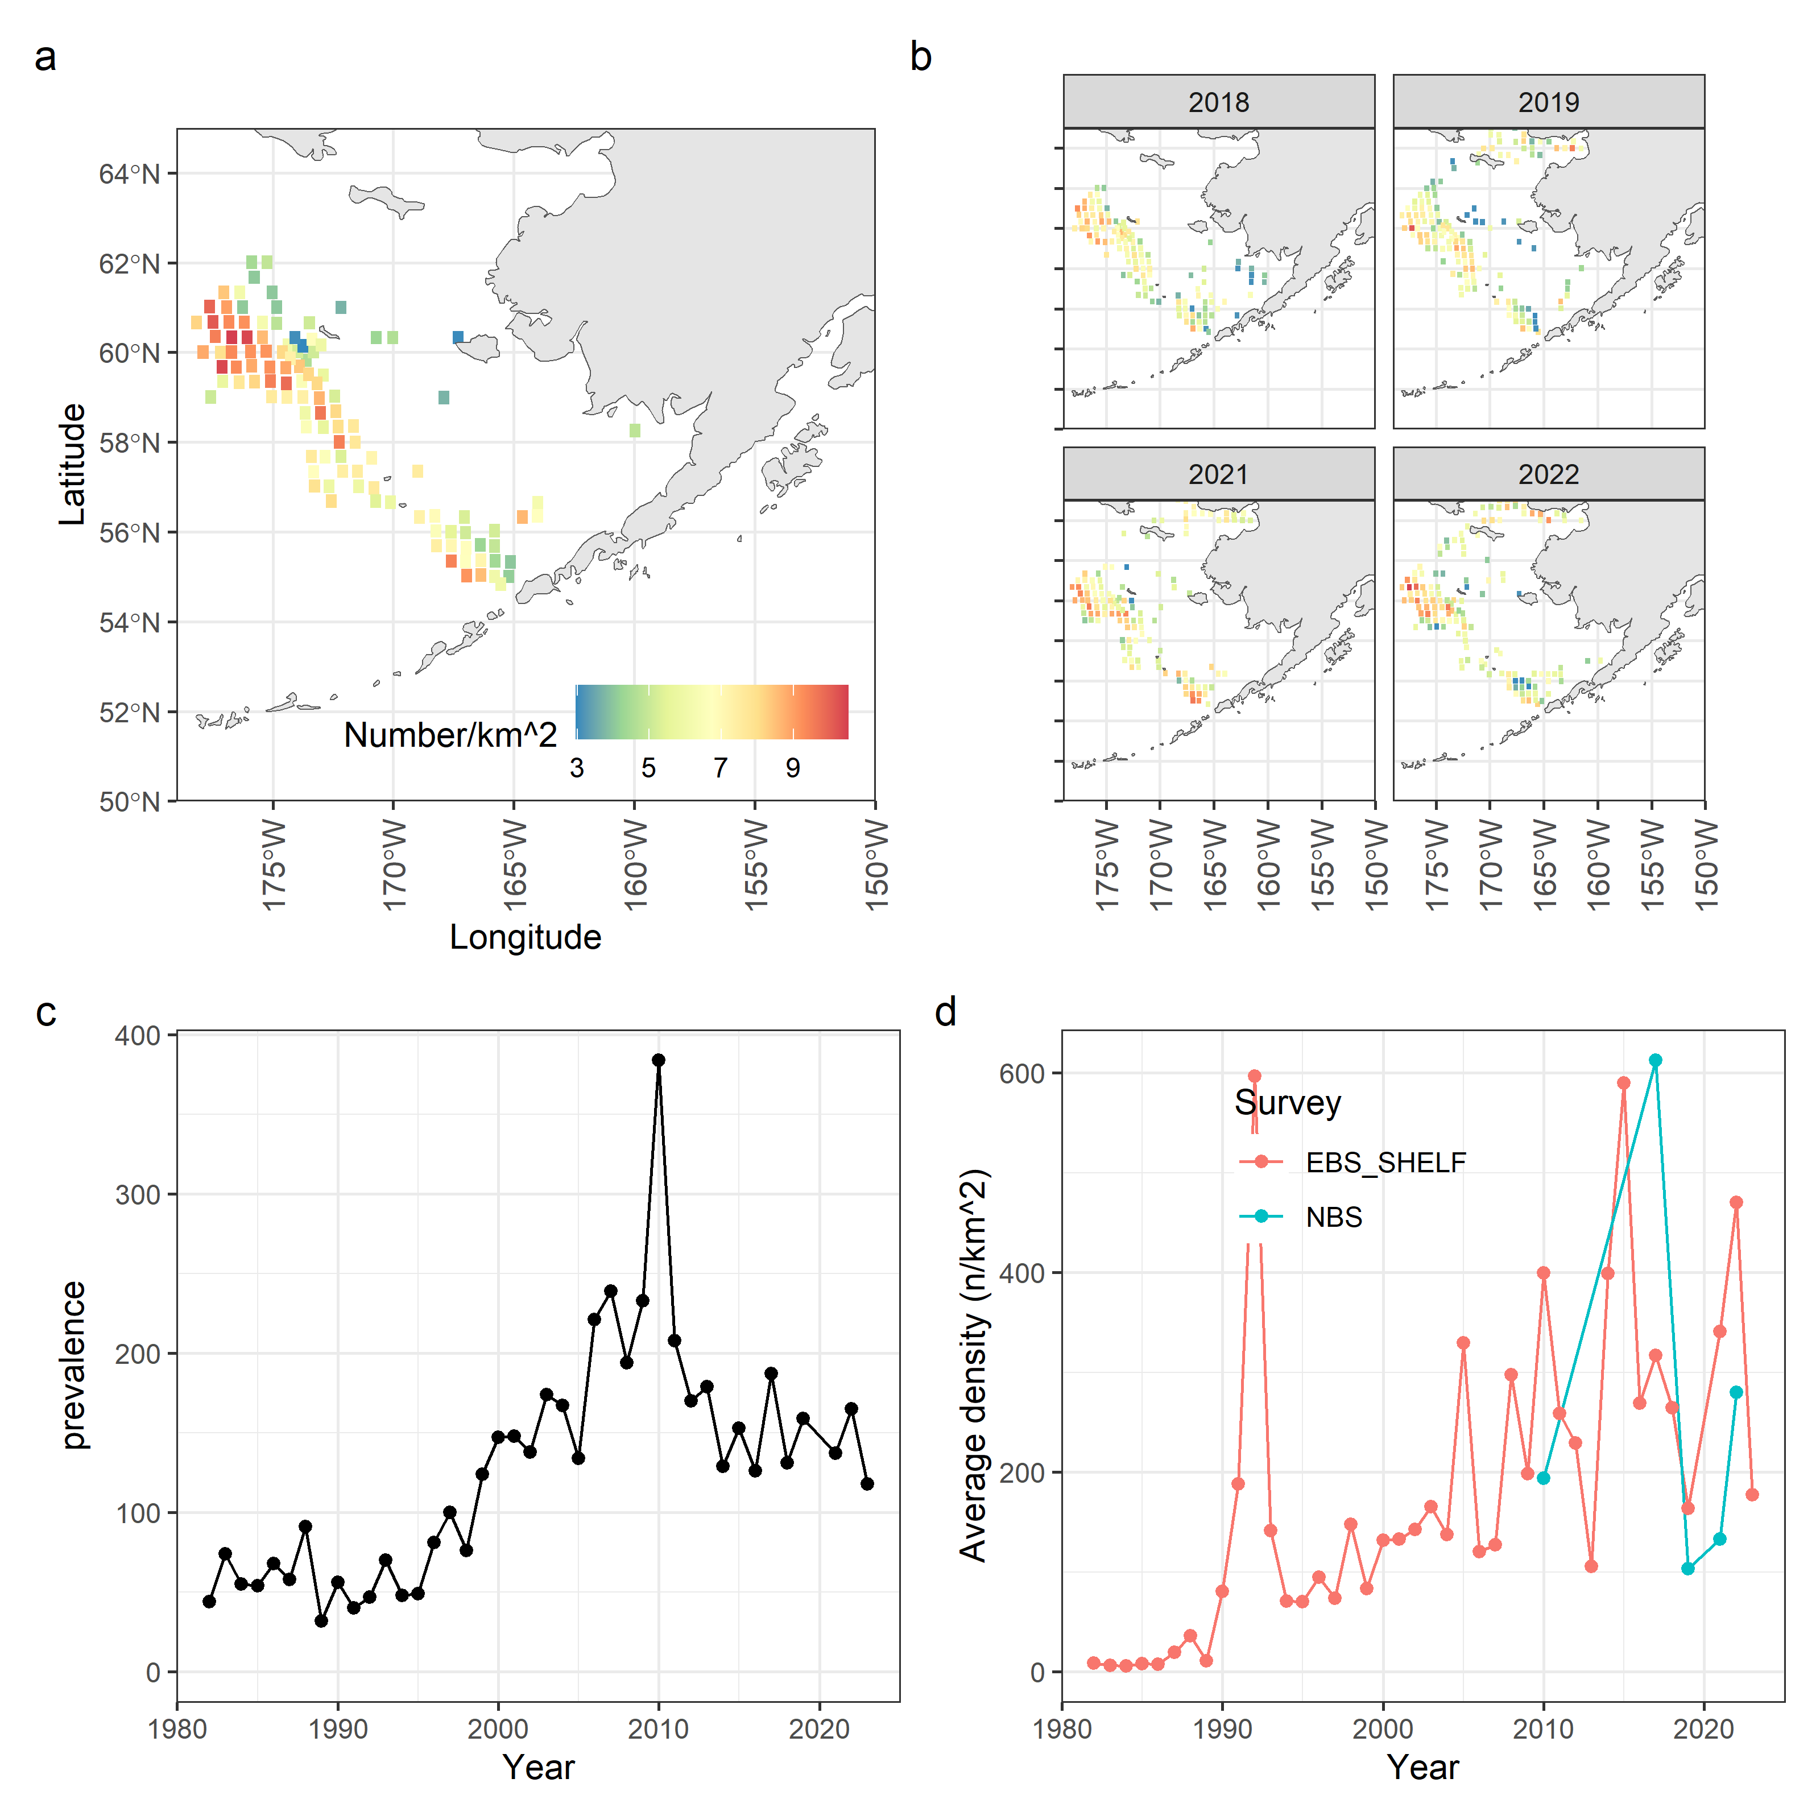
Species/group | Prevalence | Density
Pacific capelin
Eulachon
Rainbow smelt
Sand lance
Sandfish
Pricklebacks
Eelblennies
Herring
Squid
Shrimp
Species/group | Prevalence | Density
Pacific capelin
Eulachon
Rainbow smelt
Sand lance
Sandfish
Pricklebacks
Eelblennies
Herring
Squid
Shrimp | ~
Shrimp survey data. Spatial density in BSAI surveys (a), spatial densities in the previous four years for which survey data was available (b), prevalence in terms of the number of survey stations that returned positive tows for this species (c), and average densities split by survey location in the BSAI (d).

Slide 24
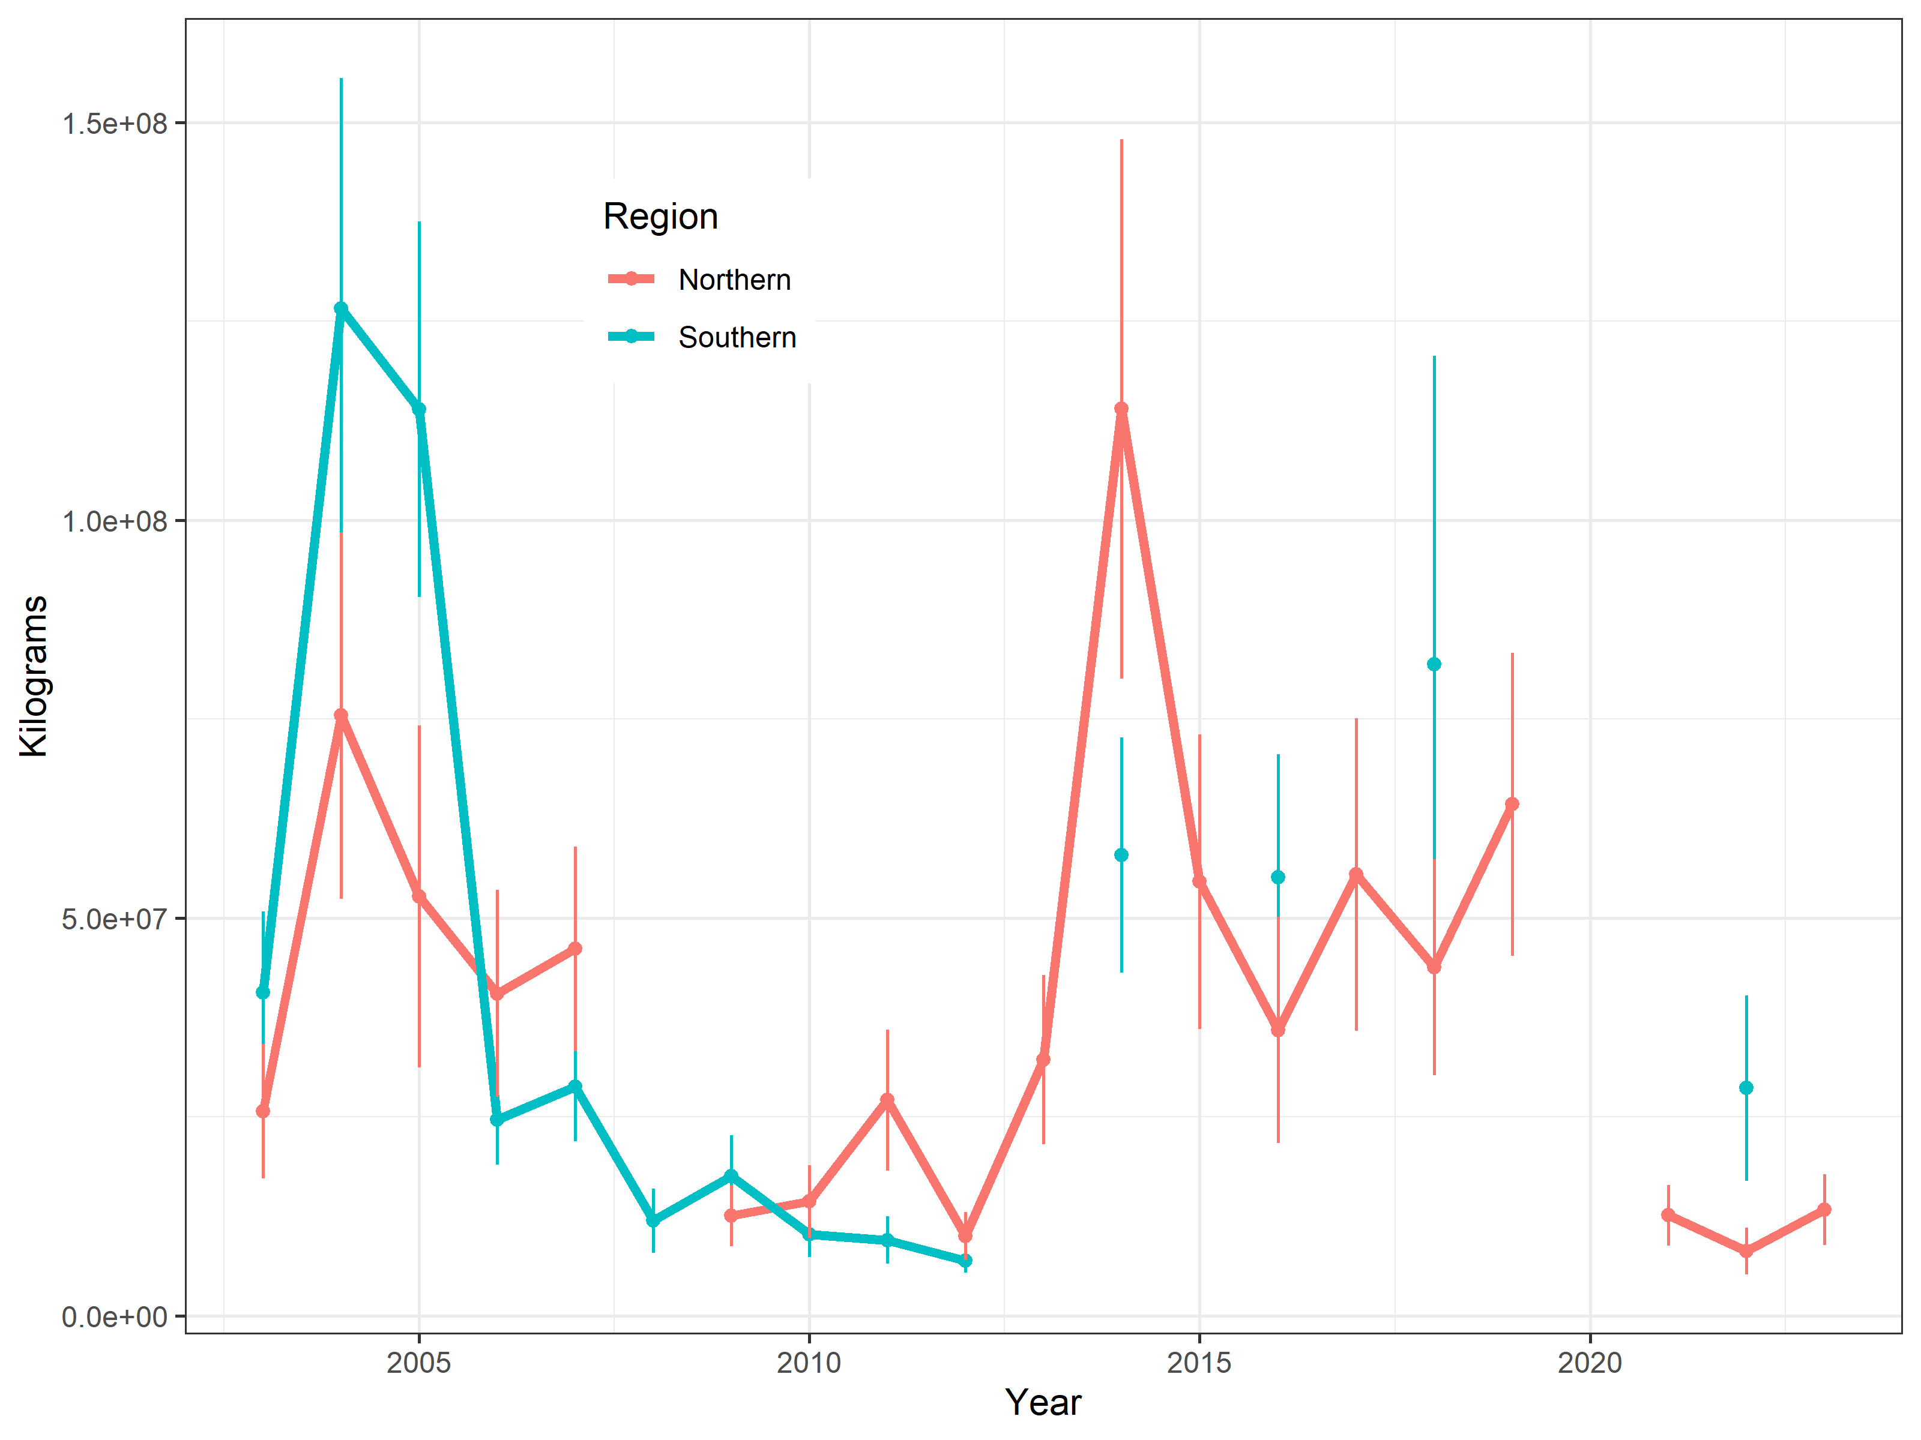
Index of forage abundance developed based on the BASIS surface trawls.

Slide 25
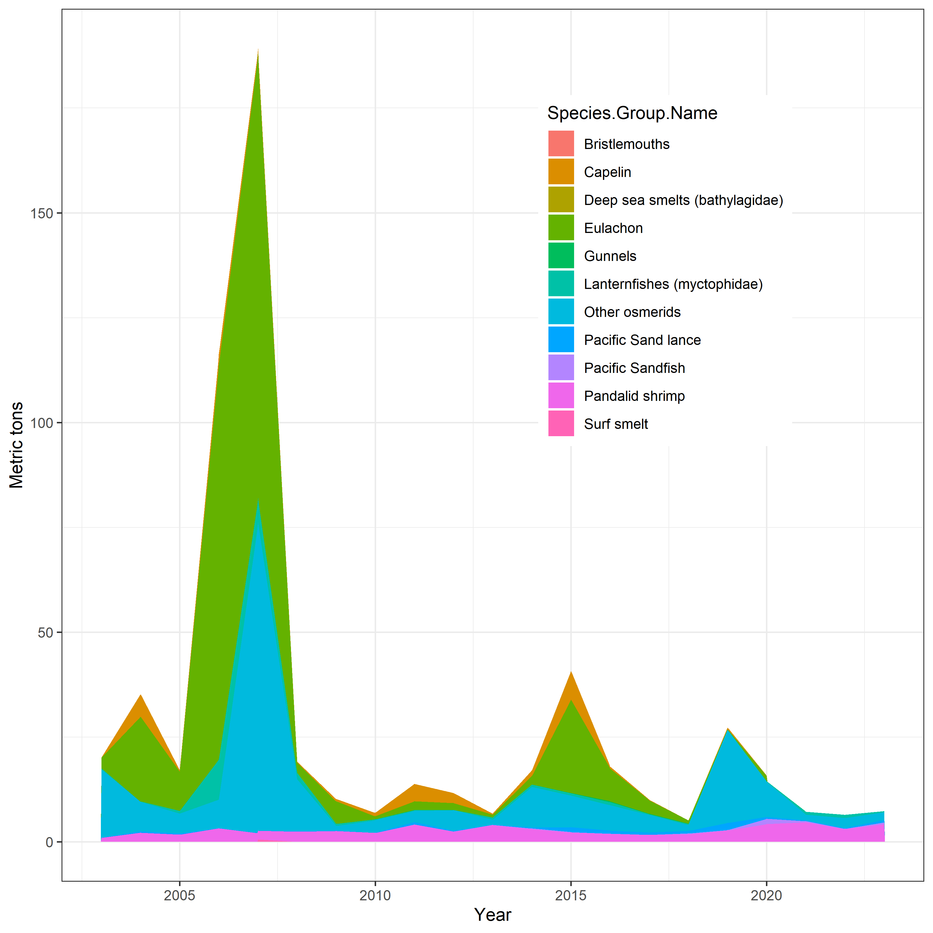
Incidental catches of fishes in the BSAI FMP forage group (2003-2023).

Slide 26
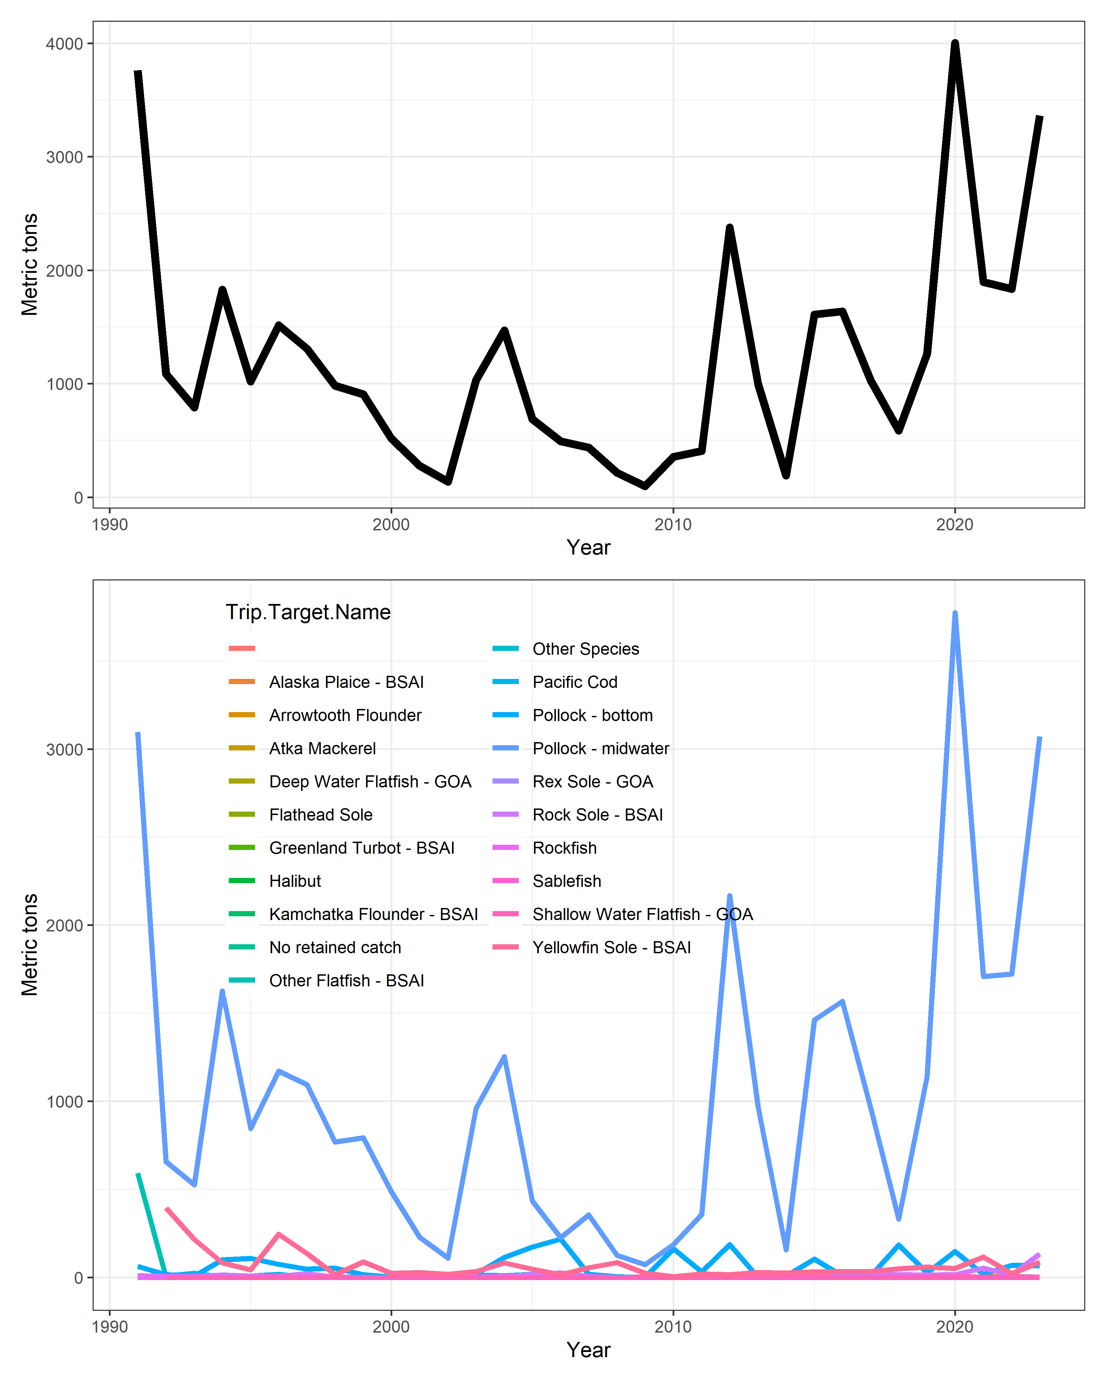
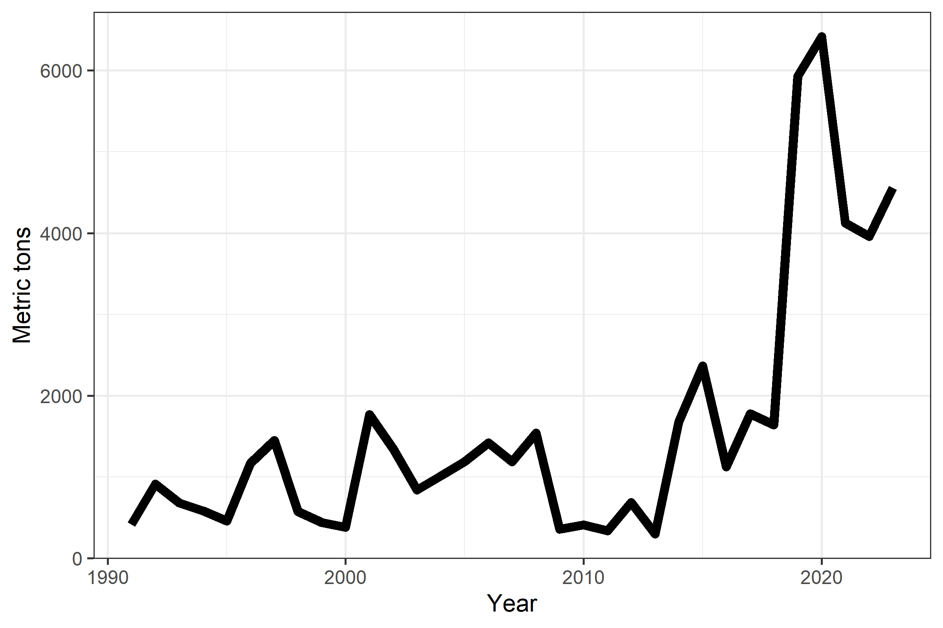
Catches of Pacific herring in the BSAI.
Catches of squid in the BSAI.

Slide 27
Summary
Capelin and eulachon down.
Herring and shrimp up.
BASIS survey down.
Squid and herring catches up.
All other catches down.

Slide 28
Future research directions
Synthetic indices of forage
Forage for whom?
Spatiotemporal models + environmental linkages

